Slide 1
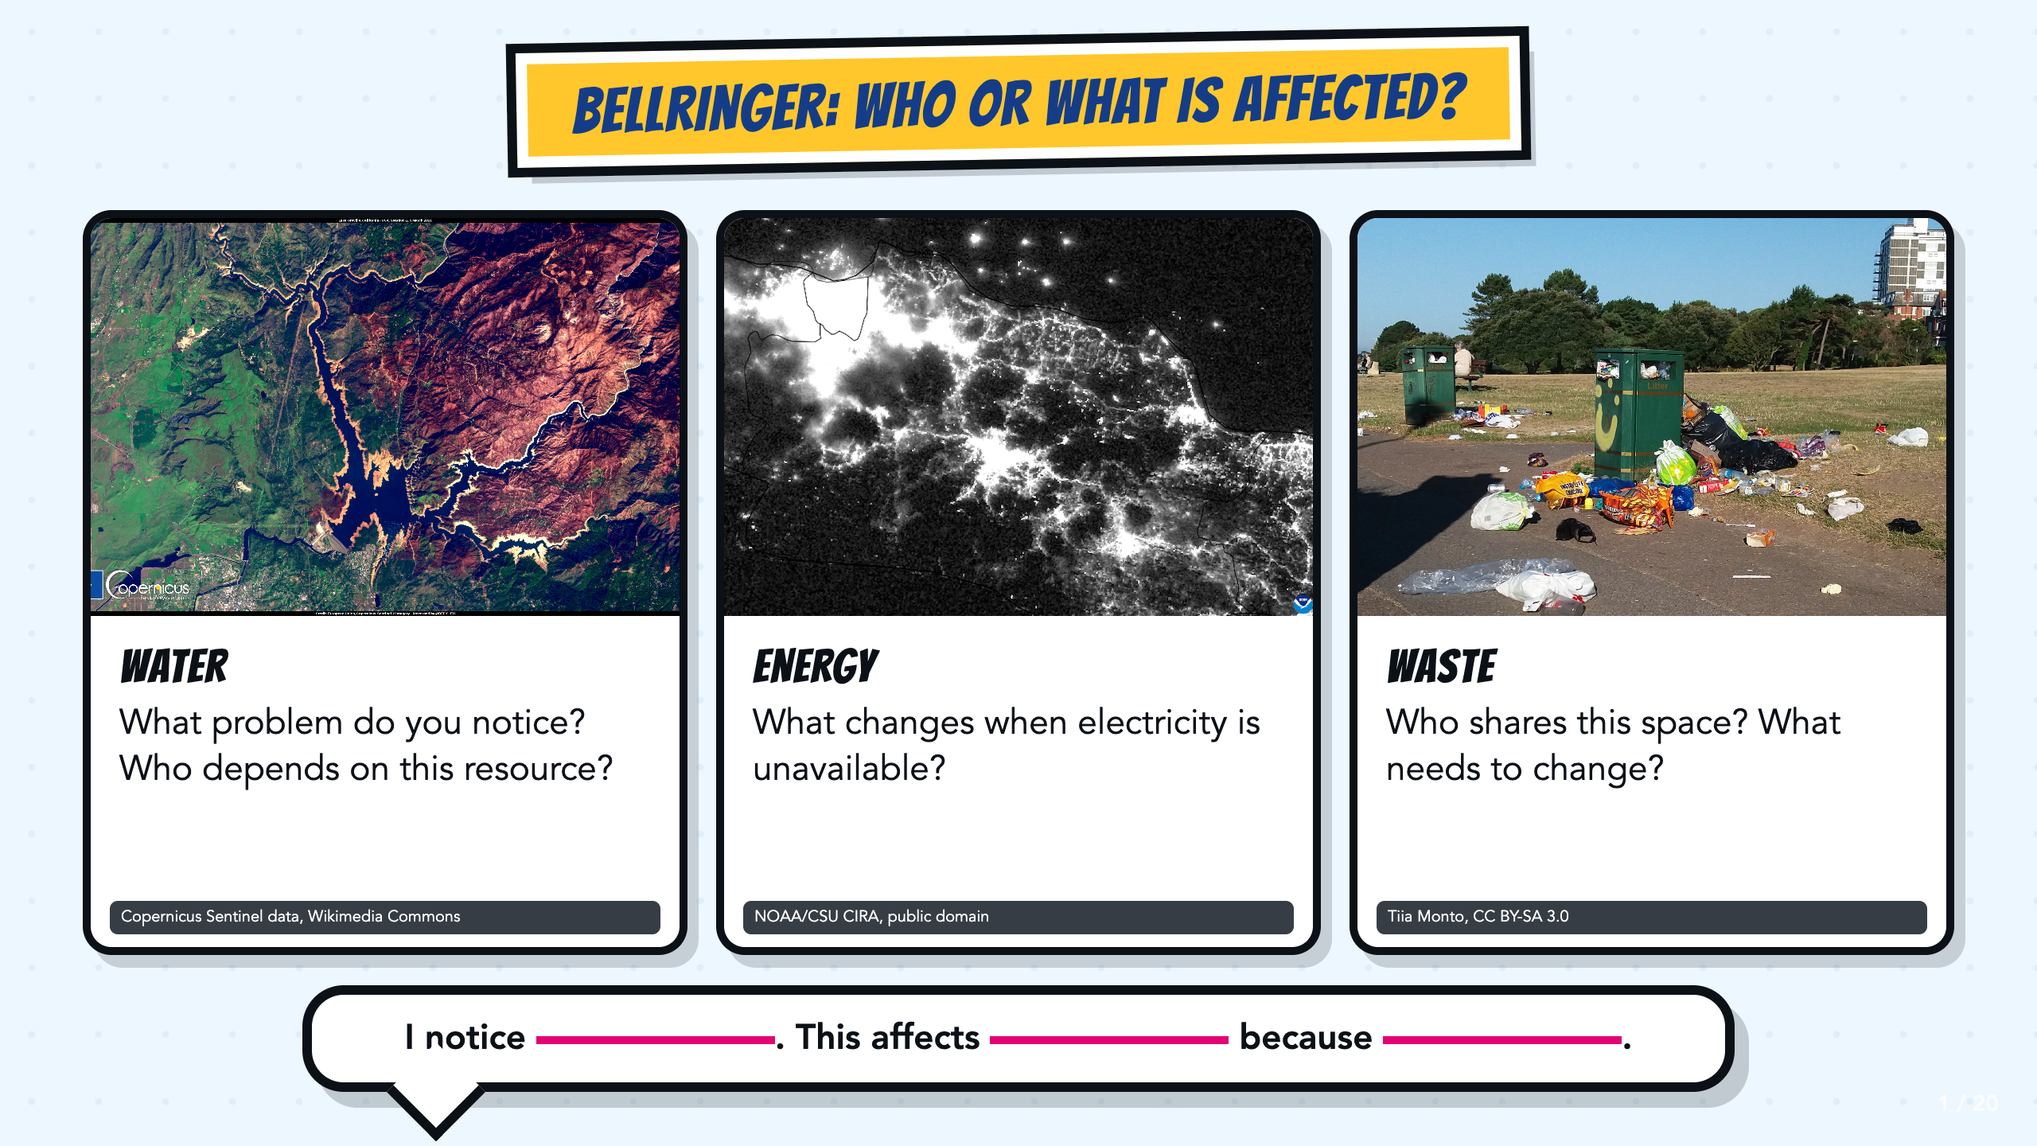
Notes:
Give students one minute to study all three photographs. Let them name what they notice before asking who or what is affected. Use the sentence stem for a quick write, partner share, or call-out.
[Sources]
- Copernicus Sentinel data, Severe drought in California, USA, Wikimedia Commons: https://commons.wikimedia.org/wiki/File:Severe_drought_in_California,_USA.jpg
- NOAA/CSU CIRA, Power Blackout on Java in Indonesia, public domain, Wikimedia Commons: https://commons.wikimedia.org/wiki/File:Power_Blackout_on_Java_in_Indonesia_(CIRA_2019-08-04_-_201908041806_n20-snpp_viirs_dnb_javablackout_nolabels0).png
- Tiia Monto, Trash in park, CC BY-SA 3.0, Wikimedia Commons: https://commons.wikimedia.org/wiki/File:Trash_in_park.jpg

Slide 2
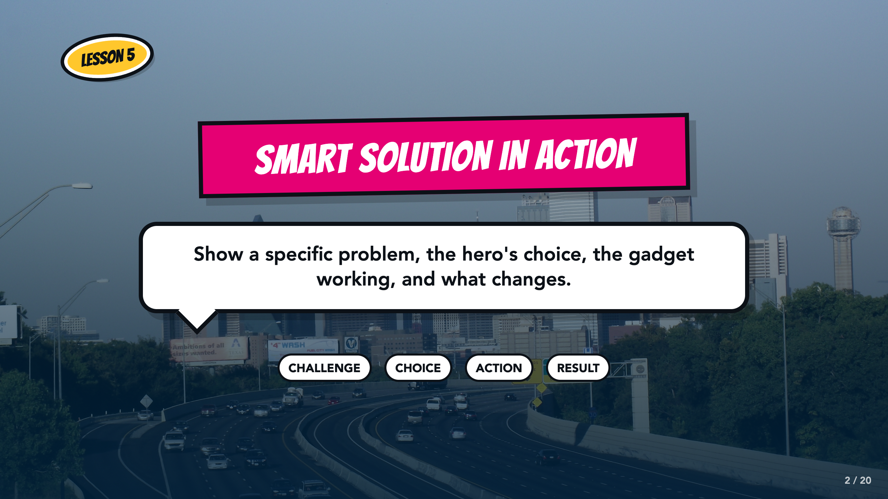
Notes:
Frame the final comic page as a cause-and-effect sequence. Students will show the challenge, the hero's choice, the gadget action, and a visible result.
[Sources]
- medea_material, Skyline of Dallas, TX, CC BY 2.0, Wikimedia Commons: https://commons.wikimedia.org/wiki/File:Skyline_of_Dallas,_TX.jpg
- ASU Identifying Challenges in Your Communities facilitator guide, teacher copy: https://docs.google.com/document/d/1JwuSSRtIizdjKJ0lHQR75Gyxw0ZuNVdKZGZQwXzeGbA/copy

Slide 3
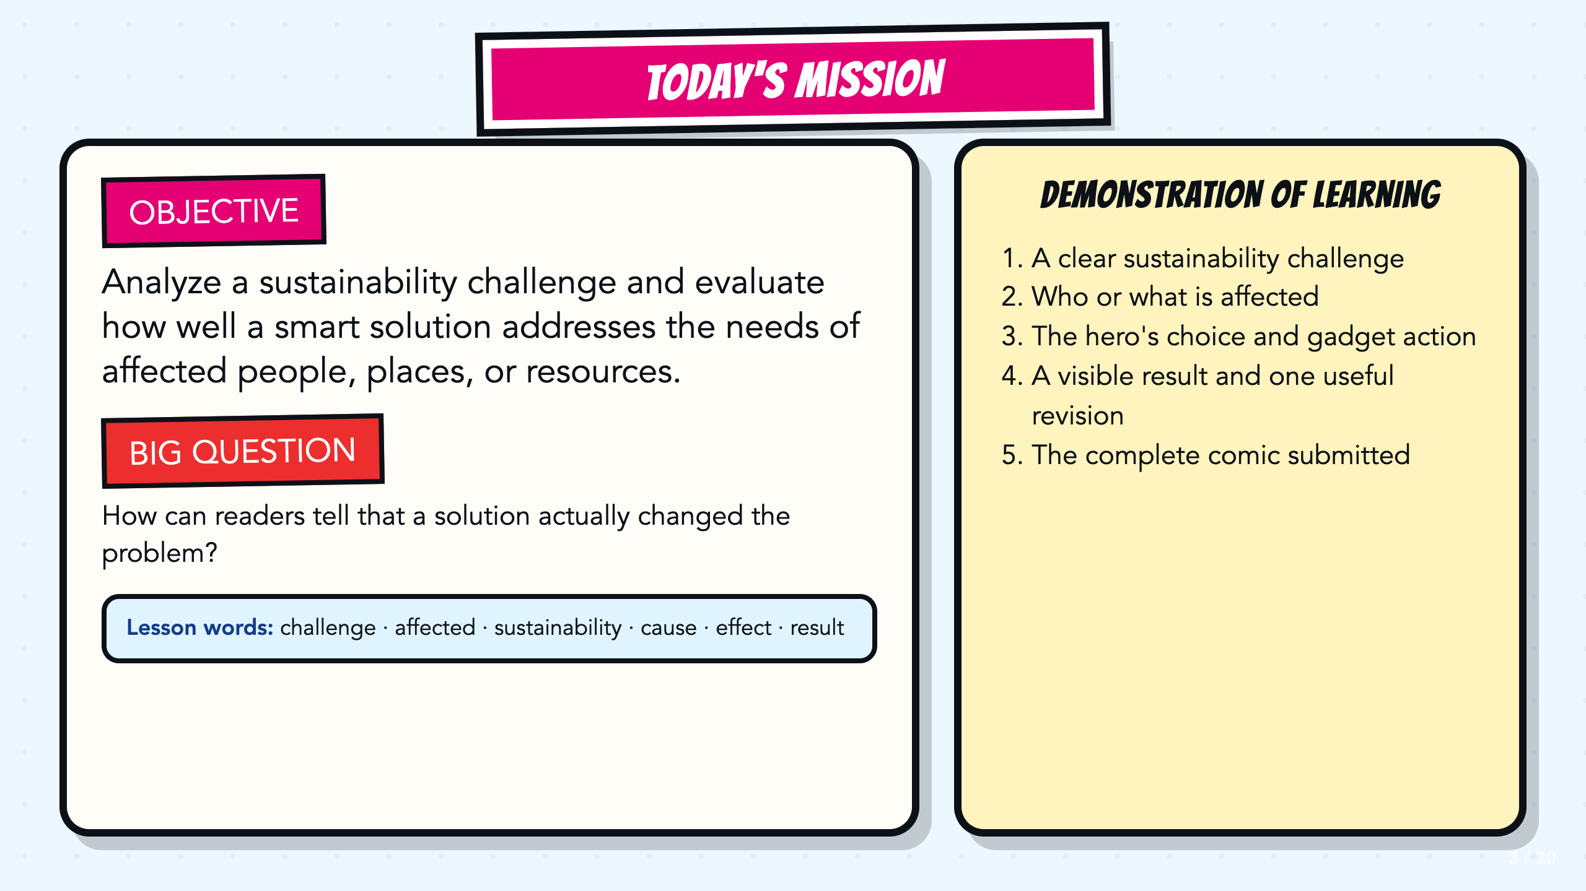
Notes:
Read the objective and Demonstration of Learning aloud. The learning is the analysis and evaluation. The revised Page 4 and complete comic are the project evidence the teacher uses to judge mastery.
[Sources]
- ASU Identifying Challenges in Your Communities facilitator guide, teacher copy: https://docs.google.com/document/d/1JwuSSRtIizdjKJ0lHQR75Gyxw0ZuNVdKZGZQwXzeGbA/copy
- ASU Identifying Challenges in Your Communities presentation, teacher copy: https://docs.google.com/presentation/d/1OIJnbxQIhfM9WmfXTnHTuC5i_WKXaqkO9k0SUvDGvp0/copy

Slide 4
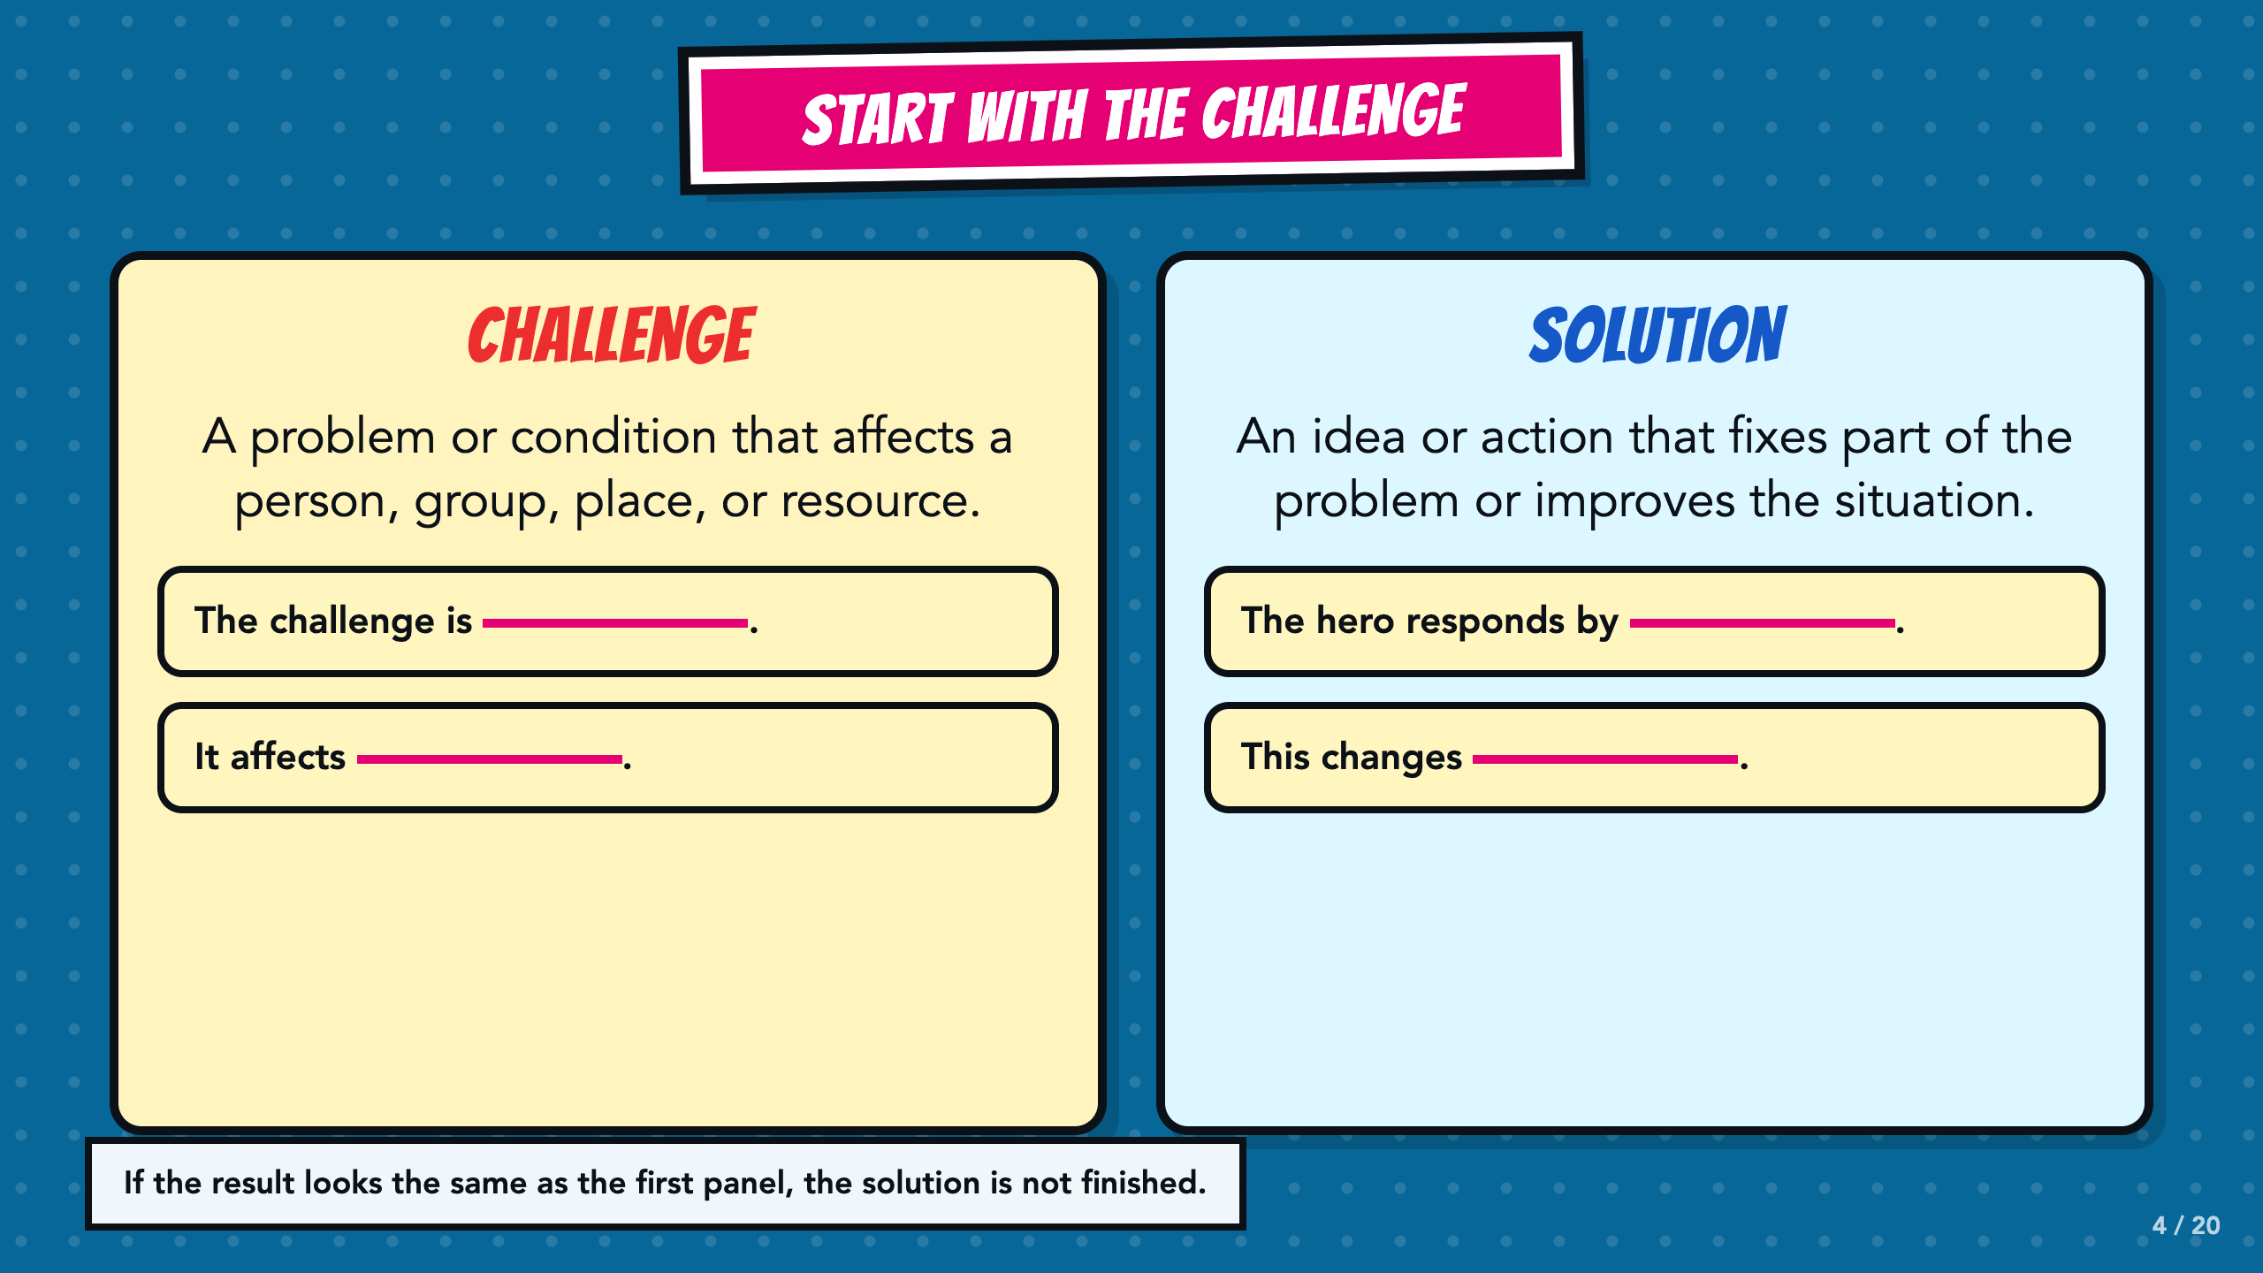
Notes:
Build the two definitions from student examples. A challenge affects someone or something. A solution improves at least part of that situation. Return to the bottom check whenever a result is unclear.
[Sources]
- ASU Identifying Challenges in Your Communities facilitator guide, teacher copy: https://docs.google.com/document/d/1JwuSSRtIizdjKJ0lHQR75Gyxw0ZuNVdKZGZQwXzeGbA/copy
- ASU Identifying Challenges in Your Communities presentation, teacher copy: https://docs.google.com/presentation/d/1OIJnbxQIhfM9WmfXTnHTuC5i_WKXaqkO9k0SUvDGvp0/copy

Slide 5
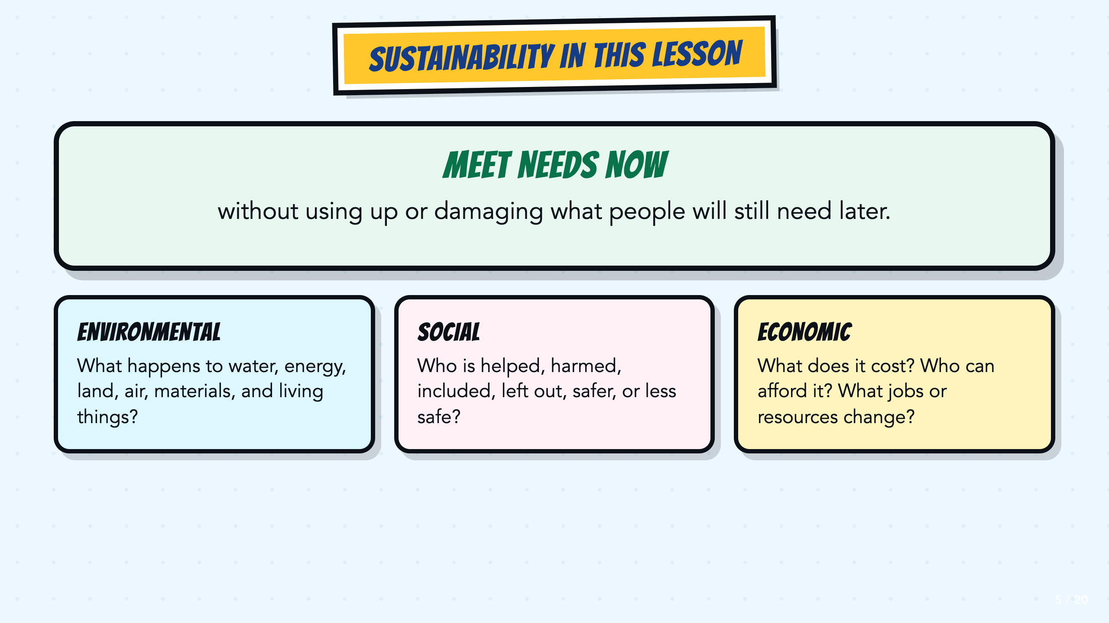
Notes:
Define sustainability, then introduce the environmental, social, and economic lenses. Ask students to name one effect that could fit each lens. The lenses help students ask questions; they are not a rule that every problem belongs in only one category.
[Sources]
- United Nations, What is sustainable development?: https://www.un.org/sustainabledevelopment/blog/2023/08/what-is-sustainable-development/
- ASU + Verizon Mapping Sustainability facilitator guide, teacher copy: https://docs.google.com/document/d/1u8MFHRMjT4c-NuFj85K5bi6QhyX8Rx6O/copy

Slide 6
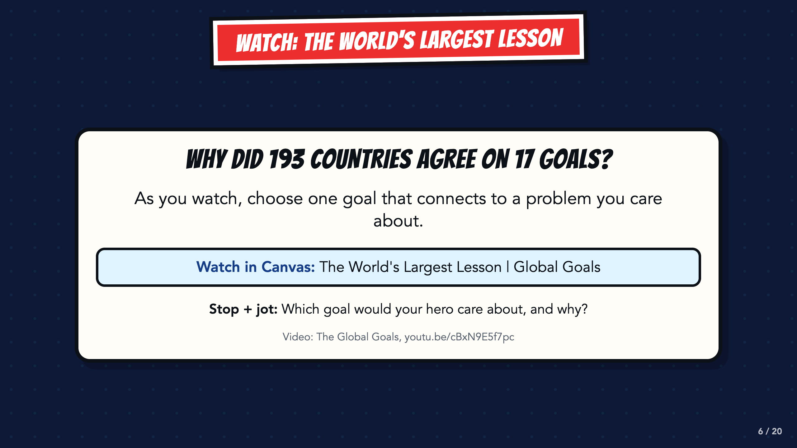
Notes:
Play The World's Largest Lesson. Ask students to choose one goal that connects to a problem they care about. The direct video link is also in the Canvas lesson for students who need to watch again.
[Sources]
- The Global Goals, The World's Largest Lesson: https://youtu.be/cBxN9E5f7pc
- United Nations, The 17 Sustainable Development Goals: https://sdgs.un.org/goals

Slide 7
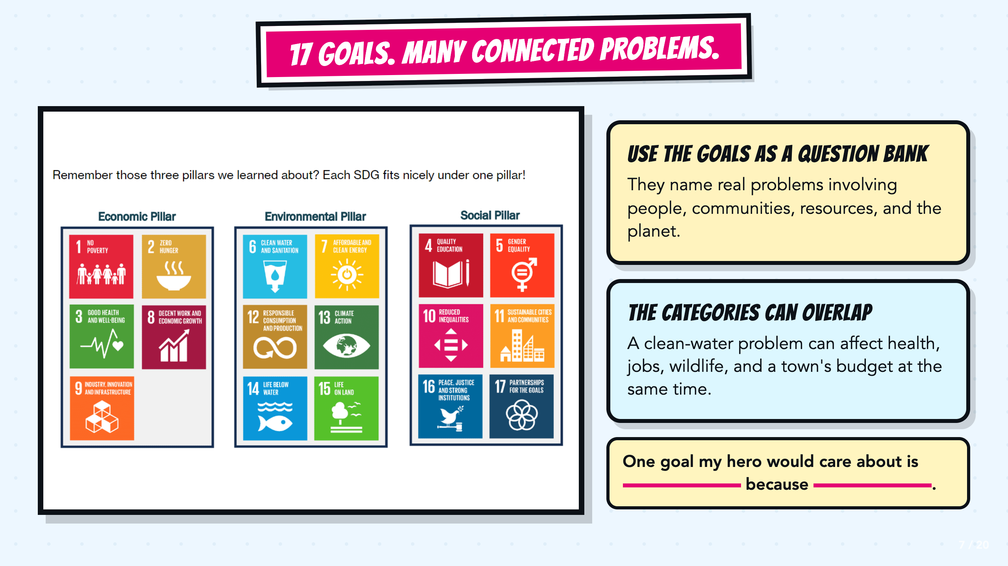
Notes:
Use the SDG image as a problem bank. Point out that the inherited chart sorts goals into three groups, but real problems often cross categories. A water problem can affect health, jobs, wildlife, and public spending at the same time.
[Sources]
- United Nations, The 17 Sustainable Development Goals: https://sdgs.un.org/goals
- ASU + Verizon Mapping Sustainability presentation, teacher copy: https://docs.google.com/presentation/d/1wLmWv11evu872SNgYDrXIUlDrSCTgHGU/copy

Slide 8
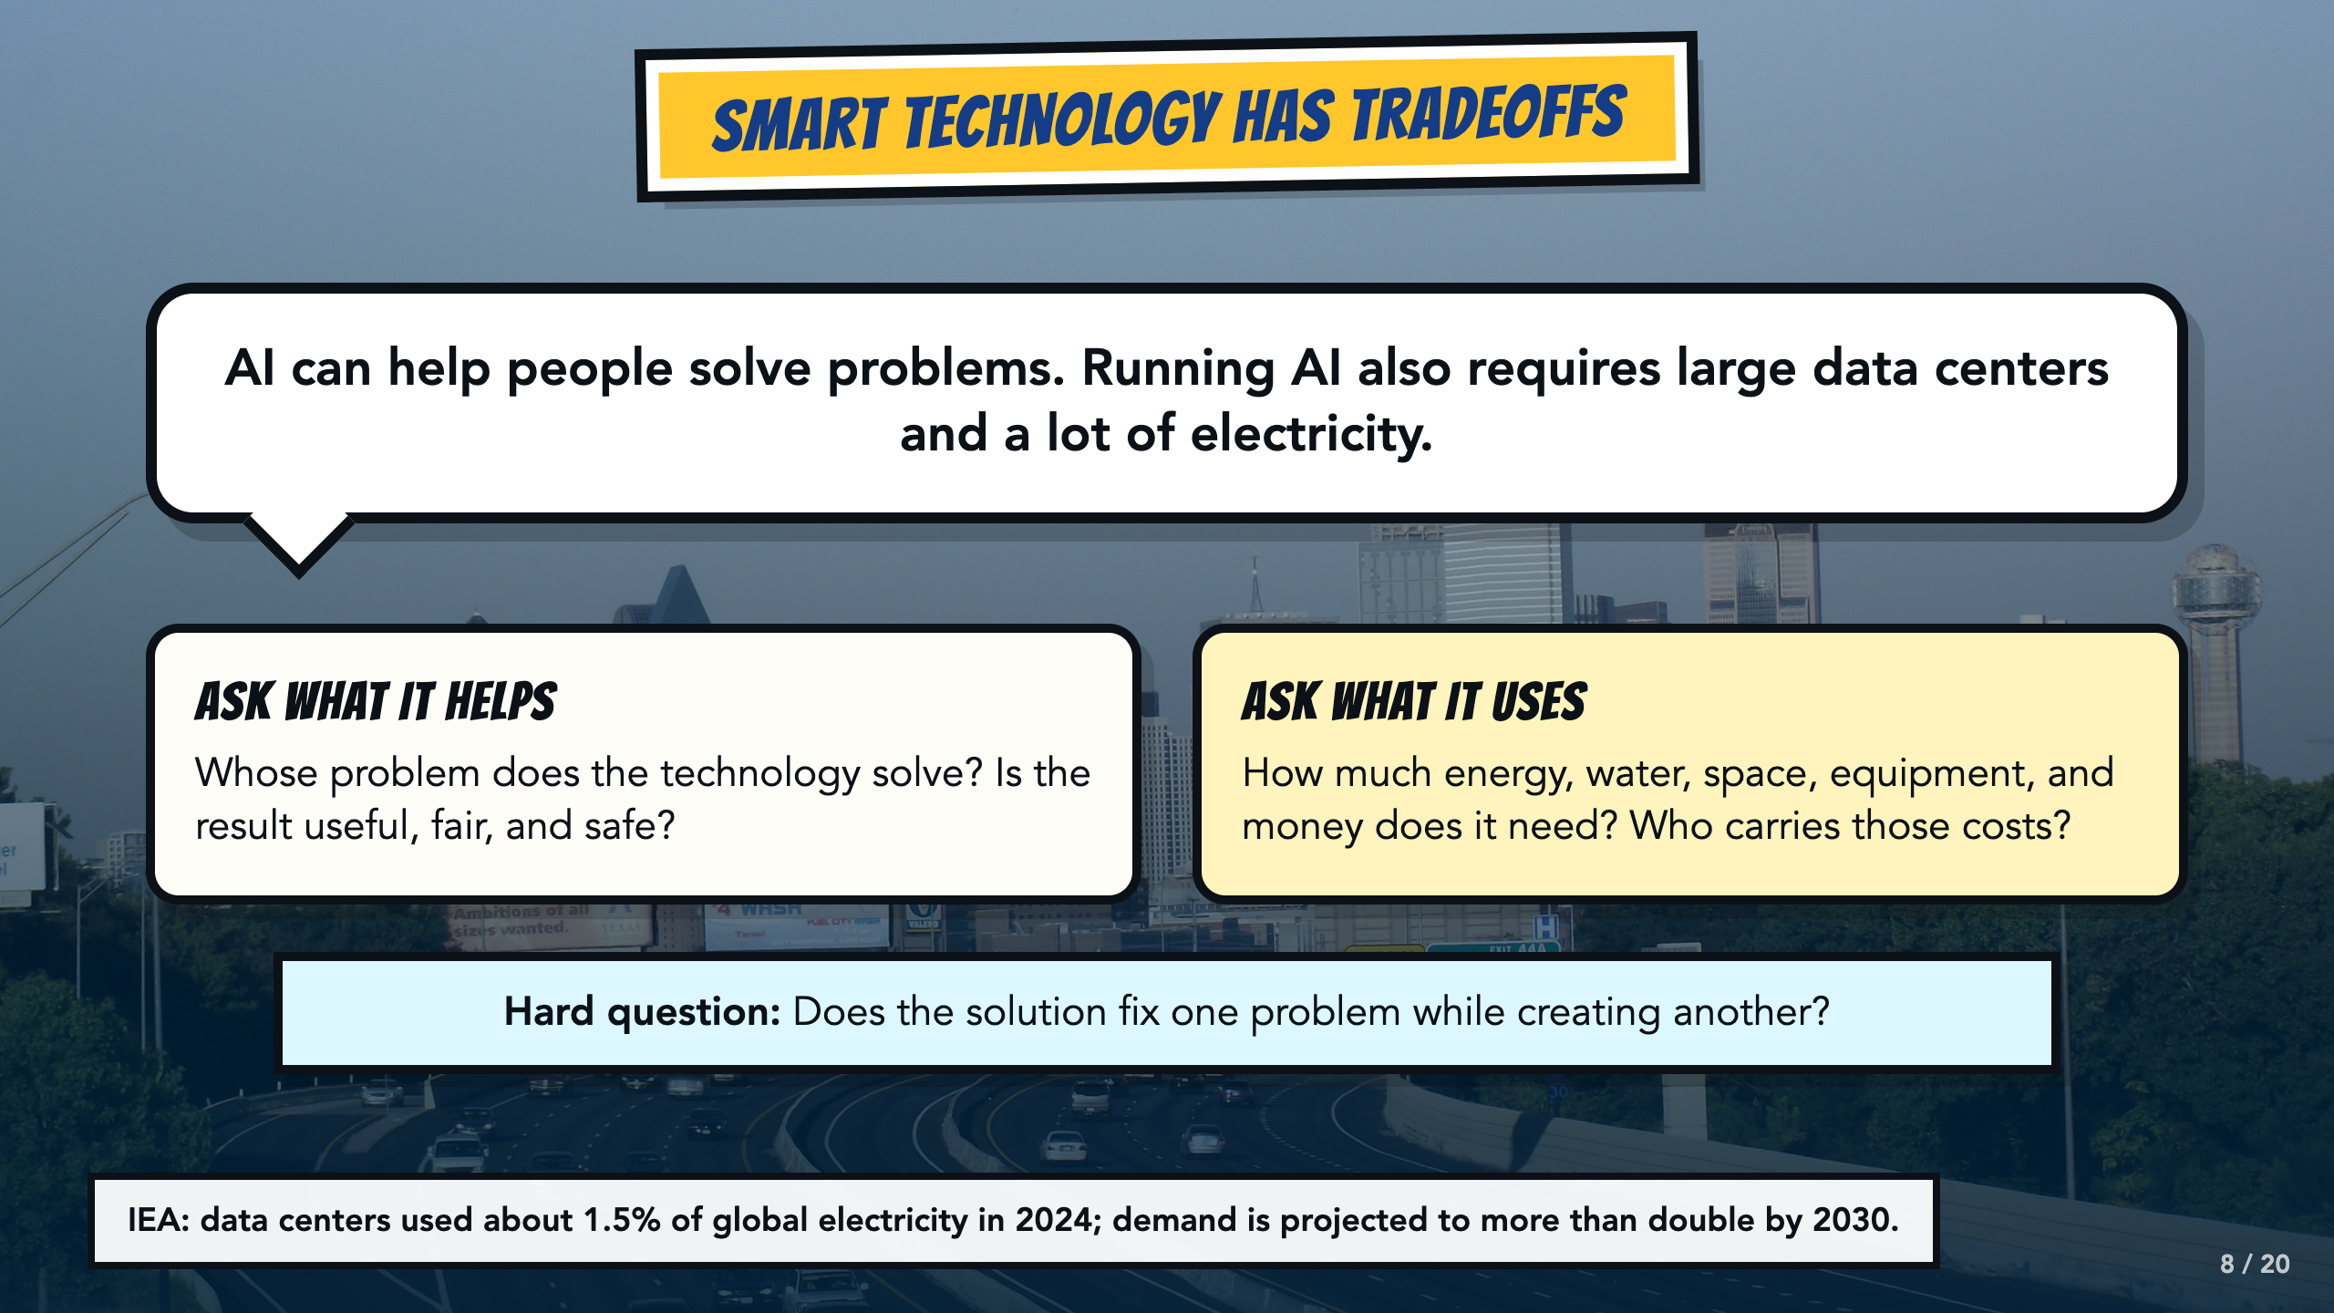
Notes:
Connect sustainability to current technology. AI can help with real problems, but training and running AI happens in power-hungry data centers. The IEA reports that data centers used about 1.5% of global electricity in 2024 and projects demand to more than double by 2030. Ask whether a solution fixes one problem while creating another.
[Sources]
- International Energy Agency, Energy and AI executive summary, 2025: https://www.iea.org/reports/energy-and-ai/executive-summary

Slide 9
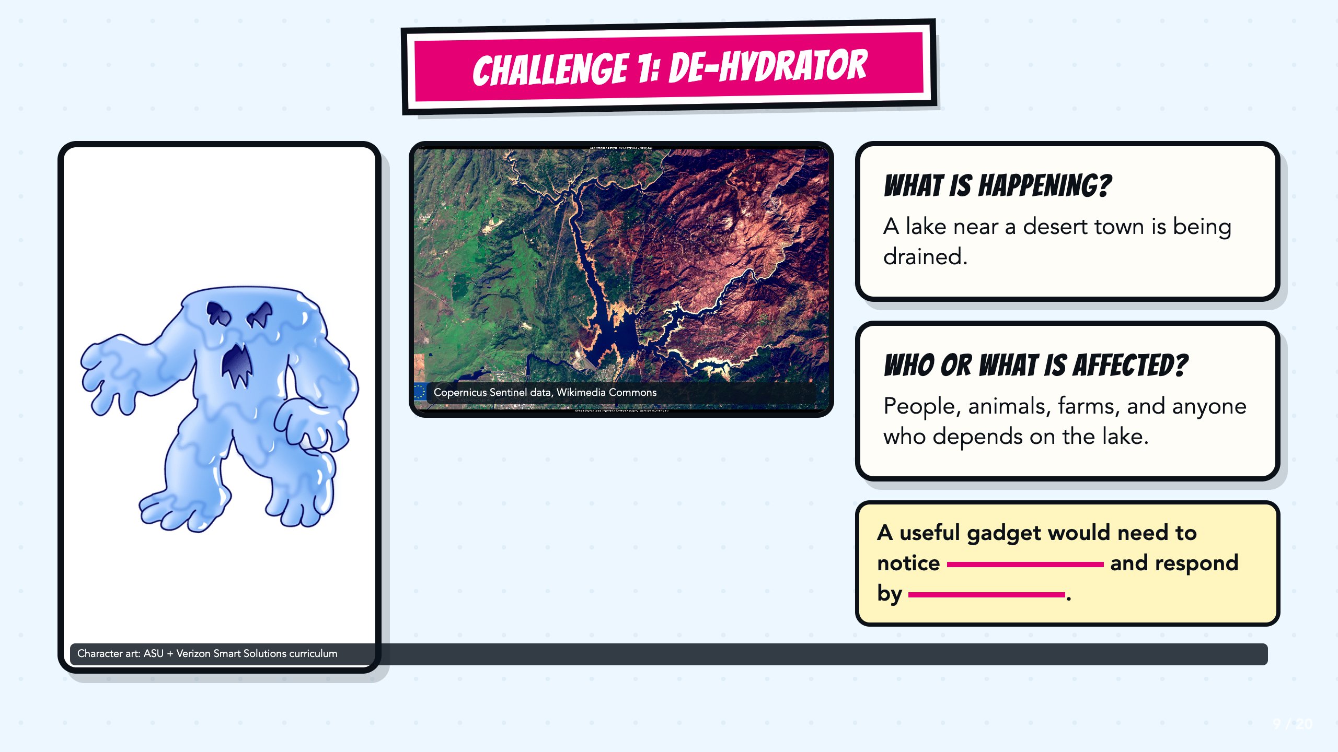
Notes:
Read the drought context, then have partners finish the stem with one kind of information a gadget could receive and one useful response. Accept several workable solutions.
[Sources]
- Copernicus Sentinel data, Severe drought in California, USA, Wikimedia Commons: https://commons.wikimedia.org/wiki/File:Severe_drought_in_California,_USA.jpg
- ASU + Verizon Mapping Sustainability facilitator guide, teacher copy: https://docs.google.com/document/d/1u8MFHRMjT4c-NuFj85K5bi6QhyX8Rx6O/copy
- ASU + Verizon Mapping Sustainability presentation, teacher copy: https://docs.google.com/presentation/d/1wLmWv11evu872SNgYDrXIUlDrSCTgHGU/copy

Slide 10
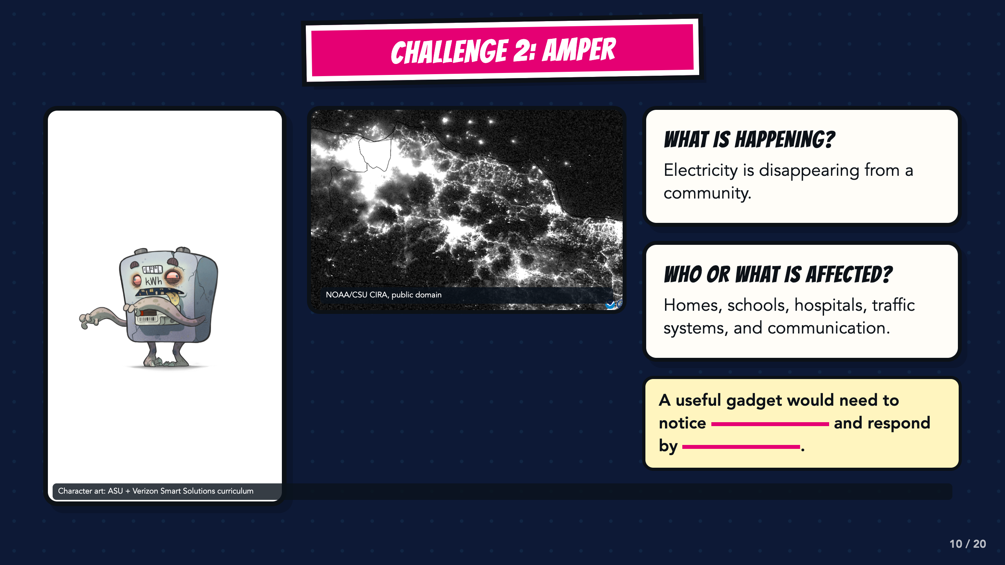
Notes:
Use the blackout image to make the effect of lost electricity visible. Ask students which systems would be affected first and what information a gadget would need before it could respond.
[Sources]
- NOAA/CSU CIRA, Power Blackout on Java in Indonesia, public domain, Wikimedia Commons: https://commons.wikimedia.org/wiki/File:Power_Blackout_on_Java_in_Indonesia_(CIRA_2019-08-04_-_201908041806_n20-snpp_viirs_dnb_javablackout_nolabels0).png
- ASU + Verizon Mapping Sustainability facilitator guide, teacher copy: https://docs.google.com/document/d/1u8MFHRMjT4c-NuFj85K5bi6QhyX8Rx6O/copy
- ASU + Verizon Mapping Sustainability presentation, teacher copy: https://docs.google.com/presentation/d/1wLmWv11evu872SNgYDrXIUlDrSCTgHGU/copy

Slide 11
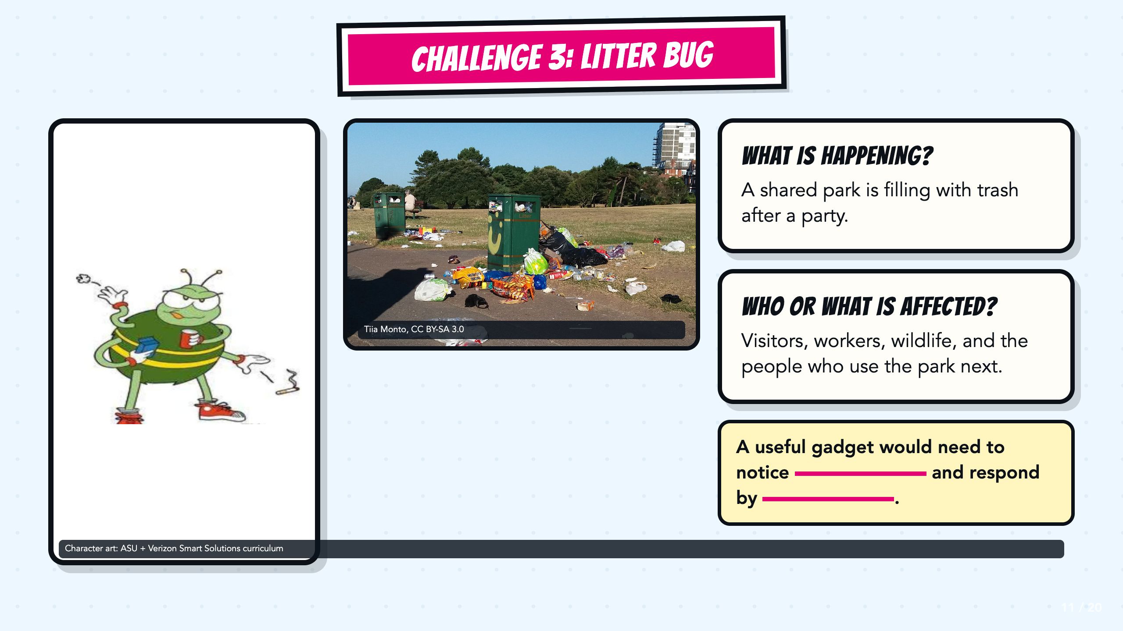
Notes:
Ask students to distinguish the trash itself from the larger challenge: a shared space is becoming unsafe or unusable. The response should change what happens next, not only decorate the scene.
[Sources]
- Tiia Monto, Trash in park, CC BY-SA 3.0, Wikimedia Commons: https://commons.wikimedia.org/wiki/File:Trash_in_park.jpg
- ASU + Verizon Mapping Sustainability facilitator guide, teacher copy: https://docs.google.com/document/d/1u8MFHRMjT4c-NuFj85K5bi6QhyX8Rx6O/copy
- ASU + Verizon Mapping Sustainability presentation, teacher copy: https://docs.google.com/presentation/d/1wLmWv11evu872SNgYDrXIUlDrSCTgHGU/copy

Slide 12
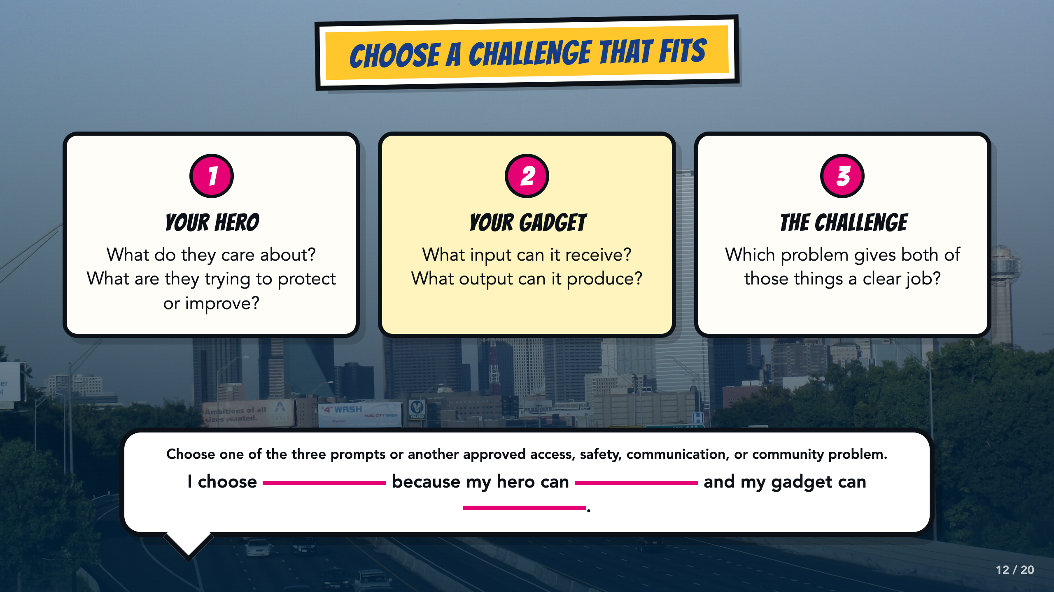
Notes:
Students may use one of the three inherited prompts or an approved access, safety, communication, community, or other problem. They should choose a challenge that gives both their existing hero and their Page 2 gadget a clear job. Use the stem to test the fit before anyone begins drawing.
[Sources]
- ASU Identifying Challenges in Your Communities facilitator guide, teacher copy: https://docs.google.com/document/d/1JwuSSRtIizdjKJ0lHQR75Gyxw0ZuNVdKZGZQwXzeGbA/copy

Slide 13
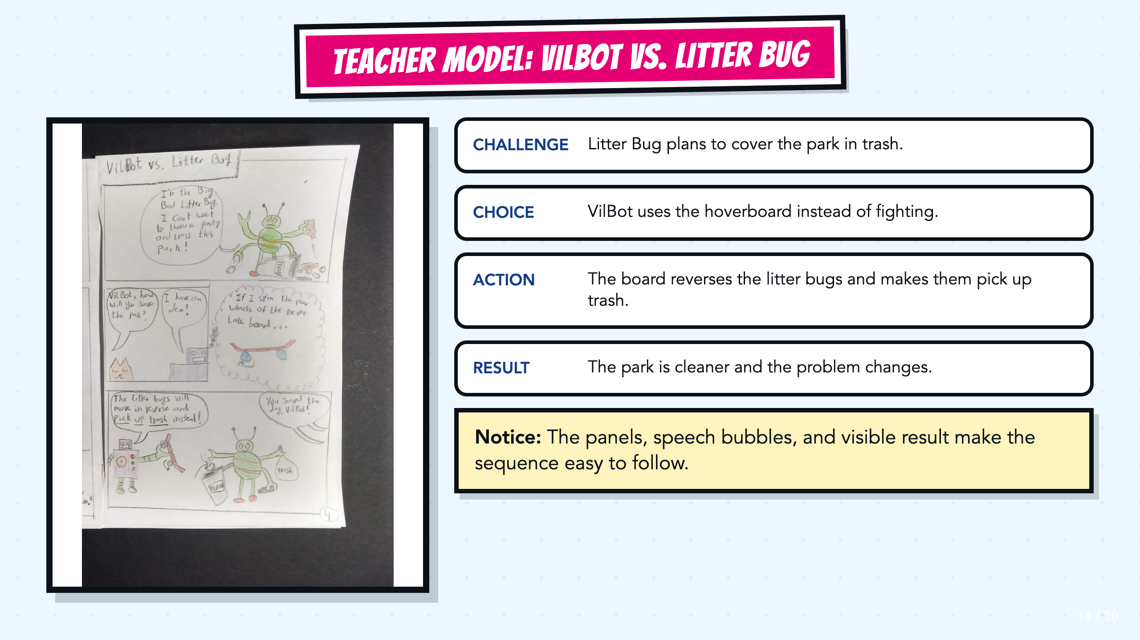
Notes:
Read the VilBot example from first panel to last. Point out the challenge, VilBot's choice, the gadget action, and the visible result. The sequence works because the page carries the explanation.
[Sources]
- Teacher-created VilBot comic exemplar used in the Smart Solutions course.

Slide 14
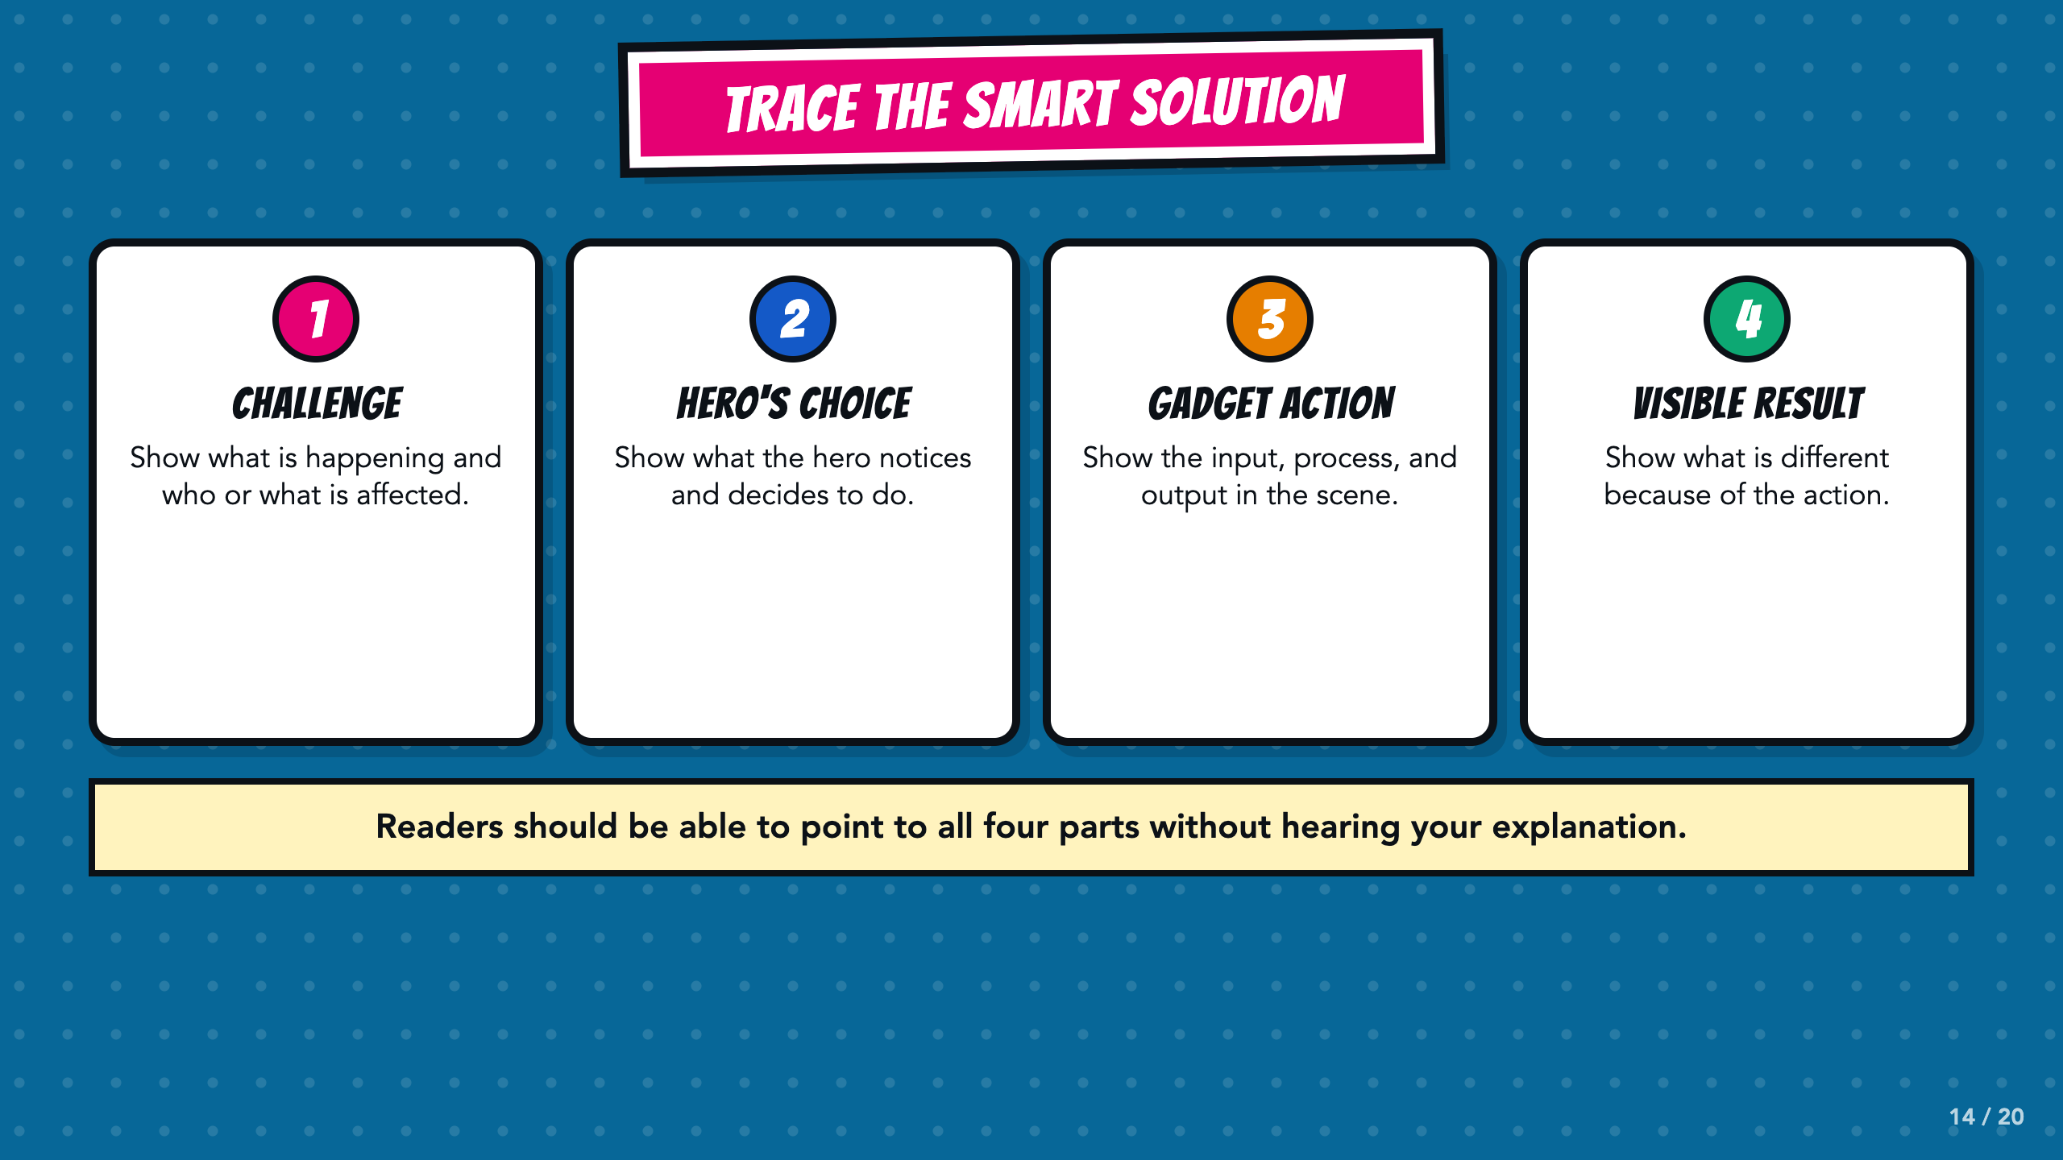
Notes:
Use these four labels as a trace. In the gadget-action section, ask students to name the input, the process or rule, and the output already established on Page 2.
[Sources]
- ASU Identifying Challenges in Your Communities facilitator guide, teacher copy: https://docs.google.com/document/d/1JwuSSRtIizdjKJ0lHQR75Gyxw0ZuNVdKZGZQwXzeGbA/copy

Slide 15
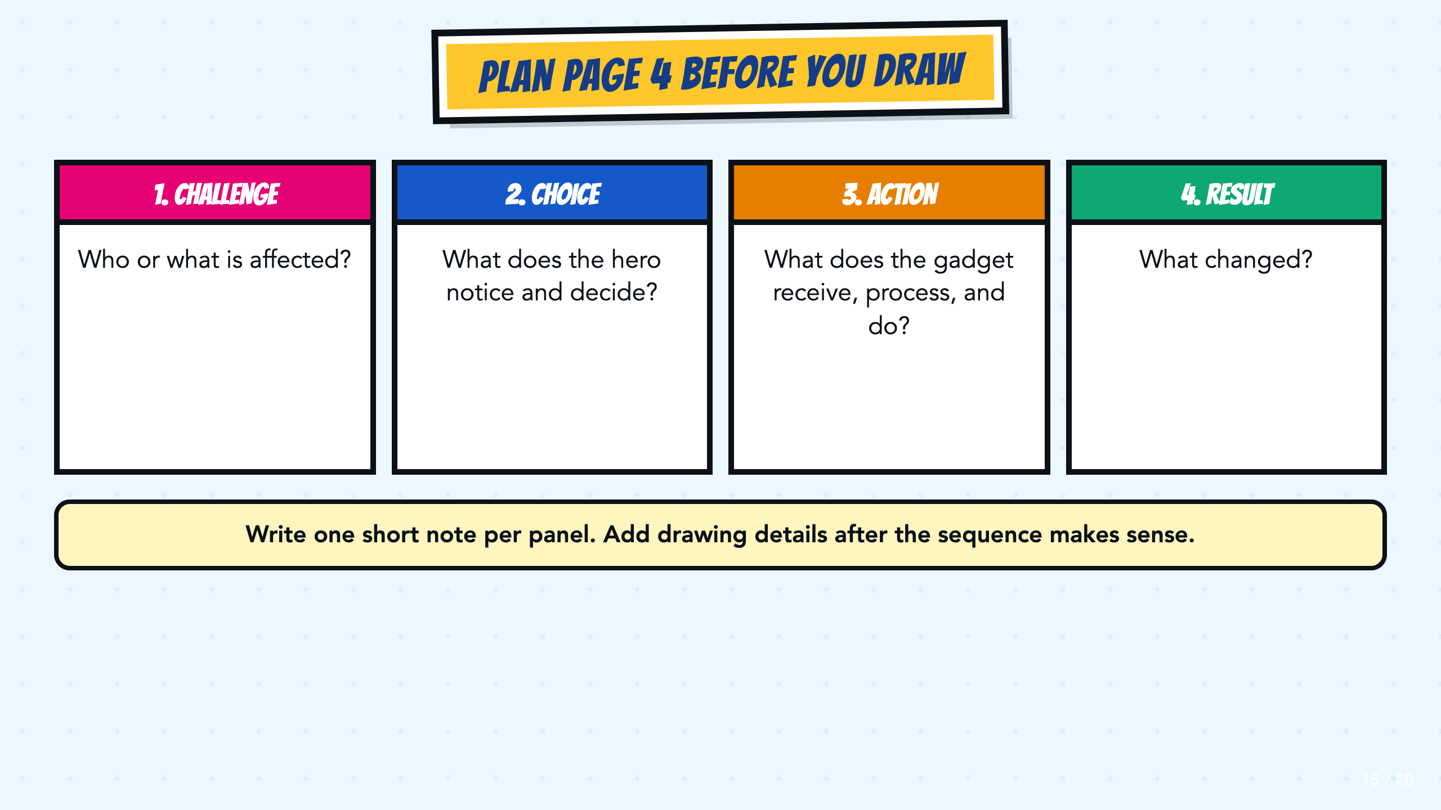
Notes:
Have students write one short planning note in each box before drawing. Check the order and the visible result first. Drawing details come after the sequence works.
[Sources]
- ASU Identifying Challenges in Your Communities facilitator guide, teacher copy: https://docs.google.com/document/d/1JwuSSRtIizdjKJ0lHQR75Gyxw0ZuNVdKZGZQwXzeGbA/copy

Slide 16
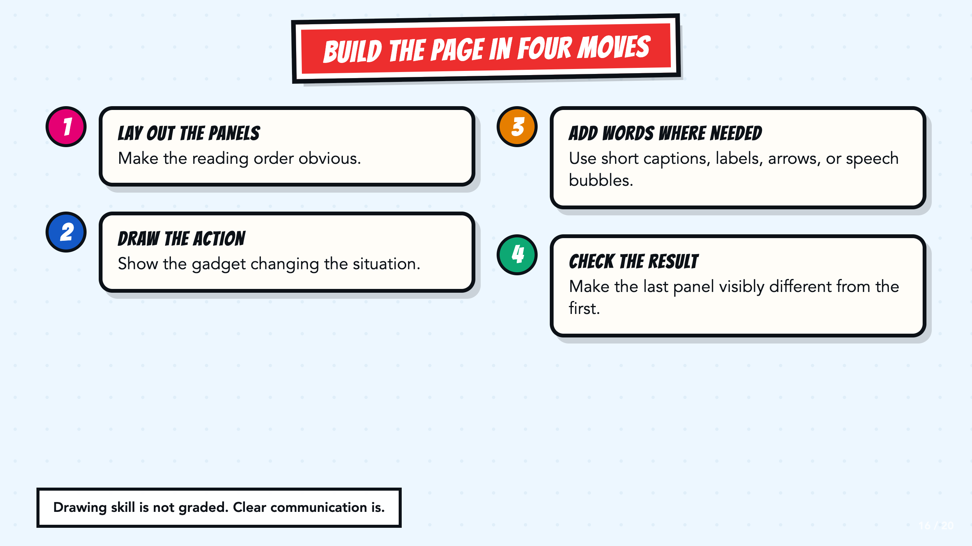
Notes:
Model the four moves quickly. Remind students that drawing skill is not scored. The reader needs to see the action, follow the order, and understand what changed.
[Sources]
- Teacher-created VilBot comic exemplar used in the Smart Solutions course.

Slide 17
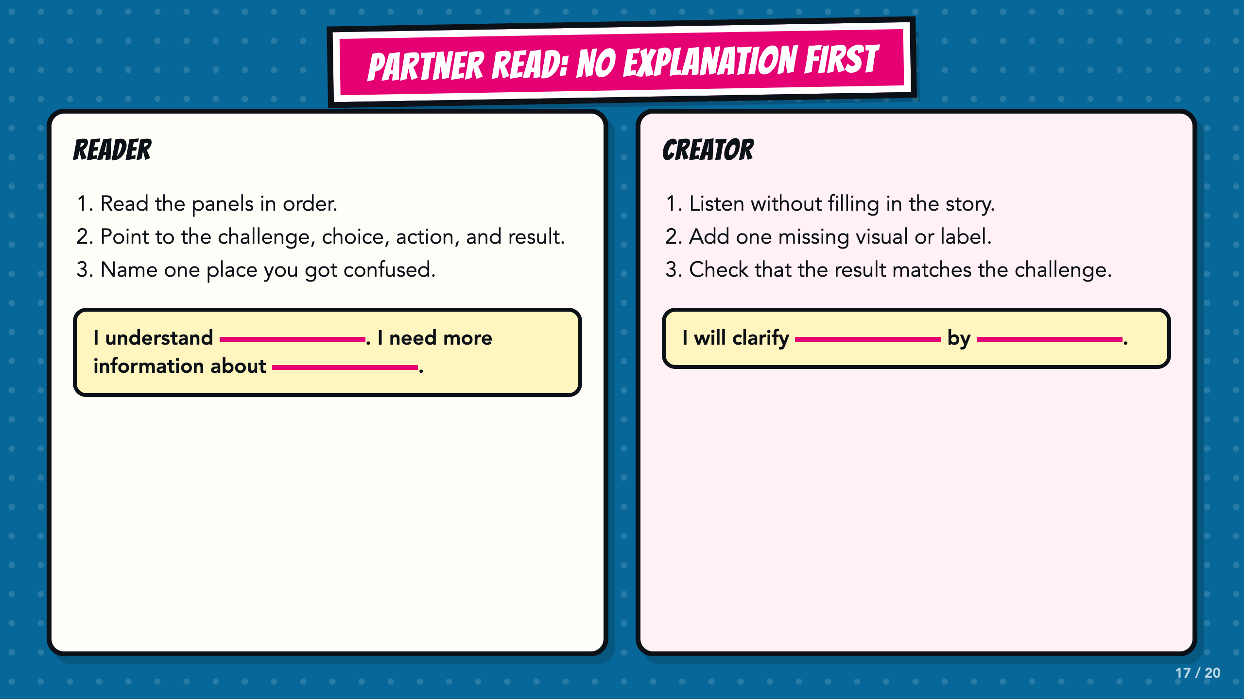
Notes:
The reader goes first and the creator stays quiet. If the reader cannot point to one of the four parts, the creator adds a visual, label, caption, arrow, or speech bubble.
[Sources]
- ASU Identifying Challenges in Your Communities facilitator guide, teacher copy: https://docs.google.com/document/d/1JwuSSRtIizdjKJ0lHQR75Gyxw0ZuNVdKZGZQwXzeGbA/copy

Slide 18
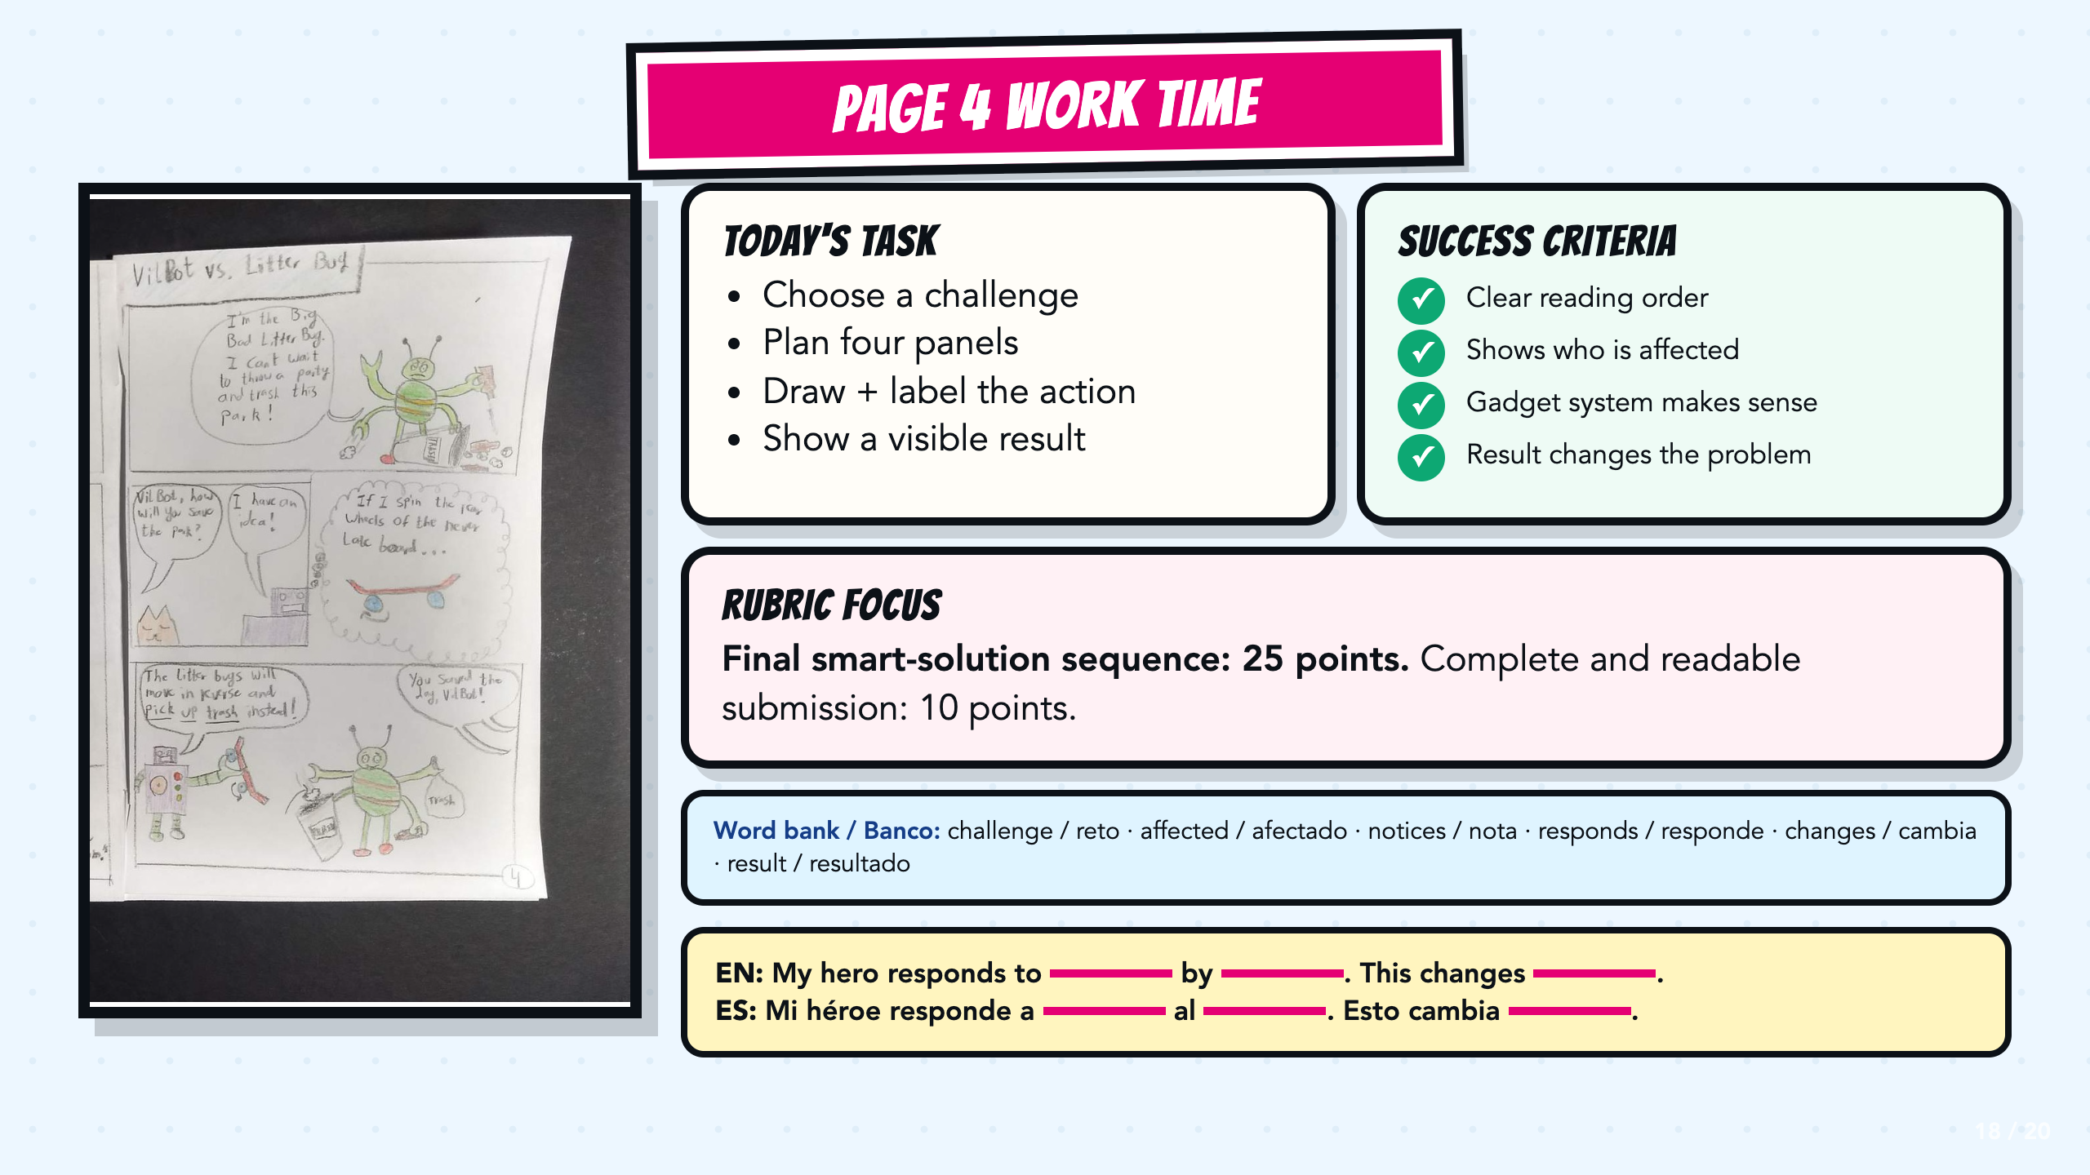
Notes:
Leave this slide projected during work time. Read the exact rubric focus before students begin. Direct students to the bilingual word bank and sentence stems when they need language support.
[Sources]
- Teacher-created VilBot comic exemplar used in the Smart Solutions course.

Slide 19
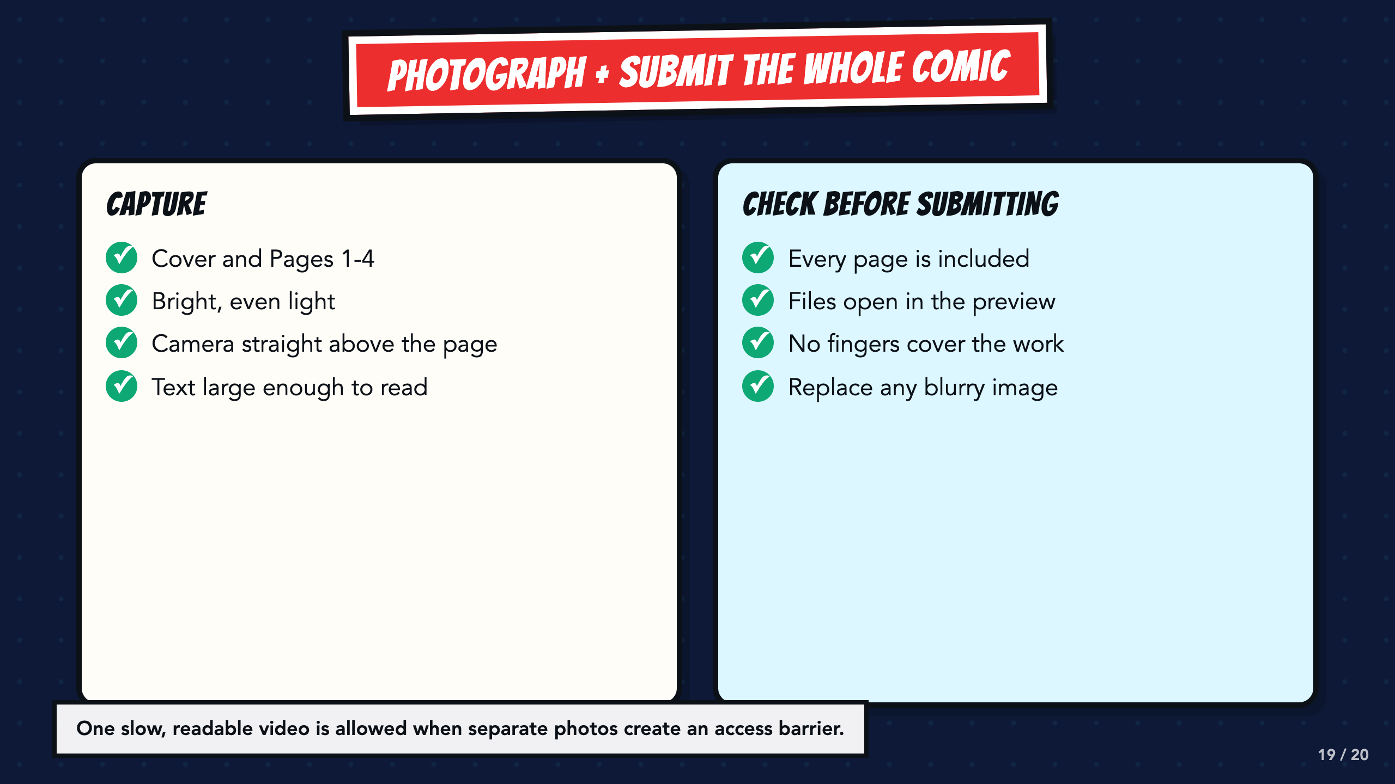
Notes:
Students submit the entire comic: cover and Pages 1 through 4. Let a student use one slow, readable video when separate photographs create a barrier. Preview every file before submitting.
[Sources]
- Teacher-created VilBot comic exemplar used in the Smart Solutions course.

Slide 20
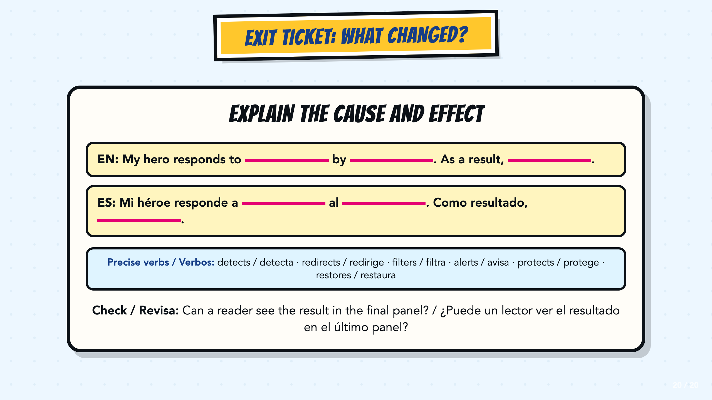
Notes:
Use the bilingual cause-and-effect stem as a written or oral exit ticket. Listen for a specific challenge, a clear response, and a result that a reader can actually see in the final panel.
[Sources]
- ASU Identifying Challenges in Your Communities facilitator guide, teacher copy: https://docs.google.com/document/d/1JwuSSRtIizdjKJ0lHQR75Gyxw0ZuNVdKZGZQwXzeGbA/copy

