Slide 1

Notes:
Open with the two ideas that organize the unit. Week A asks what the computer was told to do. Week B asks whether a beginner can use the page.
[Sources]
- Smart Solutions Code + Web Canvas module and facilitator guide (Irving 2027 Template, course 23402).
- Code.org. “Web Development.” CSD 2026, Unit 2. https://studio.code.org/courses/csd-2026/units/2 (accessed 2026-08-16).

Slide 2
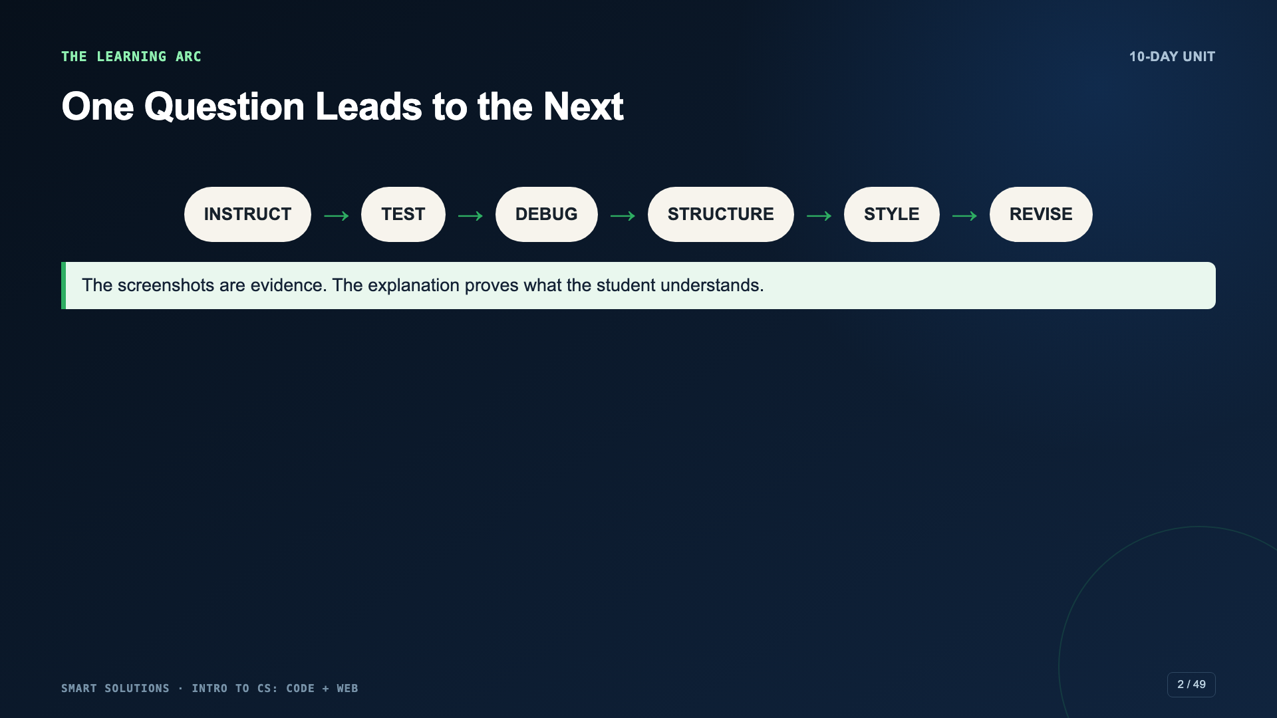
Notes:
Preview the full arc. Students should expect to explain what happened, not only click through levels.
[Sources]
- Smart Solutions Code + Web Canvas module and facilitator guide (Irving 2027 Template, course 23402).
- Code.org. “Computer Science Discoveries.” https://code.org/cs/curriculum/computer-science-discoveries (accessed 2026-08-16).

Slide 3

Notes:
Use this as the administration-ready opening. The Code.org levels are practice; the expected-versus-actual explanation is the evidence of learning.
[Sources]
- Smart Solutions Code + Web Canvas module and facilitator guide (Irving 2027 Template, course 23402).
- Code.org. “Express Course 2025.” https://studio.code.org/courses/express-2025 (accessed 2026-08-16).

Slide 4
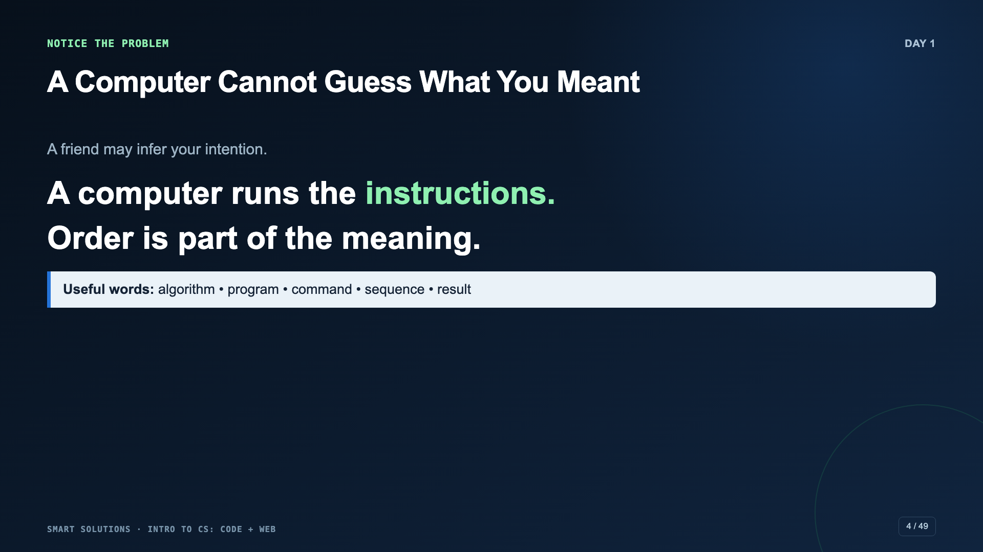
Notes:
Give a deliberately vague direction such as “go over there.” Ask what a computer would need to know that a person might infer.
[Sources]
- Smart Solutions Code + Web Canvas module and facilitator guide (Irving 2027 Template, course 23402).
- Code.org. “Express Course 2025.” https://studio.code.org/courses/express-2025 (accessed 2026-08-16).

Slide 5
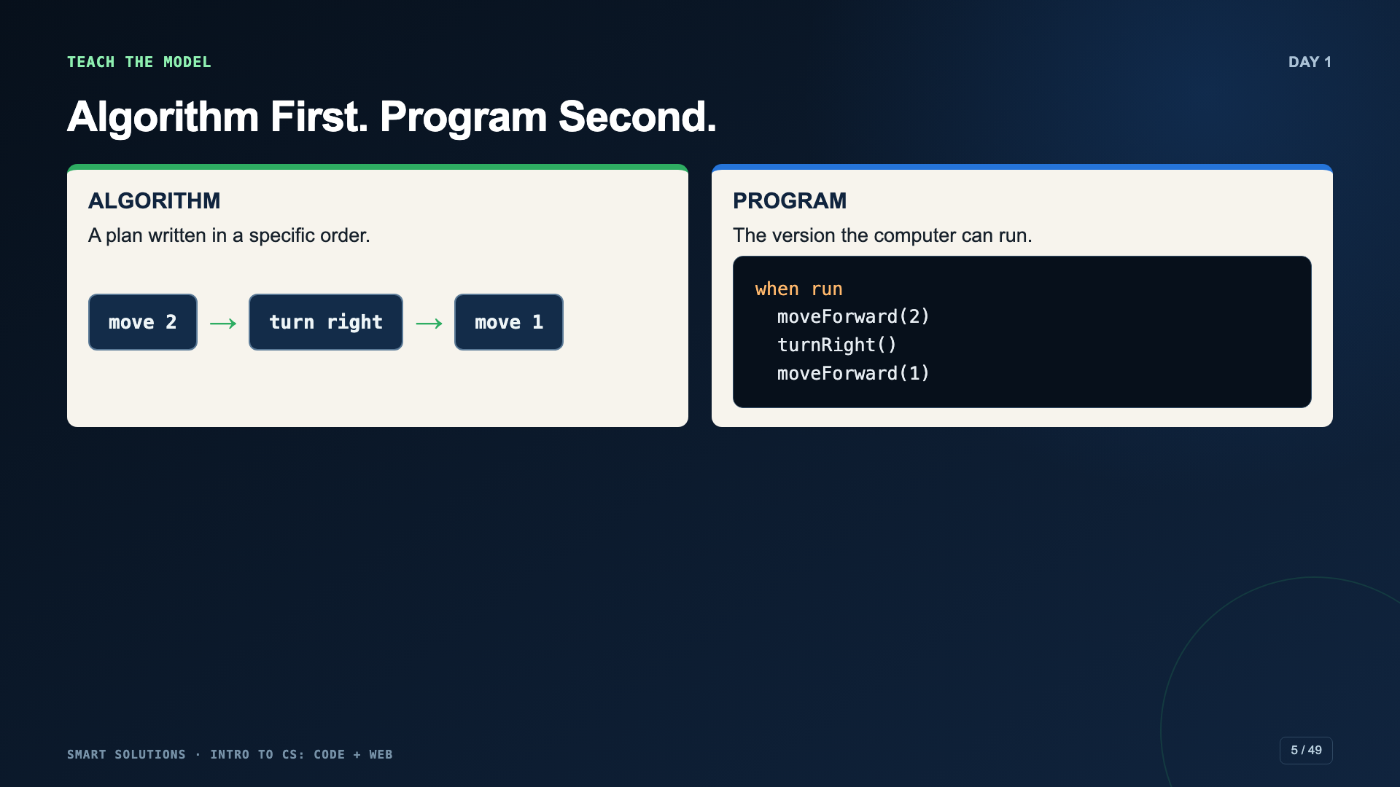
Notes:
Model the route in ordinary language, then translate it into blocks. Change the order and predict the new result before running.
[Sources]
- Code.org. “Express Course 2025.” https://studio.code.org/courses/express-2025 (accessed 2026-08-16).

Slide 6
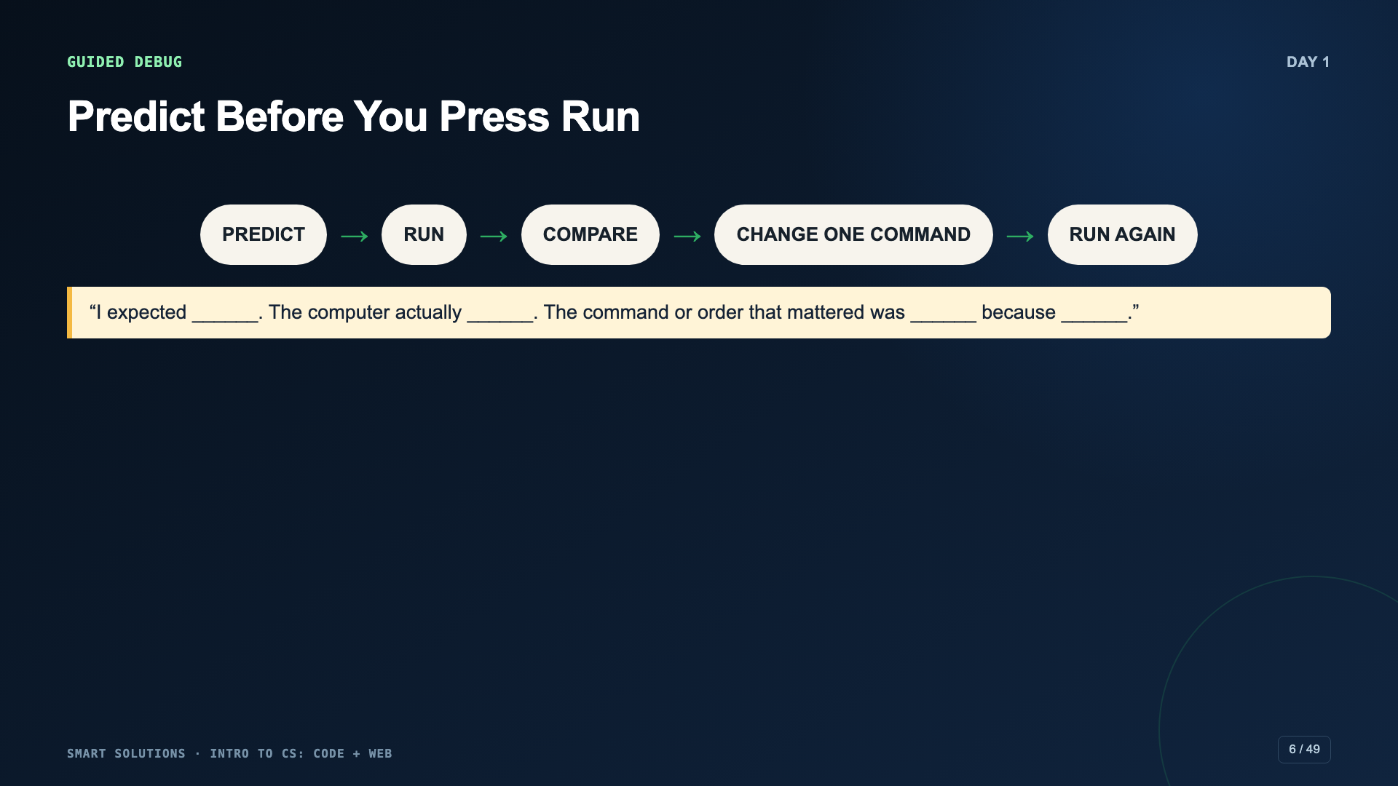
Notes:
Run one wrong Angry Birds sequence. Resist fixing it immediately. Ask students to point to the first command where the actual path stops matching the predicted path.
[Sources]
- Smart Solutions Code + Web Canvas module and facilitator guide (Irving 2027 Template, course 23402).
- Code.org. “Express Course 2025.” https://studio.code.org/courses/express-2025 (accessed 2026-08-16).

Slide 7
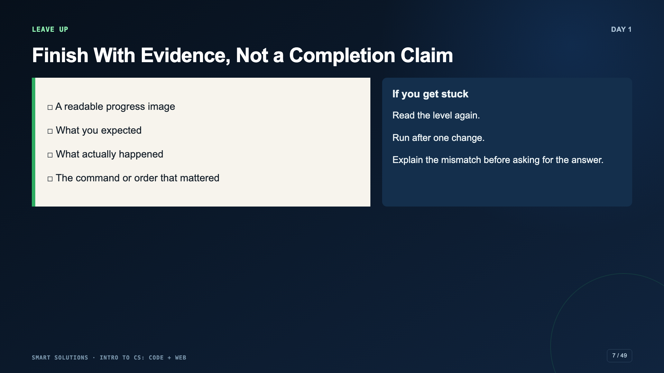
Notes:
Leave this slide up. A shorter set of levels is acceptable if students still complete the explanation.
[Sources]
- Smart Solutions Code + Web Canvas module and facilitator guide (Irving 2027 Template, course 23402).

Slide 8
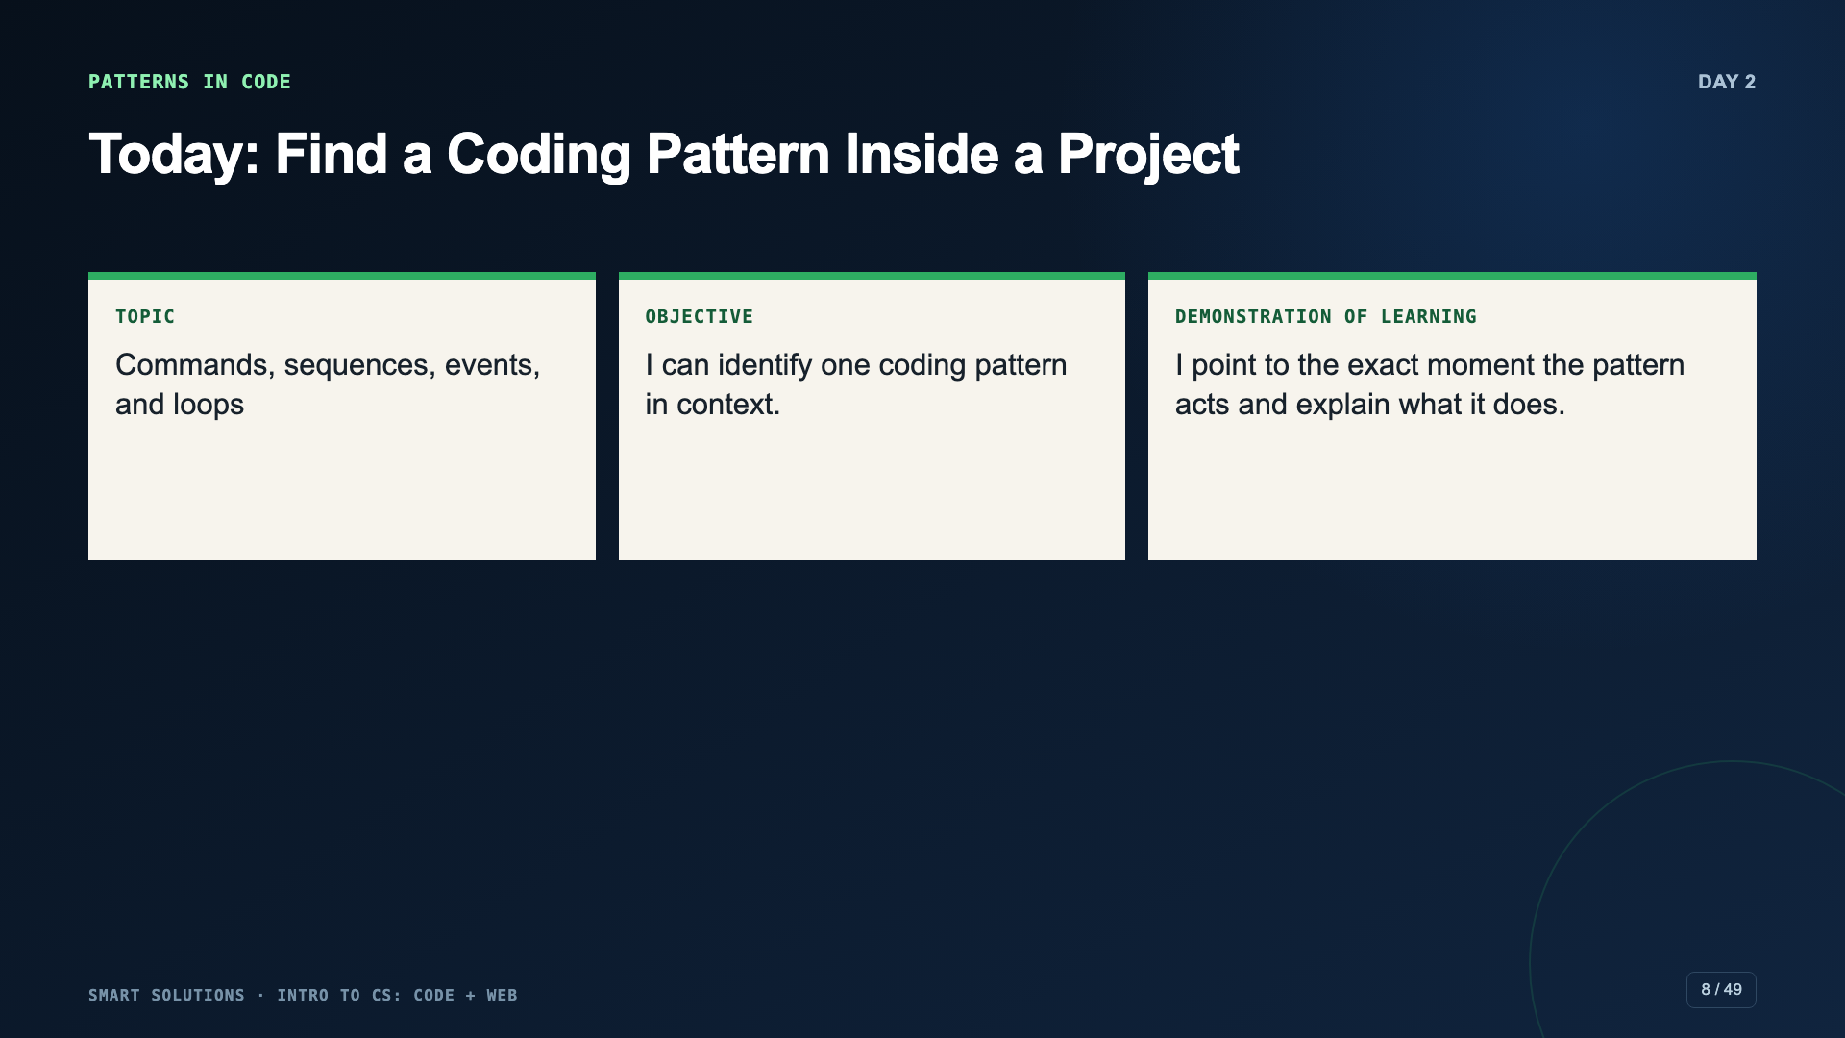
Notes:
Explain that activity choice changes the theme, but not the computer-science ideas students are looking for.
[Sources]
- Smart Solutions Code + Web Canvas module and facilitator guide (Irving 2027 Template, course 23402).
- Code.org. “Hour of Code.” https://code.org/en-US/hour-of-code (accessed 2026-08-16).

Slide 9
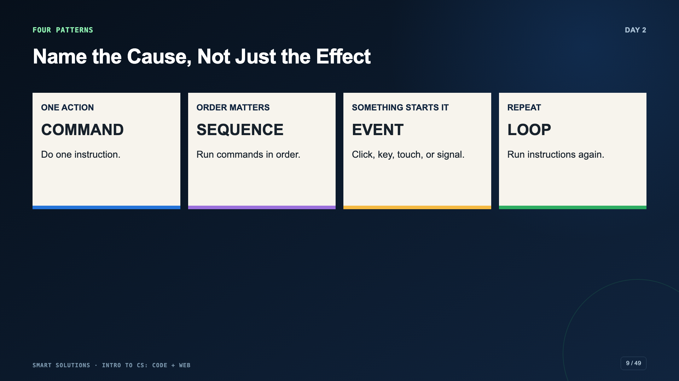
Notes:
Use one familiar game action for each pattern. Clarify that seeing repeated movement does not prove a loop; students must point to repeated code or a repeat block.
[Sources]
- Code.org. “Hour of Code.” https://code.org/en-US/hour-of-code (accessed 2026-08-16).
- Code.org. “Computer Science Discoveries.” https://code.org/cs/curriculum/computer-science-discoveries (accessed 2026-08-16).

Slide 10
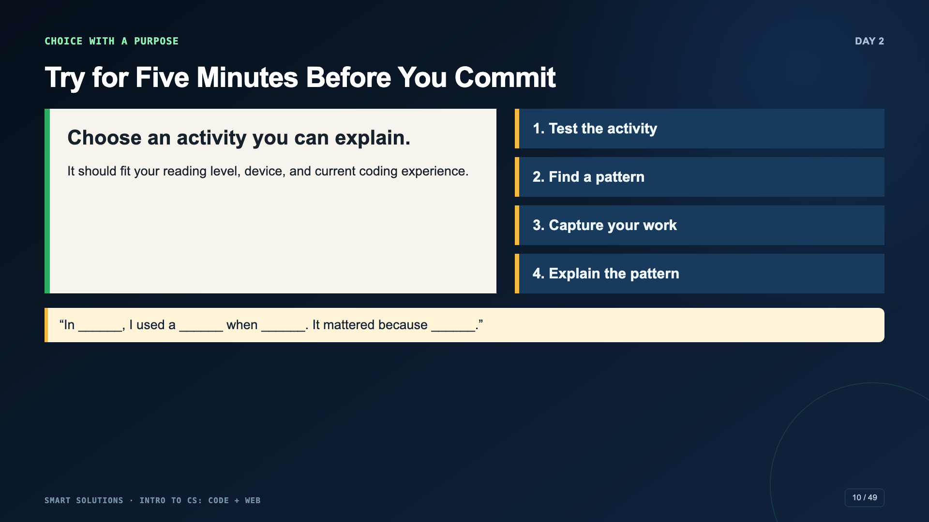
Notes:
Open the current Hour of Code catalog. Give students a small approved set if the full catalog creates choice overload.
[Sources]
- Code.org. “Hour of Code.” https://code.org/en-US/hour-of-code (accessed 2026-08-16).
- Smart Solutions Code + Web Canvas module and facilitator guide (Irving 2027 Template, course 23402).

Slide 11
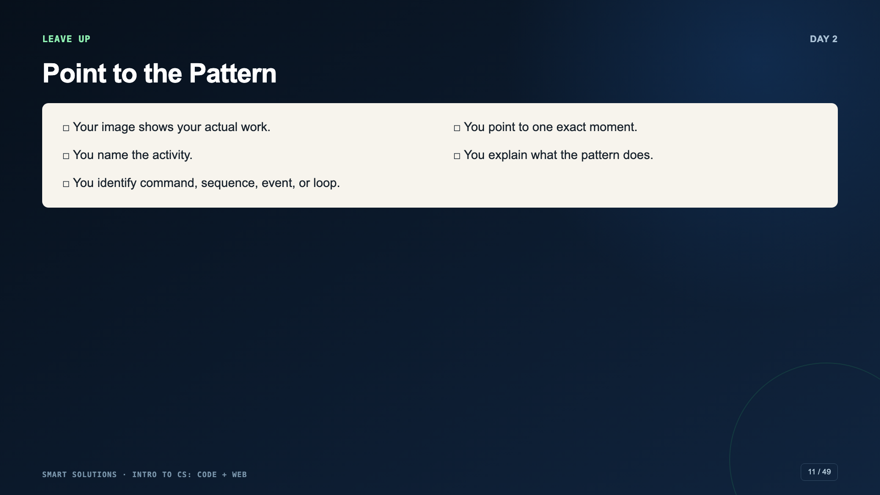
Notes:
Ask students to point at the relevant block or moment on their screen while they explain. This separates conceptual evidence from a certificate.
[Sources]
- Smart Solutions Code + Web Canvas module and facilitator guide (Irving 2027 Template, course 23402).

Slide 12
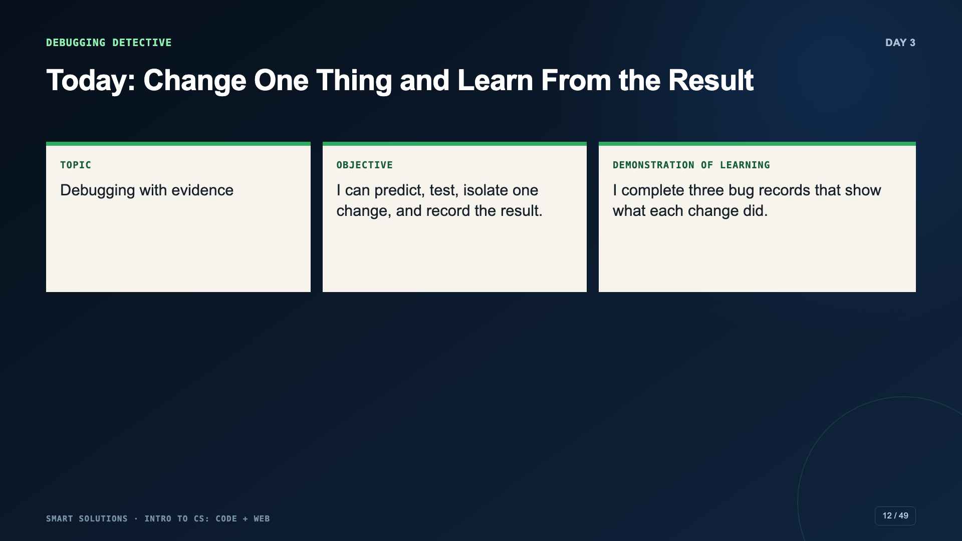
Notes:
Frame a bug as information. The goal is not to avoid all mistakes; it is to make the next test useful.
[Sources]
- Smart Solutions Code + Web Canvas module and facilitator guide (Irving 2027 Template, course 23402).
- Code.org. “Express Course 2025.” https://studio.code.org/courses/express-2025 (accessed 2026-08-16).

Slide 13
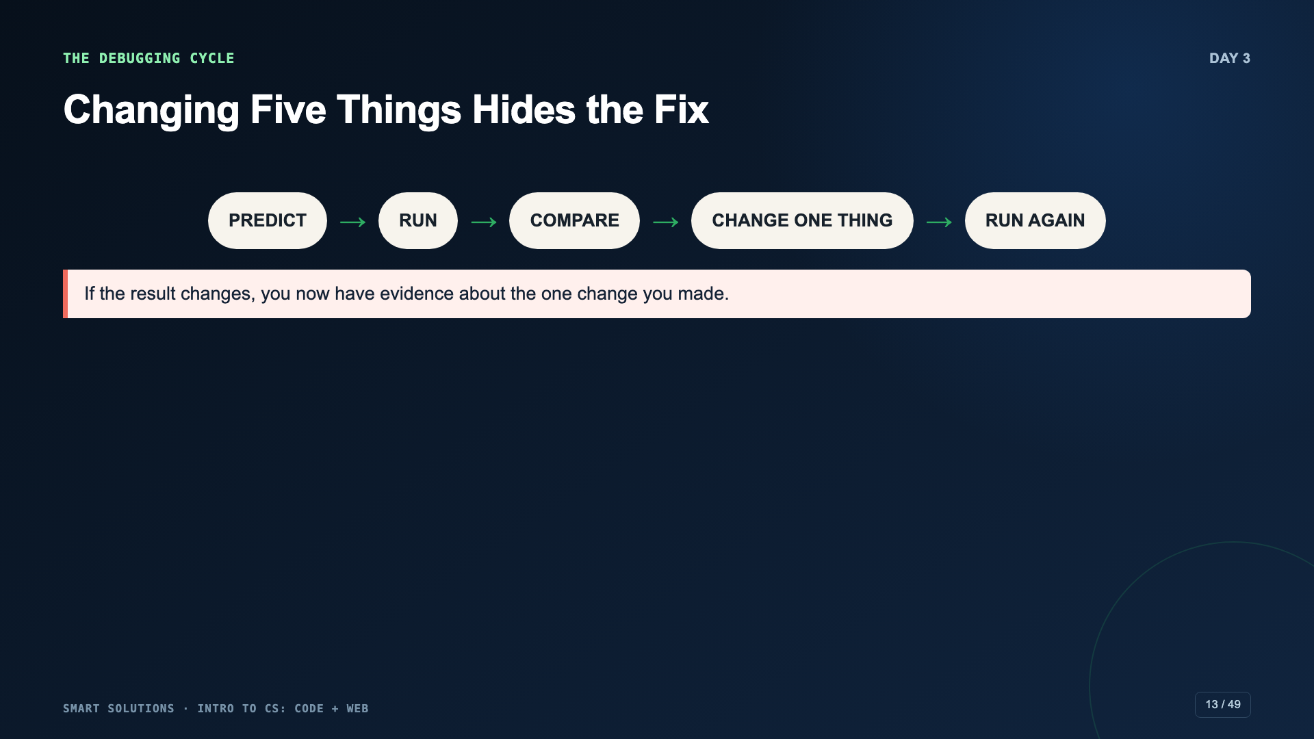
Notes:
Make two changes at once in a sample and ask which one fixed it. Undo, isolate the changes, and test again.
[Sources]
- Code.org. “Express Course 2025.” https://studio.code.org/courses/express-2025 (accessed 2026-08-16).

Slide 14
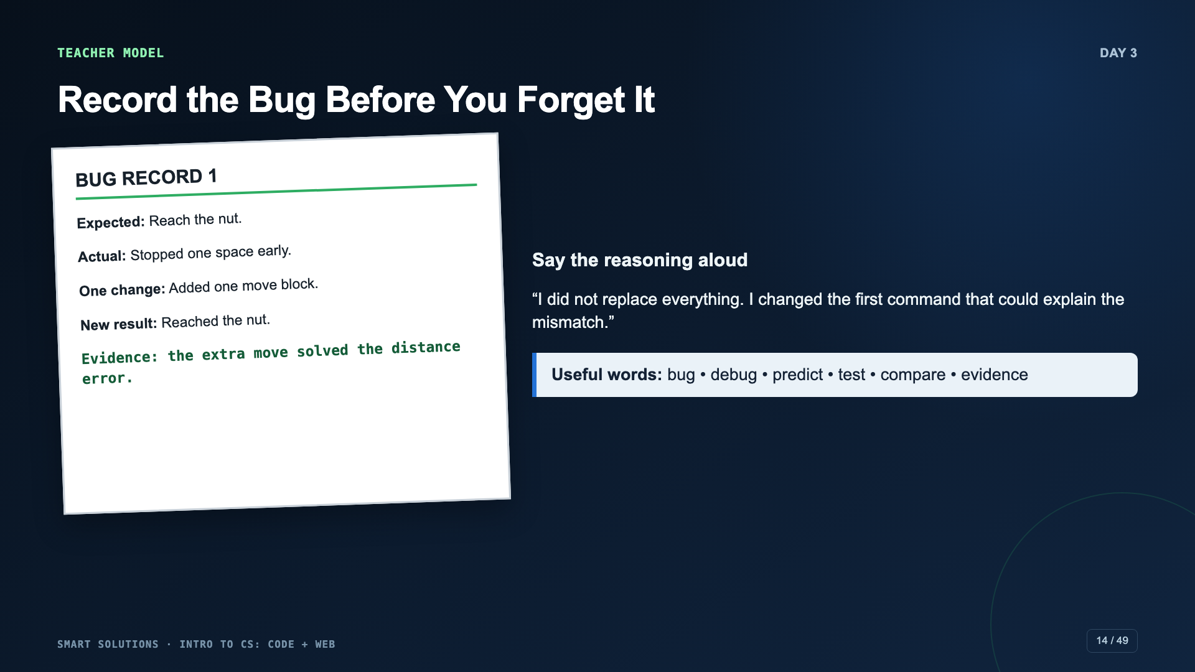
Notes:
Fill one bug record in front of students. Include one failed change if time permits so students see that a test can be useful even when it does not solve the problem.
[Sources]
- Smart Solutions Code + Web Canvas module and facilitator guide (Irving 2027 Template, course 23402).
- Code.org. “Express Course 2025.” https://studio.code.org/courses/express-2025 (accessed 2026-08-16).

Slide 15
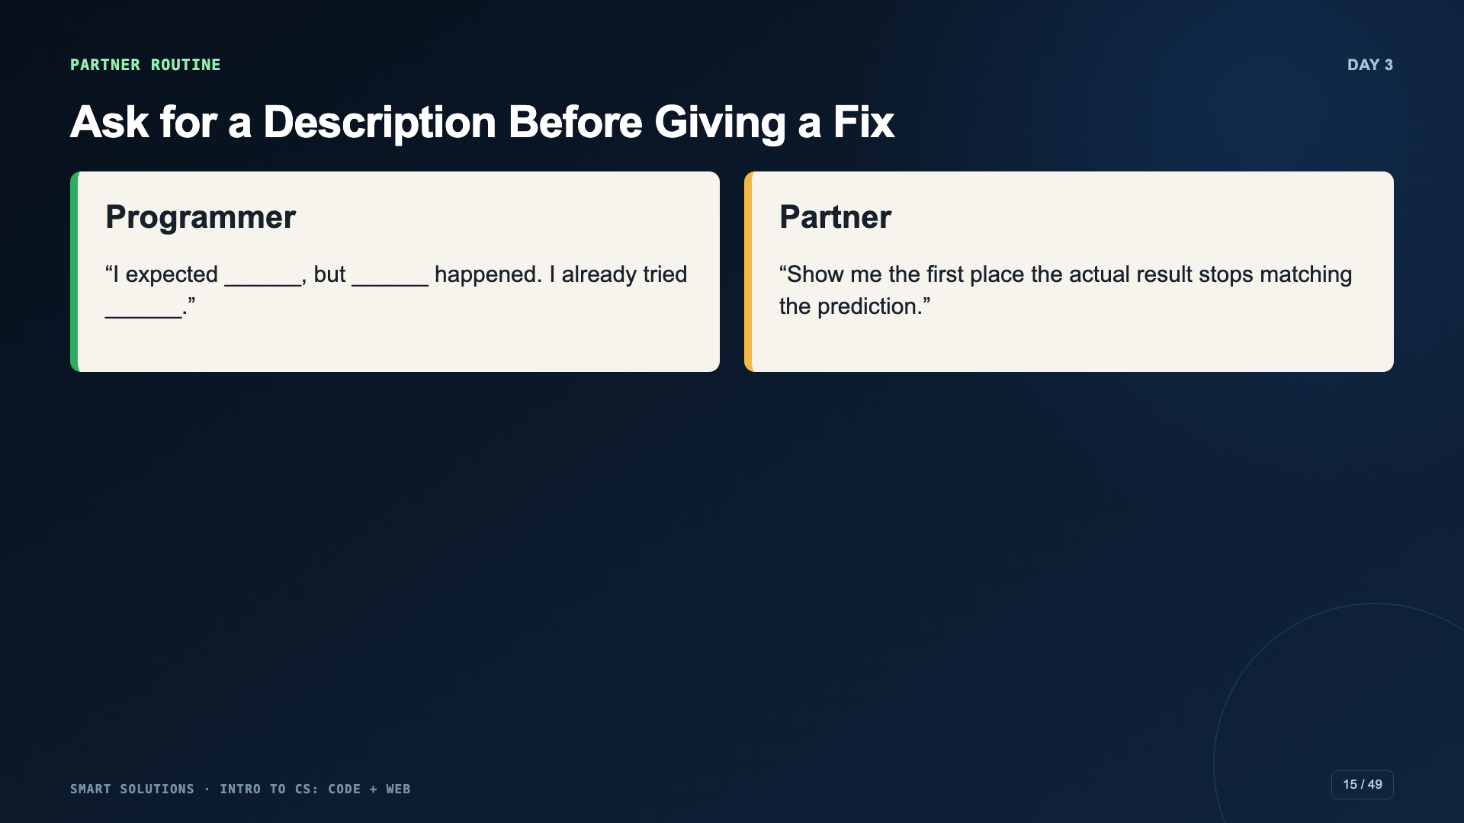
Notes:
Use this routine before students ask the teacher. Partners may ask questions and point to evidence; they should not grab the device and rebuild the code.
[Sources]
- Smart Solutions Code + Web Canvas module and facilitator guide (Irving 2027 Template, course 23402).

Slide 16
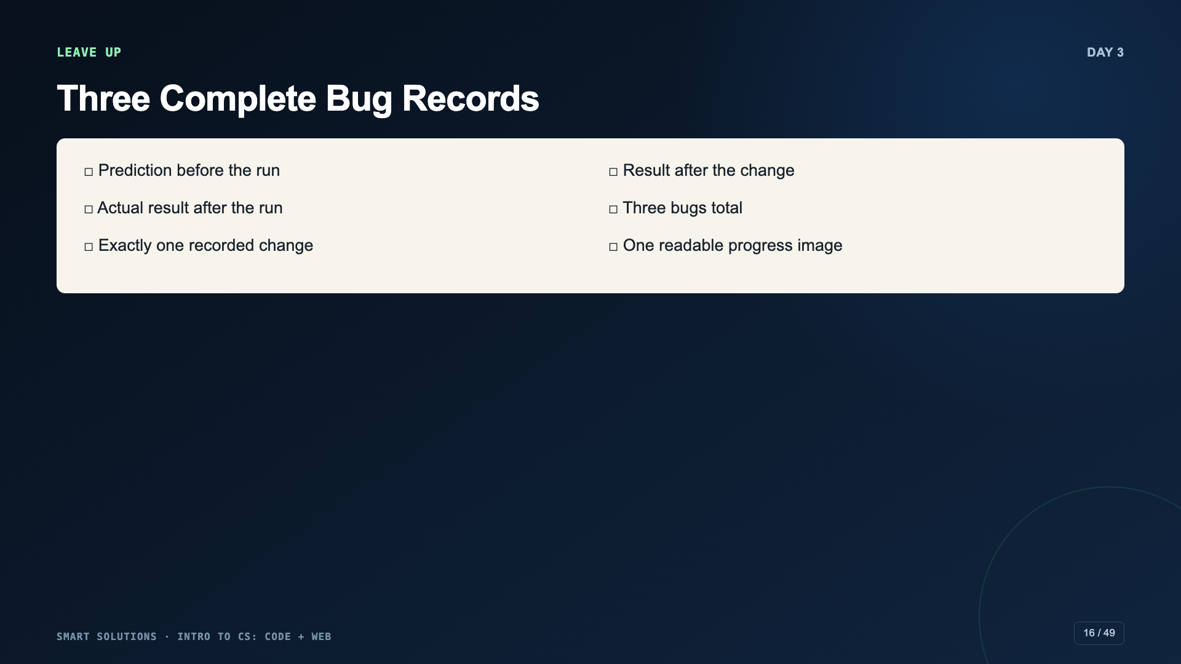
Notes:
If time is short, require two complete records instead of three. Do not remove the evidence structure.
[Sources]
- Smart Solutions Code + Web Canvas module and facilitator guide (Irving 2027 Template, course 23402).

Slide 17
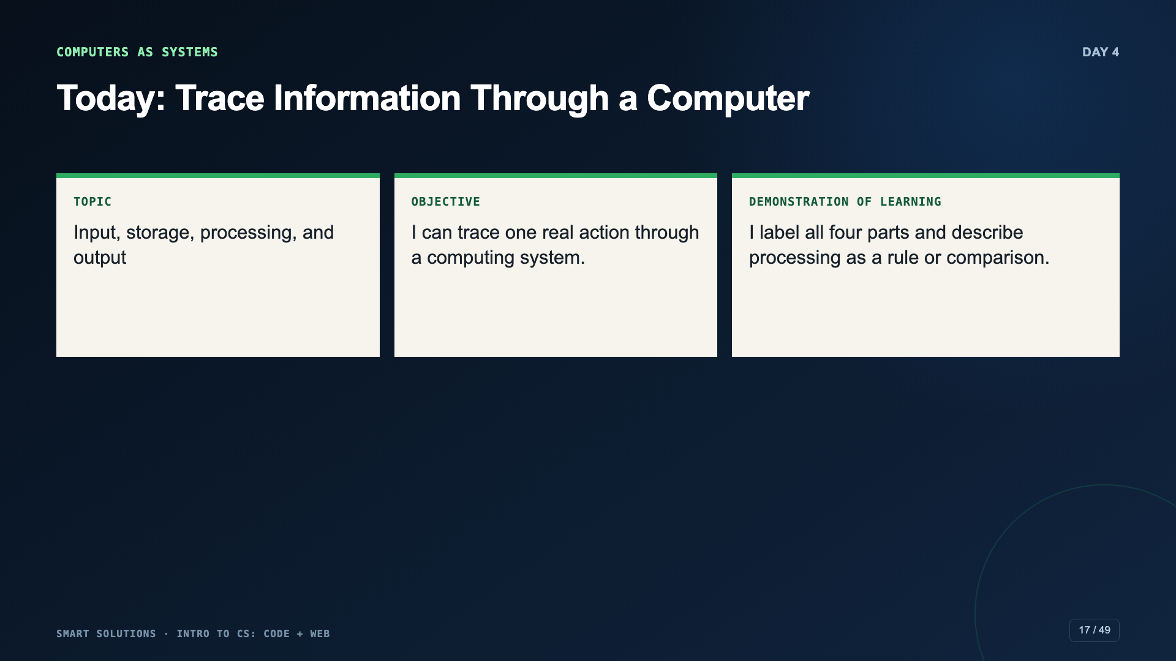
Notes:
Shift from code blocks to a systems mental model. Students should describe information, not only devices.
[Sources]
- Smart Solutions Code + Web Canvas module and facilitator guide (Irving 2027 Template, course 23402).
- Code.org. “What Is a Computer?” CSD 2026, Unit 1, Lesson 4. https://studio.code.org/courses/csd-2026/units/1/lessons/4 (accessed 2026-08-16).
- Code.org. “Processing.” CSD 2026, Unit 1, Lesson 6. https://studio.code.org/courses/csd-2026/units/1/lessons/6 (accessed 2026-08-16).

Slide 18
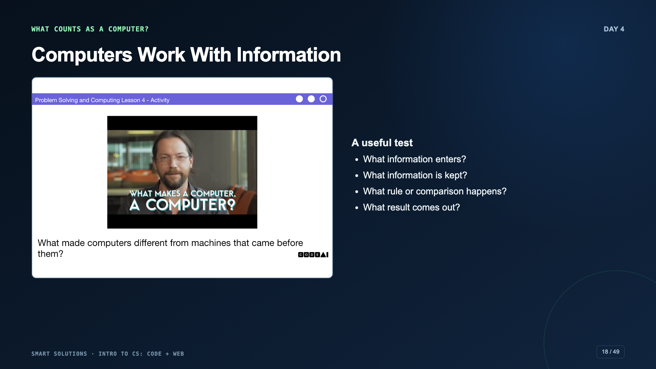
Notes:
Use the official What Is a Computer prompt. Let students classify one borderline device and justify the decision with information flow.
[Sources]
- Code.org. “What Is a Computer?” CSD 2026, Unit 1, Lesson 4. https://studio.code.org/courses/csd-2026/units/1/lessons/4 (accessed 2026-08-16).

Slide 19
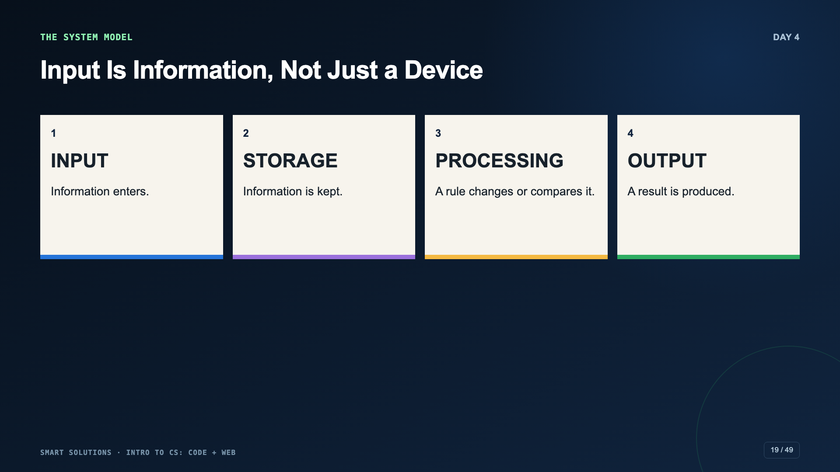
Notes:
Correct the common misconception “the keyboard is the input.” The keyboard is an input device; the typed words are the information input.
[Sources]
- Code.org. “Processing.” CSD 2026, Unit 1, Lesson 6. https://studio.code.org/courses/csd-2026/units/1/lessons/6 (accessed 2026-08-16).
- Smart Solutions Code + Web Canvas module and facilitator guide (Irving 2027 Template, course 23402).

Slide 20
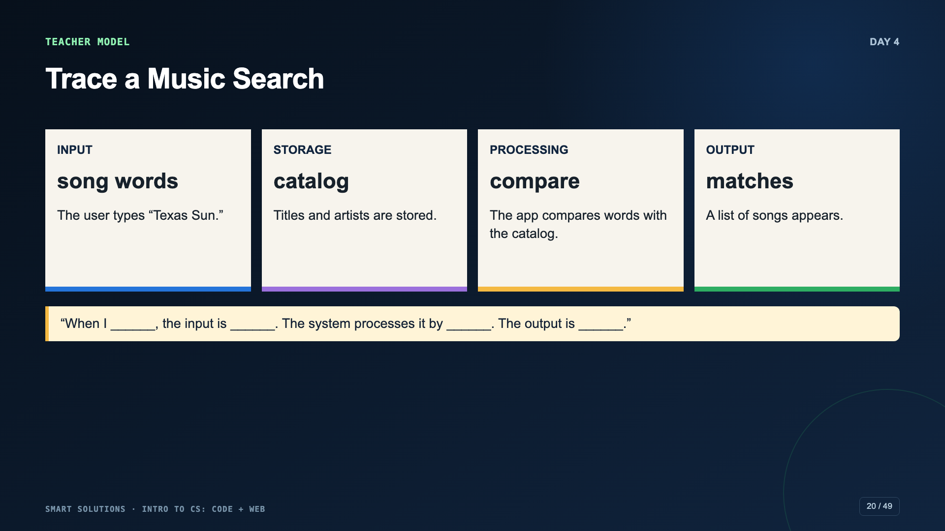
Notes:
Think aloud through the processing step. Avoid “the computer thinks.” Name the comparison, count, match, or rule.
[Sources]
- Code.org. “Processing.” CSD 2026, Unit 1, Lesson 6. https://studio.code.org/courses/csd-2026/units/1/lessons/6 (accessed 2026-08-16).
- Smart Solutions Code + Web Canvas module and facilitator guide (Irving 2027 Template, course 23402).

Slide 21
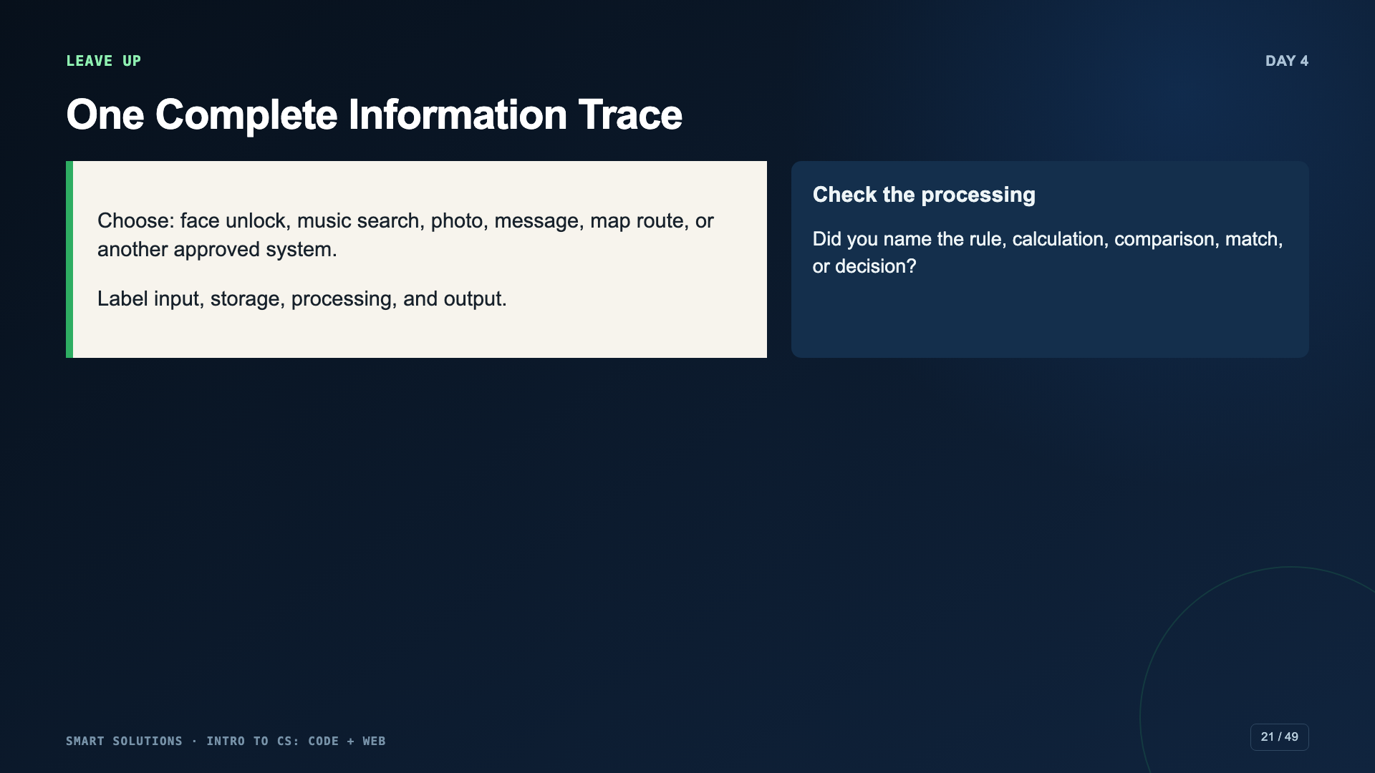
Notes:
Students may submit a labeled diagram, one slide, paper photo, or short recording. The four-part explanation is the required evidence.
[Sources]
- Smart Solutions Code + Web Canvas module and facilitator guide (Irving 2027 Template, course 23402).

Slide 22
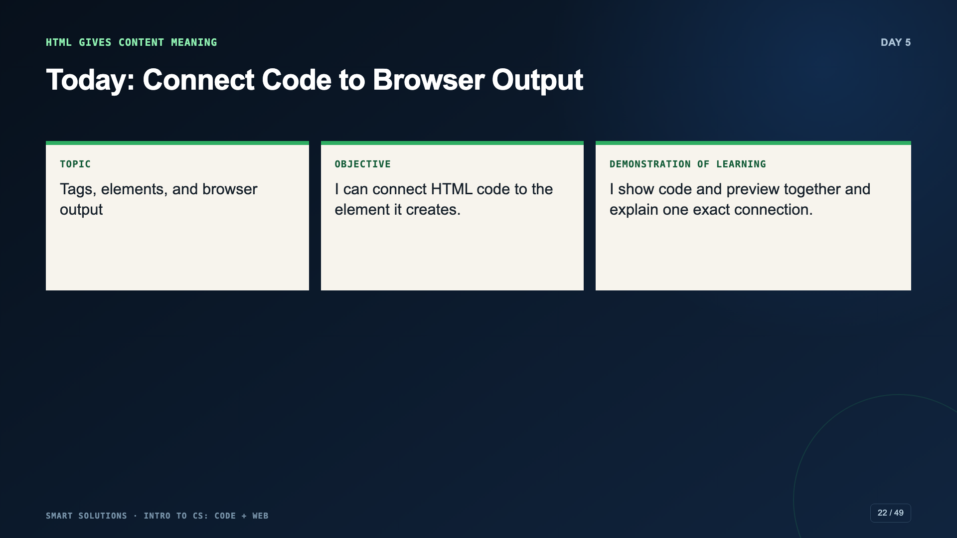
Notes:
Use this as the bridge into Web Lab. HTML is not decoration; it tells the browser the role of each part.
[Sources]
- Smart Solutions Code + Web Canvas module and facilitator guide (Irving 2027 Template, course 23402).
- Code.org. “Web Development.” CSD 2026, Unit 2. https://studio.code.org/courses/csd-2026/units/2 (accessed 2026-08-16).

Slide 23

Notes:
Inspect the official examples. Focus first on structure and audience, not whether students like the colors.
[Sources]
- Code.org. “Web Development.” CSD 2026, Unit 2. https://studio.code.org/courses/csd-2026/units/2 (accessed 2026-08-16).

Slide 24
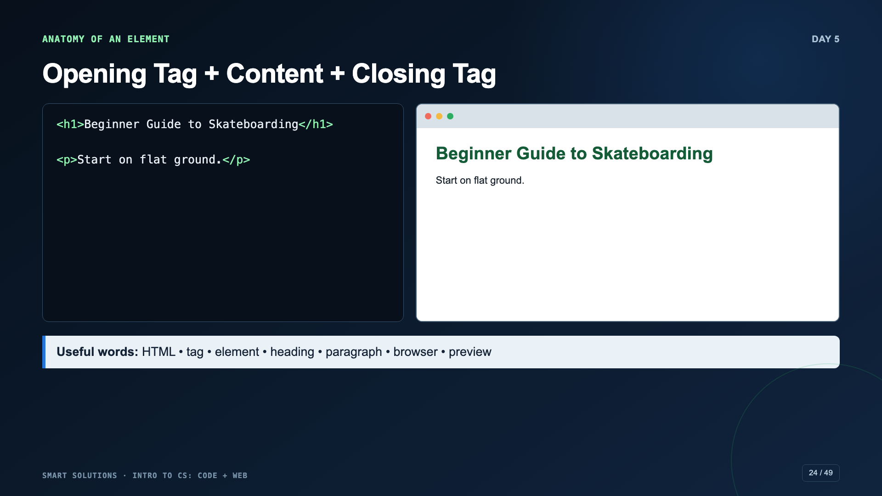
Notes:
Point to each opening tag, content, and closing tag. Change h1 to h2 and ask students to predict the visual change before refreshing.
[Sources]
- Code.org. “Web Development.” CSD 2026, Unit 2. https://studio.code.org/courses/csd-2026/units/2 (accessed 2026-08-16).

Slide 25
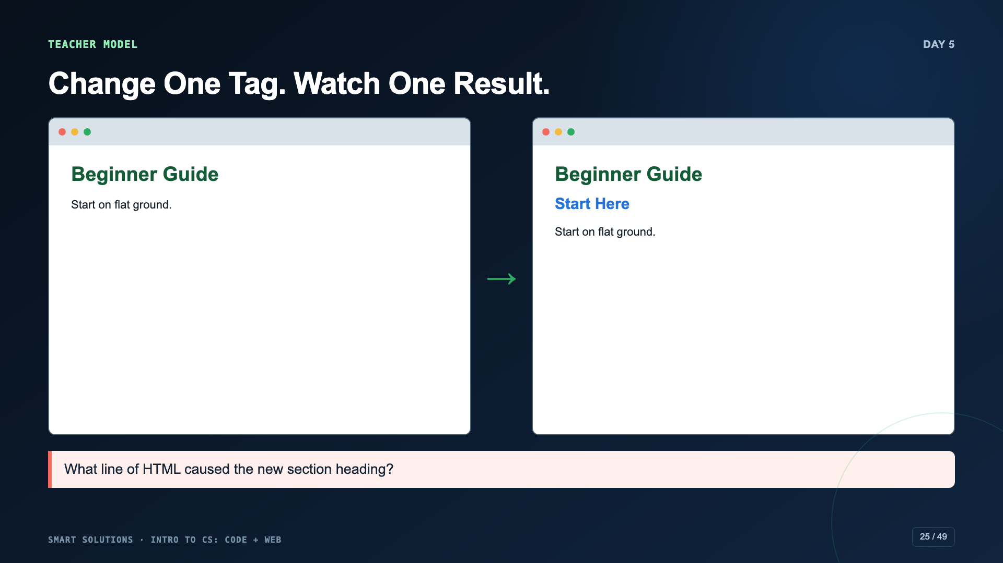
Notes:
Live-demo one tag change in Web Lab. Keep code and preview visible together. Fix a missing closing tag in front of students.
[Sources]
- Code.org. “Web Development.” CSD 2026, Unit 2. https://studio.code.org/courses/csd-2026/units/2 (accessed 2026-08-16).
- Smart Solutions Code + Web Canvas module and facilitator guide (Irving 2027 Template, course 23402).

Slide 26
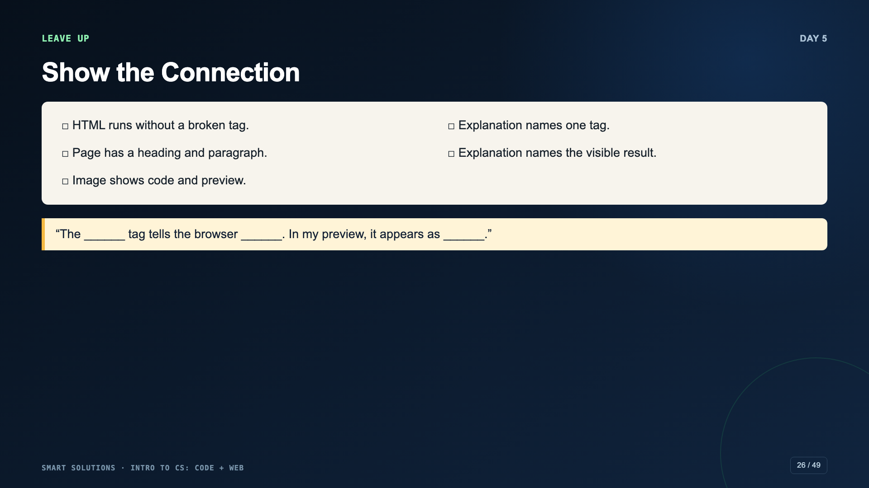
Notes:
Require a specific tag-to-output explanation. “I learned HTML” is not enough.
[Sources]
- Smart Solutions Code + Web Canvas module and facilitator guide (Irving 2027 Template, course 23402).

Slide 27
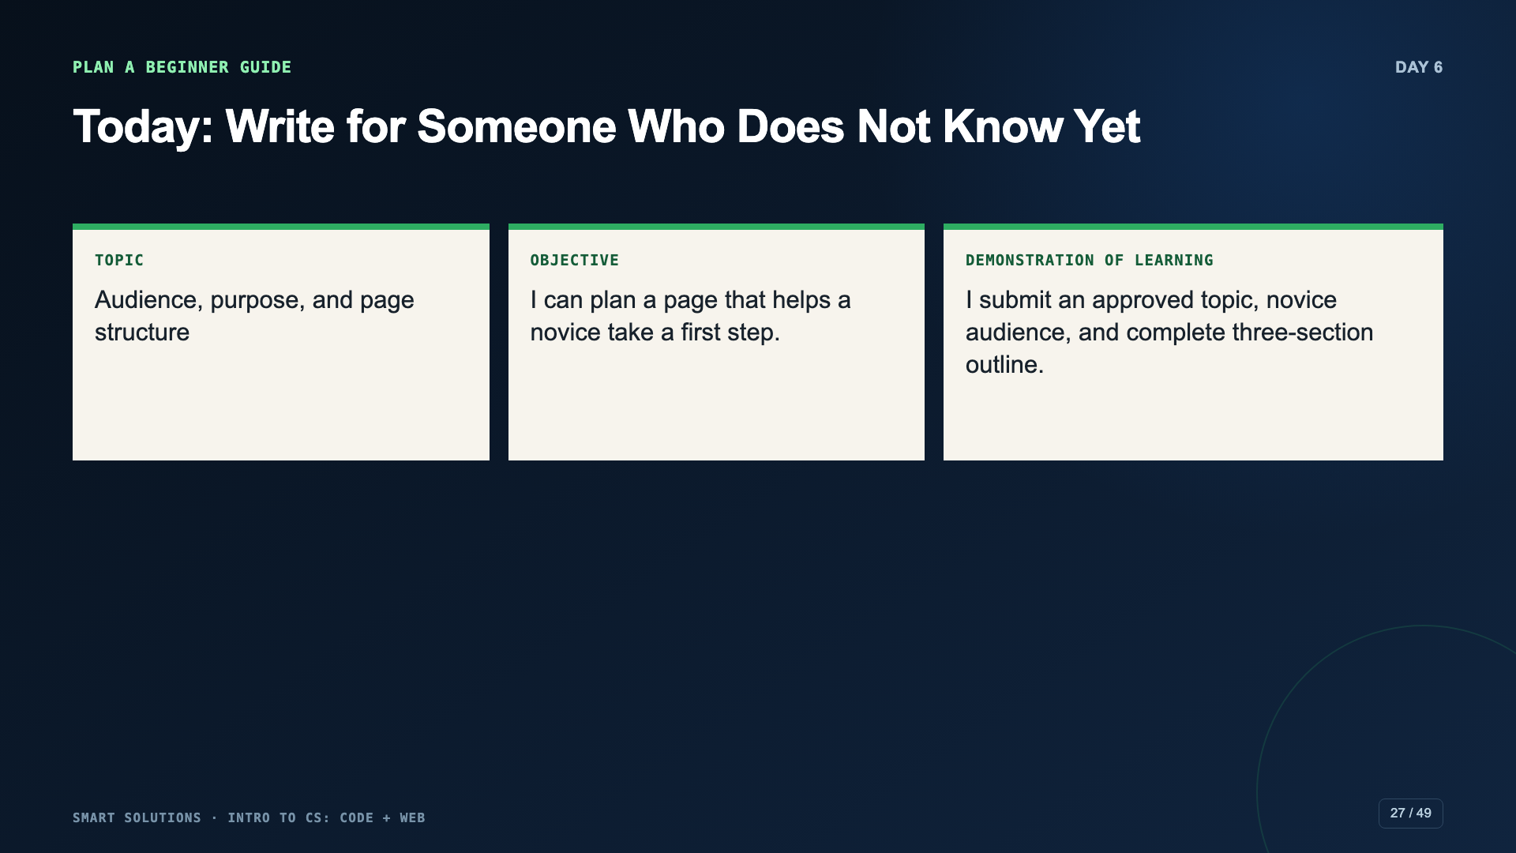
Notes:
Introduce the shared project brief. Student topic choice remains, but the audience problem and three-section contract are fixed.
[Sources]
- Smart Solutions Code + Web Canvas module and facilitator guide (Irving 2027 Template, course 23402).
- Code.org. “Mini-Project: HTML Web Page.” CSD 2026, Unit 2, Lesson 5. https://studio.code.org/courses/csd-2026/units/2/lessons/5 (accessed 2026-08-16).

Slide 28
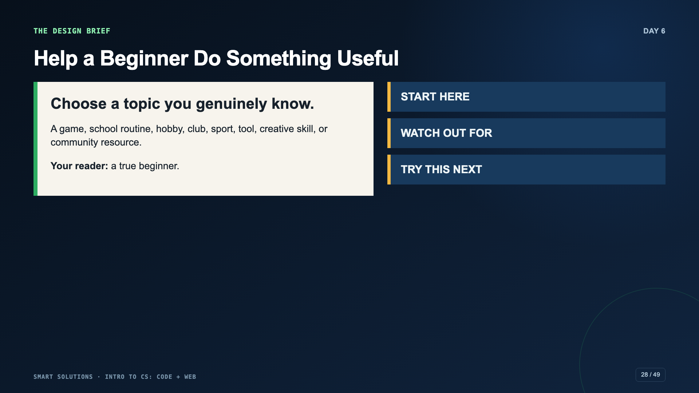
Notes:
Model narrowing a broad topic. “Basketball” becomes “What to bring to your first middle-school basketball practice.”
[Sources]
- Smart Solutions Code + Web Canvas module and facilitator guide (Irving 2027 Template, course 23402).
- Code.org. “Mini-Project: HTML Web Page.” CSD 2026, Unit 2, Lesson 5. https://studio.code.org/courses/csd-2026/units/2/lessons/5 (accessed 2026-08-16).

Slide 29
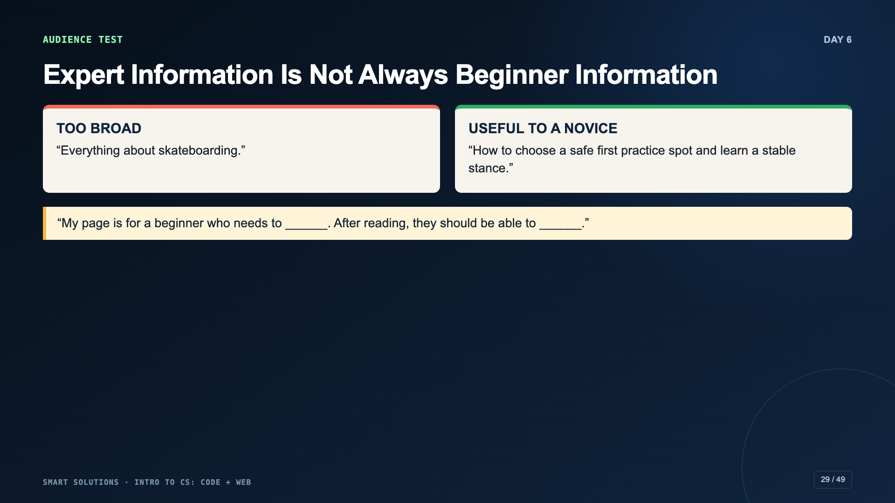
Notes:
Ask students what the beginner can actually do after reading. Reject topic lists that do not produce a reader outcome.
[Sources]
- Smart Solutions Code + Web Canvas module and facilitator guide (Irving 2027 Template, course 23402).

Slide 30
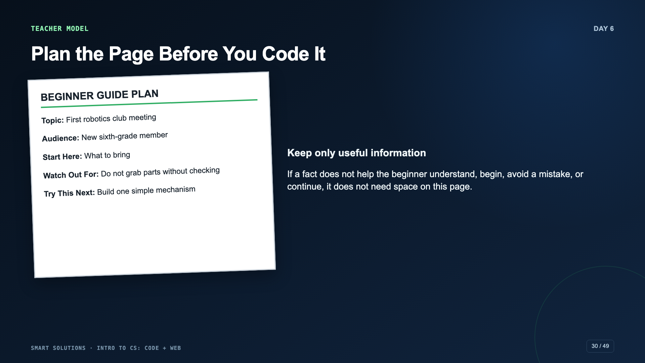
Notes:
Think aloud while removing an interesting but irrelevant fact. Approve the plan before students build the full HTML.
[Sources]
- Smart Solutions Code + Web Canvas module and facilitator guide (Irving 2027 Template, course 23402).
- Code.org. “Mini-Project: HTML Web Page.” CSD 2026, Unit 2, Lesson 5. https://studio.code.org/courses/csd-2026/units/2/lessons/5 (accessed 2026-08-16).

Slide 31
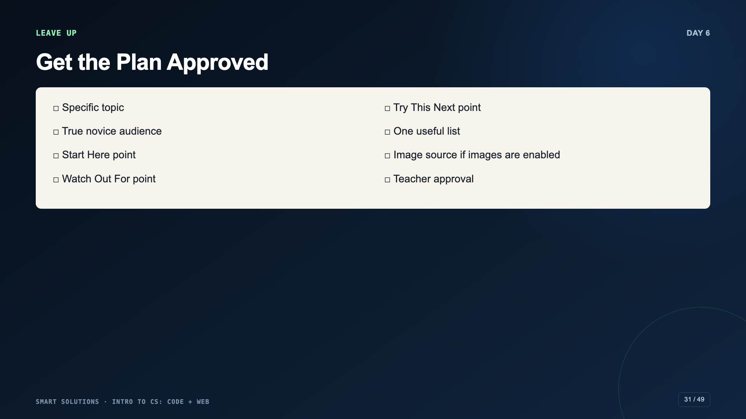
Notes:
Students use packet page 2. If time is short, offer a topic bank but preserve the audience and section constraints.
[Sources]
- Smart Solutions Code + Web Canvas module and facilitator guide (Irving 2027 Template, course 23402).

Slide 32
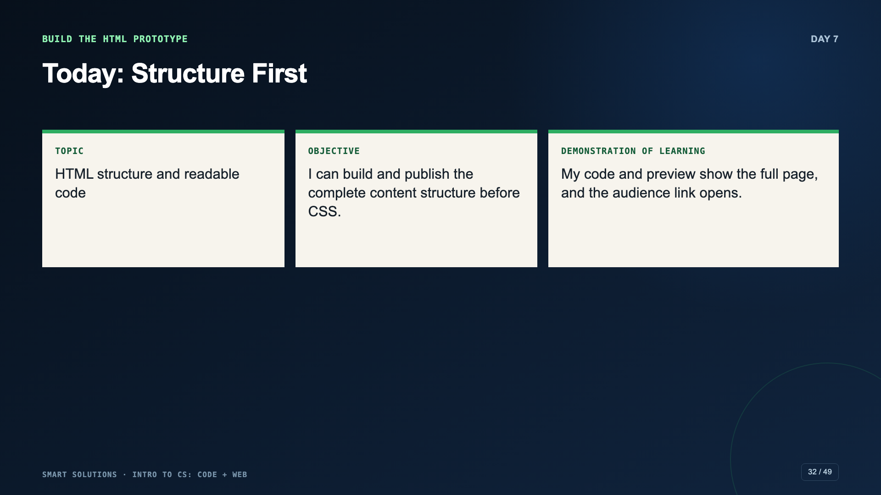
Notes:
Tell students that styling broken HTML only makes the problem harder to see. Day 7 is deliberately about structure.
[Sources]
- Smart Solutions Code + Web Canvas module and facilitator guide (Irving 2027 Template, course 23402).
- Code.org. “Mini-Project: HTML Web Page.” CSD 2026, Unit 2, Lesson 5. https://studio.code.org/courses/csd-2026/units/2/lessons/5 (accessed 2026-08-16).

Slide 33
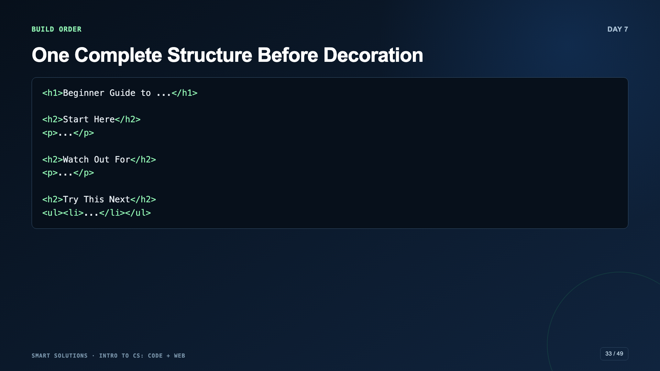
Notes:
Build the h1, all three h2 sections, paragraphs, and list before adding CSS. Model indentation so students can see nesting.
[Sources]
- Code.org. “Mini-Project: HTML Web Page.” CSD 2026, Unit 2, Lesson 5. https://studio.code.org/courses/csd-2026/units/2/lessons/5 (accessed 2026-08-16).
- Smart Solutions Code + Web Canvas module and facilitator guide (Irving 2027 Template, course 23402).

Slide 34
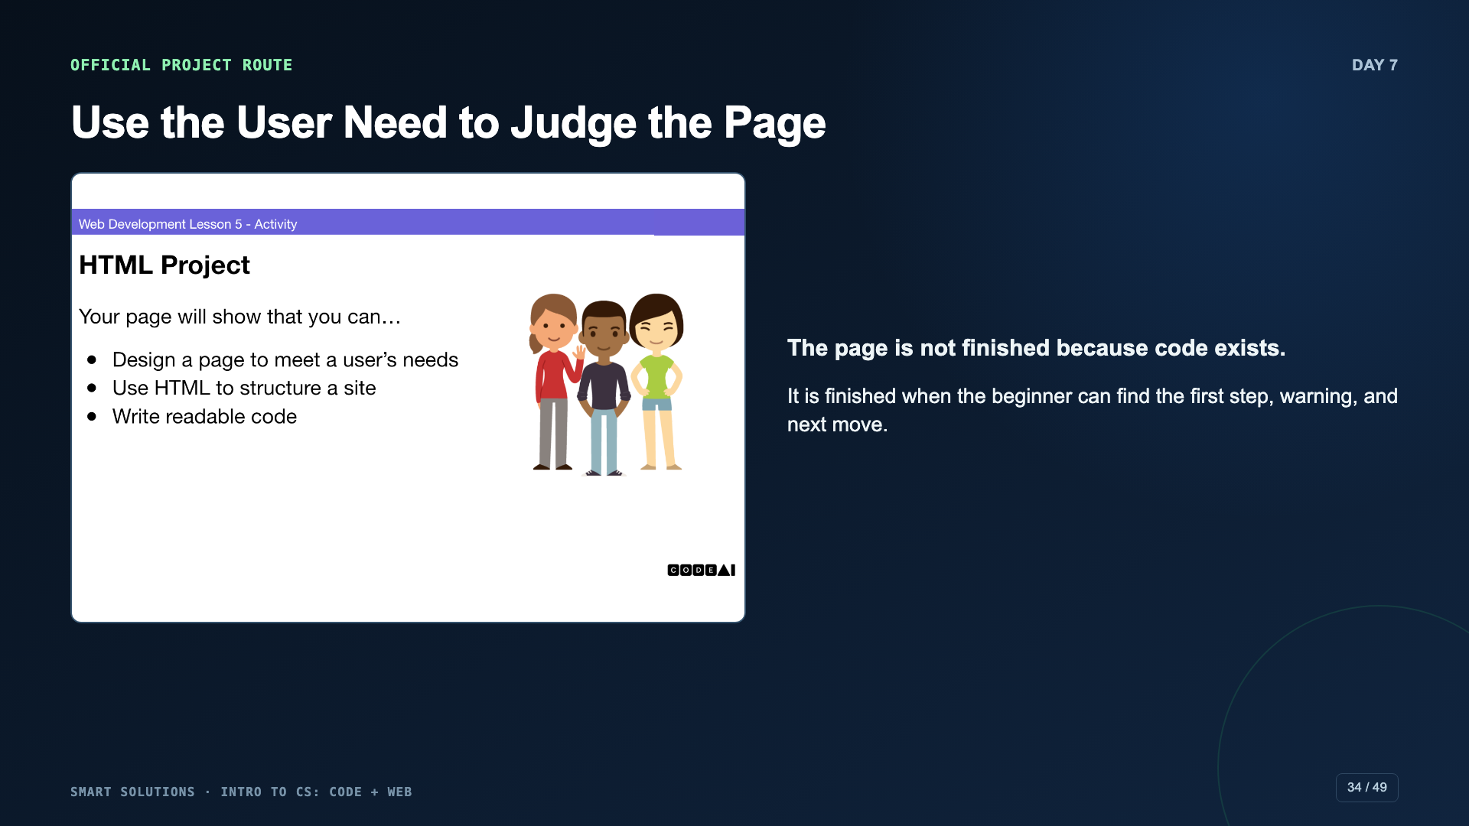
Notes:
Connect the course brief to Code.org’s user-centered mini-project framing. Students keep the same Beginner Guide across HTML and CSS days.
[Sources]
- Code.org. “Mini-Project: HTML Web Page.” CSD 2026, Unit 2, Lesson 5. https://studio.code.org/courses/csd-2026/units/2/lessons/5 (accessed 2026-08-16).

Slide 35
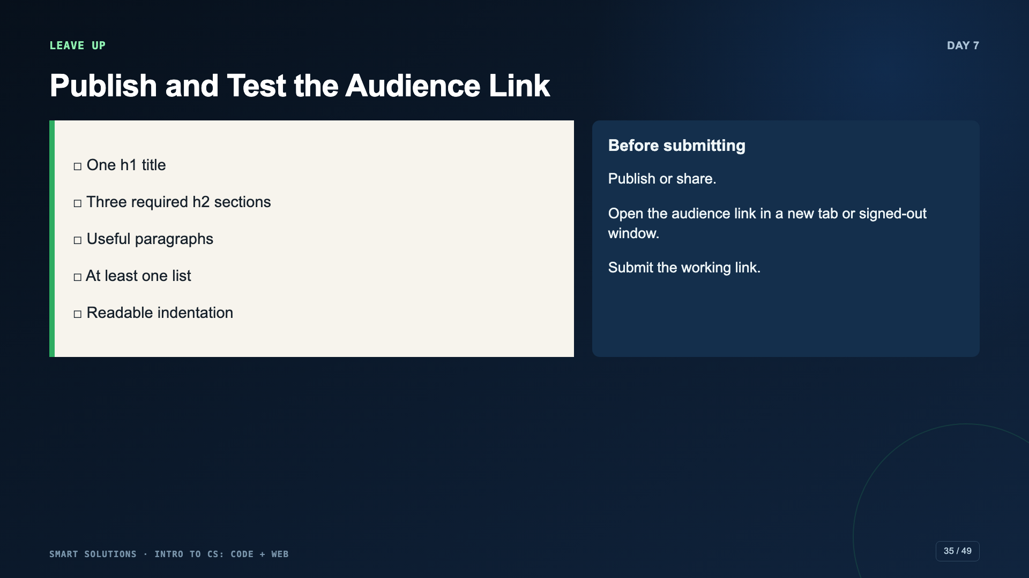
Notes:
A project link that works only inside the student account is not an audience link. Test it before dismissal.
[Sources]
- Smart Solutions Code + Web Canvas module and facilitator guide (Irving 2027 Template, course 23402).
- Code.org. “Mini-Project: HTML Web Page.” CSD 2026, Unit 2, Lesson 5. https://studio.code.org/courses/csd-2026/units/2/lessons/5 (accessed 2026-08-16).

Slide 36
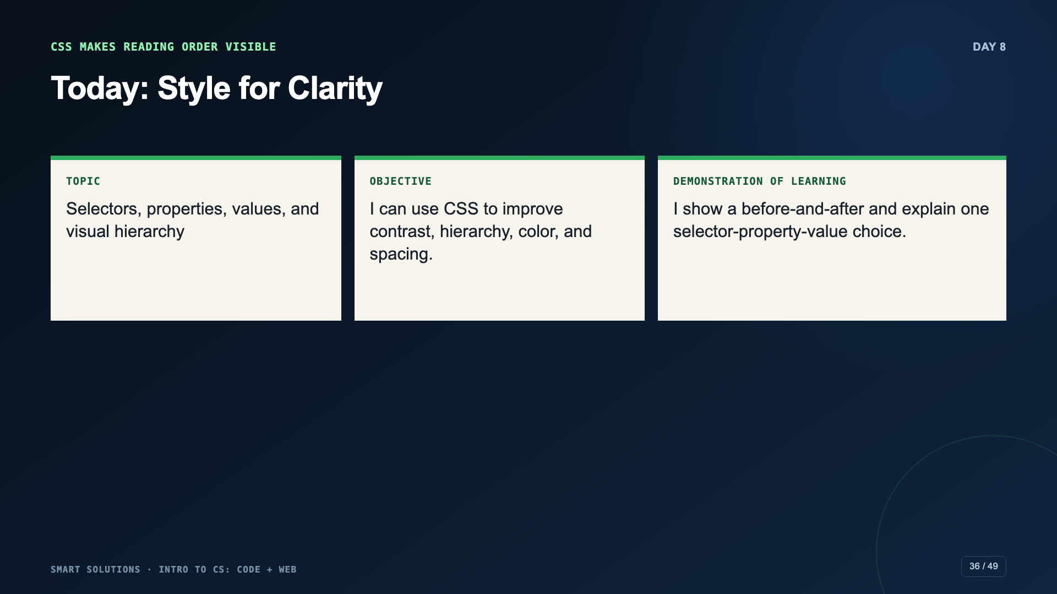
Notes:
Separate content, structure, and style. CSS is useful when it helps the reader see what matters and where to go next.
[Sources]
- Smart Solutions Code + Web Canvas module and facilitator guide (Irving 2027 Template, course 23402).
- Code.org. “Styling Text with CSS.” CSD 2026, Unit 2, Lesson 6. https://studio.code.org/courses/csd-2026/units/2/lessons/6 (accessed 2026-08-16).

Slide 37
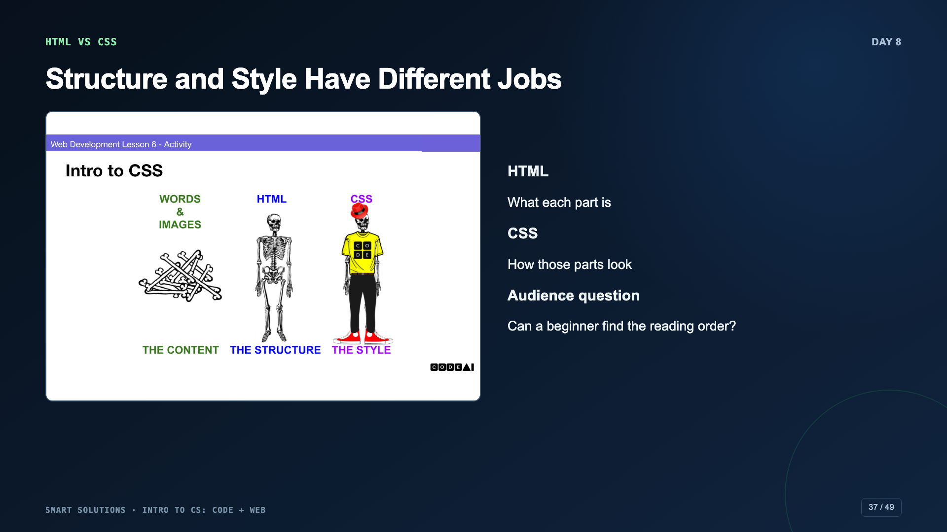
Notes:
Use the official visual to distinguish content, structure, and style. Ask which problem should be fixed in HTML and which in CSS.
[Sources]
- Code.org. “Styling Text with CSS.” CSD 2026, Unit 2, Lesson 6. https://studio.code.org/courses/csd-2026/units/2/lessons/6 (accessed 2026-08-16).

Slide 38
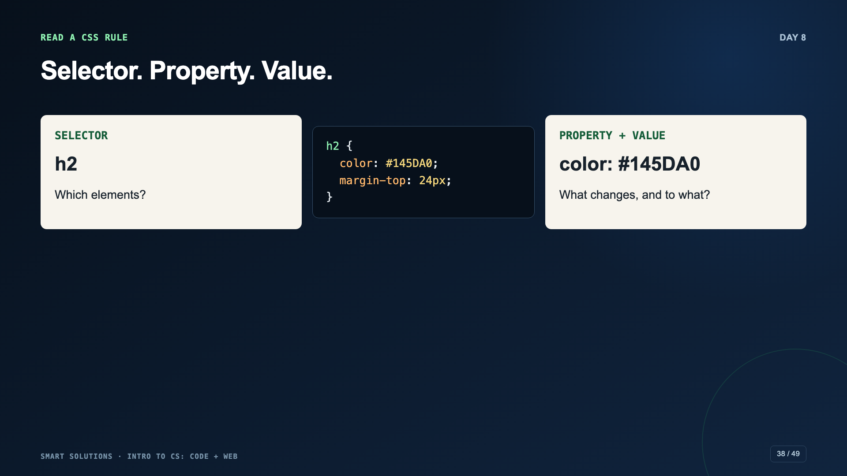
Notes:
Change one property at a time. Have students point to the selector, property, and value in the same rule.
[Sources]
- Code.org. “Styling Text with CSS.” CSD 2026, Unit 2, Lesson 6. https://studio.code.org/courses/csd-2026/units/2/lessons/6 (accessed 2026-08-16).
- Smart Solutions Code + Web Canvas module and facilitator guide (Irving 2027 Template, course 23402).

Slide 39
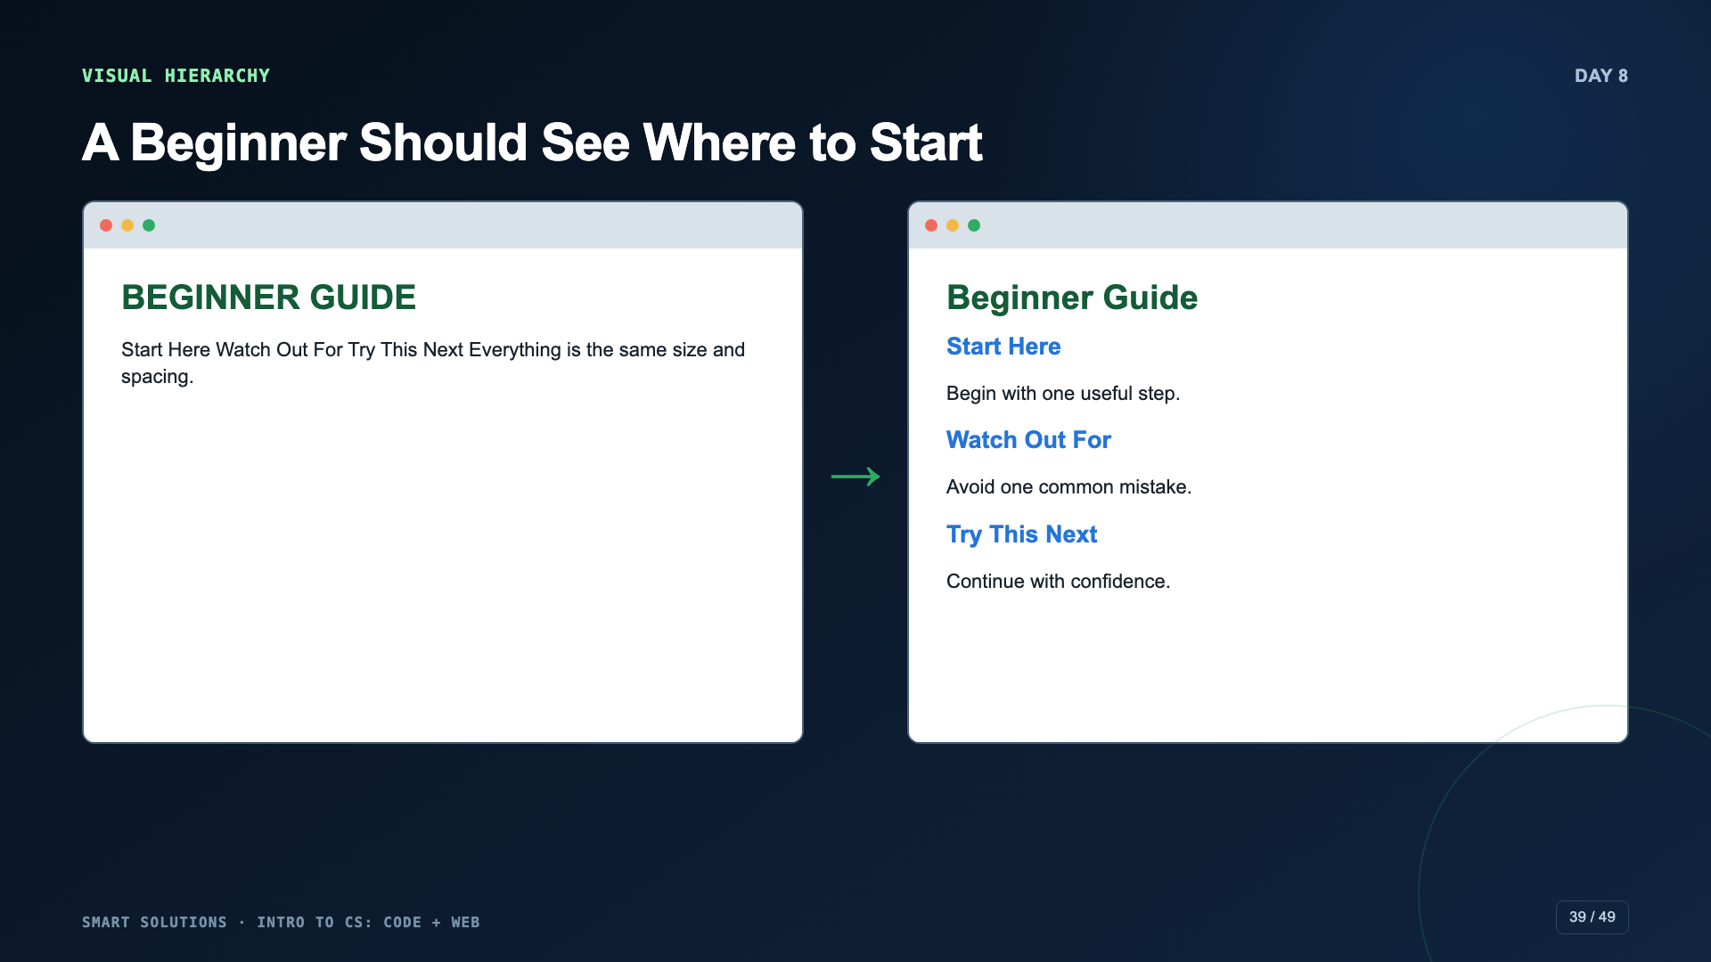
Notes:
Give students ten seconds with each version. Ask which one they can scan and why. Name the specific contrast, size, and spacing differences.
[Sources]
- Smart Solutions Code + Web Canvas module and facilitator guide (Irving 2027 Template, course 23402).
- Code.org. “Styling Text with CSS.” CSD 2026, Unit 2, Lesson 6. https://studio.code.org/courses/csd-2026/units/2/lessons/6 (accessed 2026-08-16).

Slide 40
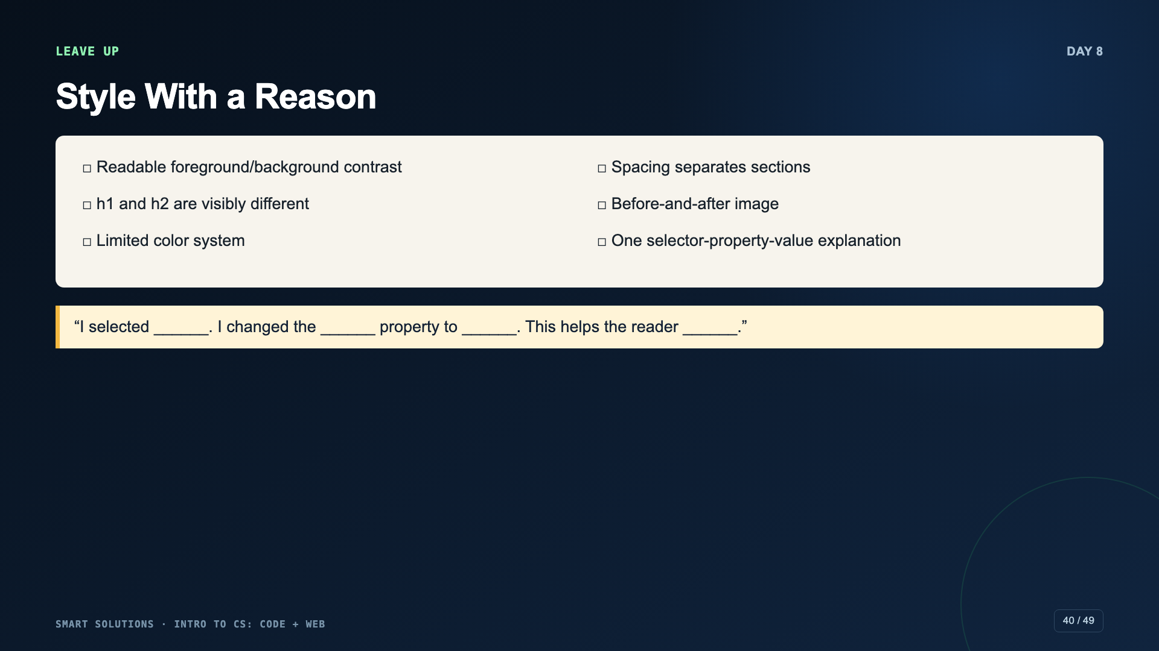
Notes:
Do not allow color and font choices to hide broken structure. If the HTML fails, fix it before continuing to style.
[Sources]
- Smart Solutions Code + Web Canvas module and facilitator guide (Irving 2027 Template, course 23402).

Slide 41
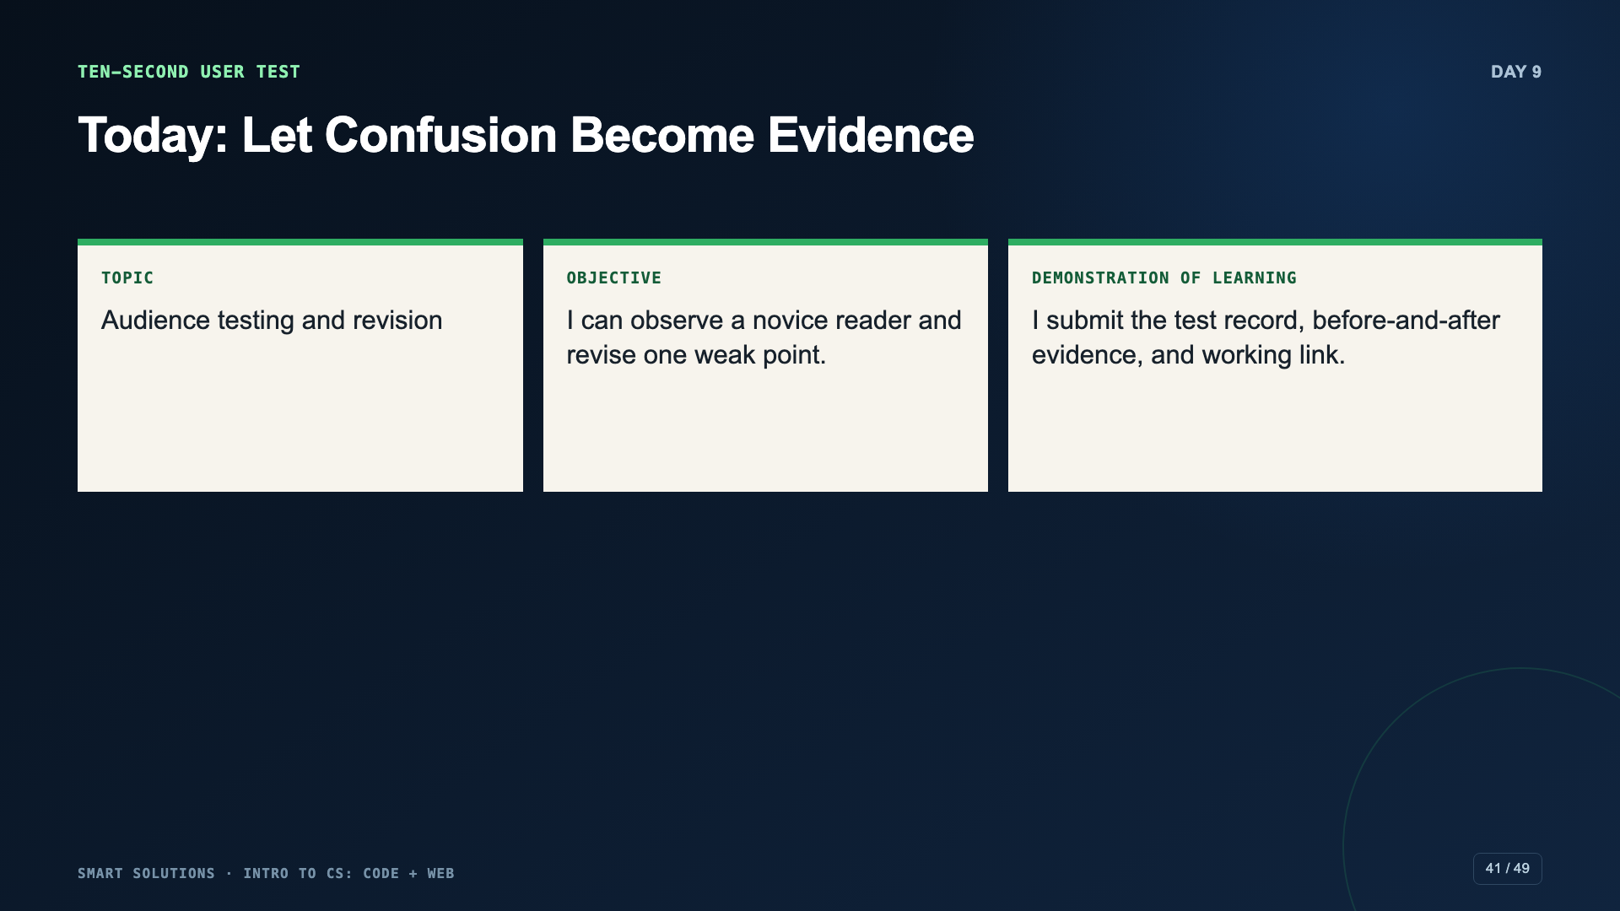
Notes:
Students must stay quiet during the first ten seconds. If the designer explains the page, the test no longer measures the page.
[Sources]
- Smart Solutions Code + Web Canvas module and facilitator guide (Irving 2027 Template, course 23402).
- Code.org. “Mini-Project: Adding Style to a Web Page.” CSD 2026, Unit 2, Lesson 10. https://studio.code.org/courses/csd-2026/units/2/lessons/10 (accessed 2026-08-16).

Slide 42
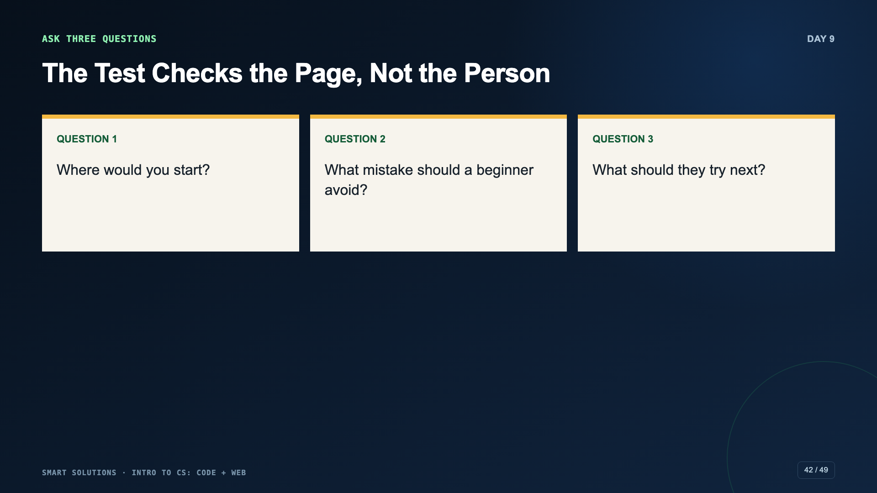
Notes:
The tester should be a real novice to the topic. Record exact answers and moments of hesitation.
[Sources]
- Smart Solutions Code + Web Canvas module and facilitator guide (Irving 2027 Template, course 23402).
- Code.org. “Mini-Project: Adding Style to a Web Page.” CSD 2026, Unit 2, Lesson 10. https://studio.code.org/courses/csd-2026/units/2/lessons/10 (accessed 2026-08-16).

Slide 43
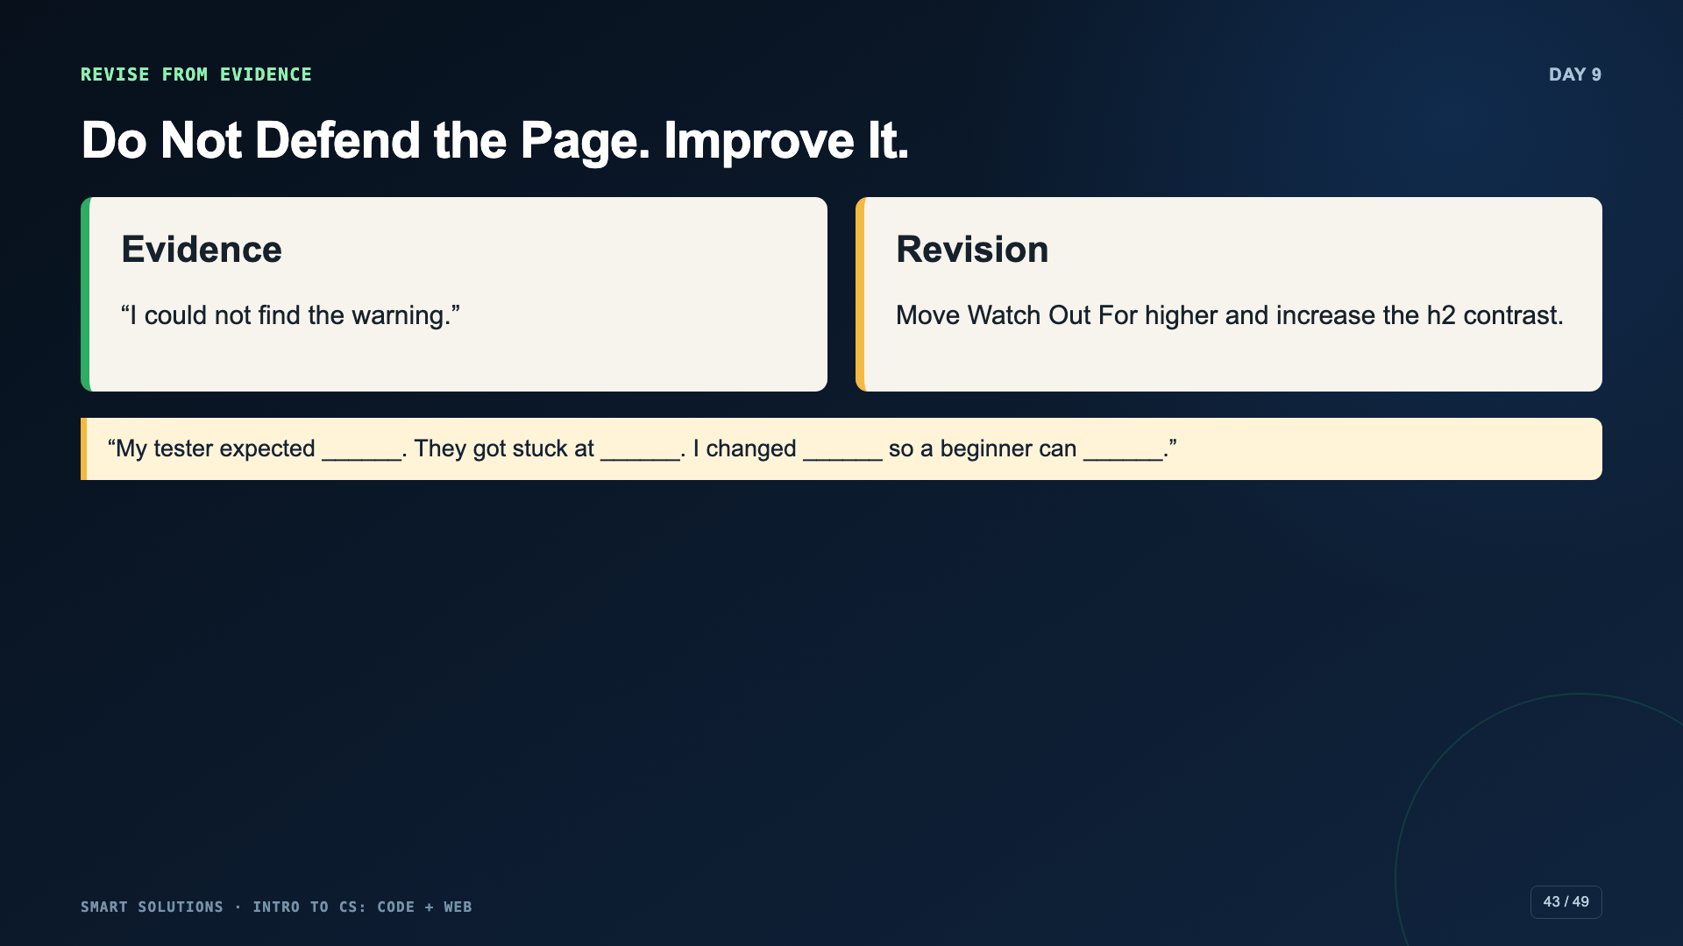
Notes:
Model a revision that directly responds to the observation. A random color change is not a test-driven revision.
[Sources]
- Smart Solutions Code + Web Canvas module and facilitator guide (Irving 2027 Template, course 23402).
- Code.org. “Mini-Project: Adding Style to a Web Page.” CSD 2026, Unit 2, Lesson 10. https://studio.code.org/courses/csd-2026/units/2/lessons/10 (accessed 2026-08-16).

Slide 44
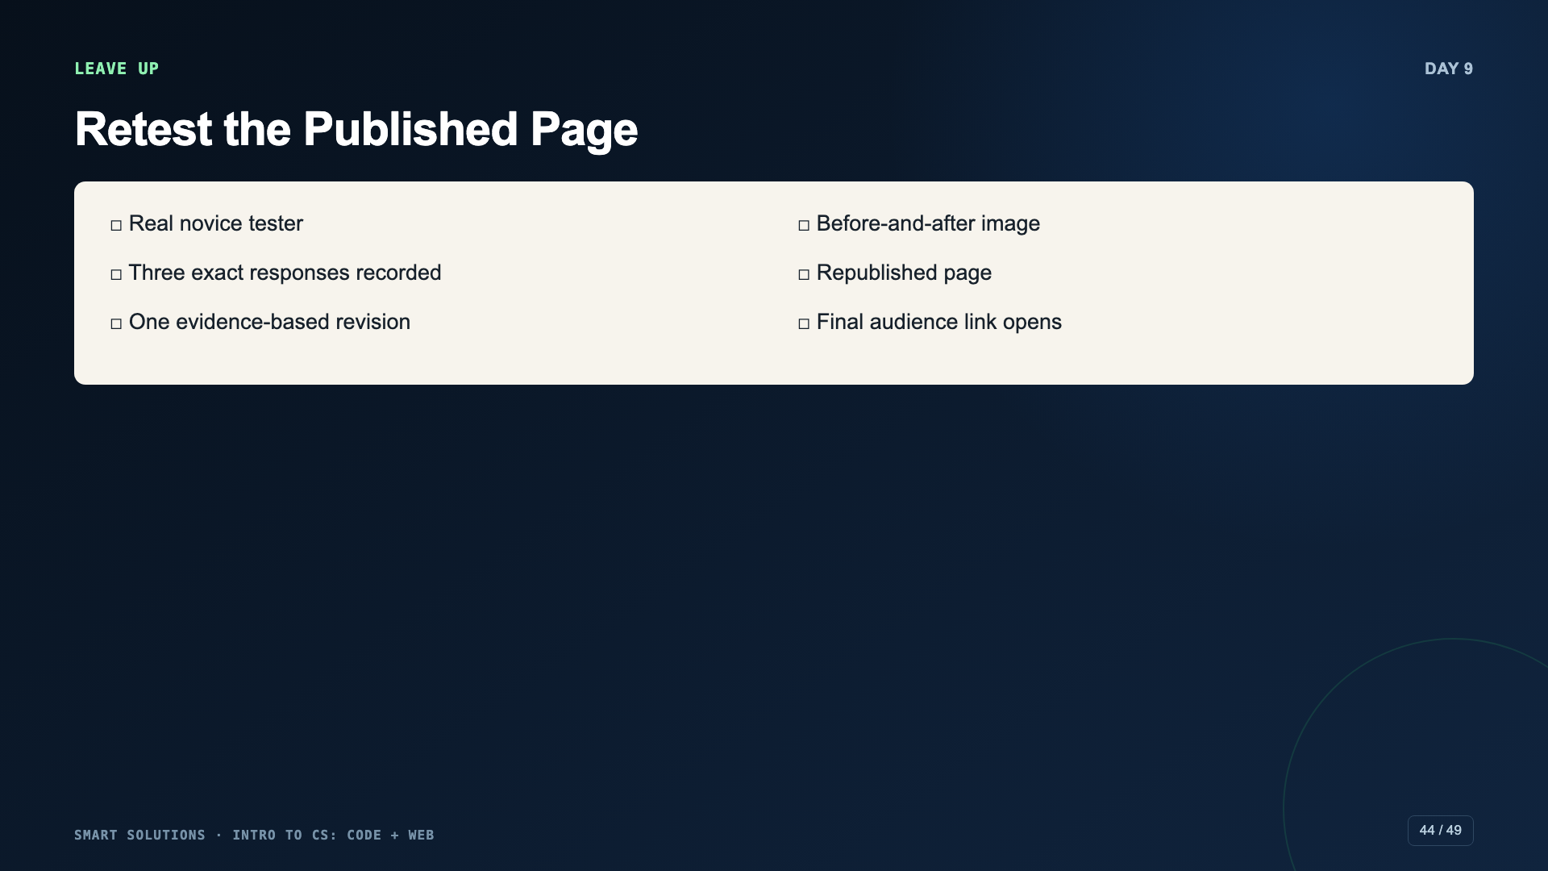
Notes:
Use packet page 4. Require republishing and a new-tab link test after the revision.
[Sources]
- Smart Solutions Code + Web Canvas module and facilitator guide (Irving 2027 Template, course 23402).

Slide 45
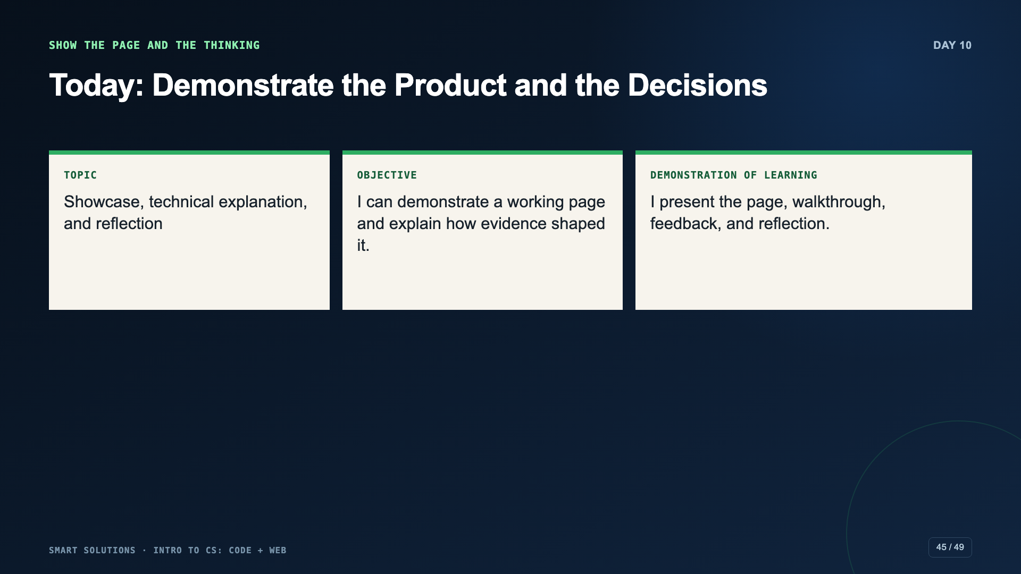
Notes:
The final demonstration includes the working page and the reasoning behind it. Students should point at the page while explaining.
[Sources]
- Smart Solutions Code + Web Canvas module and facilitator guide (Irving 2027 Template, course 23402).
- Code.org. “Mini-Project: Adding Style to a Web Page.” CSD 2026, Unit 2, Lesson 10. https://studio.code.org/courses/csd-2026/units/2/lessons/10 (accessed 2026-08-16).

Slide 46
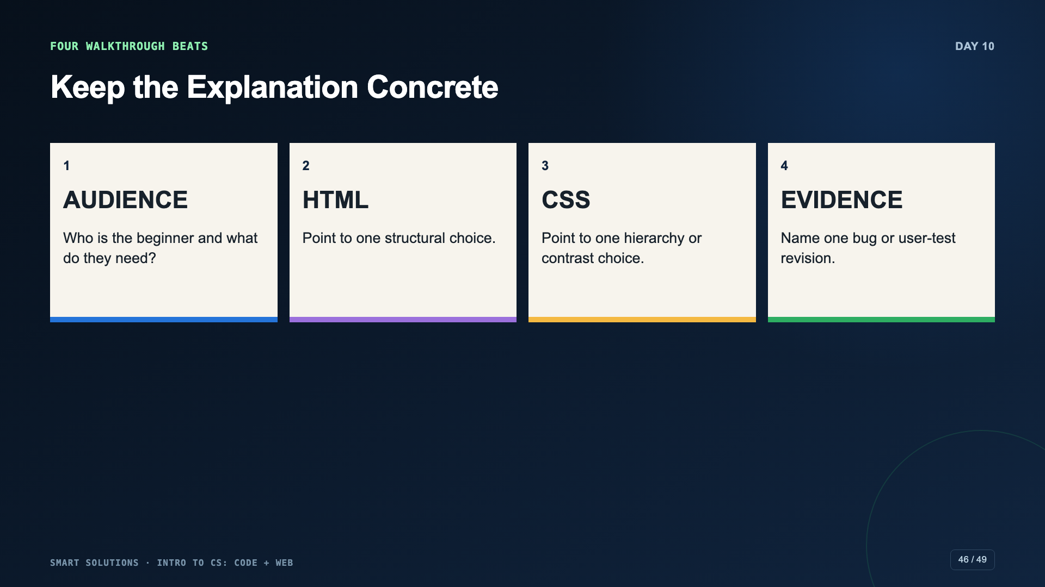
Notes:
Rehearse the four beats with a timer. Students may present live or submit a short recording according to the Canvas route.
[Sources]
- Smart Solutions Code + Web Canvas module and facilitator guide (Irving 2027 Template, course 23402).

Slide 47
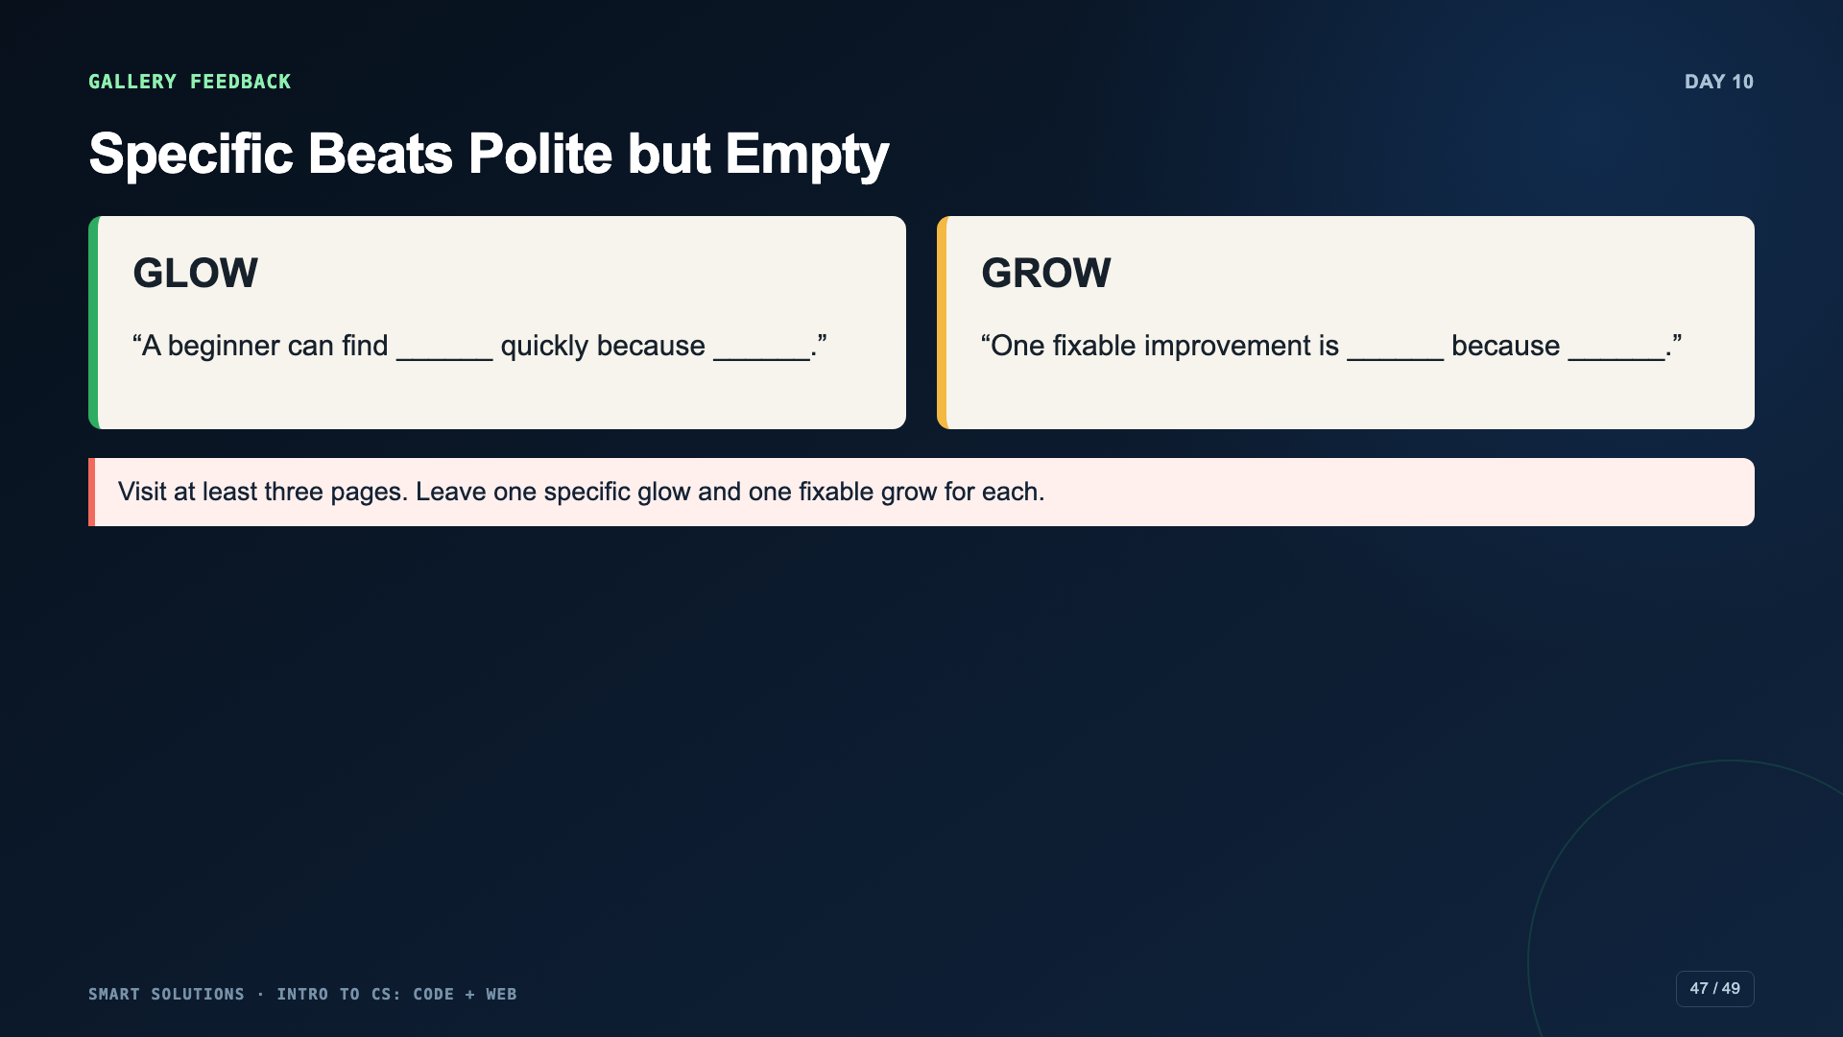
Notes:
Model the difference between “looks good” and evidence-based feedback. Keep feedback about the page, not the person.
[Sources]
- Smart Solutions Code + Web Canvas module and facilitator guide (Irving 2027 Template, course 23402).

Slide 48
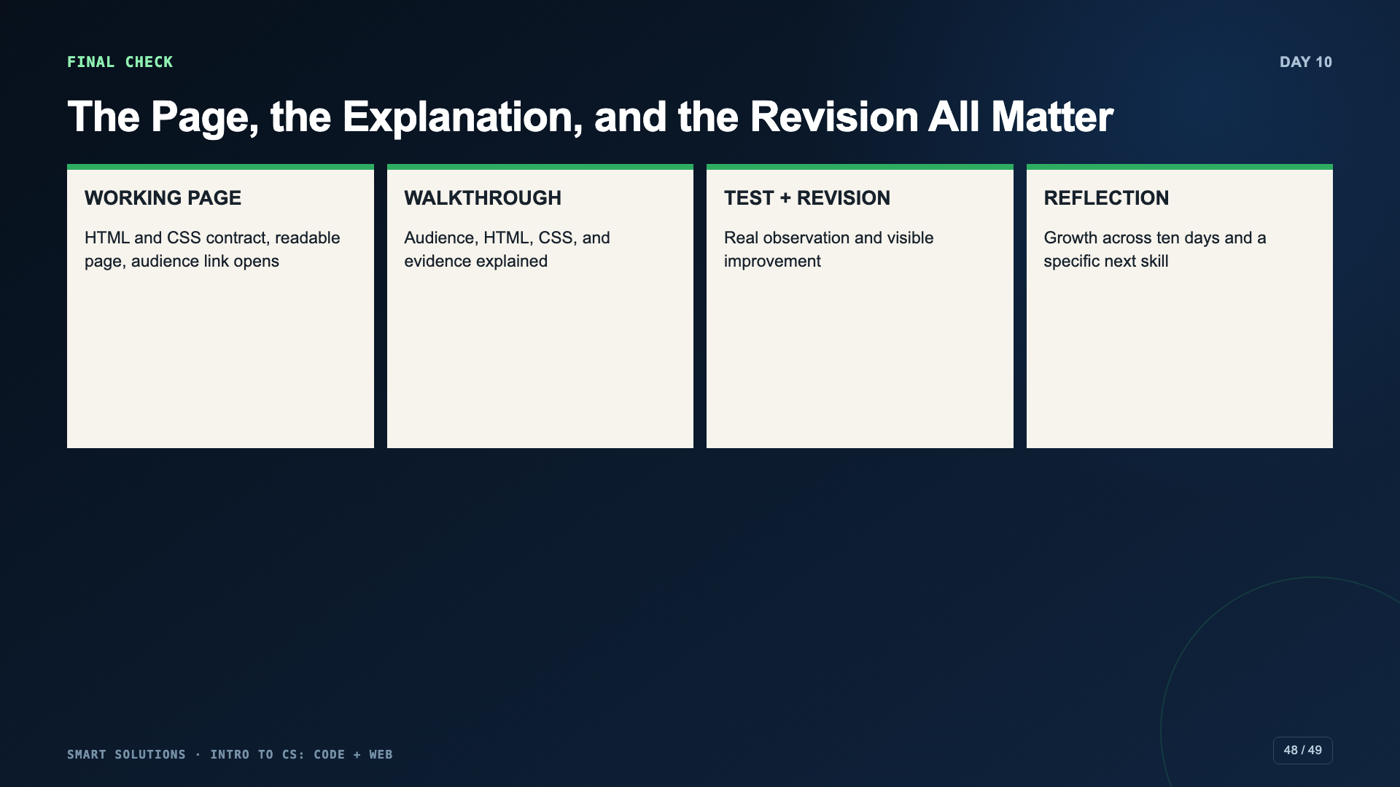
Notes:
Review the exact Canvas rubric before submission. Missing work earns missing credit; partial evidence should not receive an automatic floor.
[Sources]
- Smart Solutions Code + Web Canvas module and facilitator guide (Irving 2027 Template, course 23402).

Slide 49
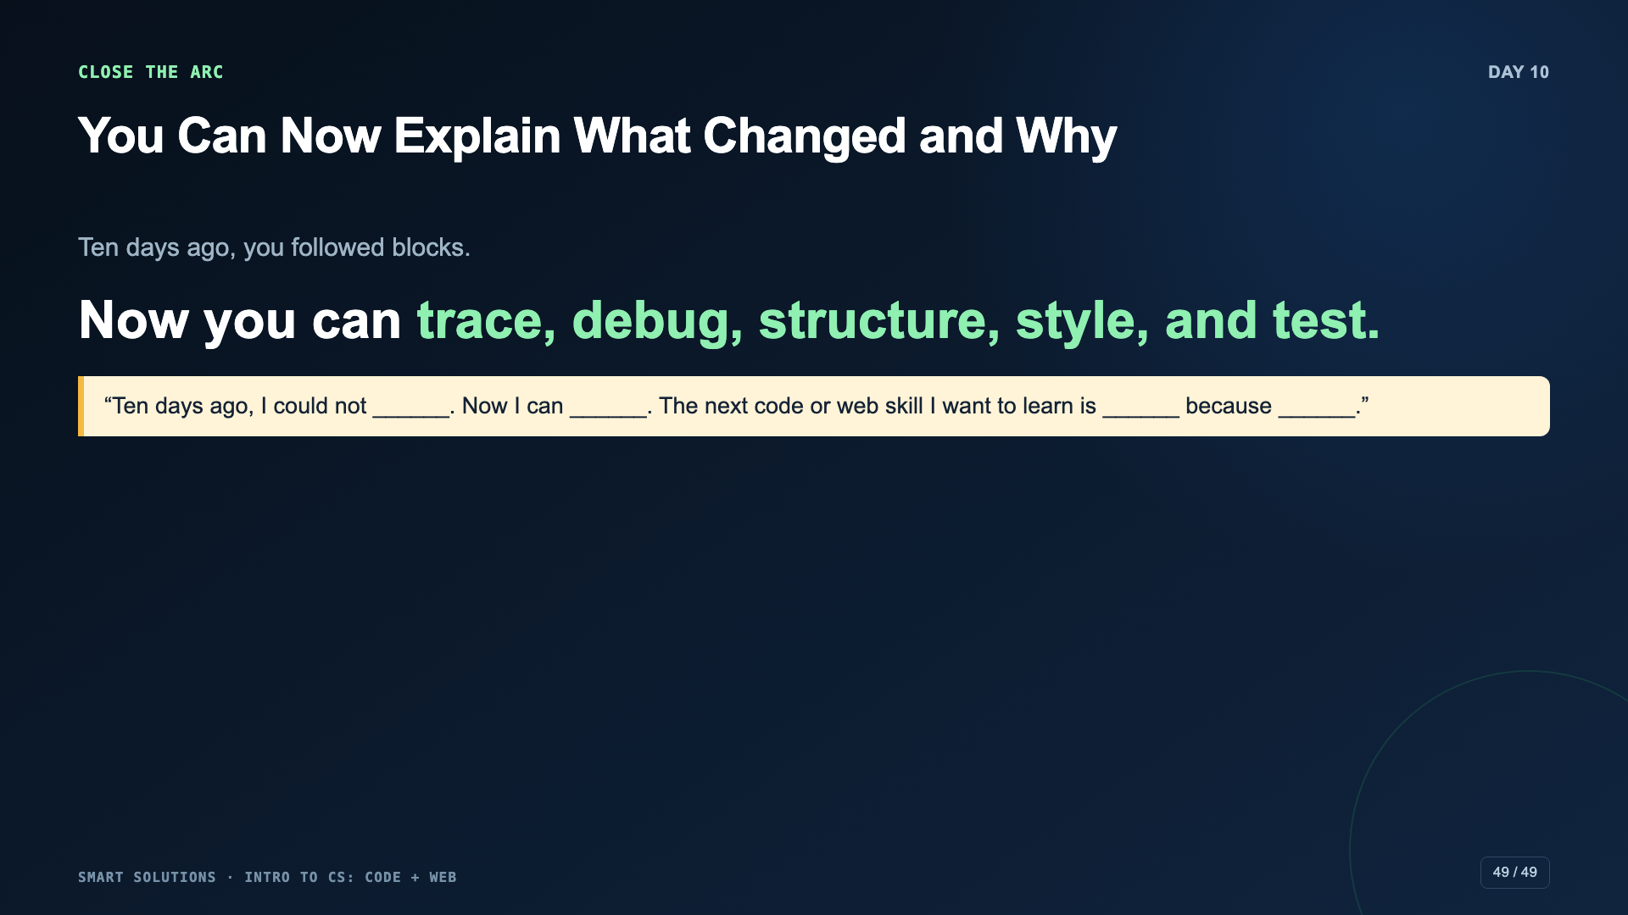
Notes:
Close by returning to the unit’s opening distinction: computers follow instructions, and pages serve people. Ask students to name one skill they can transfer to a future game, app, or website.
[Sources]
- Smart Solutions Code + Web Canvas module and facilitator guide (Irving 2027 Template, course 23402).
- Code.org. “Computer Science Discoveries.” https://code.org/cs/curriculum/computer-science-discoveries (accessed 2026-08-16).

