Slide 1
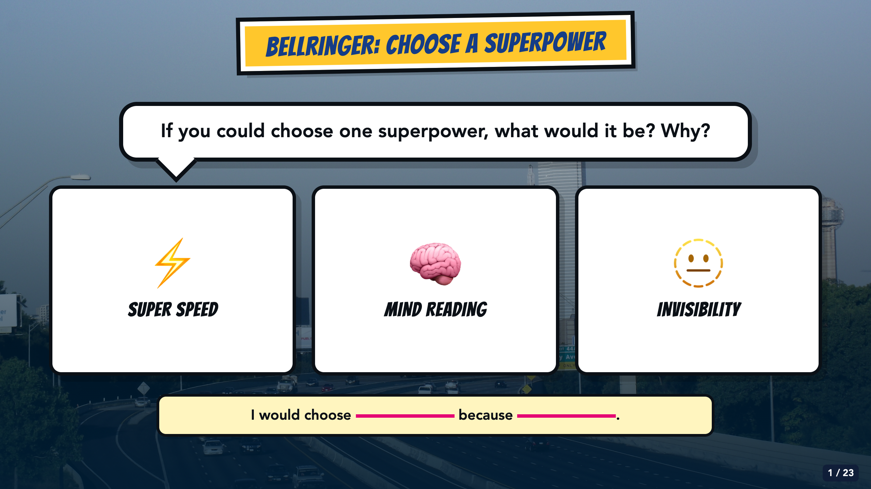
Notes:
Give students 60 to 90 seconds to choose and explain. Accept an oral response, drawing, or the sentence stem. Do not turn this into a full icebreaker; its job is to open the superhero frame and give students an easy first success.
[Sources]
- Owner-created Smart Solutions Lesson 1 source decks: From Google Drive 2026/Units/SS U0 (Superhero)/My Slides/SmartSolutions SuperHero L1 Final.pdf and /Users/elishalucero/Downloads/smart_solutions_superhero_enhanced_20250817181901.pdf
- Owner-approved staged Comics Lesson 1 bodies: tmp/comic_scaffold_agent/lesson_1_cover.html and teacher_guide_lesson_1.html
- Dallas skyline photograph by medea_material, CC BY 2.0; cropped and color-treated: https://commons.wikimedia.org/wiki/File:Skyline_of_Dallas,_TX.jpg

Slide 2
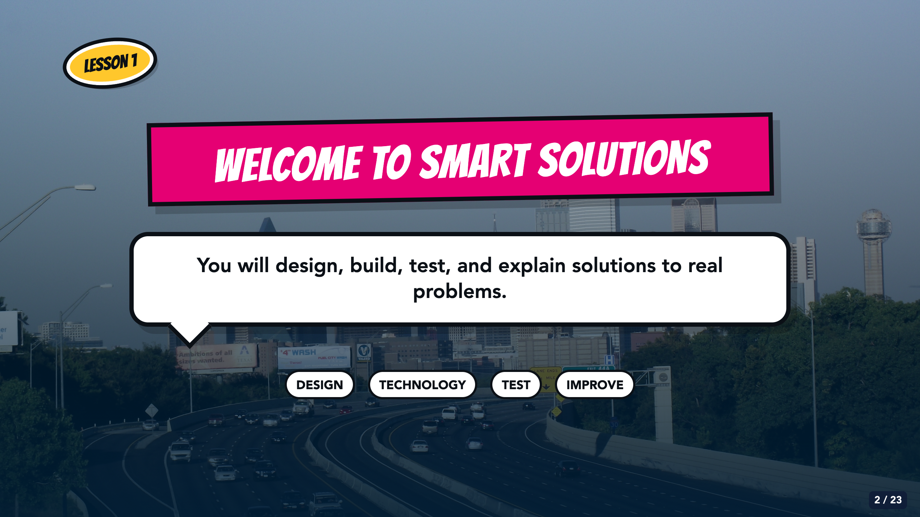
Notes:
Keep the course introduction concrete. Smart Solutions asks students to design, build, test, and explain solutions. Avoid promising that the same hero or theme will continue through every later unit.
[Sources]
- Owner-created Smart Solutions Lesson 1 source decks: From Google Drive 2026/Units/SS U0 (Superhero)/My Slides/SmartSolutions SuperHero L1 Final.pdf and /Users/elishalucero/Downloads/smart_solutions_superhero_enhanced_20250817181901.pdf
- Owner-approved staged Comics Lesson 1 bodies: tmp/comic_scaffold_agent/lesson_1_cover.html and teacher_guide_lesson_1.html
- Dallas skyline photograph by medea_material, CC BY 2.0; cropped and color-treated: https://commons.wikimedia.org/wiki/File:Skyline_of_Dallas,_TX.jpg

Slide 3
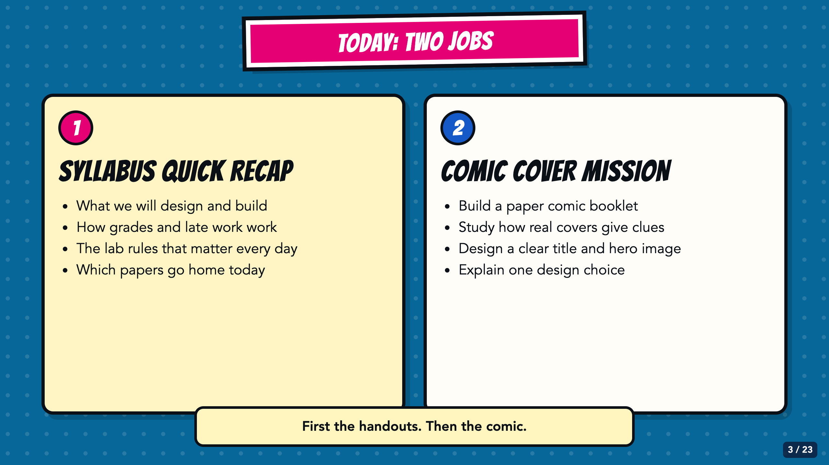
Notes:
Preview the two-part class period before passing out papers. The syllabus and forms come first; the Comic Cover lesson begins after students know which papers to keep and which papers go home.
[Sources]
- Owner-provided English syllabus: /Users/elishalucero/Downloads/lucero syllabus 2027 (2).pdf
- Owner-provided Spanish syllabus: /Users/elishalucero/Downloads/spanish lucero syllabus 2027 (1).pdf
- Owner-provided 2027 VILS Lab Usage Agreement: /Users/elishalucero/Downloads/VILS_Lab_Usage_Agreement_2026.docx (1) (1).pdf
- Owner-provided Verizon General Release for Minors, program period August 2026-June 2027: /Users/elishalucero/Downloads/Verizon_General_Release_Minors_2026-2027_English (1).pdf
- Owner-approved staged Comics Lesson 1 bodies: tmp/comic_scaffold_agent/lesson_1_cover.html and teacher_guide_lesson_1.html

Slide 4
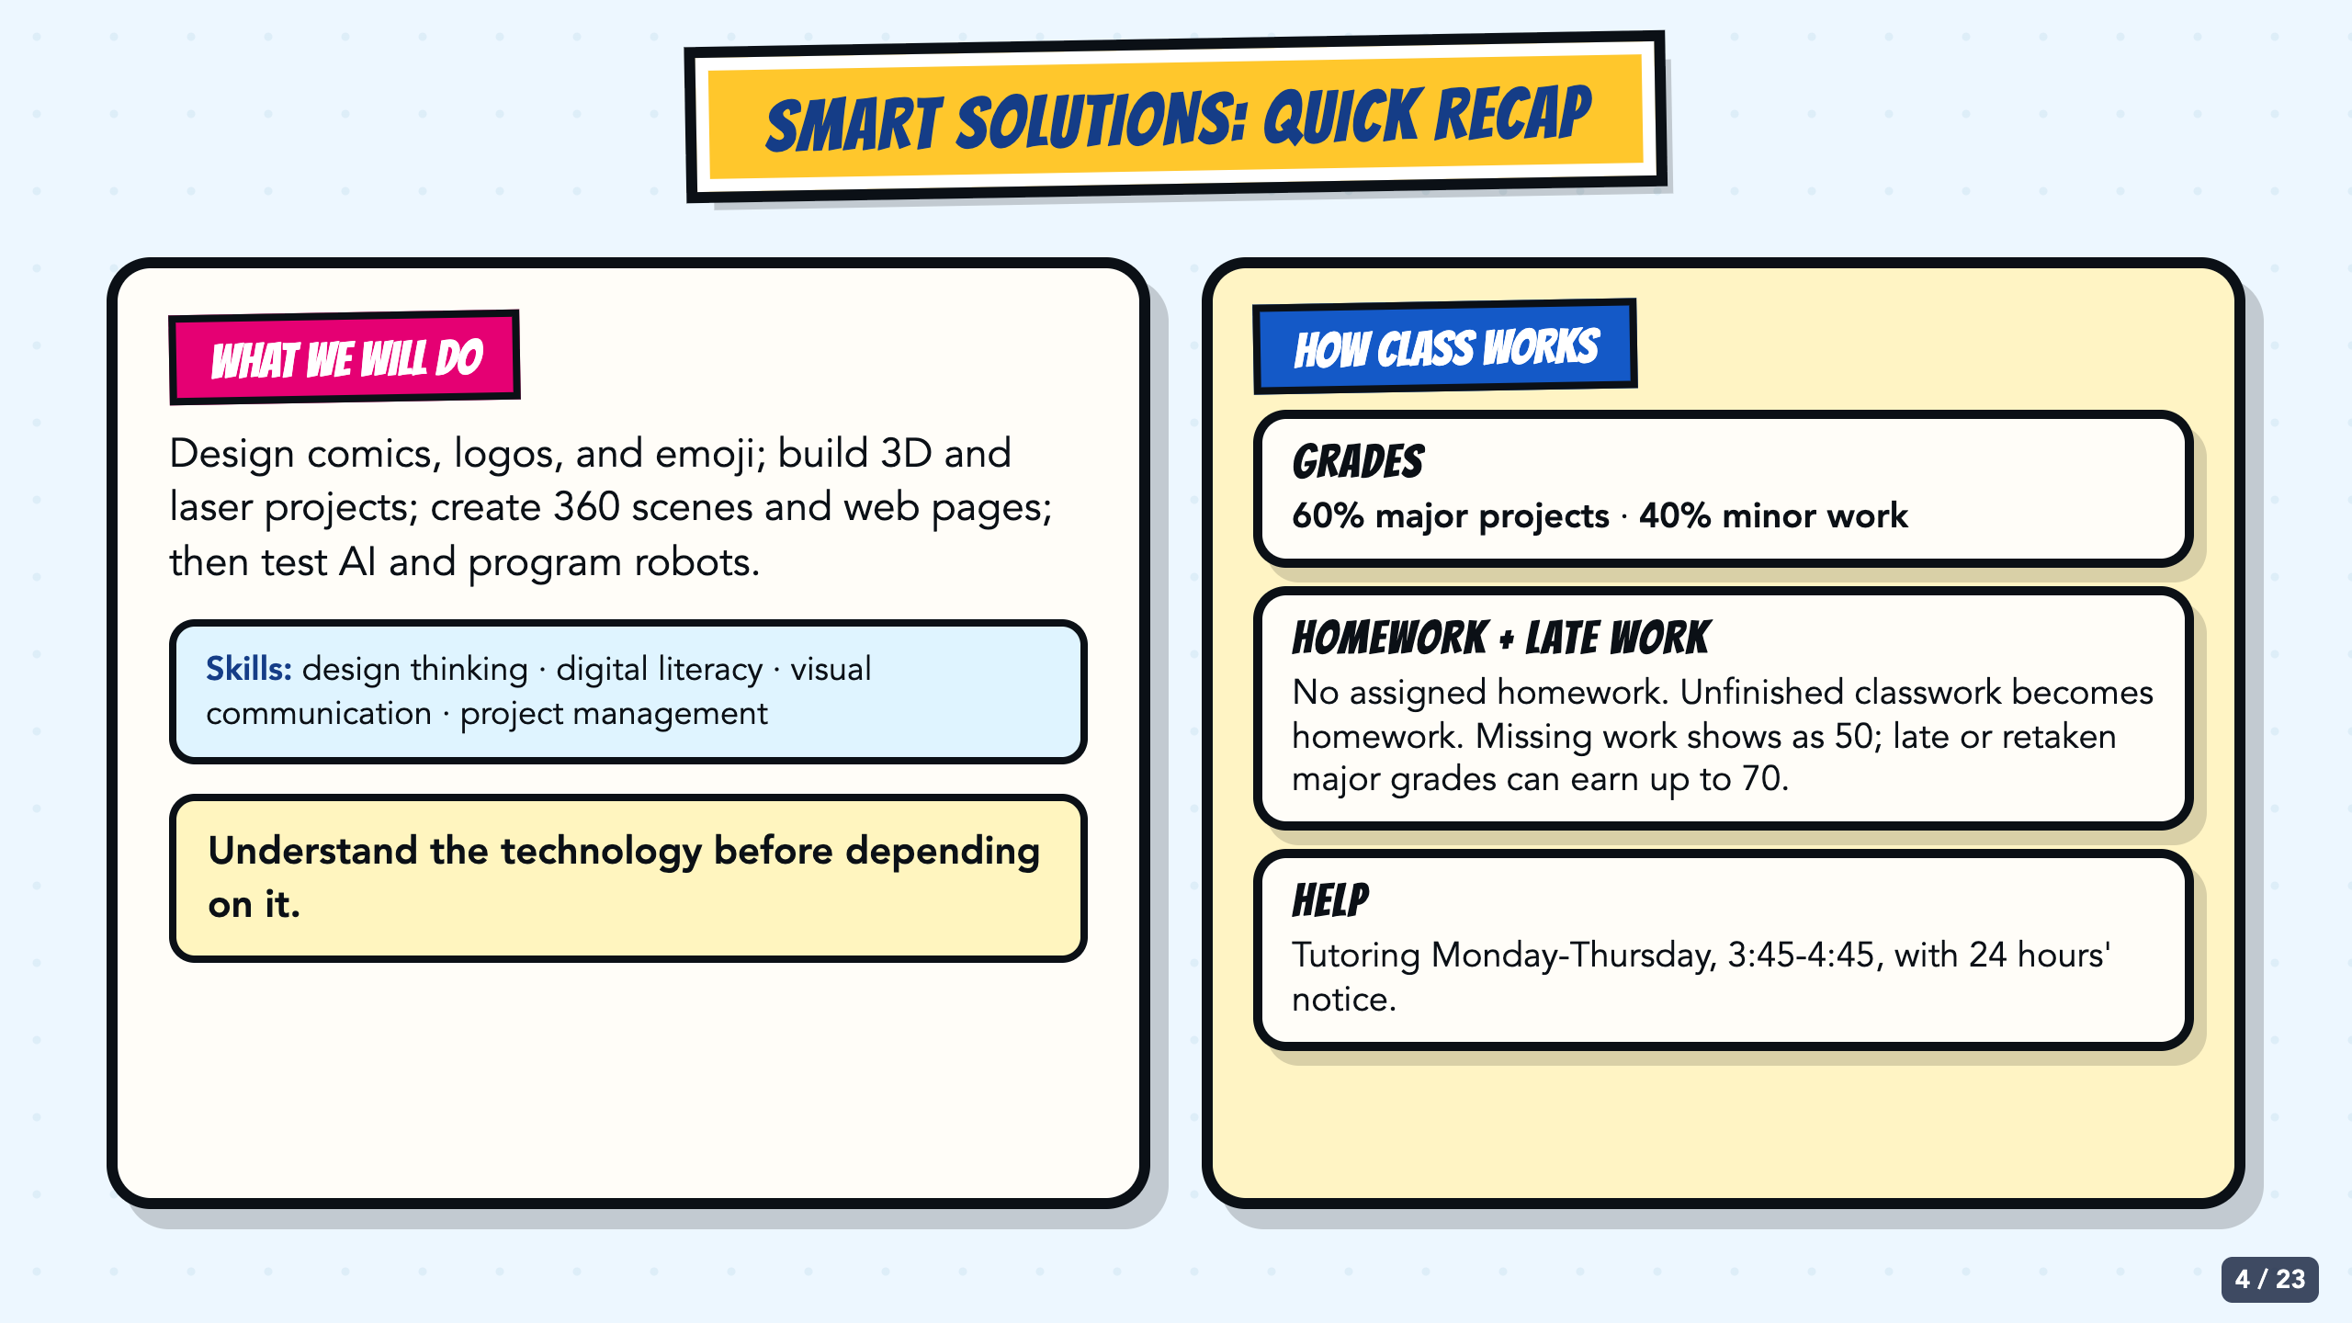
Notes:
Hand each student an English or Spanish syllabus to keep. Recap the course scope, 60/40 grading split, no-assigned-homework policy, late-work ceiling, and tutoring window without reading the whole document aloud. The visible course list is a compressed recap, not a replacement syllabus.
[Sources]
- Owner-provided English syllabus: /Users/elishalucero/Downloads/lucero syllabus 2027 (2).pdf
- Owner-provided Spanish syllabus: /Users/elishalucero/Downloads/spanish lucero syllabus 2027 (1).pdf

Slide 5
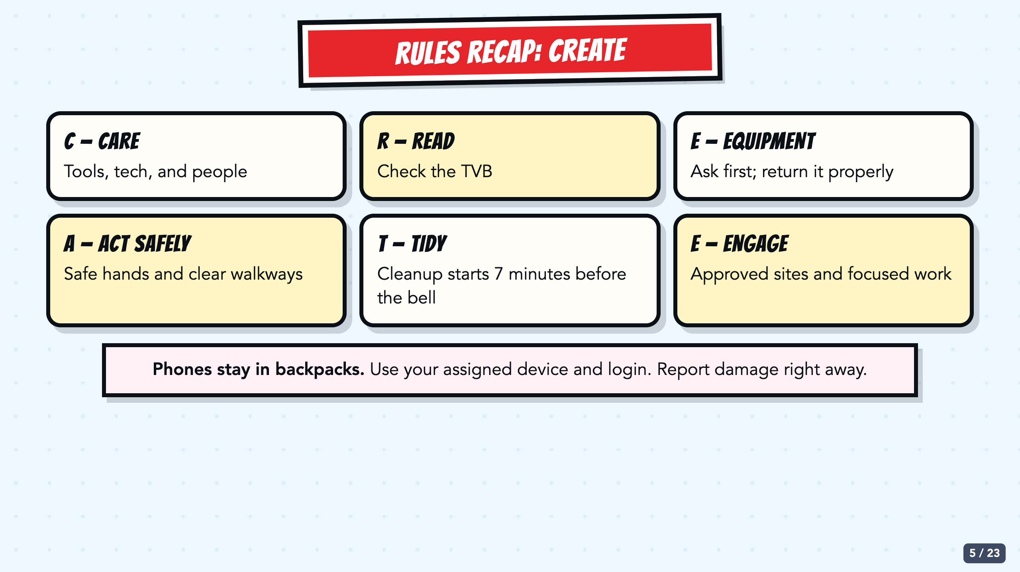
Notes:
The full rules were taught last week, so use this as retrieval rather than a second long rules presentation. Ask students to supply each CREATE word, then confirm phones in backpacks, assigned-device use, damage reporting, and the seven-minute cleanup.
[Sources]
- Owner-provided classroom rules presentation: /Users/elishalucero/Downloads/classroom_rules_20250814025941 (2).pdf
- Owner-provided 2027 VILS Lab Usage Agreement: /Users/elishalucero/Downloads/VILS_Lab_Usage_Agreement_2026.docx (1) (1).pdf
- Owner-provided English syllabus: /Users/elishalucero/Downloads/lucero syllabus 2027 (2).pdf
- Owner-provided Spanish syllabus: /Users/elishalucero/Downloads/spanish lucero syllabus 2027 (1).pdf

Slide 6
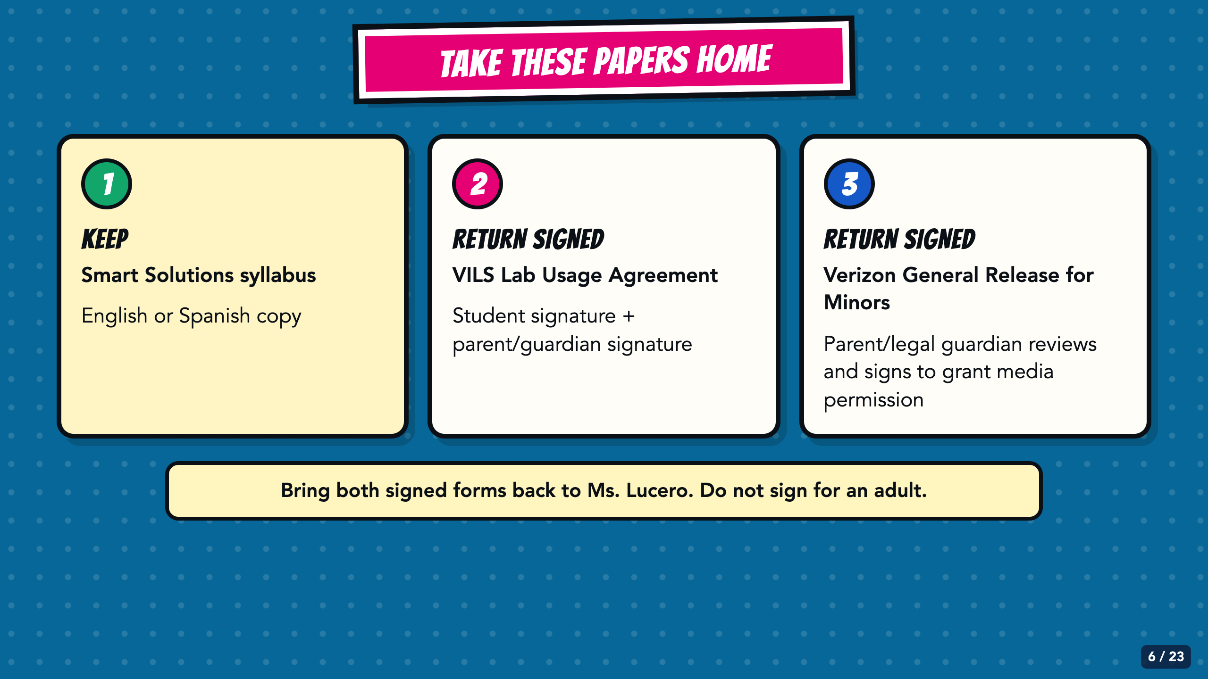
Notes:
Hold up all three papers while giving directions. Students keep the syllabus. The VILS Lab Usage Agreement has student and parent/guardian signature lines. The Verizon release is a separate media-permission form for the parent/legal guardian to review and sign; do not describe it as the lab agreement or as a grade. Students must not sign for an adult.
[Sources]
- Owner-provided English syllabus: /Users/elishalucero/Downloads/lucero syllabus 2027 (2).pdf
- Owner-provided Spanish syllabus: /Users/elishalucero/Downloads/spanish lucero syllabus 2027 (1).pdf
- Owner-provided 2027 VILS Lab Usage Agreement: /Users/elishalucero/Downloads/VILS_Lab_Usage_Agreement_2026.docx (1) (1).pdf
- Owner-provided Verizon General Release for Minors, program period August 2026-June 2027: /Users/elishalucero/Downloads/Verizon_General_Release_Minors_2026-2027_English (1).pdf

Slide 7
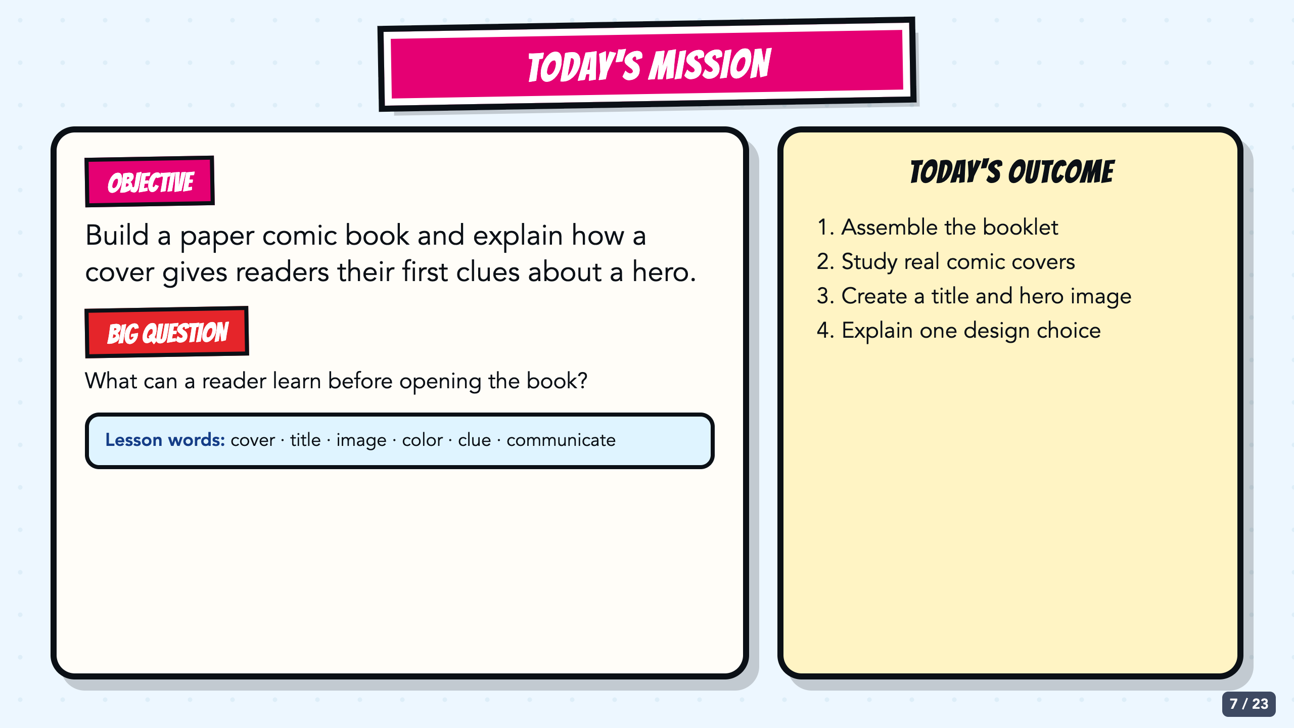
Notes:
Read the objective and outcome aloud. The learning target is visual communication: students use observable cover evidence to explain what readers notice and infer. The booklet assembly is the making routine that supports the five-day project.
[Sources]
- Owner-created Smart Solutions Lesson 1 source decks: From Google Drive 2026/Units/SS U0 (Superhero)/My Slides/SmartSolutions SuperHero L1 Final.pdf and /Users/elishalucero/Downloads/smart_solutions_superhero_enhanced_20250817181901.pdf
- Owner-approved staged Comics Lesson 1 bodies: tmp/comic_scaffold_agent/lesson_1_cover.html and teacher_guide_lesson_1.html

Slide 8
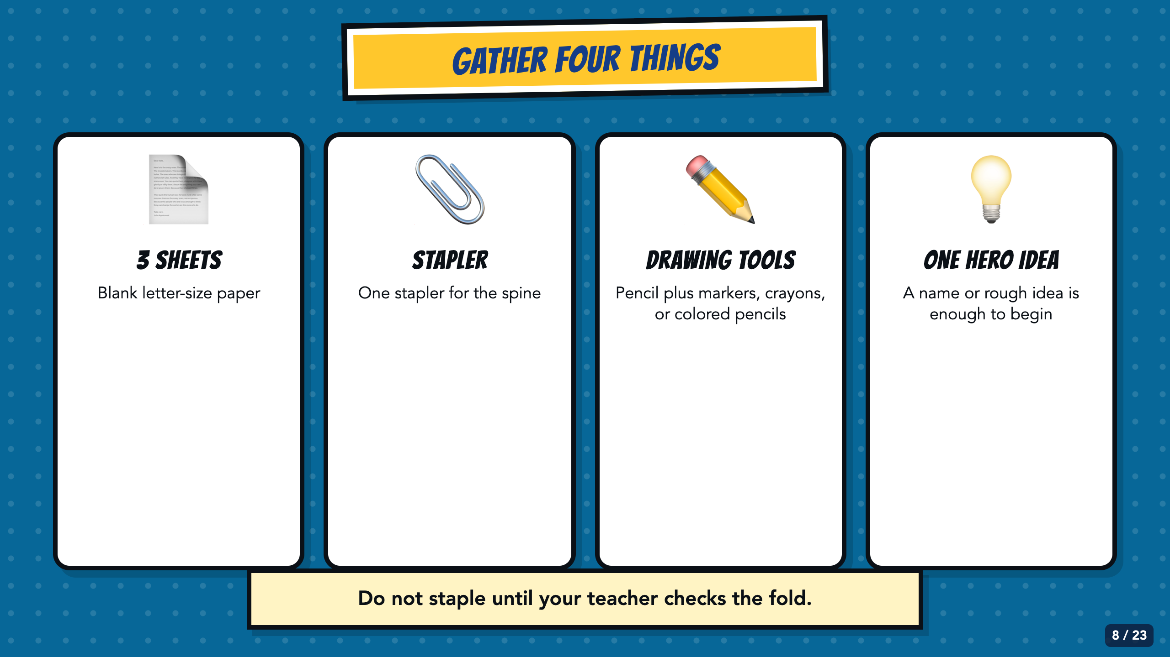
Notes:
Hold up each item as students gather it. If staplers are limited, place one at a supervised station. Students need only a rough hero idea at this point; Lesson 2 develops the character.
[Sources]
- Owner-created Smart Solutions Lesson 1 source decks: From Google Drive 2026/Units/SS U0 (Superhero)/My Slides/SmartSolutions SuperHero L1 Final.pdf and /Users/elishalucero/Downloads/smart_solutions_superhero_enhanced_20250817181901.pdf
- Owner-approved staged Comics Lesson 1 bodies: tmp/comic_scaffold_agent/lesson_1_cover.html and teacher_guide_lesson_1.html

Slide 9
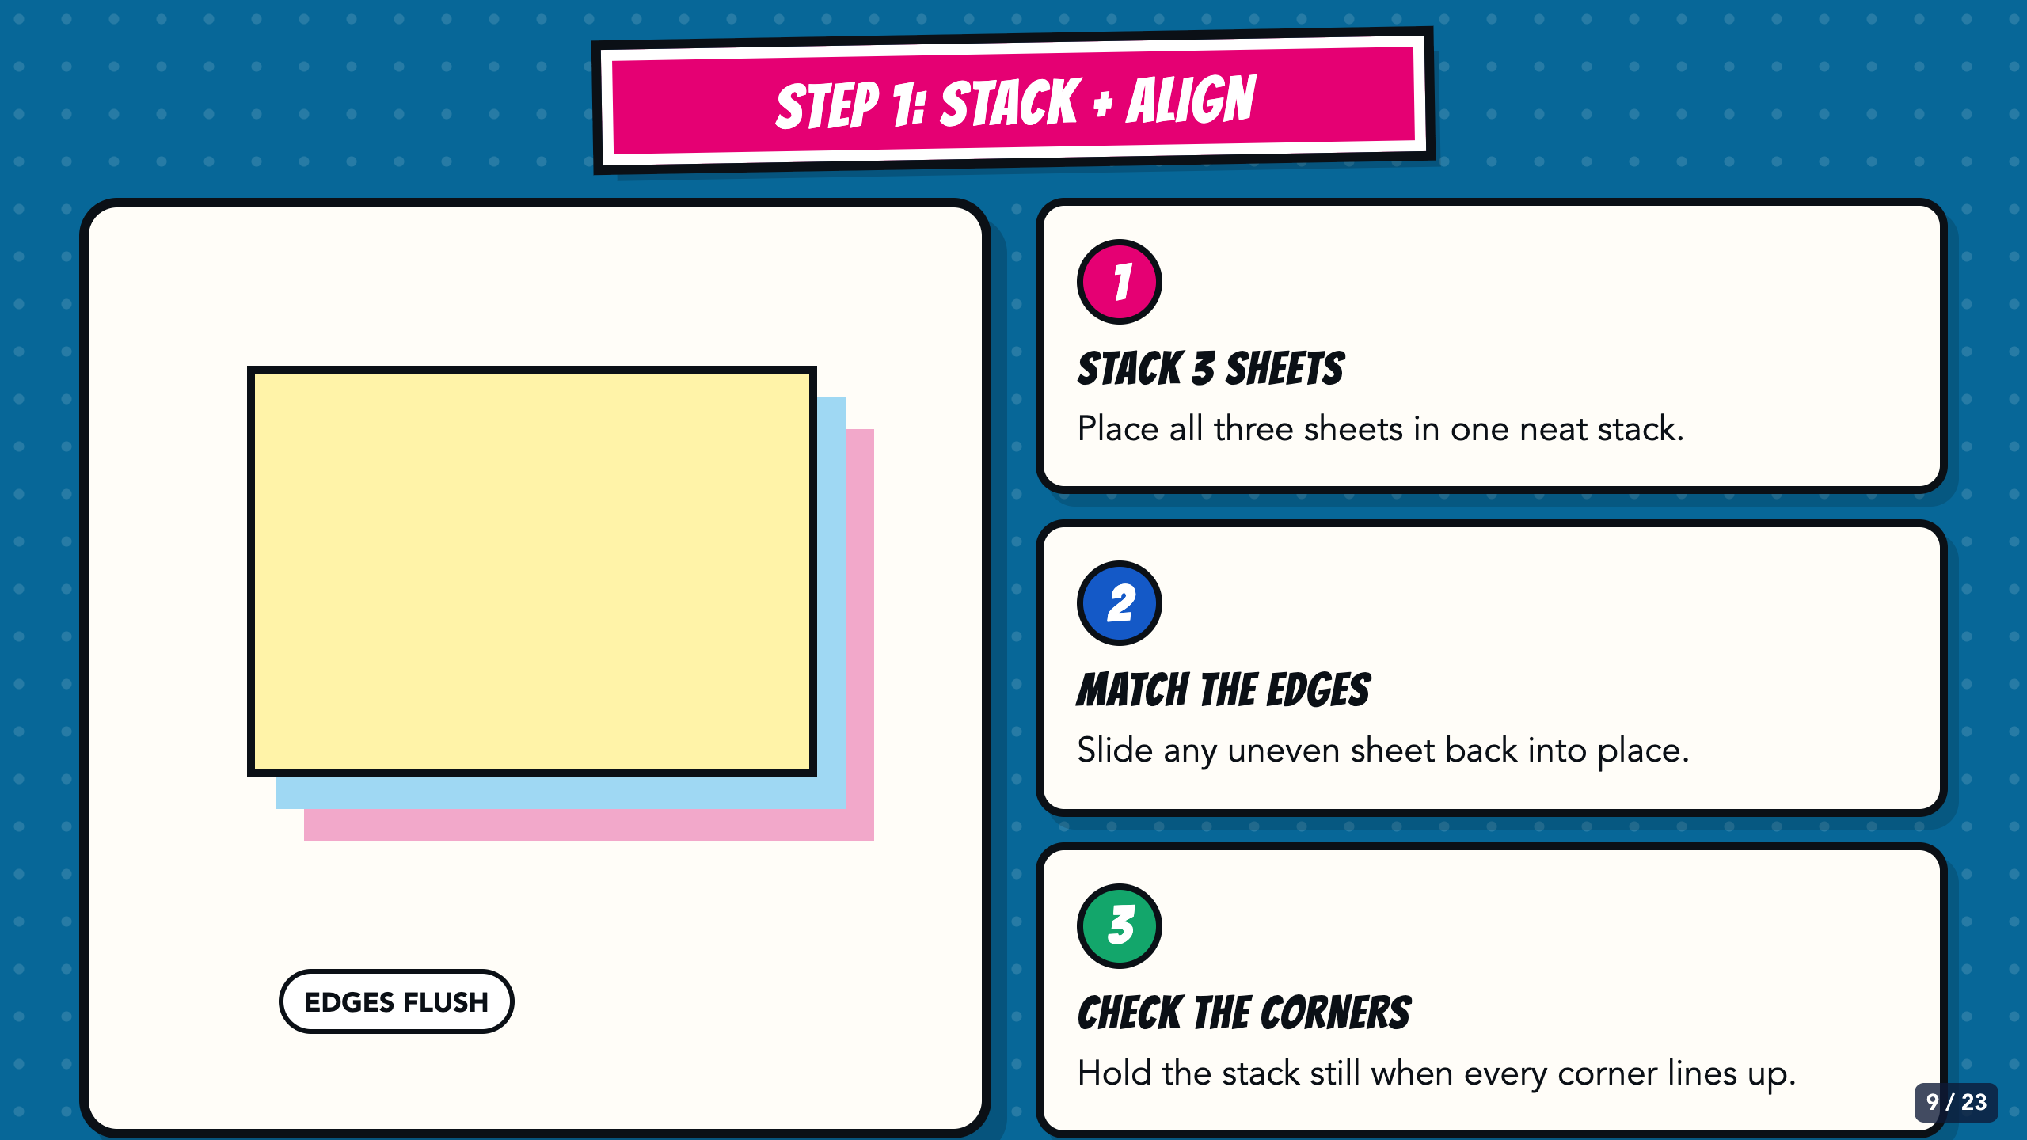
Notes:
Model the stack before the fold. Students place all three sheets together, slide the edges and corners into alignment, and hold the stack still. Do not move on until the stack is flush.
[Sources]
- Owner-created Smart Solutions Lesson 1 source decks: From Google Drive 2026/Units/SS U0 (Superhero)/My Slides/SmartSolutions SuperHero L1 Final.pdf and /Users/elishalucero/Downloads/smart_solutions_superhero_enhanced_20250817181901.pdf
- Fold, stack, staple, and booklet-check illustrations are original CSS process diagrams created for this lesson.

Slide 10
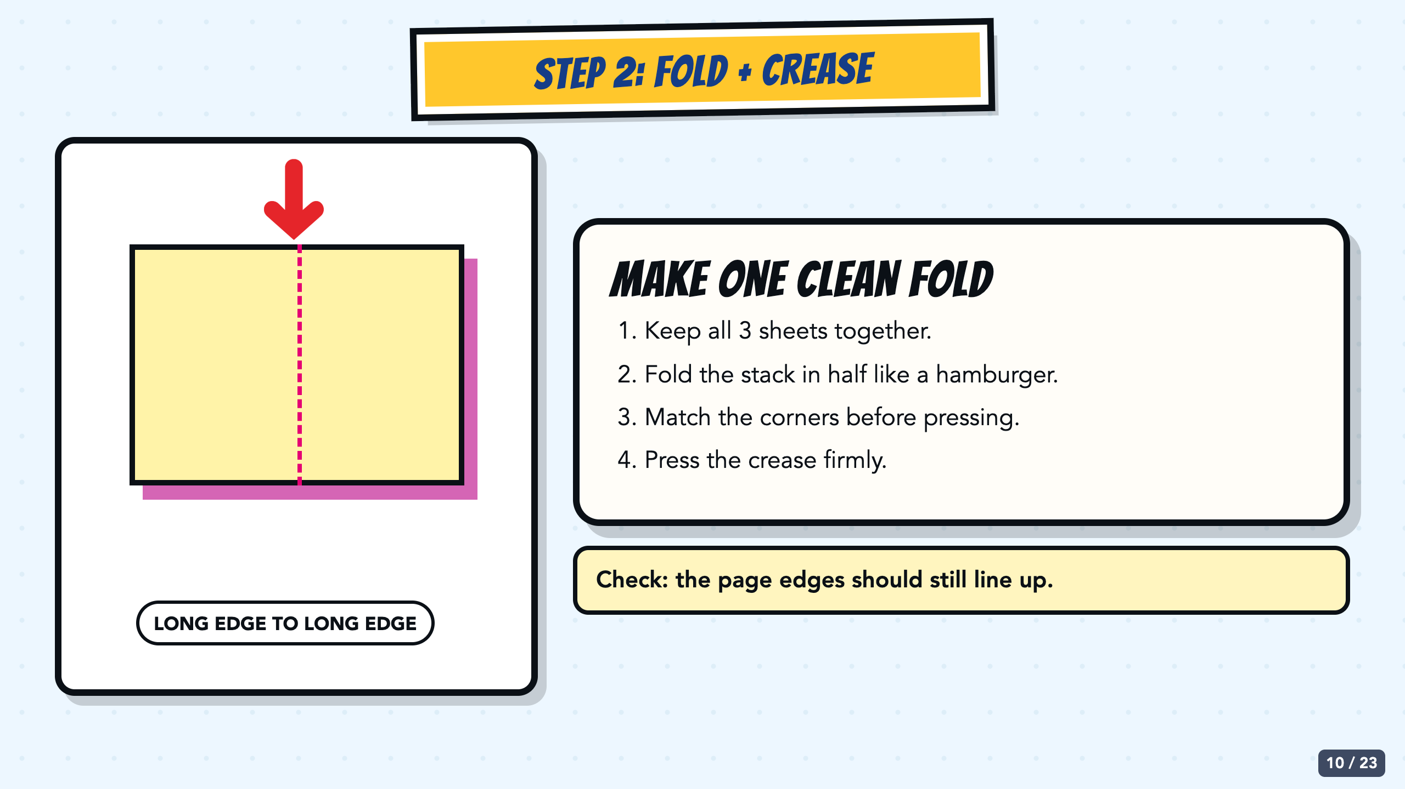
Notes:
Now model one hamburger fold with the aligned stack. Match the corners before pressing the crease. Face the same direction as students so the fold does not appear reversed.
[Sources]
- Owner-created Smart Solutions Lesson 1 source decks: From Google Drive 2026/Units/SS U0 (Superhero)/My Slides/SmartSolutions SuperHero L1 Final.pdf and /Users/elishalucero/Downloads/smart_solutions_superhero_enhanced_20250817181901.pdf
- Fold, stack, staple, and booklet-check illustrations are original CSS process diagrams created for this lesson.

Slide 11
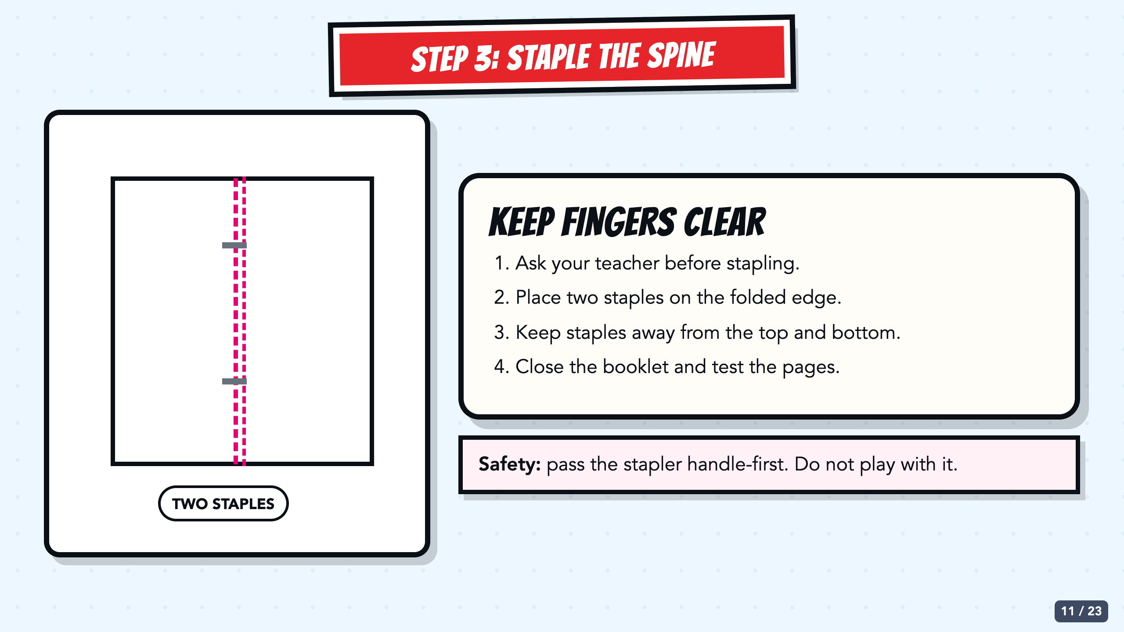
Notes:
Decide whether students staple or bring booklets to a supervised station. Use two staples on the fold, away from the top and bottom edges. Check for loose or raised staples.
[Sources]
- Owner-created Smart Solutions Lesson 1 source decks: From Google Drive 2026/Units/SS U0 (Superhero)/My Slides/SmartSolutions SuperHero L1 Final.pdf and /Users/elishalucero/Downloads/smart_solutions_superhero_enhanced_20250817181901.pdf
- Fold, stack, staple, and booklet-check illustrations are original CSS process diagrams created for this lesson.

Slide 12
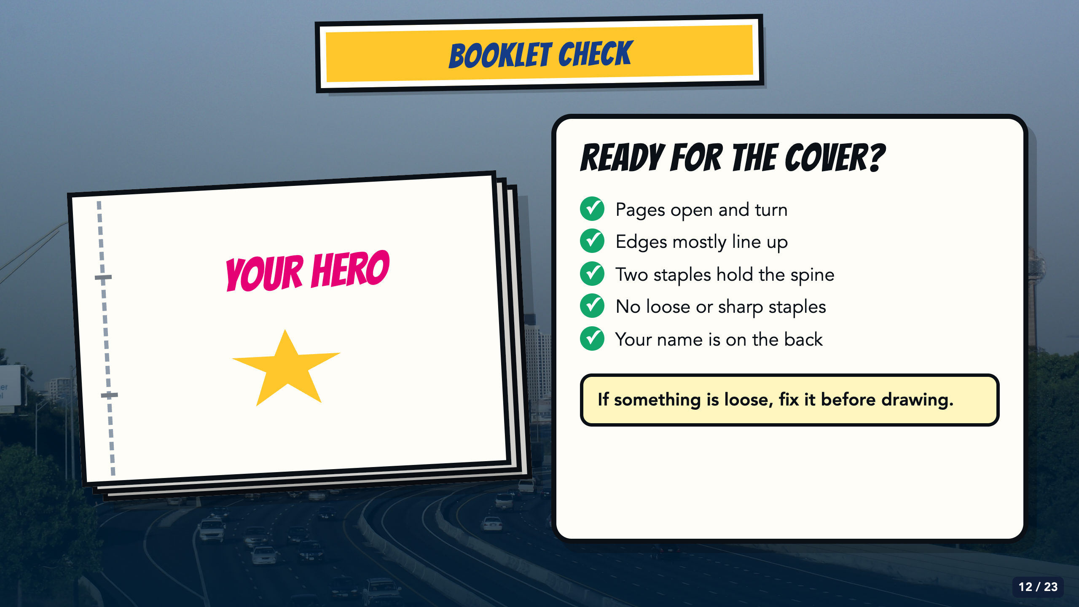
Notes:
Run the five-item booklet check before introducing cover design. Have students write their name and class period on the back now, while the paper is still blank.
[Sources]
- Owner-created Smart Solutions Lesson 1 source decks: From Google Drive 2026/Units/SS U0 (Superhero)/My Slides/SmartSolutions SuperHero L1 Final.pdf and /Users/elishalucero/Downloads/smart_solutions_superhero_enhanced_20250817181901.pdf
- Owner-approved staged Comics Lesson 1 bodies: tmp/comic_scaffold_agent/lesson_1_cover.html and teacher_guide_lesson_1.html
- Dallas skyline photograph by medea_material, CC BY 2.0; cropped and color-treated: https://commons.wikimedia.org/wiki/File:Skyline_of_Dallas,_TX.jpg
- Fold, stack, staple, and booklet-check illustrations are original CSS process diagrams created for this lesson.

Slide 13
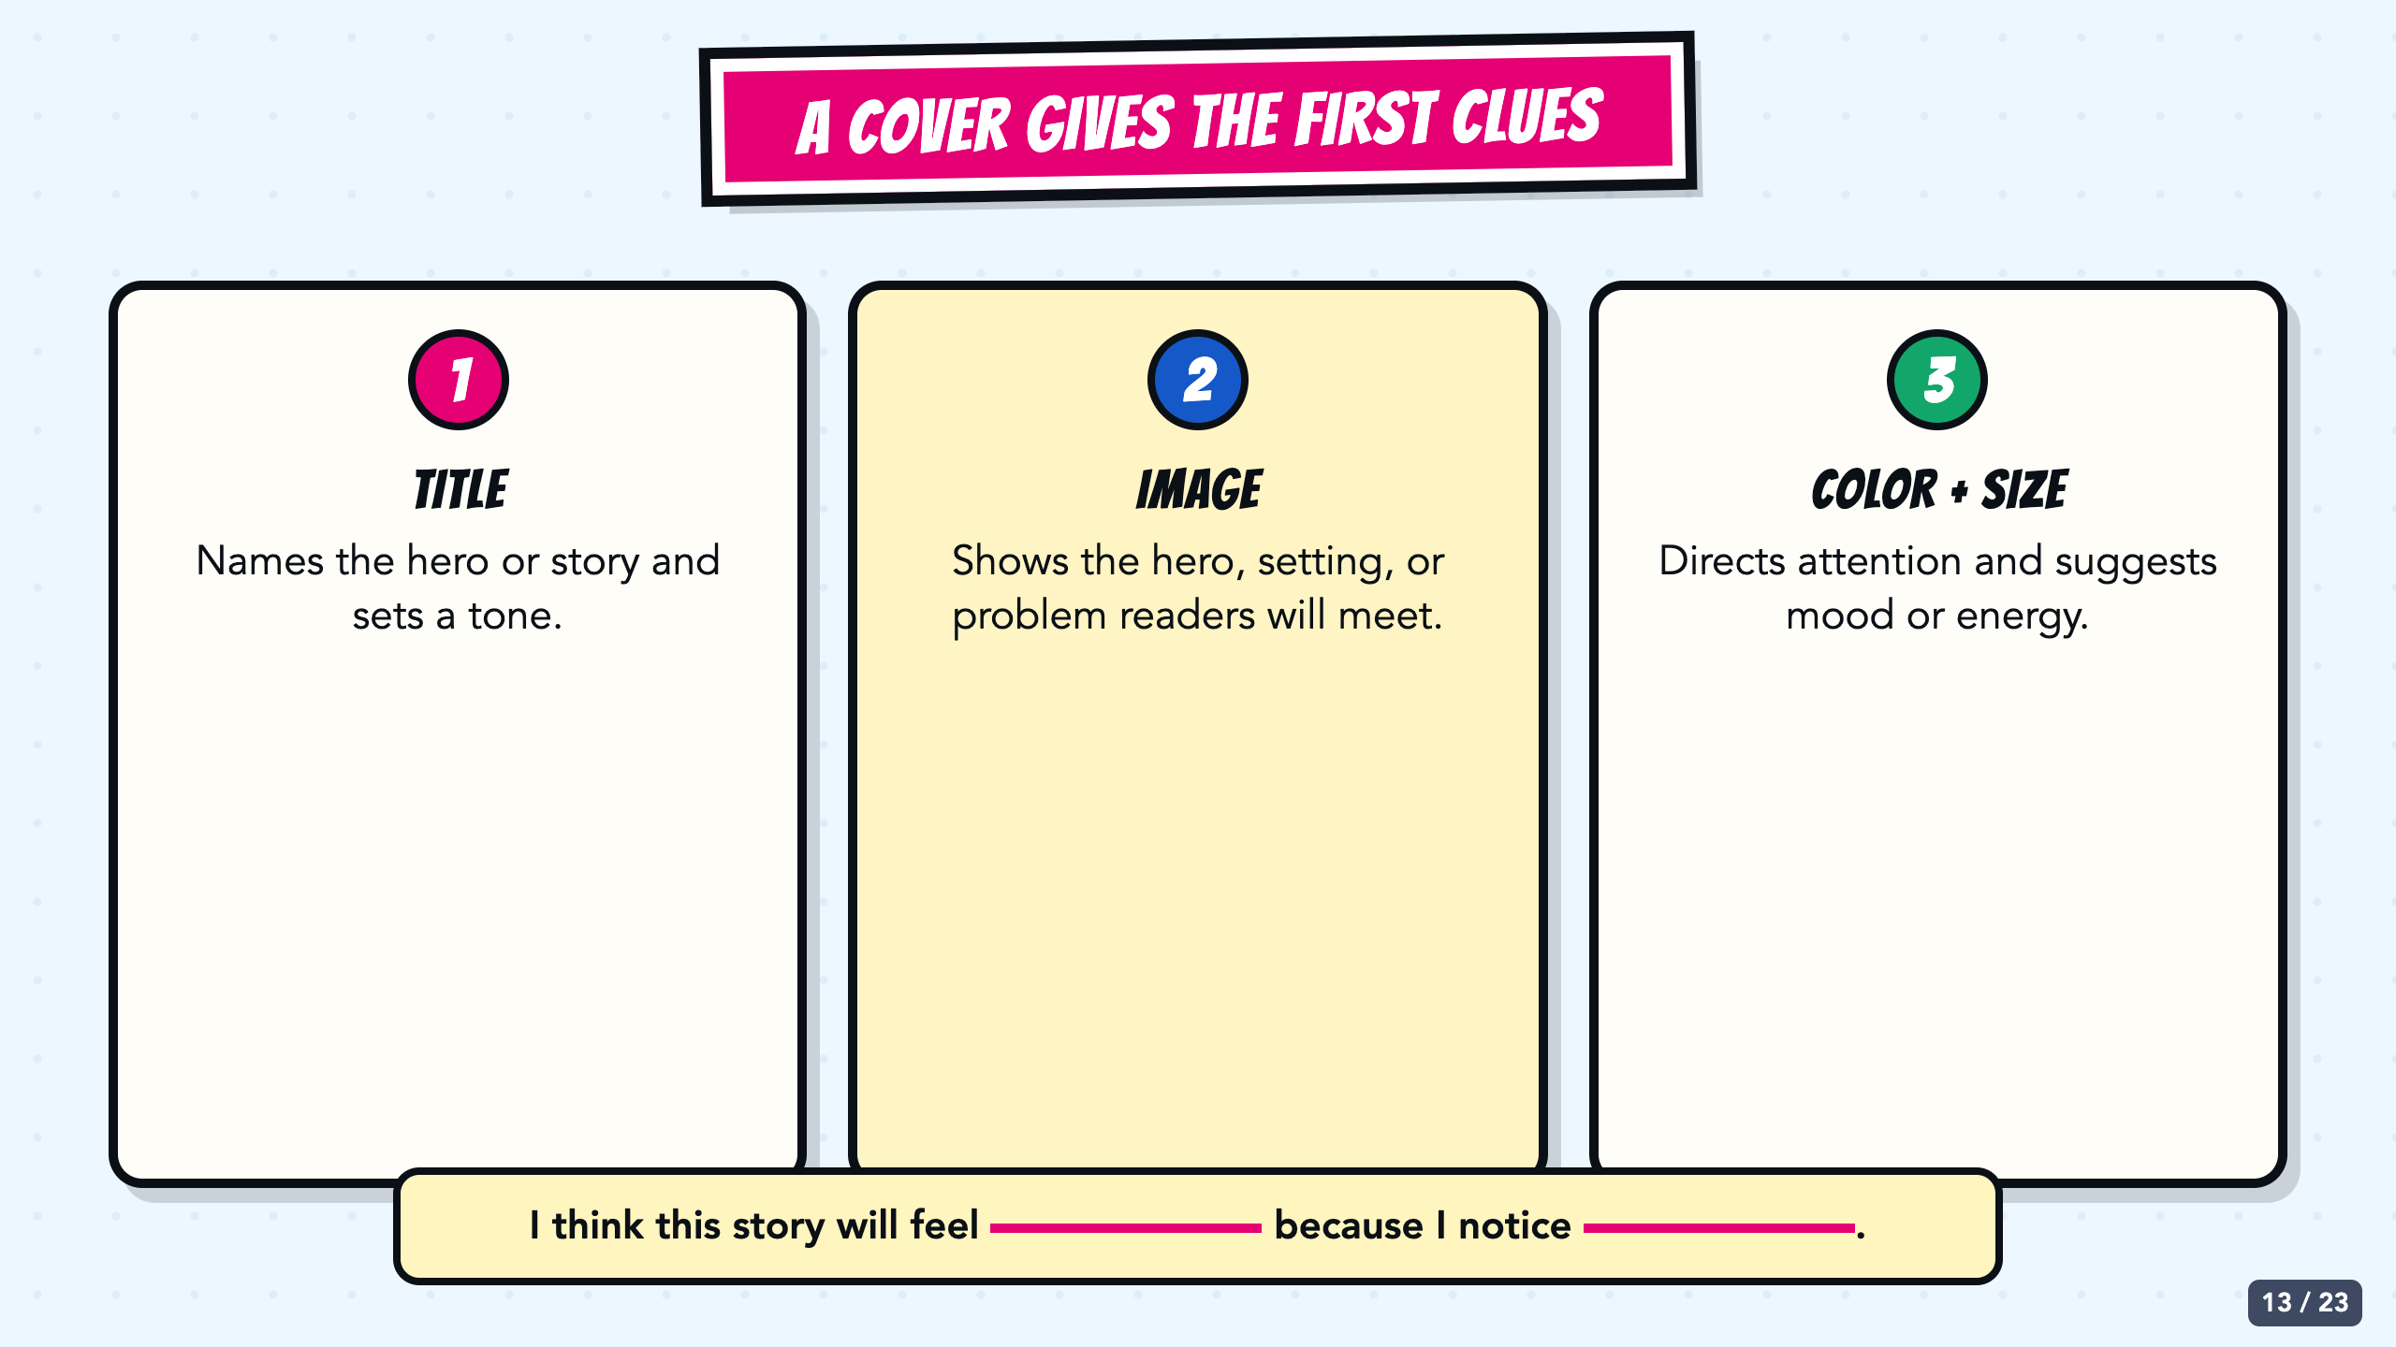
Notes:
Teach cover design as first clues, not as a formal brand promise. Title, image, color, size, and placement help readers decide what to notice and what kind of hero or story they may meet.
[Sources]
- Owner-created Smart Solutions Lesson 1 source decks: From Google Drive 2026/Units/SS U0 (Superhero)/My Slides/SmartSolutions SuperHero L1 Final.pdf and /Users/elishalucero/Downloads/smart_solutions_superhero_enhanced_20250817181901.pdf
- Owner-approved staged Comics Lesson 1 bodies: tmp/comic_scaffold_agent/lesson_1_cover.html and teacher_guide_lesson_1.html

Slide 14
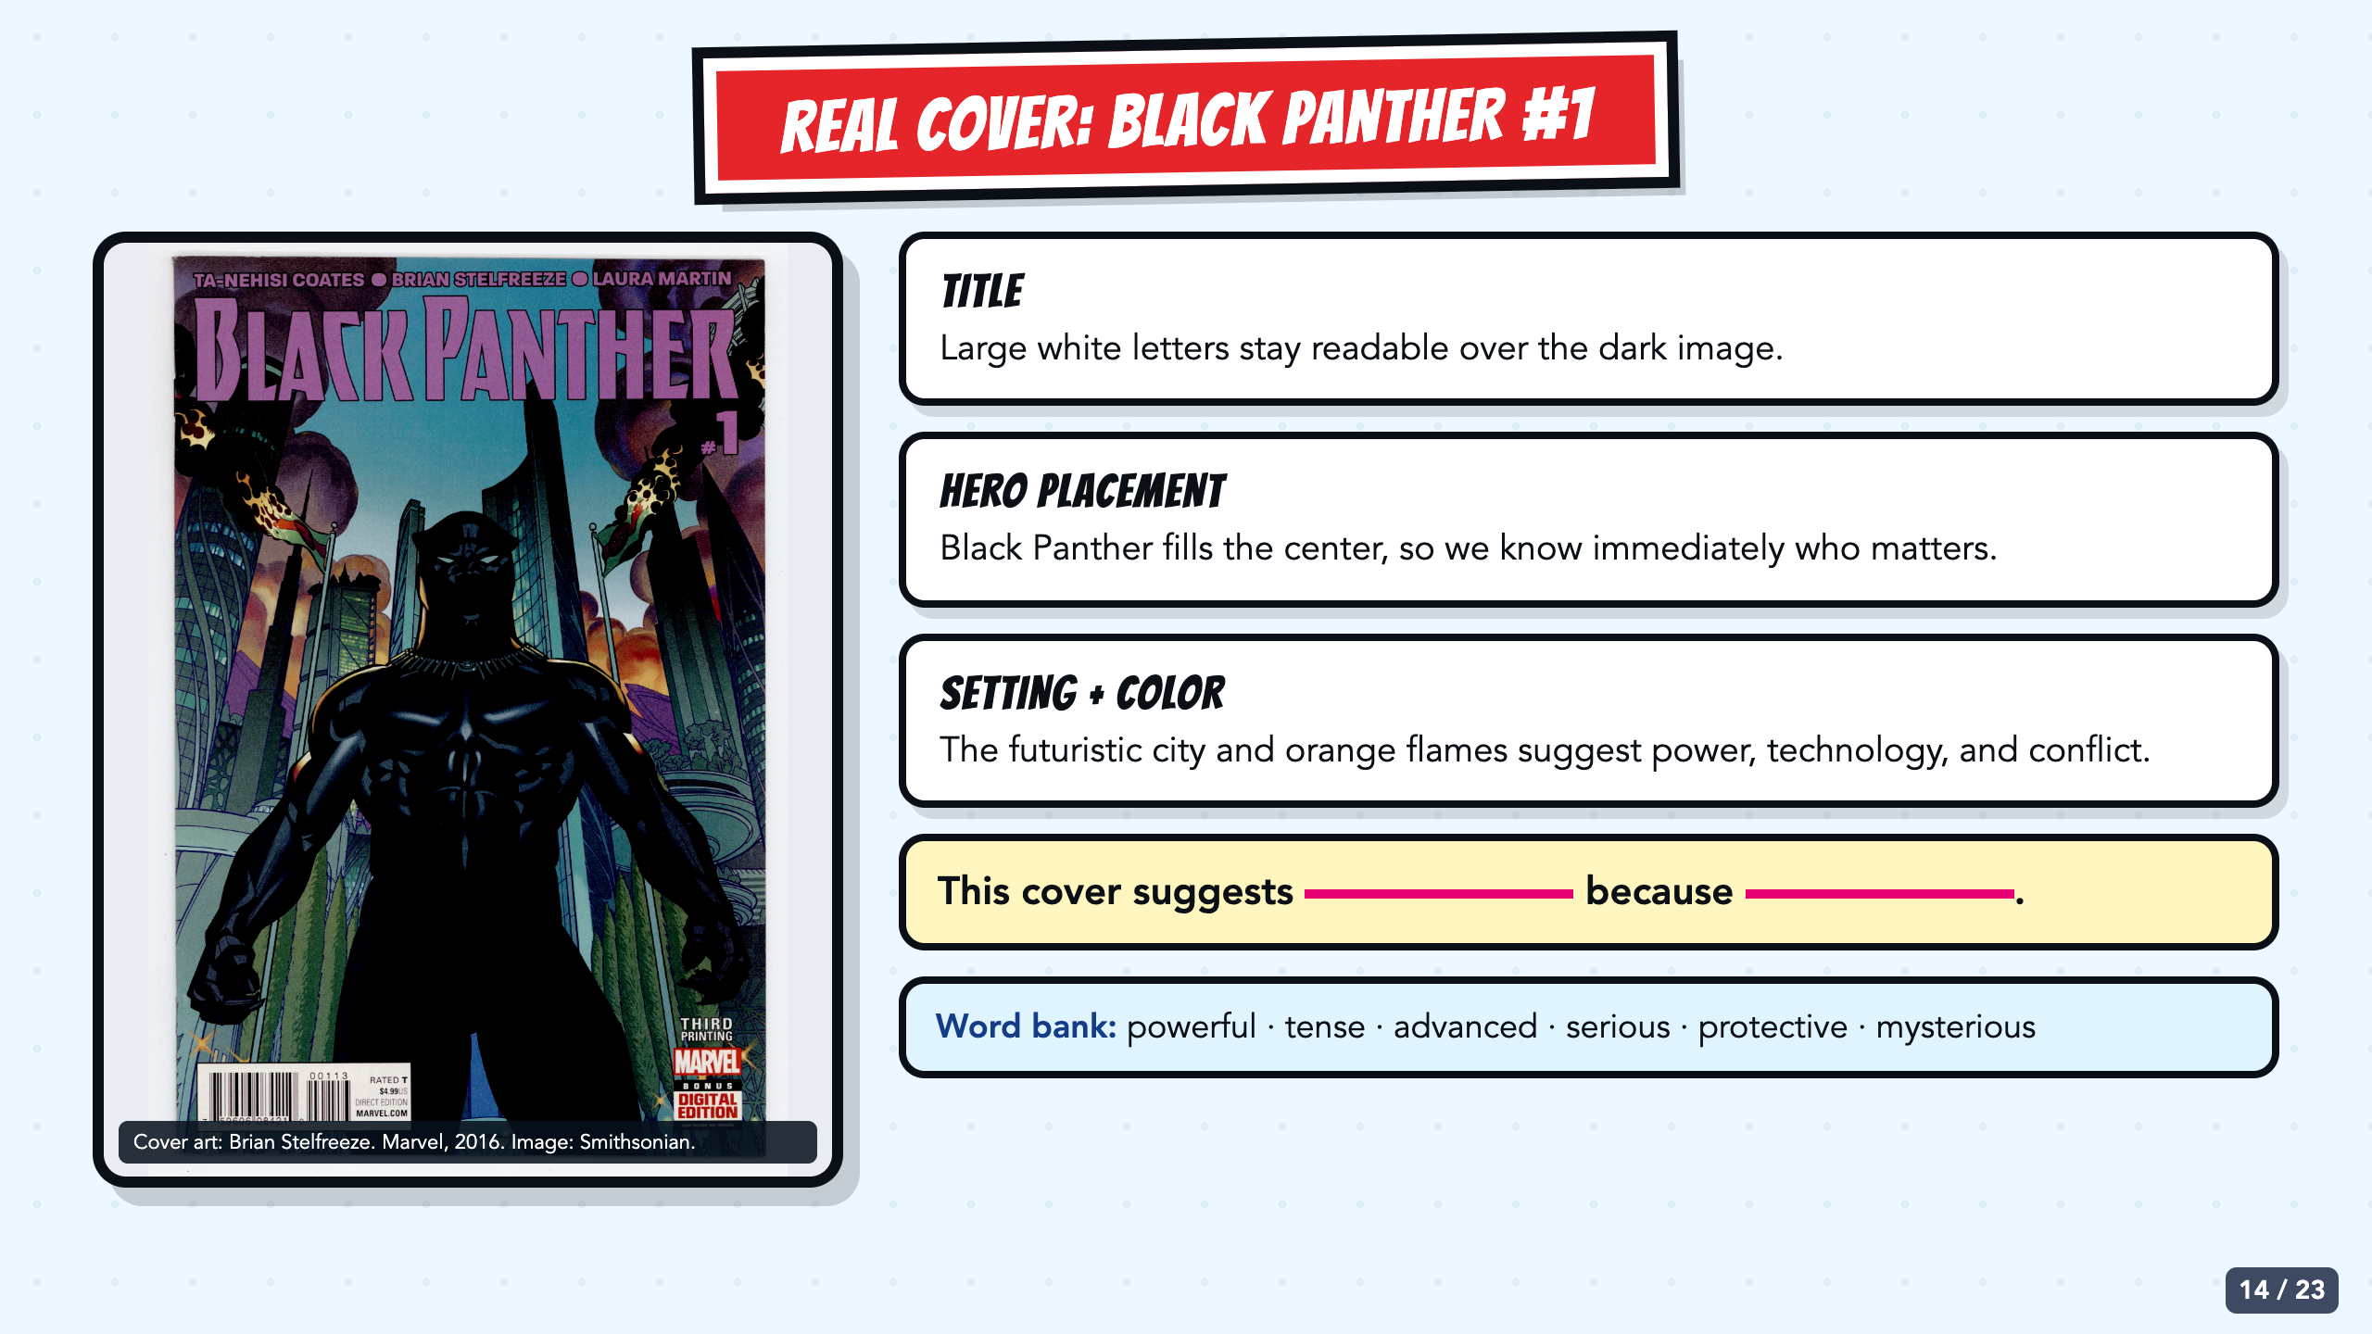
Notes:
Ask students to point to evidence before naming a trait. The central hero, readable title, futuristic city, and orange flames are visible design choices. Use the sentence stem and word bank for oral or written responses.
[Sources]
- Black Panther (2016) #1 cover by Brian Stelfreeze. Marvel issue page: https://www.marvel.com/comics/issue/57382/black-panther-2016-1 ; high-resolution object image from the National Museum of American History, Smithsonian Institution: https://www.si.edu/object/black-panther-1%3Anmah_1889259

Slide 15
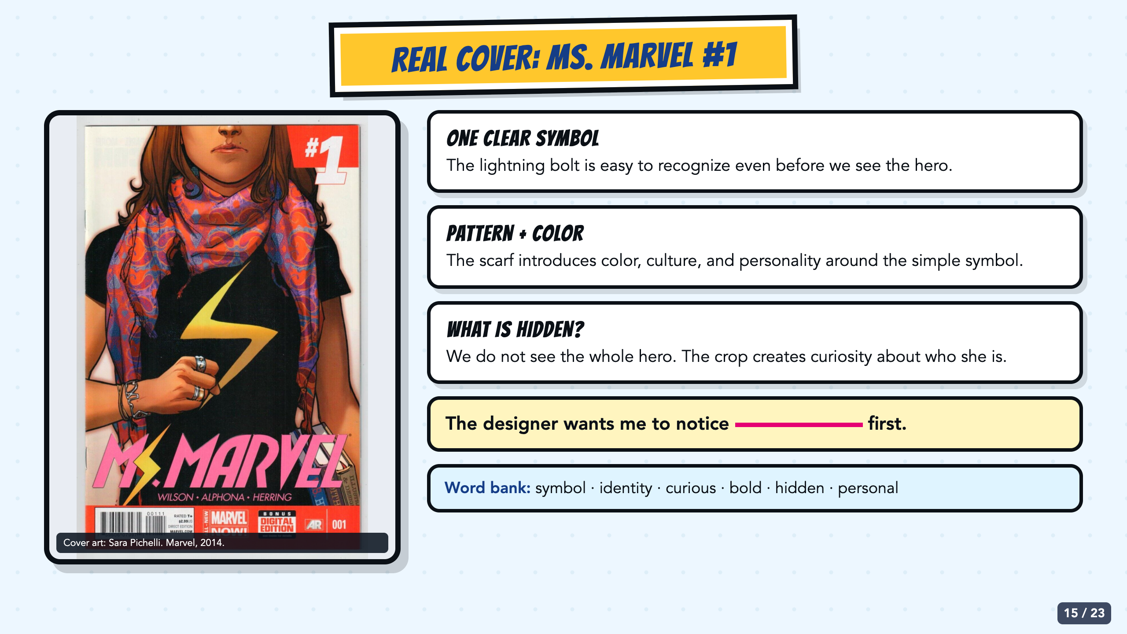
Notes:
Ask what is deliberately hidden. The close crop, lightning-bolt symbol, scarf pattern, and color contrast create identity and curiosity without showing a full action scene.
[Sources]
- Ms. Marvel (2014) #1 cover by Sara Pichelli. Marvel issue page: https://www.marvel.com/comics/issue/49089/ms-marvel-2014-1 ; classroom analysis image retrieved from: https://www.ebay.com/itm/204261392148

Slide 16
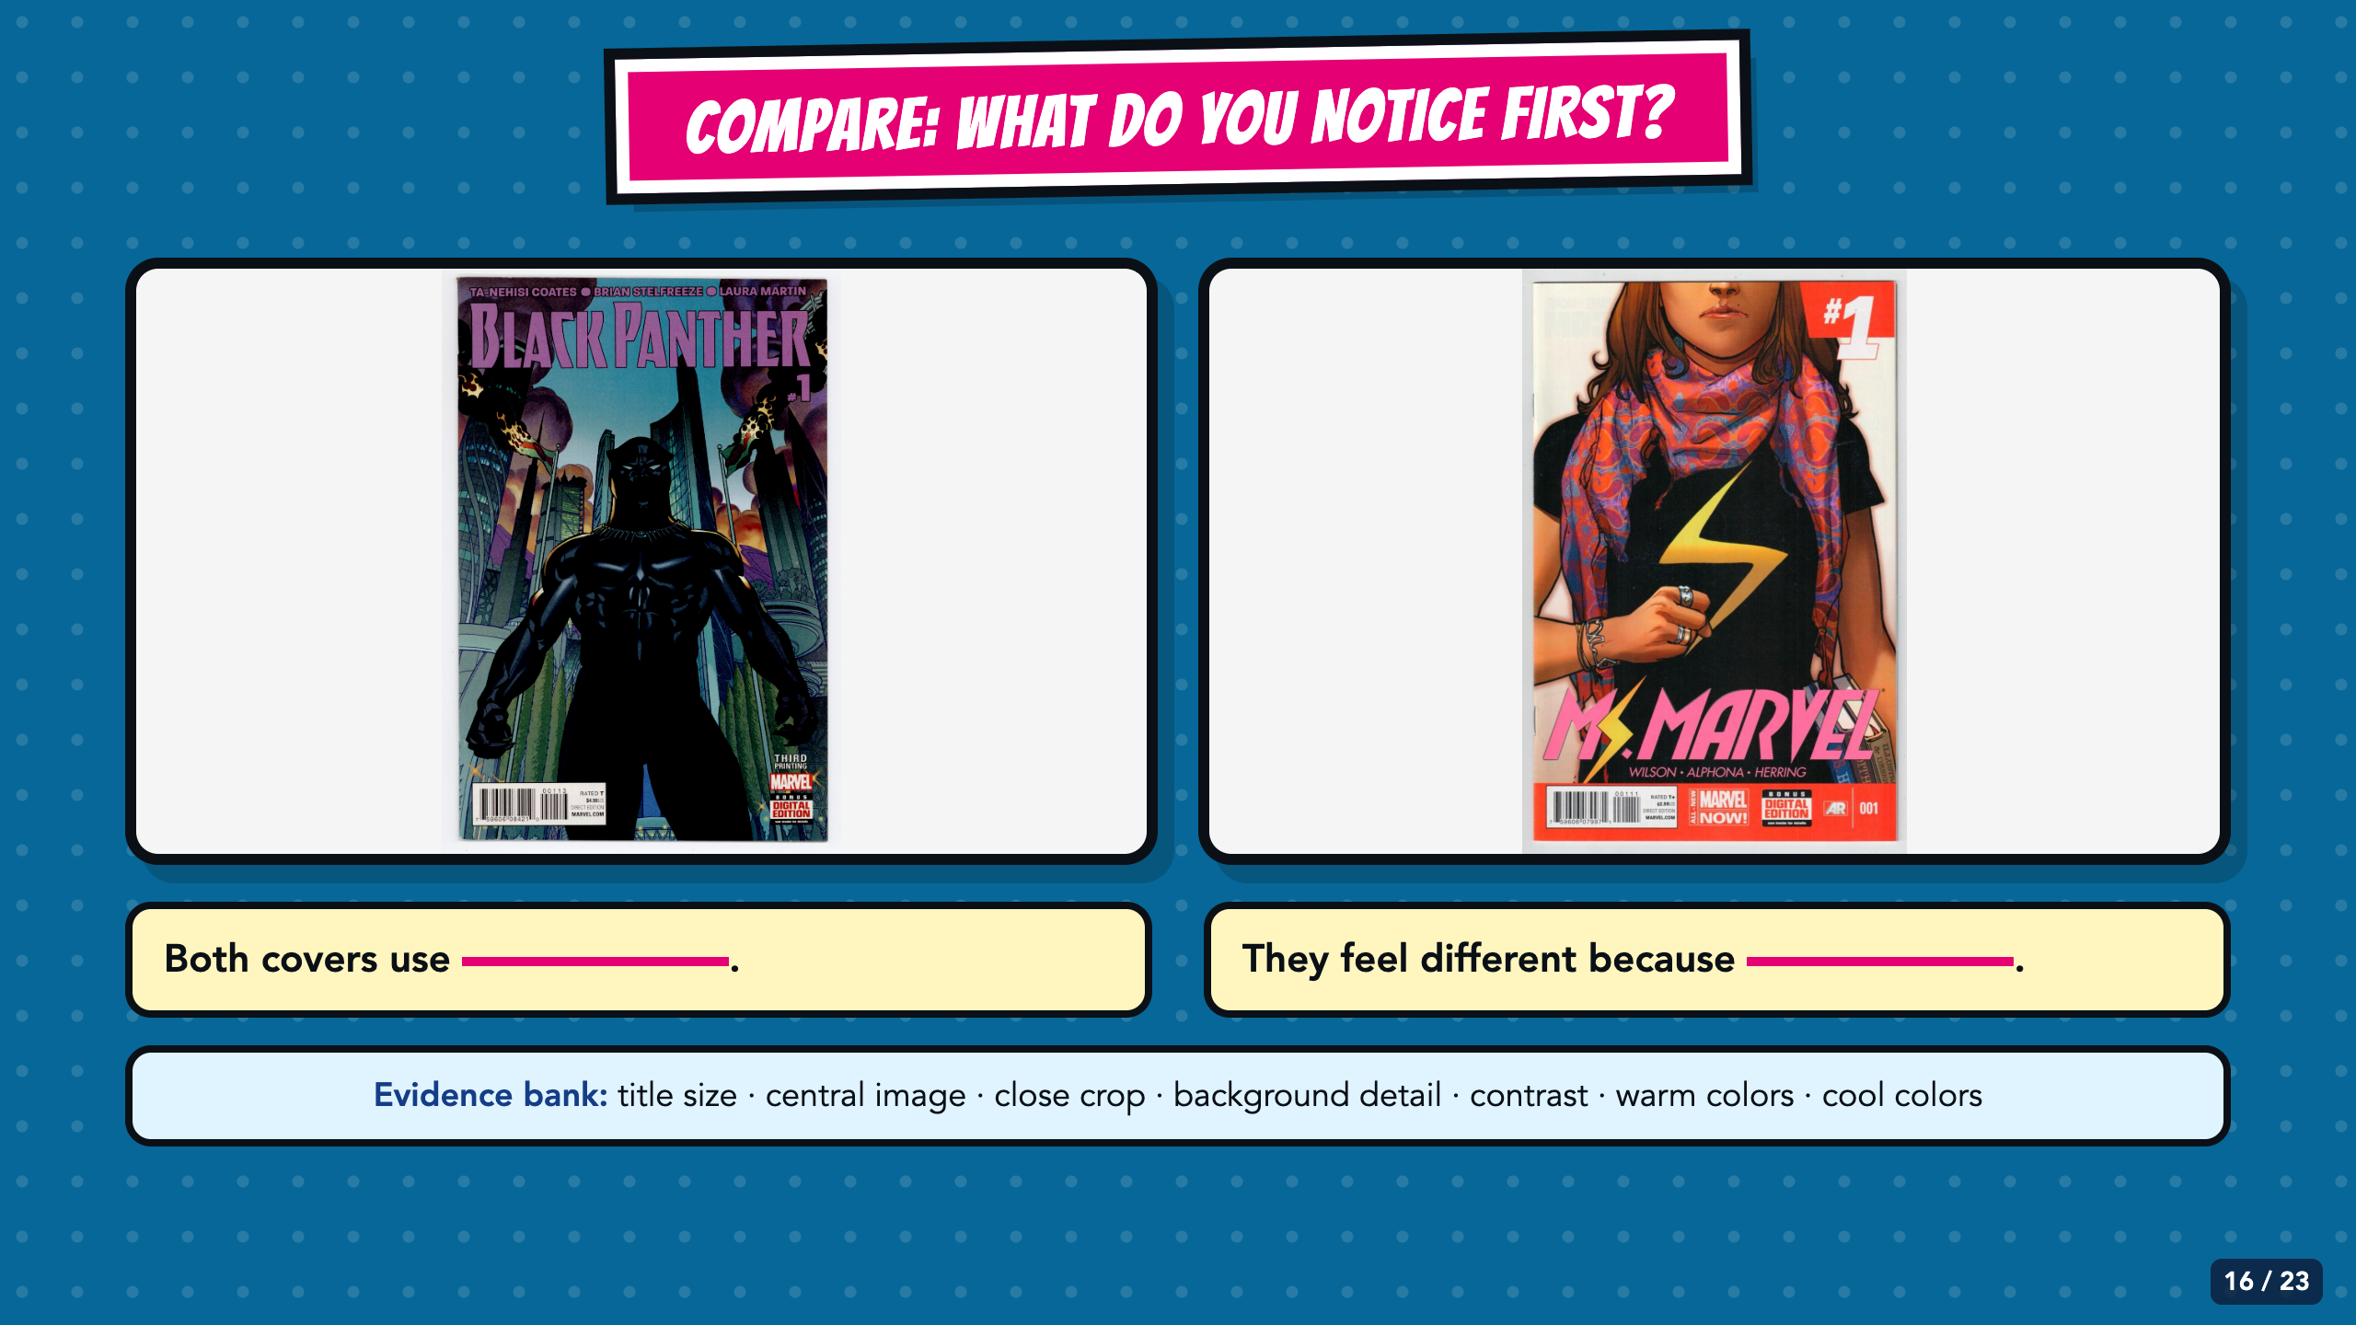
Notes:
Partners compare one similarity and one difference. Require evidence such as title size, crop, background detail, or contrast. Do not accept only 'I like this one better.'
[Sources]
- Black Panther (2016) #1 cover by Brian Stelfreeze. Marvel issue page: https://www.marvel.com/comics/issue/57382/black-panther-2016-1 ; high-resolution object image from the National Museum of American History, Smithsonian Institution: https://www.si.edu/object/black-panther-1%3Anmah_1889259
- Ms. Marvel (2014) #1 cover by Sara Pichelli. Marvel issue page: https://www.marvel.com/comics/issue/49089/ms-marvel-2014-1 ; classroom analysis image retrieved from: https://www.ebay.com/itm/204261392148

Slide 17
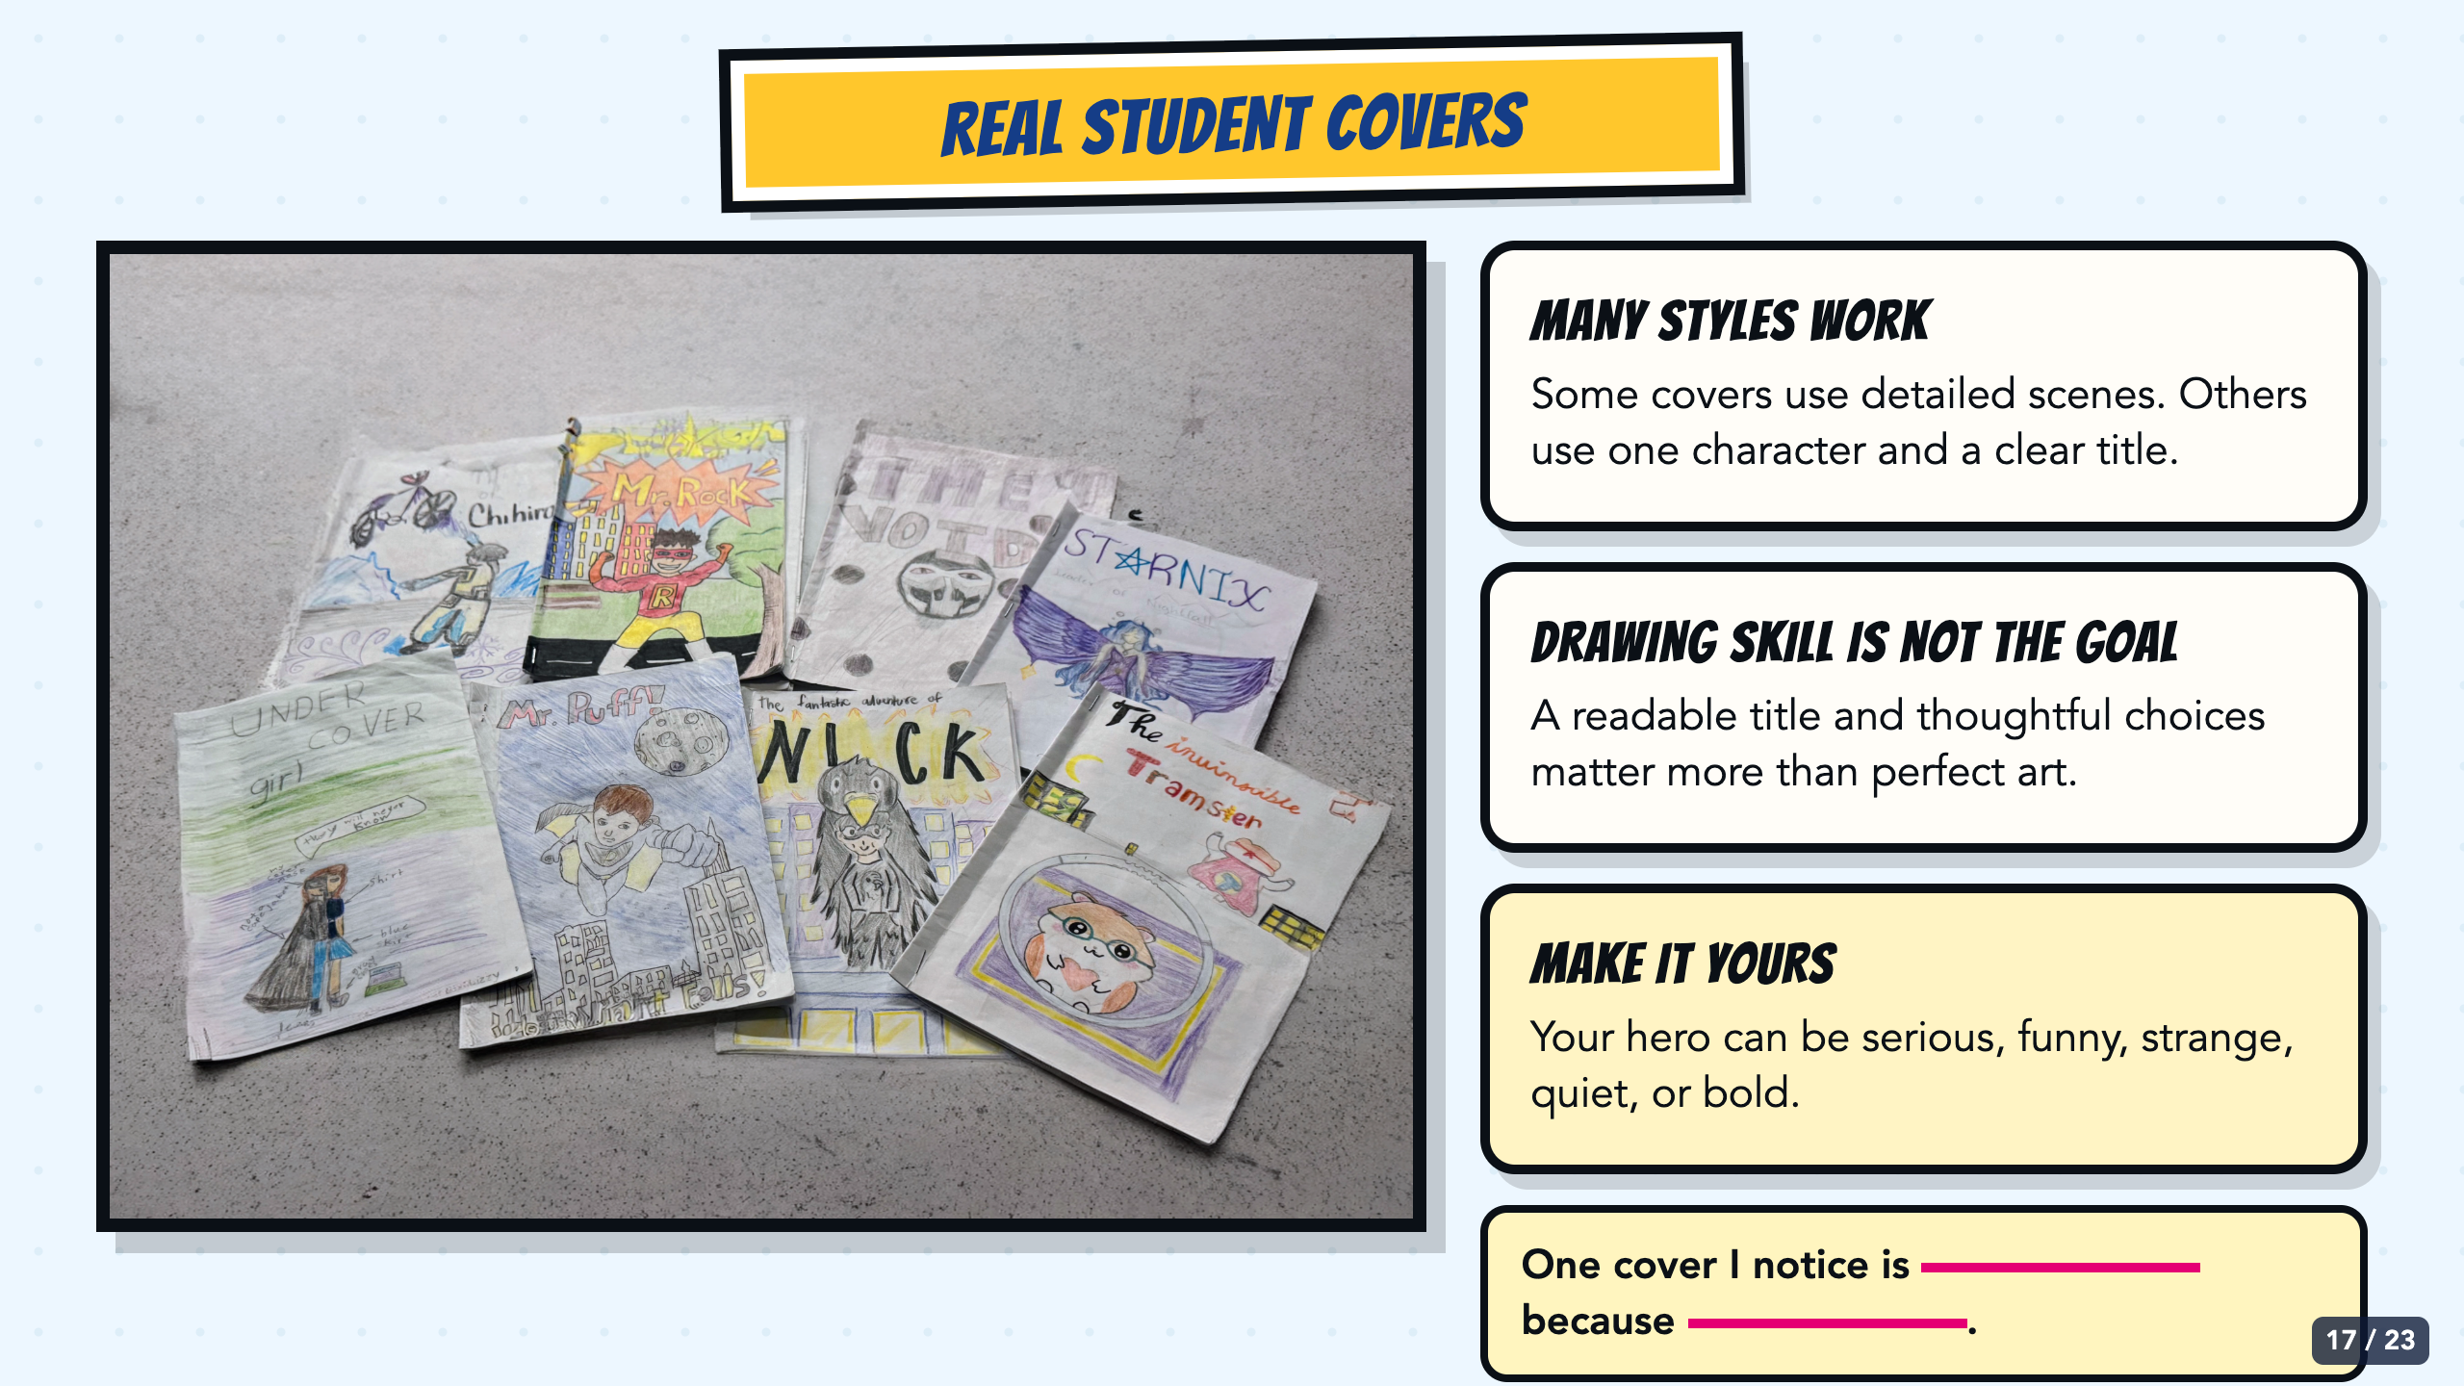
Notes:
Use the authentic student examples to lower perfection pressure without lowering the communication target. Point out that the covers use many drawing styles while still naming a hero and giving readers a visual clue.
[Sources]
- Owner-provided authentic student cover exemplar: /Users/elishalucero/Downloads/Cover_Exemplar.jpg

Slide 18
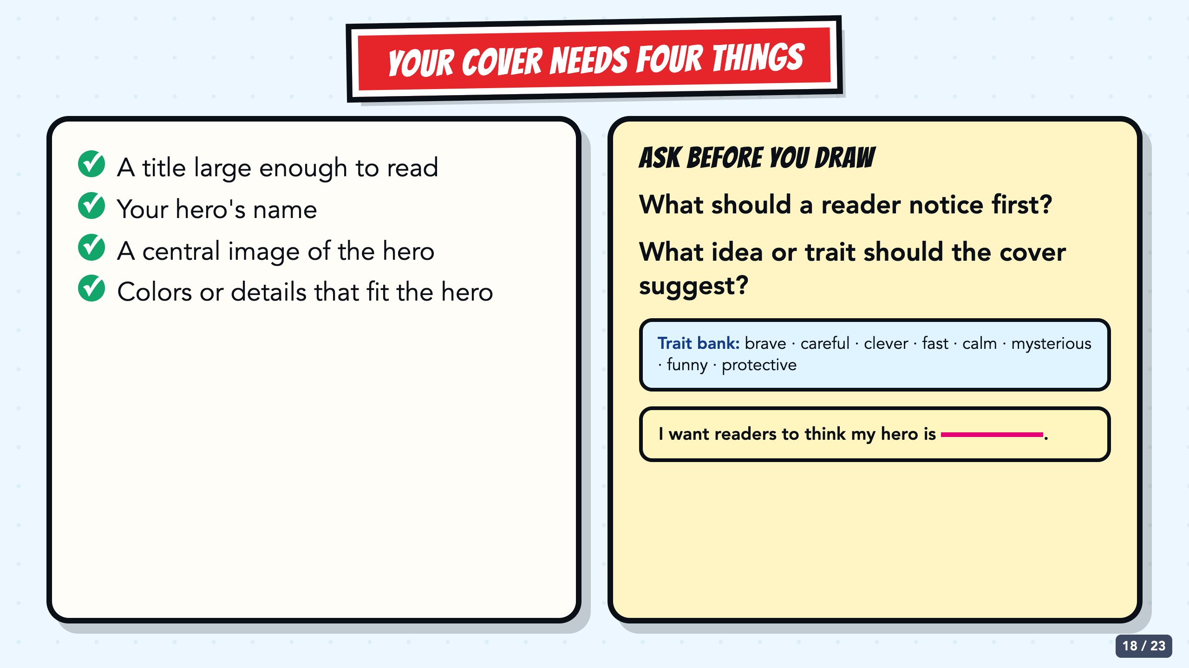
Notes:
Read the four requirements before students sketch. Replace vague questions about 'expectations' with a concrete prompt: What idea or trait should the cover suggest, and what should the reader notice first?
[Sources]
- Owner-approved staged Comics Lesson 1 bodies: tmp/comic_scaffold_agent/lesson_1_cover.html and teacher_guide_lesson_1.html
- Owner-provided authentic student cover exemplar: /Users/elishalucero/Downloads/Cover_Exemplar.jpg

Slide 19
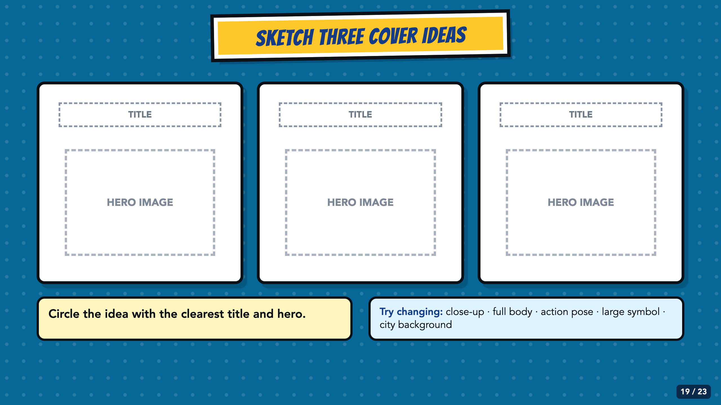
Notes:
Require three quick thumbnails before the final drawing. These are planning sketches, not polished art. Students can change the crop, pose, title placement, symbol size, or background.
[Sources]
- Owner-approved staged Comics Lesson 1 bodies: tmp/comic_scaffold_agent/lesson_1_cover.html and teacher_guide_lesson_1.html

Slide 20
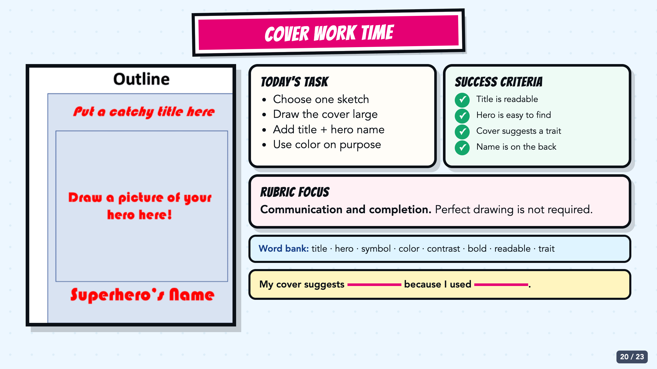
Notes:
Leave this slide projected during independent or partner work. The cover outline shows where the title, hero image, and hero name belong; the task, success criteria, rubric focus, word bank, and sentence stem remain visible without prescribing time, voice level, or body position.
[Sources]
- Cover layout reference from Smart Solutions Comics, Canvas course 22742 file 2700762; owner-provided crop: CleanShot 2026-08-09 at 21.39.47@2x.png.
- Owner-approved staged Comics Lesson 1 bodies: tmp/comic_scaffold_agent/lesson_1_cover.html and teacher_guide_lesson_1.html

Slide 21
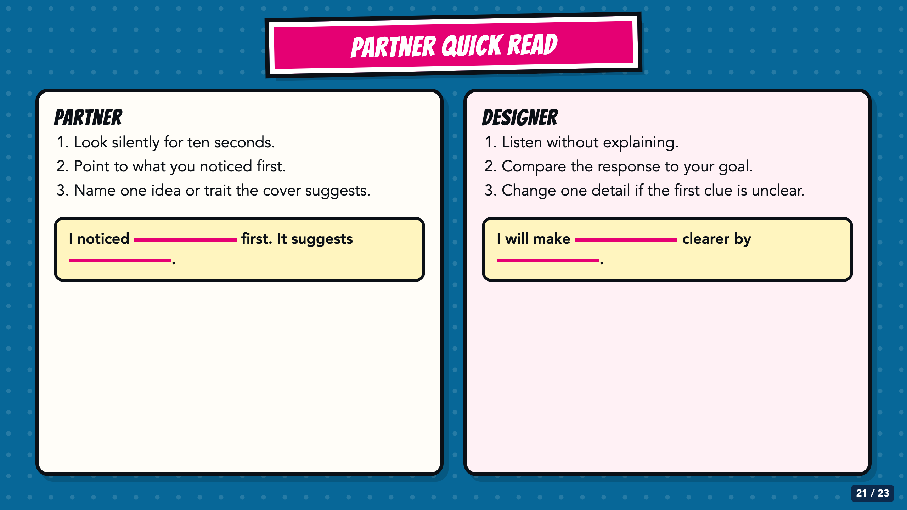
Notes:
The partner gets ten silent seconds before speaking. The designer listens before explaining. A mismatch between the partner's first impression and the designer's goal creates a specific revision opportunity.
[Sources]
- Owner-approved staged Comics Lesson 1 bodies: tmp/comic_scaffold_agent/lesson_1_cover.html and teacher_guide_lesson_1.html

Slide 22
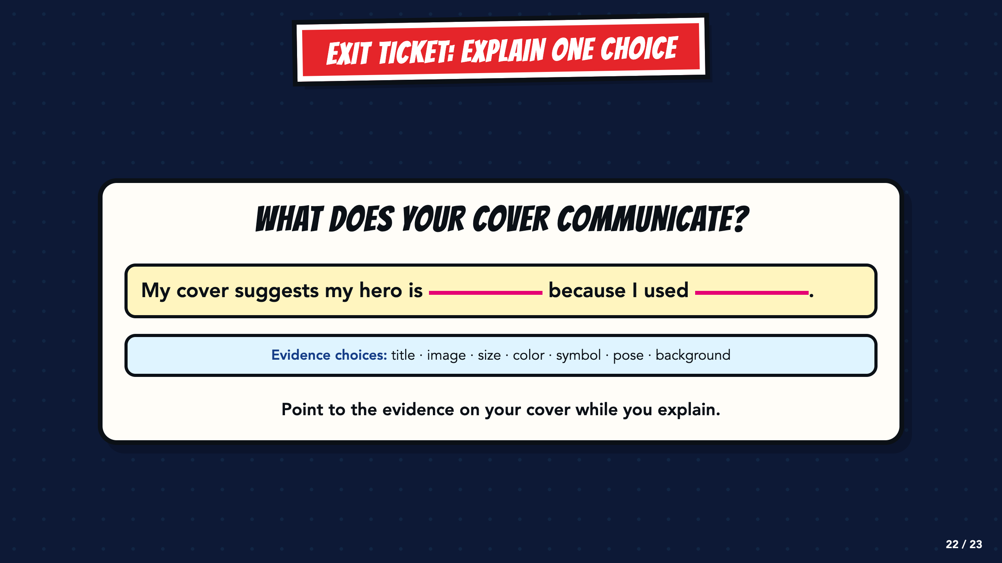
Notes:
Use the sentence as a written, oral, or point-and-explain exit ticket. Look for one trait or idea and one visible design choice that supports it.
[Sources]
- Owner-approved staged Comics Lesson 1 bodies: tmp/comic_scaffold_agent/lesson_1_cover.html and teacher_guide_lesson_1.html

Slide 23
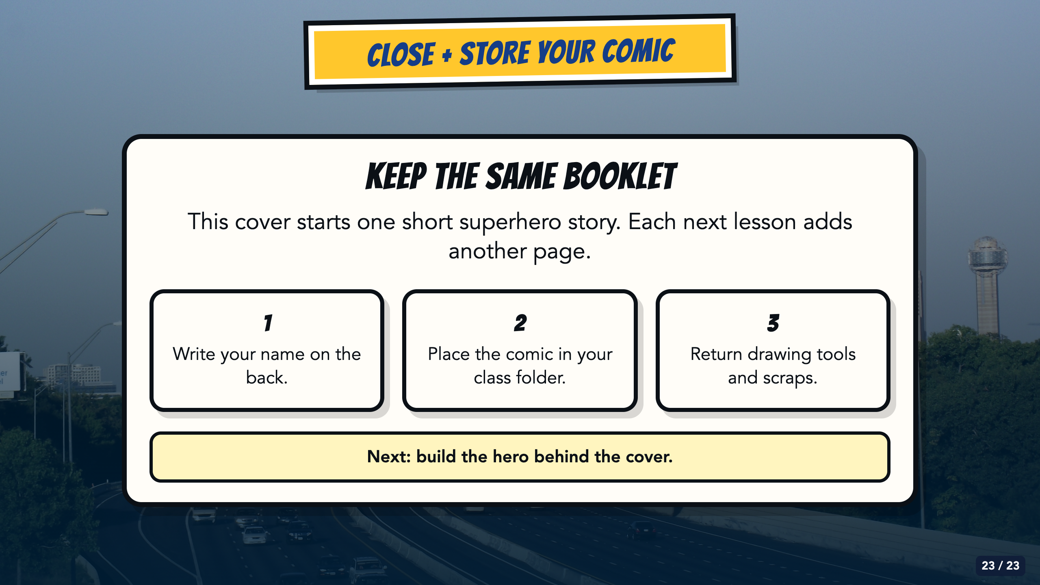
Notes:
Store the same booklet for all five Comics lessons. The next lesson develops the character behind the cover. Do not use this closing to advertise later course units or promise a semester-long superhero theme.
[Sources]
- Owner-created Smart Solutions Lesson 1 source decks: From Google Drive 2026/Units/SS U0 (Superhero)/My Slides/SmartSolutions SuperHero L1 Final.pdf and /Users/elishalucero/Downloads/smart_solutions_superhero_enhanced_20250817181901.pdf
- Owner-approved staged Comics Lesson 1 bodies: tmp/comic_scaffold_agent/lesson_1_cover.html and teacher_guide_lesson_1.html
- Dallas skyline photograph by medea_material, CC BY 2.0; cropped and color-treated: https://commons.wikimedia.org/wiki/File:Skyline_of_Dallas,_TX.jpg

