Slide 1
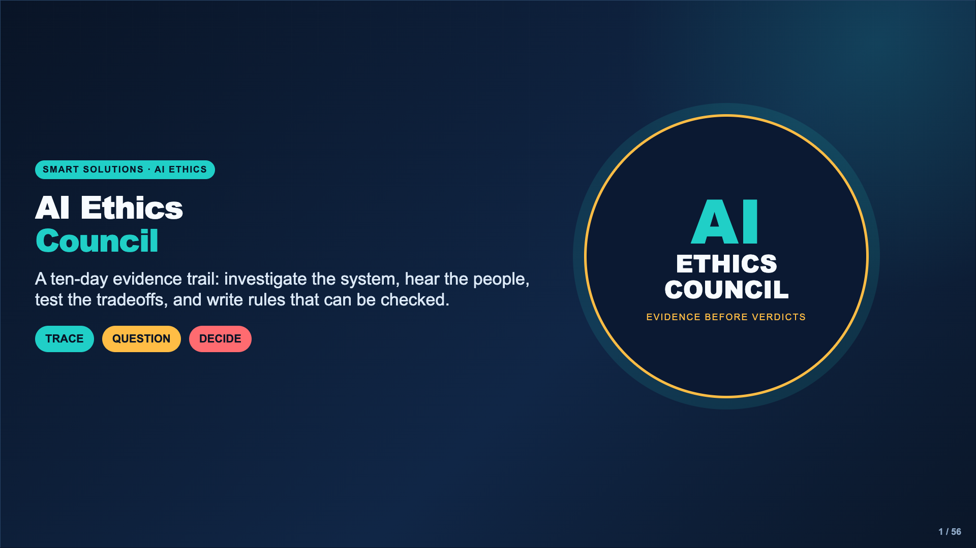
Notes:
Welcome students as members of an ethics council, not passive consumers of AI news. Their job is to trace one decision through people, incentives, evidence, and consequences before proposing a rule.
[Sources]
- AI Ethics Council Casebook and teacher facilitation sequence.

Slide 2
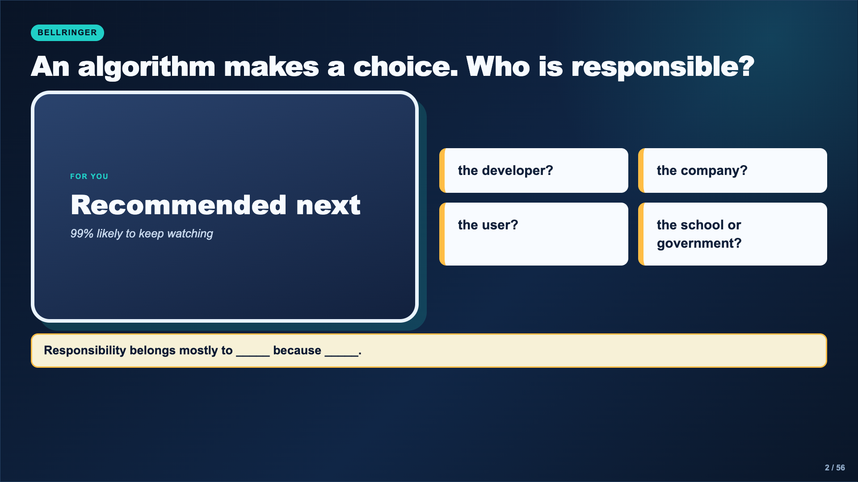
Notes:
Give students one quiet minute, then take a fast four-corner vote. Do not settle the question. Record which kinds of responsibility students already name so the class can revisit them on Day 10.
[Sources]
- https://www.media.mit.edu/projects/ai-ethics-for-middle-school/overview/
- https://studio.code.org/s/aiml-2022/lessons/14

Slide 3
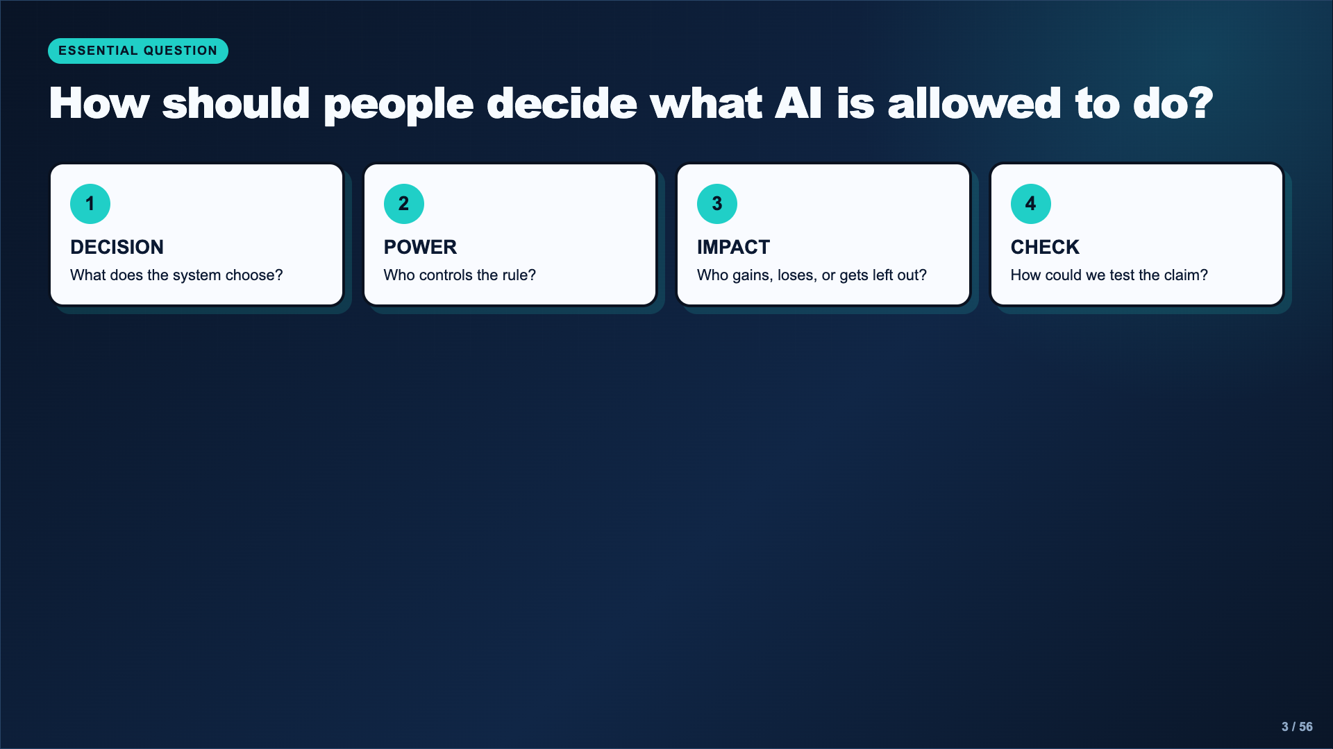
Notes:
Read the essential question aloud. Explain that the class will not decide whether AI is simply good or bad. Every day adds another piece of evidence to the same decision process.
[Sources]
- https://studio.code.org/s/aiml-2022/lessons/14
- https://www.media.mit.edu/projects/ai-ethics-for-middle-school/overview/

Slide 4
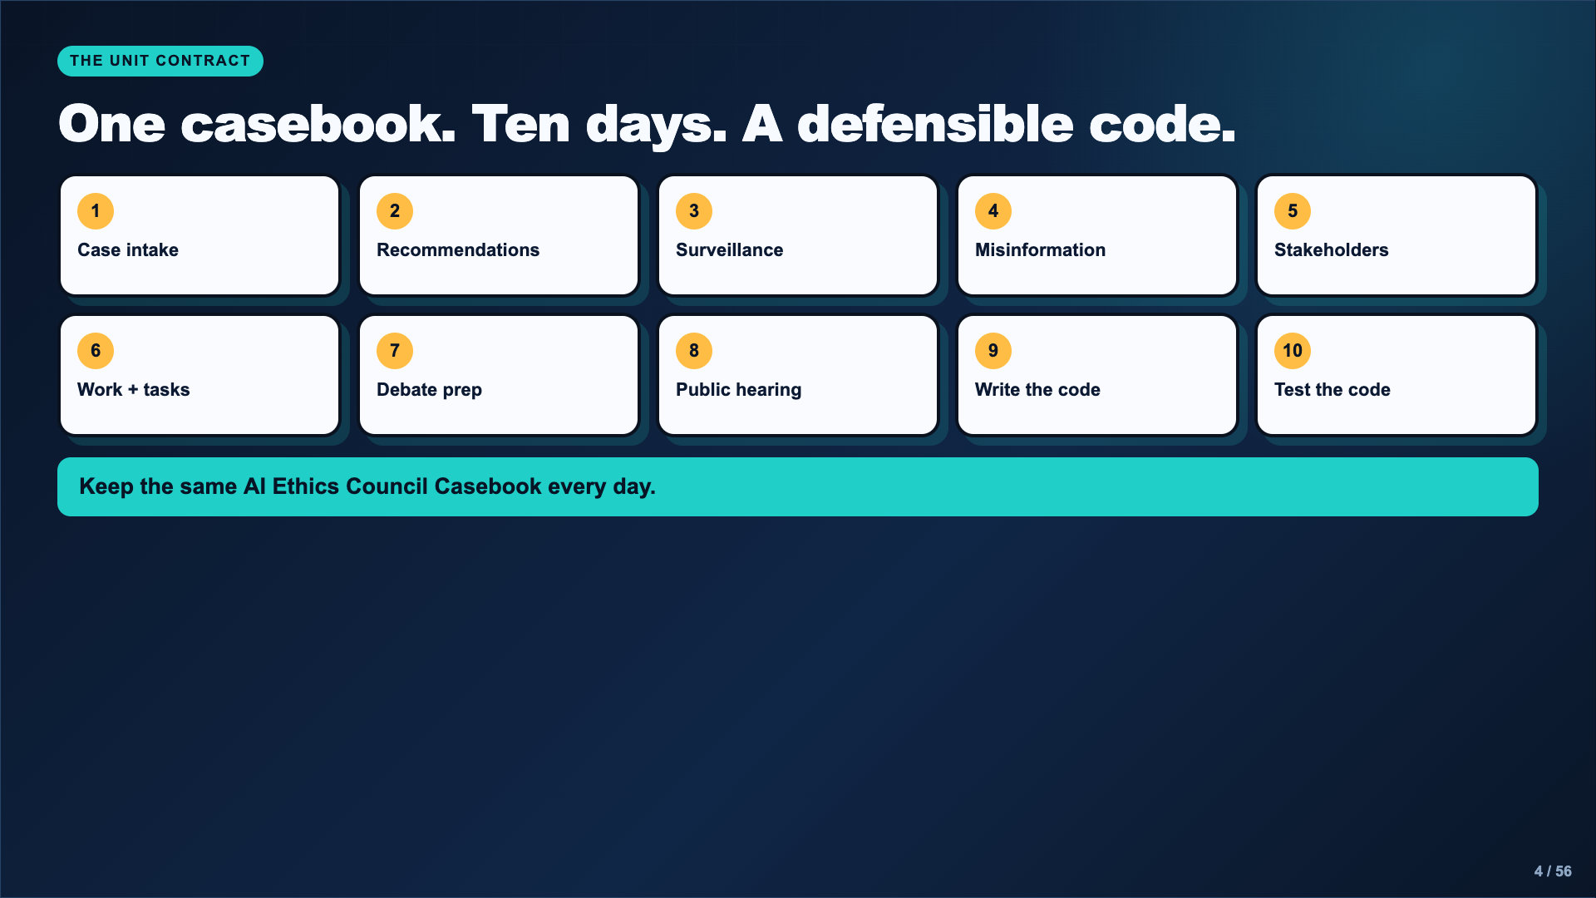
Notes:
Show students the cumulative casebook. Pages are completed in order, but the earlier pages remain available as evidence during the debate and code-writing days.
[Sources]
- AI Ethics Council Casebook and teacher facilitation sequence.

Slide 5
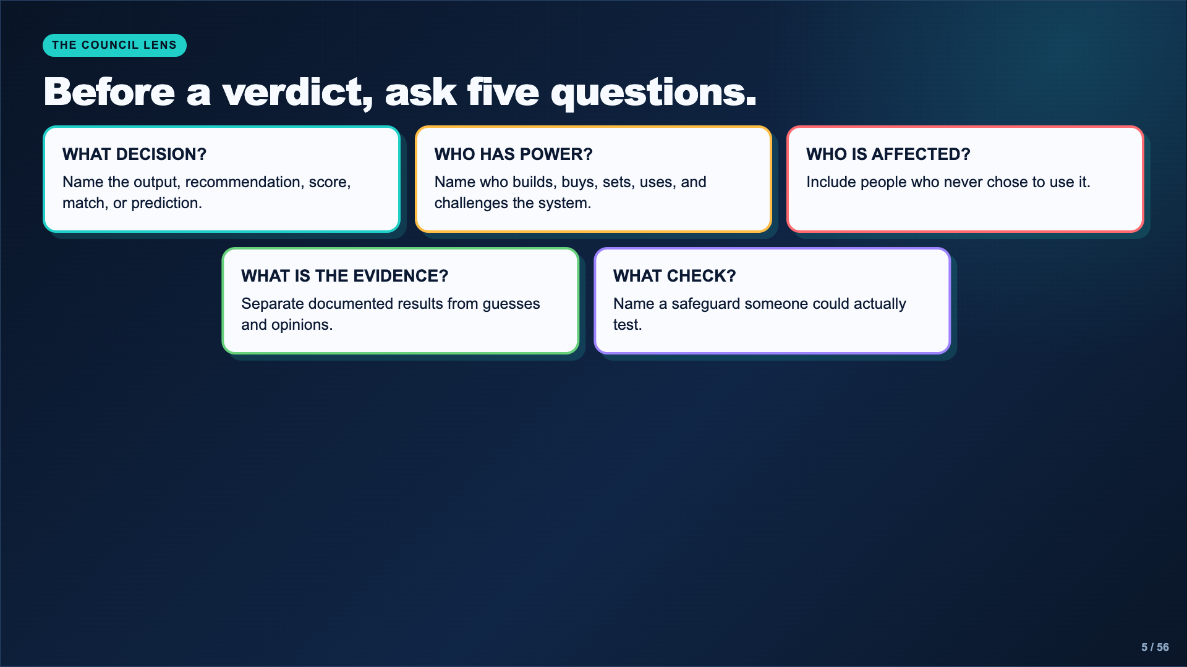
Notes:
Use these questions repeatedly. Students do not need to memorize them today; the repetition across the deck and casebook does the teaching.
[Sources]
- AI Ethics Council Casebook and teacher facilitation sequence.

Slide 6
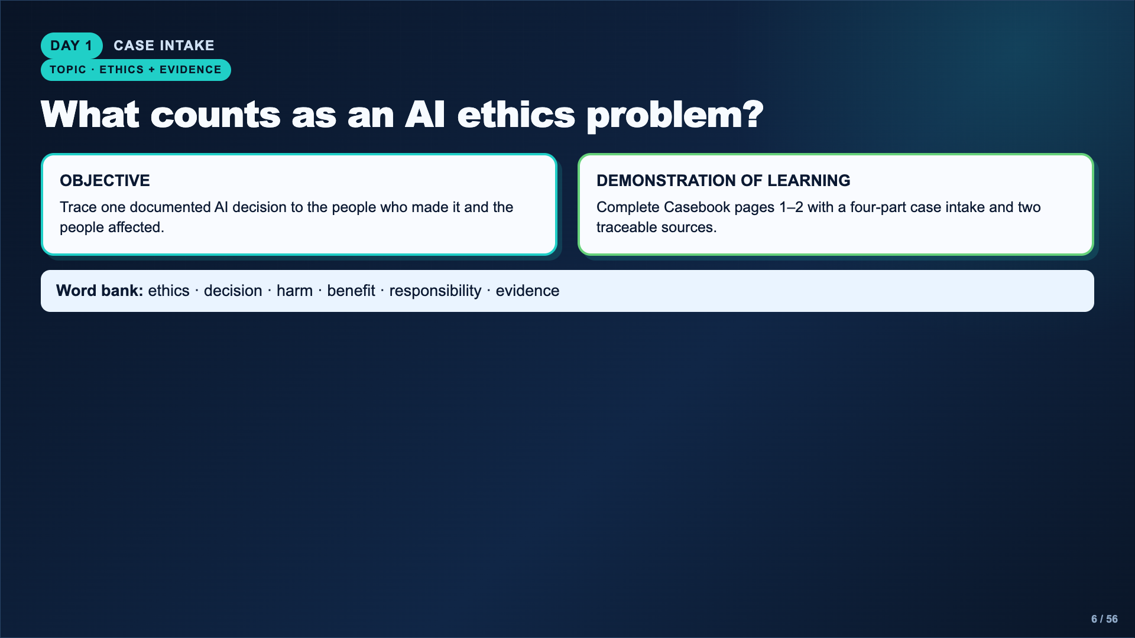
Notes:
State the objective and demonstration of learning. Students are not researching “AI” broadly. They need one system, one decision, and a documented effect.
[Sources]
- https://studio.code.org/s/aiml-2022/lessons/14
- https://www.media.mit.edu/projects/ai-ethics-for-middle-school/overview/

Slide 7
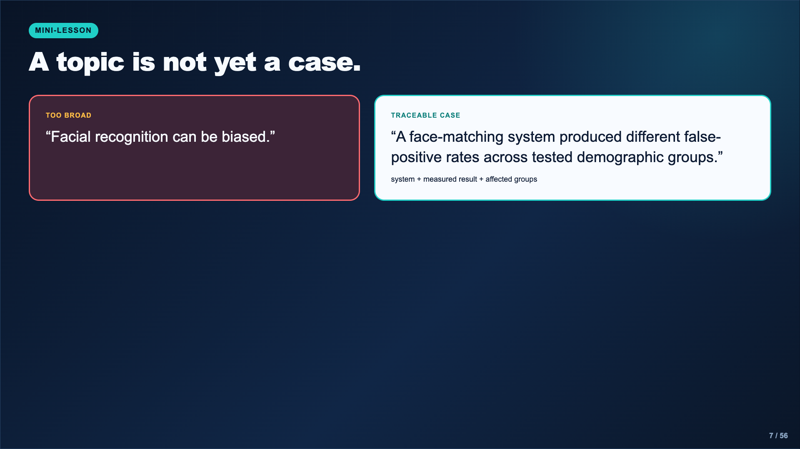
Notes:
Model the move from a broad concern to a traceable case. The case must identify a system and a documented decision or result. Do not claim that NIST identified the causes; its study measured performance differences and did not establish why they occurred.
[Sources]
- https://www.nist.gov/news-events/news/2019/12/nist-study-evaluates-effects-race-age-sex-face-recognition-software

Slide 8
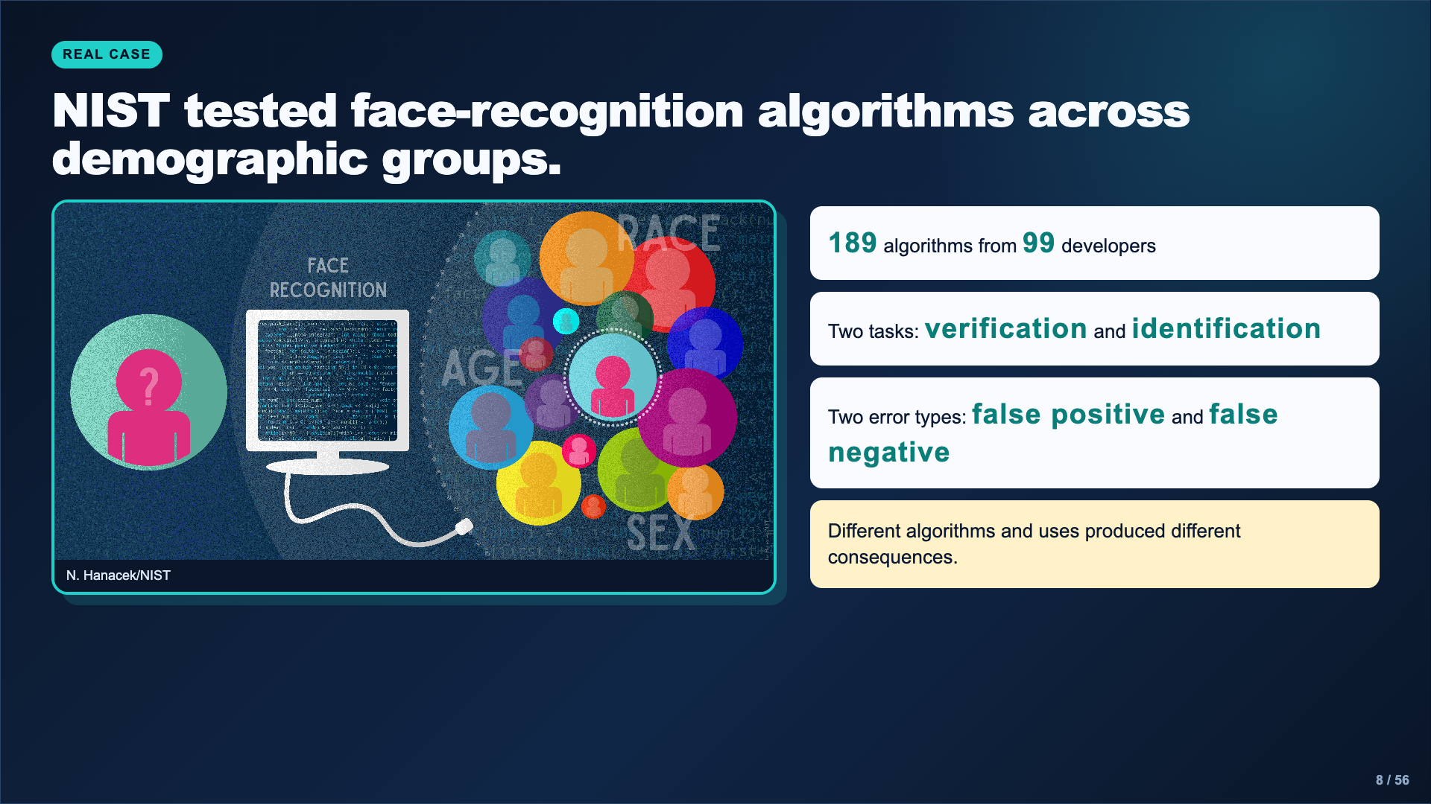
Notes:
Project the real NIST infographic and resist oversimplifying. The important lesson is that the task, error type, algorithm, and use matter. A false positive can have very different consequences in a phone unlock versus a one-to-many search.
[Sources]
- https://www.nist.gov/news-events/news/2019/12/nist-study-evaluates-effects-race-age-sex-face-recognition-software
- Image: N. Hanacek/NIST, https://www.nist.gov/image/face-recognition-search

Slide 9
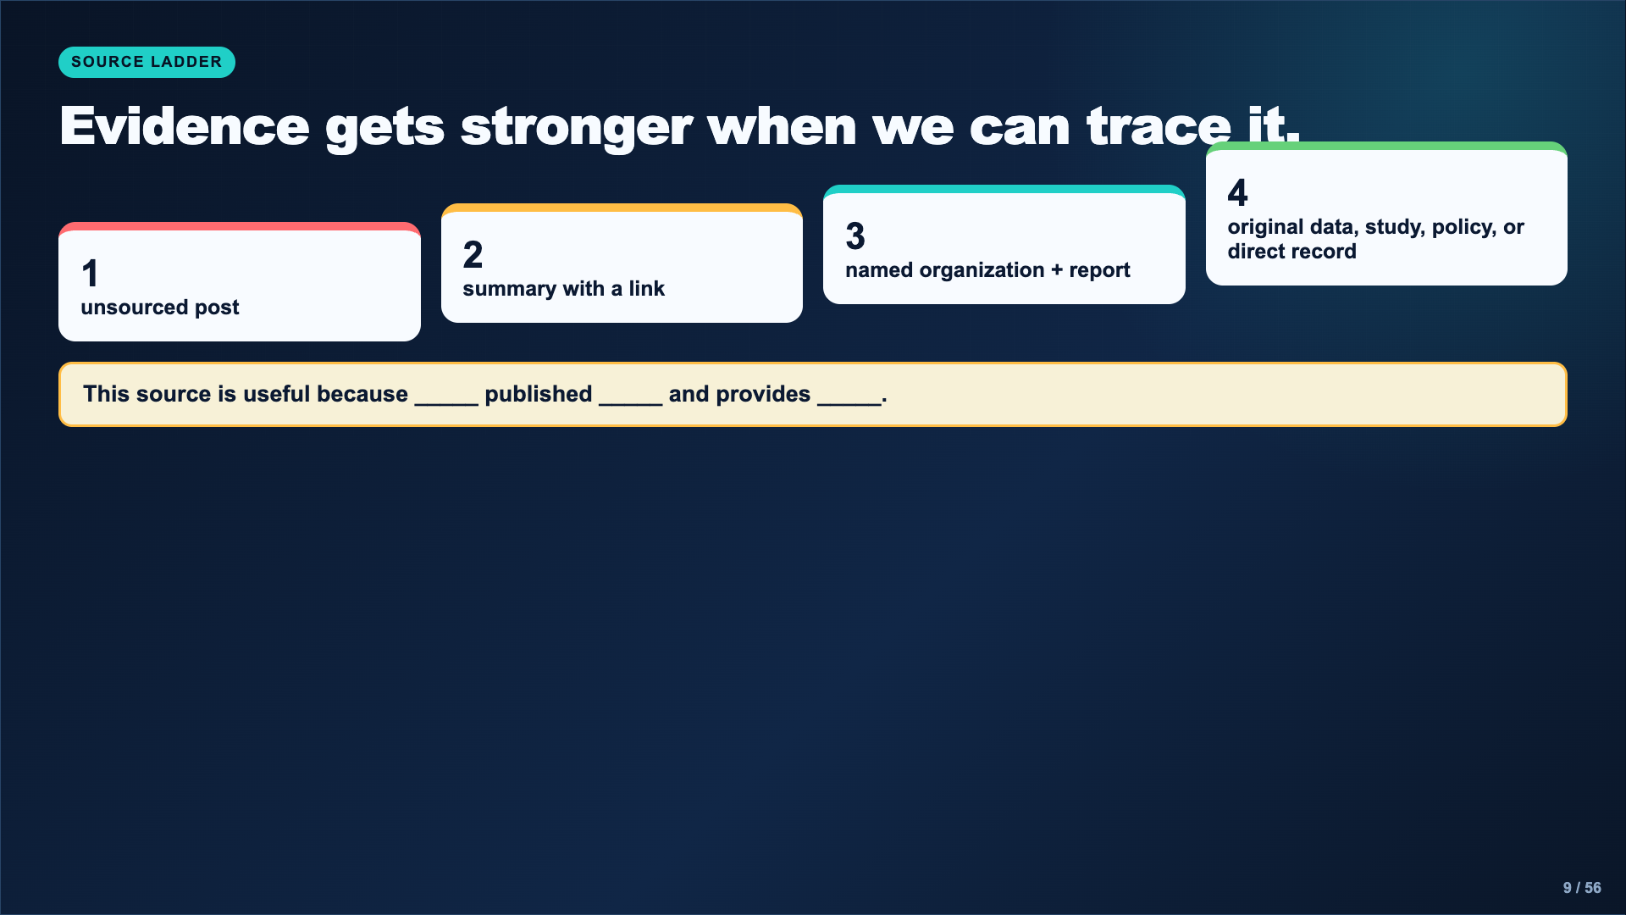
Notes:
Explain that students do not always begin at the strongest source. They may use a summary to locate the original report. The casebook requires the publisher, title, link, and one supported fact.
[Sources]
- AI Ethics Council Casebook and teacher facilitation sequence.

Slide 10
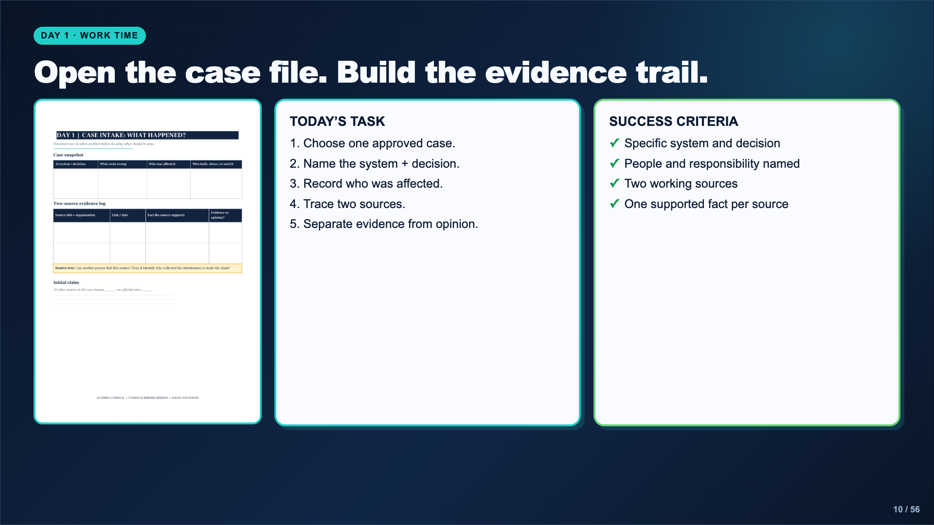
Notes:
Leave this slide projected. If research access is limited, provide two teacher-vetted source pairs and let students choose which case to trace. Check every source before students leave.
[Sources]
- AI Ethics Council Casebook and teacher facilitation sequence.

Slide 11
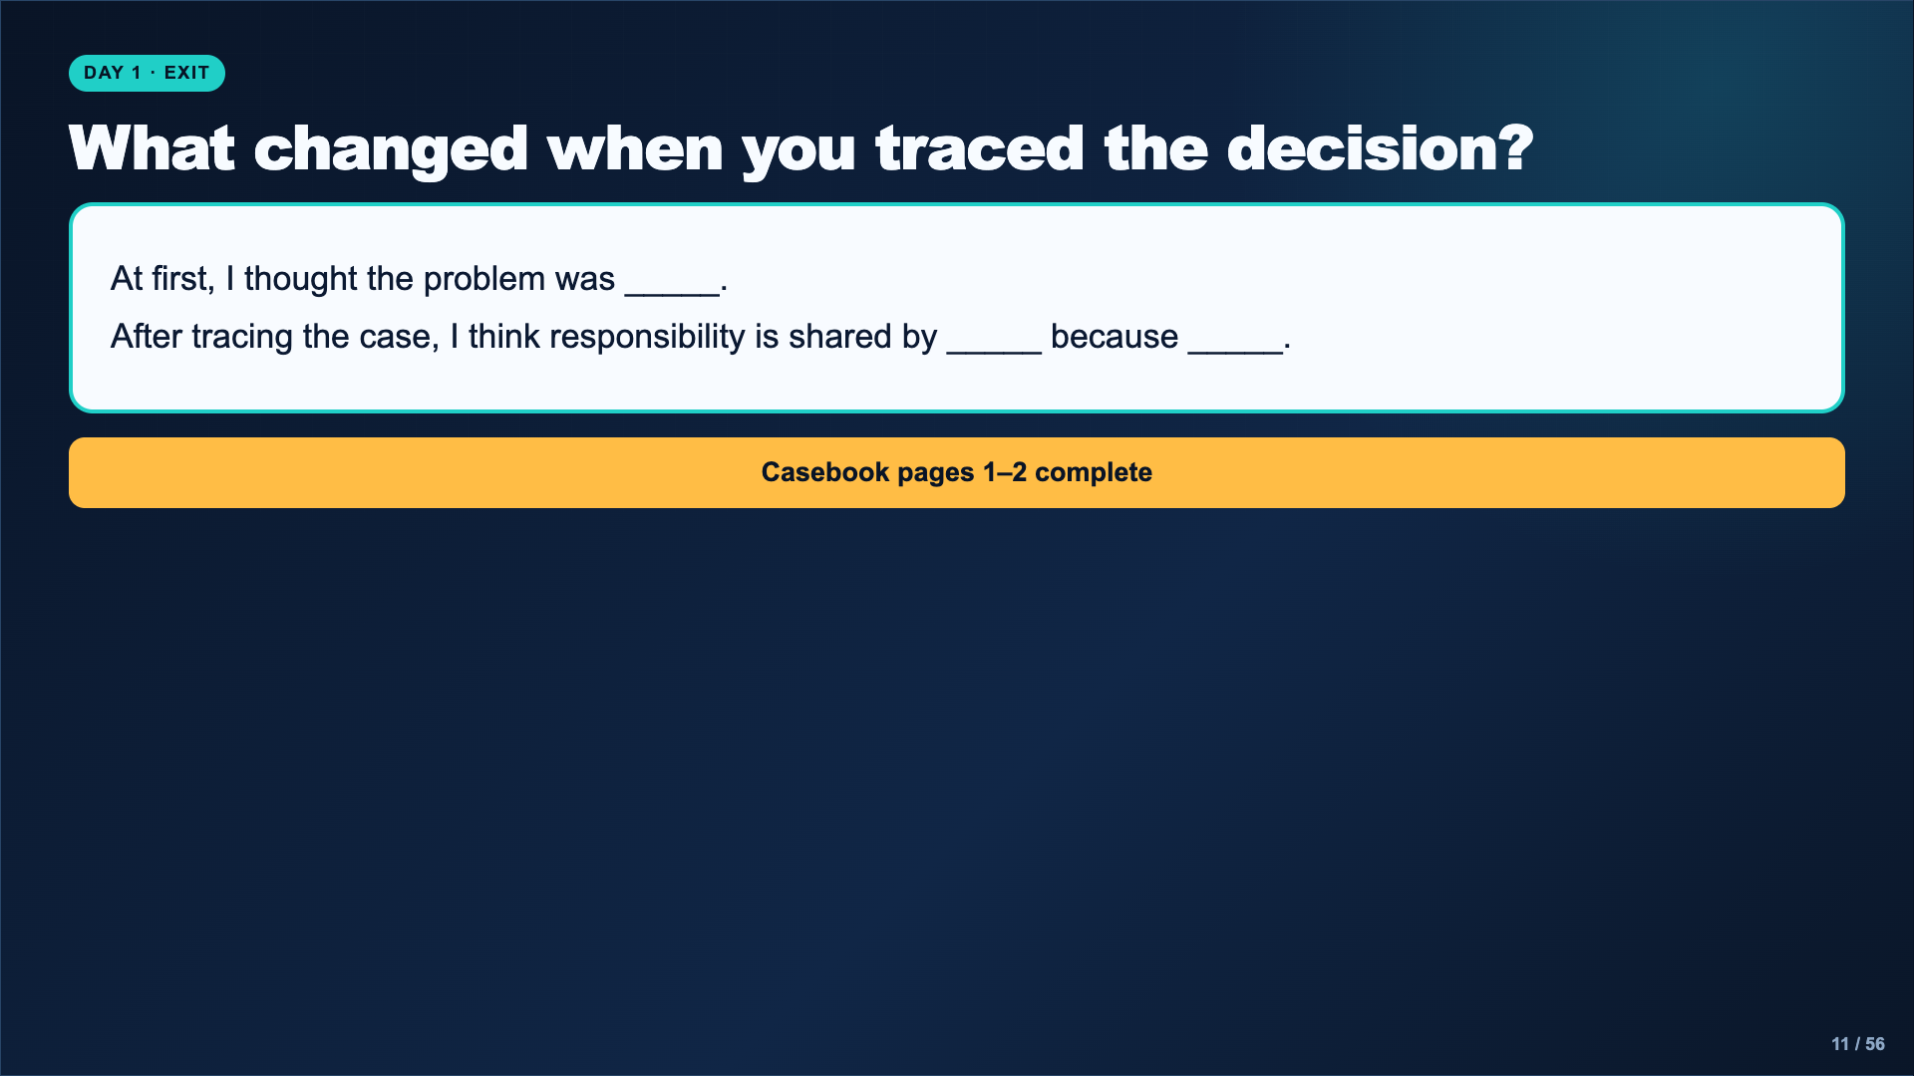
Notes:
Collect two or three answers that disagree. The point is not consensus; it is a clearer chain of responsibility supported by evidence.
[Sources]
- AI Ethics Council Casebook and teacher facilitation sequence.

Slide 12
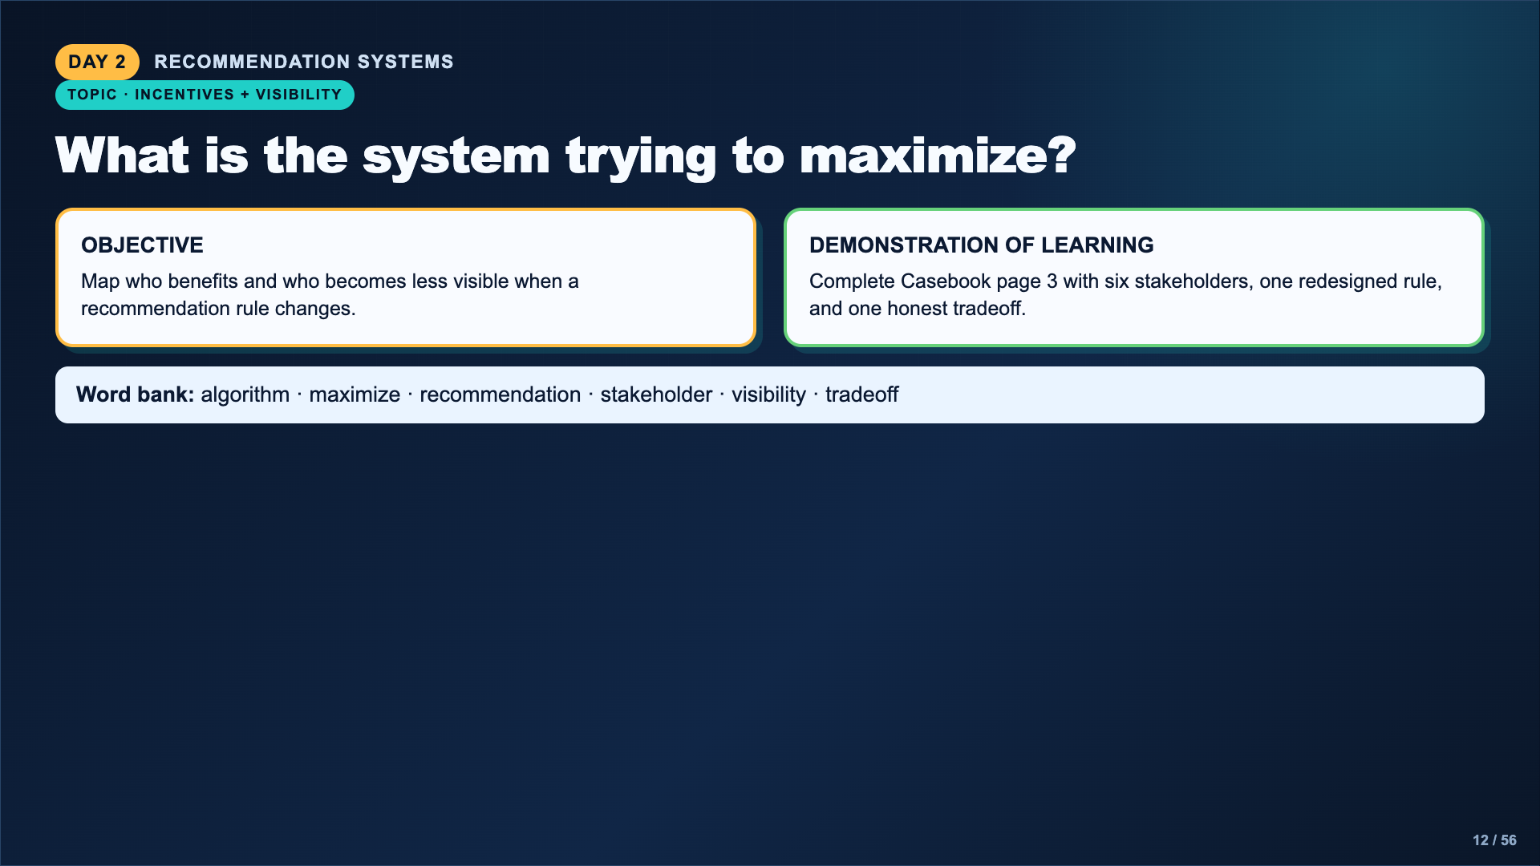
Notes:
Frame recommendation systems as choices made under goals. The goal might be watch time, clicks, purchases, completion, or another measurable behavior.
[Sources]
- https://www.media.mit.edu/projects/ai-ethics-for-middle-school/overview/
- https://www.dayofai.net/curriculum

Slide 13
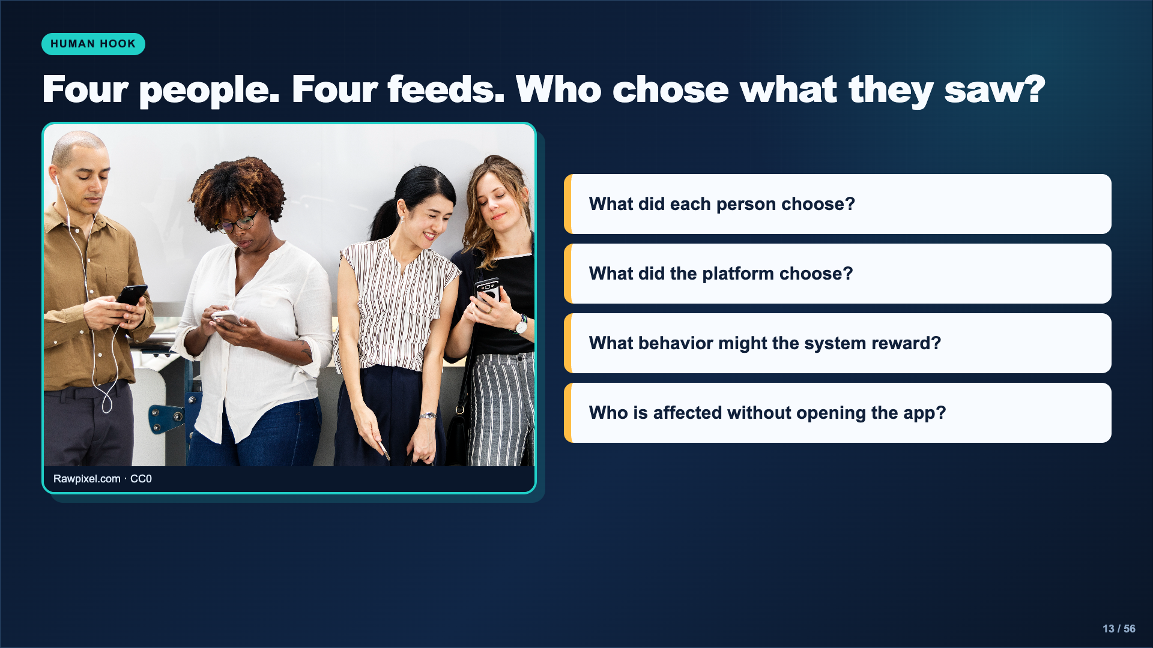
Notes:
Use the real smartphone photo to separate user choice from system choice. Ask students to name indirect stakeholders such as creators, families, communities, advertisers, or people represented in recommended content.
[Sources]
- Image: Rawpixel.com, CC0, https://commons.wikimedia.org/wiki/File:Digital_media_use.jpg
- https://www.media.mit.edu/projects/ai-ethics-for-middle-school/overview/

Slide 14
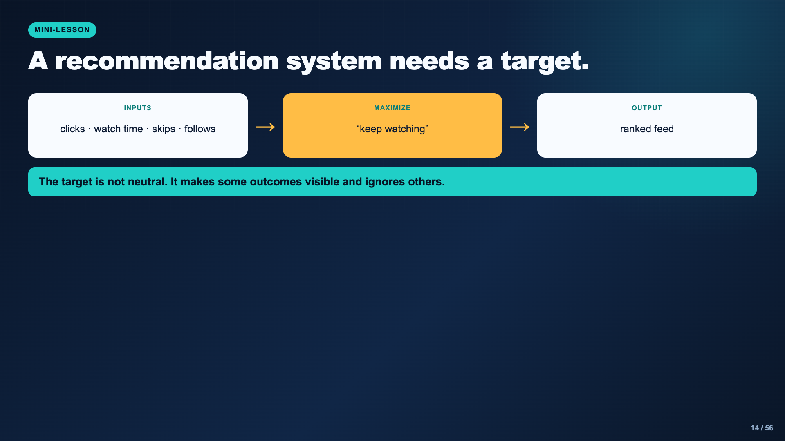
Notes:
Model a simplified recommendation loop. Explain that real systems use many signals, but the ethical question remains: which measurable result is rewarded, and which human value is left outside the target?
[Sources]
- https://www.media.mit.edu/projects/ai-ethics-for-middle-school/overview/

Slide 15
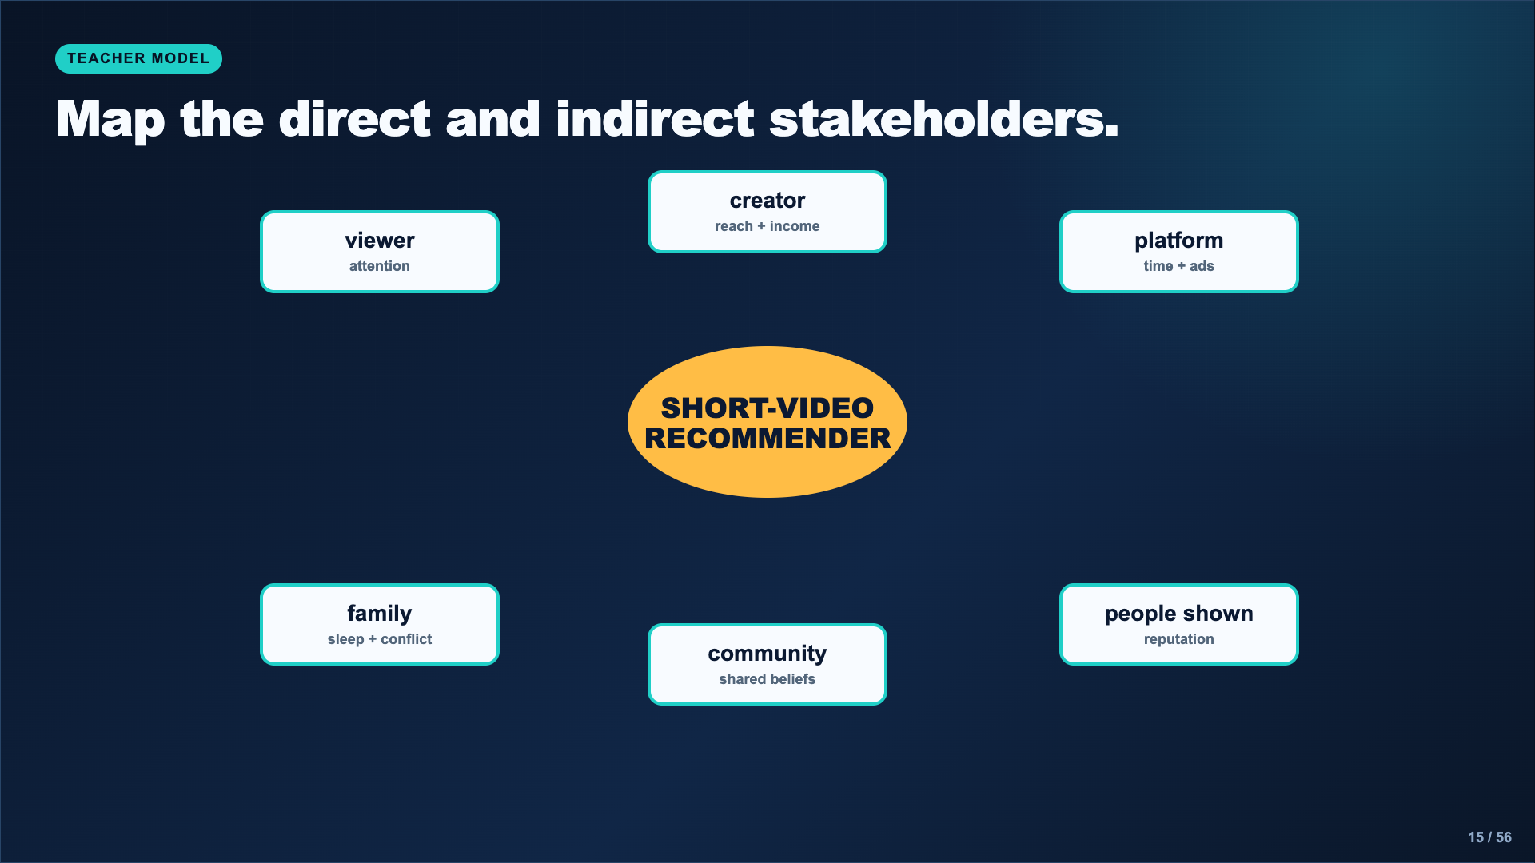
Notes:
Think aloud while adding indirect stakeholders. Power does not equal impact: a person can have little control over the rule and still absorb a major consequence.
[Sources]
- AI Ethics Council Casebook and teacher facilitation sequence.

Slide 16
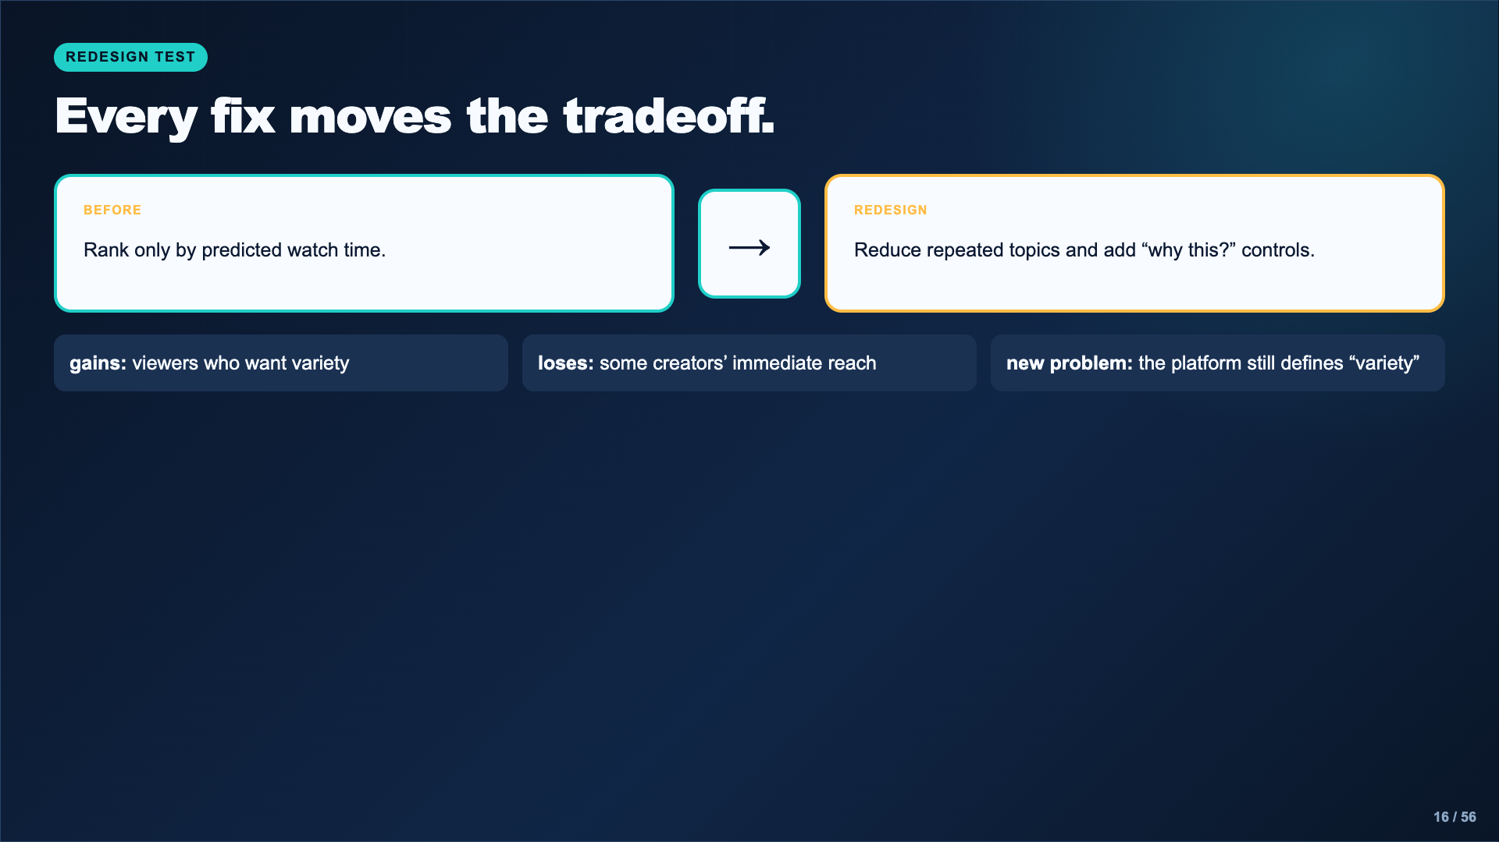
Notes:
Reject redesigns with no tradeoff. If everyone wins and nothing new becomes difficult, students have probably not followed the incentive far enough.
[Sources]
- https://www.media.mit.edu/projects/ai-ethics-for-middle-school/overview/

Slide 17
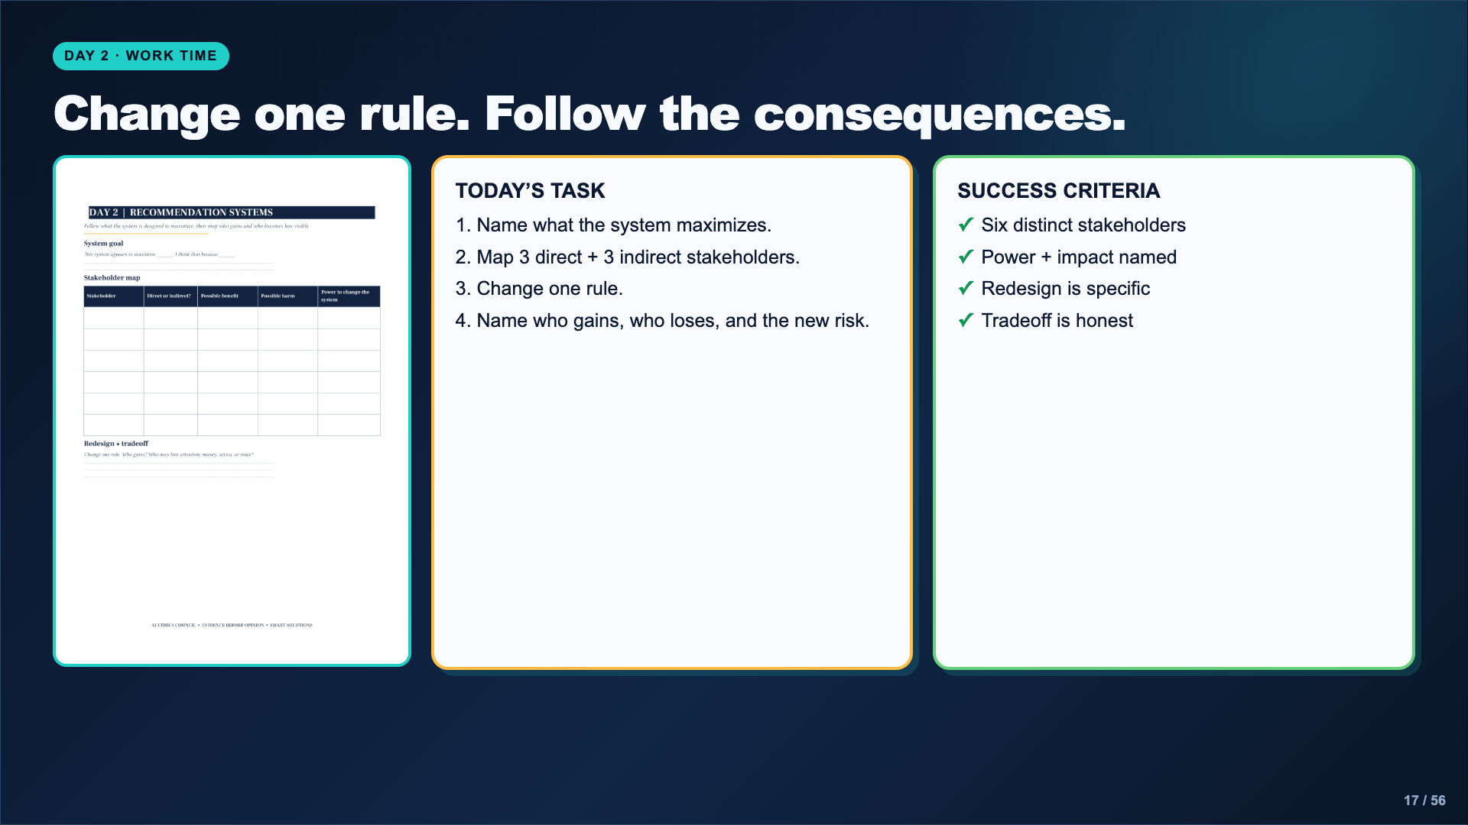
Notes:
Leave this slide projected. Ask students to point to the stakeholder who has the least power and the stakeholder who controls the target.
[Sources]
- AI Ethics Council Casebook and teacher facilitation sequence.

Slide 18
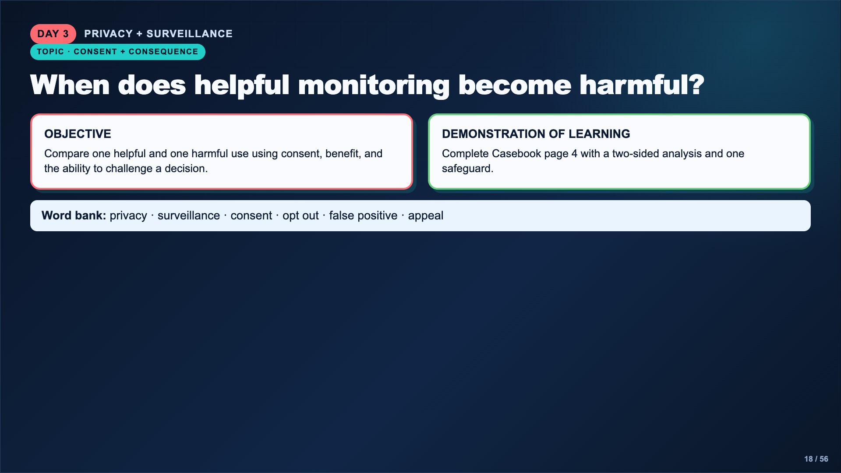
Notes:
Name the privacy boundary: students analyze public or teacher-provided scenarios. They do not disclose personal location, messages, faces, or family experiences.
[Sources]
- https://www.nist.gov/news-events/news/2019/12/nist-study-evaluates-effects-race-age-sex-face-recognition-software
- https://www.dayofai.net/curriculum

Slide 19
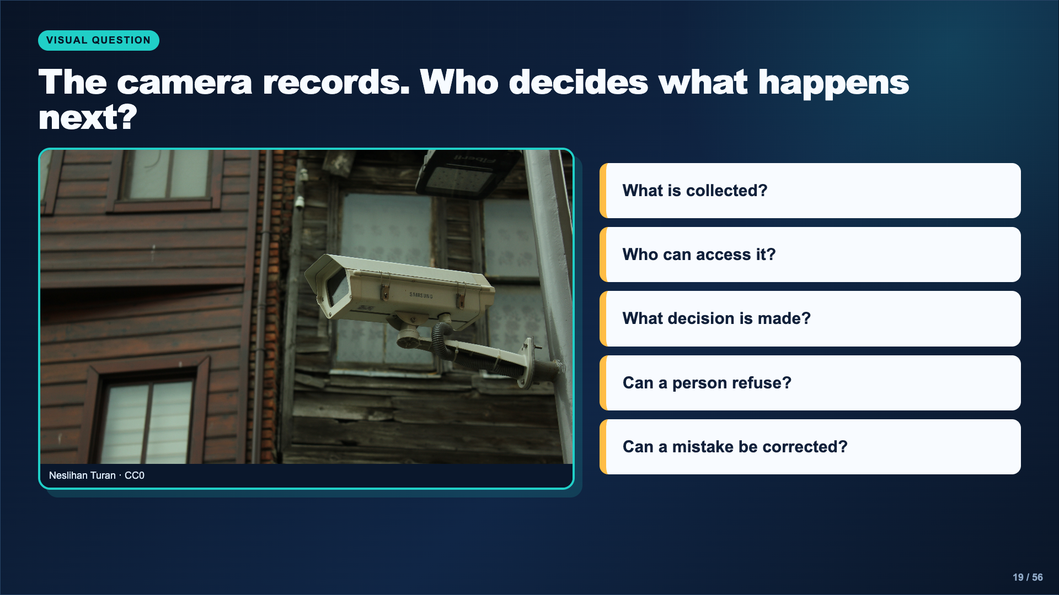
Notes:
Keep the discussion focused on the decision chain after collection. A camera by itself is not the full ethical case; the storage, access, matching, and consequences matter.
[Sources]
- Image: Neslihan Turan, CC0, https://commons.wikimedia.org/wiki/File:Surveillance_camera.jpg

Slide 20
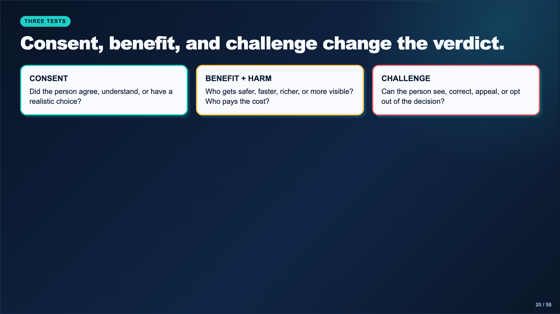
Notes:
Apply all three tests to one ordinary example, such as a library camera, then to a higher-stakes example, such as automated face matching. A useful safeguard should repair a specific weakness in one of these tests.
[Sources]
- AI Ethics Council Casebook and teacher facilitation sequence.

Slide 21
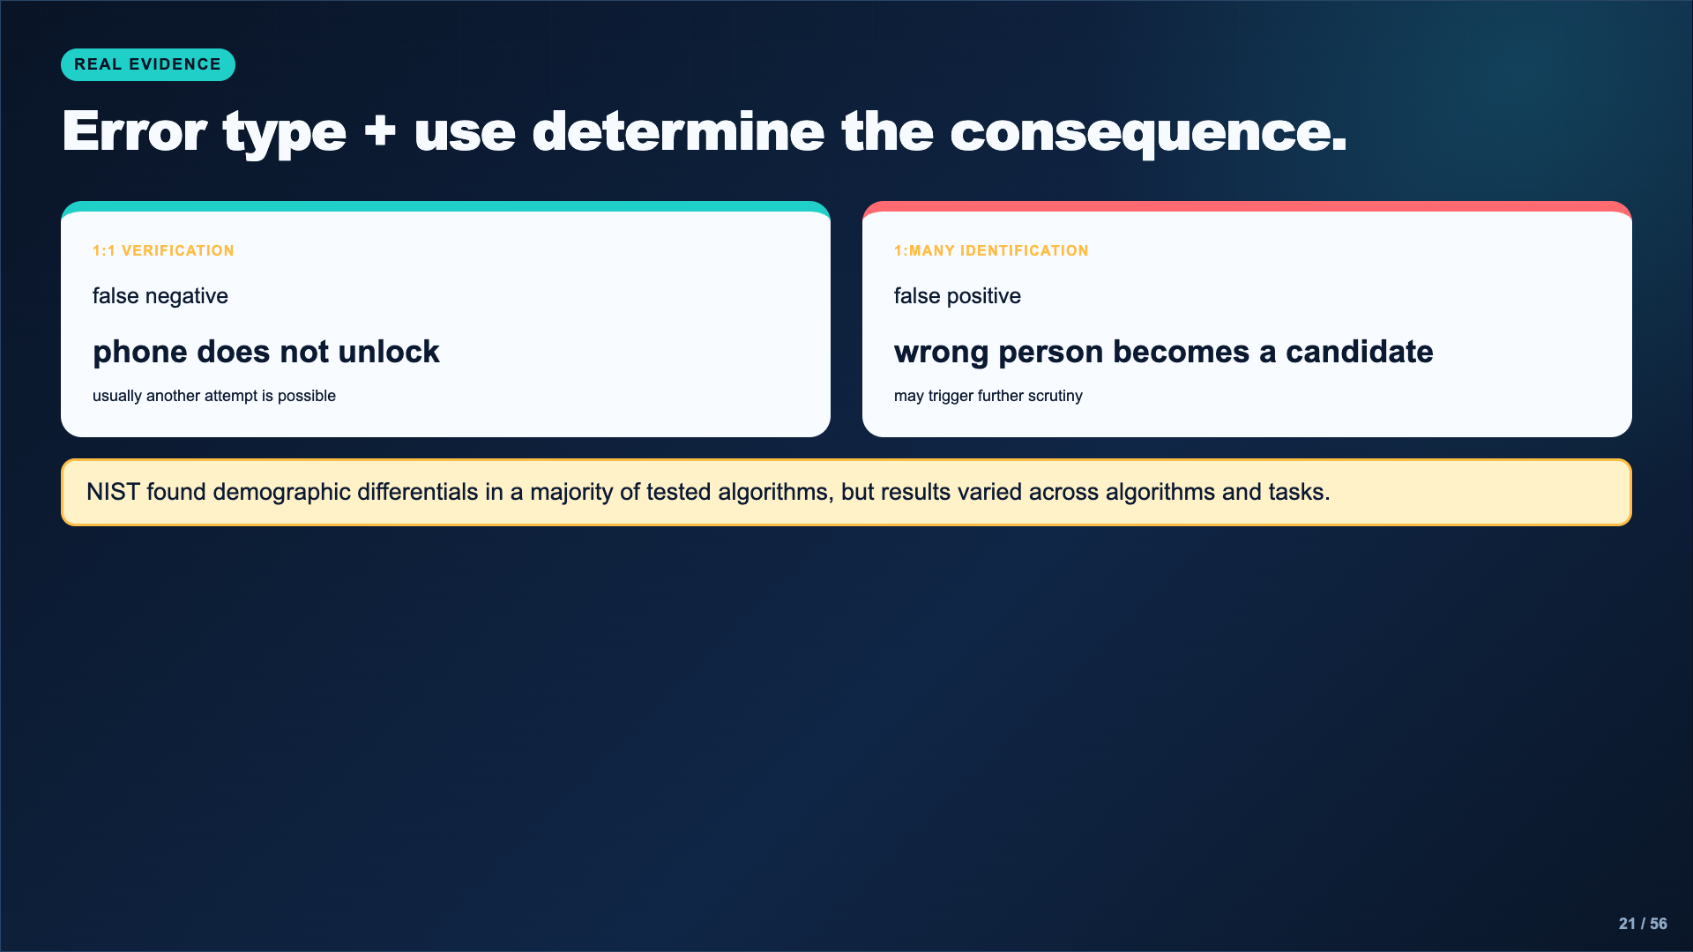
Notes:
Teach the two tasks and error types before discussing fairness claims. Do not say every algorithm performs the same way. Do not say NIST proved the cause. Students should be precise about what the evidence measured.
[Sources]
- https://www.nist.gov/news-events/news/2019/12/nist-study-evaluates-effects-race-age-sex-face-recognition-software

Slide 22
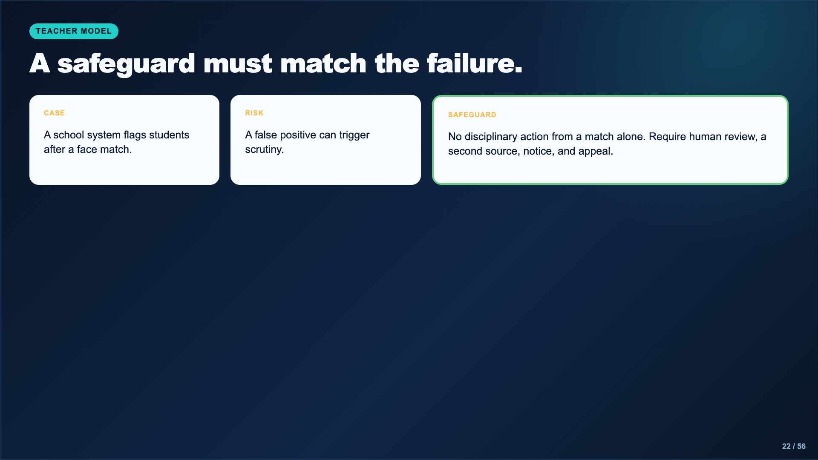
Notes:
Model a safeguard that limits what the system is allowed to do. “Improve the AI” is too vague. The safeguard shown creates a procedural check even while the technology remains imperfect.
[Sources]
- AI Ethics Council Casebook and teacher facilitation sequence.

Slide 23
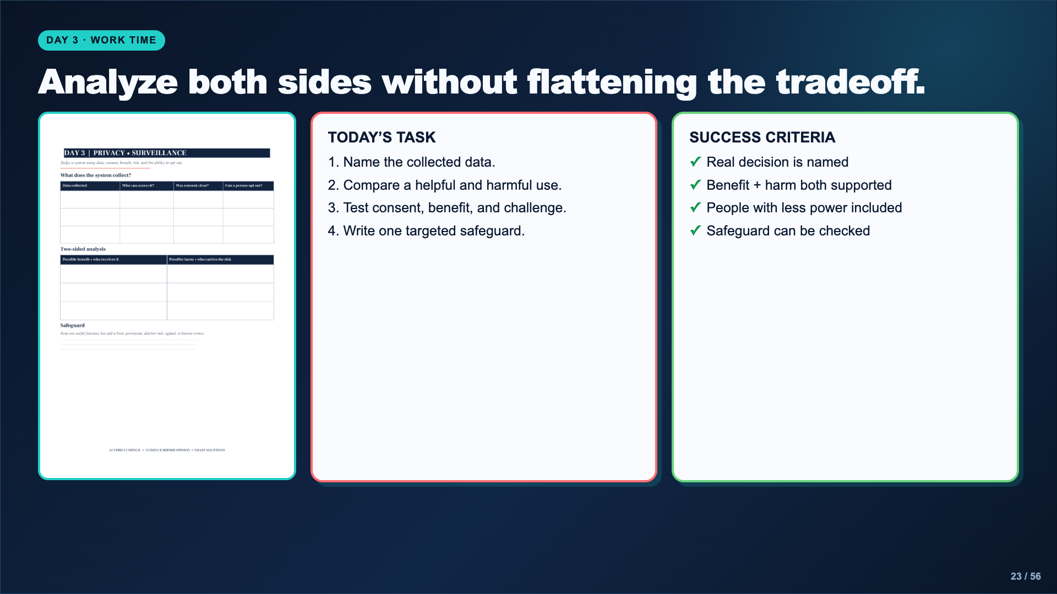
Notes:
Leave this slide projected. Push students beyond “privacy is important” by asking what specific data, user, decision, consequence, and challenge route they mean.
[Sources]
- AI Ethics Council Casebook and teacher facilitation sequence.

Slide 24
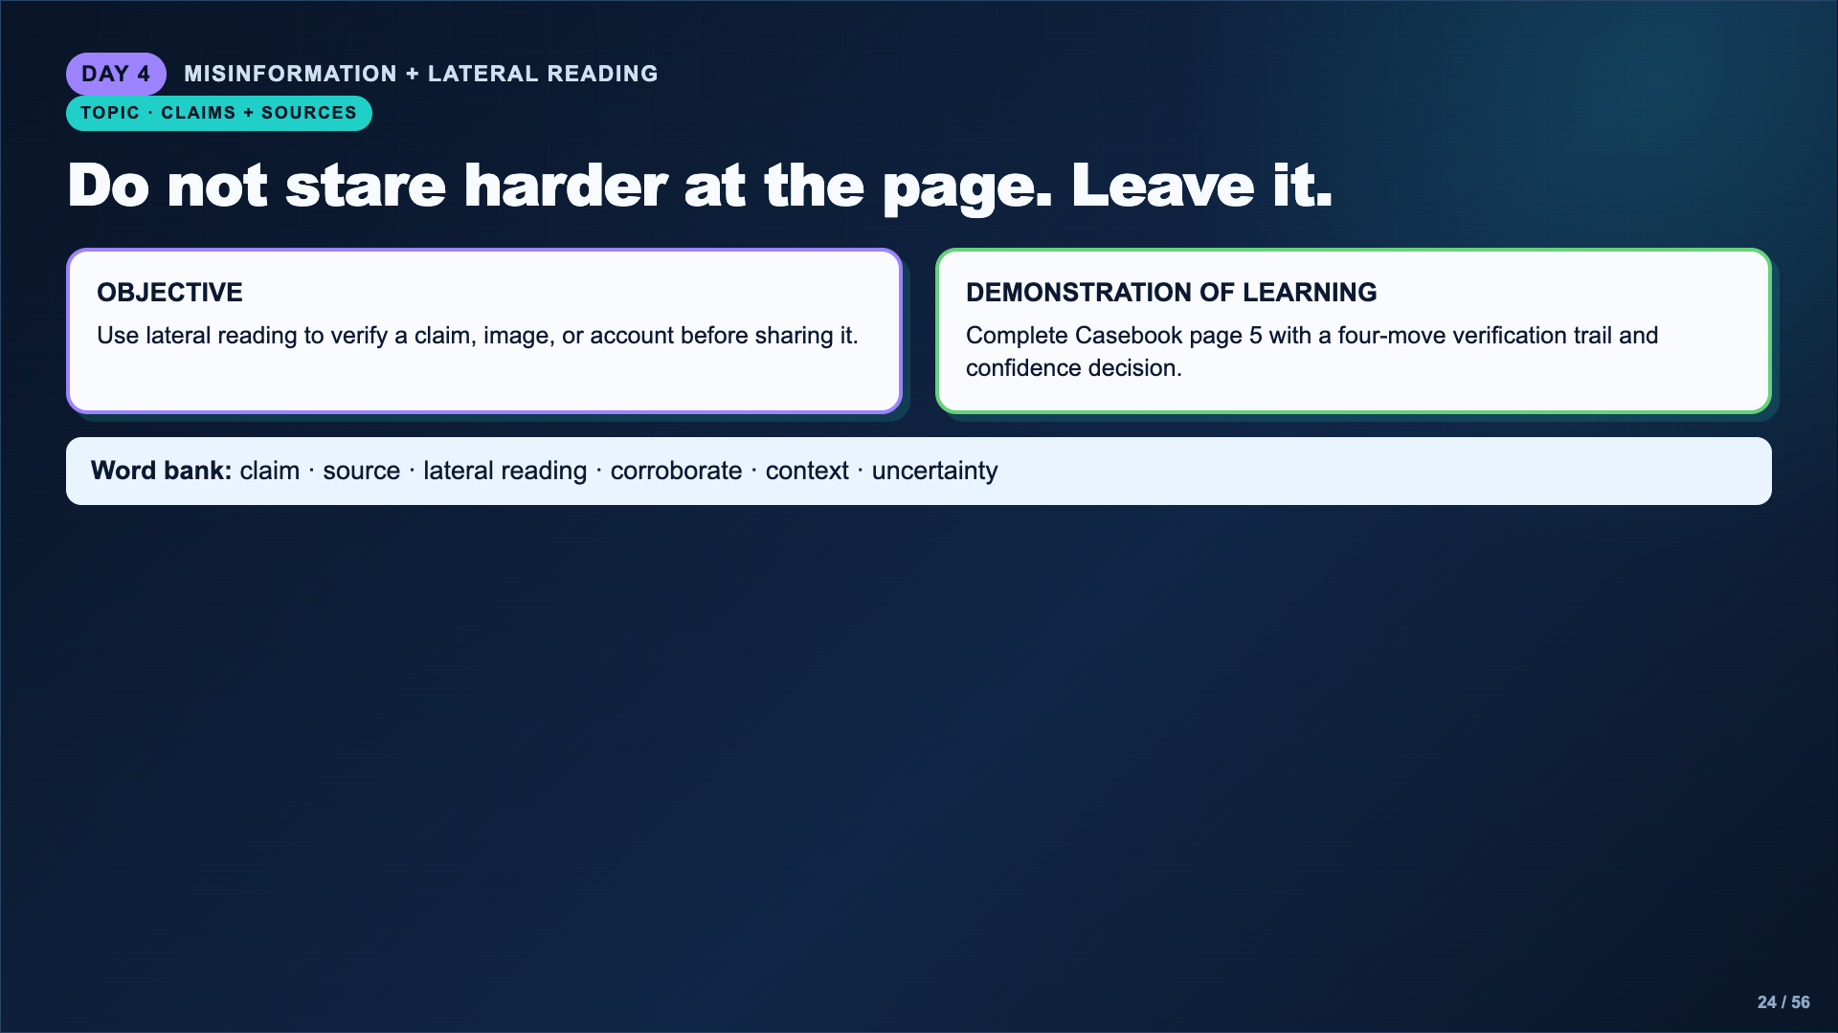
Notes:
Emphasize that polished appearance is weak evidence. Lateral reading means leaving the original page to investigate the source and claim elsewhere.
[Sources]
- https://cor.inquirygroup.org/curriculum/lessons/intro-to-lateral-reading/

Slide 25
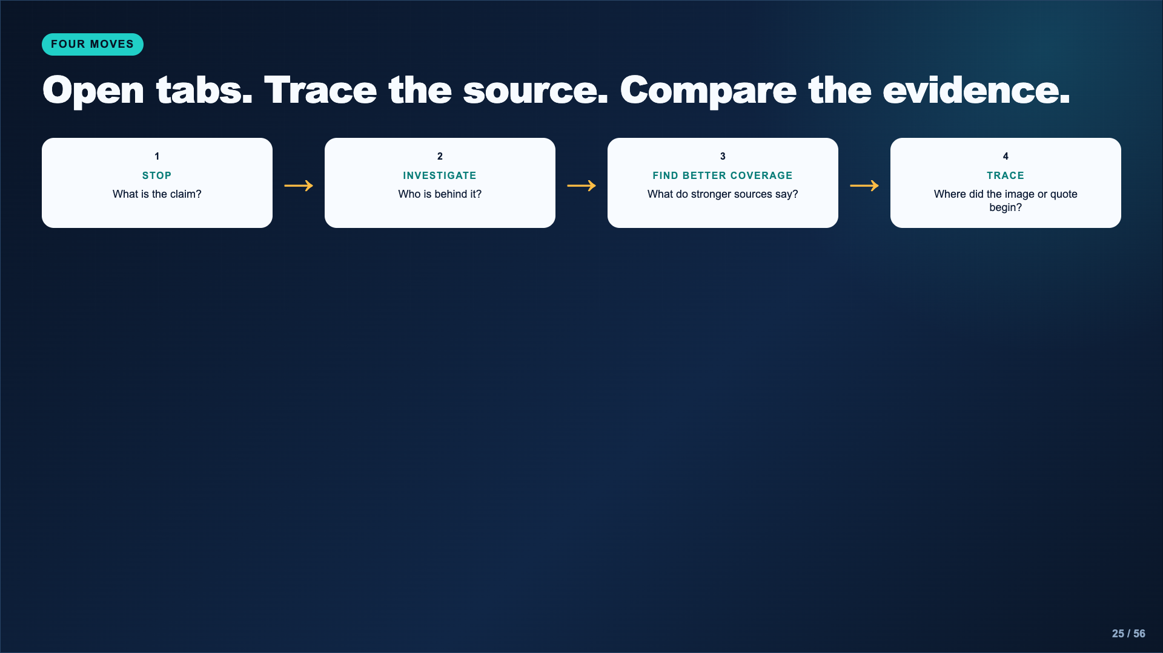
Notes:
Model with teacher-vetted material. Students should open new tabs and search for the organization, claim, and original image or report rather than relying on the About page alone.
[Sources]
- https://cor.inquirygroup.org/curriculum/lessons/intro-to-lateral-reading/

Slide 26
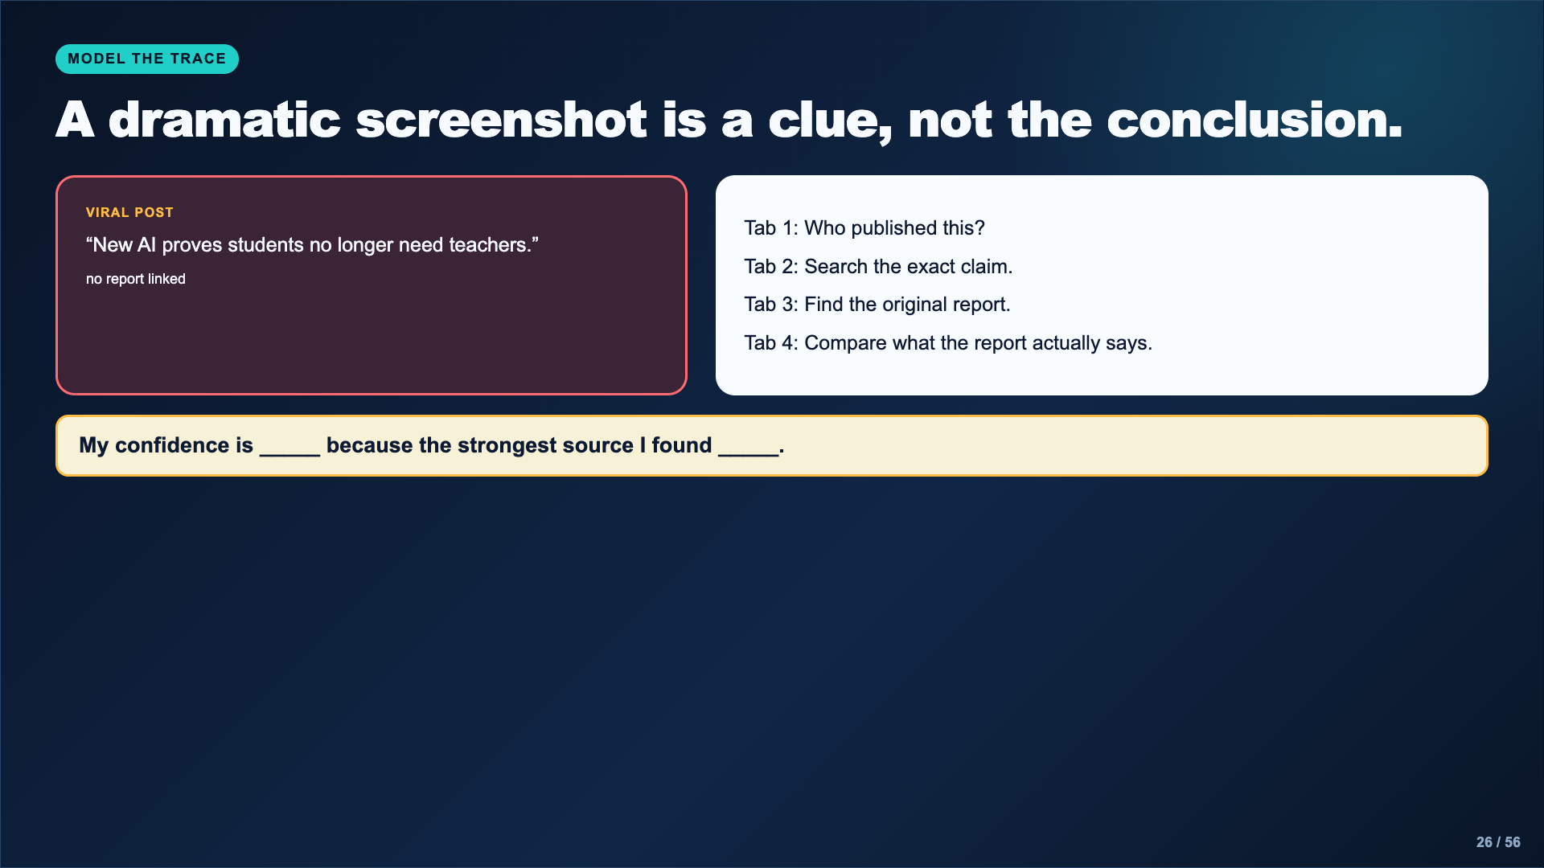
Notes:
This is an instructional example, not a real claim. The evidence move is real: identify the publisher, search the claim, find the original record, and compare the wording. Do not assess students on guessing whether the post is true before verification.
[Sources]
- https://cor.inquirygroup.org/curriculum/lessons/intro-to-lateral-reading/

Slide 27
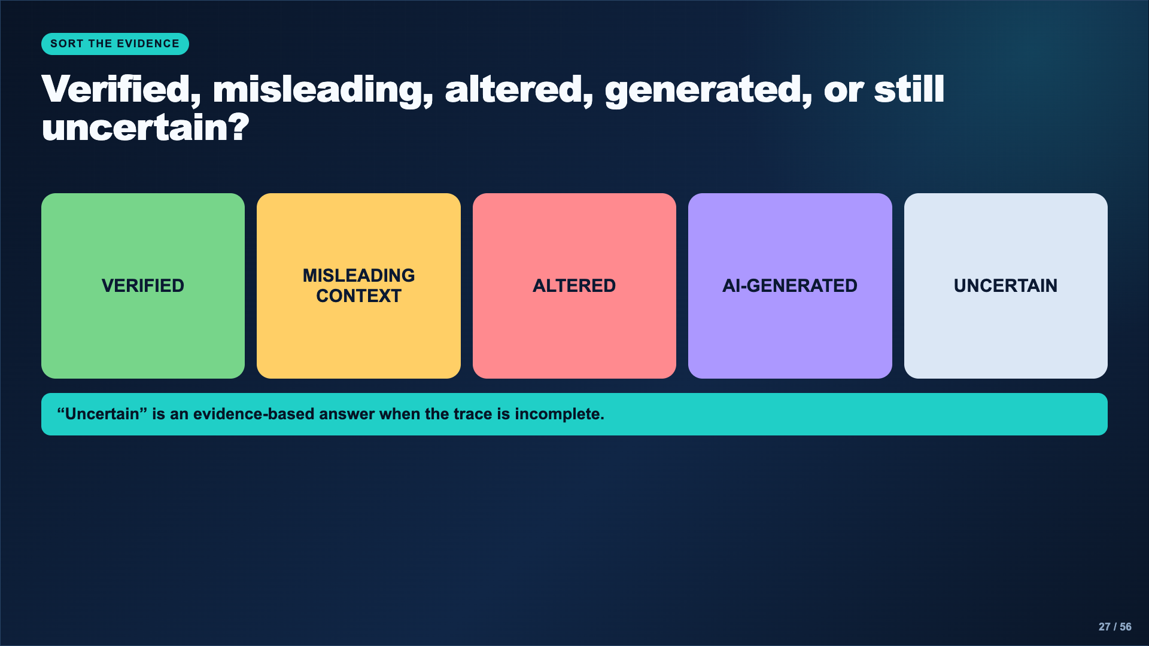
Notes:
Use teacher-vetted examples with the original sources retained. Do not turn the activity into a visual guessing game. Students earn credit for the trace and justification, not confidence or speed.
[Sources]
- https://cor.inquirygroup.org/curriculum/lessons/intro-to-lateral-reading/

Slide 28
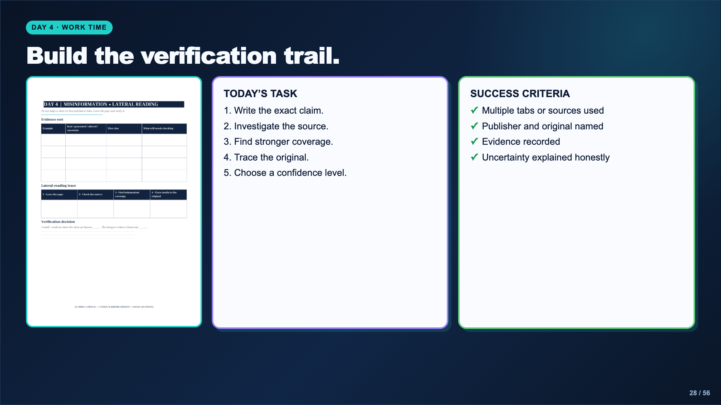
Notes:
Leave this slide projected. The teacher provides the source set or case links. Students should not upload personal feeds, private messages, or classmates’ content.
[Sources]
- AI Ethics Council Casebook and teacher facilitation sequence.

Slide 29

Notes:
The teacher chooses one scenario for the whole class or approves a small set. This common case makes the hearing discussion possible and limits research sprawl.
[Sources]
- https://www.media.mit.edu/projects/ai-ethics-for-middle-school/overview/
- https://www.dayofai.net/curriculum

Slide 30
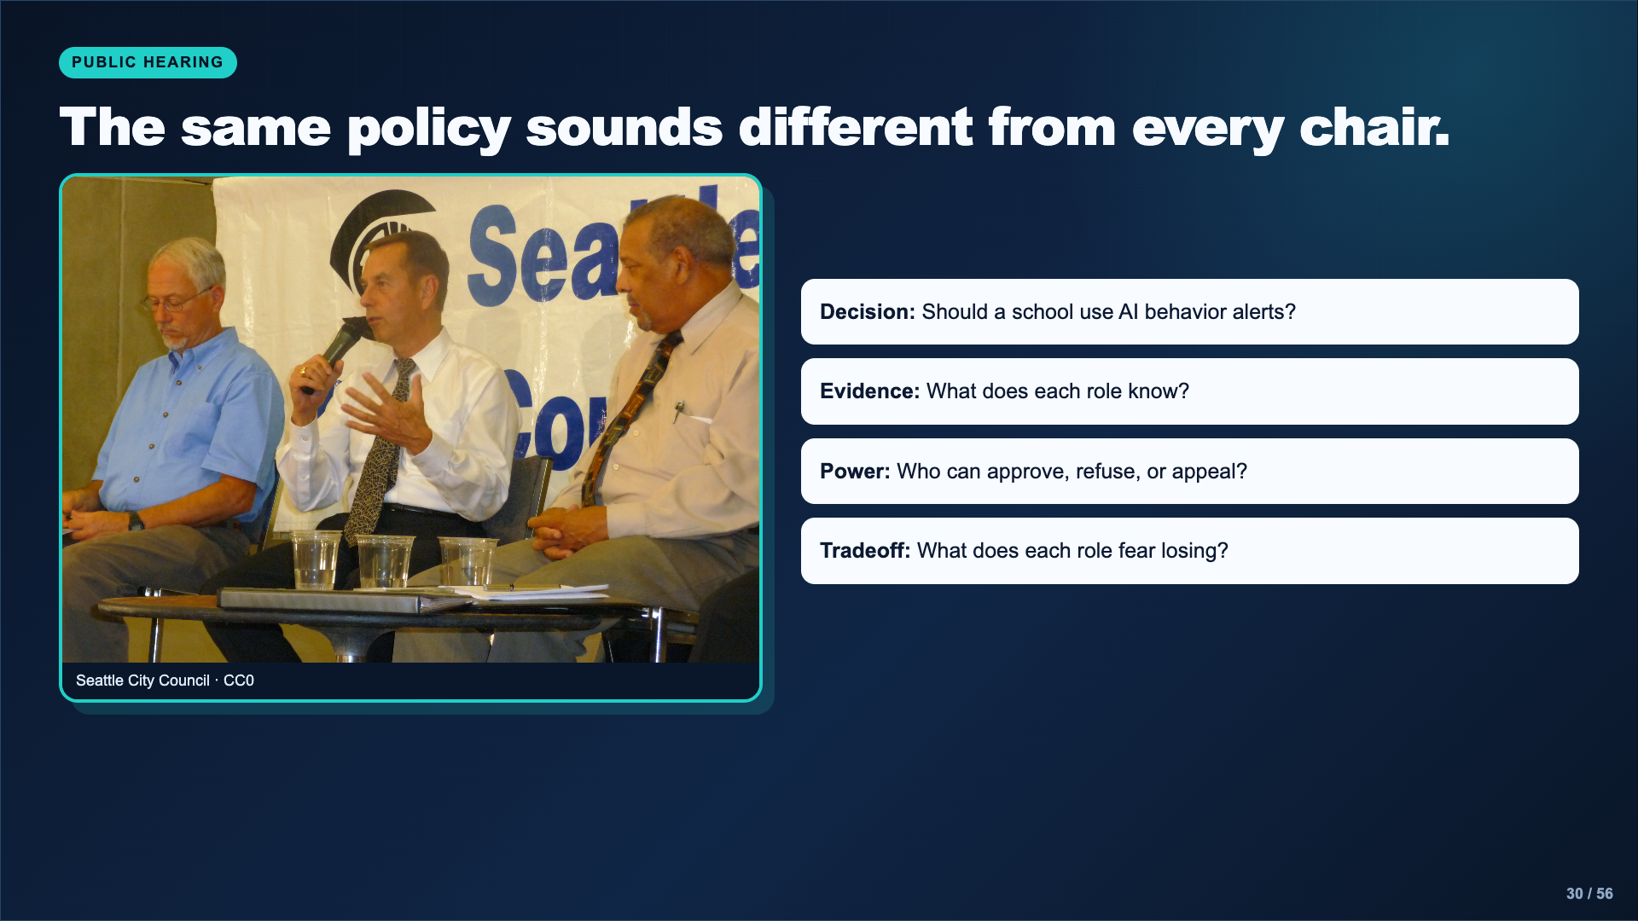
Notes:
Explain that a stakeholder position is not the student’s personal belief. Students represent the incentives and evidence available to the role. Avoid personal disclosures about discipline or family situations.
[Sources]
- Image: Seattle City Council, CC0, https://commons.wikimedia.org/wiki/File:Council_Public_Meeting_(8902417371).jpg

Slide 31
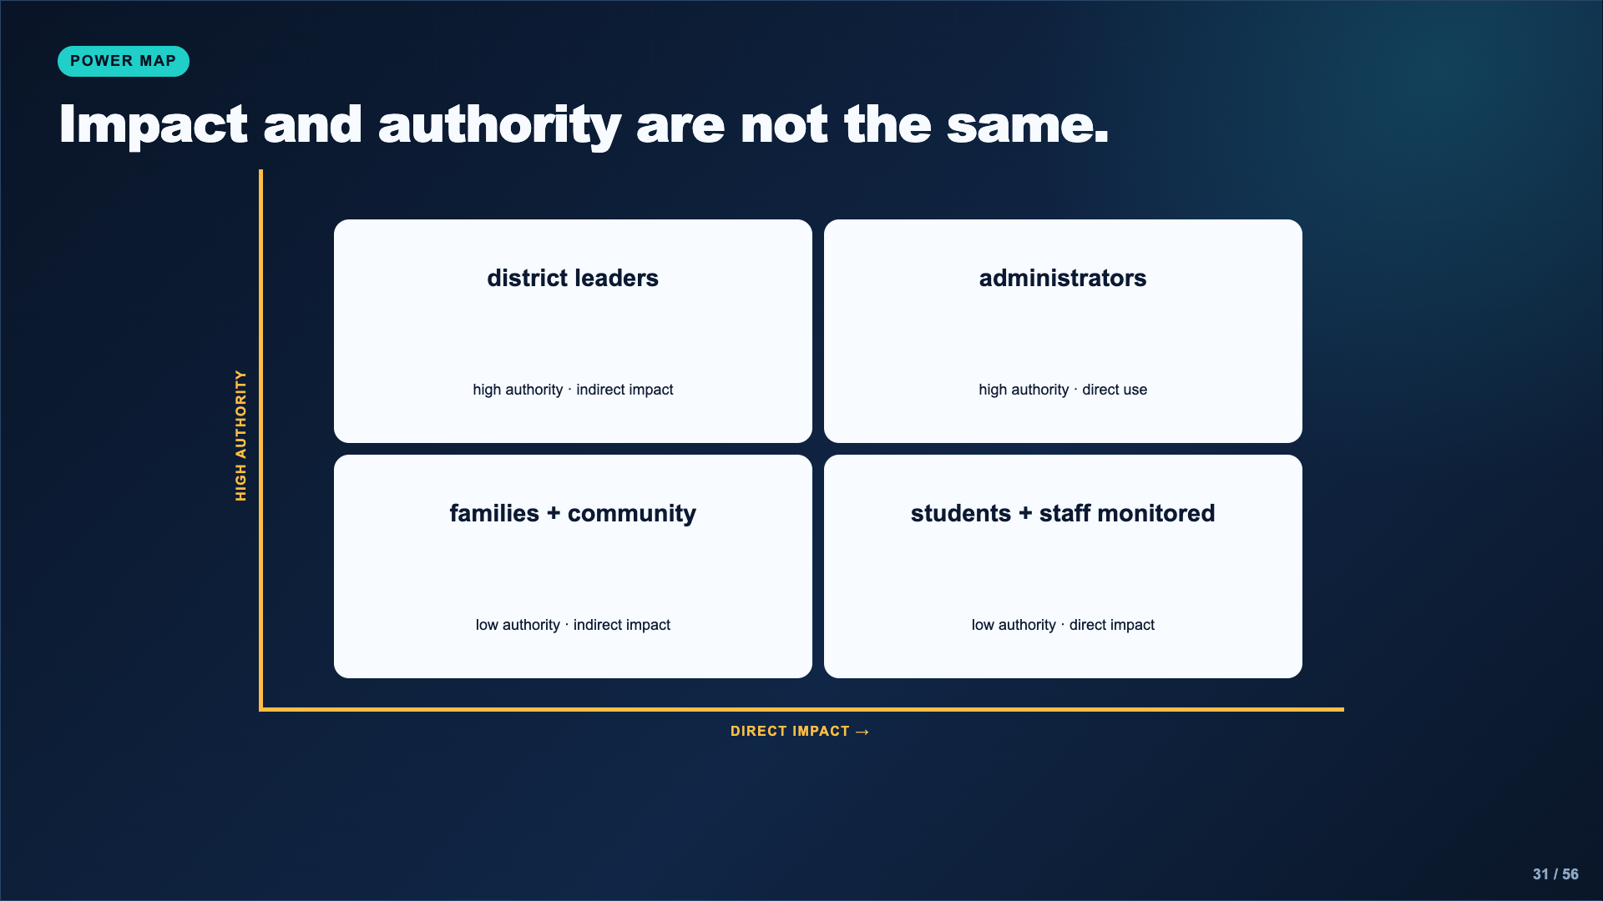
Notes:
Model the difference between formal authority and lived impact. The exact placement can be debated; require evidence for the placement rather than treating the teacher model as the only answer.
[Sources]
- AI Ethics Council Casebook and teacher facilitation sequence.

Slide 32
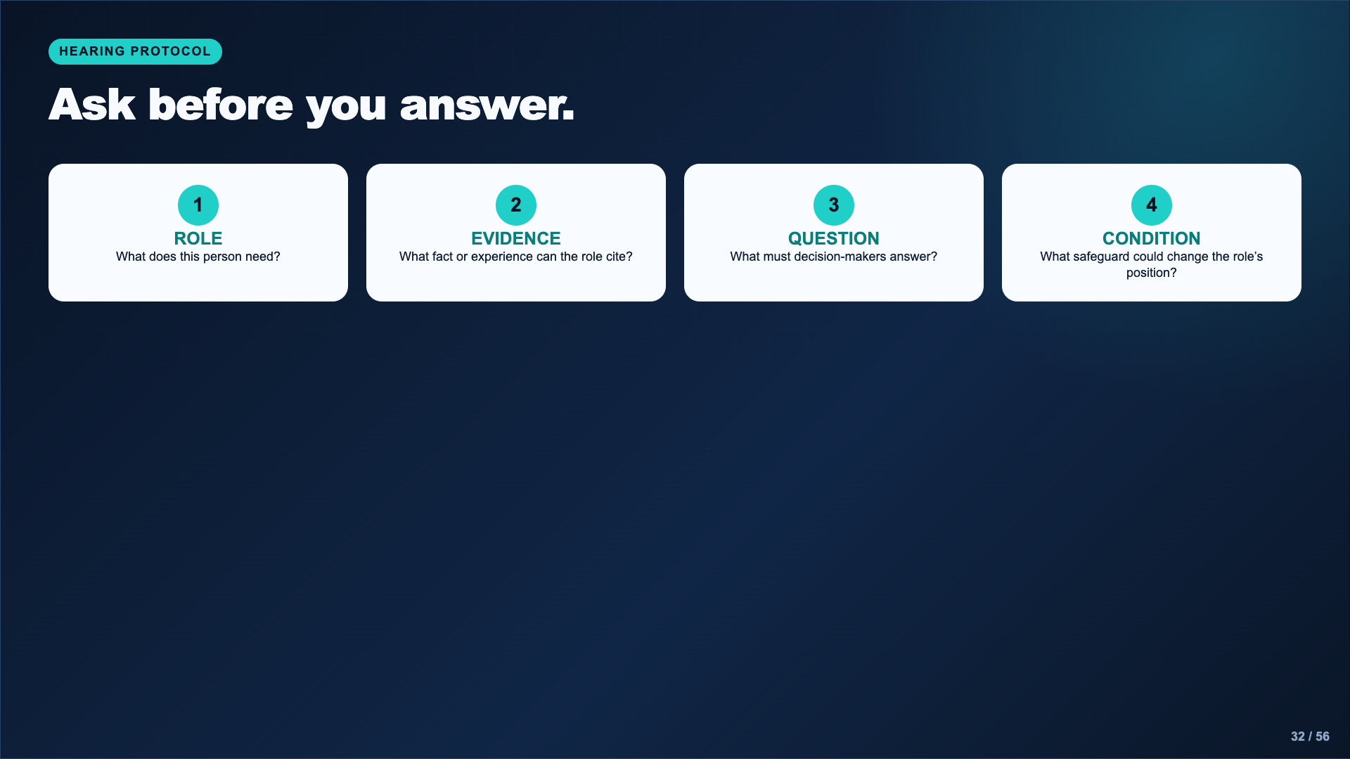
Notes:
Have students write questions that expose missing evidence. “Why do you hate safety?” is not a hearing question. “What is the false-positive rate, and who reviews an alert?” is.
[Sources]
- AI Ethics Council Casebook and teacher facilitation sequence.

Slide 33
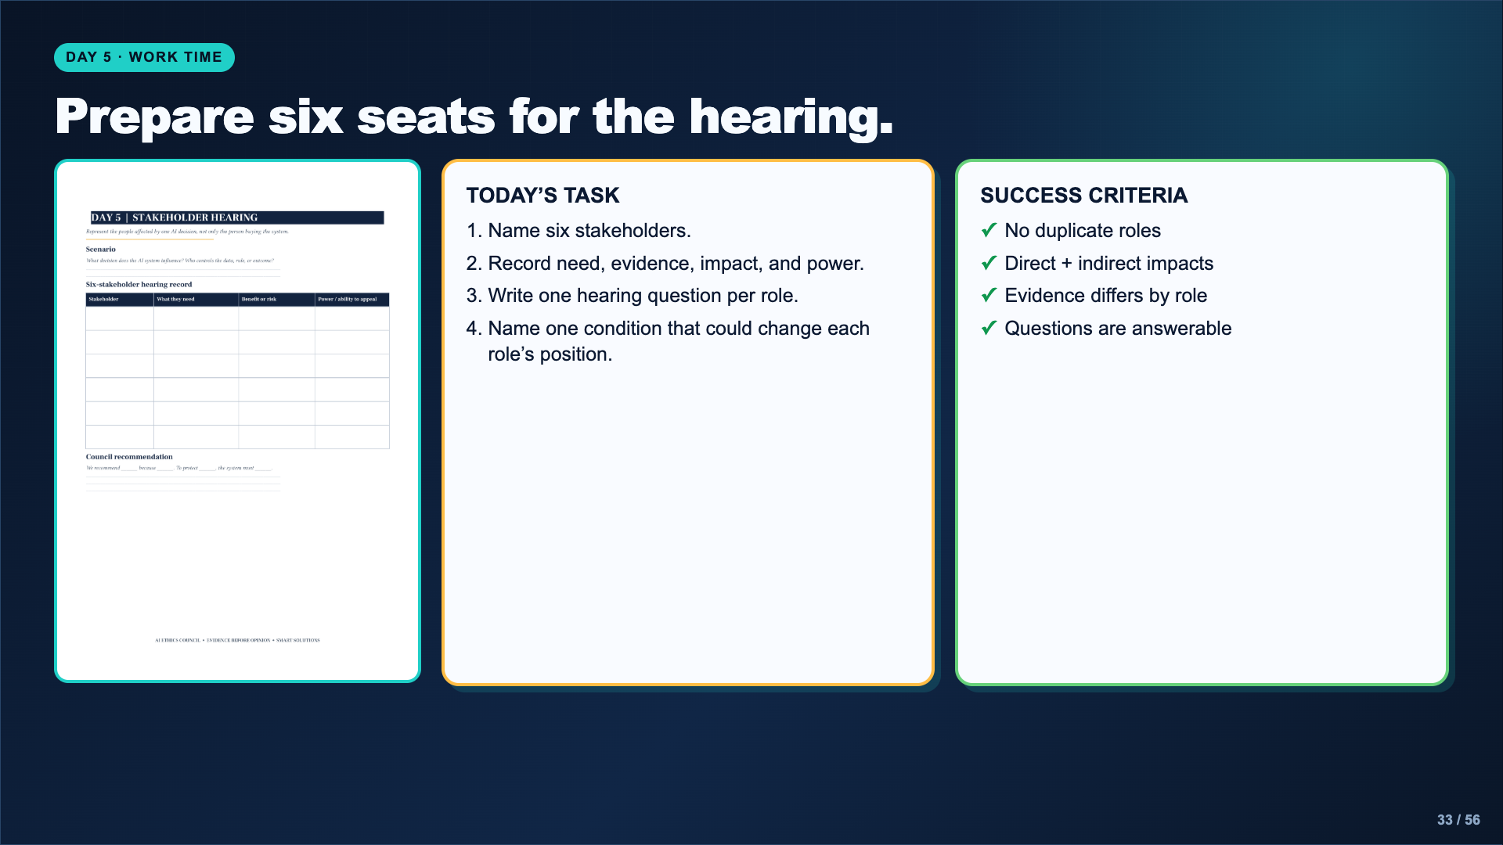
Notes:
Leave this slide projected. Circulate for caricatures. A technology company is not automatically evil; a student is not automatically opposed. The role needs a plausible incentive and evidence base.
[Sources]
- AI Ethics Council Casebook and teacher facilitation sequence.

Slide 34
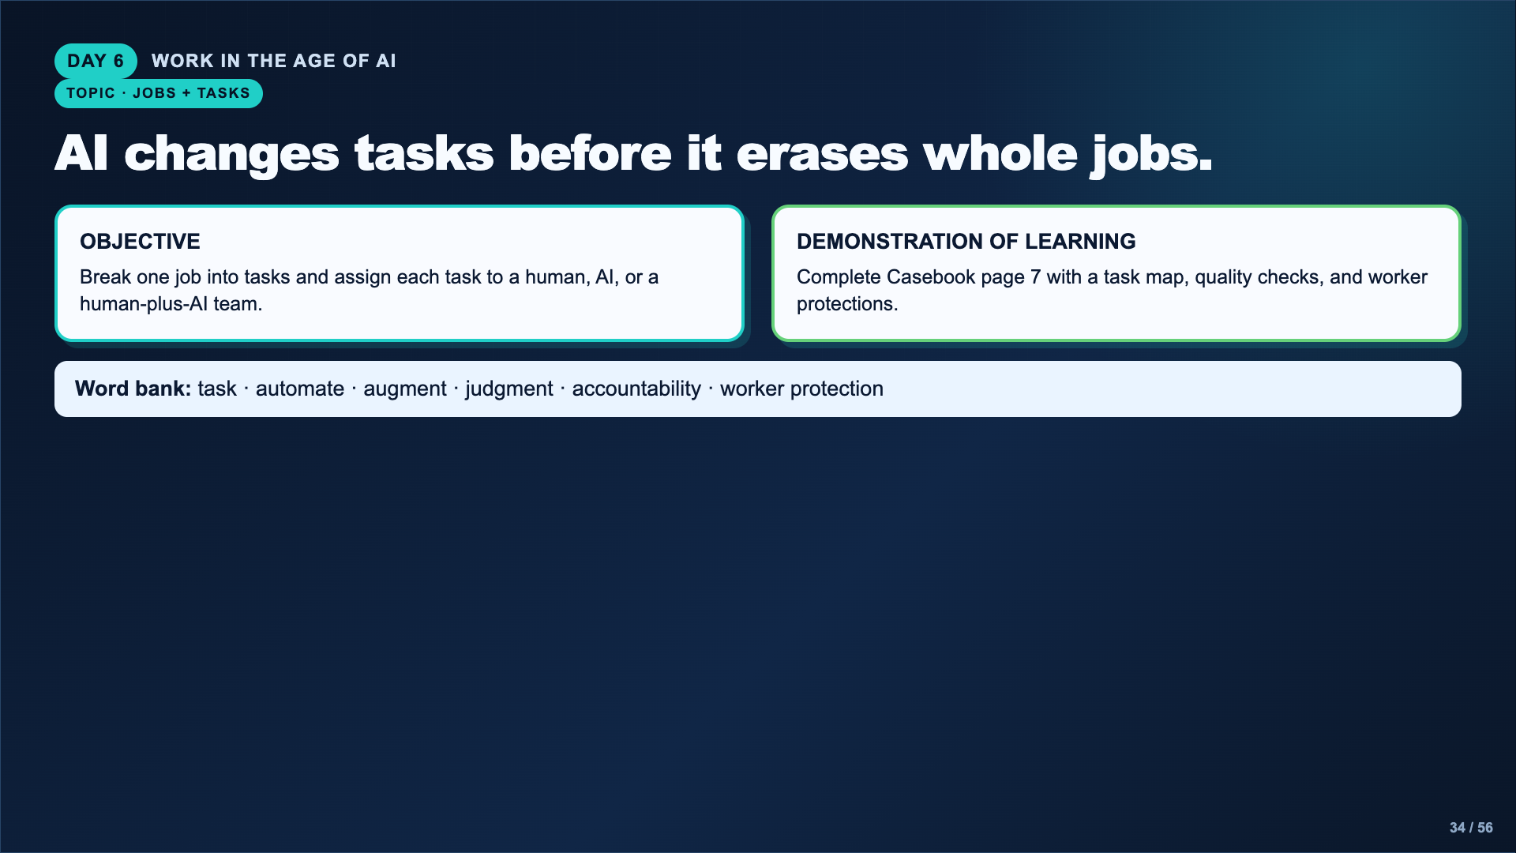
Notes:
Use the language of tasks rather than predicting that an entire career will disappear. Students should ask what the task requires and who remains responsible for the result.
[Sources]
- https://dayofai.org/units/work-in-the-age-of-ai

Slide 35
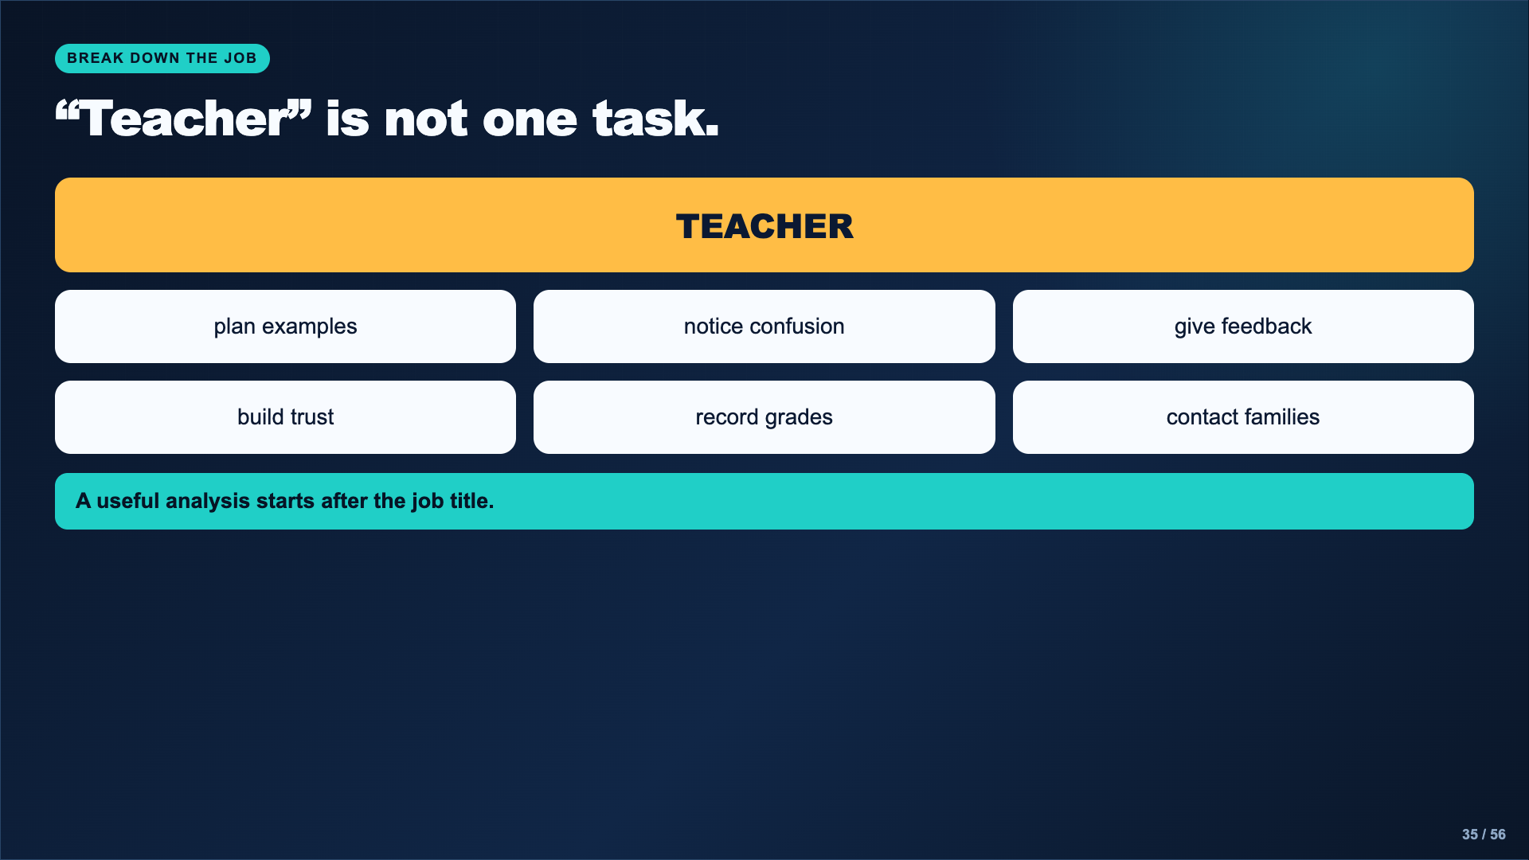
Notes:
Ask students which tasks require pattern recognition, relationship, physical presence, judgment, privacy, or legal responsibility. Different tasks in the same job may need different assignments.
[Sources]
- https://dayofai.org/units/work-in-the-age-of-ai

Slide 36
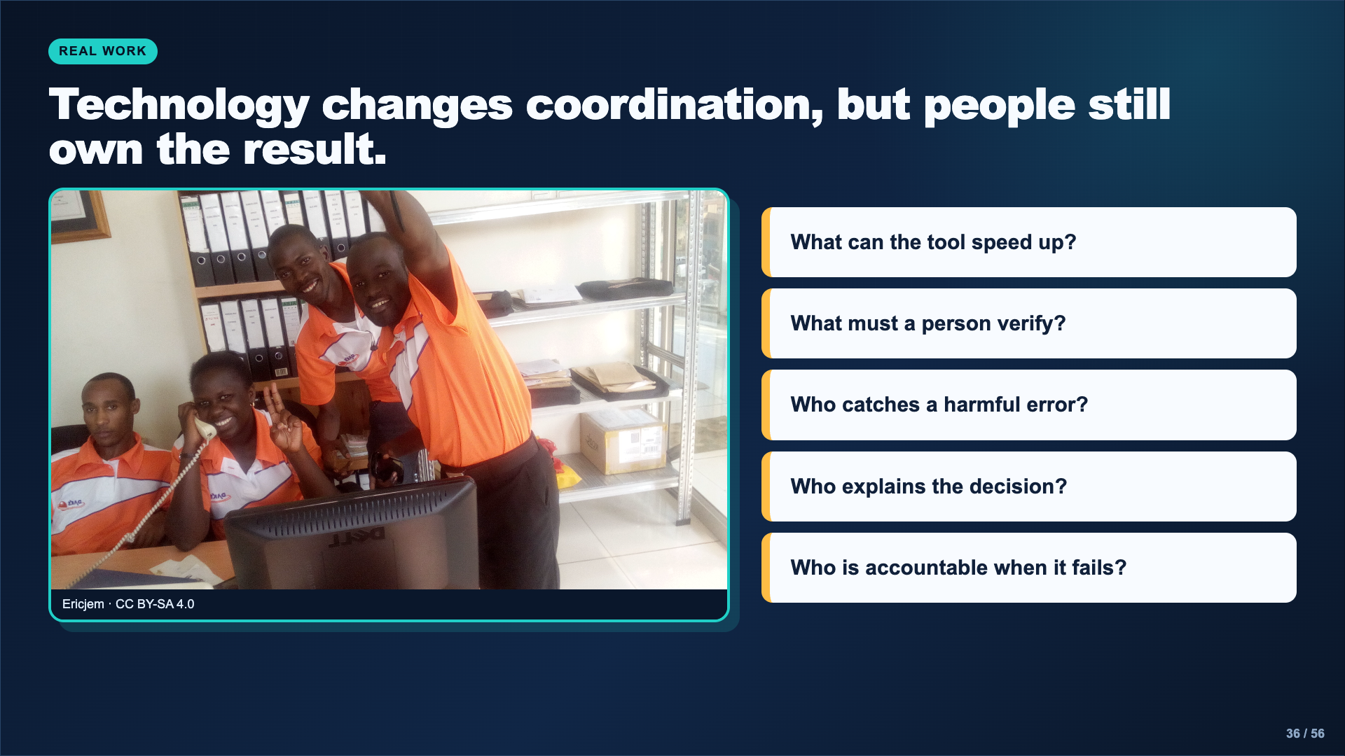
Notes:
Use the workplace photo to keep the question grounded in collaboration rather than a human-versus-machine contest. The student’s recommendation must preserve a quality check and a person responsible for consequences.
[Sources]
- Image: Ericjem, CC BY-SA 4.0, https://commons.wikimedia.org/wiki/File:Working_as_a_team.jpg
- https://dayofai.org/units/work-in-the-age-of-ai

Slide 37
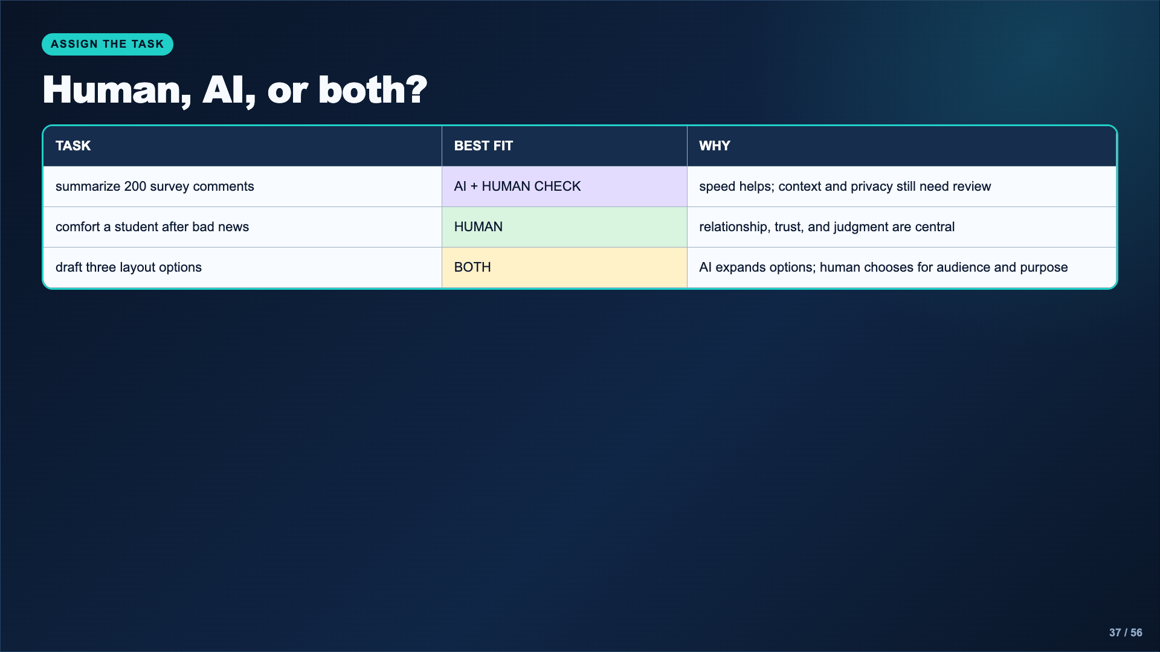
Notes:
Model that “both” is not an escape answer. Students must say what the AI does, what the human checks, and who is responsible.
[Sources]
- AI Ethics Council Casebook and teacher facilitation sequence.

Slide 38
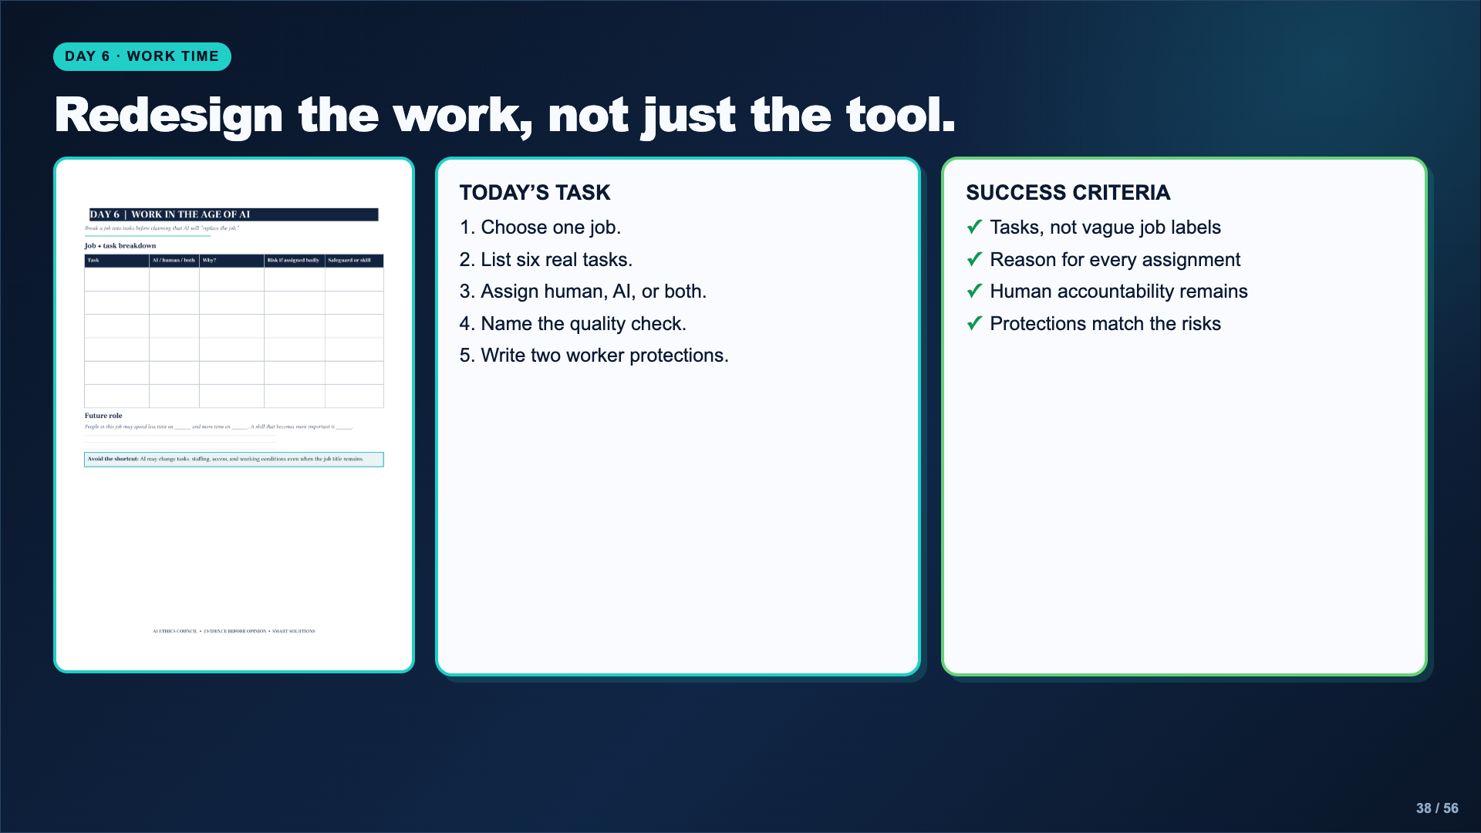
Notes:
Leave this slide projected. If students cannot name tasks, direct them to the Day of AI career unit or a vetted occupational source. Do not let the lesson become unsupported career prediction.
[Sources]
- AI Ethics Council Casebook and teacher facilitation sequence.

Slide 39
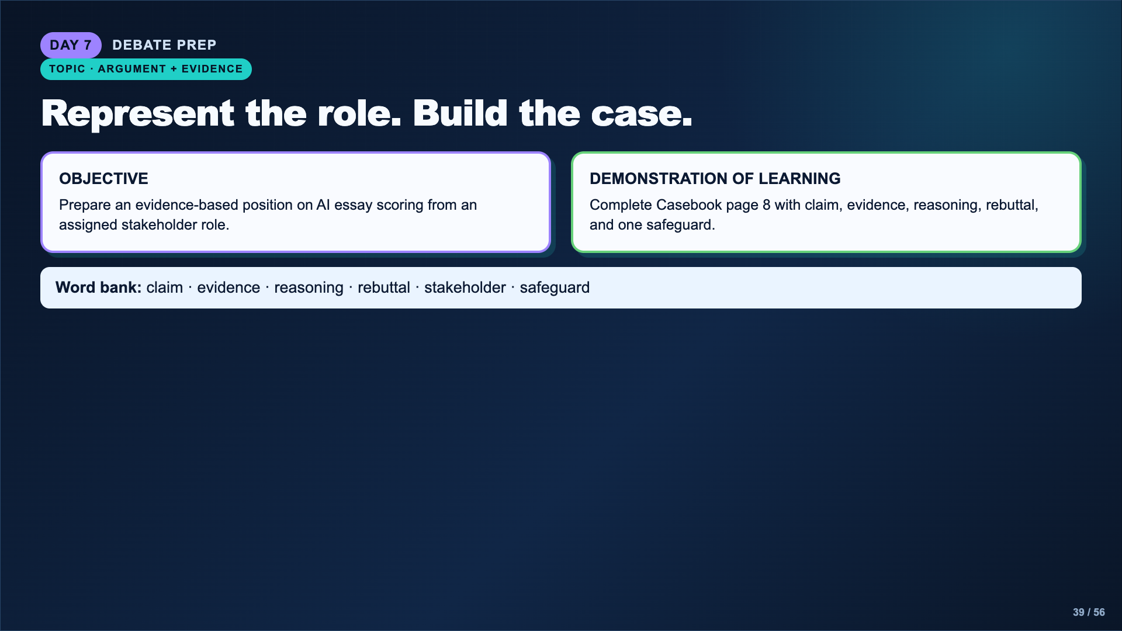
Notes:
Assign roles before students prepare: student, teacher, parent, technology company, and district or government decision-maker. The role is not a statement of personal belief.
[Sources]
- AI Ethics Council Casebook and teacher facilitation sequence.

Slide 40
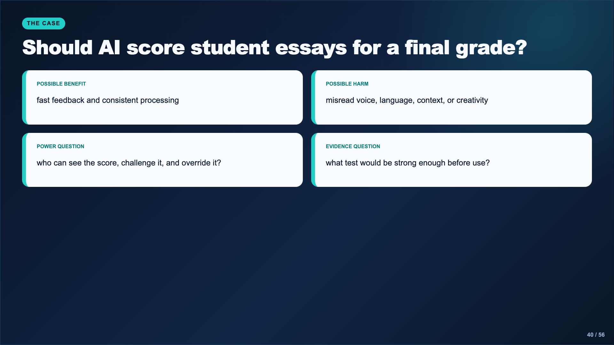
Notes:
Present this as a decision scenario, not as evidence that a particular product is currently used in the district. Students must build the assigned role’s strongest defensible argument.
[Sources]
- AI Ethics Council Casebook and teacher facilitation sequence.

Slide 41
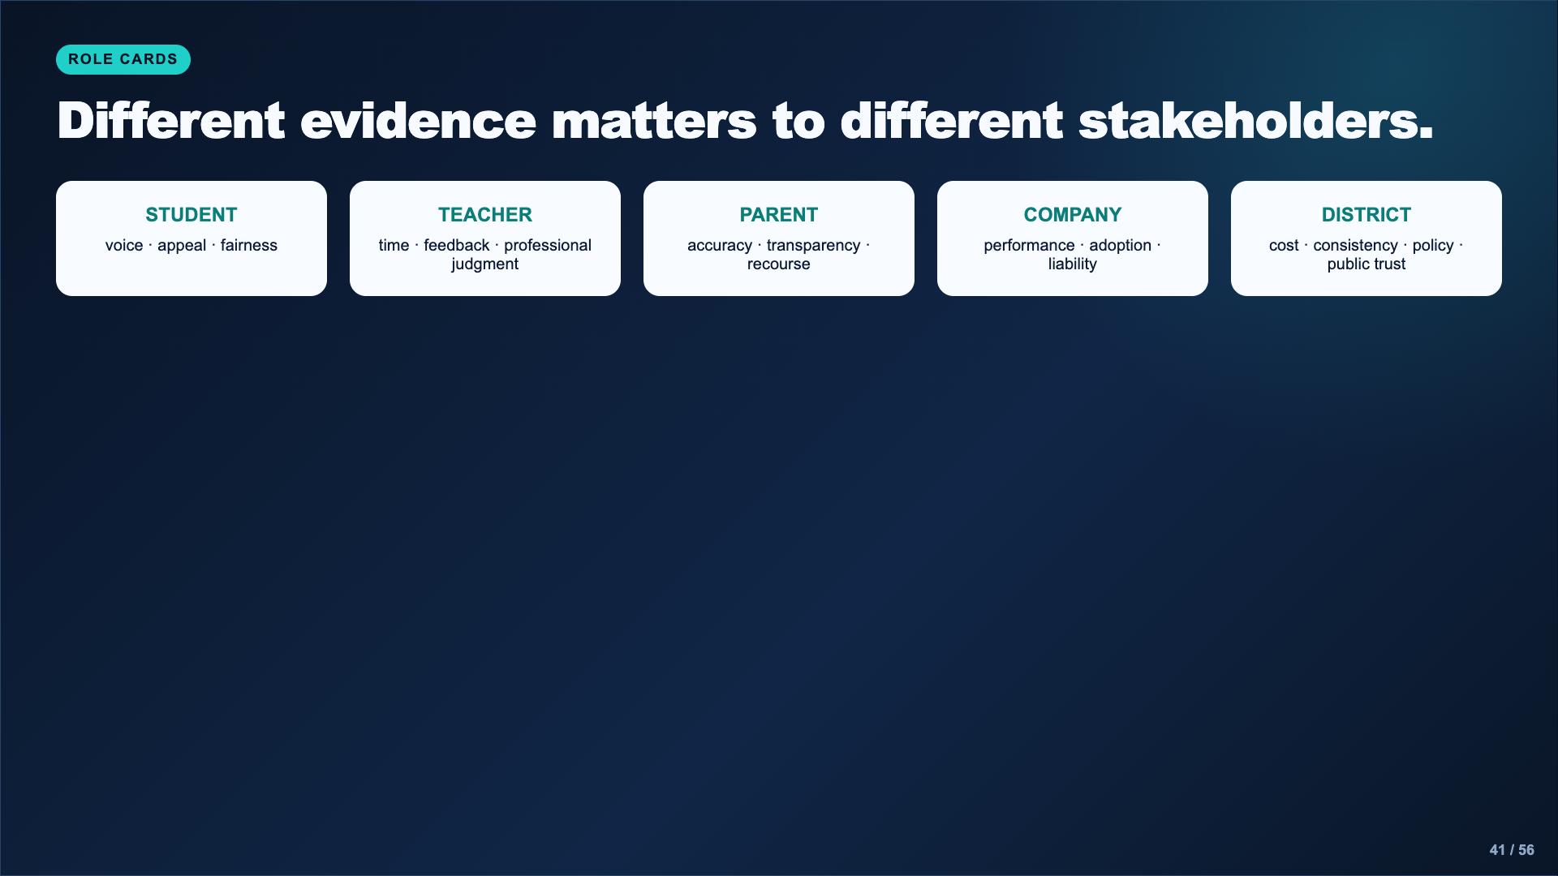
Notes:
Have students identify one need, one fear, and one piece of evidence for the role. A role card does not give them the answer; it gives them a starting point for research and reasoning.
[Sources]
- AI Ethics Council Casebook and teacher facilitation sequence.

Slide 42
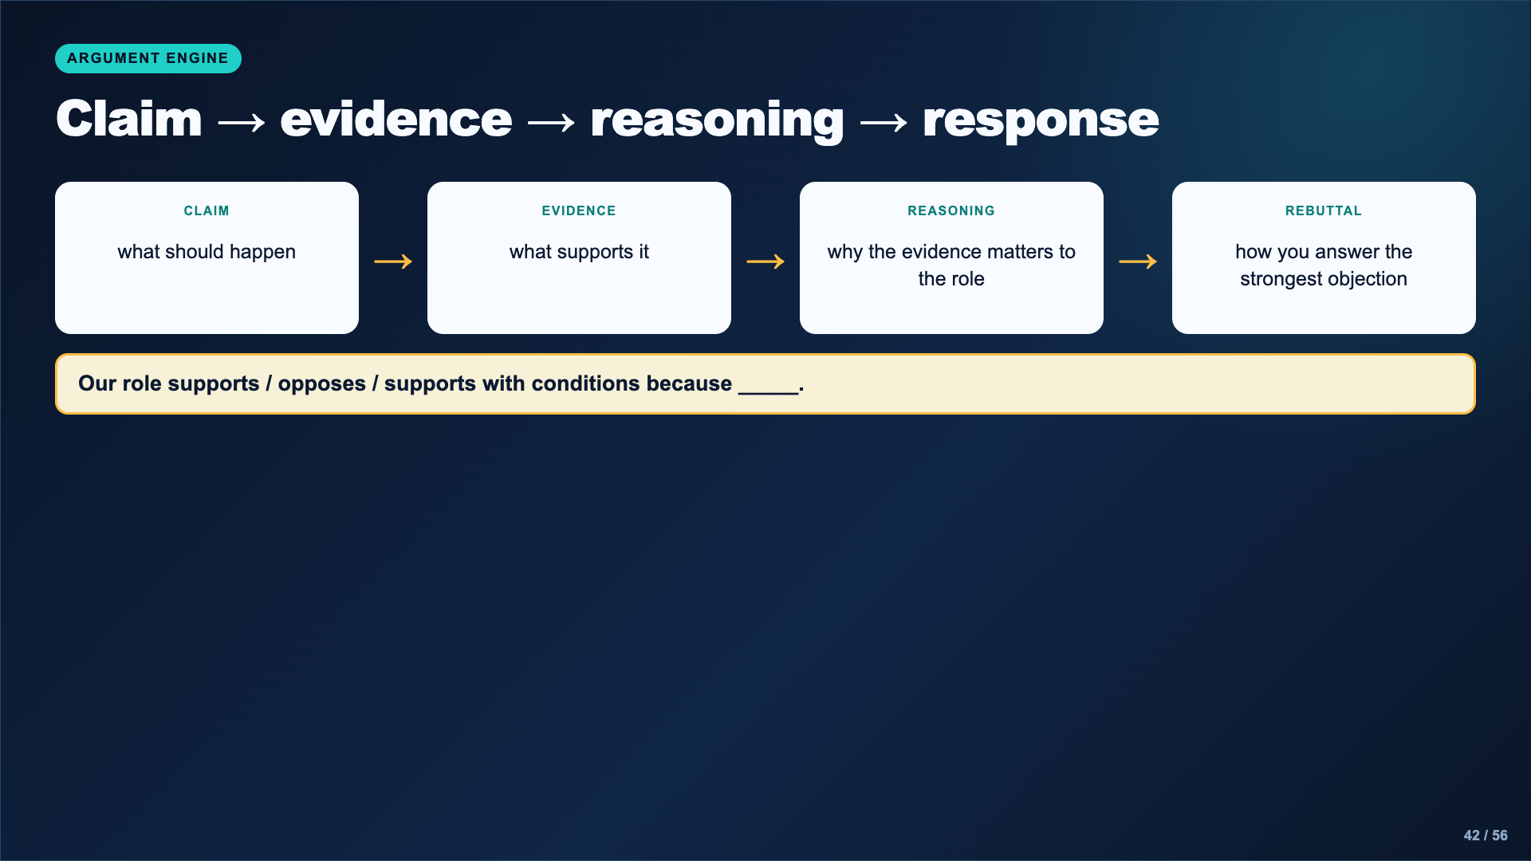
Notes:
Require students to answer the strongest objection, not the easiest one. A safeguard can produce a conditional position even when the role rejects fully automated scoring.
[Sources]
- AI Ethics Council Casebook and teacher facilitation sequence.

Slide 43
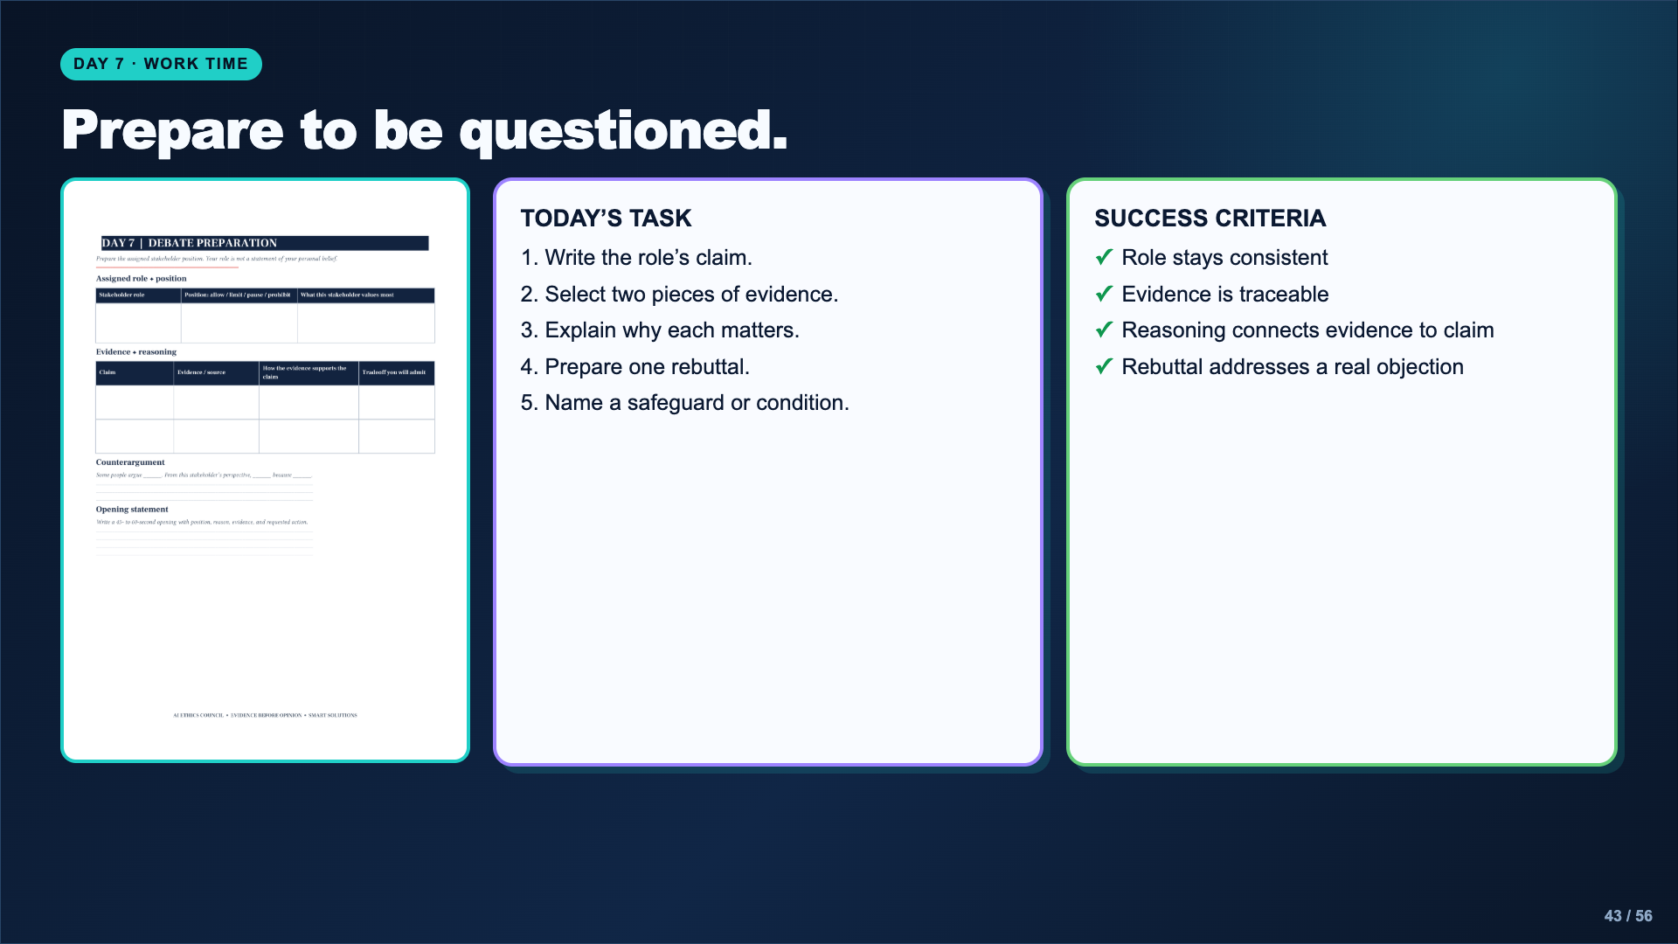
Notes:
Leave this slide projected. Conference with each role group. Ask what evidence would change its position and what decision-making power the role actually has.
[Sources]
- AI Ethics Council Casebook and teacher facilitation sequence.

Slide 44
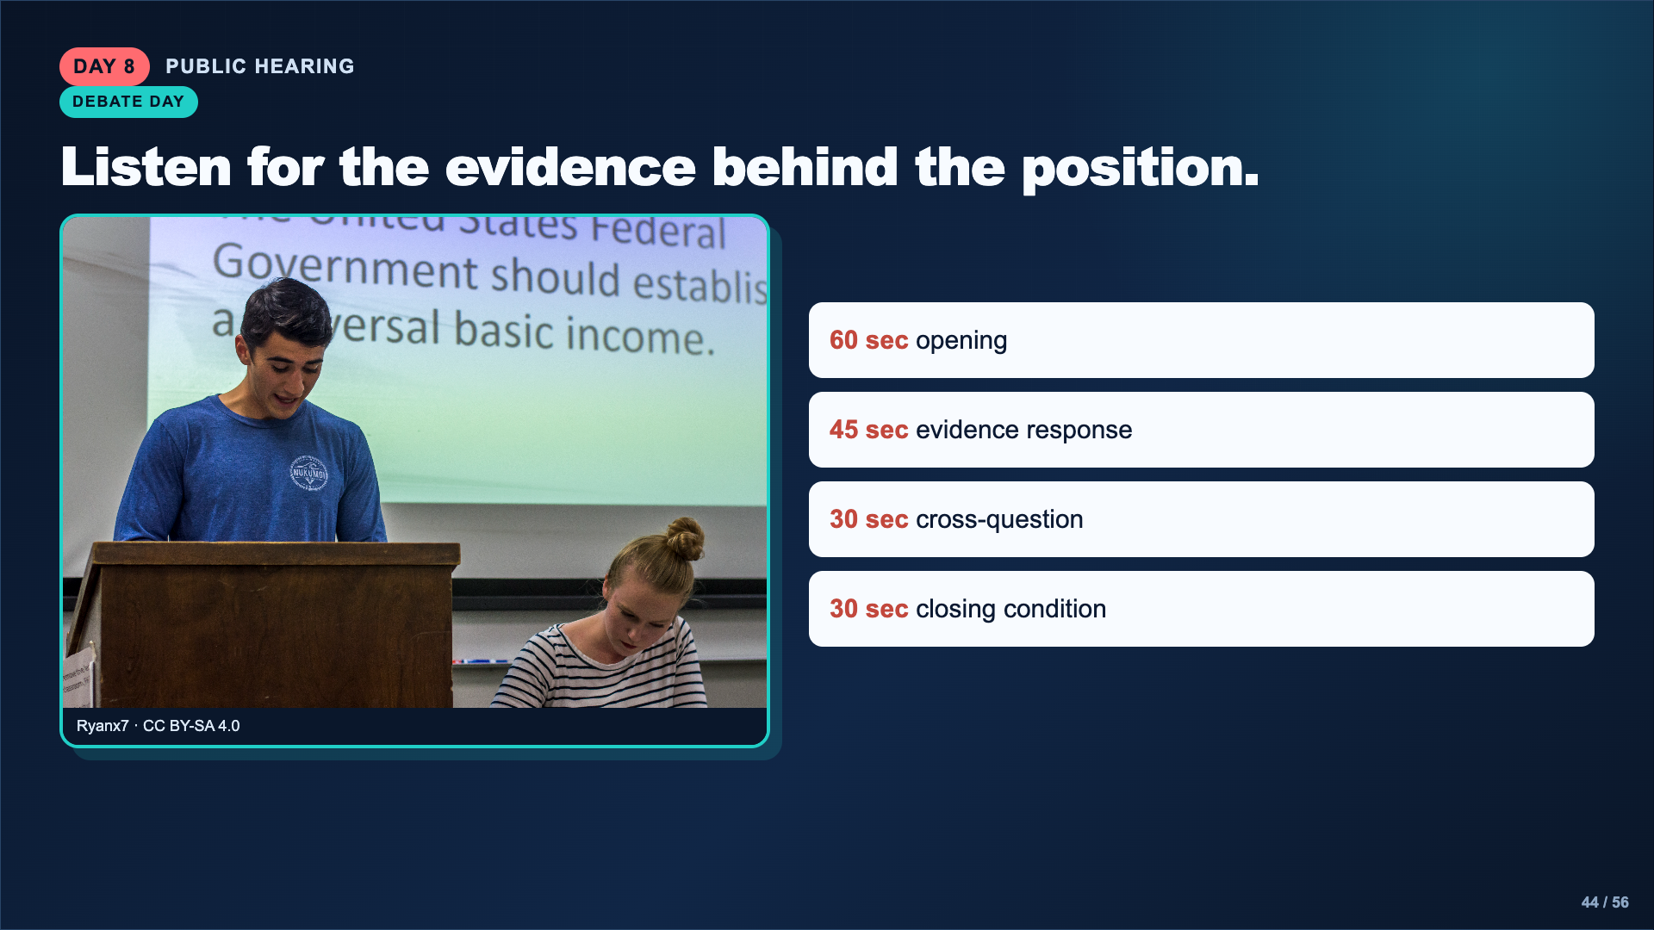
Notes:
Review the exact timing and order that fits the class period. Students who need a support route may read from prepared notes, submit a recorded statement, or serve as evidence tracker while still completing the reflection.
[Sources]
- Image: Ryanx7, CC BY-SA 4.0, https://commons.wikimedia.org/wiki/File:Two_college_students_debating.jpg

Slide 45
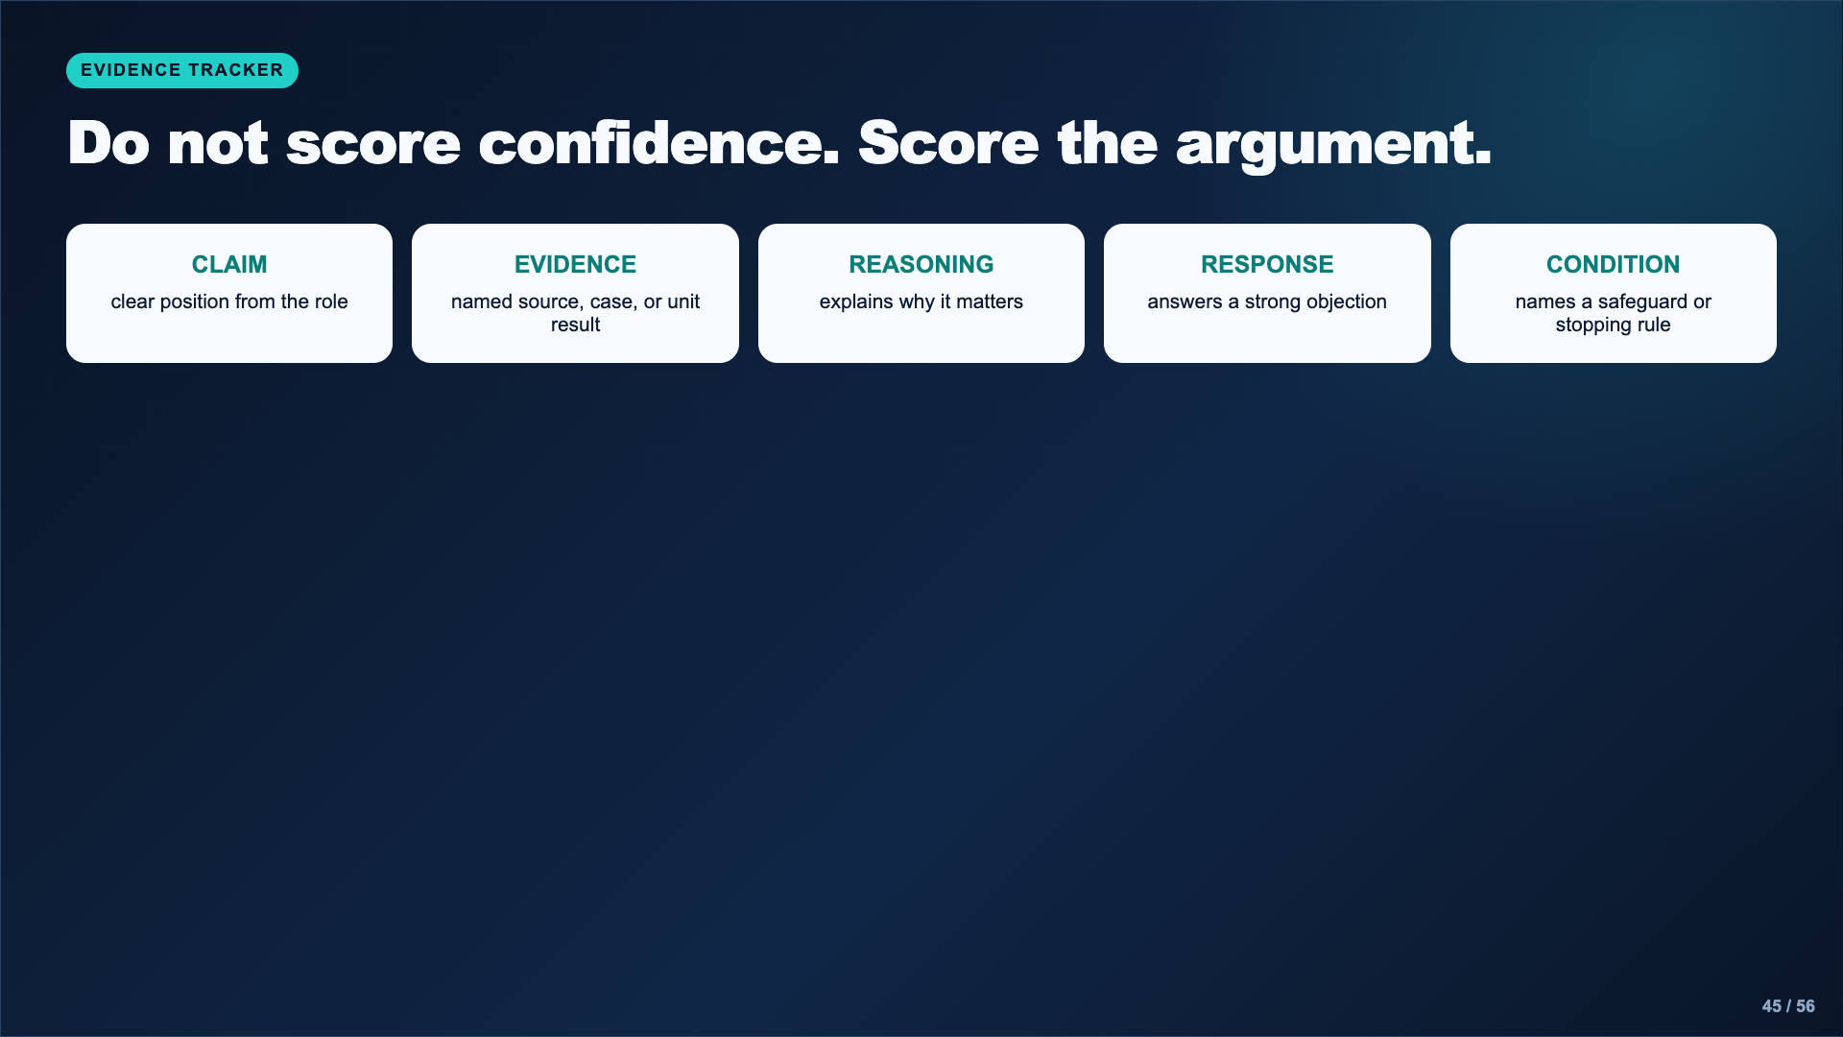
Notes:
Remind the audience that speaking style is not the evidence. Use the casebook tracker to record one strong move and one unanswered question from each role.
[Sources]
- AI Ethics Council Casebook and teacher facilitation sequence.

Slide 46
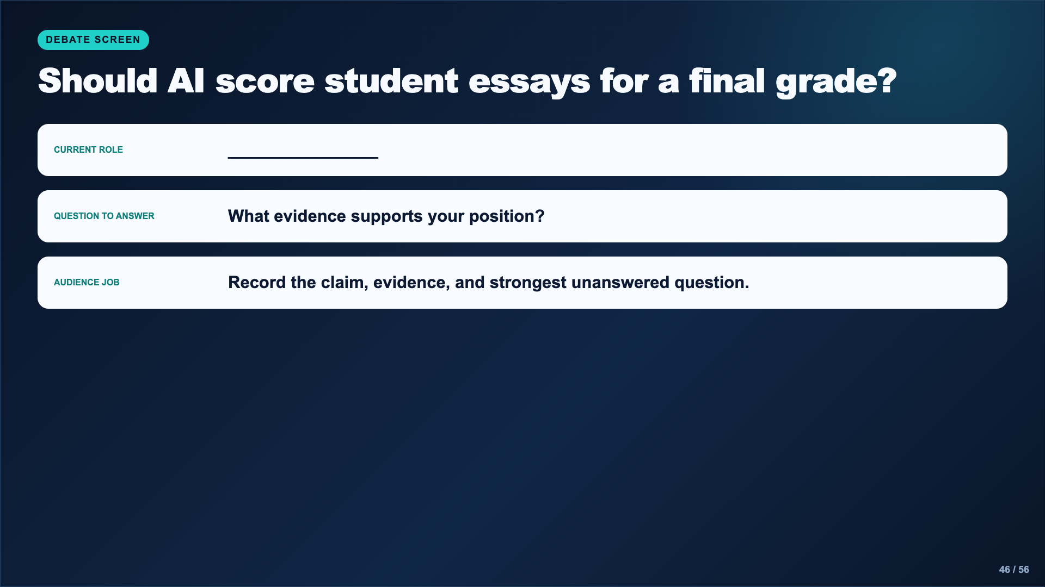
Notes:
Leave this slide up during the hearing and type the current role if practical. Pause after each role for the audience to finish its evidence note.
[Sources]
- AI Ethics Council Casebook and teacher facilitation sequence.

Slide 47
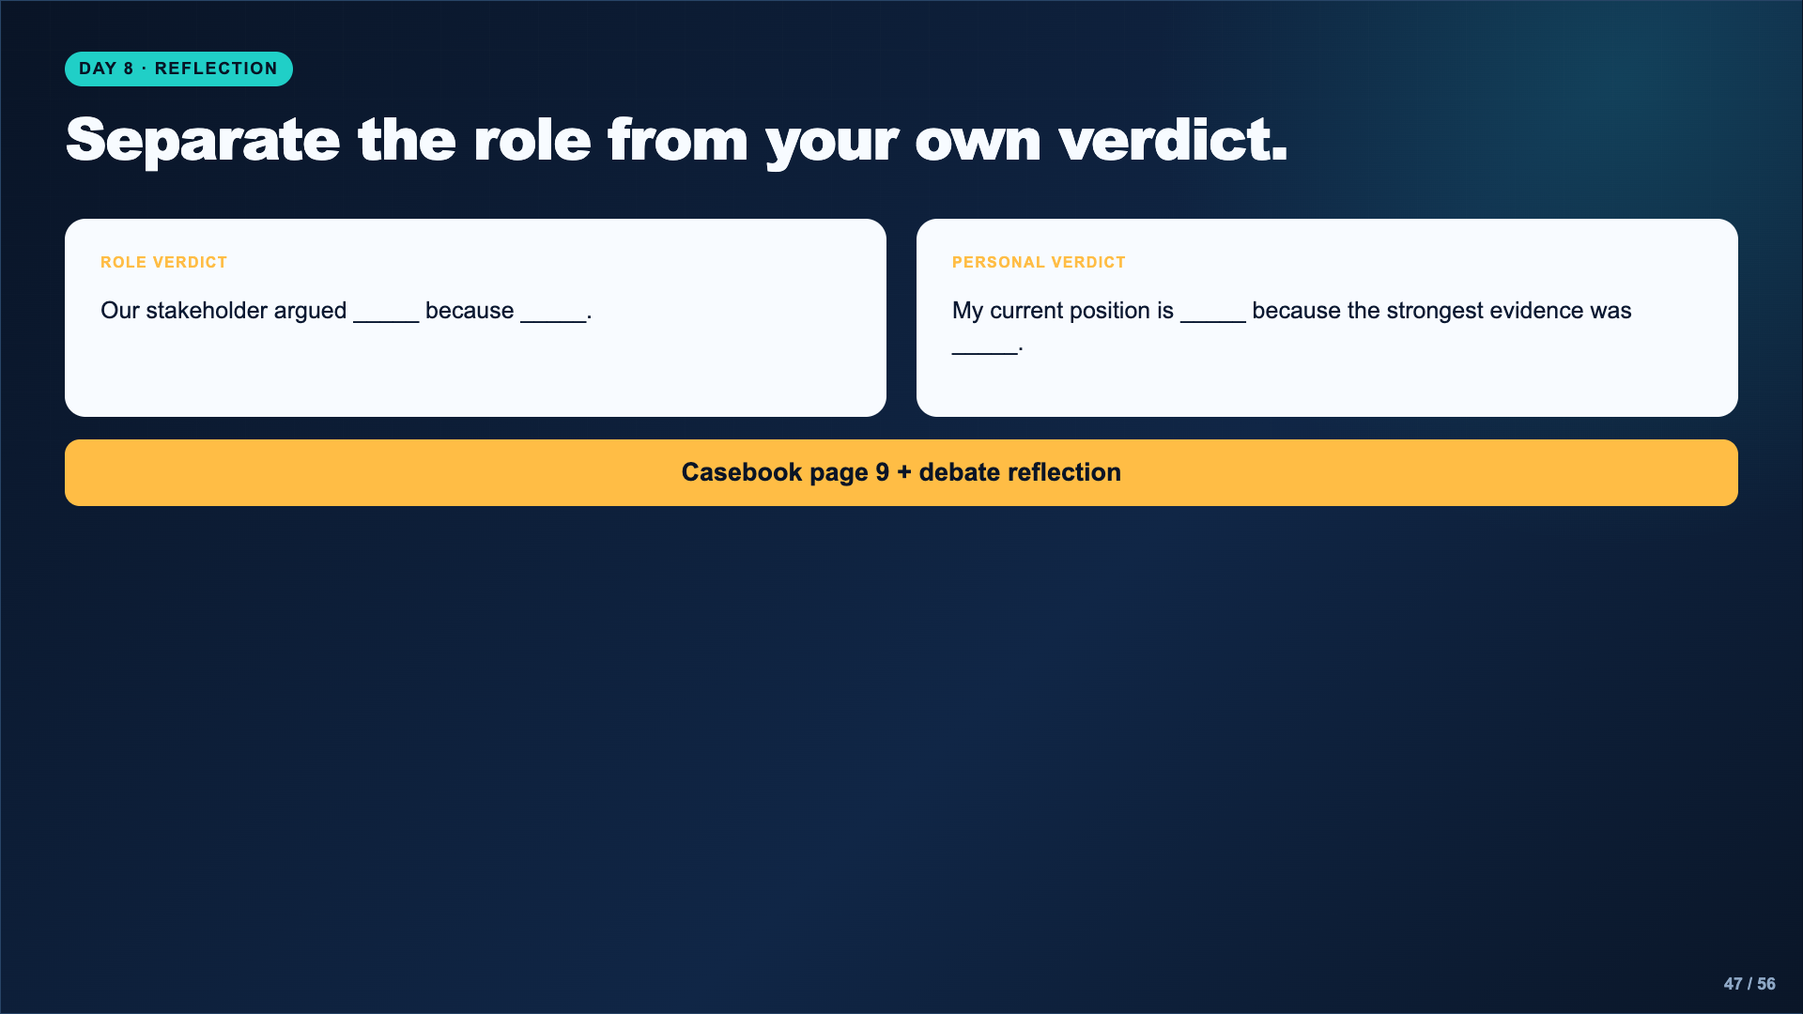
Notes:
Give students quiet time immediately after the hearing. The personal verdict may differ from the assigned role. Require one named piece of evidence or argument.
[Sources]
- AI Ethics Council Casebook and teacher facilitation sequence.

Slide 48
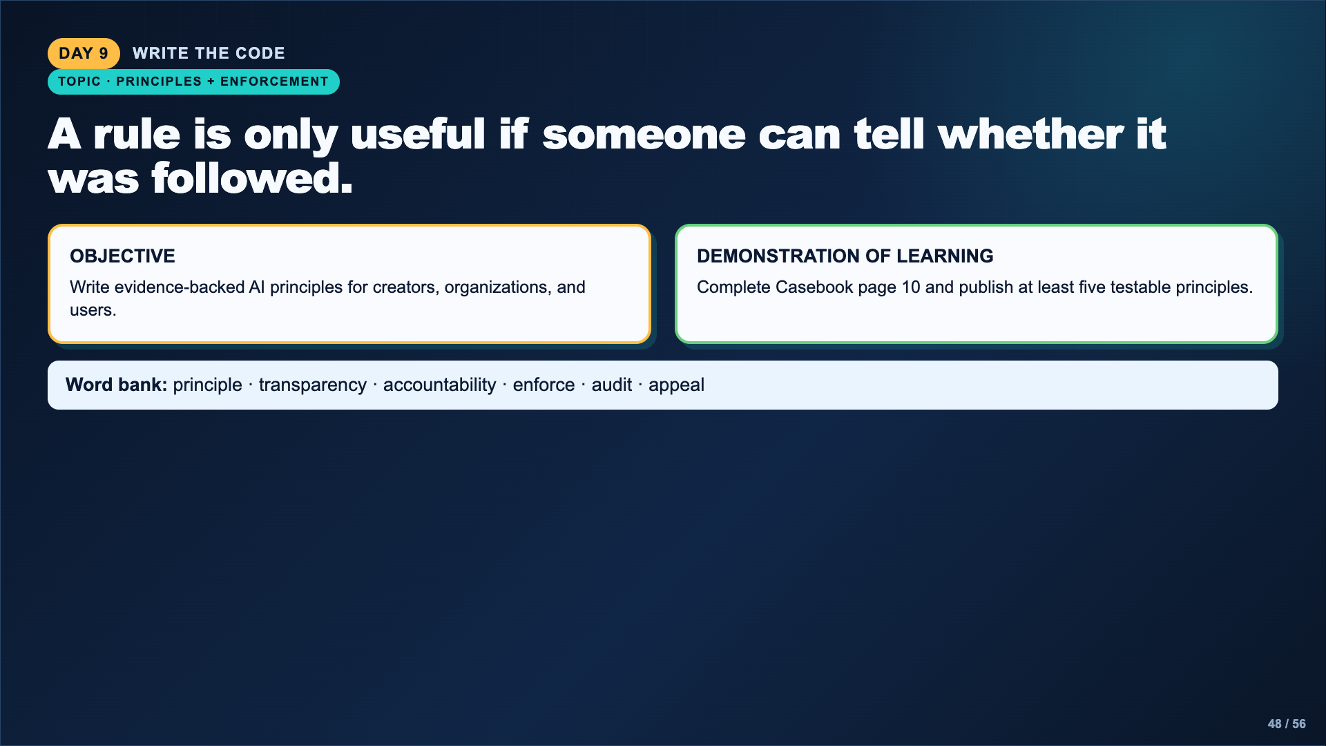
Notes:
Return to the Day 1 case and all later evidence. The code must include bias, privacy, misinformation, transparency, and accountability, with at least one rule for creators and one for users.
[Sources]
- https://studio.code.org/s/aiml-2022/lessons/14

Slide 49
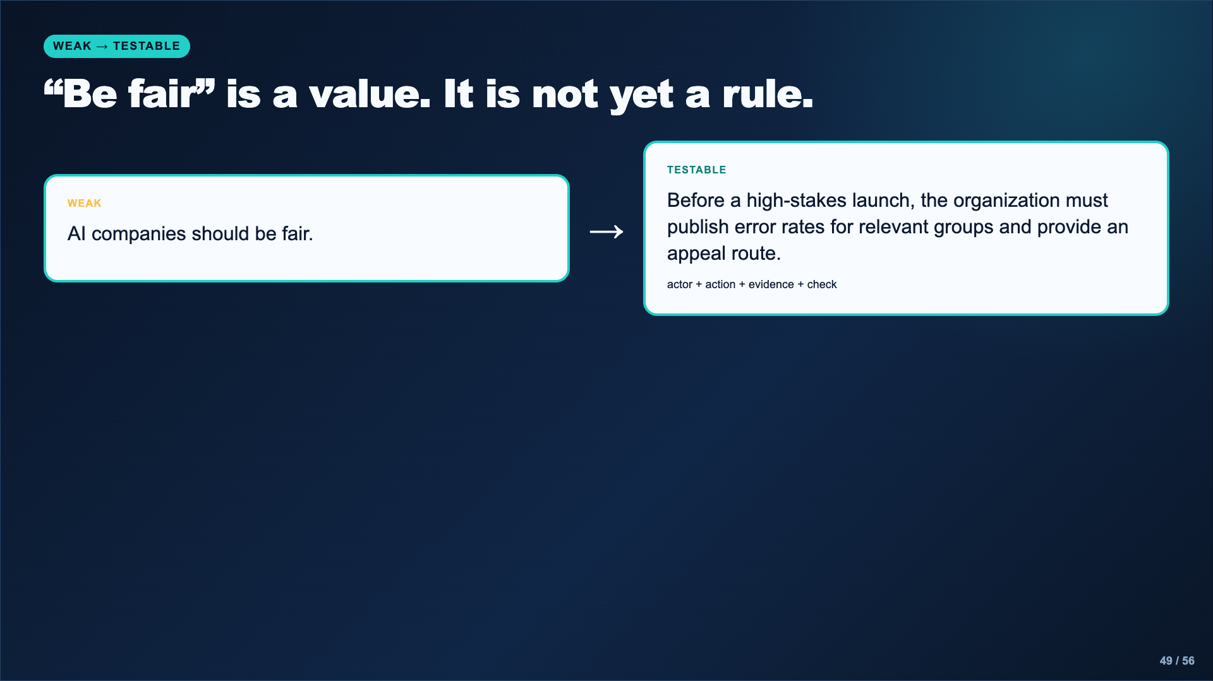
Notes:
Model the revision. A principle should name who must act, what the actor must do, and how someone can check whether it happened. Avoid guarantees such as “AI must never be biased.”
[Sources]
- https://studio.code.org/s/aiml-2022/lessons/14
- https://www.nist.gov/news-events/news/2019/12/nist-study-evaluates-effects-race-age-sex-face-recognition-software

Slide 50
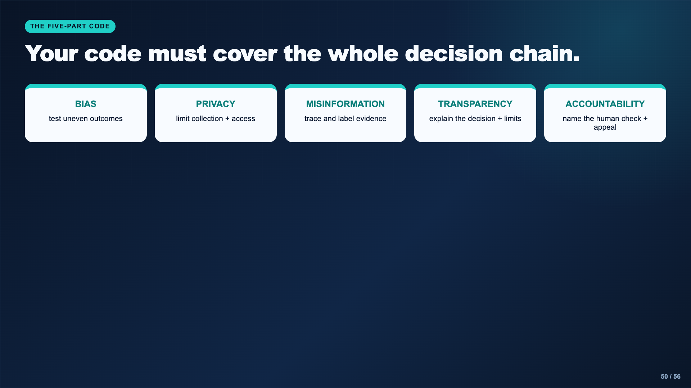
Notes:
Require at least five principles, not necessarily exactly one per category. Every principle needs a connection to a named case, source, or unit day.
[Sources]
- AI Ethics Council Casebook and teacher facilitation sequence.

Slide 51
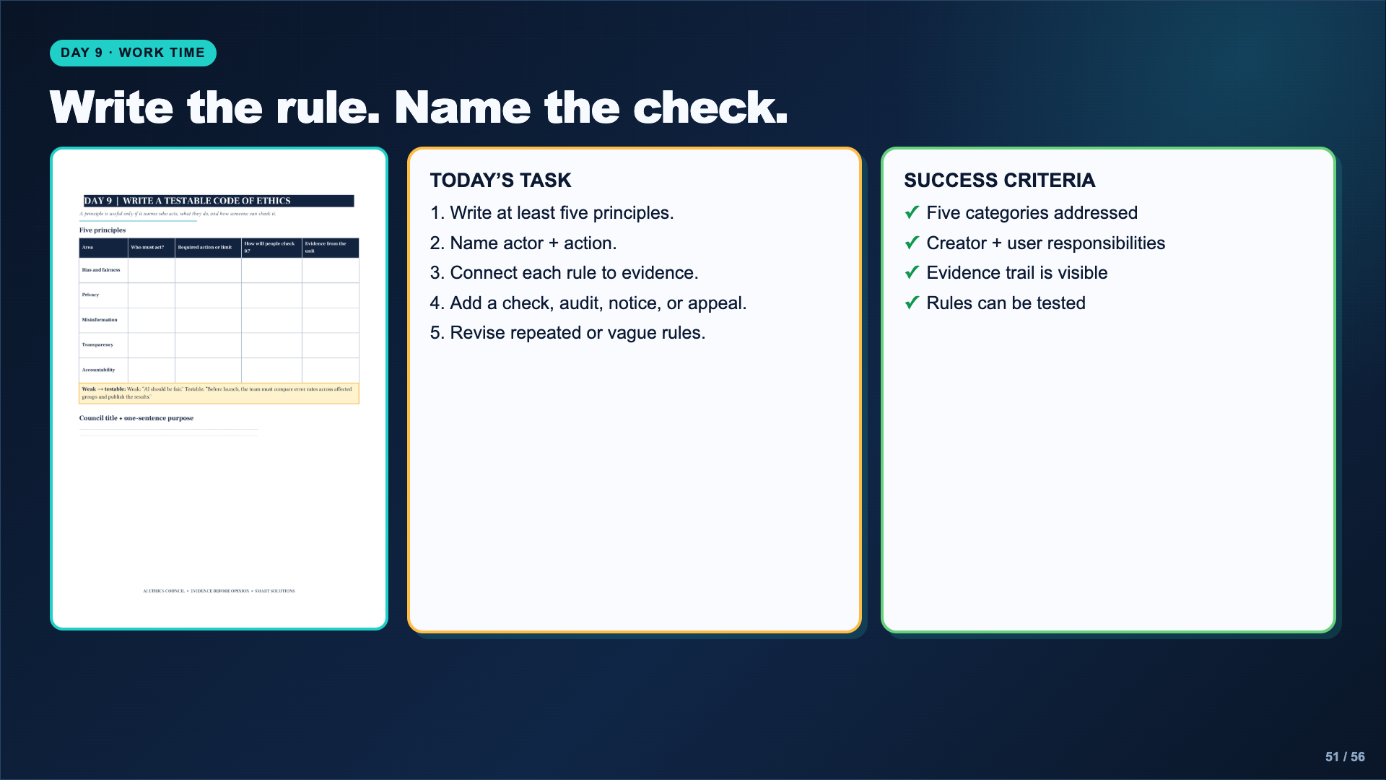
Notes:
Leave this slide projected. Do not let poster decoration consume the evidence work. A readable document or poster is enough.
[Sources]
- AI Ethics Council Casebook and teacher facilitation sequence.

Slide 52

Notes:
Set up a gallery walk or digital review. Every student must explain one principle and trace it to evidence, not only admire the design.
[Sources]
- AI Ethics Council Casebook and teacher facilitation sequence.

Slide 53

Notes:
Assign a direction and timer. Each group leaves one evidence-based strength and one question, missing case, or revision. Generic praise does not count as feedback.
[Sources]
- AI Ethics Council Casebook and teacher facilitation sequence.

Slide 54

Notes:
Keep these stems available at the point of use. They support emergent bilinguals without duplicating every instruction in two languages.
[Sources]
- AI Ethics Council Casebook and teacher facilitation sequence.

Slide 55

Notes:
Students may say their view did not change, but they must explain how the unit evidence strengthened or complicated it. Collect the complete casebook and final code.
[Sources]
- AI Ethics Council Casebook and teacher facilitation sequence.

Slide 56

Notes:
Close by naming the transferable routine. Students can use this evidence trail for AI recommendations, automated scores, surveillance, generated media, workplace tools, and future systems they have not seen yet.
[Sources]
- https://studio.code.org/s/aiml-2022/lessons/14
- https://www.media.mit.edu/projects/ai-ethics-for-middle-school/overview/
- https://www.dayofai.net/curriculum
- https://www.nist.gov/news-events/news/2019/12/nist-study-evaluates-effects-race-age-sex-face-recognition-software
- https://cor.inquirygroup.org/curriculum/lessons/intro-to-lateral-reading/

