Slide 1
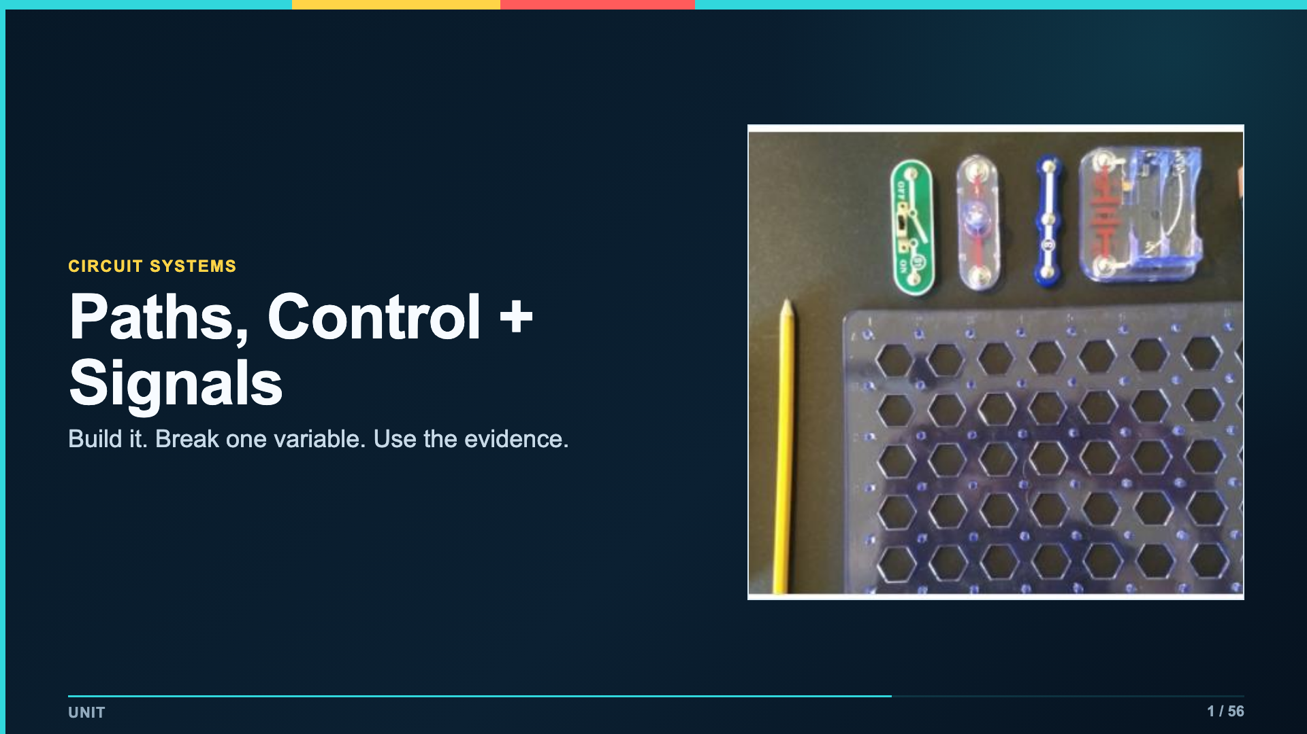
Notes:
Open with the unit habit: trace the path before swapping parts. Students will reuse that habit in every build and in the final signal system.
[Sources]
- Verizon Innovative Learning Schools and Arizona State University, Circuits lesson materials
- https://www.elenco.com/wp-content/uploads/2021/12/SC_300_Manual_2021.pdf

Slide 2
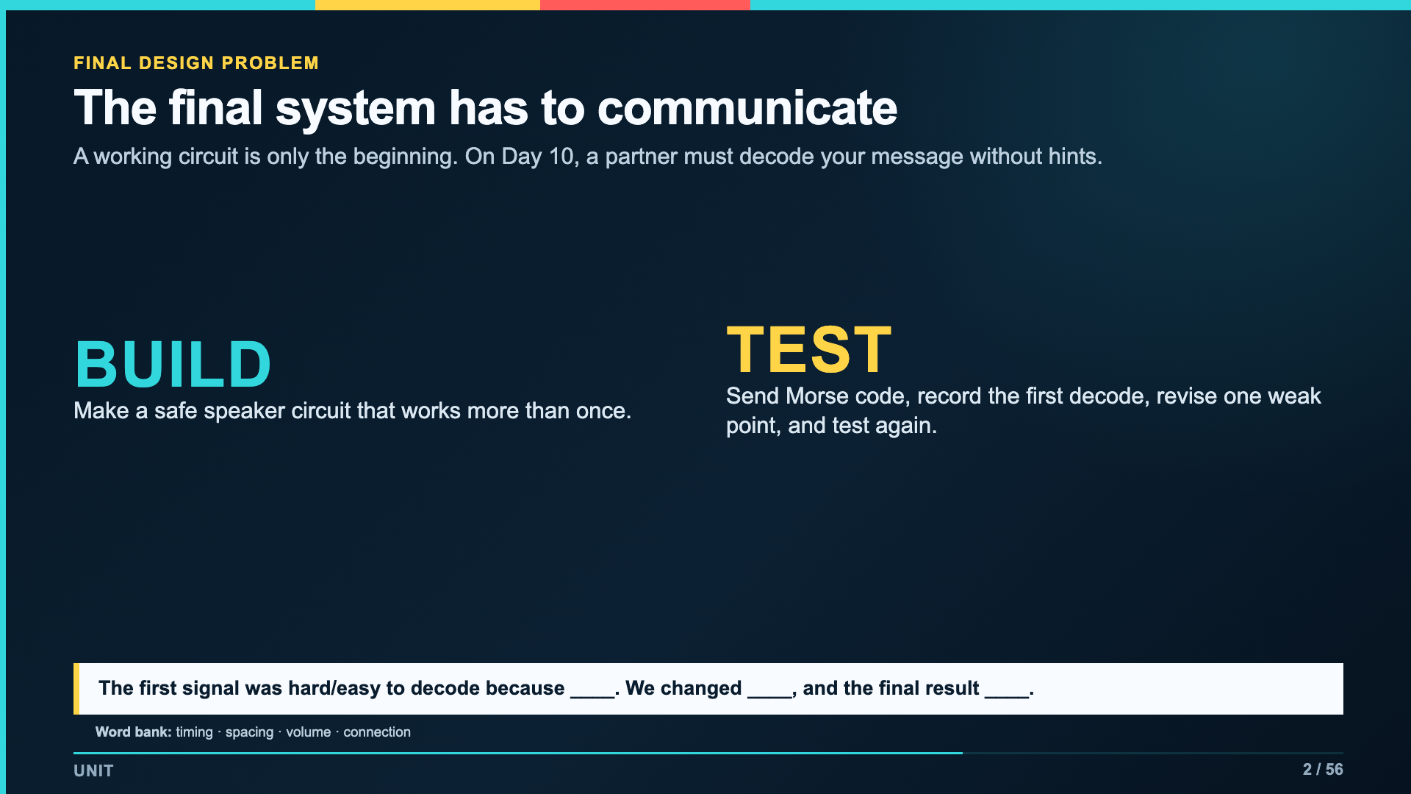
Notes:
Do not teach the final rubric yet. Give students a reason to care about path tracing: their partner will be the judge of whether the system communicates.
[Sources]
- Verizon Innovative Learning Schools and Arizona State University, Circuits lesson materials

Slide 3
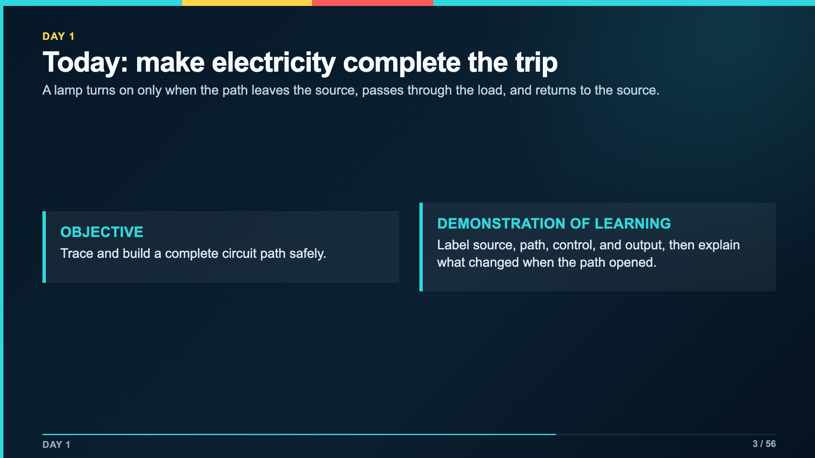
Notes:
Read the objective and evidence aloud. Administration should be able to see both without interrupting the lesson flow.
[Sources]
- Verizon Innovative Learning Schools and Arizona State University, Circuits lesson materials
- https://www.elenco.com/wp-content/uploads/2021/12/SC_300_Manual_2021.pdf

Slide 4
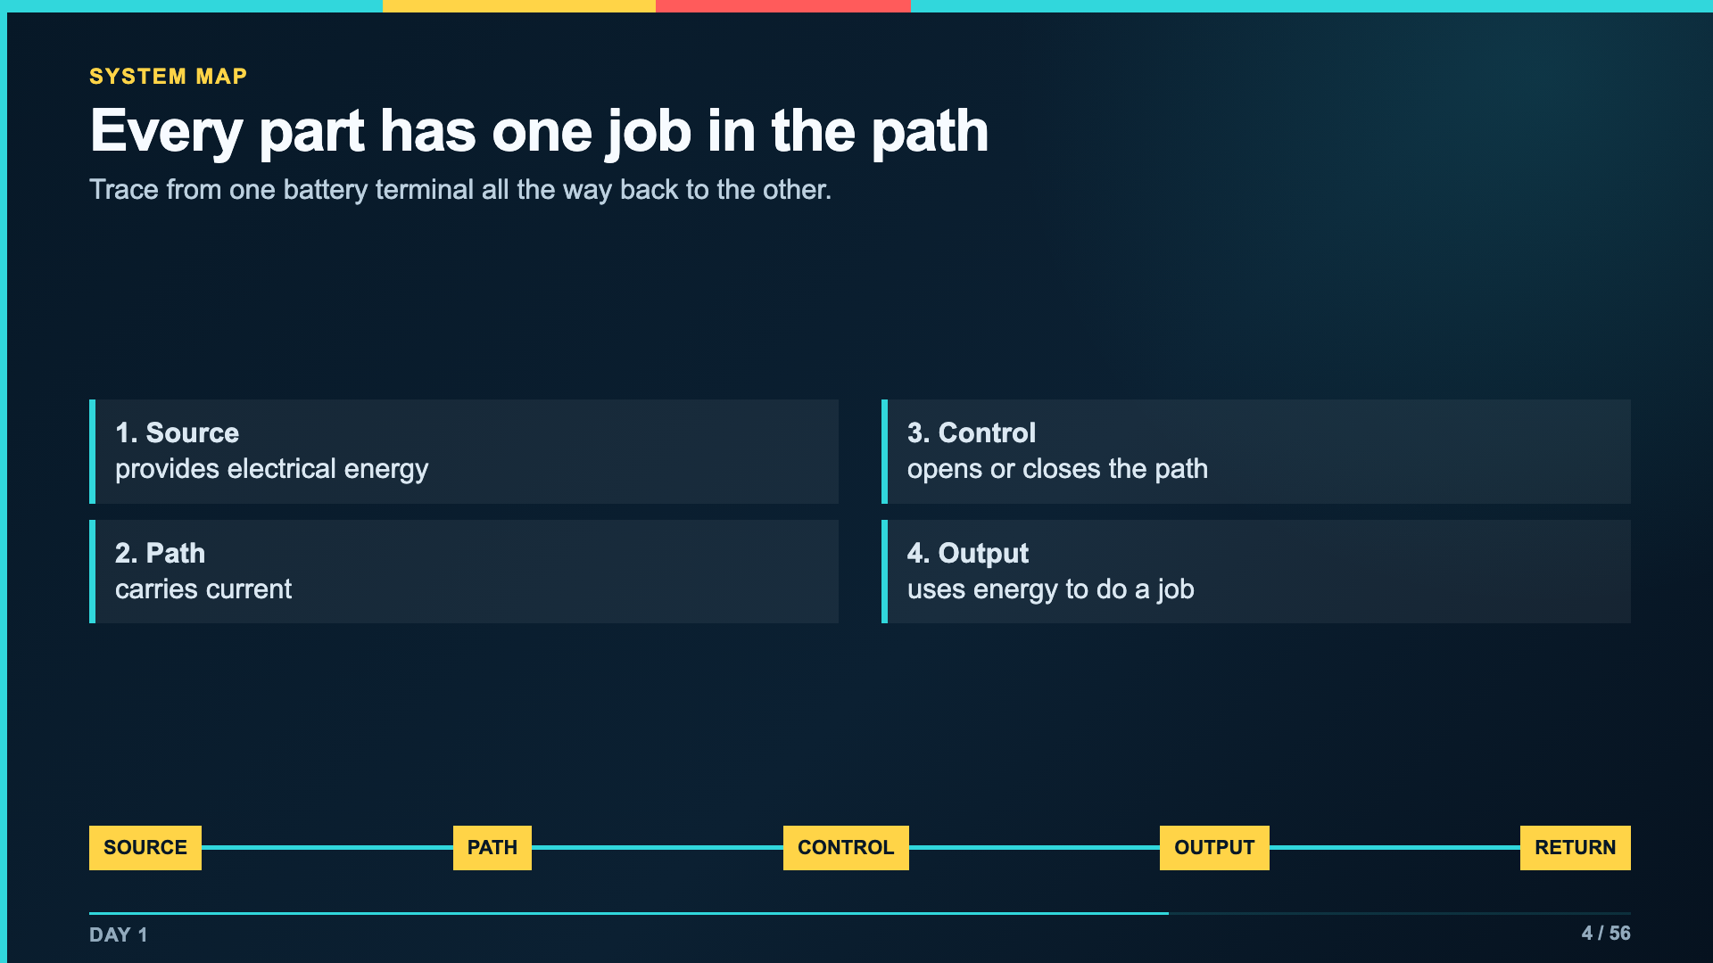
Notes:
Trace the wire line with a finger or pointer. Ask students to name the job before naming a specific component.
[Sources]
- https://www.elenco.com/wp-content/uploads/2021/12/SC_300_Manual_2021.pdf
- Verizon Innovative Learning Schools and Arizona State University, Circuits lesson materials

Slide 5
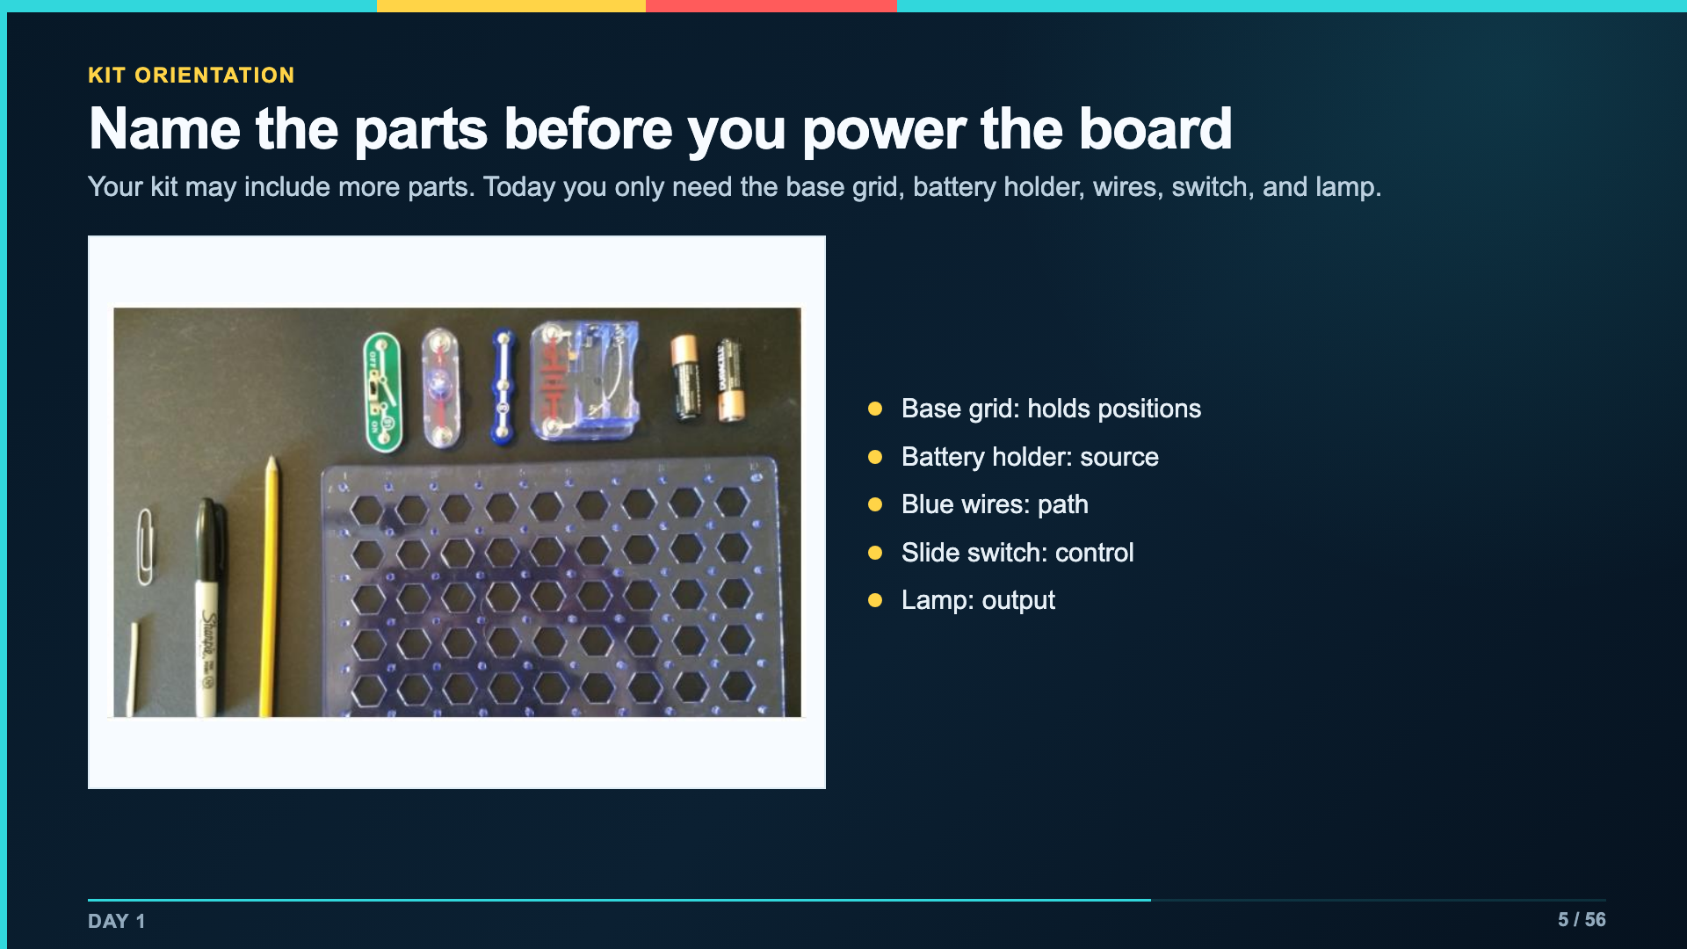
Notes:
Have students touch each part in an unpowered kit. Keep batteries out until every group can identify the switch and output.
[Sources]
- Verizon Innovative Learning Schools and Arizona State University, Circuits lesson materials
- https://www.elenco.com/wp-content/uploads/2021/12/SC_300_Manual_2021.pdf

Slide 6
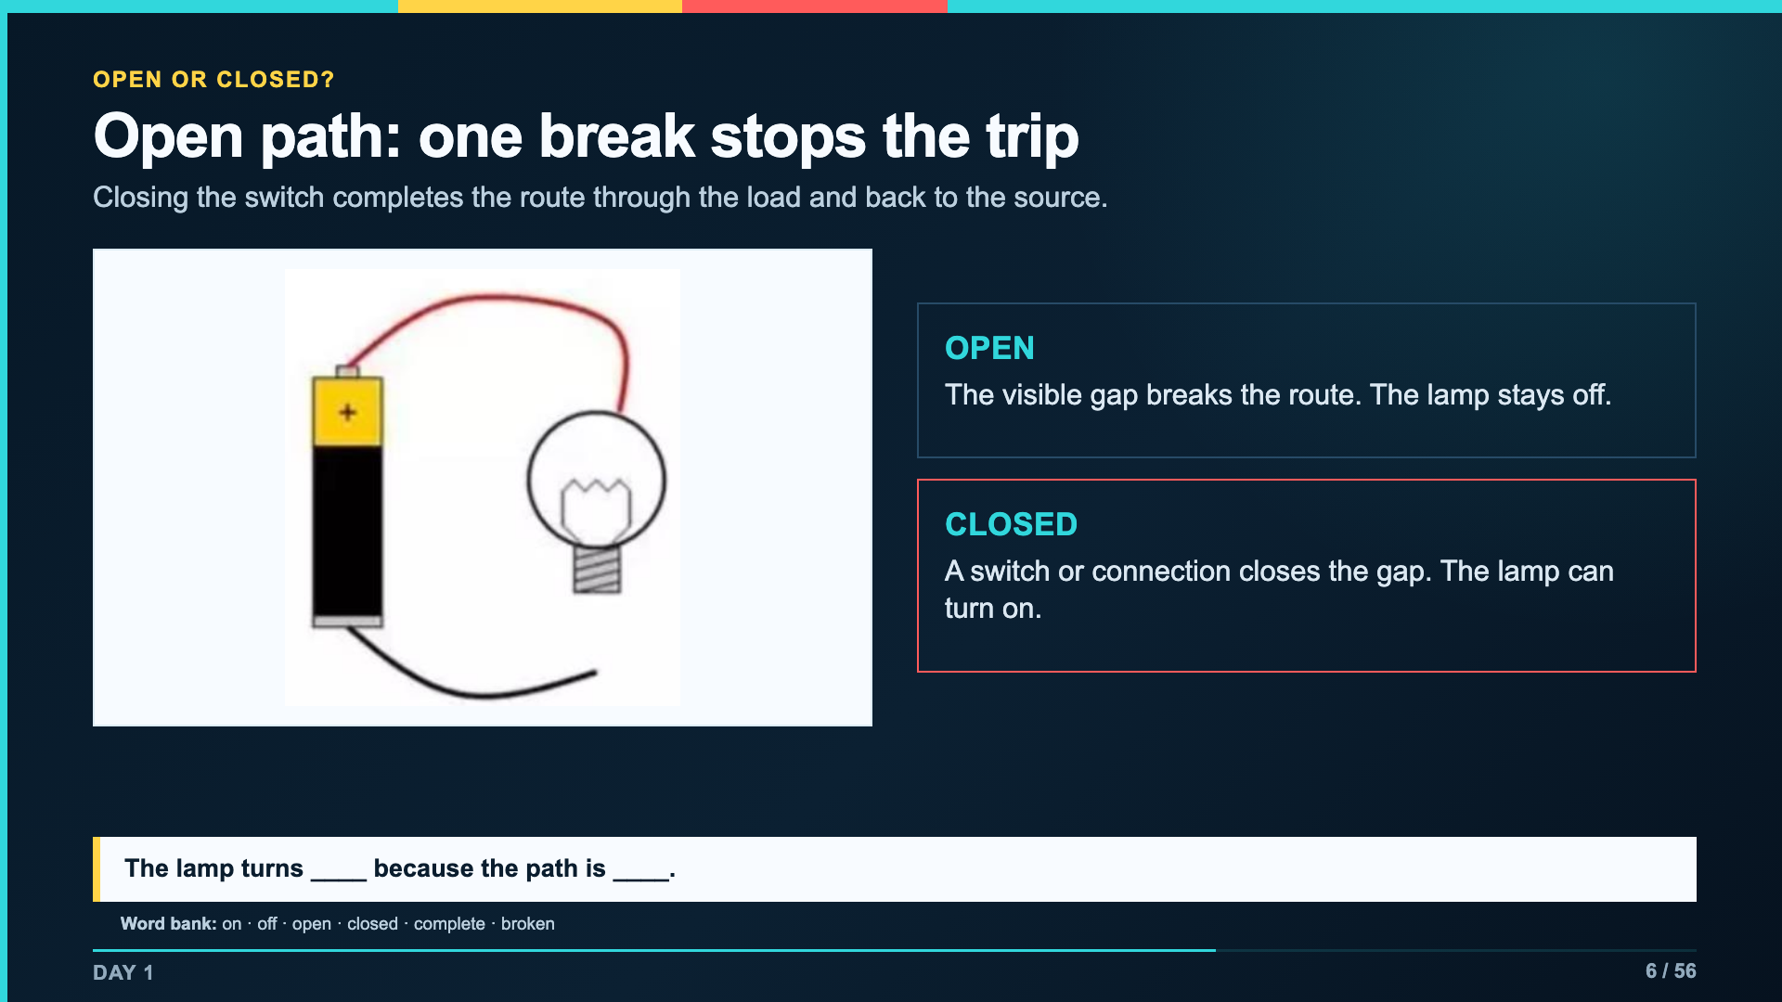
Notes:
Close the open connection in the diagram with a finger. Then point to the switch on the physical kit and show that it creates the same kind of break on purpose.
[Sources]
- Verizon Innovative Learning Schools and Arizona State University, Circuits lesson materials
- https://www.elenco.com/wp-content/uploads/2021/12/SC_300_Manual_2021.pdf

Slide 7
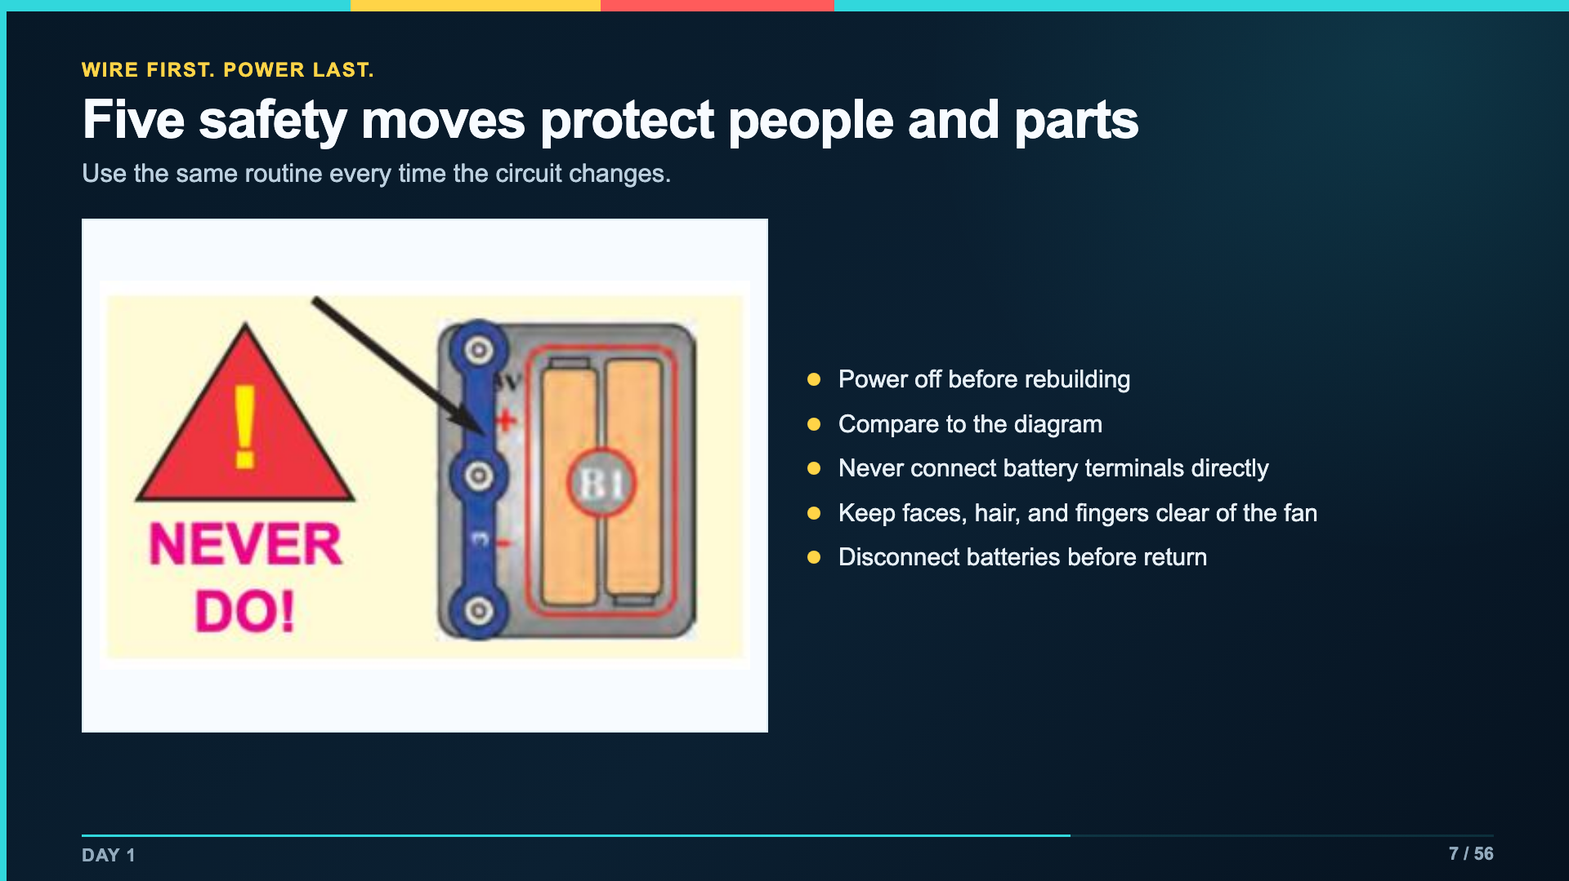
Notes:
These are operating conditions, not an optional reminder. Stop any group that powers while rebuilding or makes a direct battery connection.
[Sources]
- https://www.elenco.com/wp-content/uploads/2021/12/SC_300_Manual_2021.pdf
- Verizon Innovative Learning Schools and Arizona State University, Circuits lesson materials

Slide 8
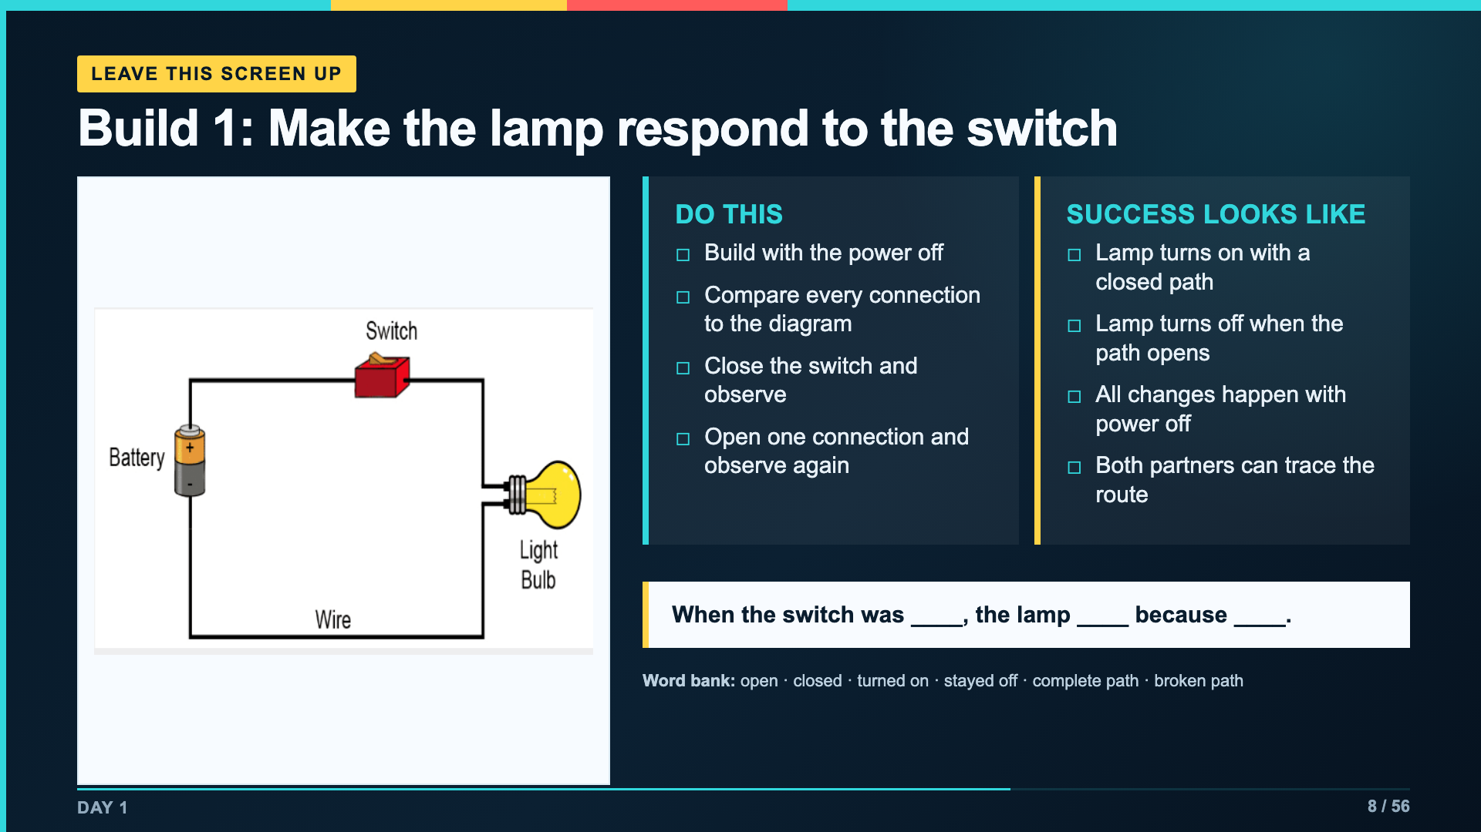
Notes:
Leave this slide projected for the Day 1 build. Students record the component jobs and open/closed evidence in Lab Packet 1.
[Sources]
- Verizon Innovative Learning Schools and Arizona State University, Circuits lesson materials
- https://www.elenco.com/wp-content/uploads/2021/12/SC_300_Manual_2021.pdf

Slide 9
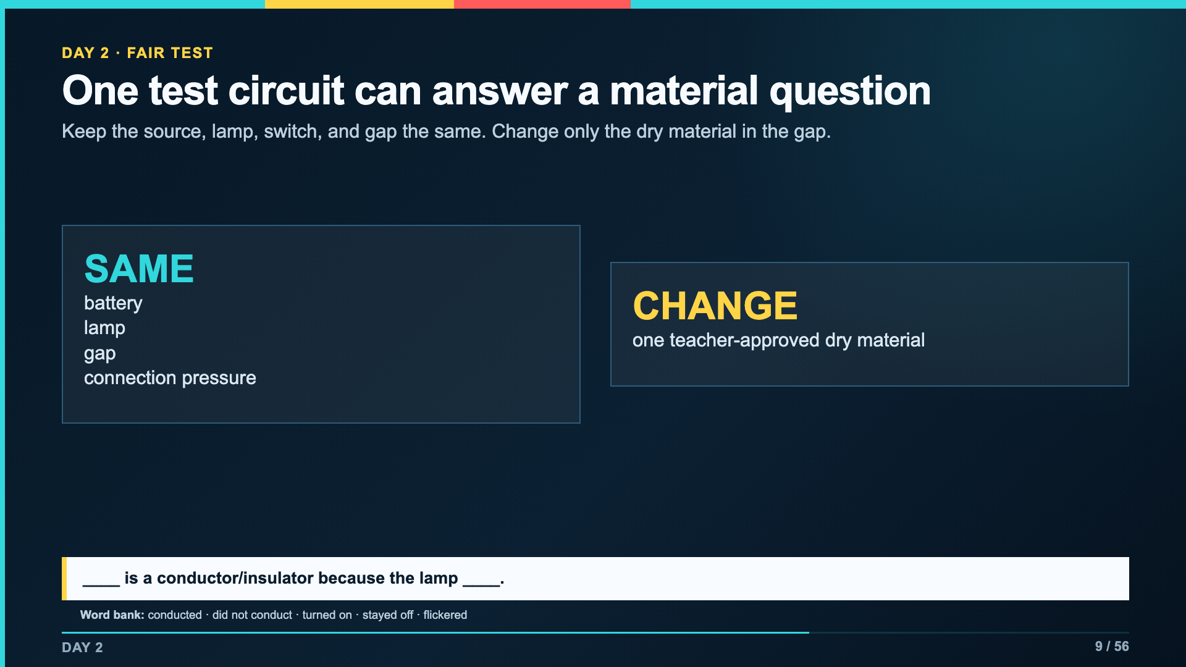
Notes:
Set up one stable test circuit before students rotate materials. A flicker is a result to repeat, not an invitation to change several things at once.
[Sources]
- Verizon Innovative Learning Schools and Arizona State University, Circuits lesson materials

Slide 10
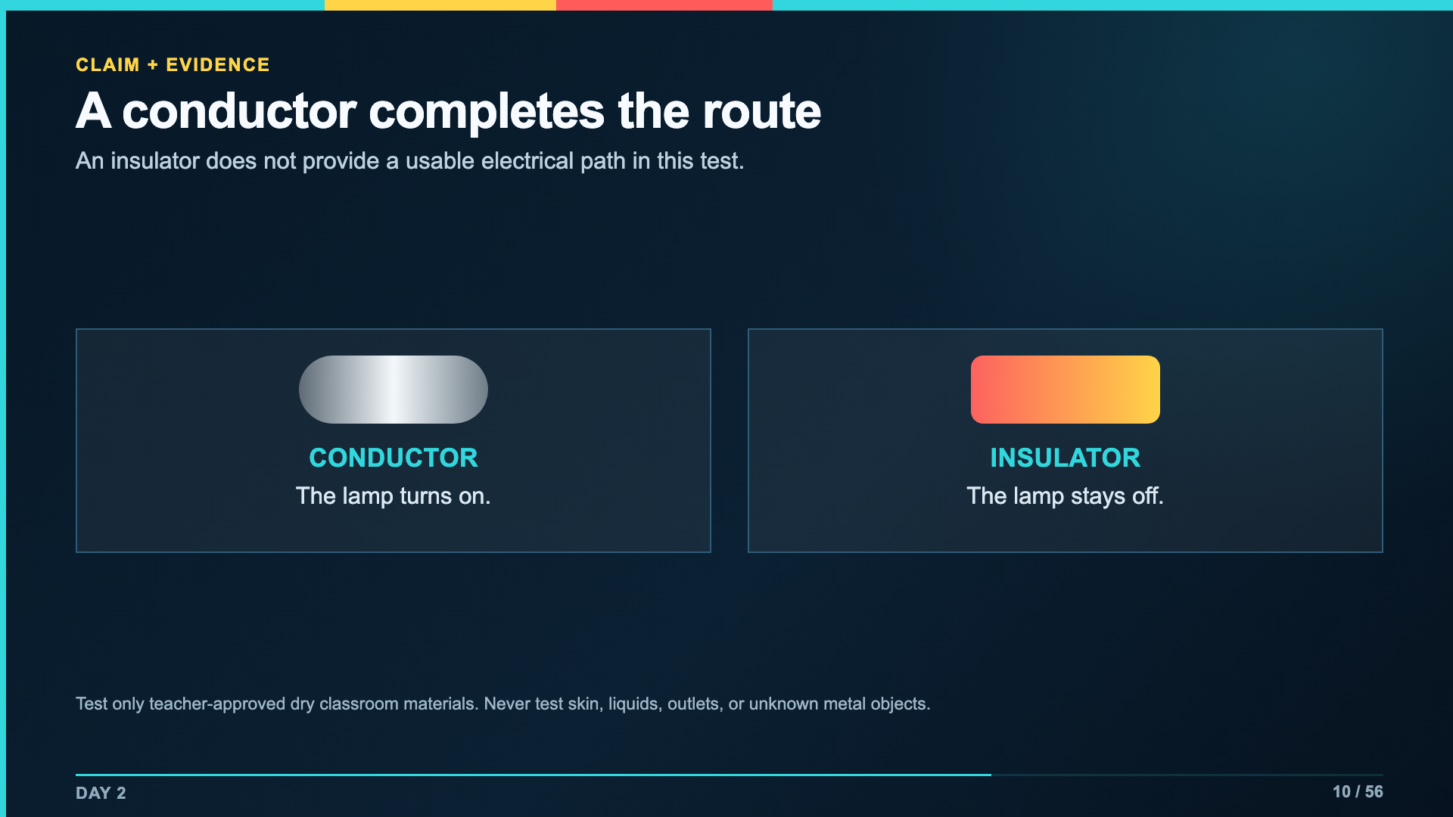
Notes:
Use metal and plastic as contrasting teacher examples. Avoid saying that every metal result will be identical; poor contact can create a flicker.
[Sources]
- Verizon Innovative Learning Schools and Arizona State University, Circuits lesson materials
- https://www.elenco.com/wp-content/uploads/2021/12/SC_300_Manual_2021.pdf

Slide 11
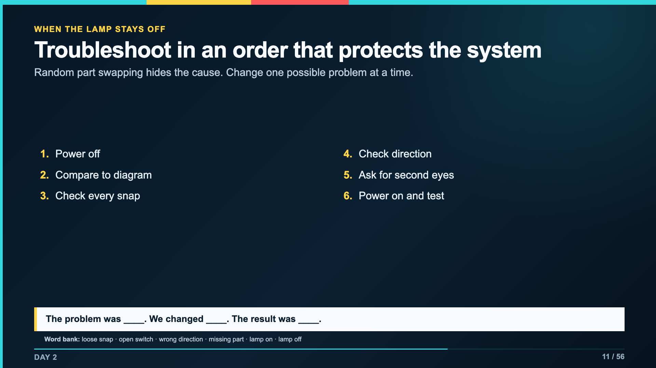
Notes:
Model one deliberate fault. Narrate that troubleshooting is a controlled test, not guessing faster.
[Sources]
- https://www.elenco.com/wp-content/uploads/2021/12/SC_300_Manual_2021.pdf
- Verizon Innovative Learning Schools and Arizona State University, Circuits lesson materials

Slide 12
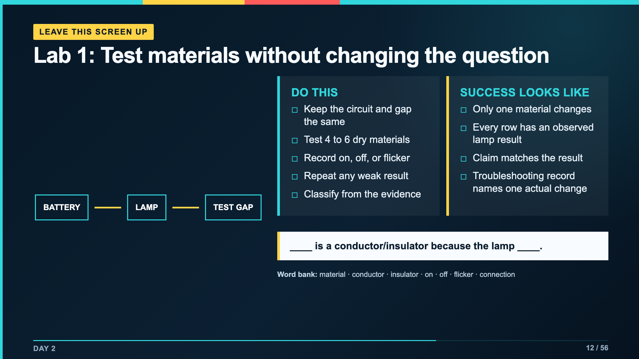
Notes:
Leave this slide projected during the material test. The packet has six rows so teachers can reduce, not expand, the number of samples when time is tight.
[Sources]
- Verizon Innovative Learning Schools and Arizona State University, Circuits lesson materials

Slide 13
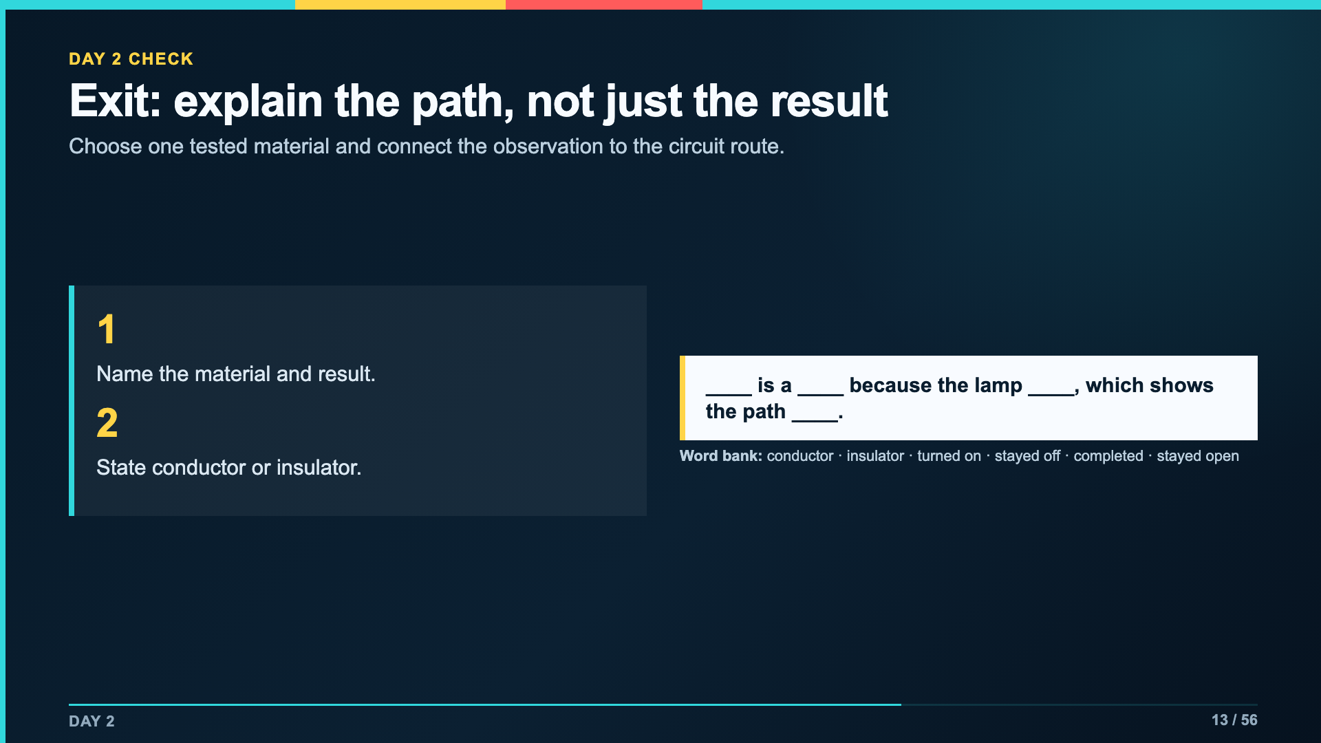
Notes:
Collect this response in Canvas Checkpoint 1 or on the paper packet. The explanation must connect the lamp evidence to the path.
[Sources]
- Verizon Innovative Learning Schools and Arizona State University, Circuits lesson materials

Slide 14
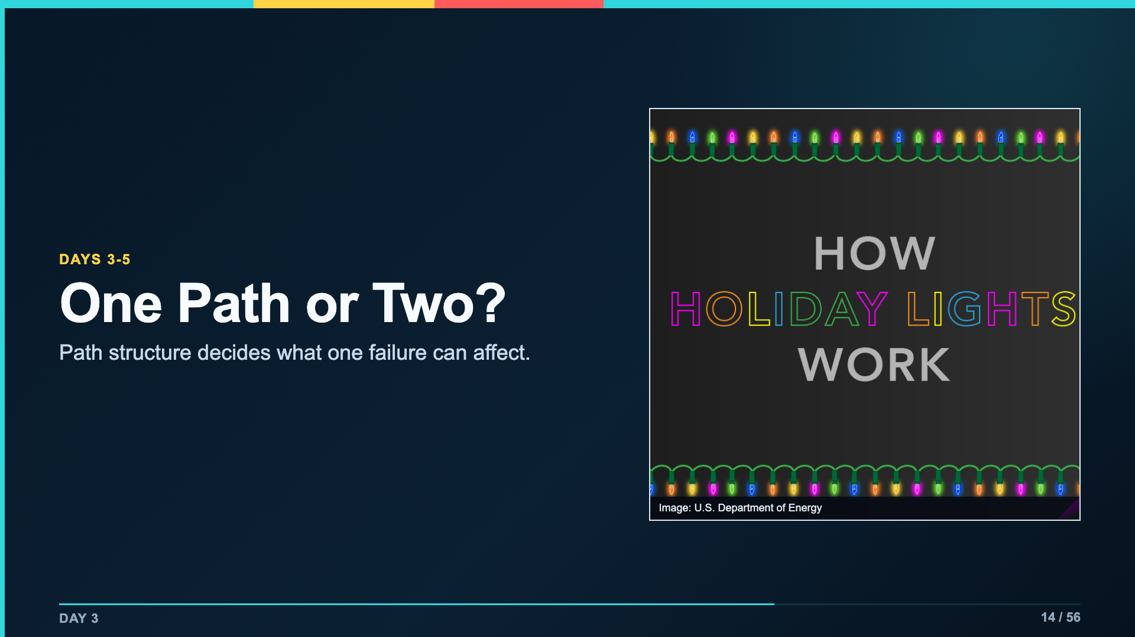
Notes:
Use the lights as a hook, not as proof of one exact wiring design. Ask what a single failed bulb can affect and what evidence students would need.
[Sources]
- https://www.energy.gov/articles/how-do-holiday-lights-work
- Verizon Innovative Learning Schools and Arizona State University, Circuits lesson materials

Slide 15
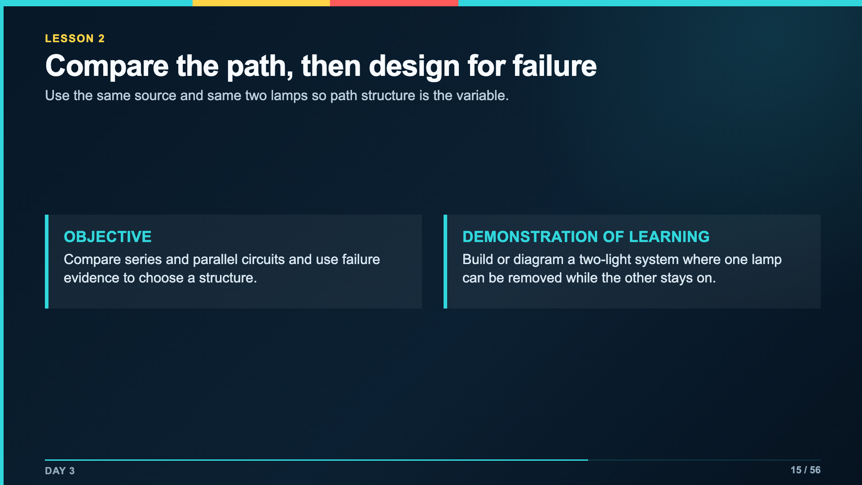
Notes:
Keep students focused on reliability, not only brightness. The final Day 5 test gives the comparison a design purpose.
[Sources]
- https://www.energy.gov/articles/how-do-holiday-lights-work
- Verizon Innovative Learning Schools and Arizona State University, Circuits lesson materials
- https://www.elenco.com/wp-content/uploads/2021/12/SC_300_Manual_2021.pdf

Slide 16
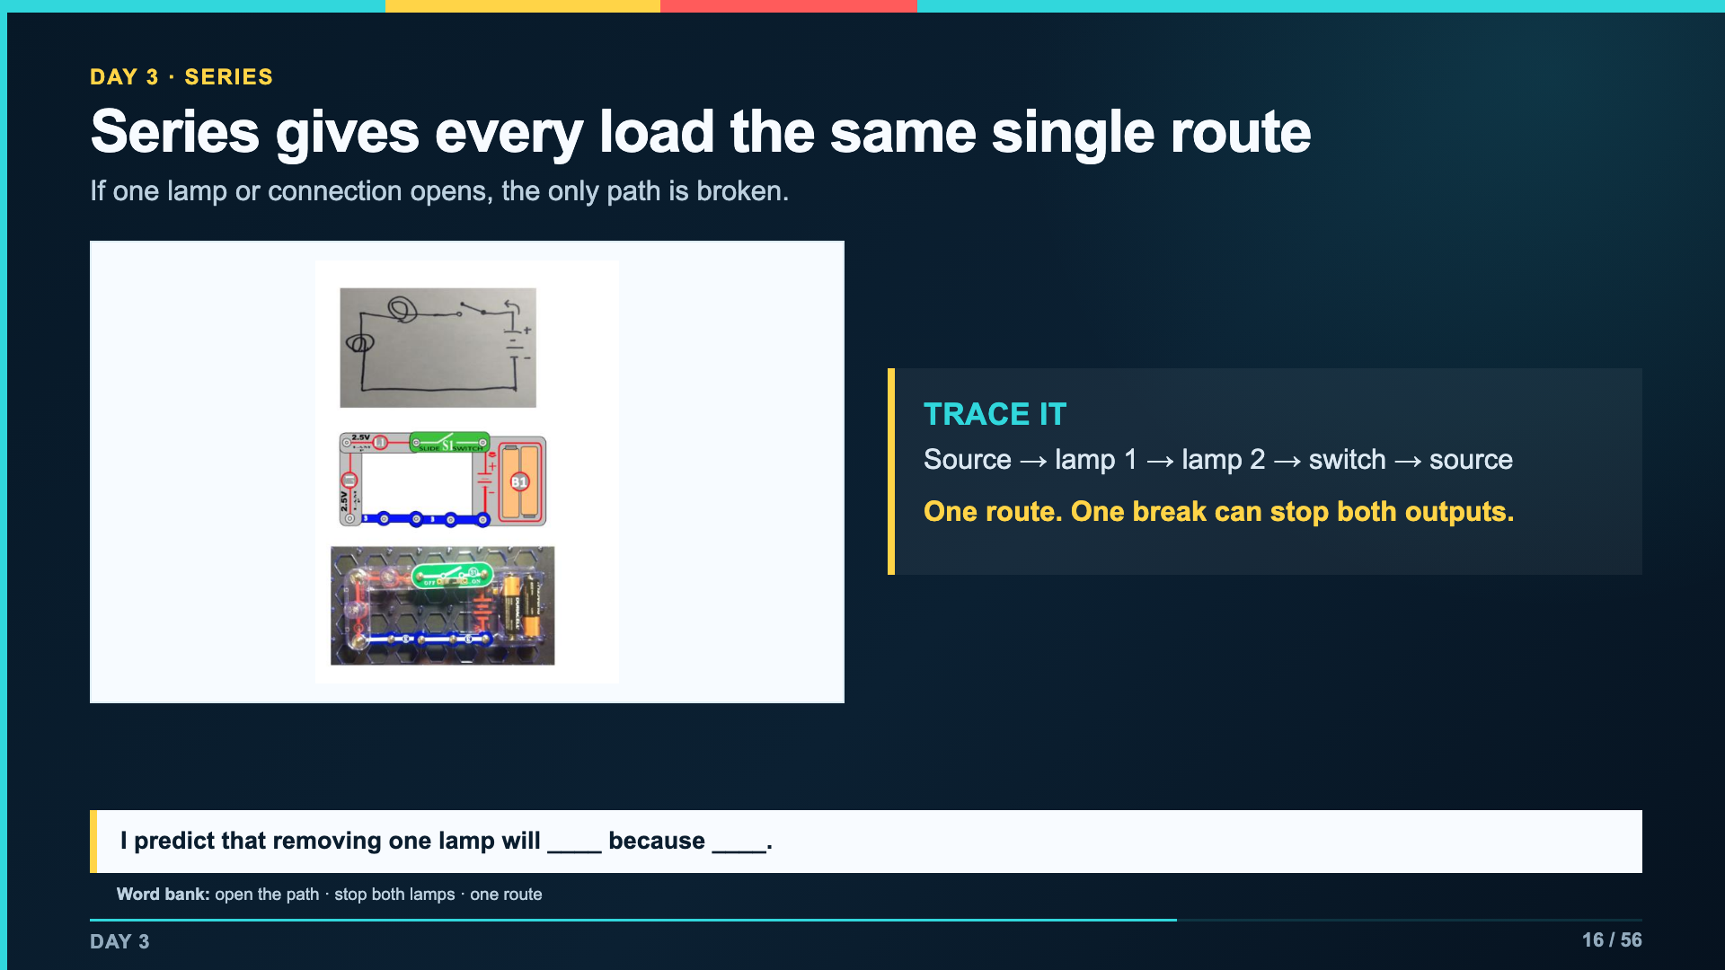
Notes:
Have students trace the same route in all three representations before they build. The hand sketch, kit diagram, and physical board should agree.
[Sources]
- Verizon Innovative Learning Schools and Arizona State University, Circuits lesson materials
- https://www.elenco.com/wp-content/uploads/2021/12/SC_300_Manual_2021.pdf

Slide 17
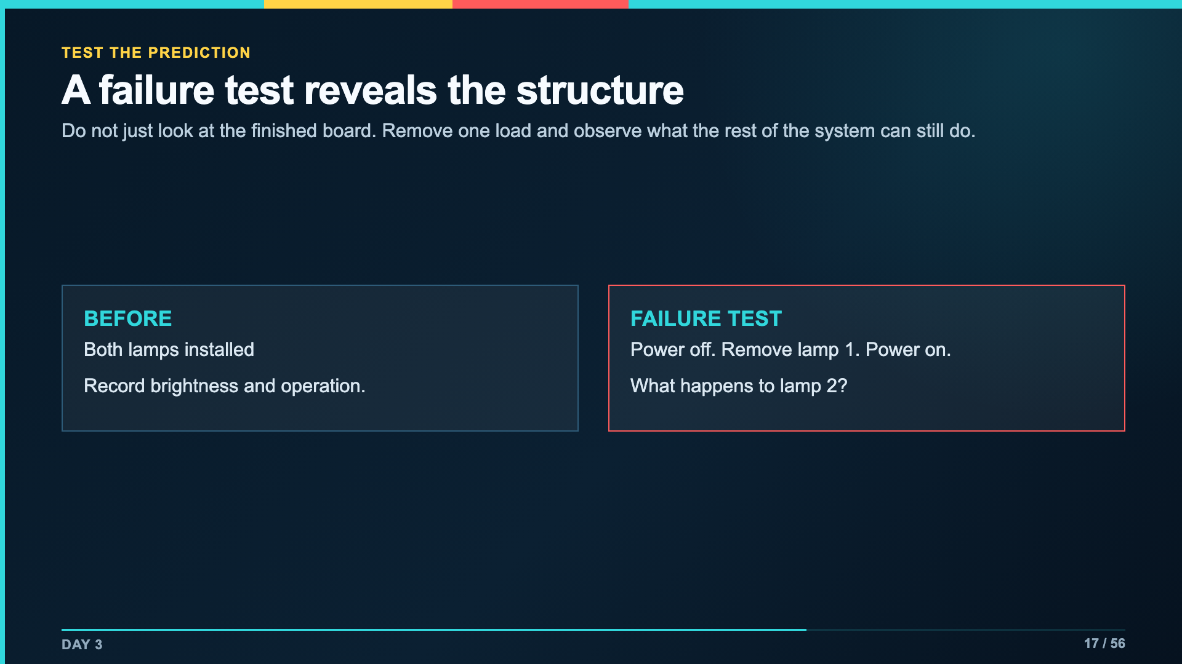
Notes:
Make students power off before lamp removal. Record the exact observation before discussing the explanation.
[Sources]
- Verizon Innovative Learning Schools and Arizona State University, Circuits lesson materials
- https://www.elenco.com/wp-content/uploads/2021/12/SC_300_Manual_2021.pdf

Slide 18
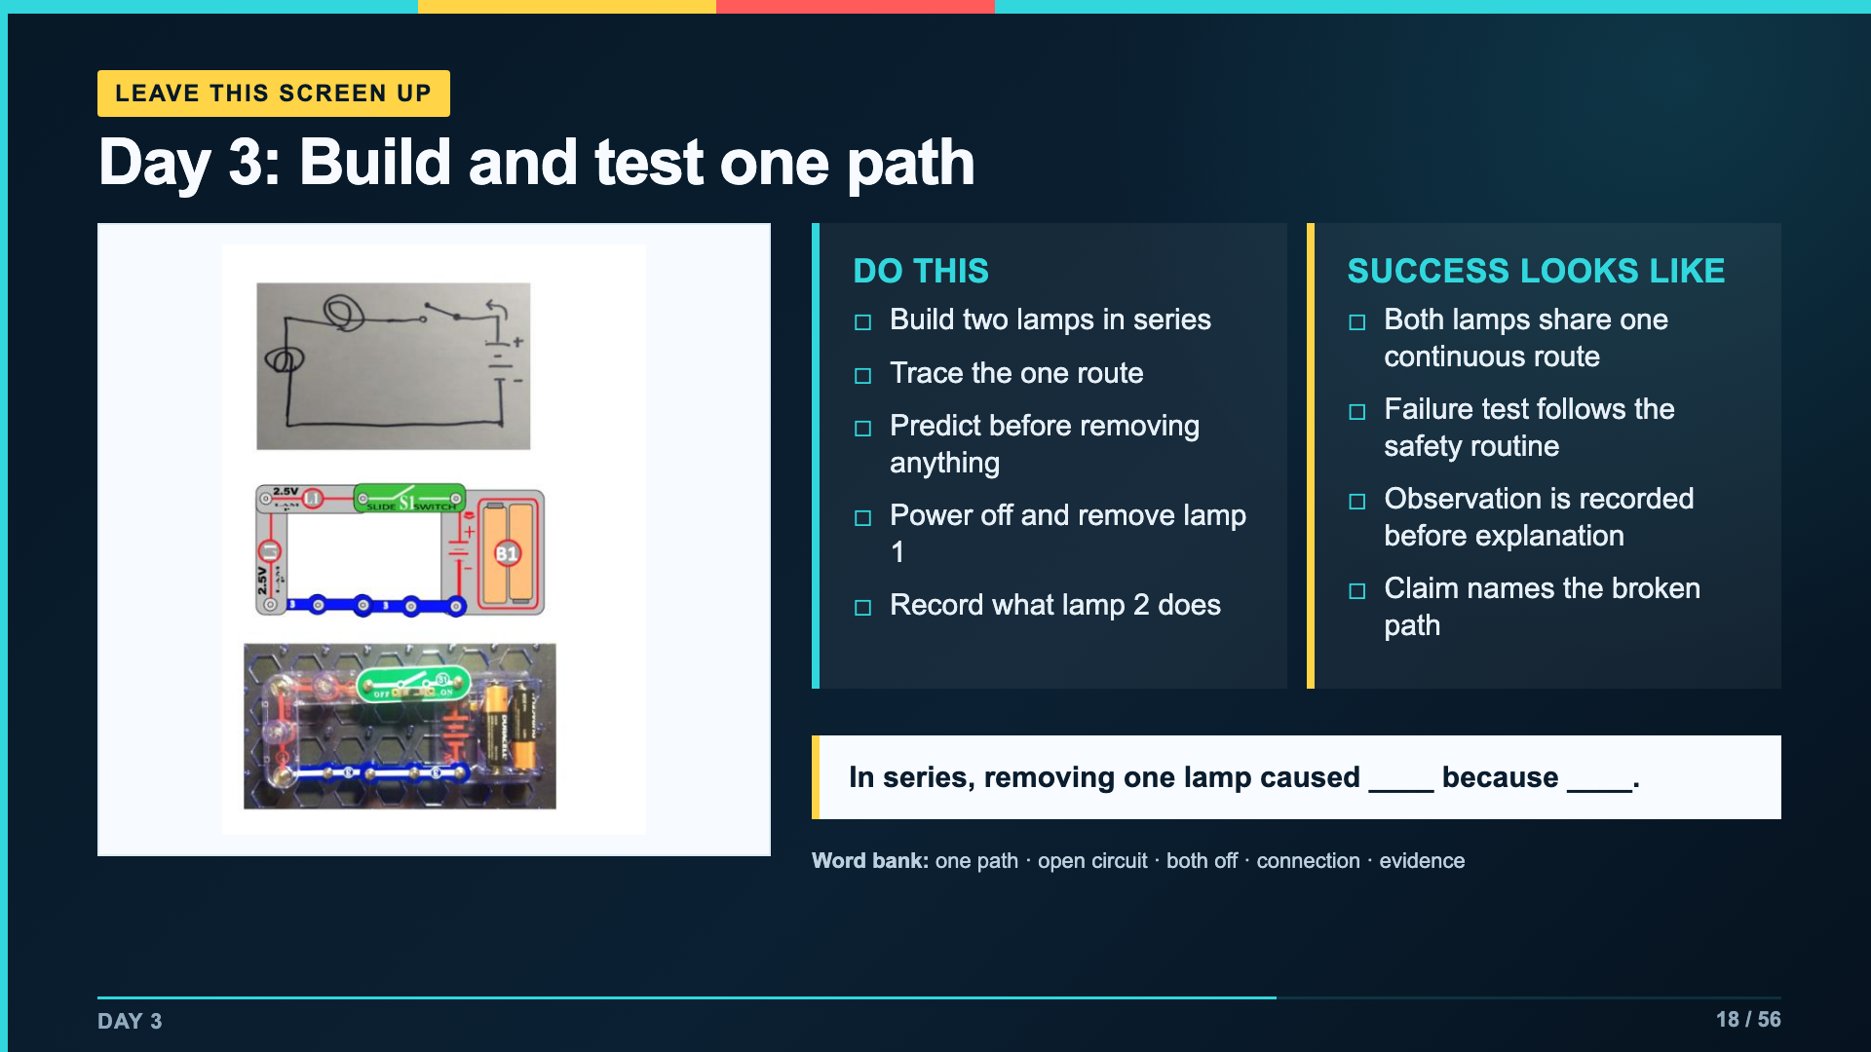
Notes:
Leave this slide projected for Day 3. Students use page 1 of Lab Packet 2.
[Sources]
- Verizon Innovative Learning Schools and Arizona State University, Circuits lesson materials
- https://www.elenco.com/wp-content/uploads/2021/12/SC_300_Manual_2021.pdf

Slide 19
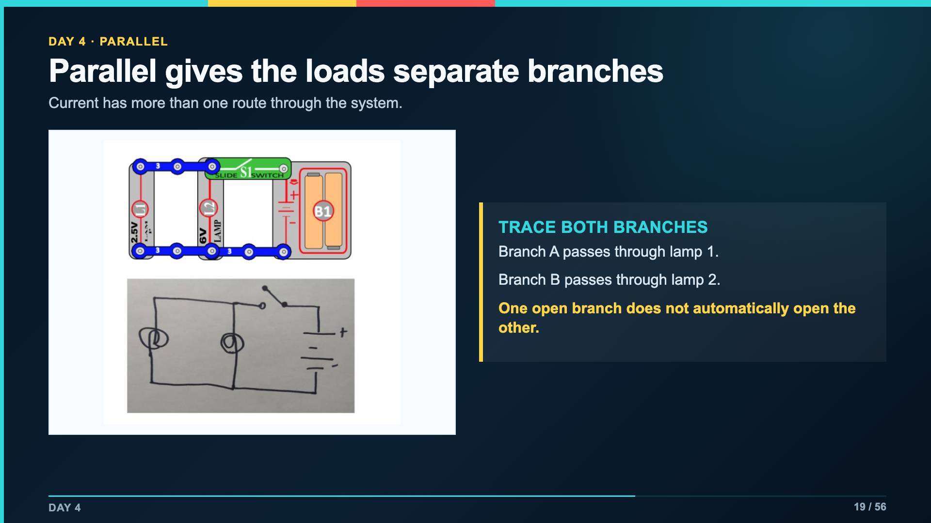
Notes:
Identify the split point and return point. Trace one branch at a time rather than waving across the whole board.
[Sources]
- Verizon Innovative Learning Schools and Arizona State University, Circuits lesson materials
- https://www.elenco.com/wp-content/uploads/2021/12/SC_300_Manual_2021.pdf

Slide 20
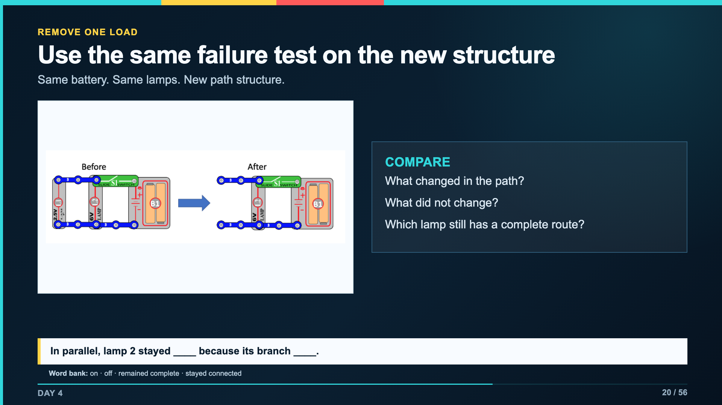
Notes:
Students should explain the surviving branch, not memorize that parallel is better. Different designs serve different constraints.
[Sources]
- Verizon Innovative Learning Schools and Arizona State University, Circuits lesson materials
- https://www.elenco.com/wp-content/uploads/2021/12/SC_300_Manual_2021.pdf

Slide 21
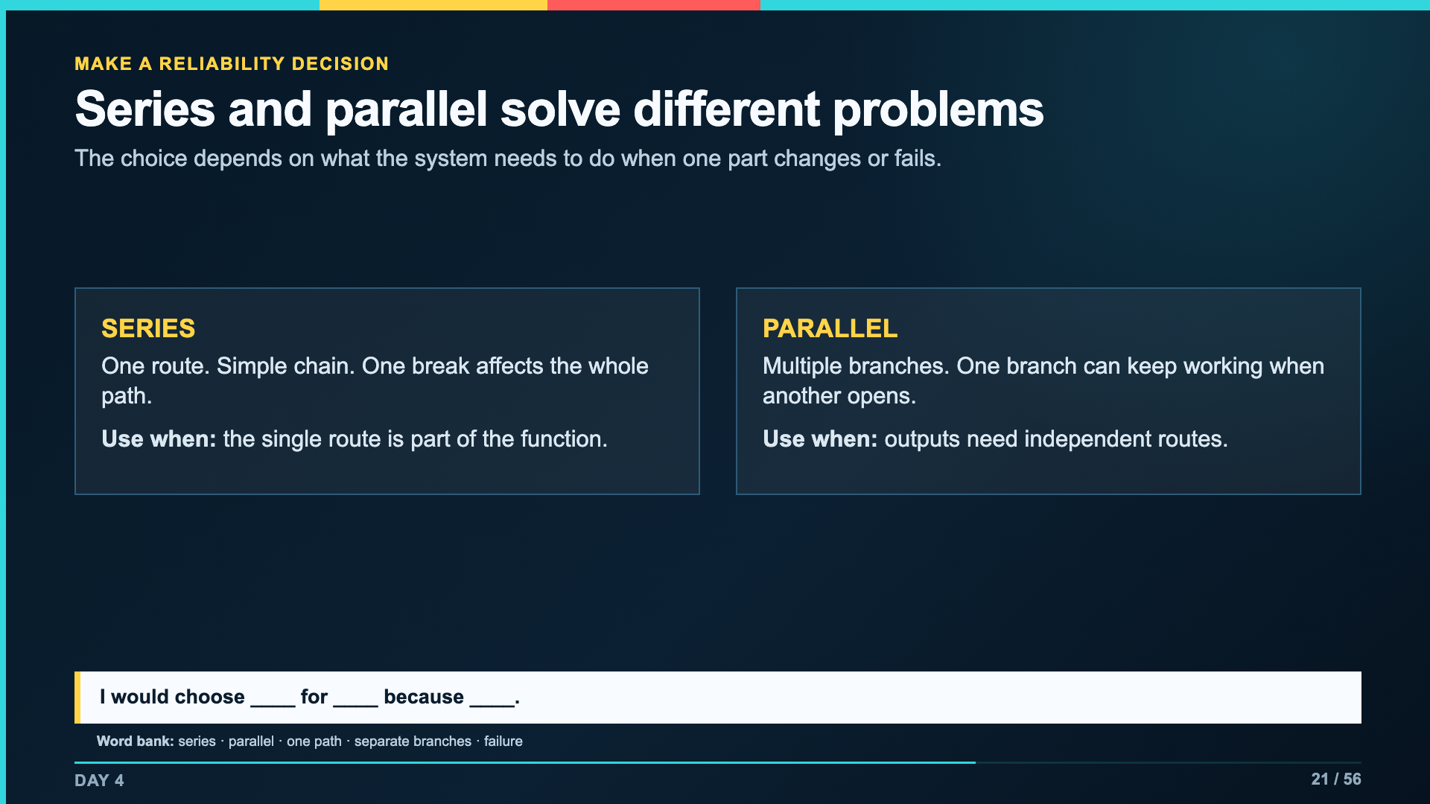
Notes:
Push back on the idea that parallel is always better. Ask which structure meets the stated need with the available components.
[Sources]
- Verizon Innovative Learning Schools and Arizona State University, Circuits lesson materials
- https://www.energy.gov/articles/how-do-holiday-lights-work
- https://www.elenco.com/wp-content/uploads/2021/12/SC_300_Manual_2021.pdf

Slide 22
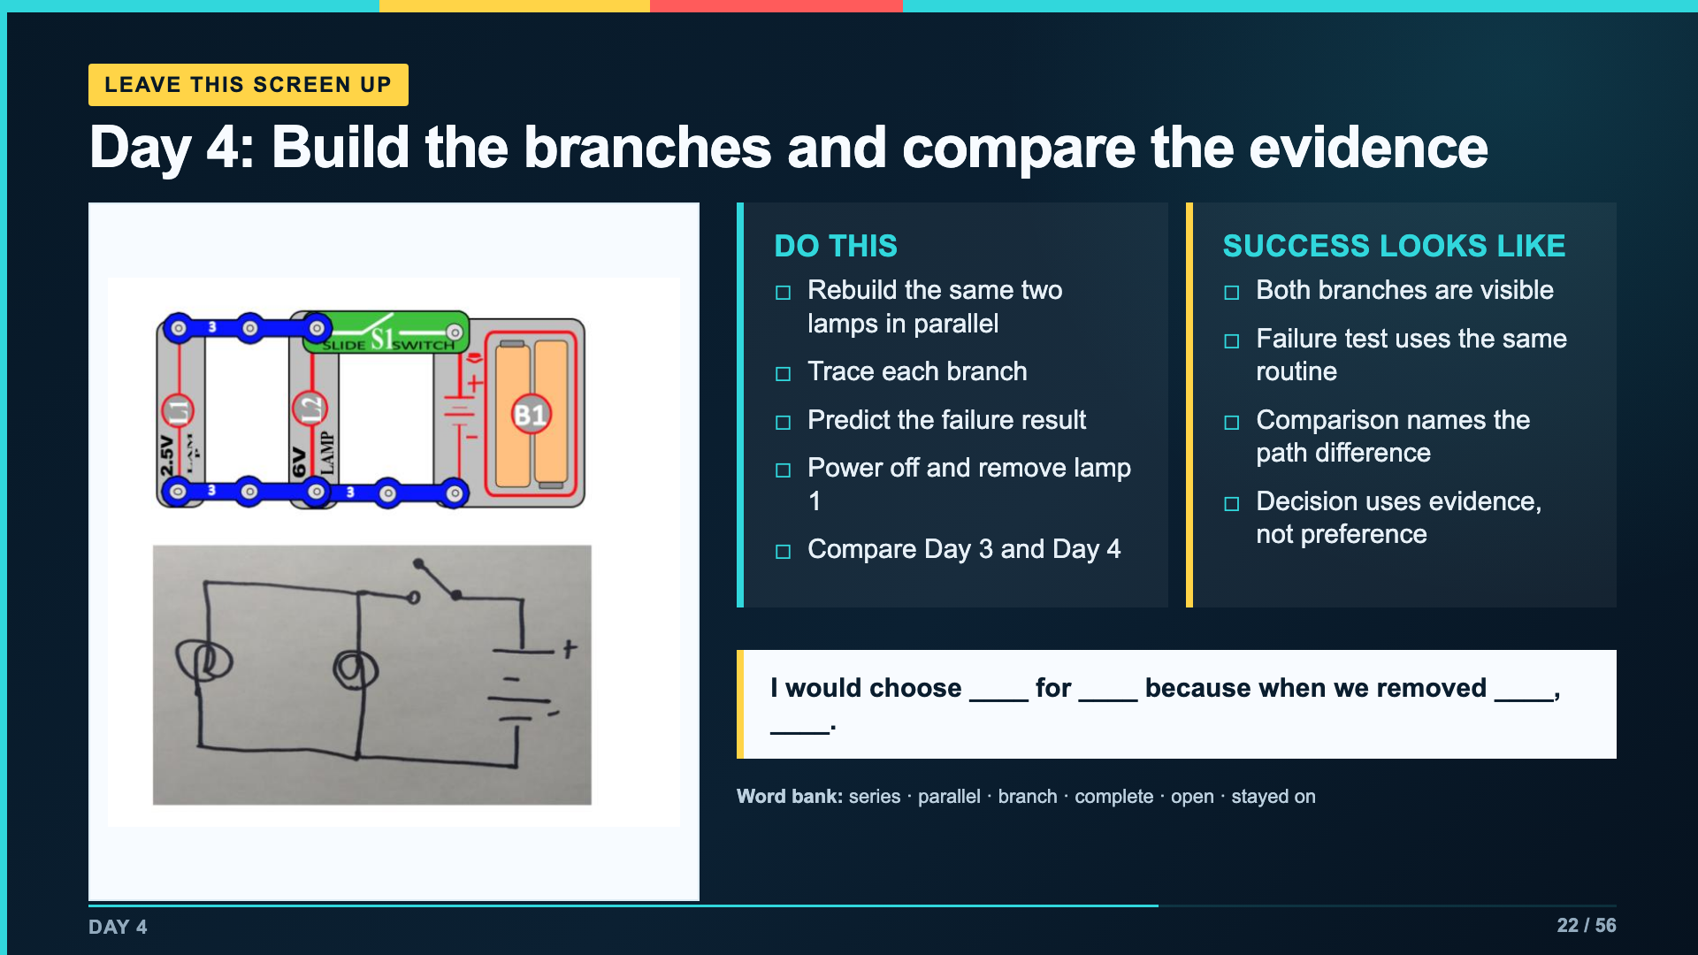
Notes:
Leave this slide projected for Day 4. Students use page 2 of Lab Packet 2.
[Sources]
- Verizon Innovative Learning Schools and Arizona State University, Circuits lesson materials
- https://www.elenco.com/wp-content/uploads/2021/12/SC_300_Manual_2021.pdf

Slide 23
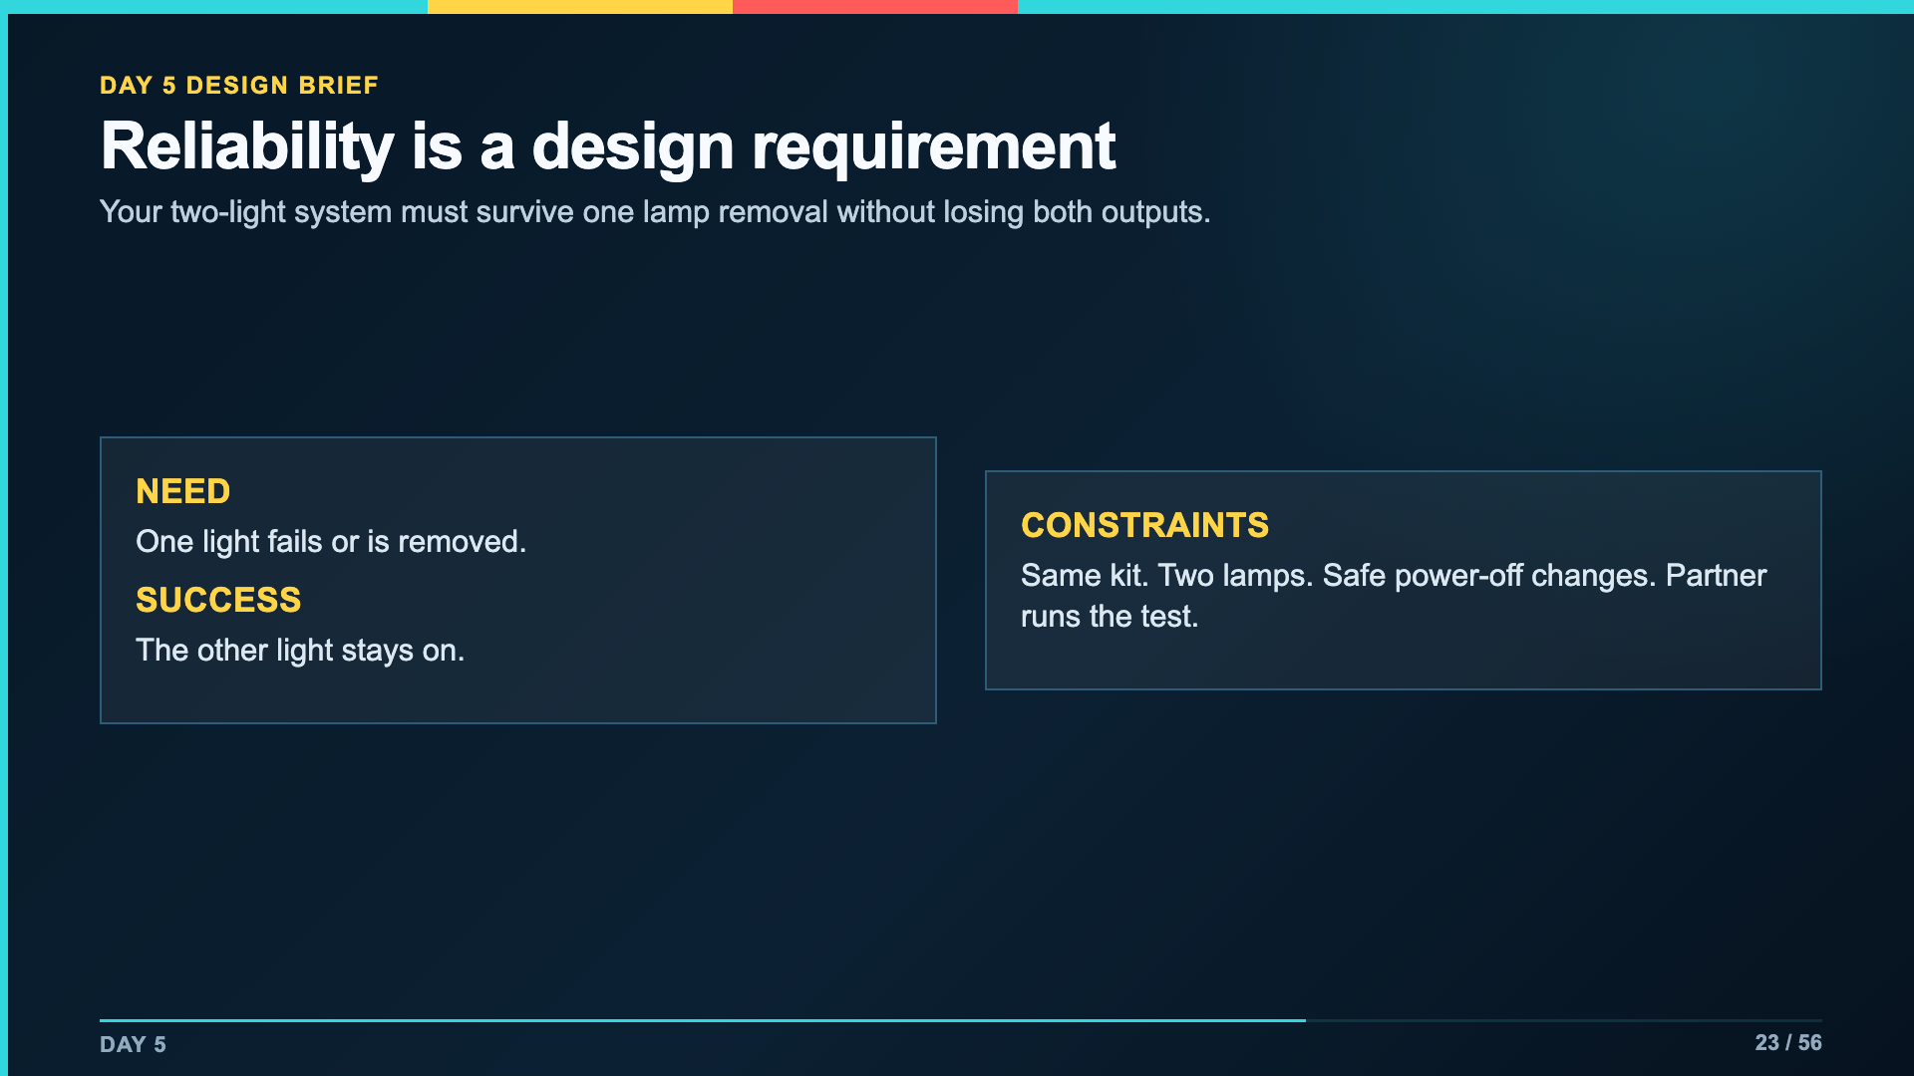
Notes:
Present the problem before naming the expected structure. Students may use the evidence to choose, then must prove the choice with the failure test.
[Sources]
- Verizon Innovative Learning Schools and Arizona State University, Circuits lesson materials

Slide 24
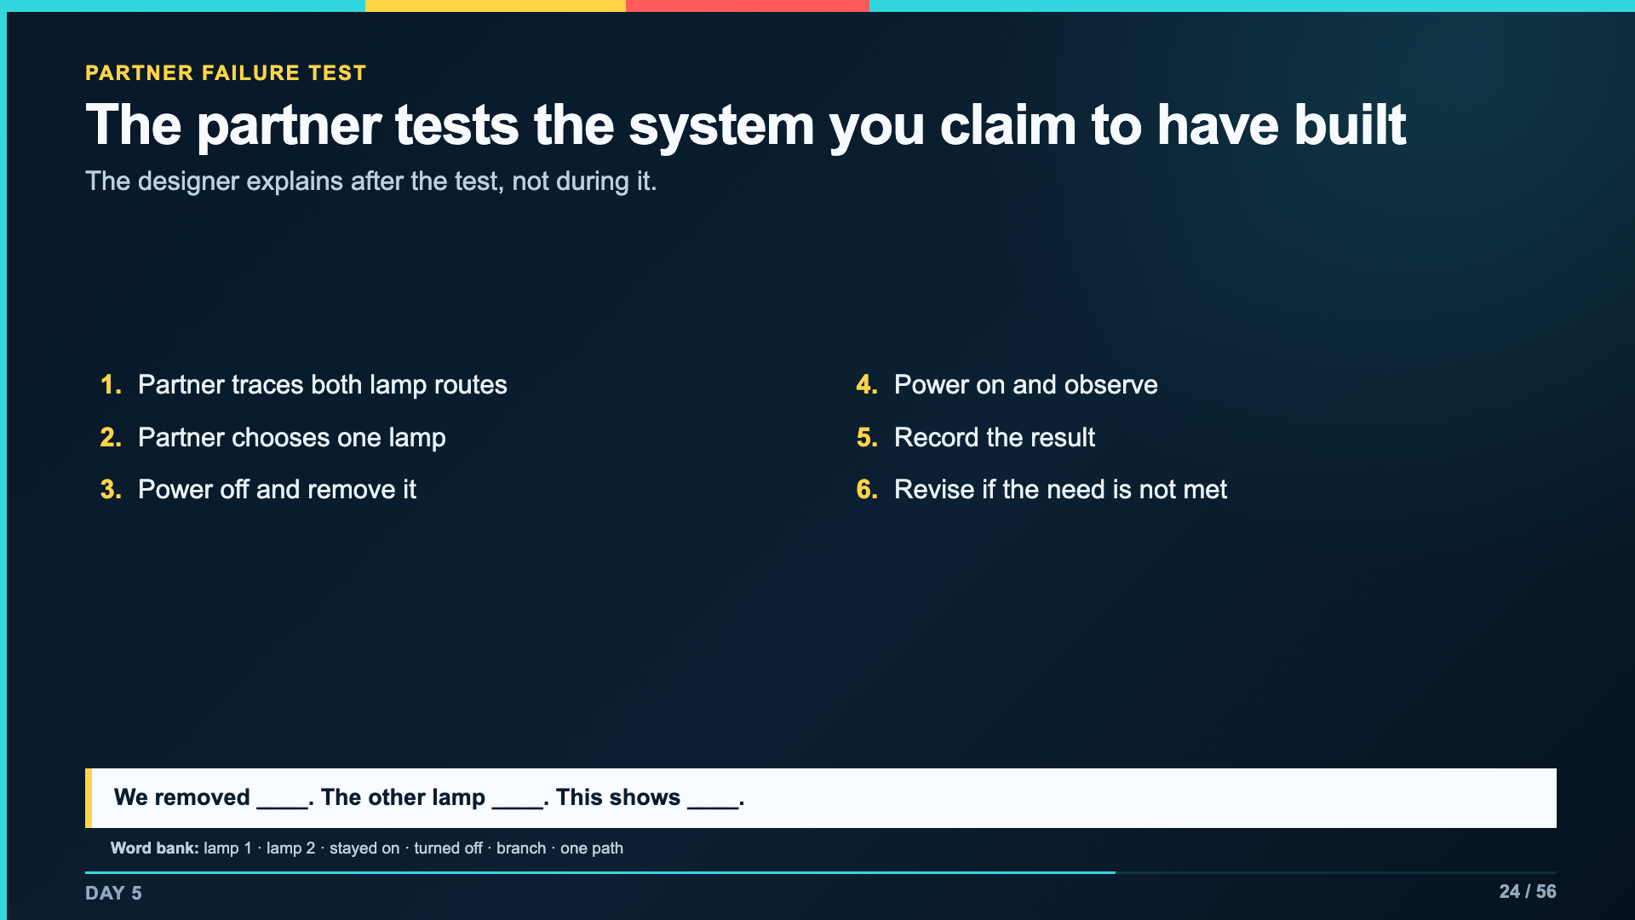
Notes:
Keep the partner test procedural. It is the unit's first explicit user-test rehearsal before the final Morse project.
[Sources]
- Verizon Innovative Learning Schools and Arizona State University, Circuits lesson materials

Slide 25
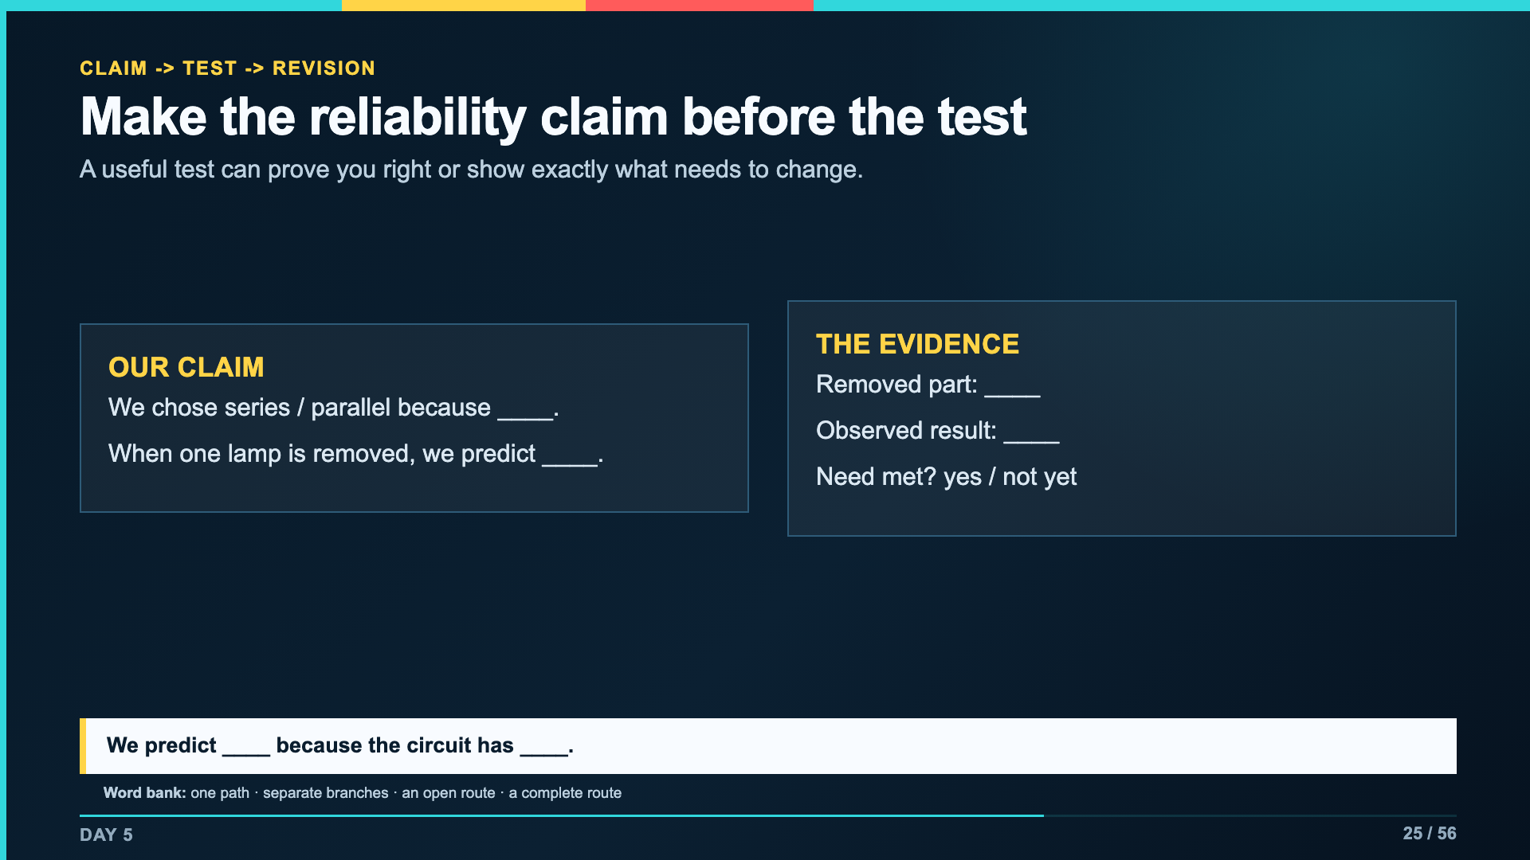
Notes:
Require the prediction before the partner touches the circuit. If the result differs, treat that mismatch as useful evidence and revise the path.
[Sources]
- Verizon Innovative Learning Schools and Arizona State University, Circuits lesson materials

Slide 26
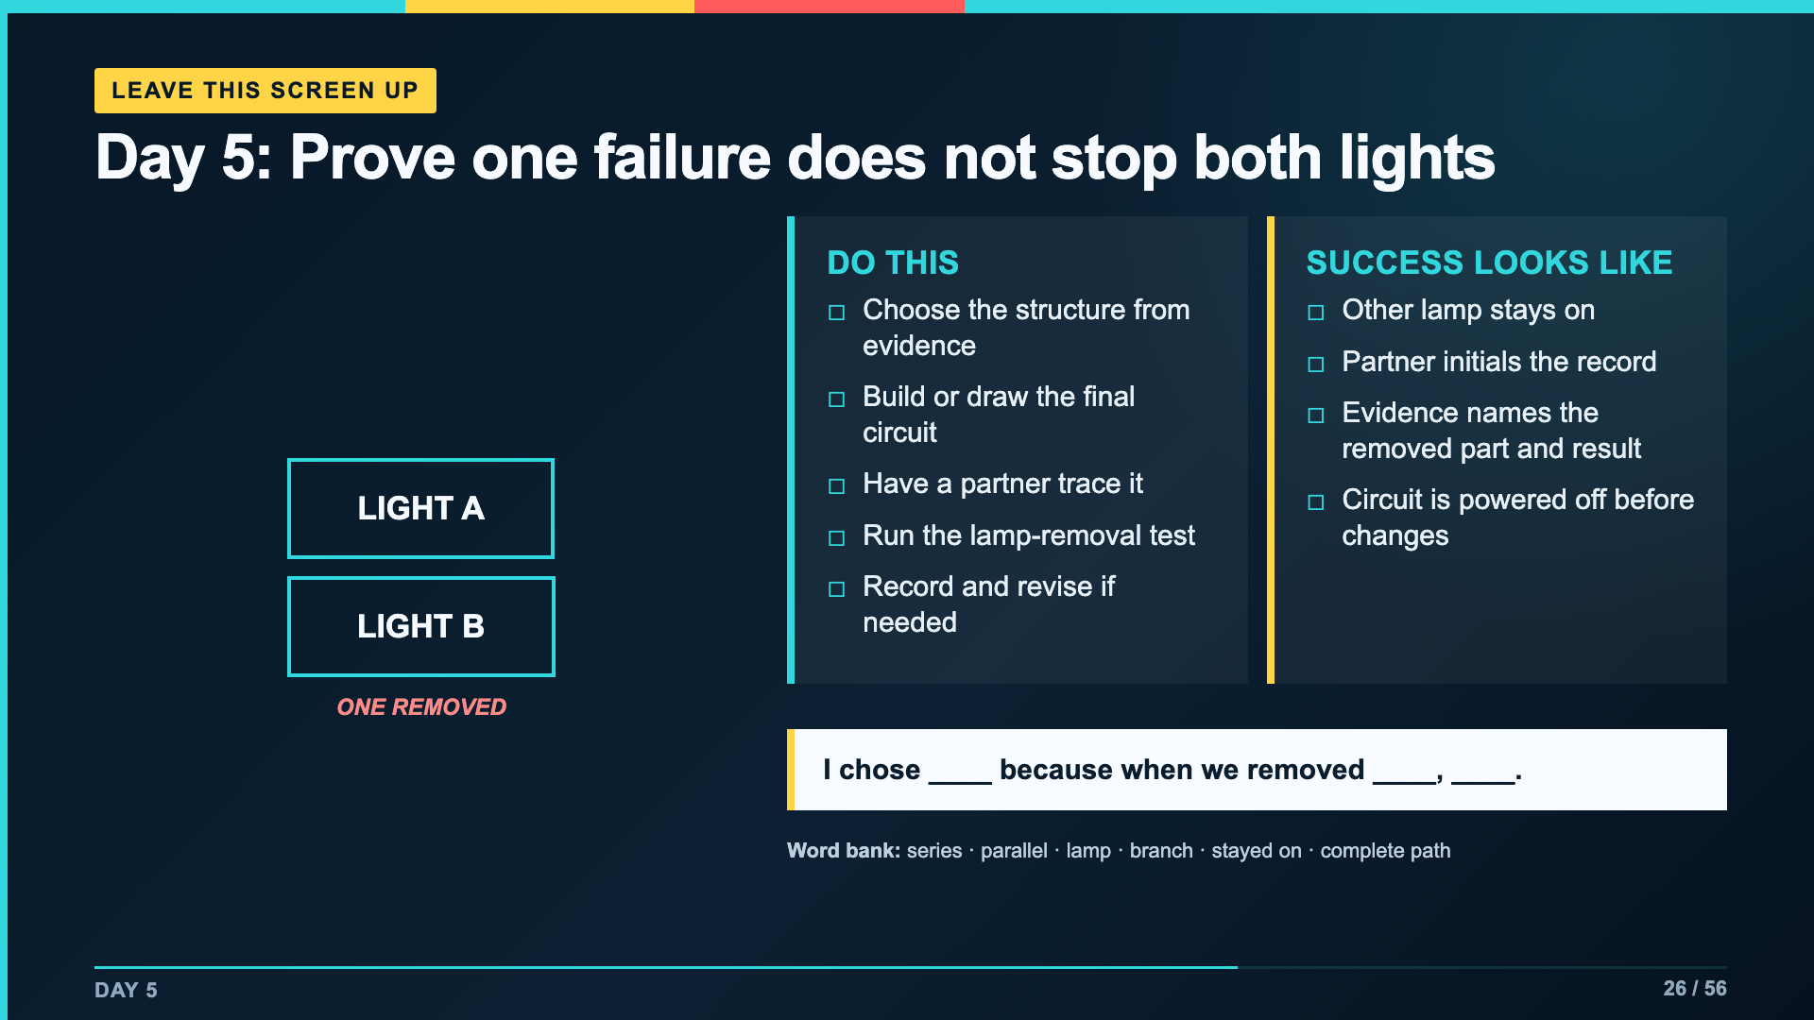
Notes:
Leave this slide projected during the reliability challenge. If kit inventory is limited, accept a correct annotated diagram plus a teacher demonstration of the failure test.
[Sources]
- Verizon Innovative Learning Schools and Arizona State University, Circuits lesson materials

Slide 27
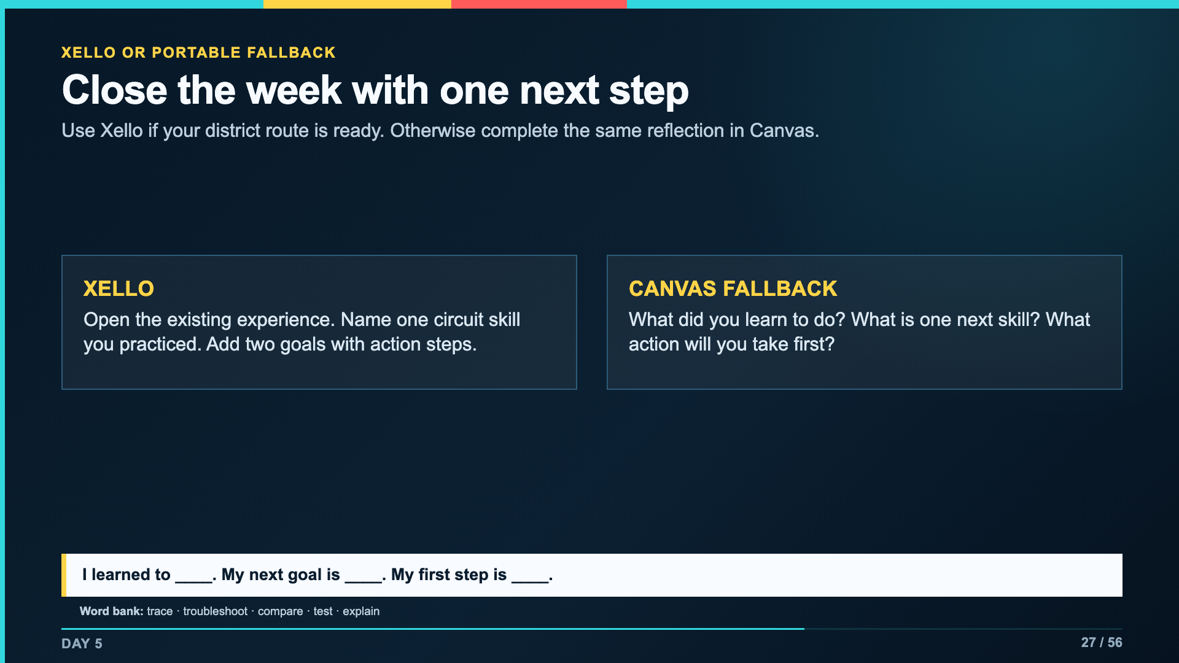
Notes:
Do not launch a new Matchmaker assessment here. Students reopen their existing Xello work. Use the Canvas reflection if the district service is unavailable.
[Sources]
- Smart Solutions Scope and Sequence, Circuitry Week 1
- Verizon Innovative Learning Schools and Arizona State University, Circuits lesson materials

Slide 28
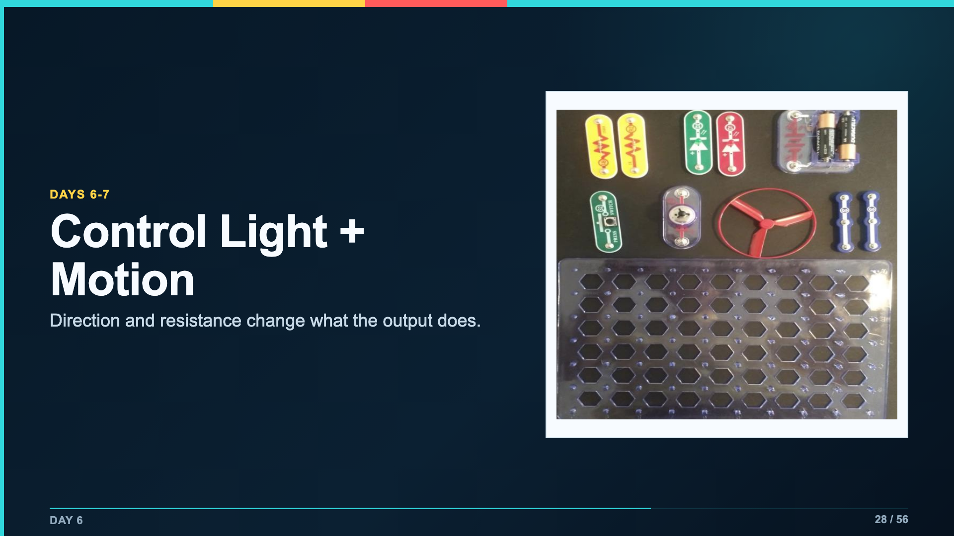
Notes:
This lesson extends the path model: some components have direction, and resistance changes system behavior. Keep the objective and evidence visible before the first build.
[Sources]
- Verizon Innovative Learning Schools and Arizona State University, Circuits lesson materials
- https://www.elenco.com/wp-content/uploads/2021/12/SC_300_Manual_2021.pdf

Slide 29
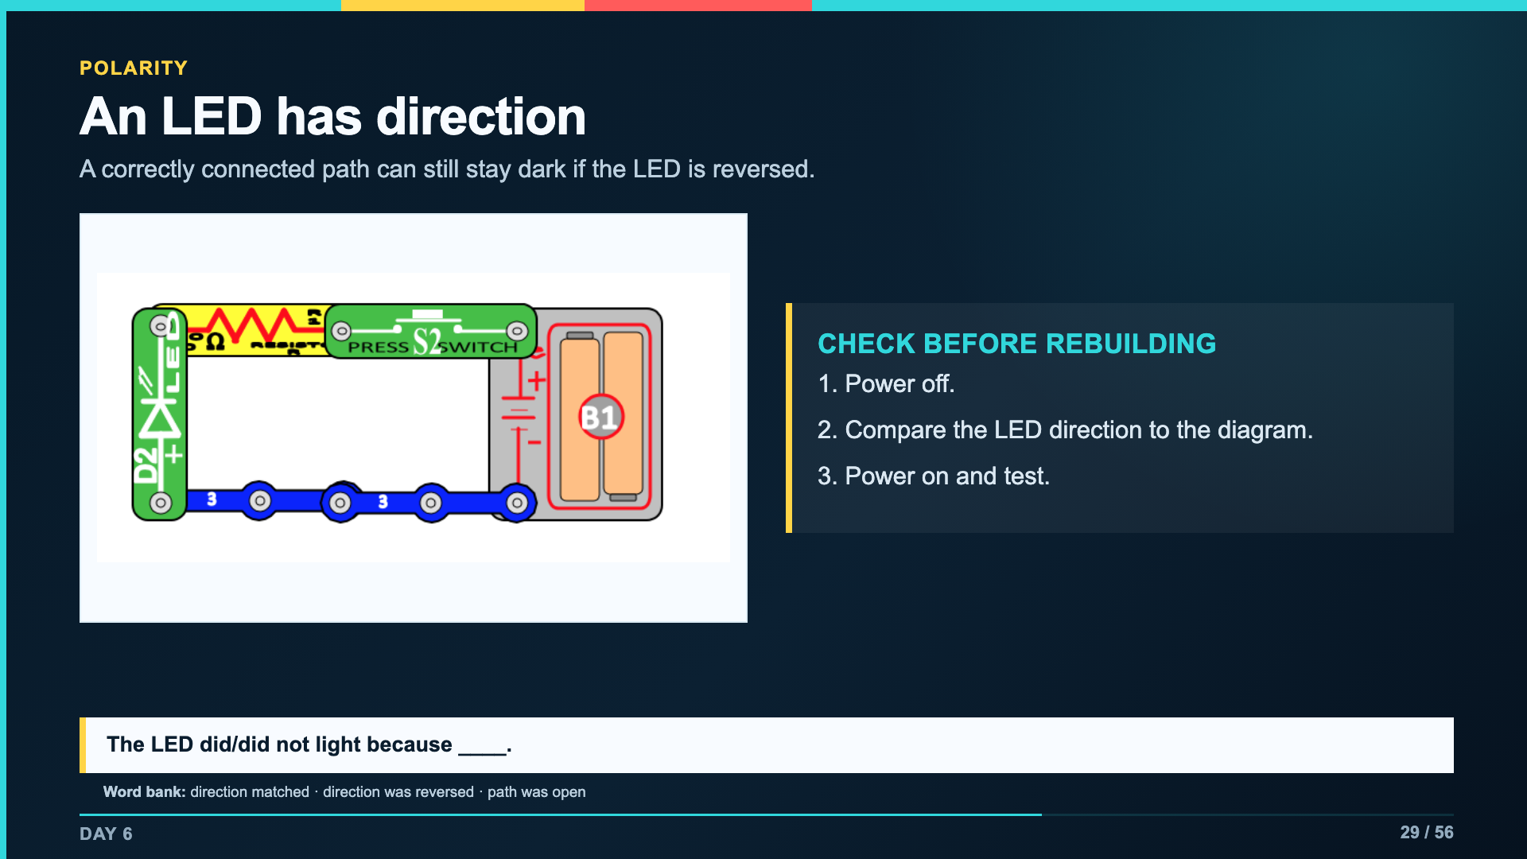
Notes:
Use direction as a troubleshooting example. Do not let students decide an LED is broken until polarity and the resistor are checked.
[Sources]
- Verizon Innovative Learning Schools and Arizona State University, Circuits lesson materials
- https://www.elenco.com/wp-content/uploads/2021/12/SC_300_Manual_2021.pdf

Slide 30
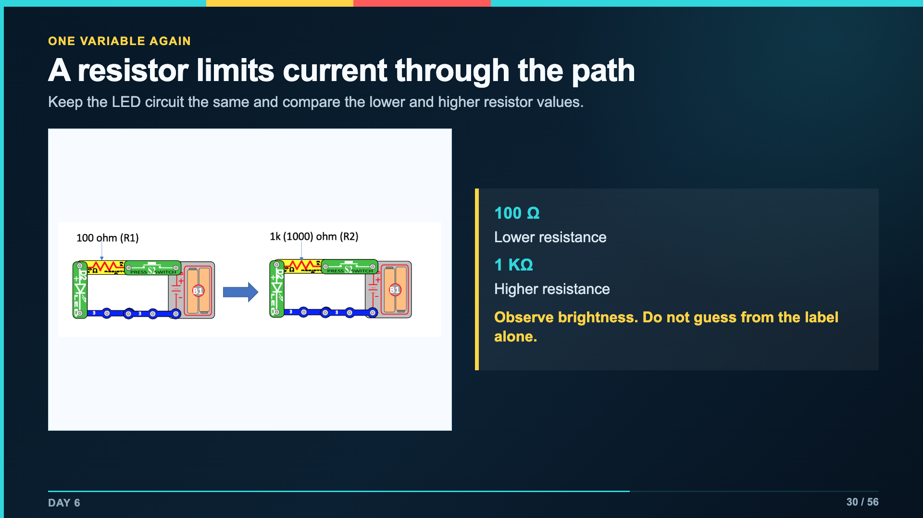
Notes:
Keep the analogy limited: resistance changes current; electricity is not literally water in a wire. Students record brightness as evidence.
[Sources]
- Verizon Innovative Learning Schools and Arizona State University, Circuits lesson materials
- https://www.elenco.com/wp-content/uploads/2021/12/SC_300_Manual_2021.pdf

Slide 31
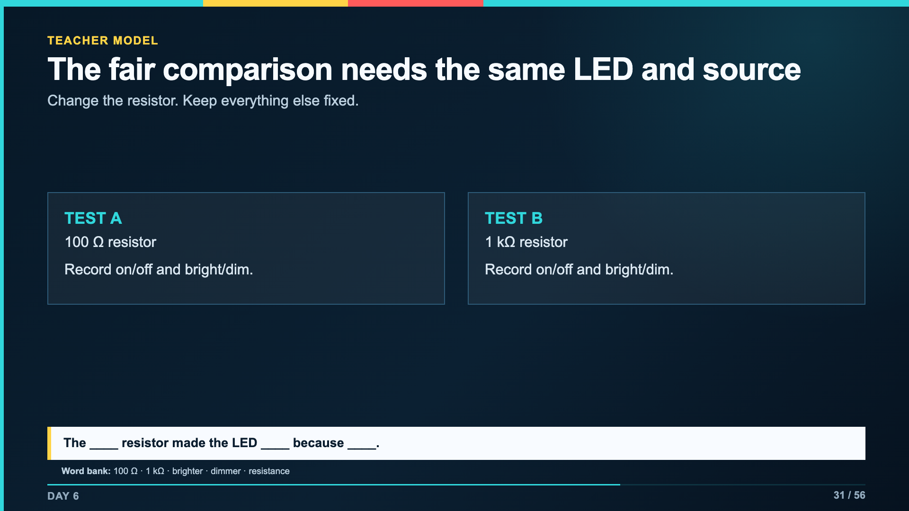
Notes:
Demonstrate one full comparison if kits are limited. Students should still handle the polarity test themselves when possible.
[Sources]
- Verizon Innovative Learning Schools and Arizona State University, Circuits lesson materials
- https://www.elenco.com/wp-content/uploads/2021/12/SC_300_Manual_2021.pdf

Slide 32
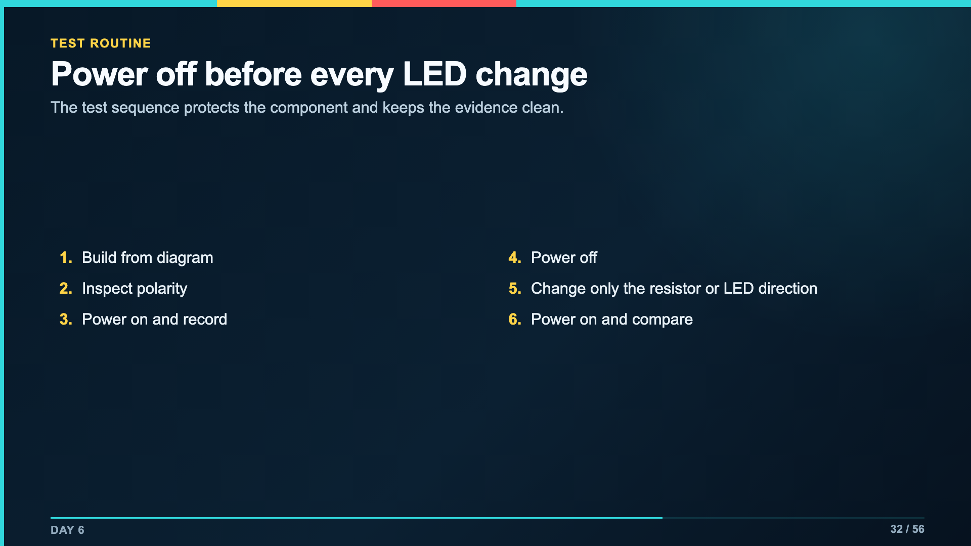
Notes:
Pause before work time and have a student repeat the six-step routine. This is the same controlled-testing habit established on Day 2.
[Sources]
- https://www.elenco.com/wp-content/uploads/2021/12/SC_300_Manual_2021.pdf
- Verizon Innovative Learning Schools and Arizona State University, Circuits lesson materials

Slide 33
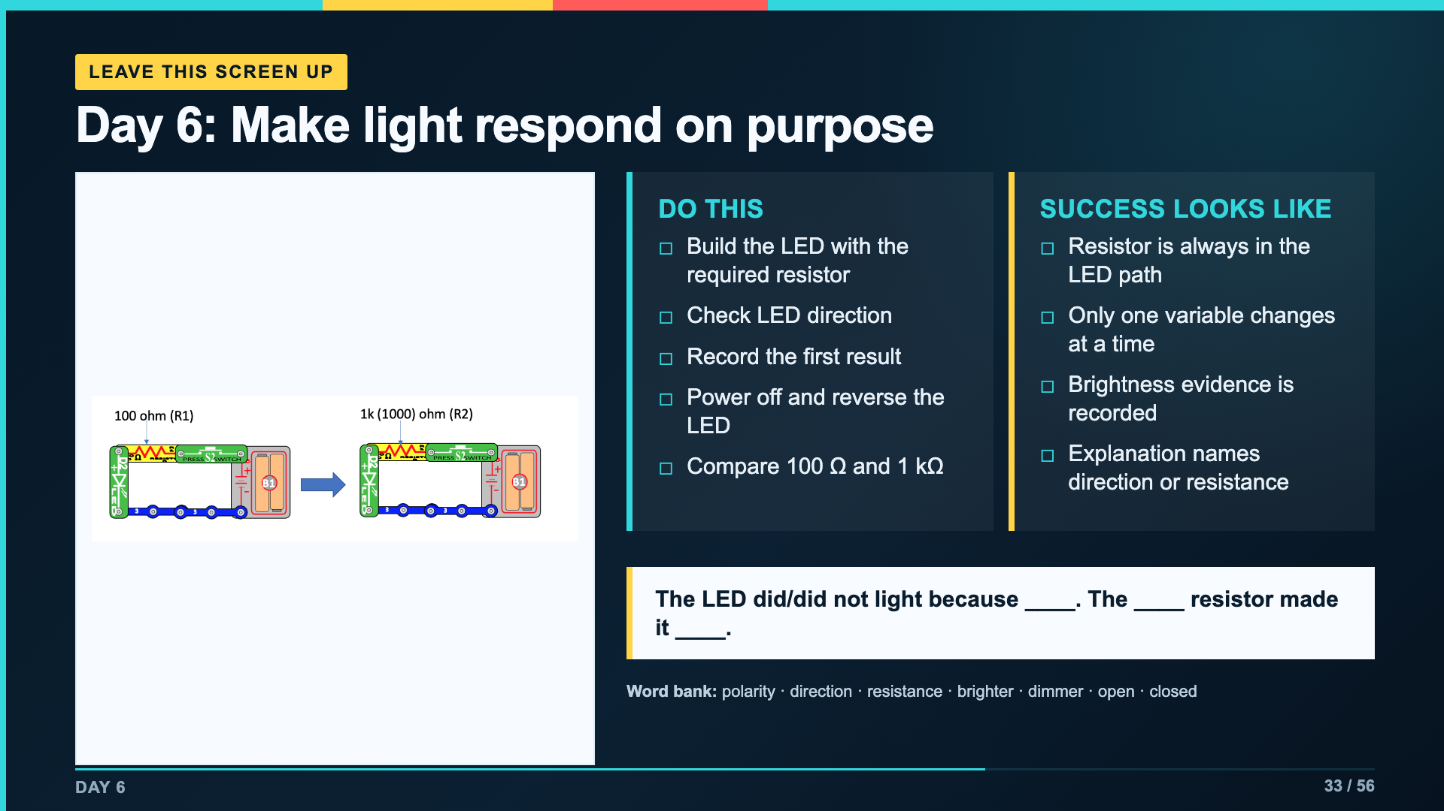
Notes:
Leave this slide projected for Day 6. Students use page 1 of Lab Packet 3.
[Sources]
- Verizon Innovative Learning Schools and Arizona State University, Circuits lesson materials
- https://www.elenco.com/wp-content/uploads/2021/12/SC_300_Manual_2021.pdf

Slide 34
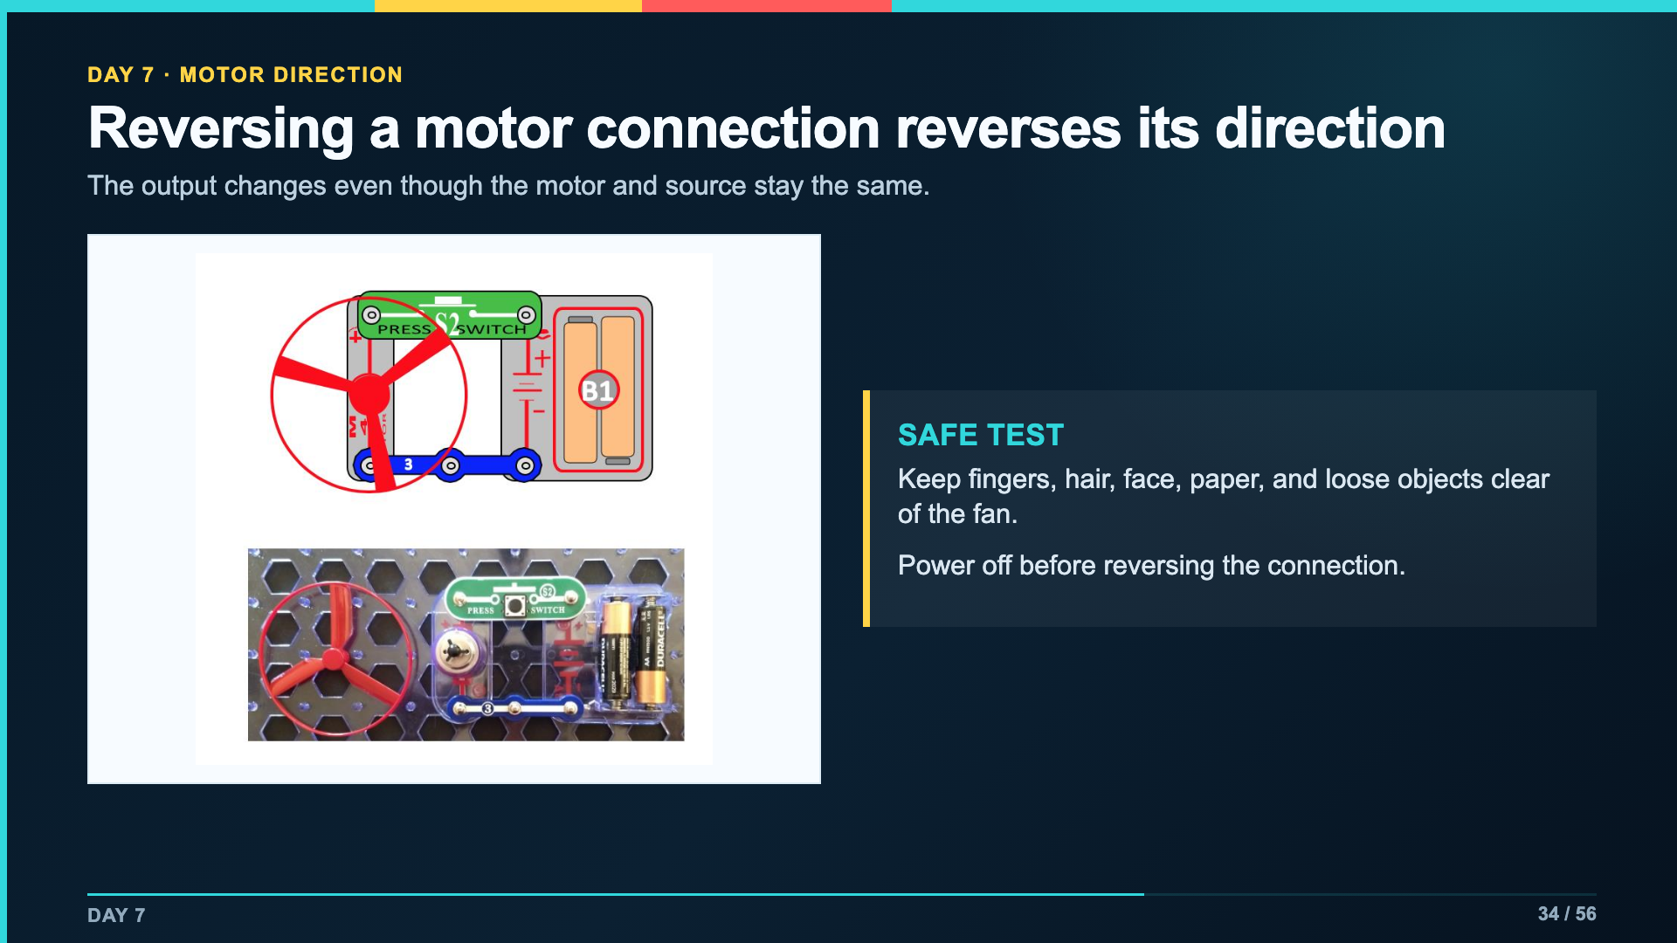
Notes:
Set a clear fan boundary before batteries enter the board. Students observe direction without leaning over the fan.
[Sources]
- Verizon Innovative Learning Schools and Arizona State University, Circuits lesson materials
- https://www.elenco.com/wp-content/uploads/2021/12/SC_300_Manual_2021.pdf

Slide 35
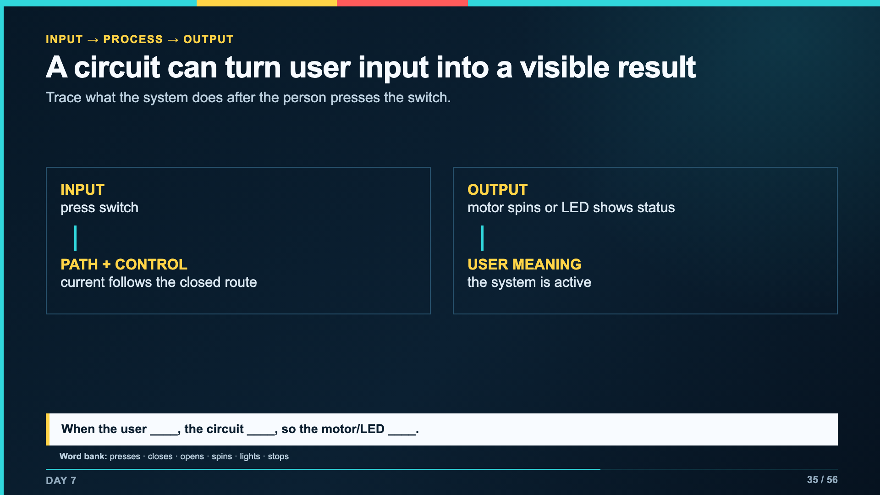
Notes:
This systems language bridges forward to sensors, code, robotics, and AI. Keep it concrete by tracing the actual switch and output.
[Sources]
- Verizon Innovative Learning Schools and Arizona State University, Circuits lesson materials
- https://www.elenco.com/wp-content/uploads/2021/12/SC_300_Manual_2021.pdf

Slide 36
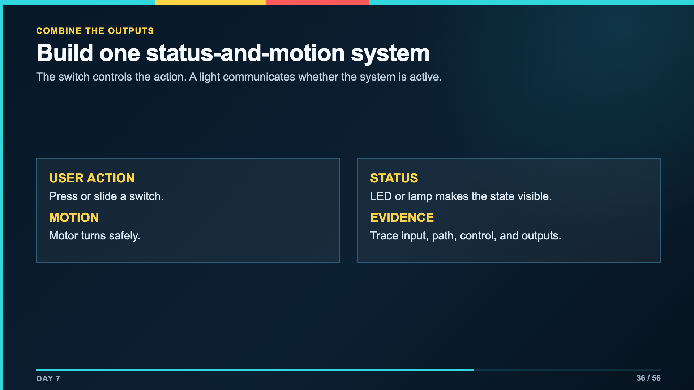
Notes:
Select a build that matches the kit version and time. A correct annotated diagram can replace a second physical build if inventory is limited.
[Sources]
- Verizon Innovative Learning Schools and Arizona State University, Circuits lesson materials
- https://www.elenco.com/wp-content/uploads/2021/12/SC_300_Manual_2021.pdf

Slide 37
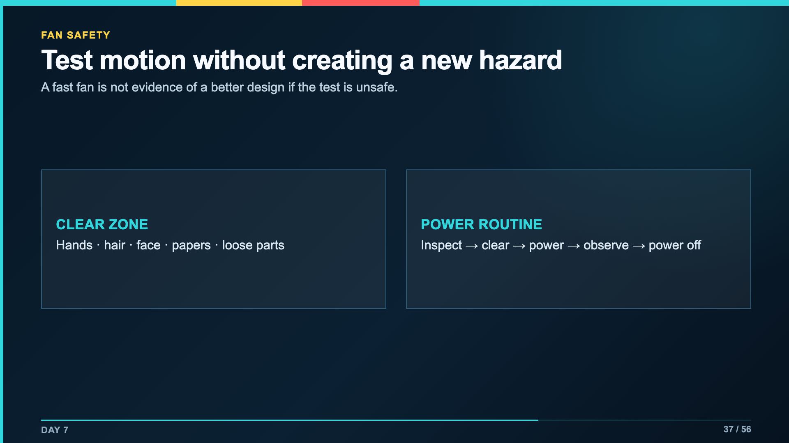
Notes:
Keep this boundary visible during every powered motor test. Stop the test if students lean over or reach into the fan.
[Sources]
- https://www.elenco.com/wp-content/uploads/2021/12/SC_300_Manual_2021.pdf
- Verizon Innovative Learning Schools and Arizona State University, Circuits lesson materials

Slide 38
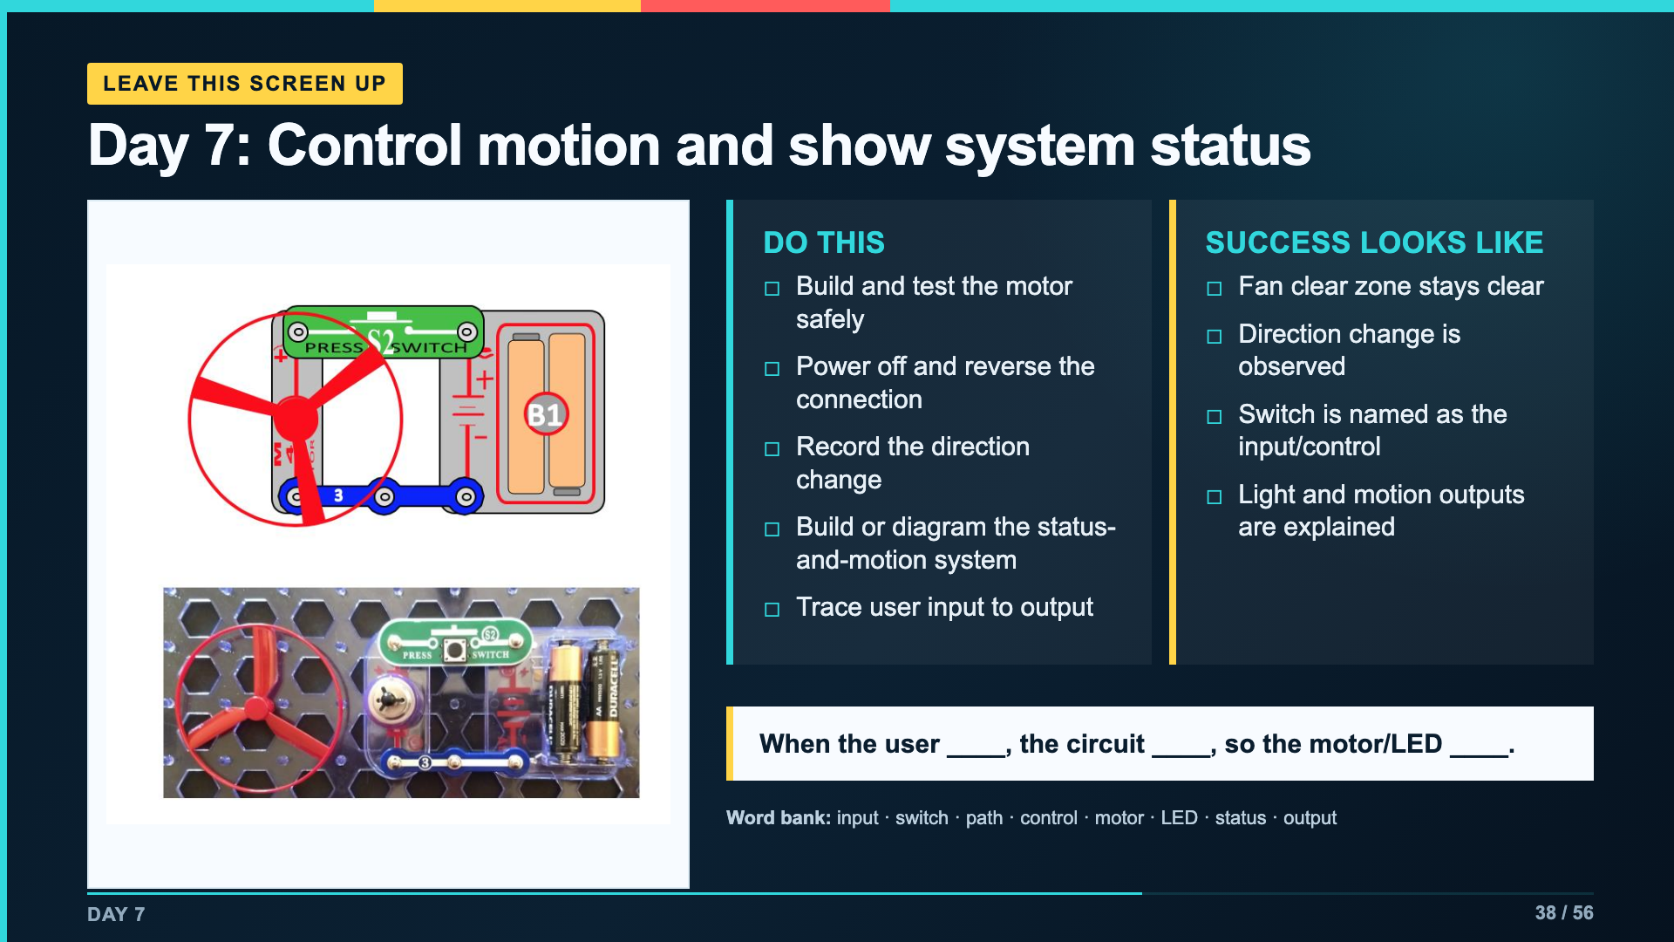
Notes:
Leave this slide projected for Day 7. Students use page 2 of Lab Packet 3.
[Sources]
- Verizon Innovative Learning Schools and Arizona State University, Circuits lesson materials
- https://www.elenco.com/wp-content/uploads/2021/12/SC_300_Manual_2021.pdf

Slide 39
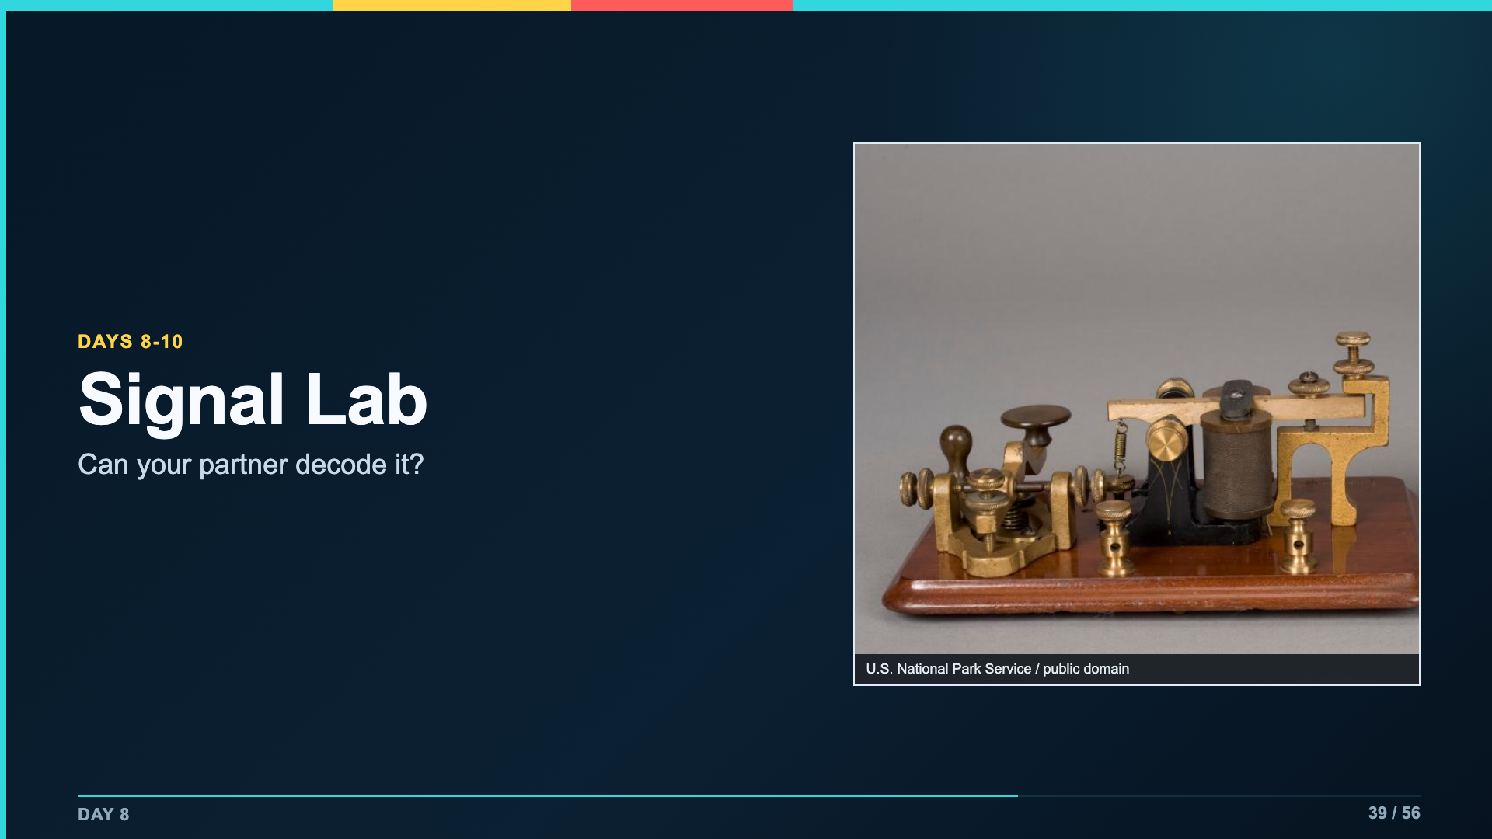
Notes:
Connect the historical tool to the design problem: the machine creates pulses, but the human listener still needs distinguishable timing and spacing.
[Sources]
- https://commons.wikimedia.org/wiki/File:Can_you_hear_us_now%3F_Dah_dah,_dit_dit._Dah_dah,_dit_dit._The_sound_of_this_J.H._Bunnell_%26_Co._telegraph_key_and_sounder_was_the_(6ed899b0-1dd8-b71b-0b94-6e32f79a79a1).jpg
- Verizon Innovative Learning Schools and Arizona State University, Circuits lesson materials

Slide 40
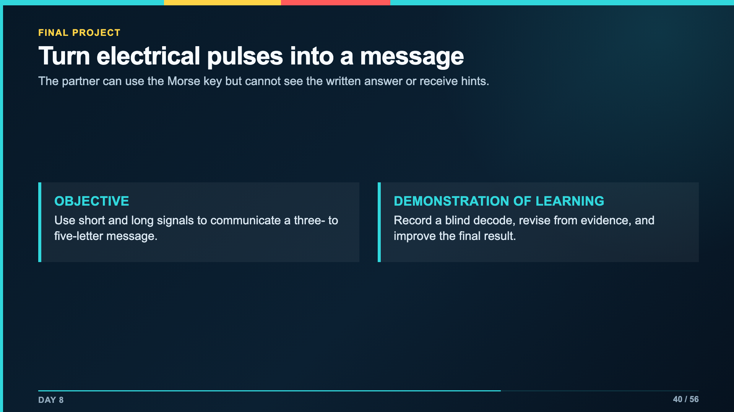
Notes:
Read the no-hint boundary before students select messages. The partner's exact first decode is required evidence, not a practice score to erase.
[Sources]
- https://commons.wikimedia.org/wiki/File:Can_you_hear_us_now%3F_Dah_dah,_dit_dit._Dah_dah,_dit_dit._The_sound_of_this_J.H._Bunnell_%26_Co._telegraph_key_and_sounder_was_the_(6ed899b0-1dd8-b71b-0b94-6e32f79a79a1).jpg
- Verizon Innovative Learning Schools and Arizona State University, Circuits lesson materials

Slide 41
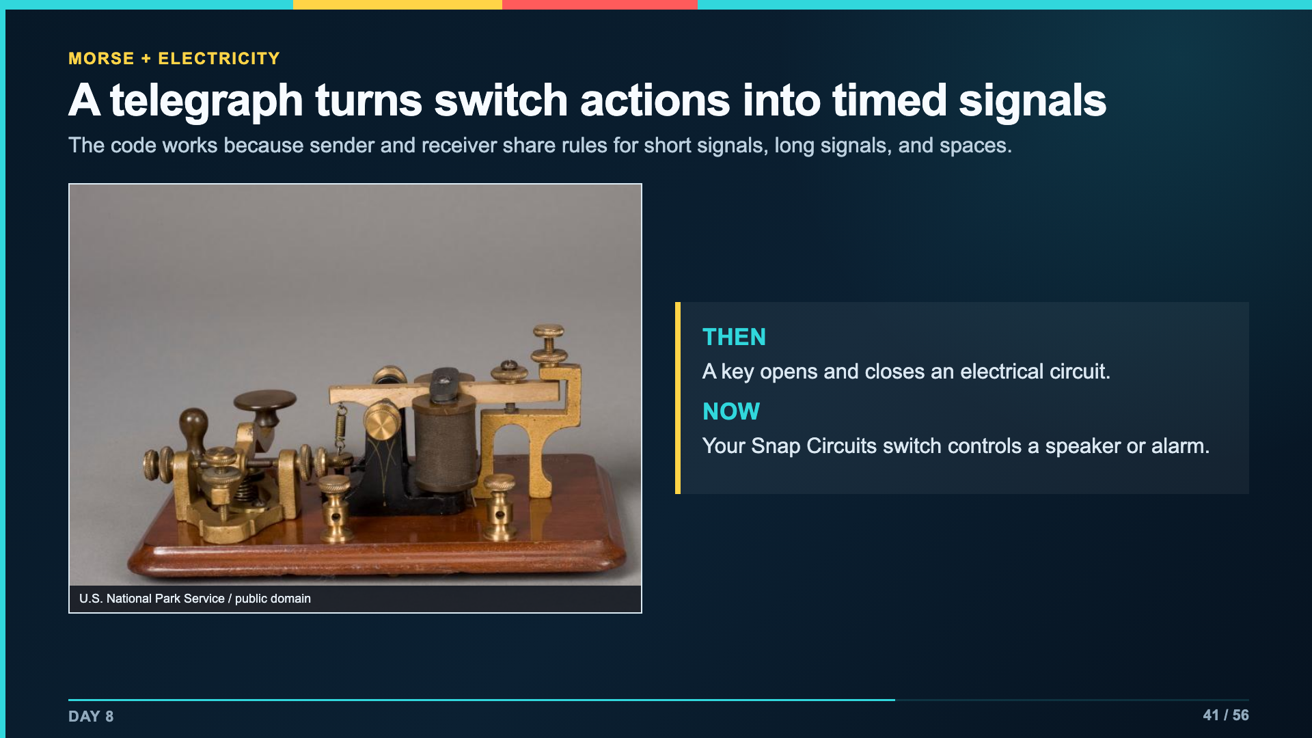
Notes:
Keep the history short and functional. Students need to understand why timing and spacing are engineering variables in the final system.
[Sources]
- https://commons.wikimedia.org/wiki/File:Can_you_hear_us_now%3F_Dah_dah,_dit_dit._Dah_dah,_dit_dit._The_sound_of_this_J.H._Bunnell_%26_Co._telegraph_key_and_sounder_was_the_(6ed899b0-1dd8-b71b-0b94-6e32f79a79a1).jpg
- Verizon Innovative Learning Schools and Arizona State University, Circuits lesson materials

Slide 42
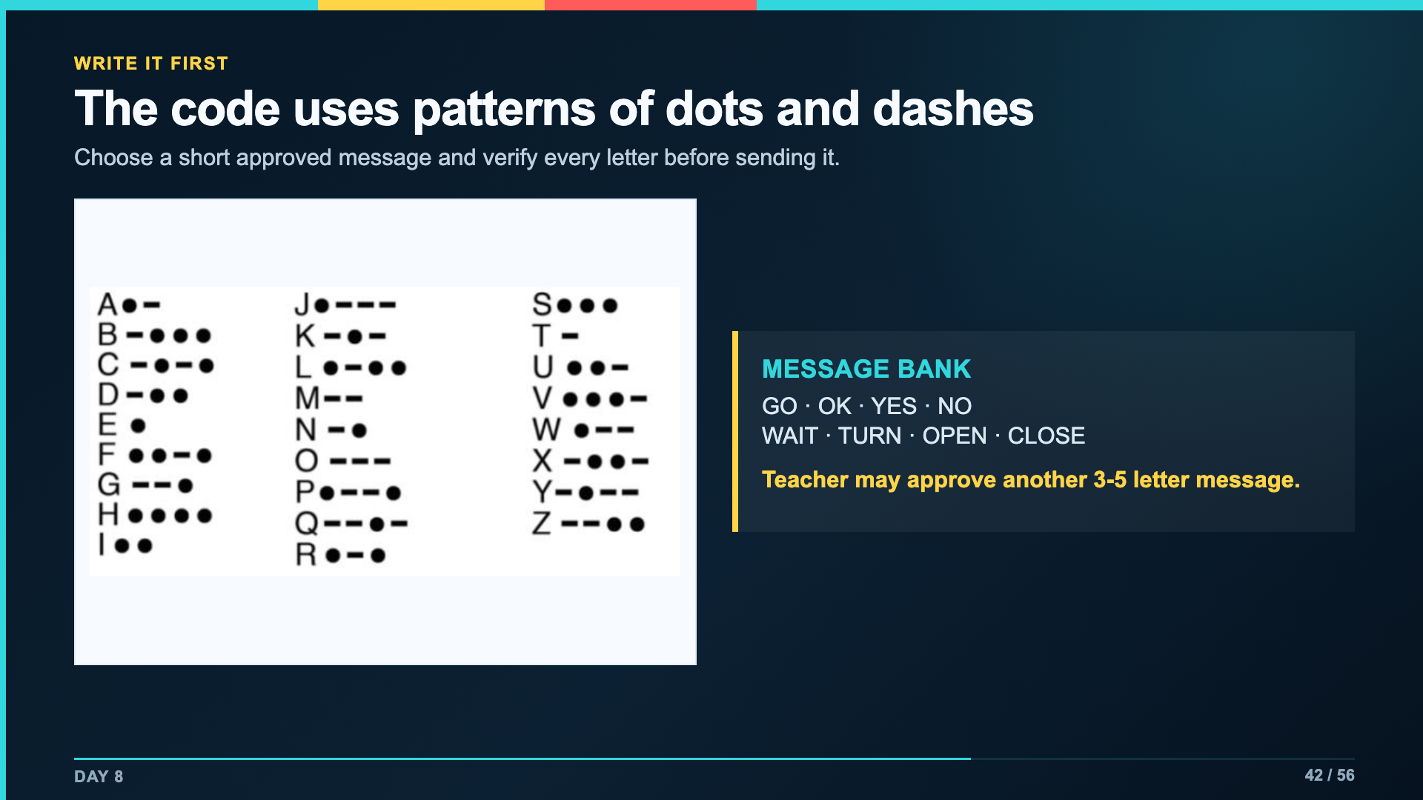
Notes:
Model one word slowly. Have students copy letters and symbols separately so they can check the code before rehearsal.
[Sources]
- Verizon Innovative Learning Schools and Arizona State University, Circuits lesson materials

Slide 43
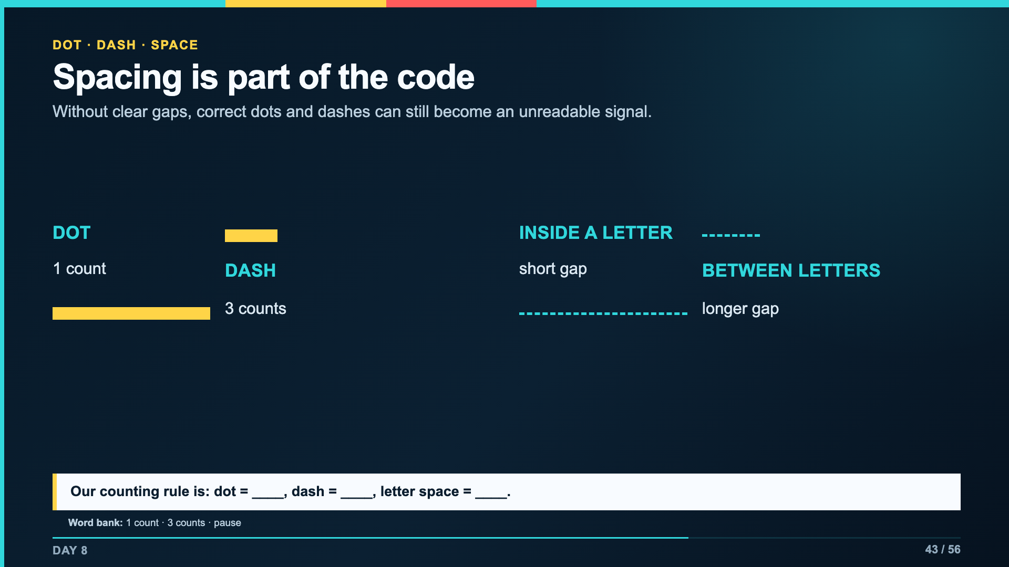
Notes:
Use one consistent classroom counting system. It does not need laboratory precision; it needs to create distinguishable signals for the partner.
[Sources]
- Verizon Innovative Learning Schools and Arizona State University, Circuits lesson materials

Slide 44
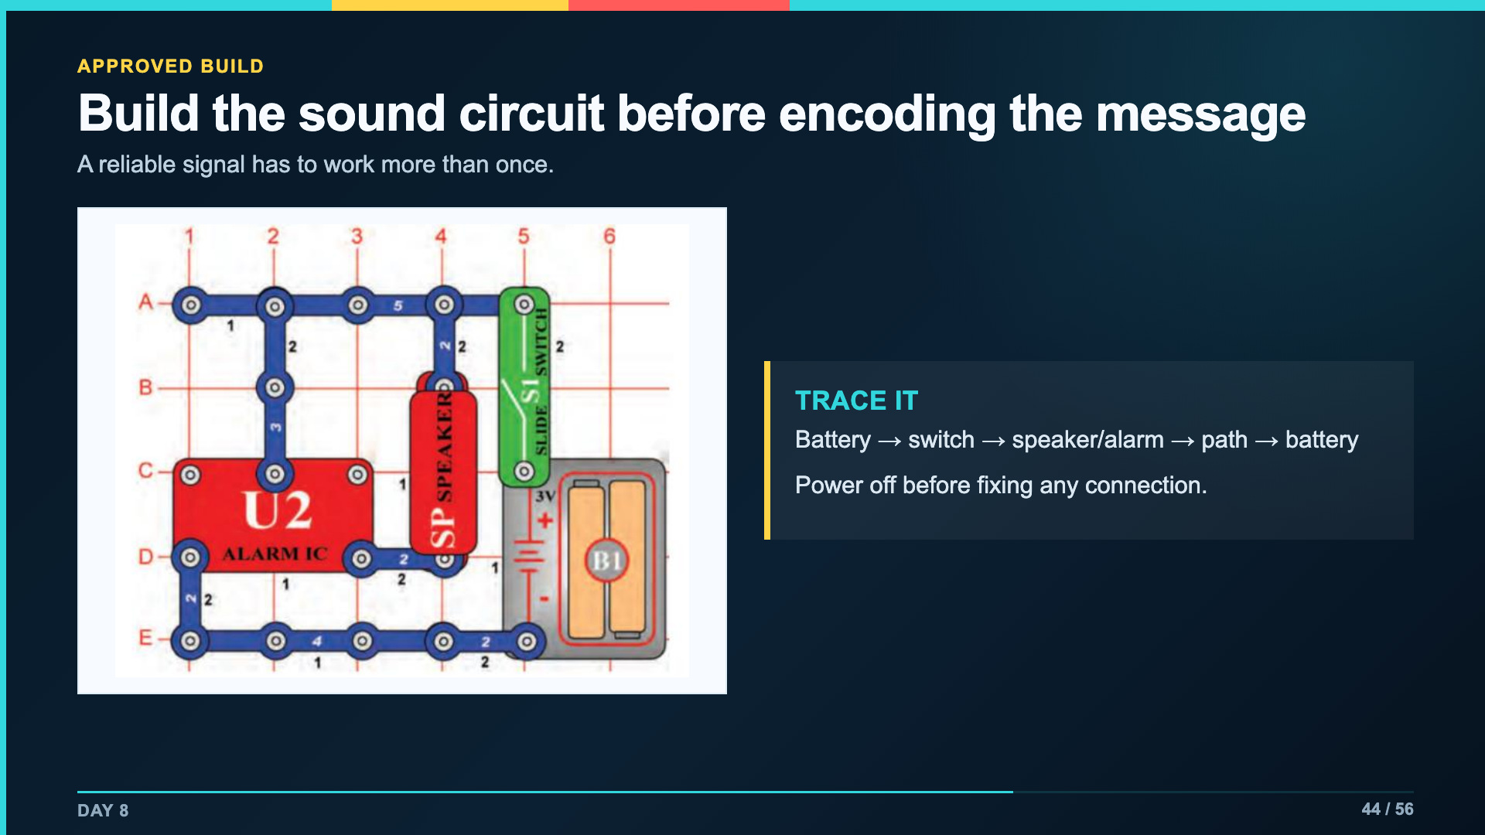
Notes:
Use the diagram that matches the available kit. Teacher checks the working sound circuit and written message before Day 9.
[Sources]
- Verizon Innovative Learning Schools and Arizona State University, Circuits lesson materials
- https://www.elenco.com/wp-content/uploads/2021/12/SC_300_Manual_2021.pdf

Slide 45
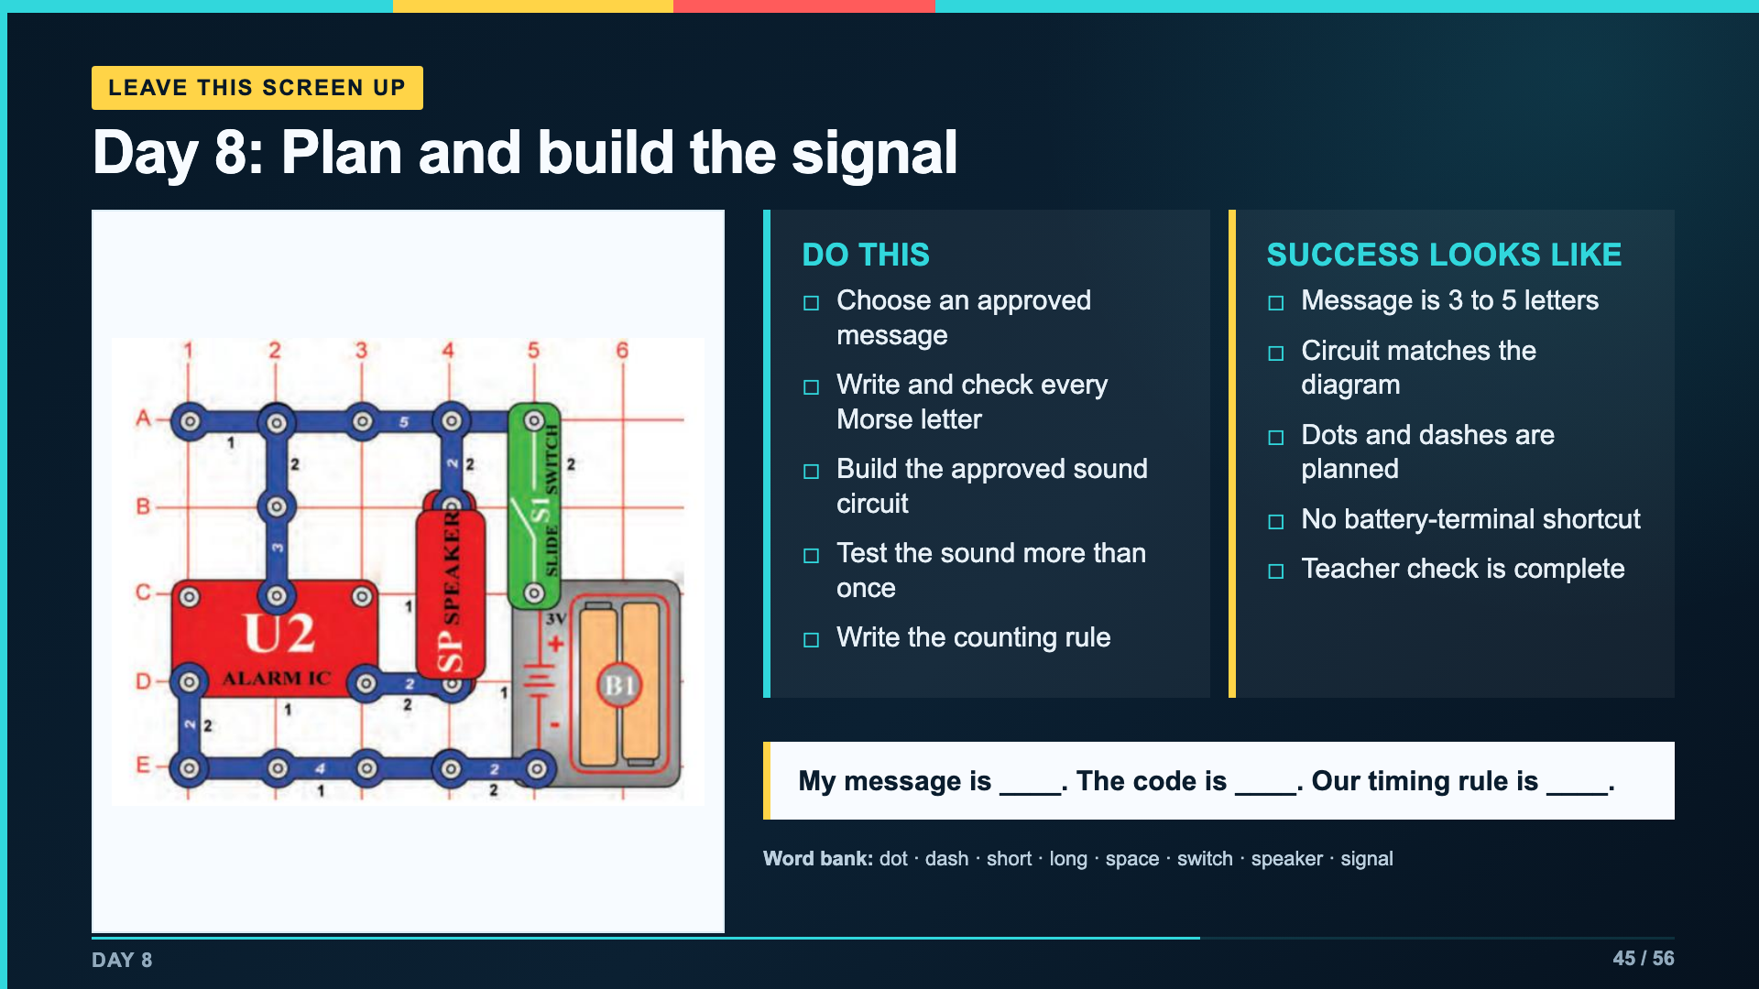
Notes:
Leave this slide projected for Day 8. Students use page 1 of the Signal Lab packet.
[Sources]
- Verizon Innovative Learning Schools and Arizona State University, Circuits lesson materials
- https://www.elenco.com/wp-content/uploads/2021/12/SC_300_Manual_2021.pdf

Slide 46
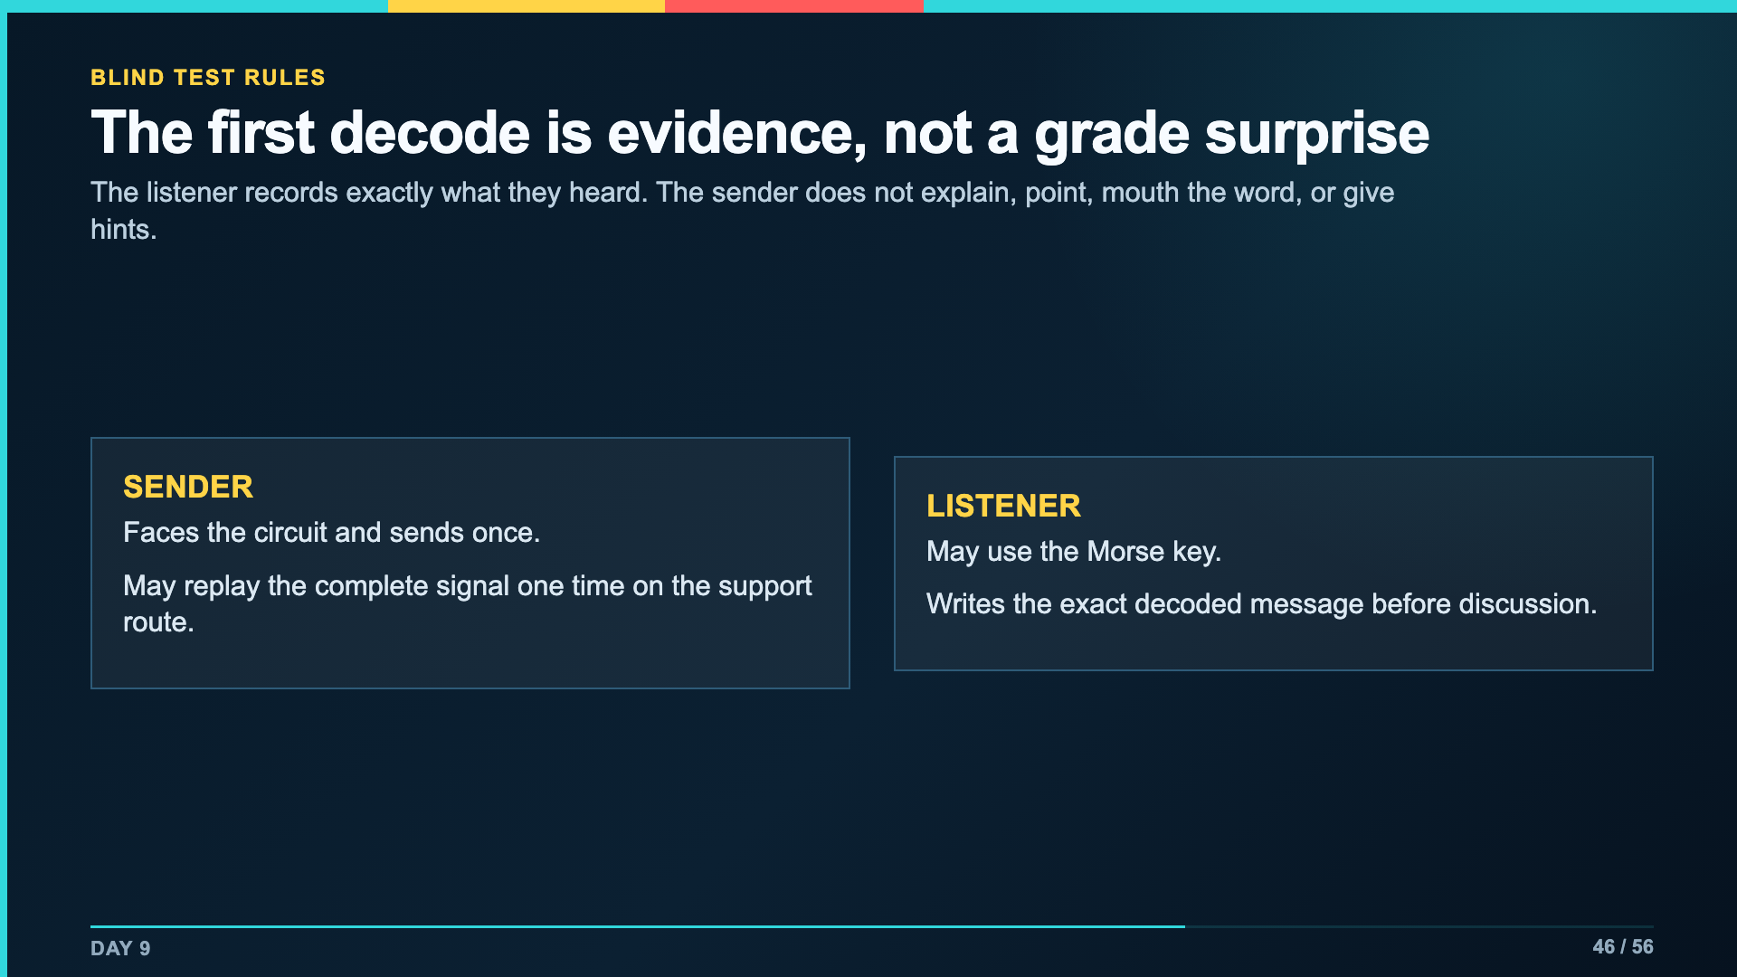
Notes:
Frame this as a user test. The first result is valuable precisely because the sender cannot coach the listener.
[Sources]
- Verizon Innovative Learning Schools and Arizona State University, Circuits lesson materials

Slide 47
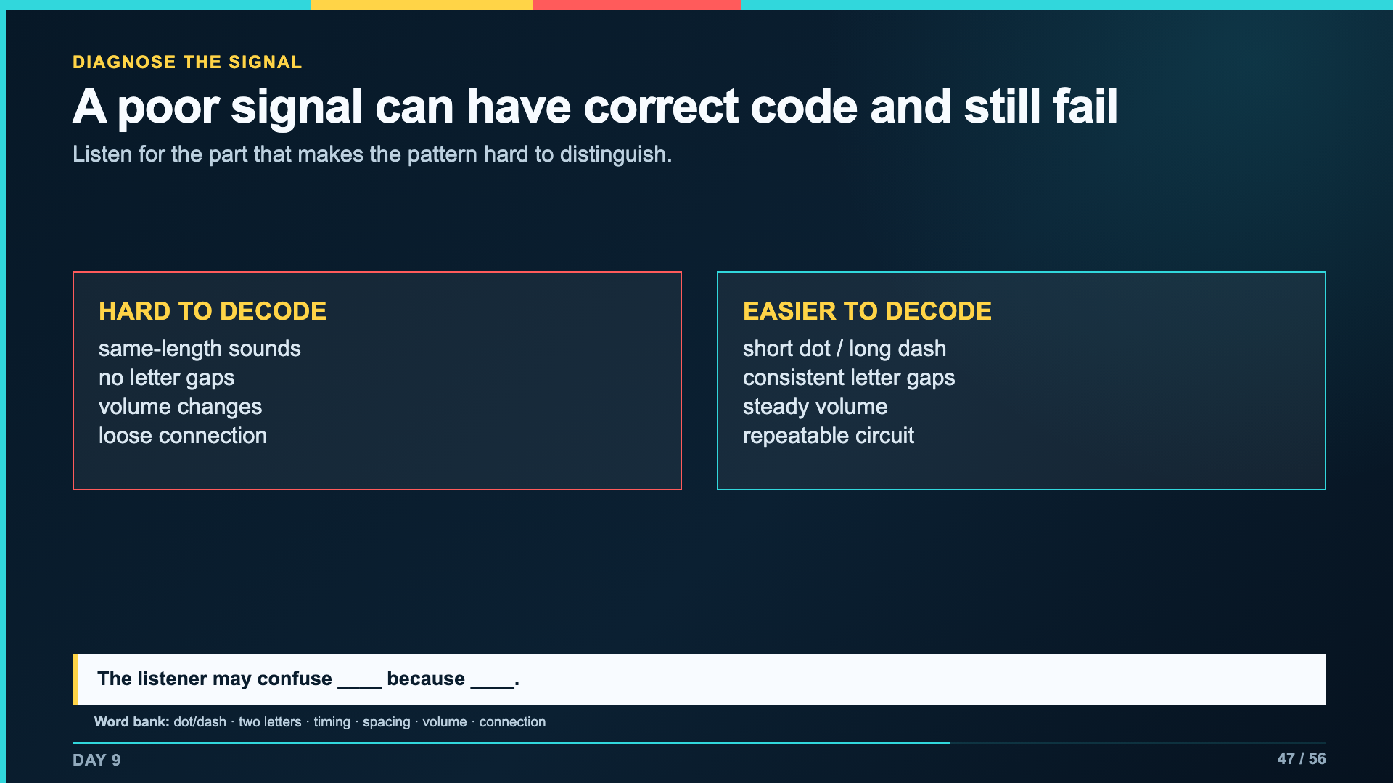
Notes:
Demonstrate one intentionally unclear letter, then one controlled version. Ask students to diagnose the variable rather than call the first attempt bad.
[Sources]
- Verizon Innovative Learning Schools and Arizona State University, Circuits lesson materials

Slide 48
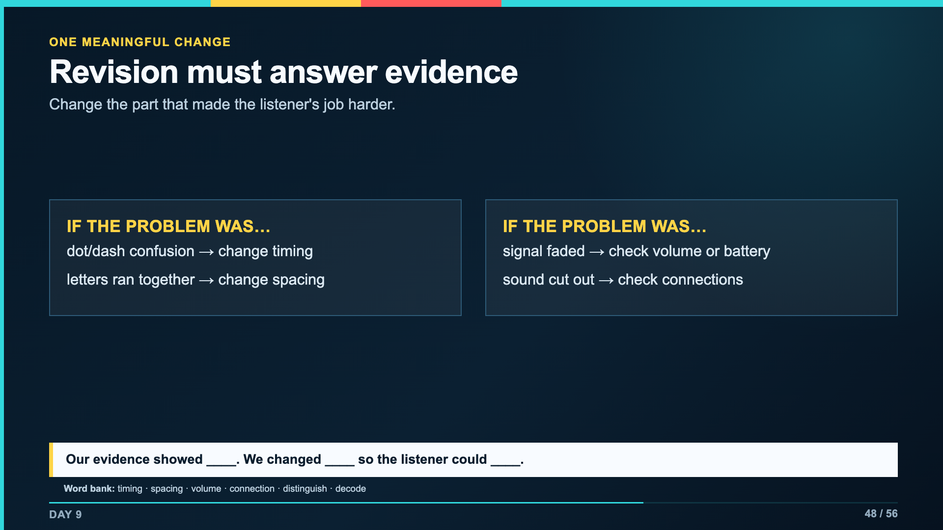
Notes:
Students may make more than one repair for safety, but the evidence record should name the main communication revision.
[Sources]
- Verizon Innovative Learning Schools and Arizona State University, Circuits lesson materials
- https://www.elenco.com/wp-content/uploads/2021/12/SC_300_Manual_2021.pdf

Slide 49
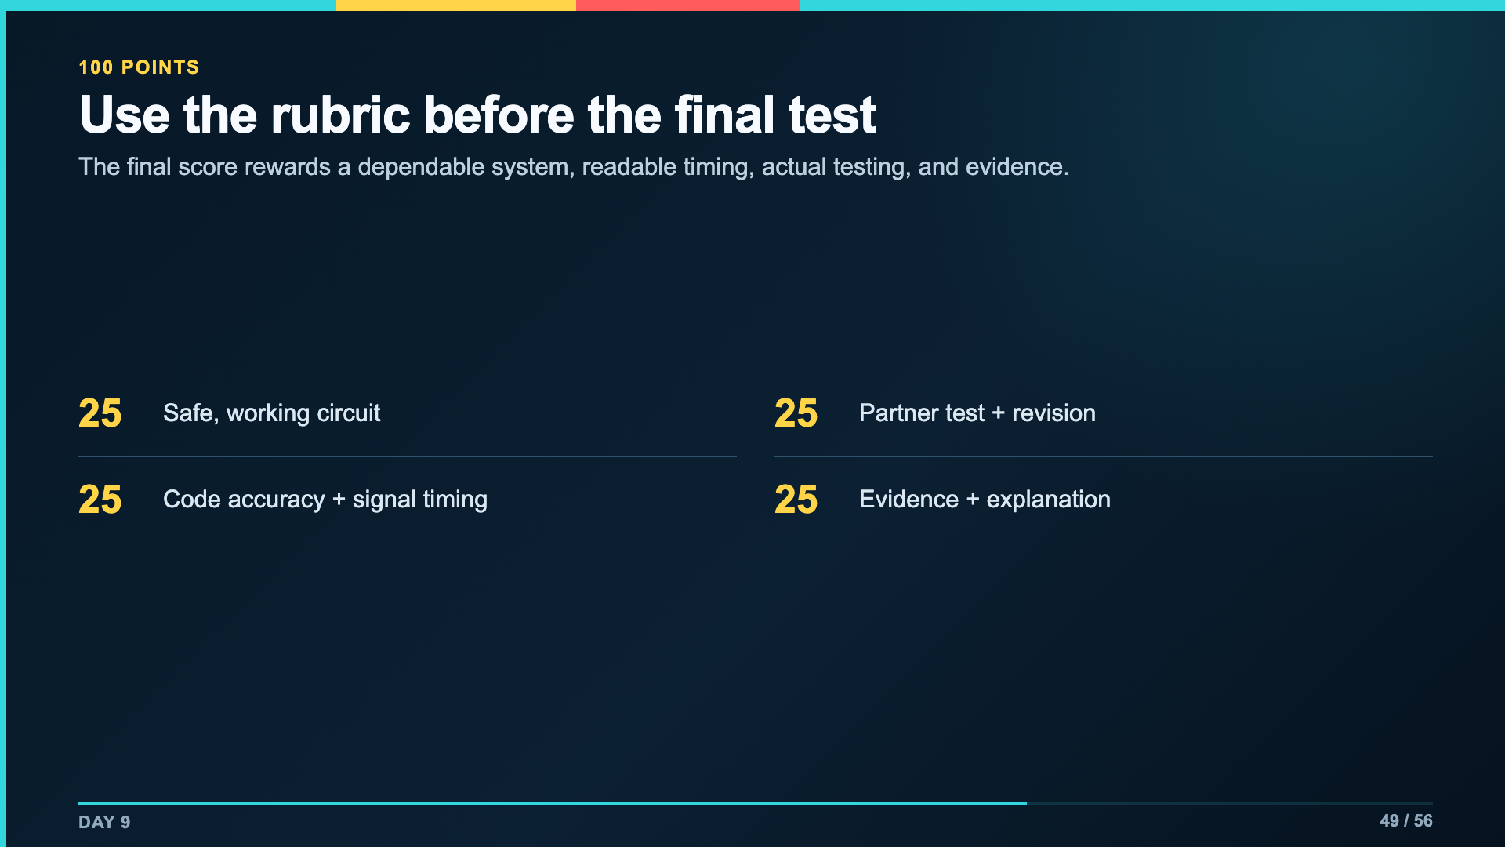
Notes:
Read the four criteria before work time. The support route uses the same criteria and is not automatically a lower score.
[Sources]
- Owner-approved staged rubric for the 2027 compressed Circuit Systems unit
- Verizon Innovative Learning Schools and Arizona State University, Circuits lesson materials

Slide 50
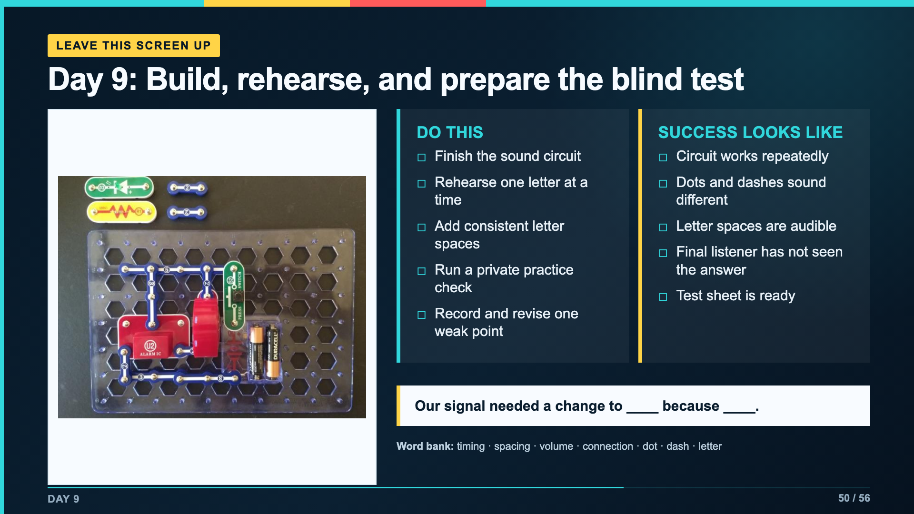
Notes:
Leave this slide projected for Day 9. This is the final rehearsal screen, not the blind-test protocol.
[Sources]
- Verizon Innovative Learning Schools and Arizona State University, Circuits lesson materials
- https://www.elenco.com/wp-content/uploads/2021/12/SC_300_Manual_2021.pdf

Slide 51

Notes:
Do not allow the sender to correct the listener mid-signal. The exact first decode is evidence for the revision criterion.
[Sources]
- Verizon Innovative Learning Schools and Arizona State University, Circuits lesson materials

Slide 52

Notes:
Require a specific change. 'We practiced more' is not enough unless the student names what the practice changed in the signal.
[Sources]
- Verizon Innovative Learning Schools and Arizona State University, Circuits lesson materials

Slide 53

Notes:
The final decode is not required to be perfect for students to show learning. The record must be honest and the explanation must match the evidence.
[Sources]
- Verizon Innovative Learning Schools and Arizona State University, Circuits lesson materials

Slide 54

Notes:
Teachers choose paper scan, file upload, or in-person circuit check. Keep the rubric evidence constant even when the collection route changes.
[Sources]
- Verizon Innovative Learning Schools and Arizona State University, Circuits lesson materials

Slide 55

Notes:
Leave this slide projected during Day 10 testing and submission.
[Sources]
- Verizon Innovative Learning Schools and Arizona State University, Circuits lesson materials

Slide 56

Notes:
Use this as an oral close, submission comment, or short exit. It resolves the unit opening: the circuit and the audience both matter.
[Sources]
- Verizon Innovative Learning Schools and Arizona State University, Circuits lesson materials

