Slide 1
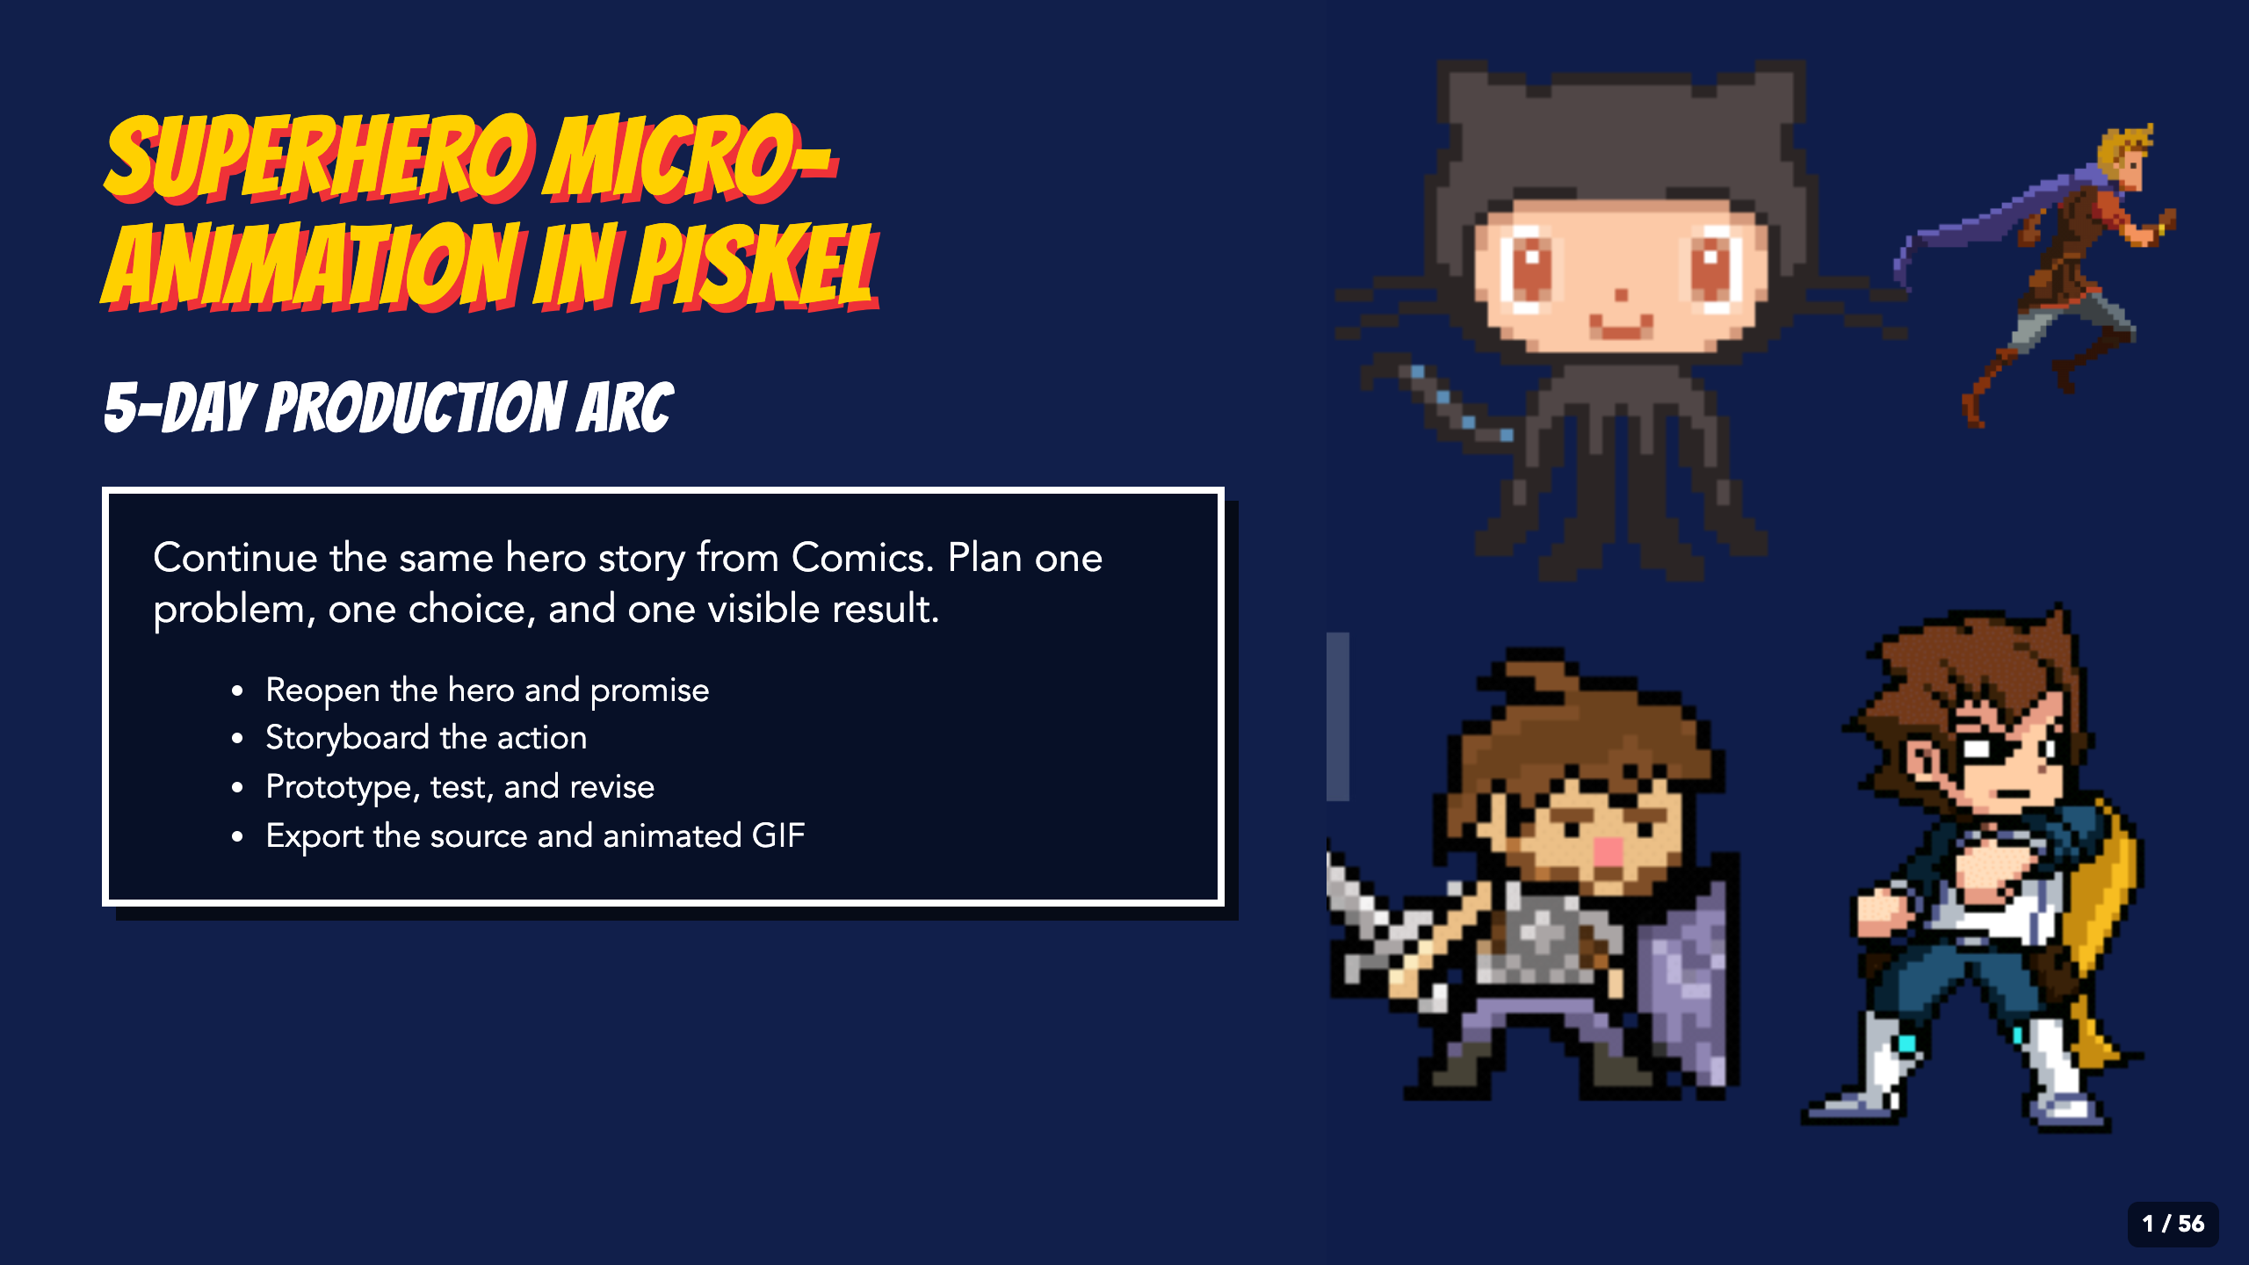
Notes:
Launch the Animation production arc as a full five-day to 1.5-week experience. Students continue the same hero story from Comics through planning, practice, production, feedback, revision, and export. Preview the standard and support routes before assigning it.
[Sources]
- Irving ISD VILS 2027 Template Animation student pages, rubric, and facilitator guide.
- Course-author-created Superhero Piskel Canva deck: Superhero Micro-Animation in Piskel.

Slide 2
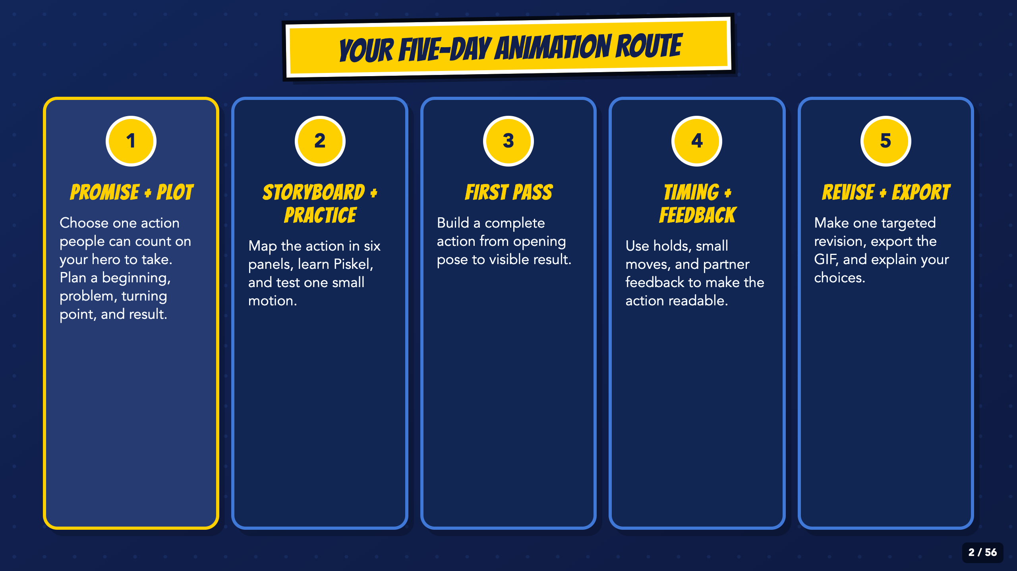
Notes:
Preview the whole week without teaching every step. Students need to know that planning, practice, production, feedback, and final export are separate jobs.
[Sources]
- Irving ISD VILS 2027 Template Animation student pages, rubric, and facilitator guide.

Slide 3
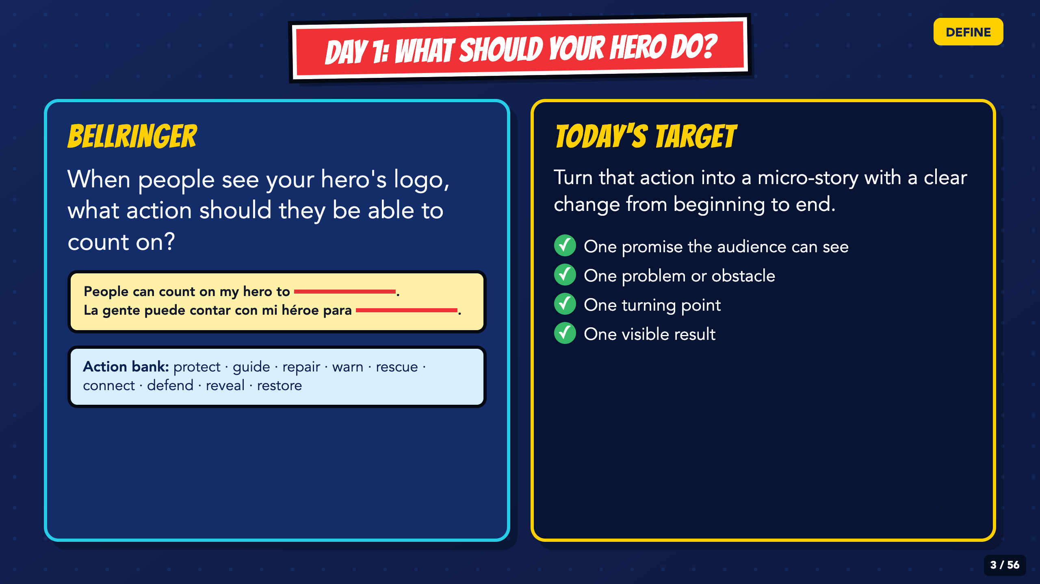
Notes:
Give students 60 to 90 seconds. Accept an oral answer, sketch, gesture, or the sentence stem. Push for one visible action instead of a list of powers.
[Sources]
- Irving ISD VILS 2027 Template Animation student pages, rubric, and facilitator guide.

Slide 4
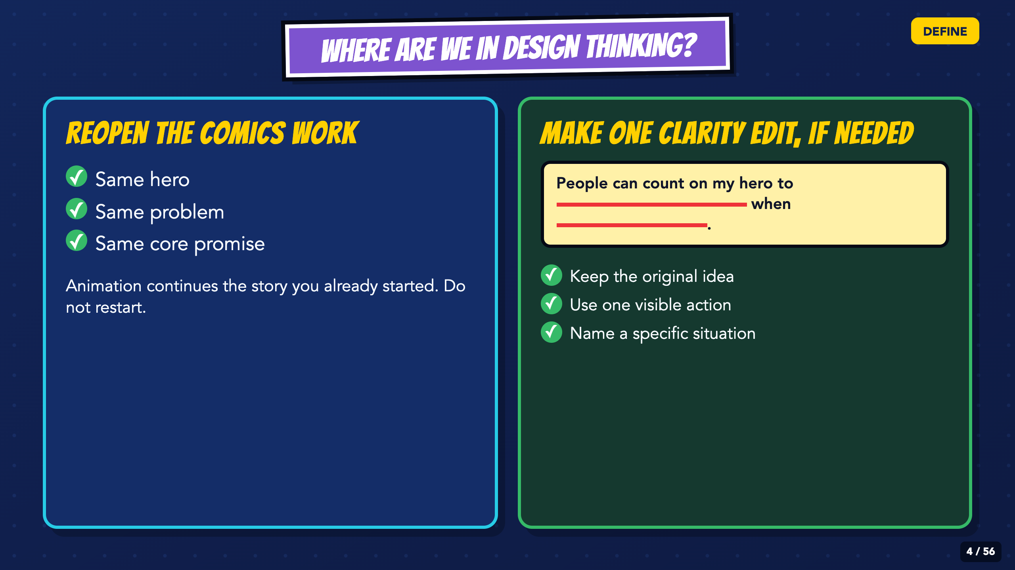
Notes:
Locate the class in Define. Have students reopen the hero, problem, and core promise from Comics. They may make one clarity edit, but they should not restart with a new hero or mission.
[Sources]
- Irving ISD VILS 2027 Template Animation student pages, rubric, and facilitator guide.

Slide 5
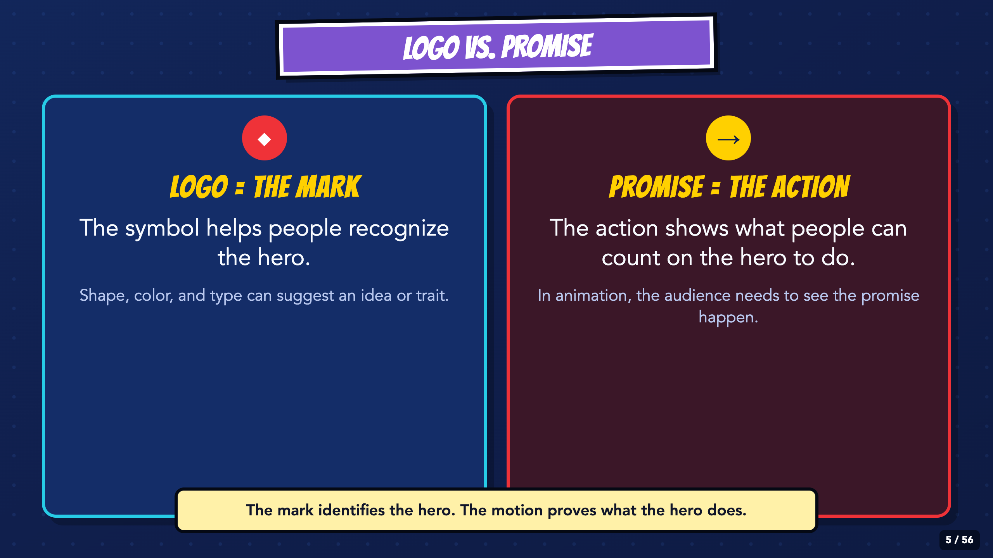
Notes:
Keep the distinction concrete. A mark helps an audience recognize the hero. The animation must show the action and result that make the promise understandable.
[Sources]
- Irving ISD VILS 2027 Template Animation student pages, rubric, and facilitator guide.

Slide 6
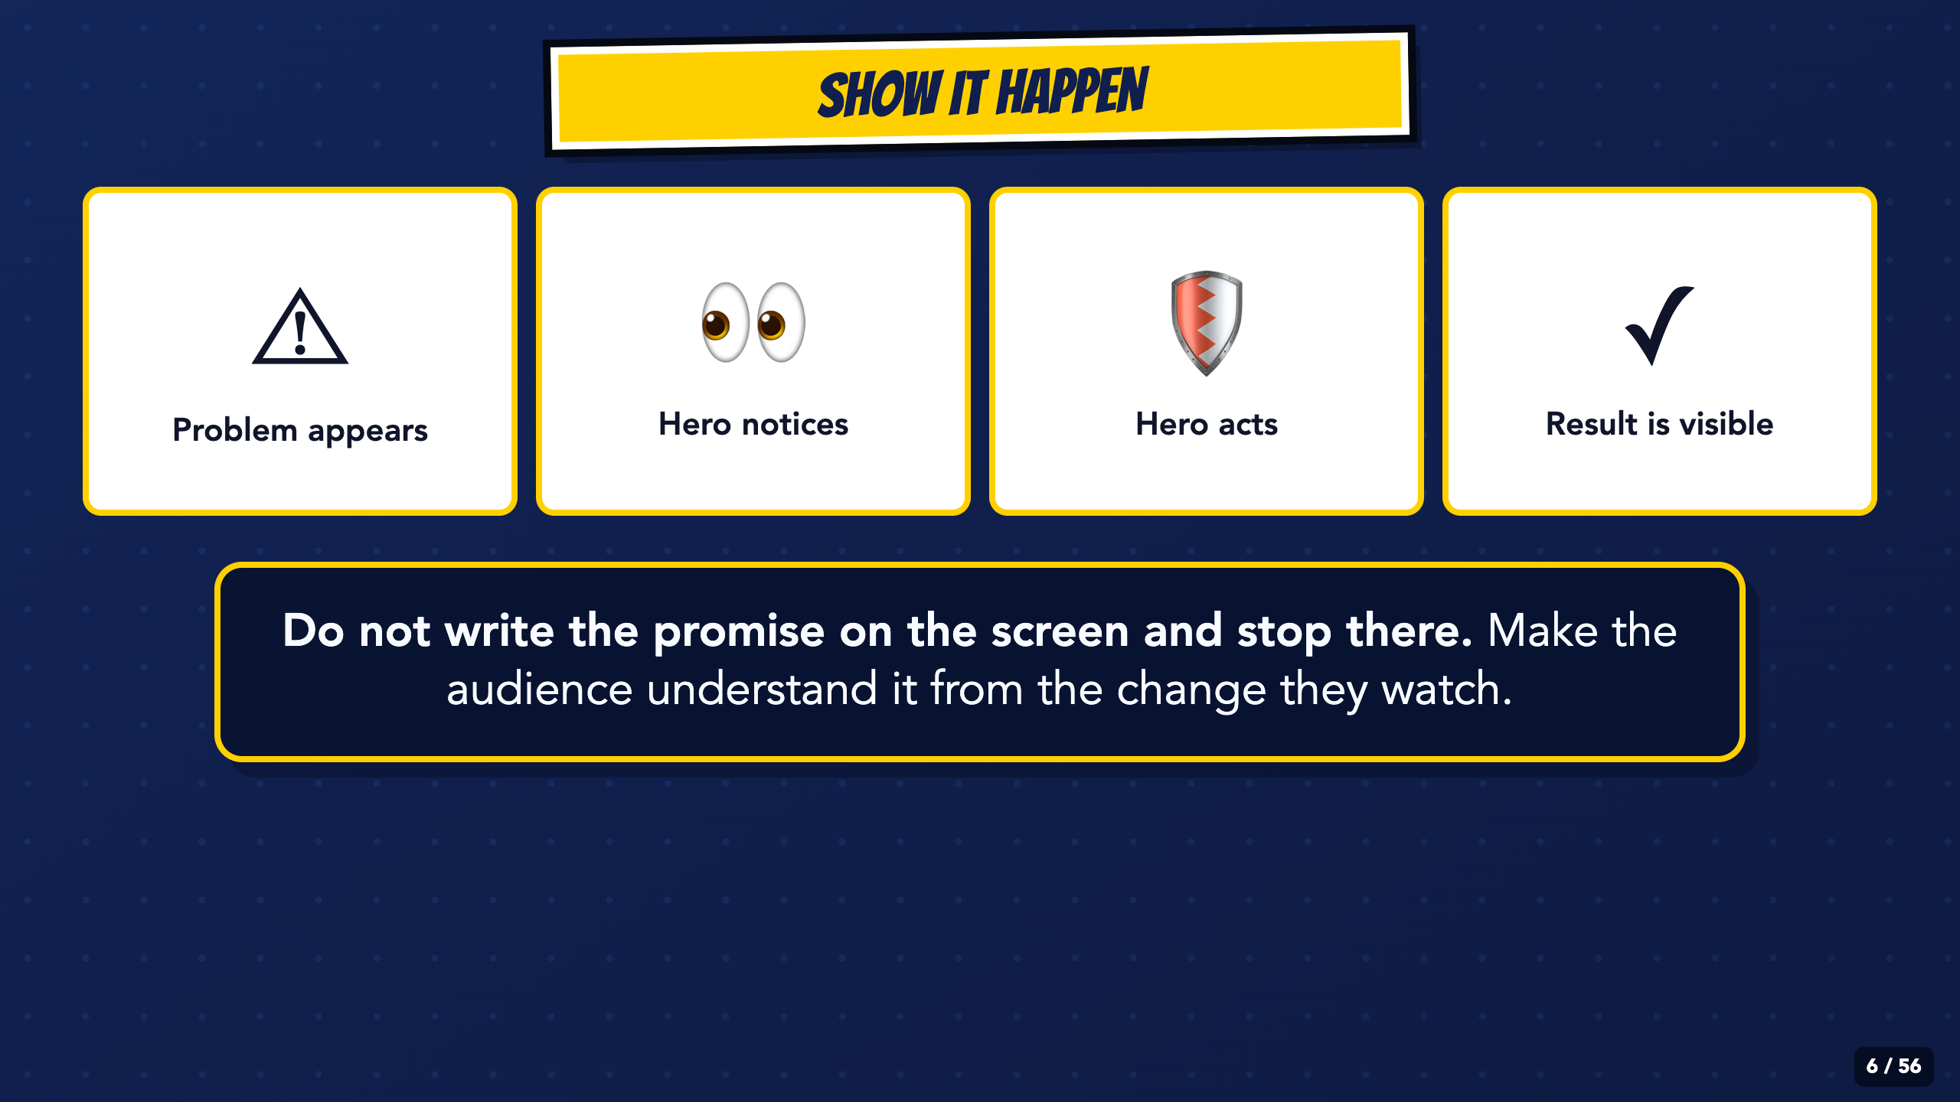
Notes:
Read the four beats from left to right. Ask students which beat would be missing if the hero only posed and never changed the scene.
[Sources]
- Irving ISD VILS 2027 Template Animation student pages, rubric, and facilitator guide.

Slide 7
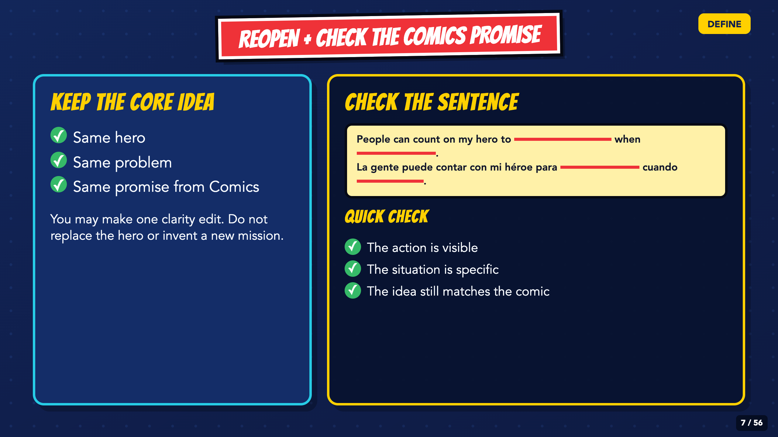
Notes:
Have students reread the Comics promise. Allow one clarity edit if needed. If the sentence contains several actions, keep the original idea and choose the one visible action that can fit in a short scene.
[Sources]
- Irving ISD VILS 2027 Template Animation student pages, rubric, and facilitator guide.

Slide 8
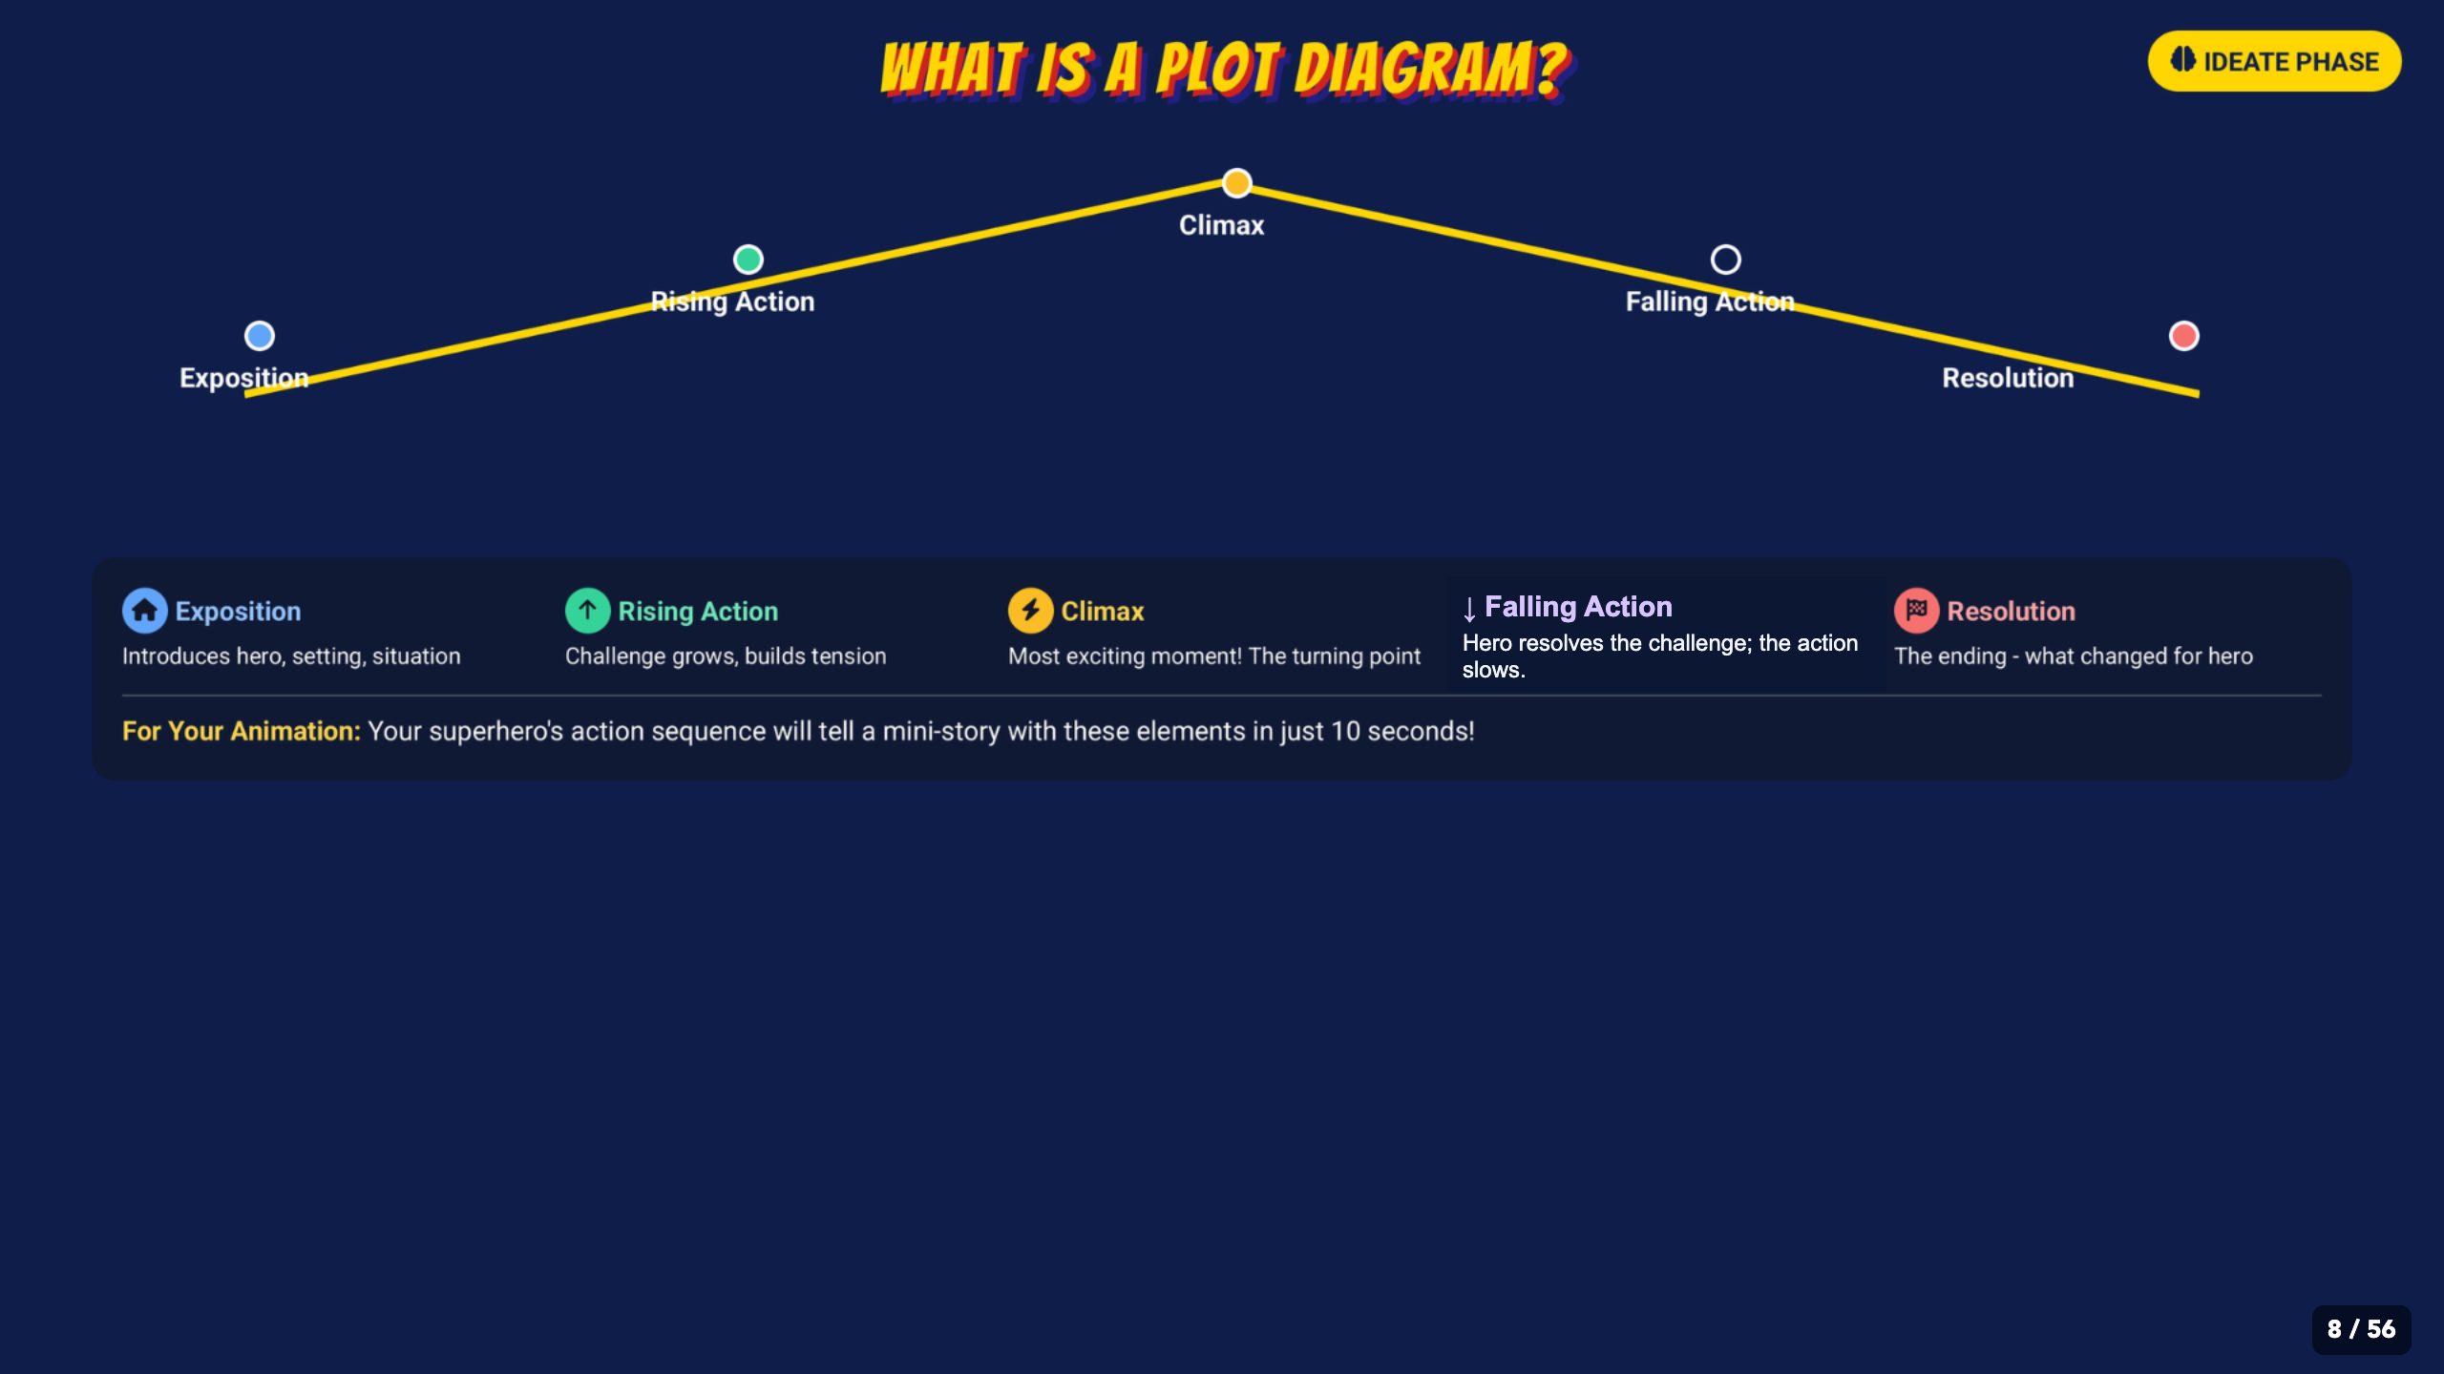
Notes:
Introduce the five plot parts as visual jobs. The template is a planning tool, not a long writing assignment.
[Sources]
- Irving ISD VILS 2027 Template Animation student pages, rubric, and facilitator guide.
- Course-author-created Superhero Piskel Canva deck: Superhero Micro-Animation in Piskel.

Slide 9
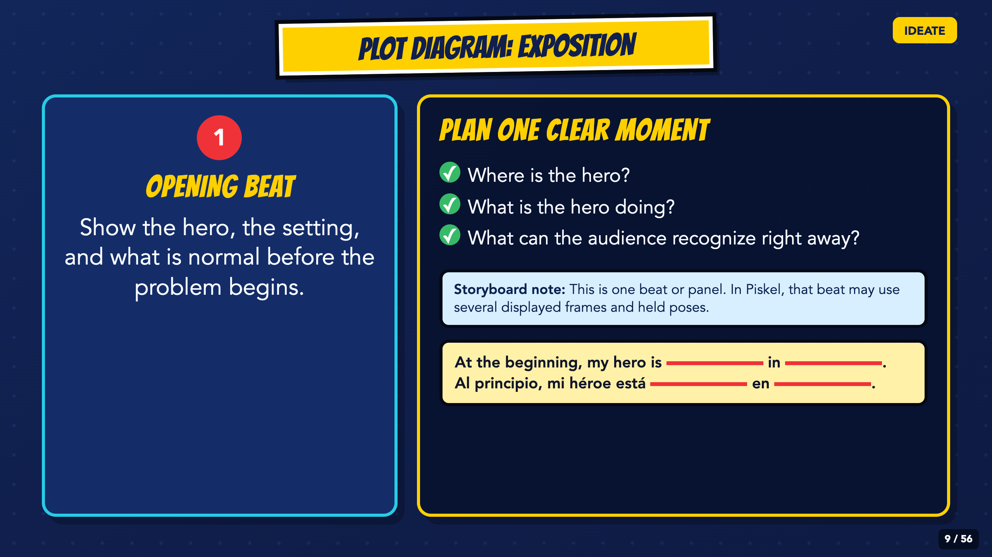
Notes:
Model one opening beat that establishes who, where, and what is normal before the problem appears. Separate a storyboard beat from animation frames: one beat may use several displayed frames and held poses.
[Sources]
- Irving ISD VILS 2027 Template Animation student pages, rubric, and facilitator guide.

Slide 10
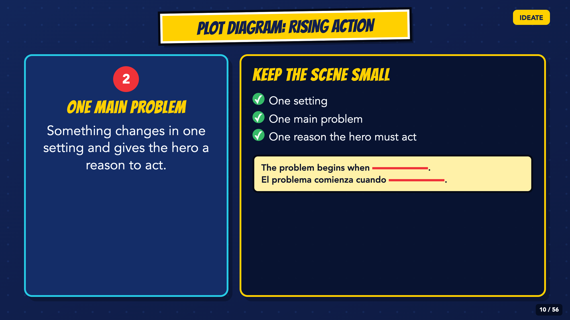
Notes:
Keep the Rising Action small: one setting, one main problem, and one reason the hero must act. The micro-scene should build toward one choice instead of adding unrelated events.
[Sources]
- Irving ISD VILS 2027 Template Animation student pages, rubric, and facilitator guide.

Slide 11
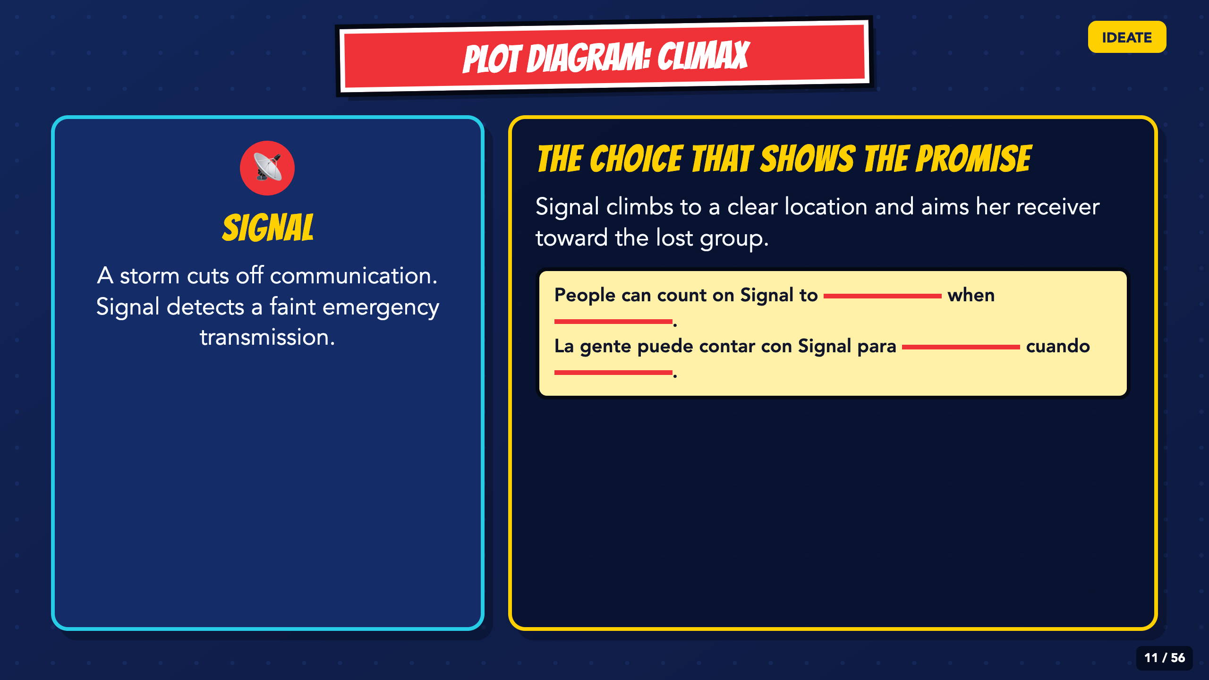
Notes:
Use Signal as the course model. Name the turning point: she climbs and aims the receiver. Ask what that choice lets people count on her to do.
[Sources]
- Irving ISD VILS 2027 Template Animation student pages, rubric, and facilitator guide.

Slide 12
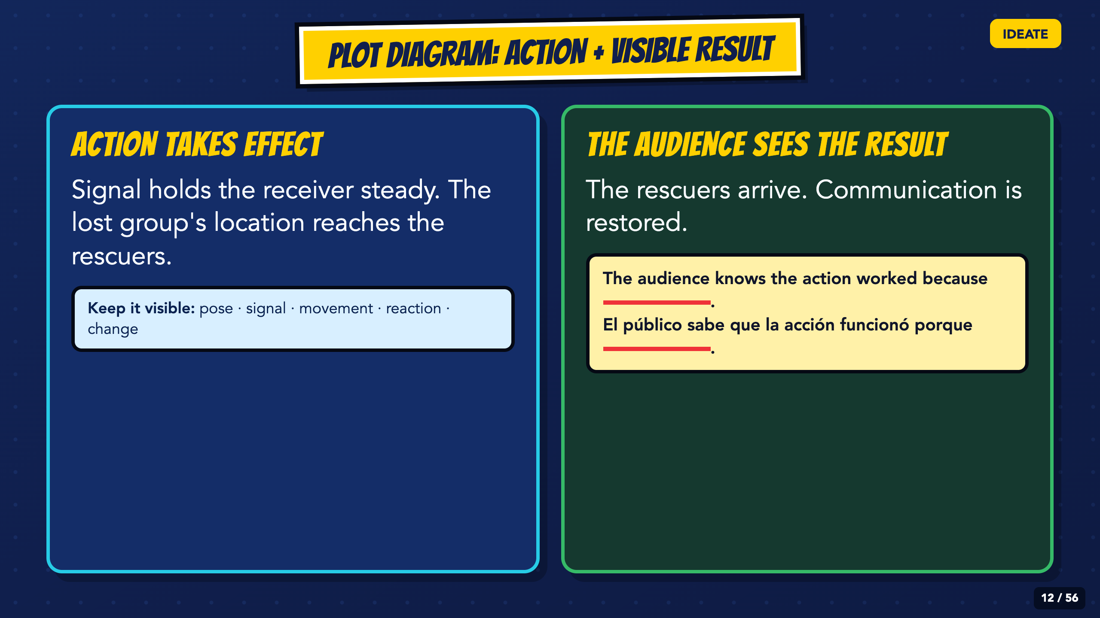
Notes:
Trace action into result. The lost group's location reaches the rescuers, and communication is restored. Require a visible change rather than a written 'The End.'
[Sources]
- Irving ISD VILS 2027 Template Animation student pages, rubric, and facilitator guide.

Slide 13
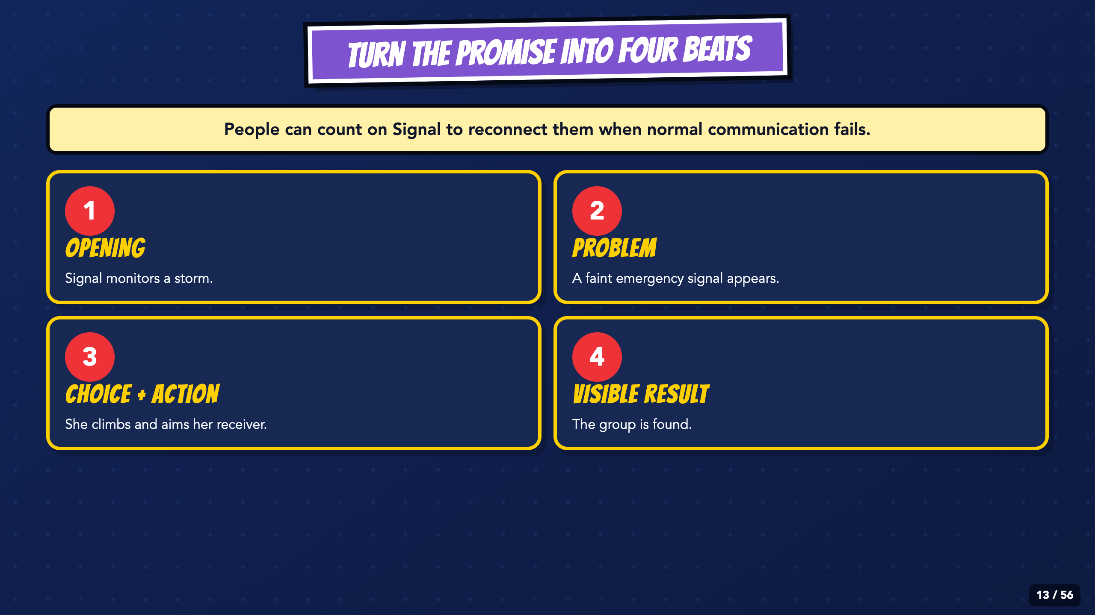
Notes:
Read Signal's promise and four beats from left to right. Students keep their own hero and problem while using the compact structure: opening, problem, choice and action, visible result.
[Sources]
- Irving ISD VILS 2027 Template Animation student pages, rubric, and facilitator guide.

Slide 14
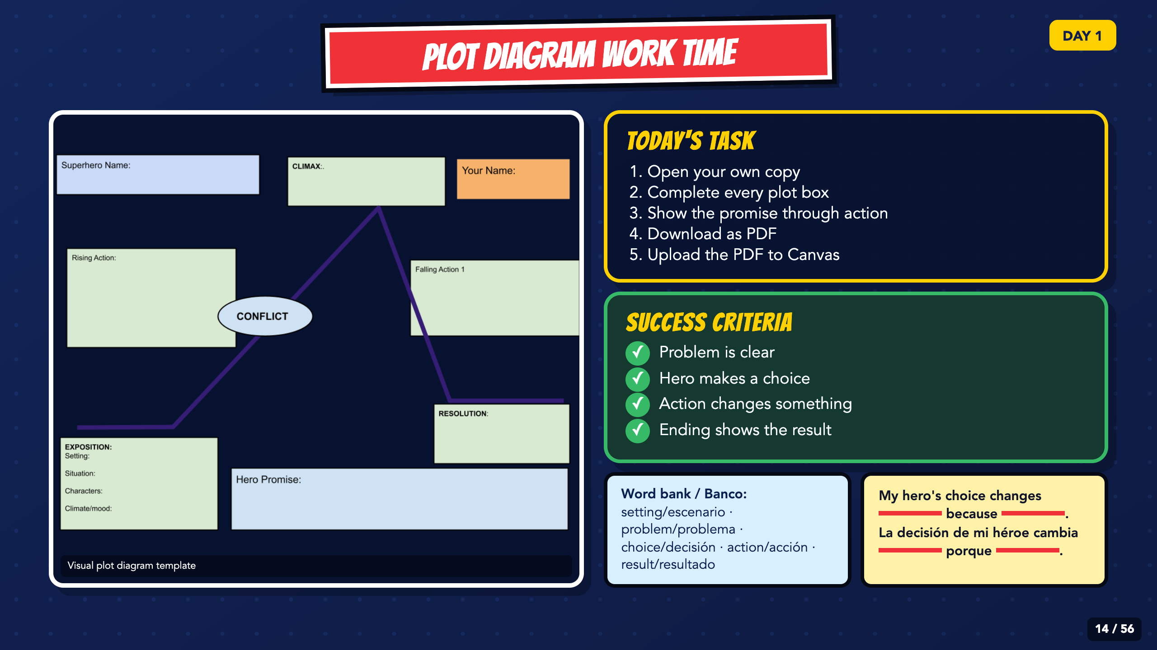
Notes:
Leave this slide projected during Plot Diagram work. The PDF upload is the portable default. Check that every student can open their copy before circulating.
[Sources]
- Irving ISD VILS 2027 Template Animation student pages, rubric, and facilitator guide.
- Course-author Google Drawing plot template: https://docs.google.com/drawings/d/1DIc8FcmFNkTEJd5oxo5Lv8cfpXEvNOq63bdb9Qiwhqw/copy

Slide 15
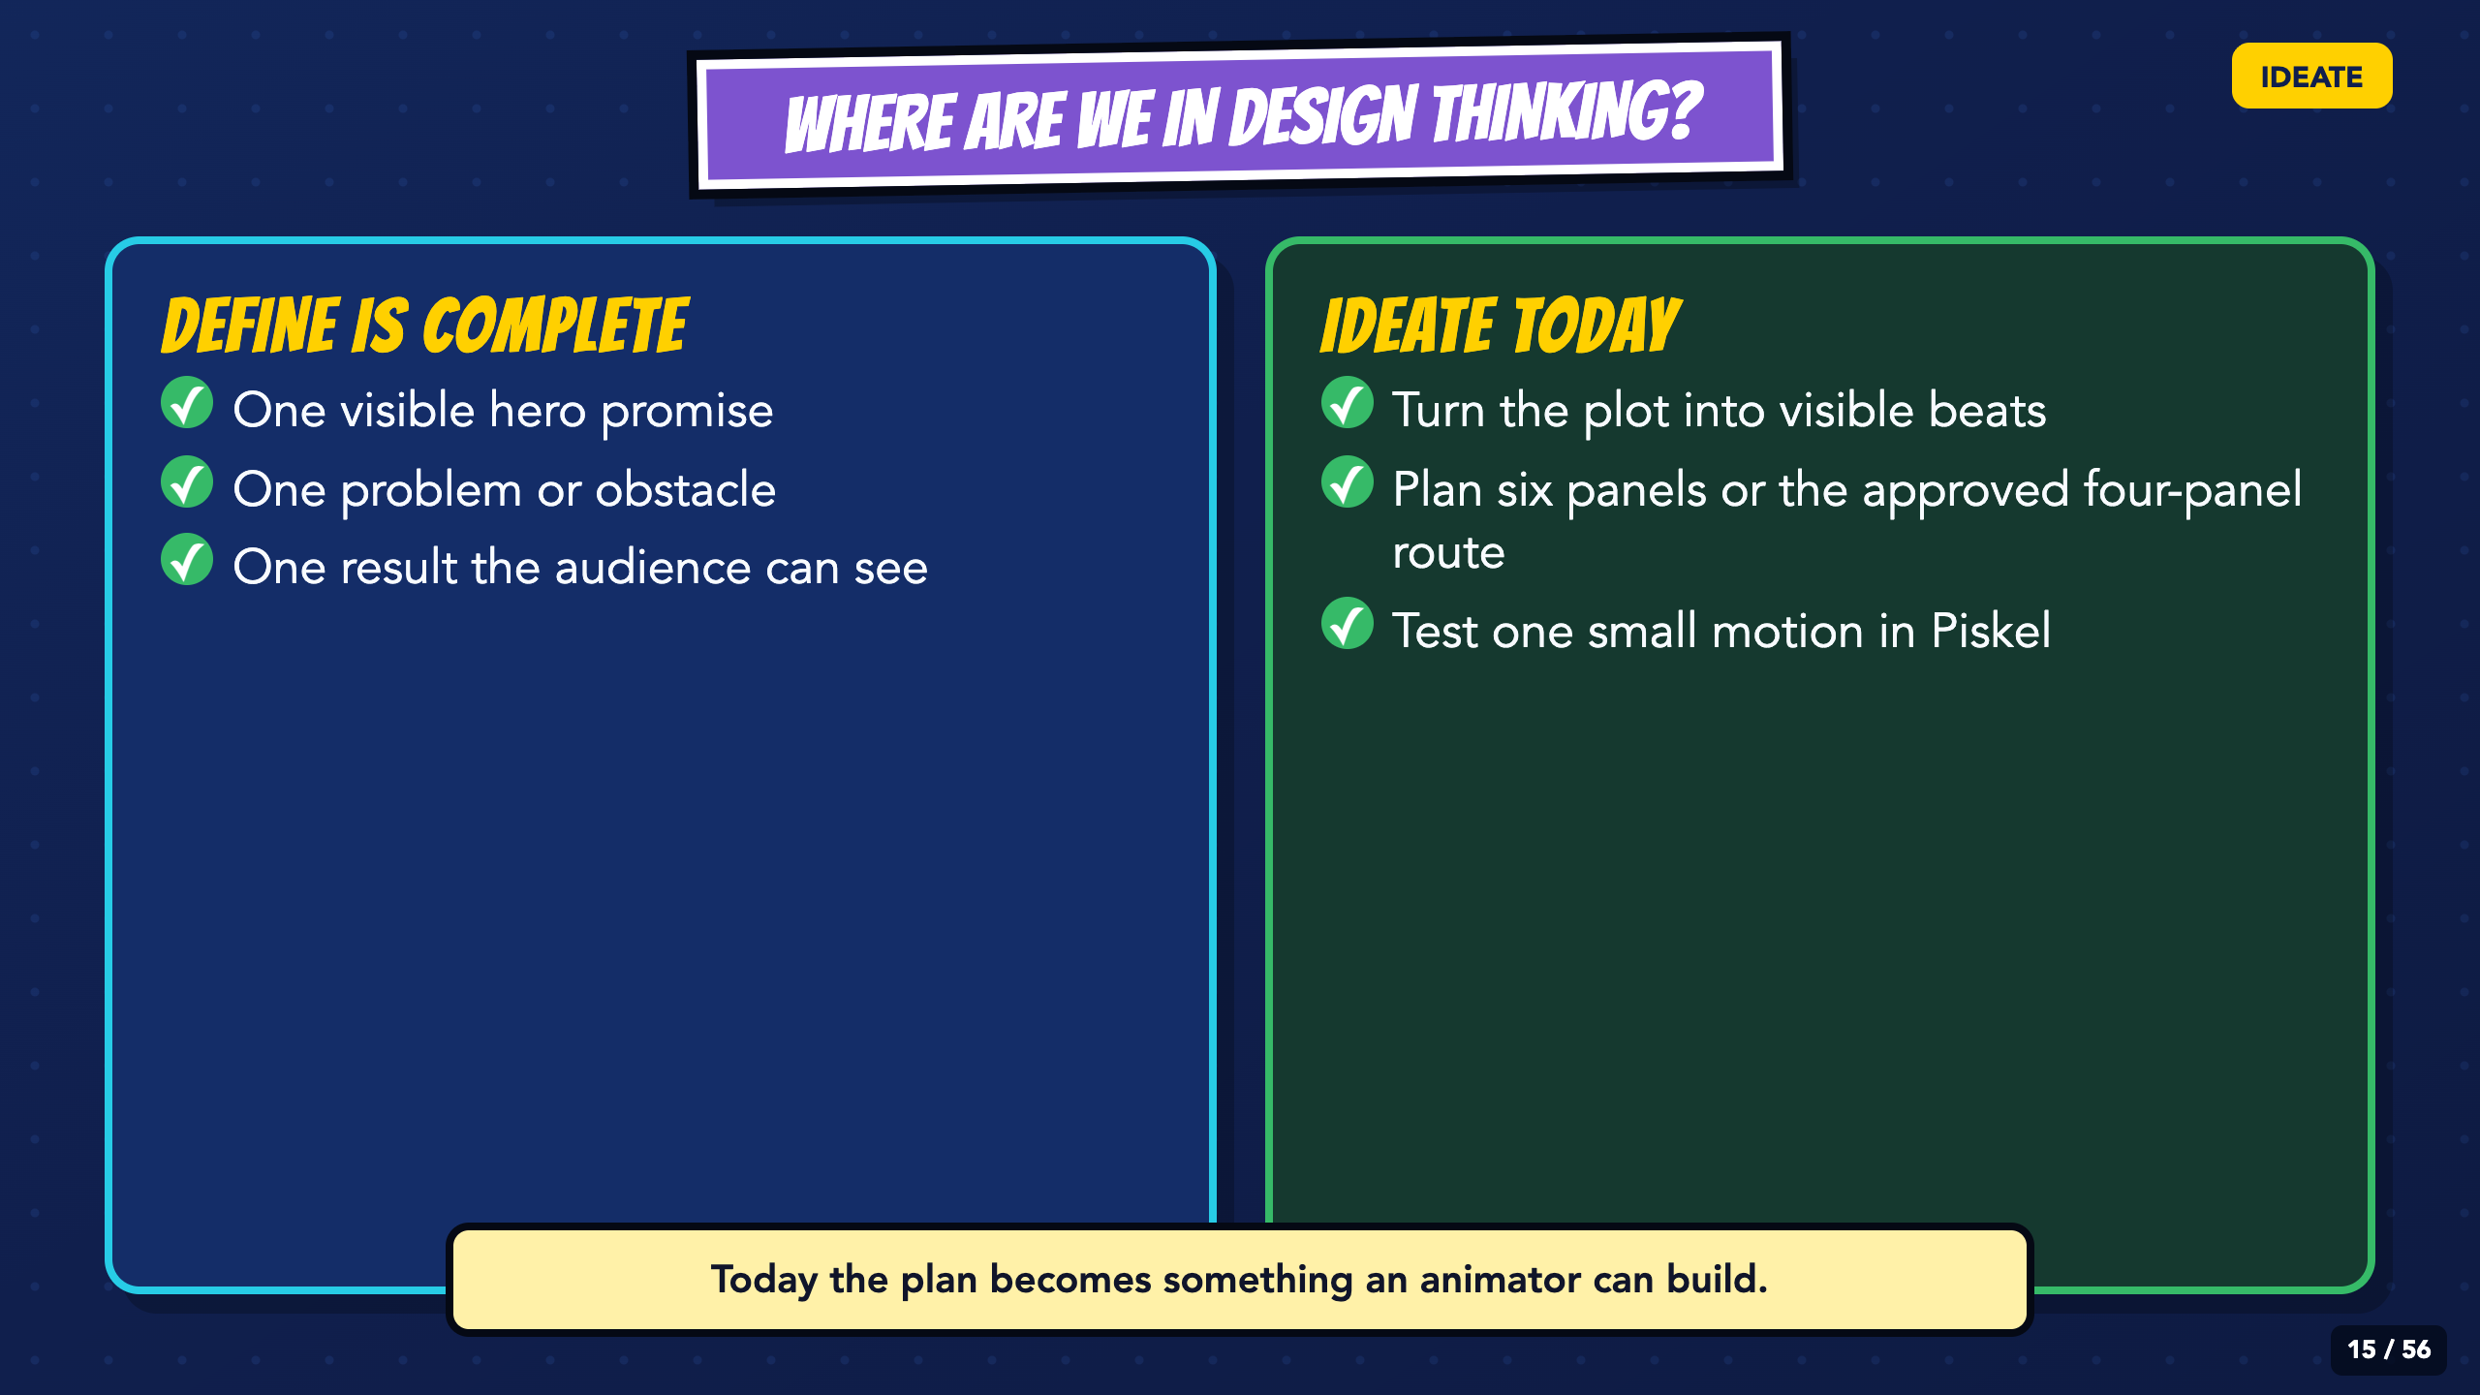
Notes:
Re-enter the unit at Ideate. Today turns the plot into visible moments and gives students a low-stakes Piskel test before major production.
[Sources]
- Irving ISD VILS 2027 Template Animation student pages, rubric, and facilitator guide.

Slide 16
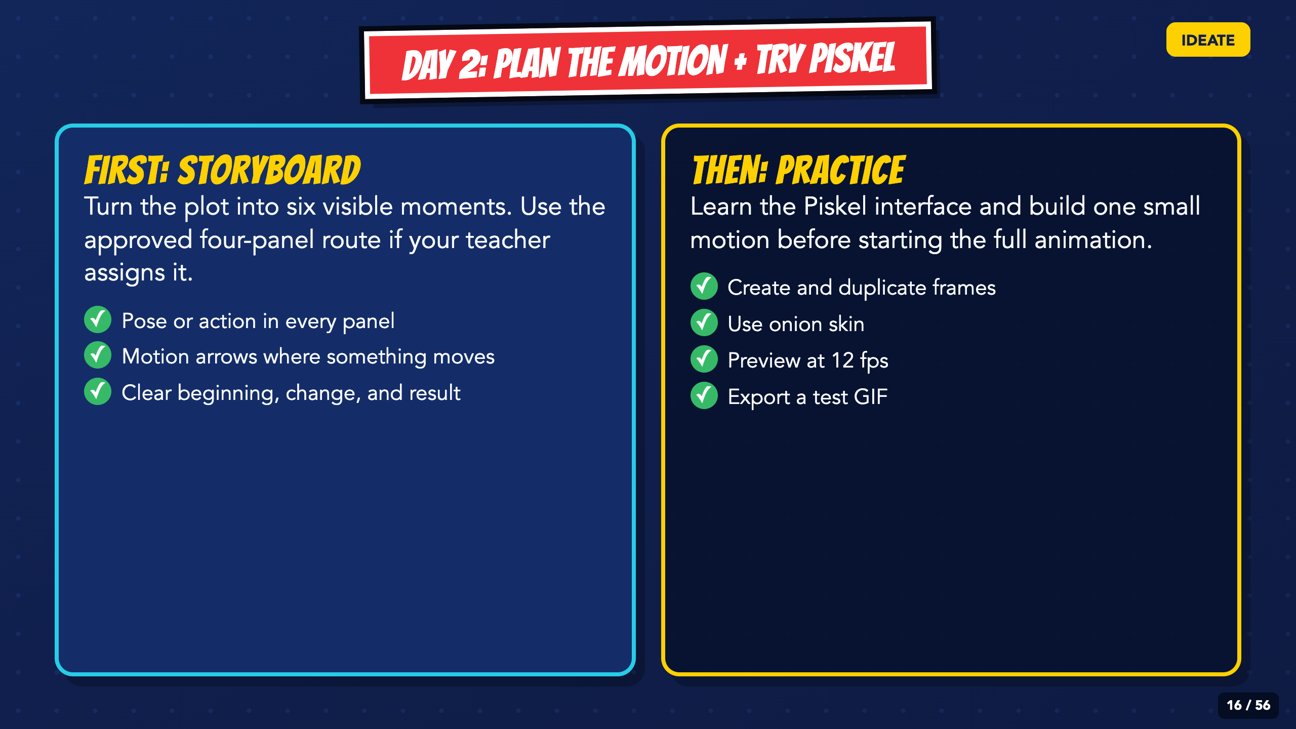
Notes:
Read the two-part route. Students should finish the storyboard before they start inventing new action inside Piskel.
[Sources]
- Irving ISD VILS 2027 Template Animation student pages, rubric, and facilitator guide.

Slide 17
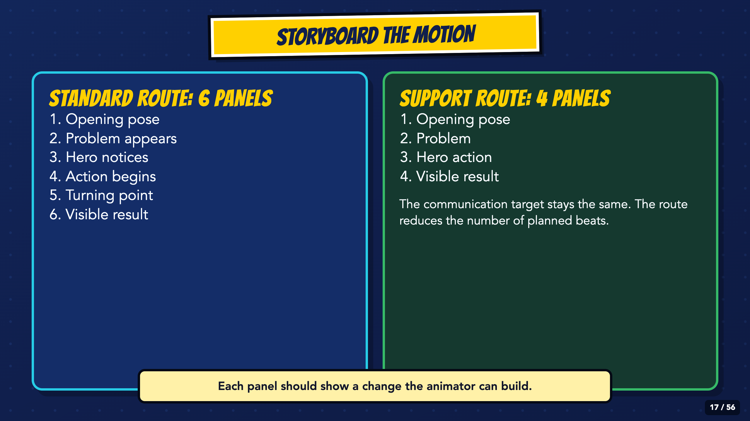
Notes:
Assign the standard six-panel route or the approved four-panel support route. Do not lower the communication, testing, revision, or export expectations for the support route.
[Sources]
- Irving ISD VILS 2027 Template Animation student pages, rubric, and facilitator guide.

Slide 18
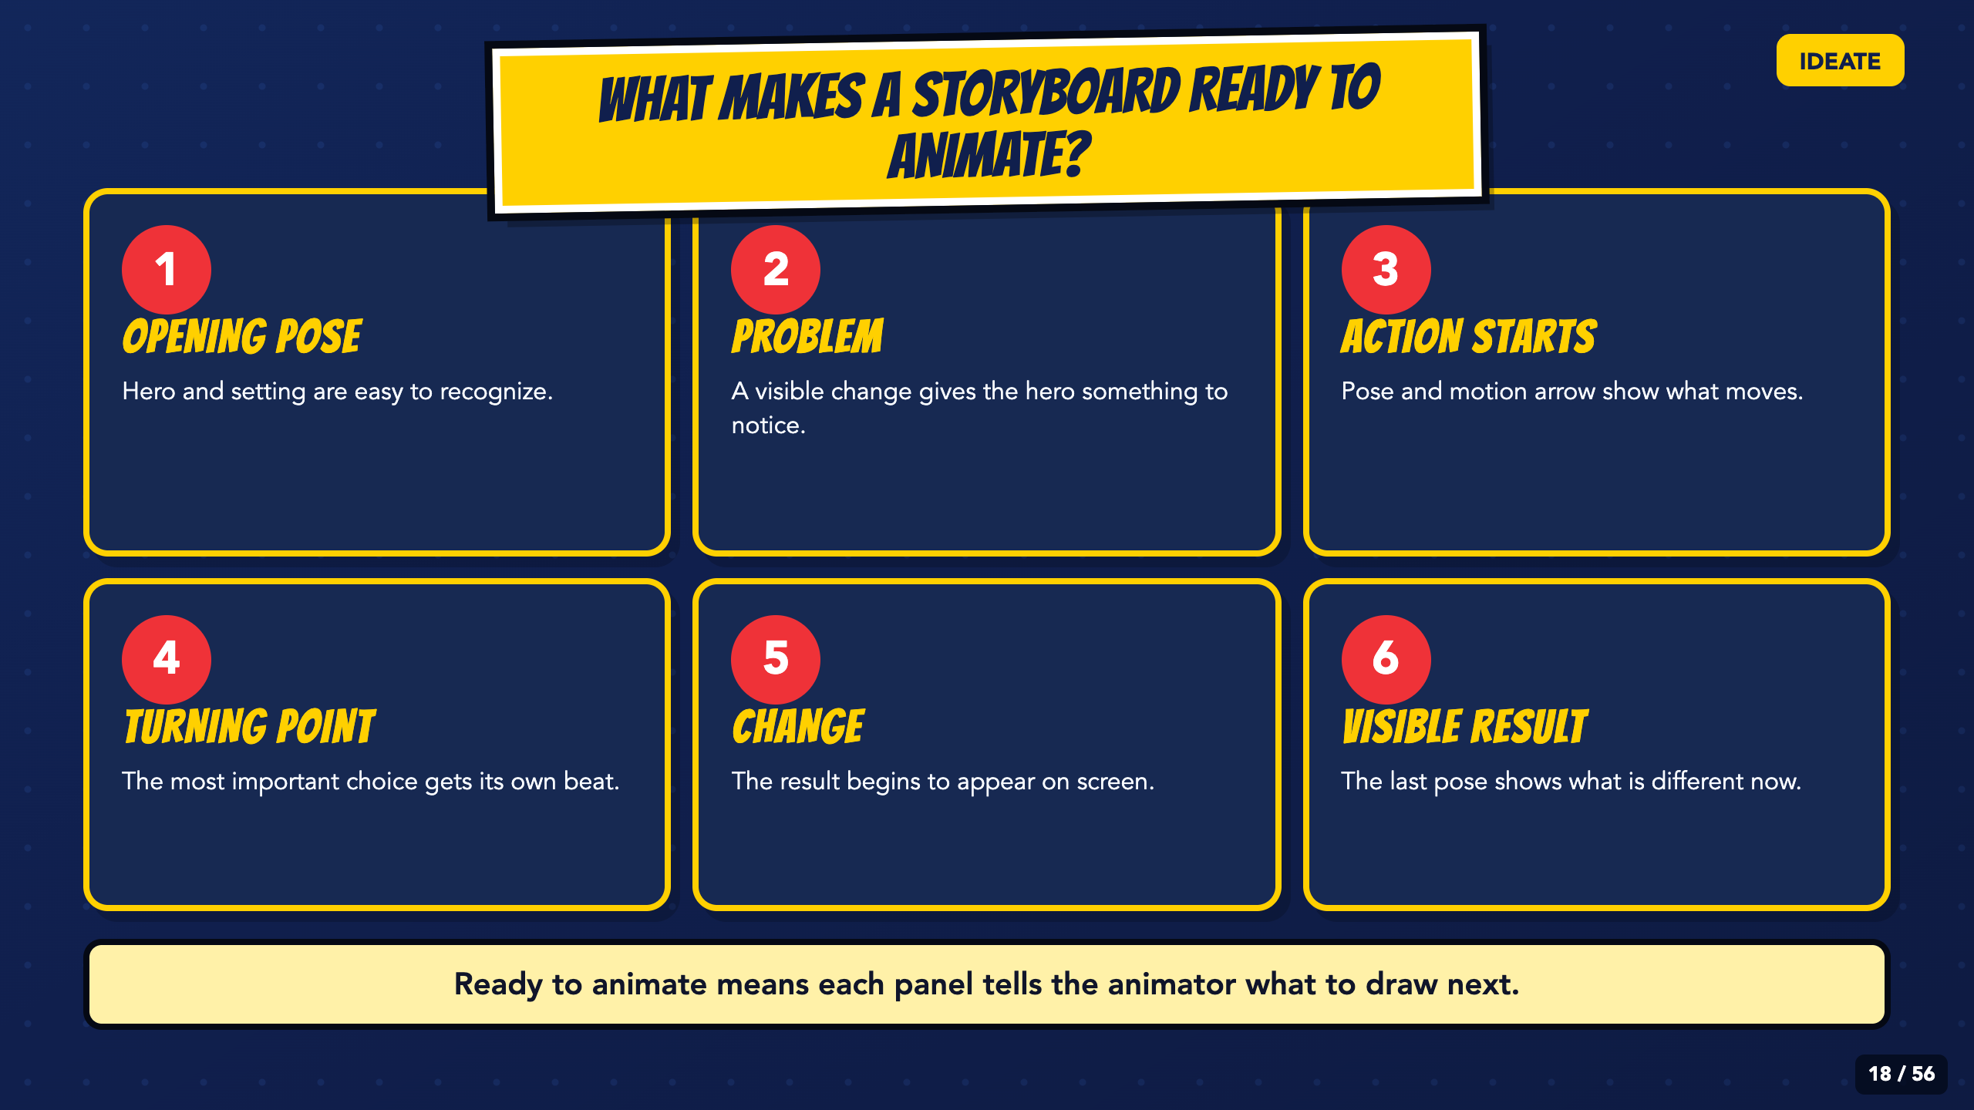
Notes:
Ask students to point to the change in each panel. Motion arrows and readable poses matter more than polished drawing.
[Sources]
- Irving ISD VILS 2027 Template Animation student pages, rubric, and facilitator guide.

Slide 19
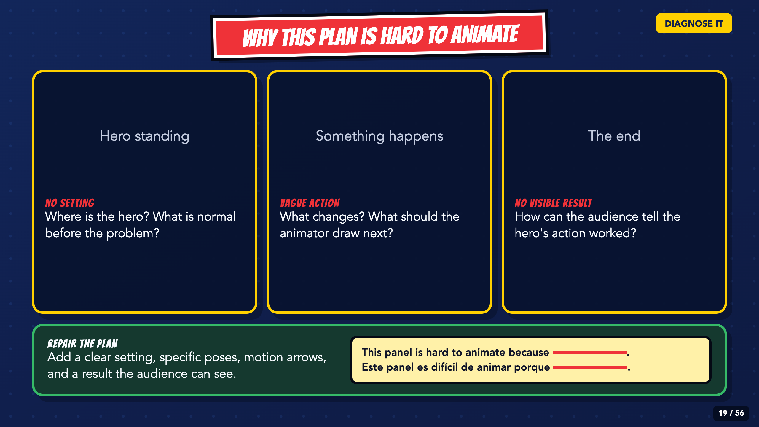
Notes:
Let students diagnose the missing setting, vague action, and skipped beats before you reveal the callouts.
[Sources]
- Irving ISD VILS 2027 Template Animation student pages, rubric, and facilitator guide.

Slide 20
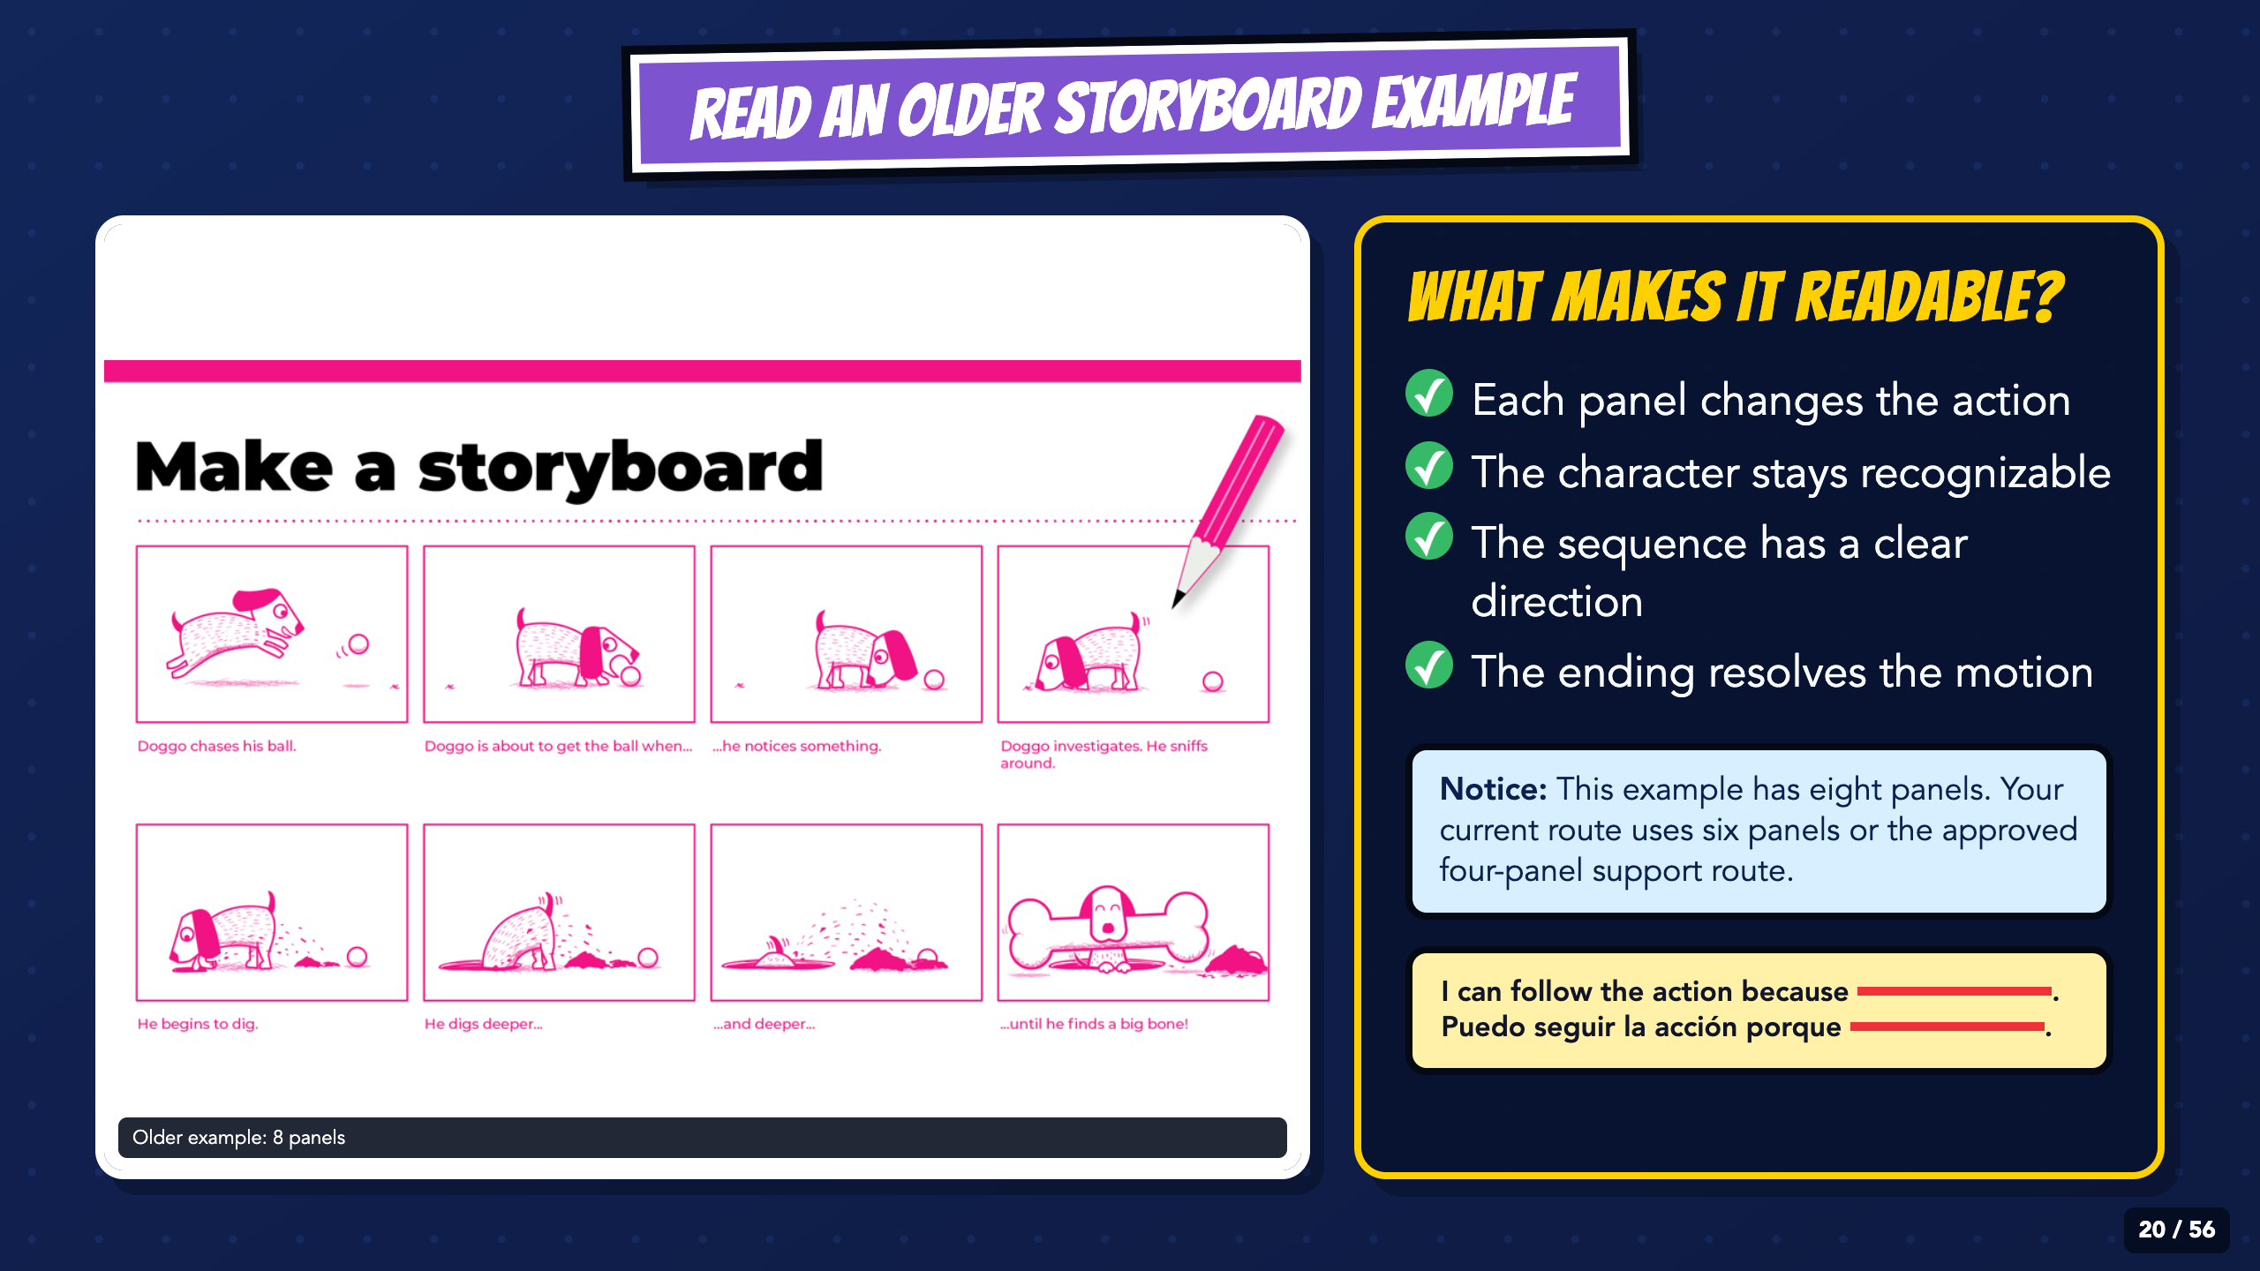
Notes:
Study the sequence, not the drawing style. This older Canva example uses eight panels; remind students that the current task uses six panels or the approved four-panel route.
[Sources]
- Irving ISD VILS 2027 Template Animation student pages, rubric, and facilitator guide.
- Course-author-supplied Canva storyboard example, used under the Canva Content License.

Slide 21
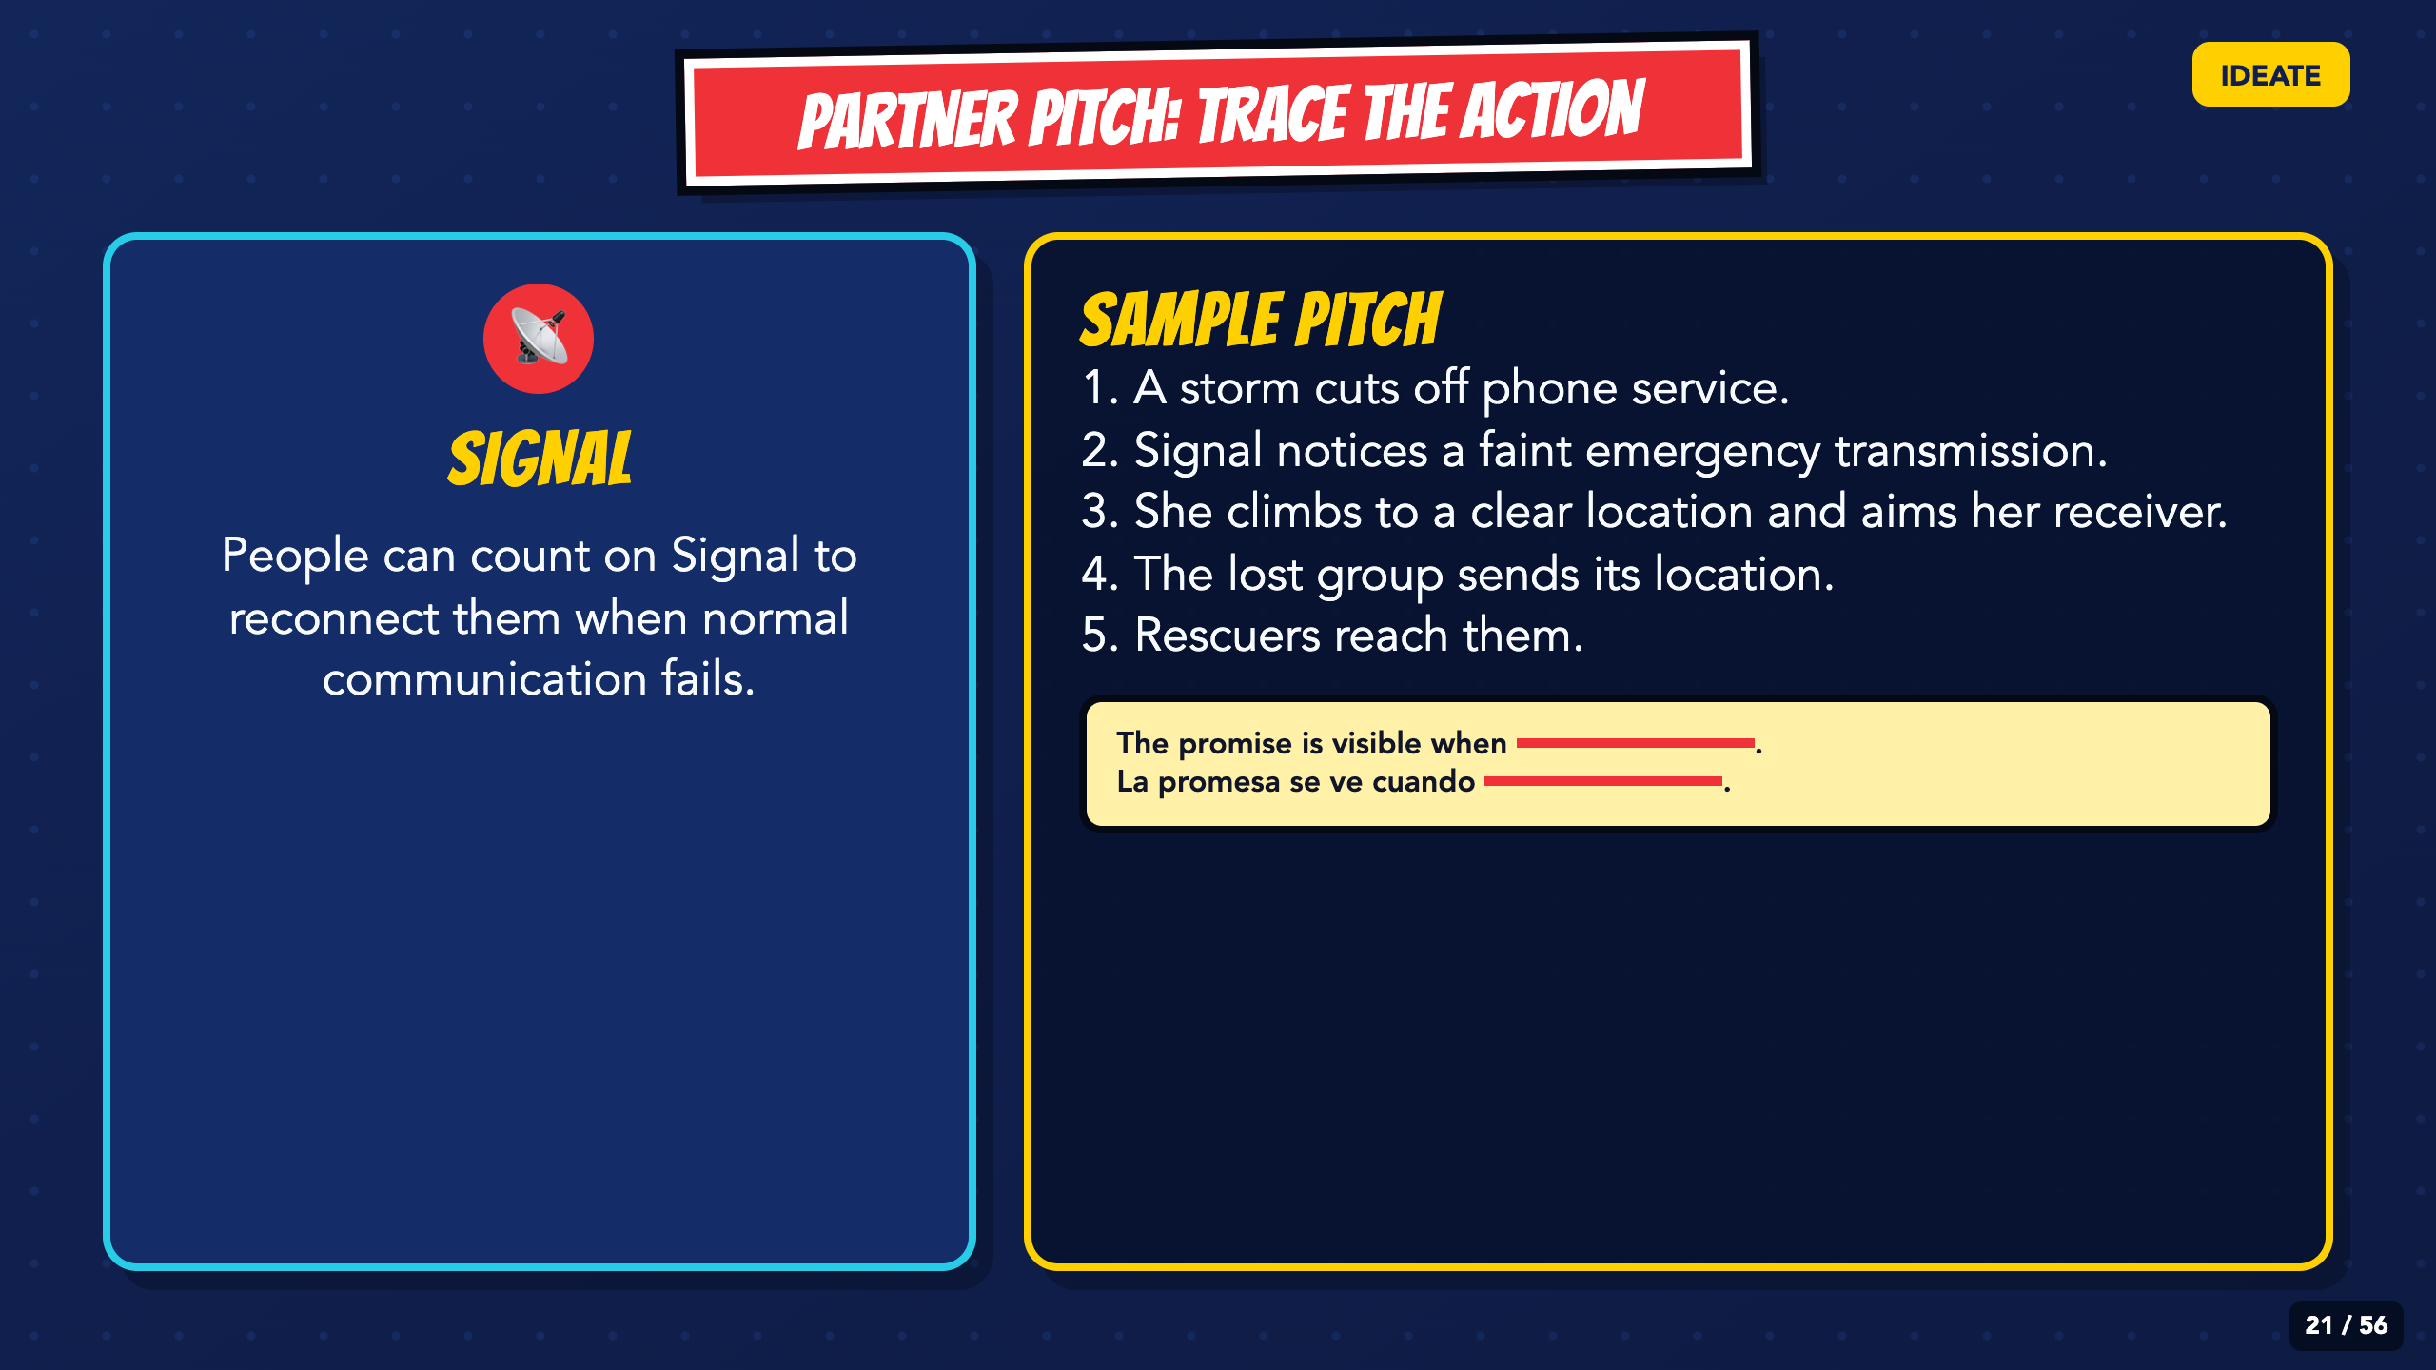
Notes:
Partners present the beats in order, then ask for one specific place where the action becomes unclear or too large for the short animation.
[Sources]
- Irving ISD VILS 2027 Template Animation student pages, rubric, and facilitator guide.

Slide 22
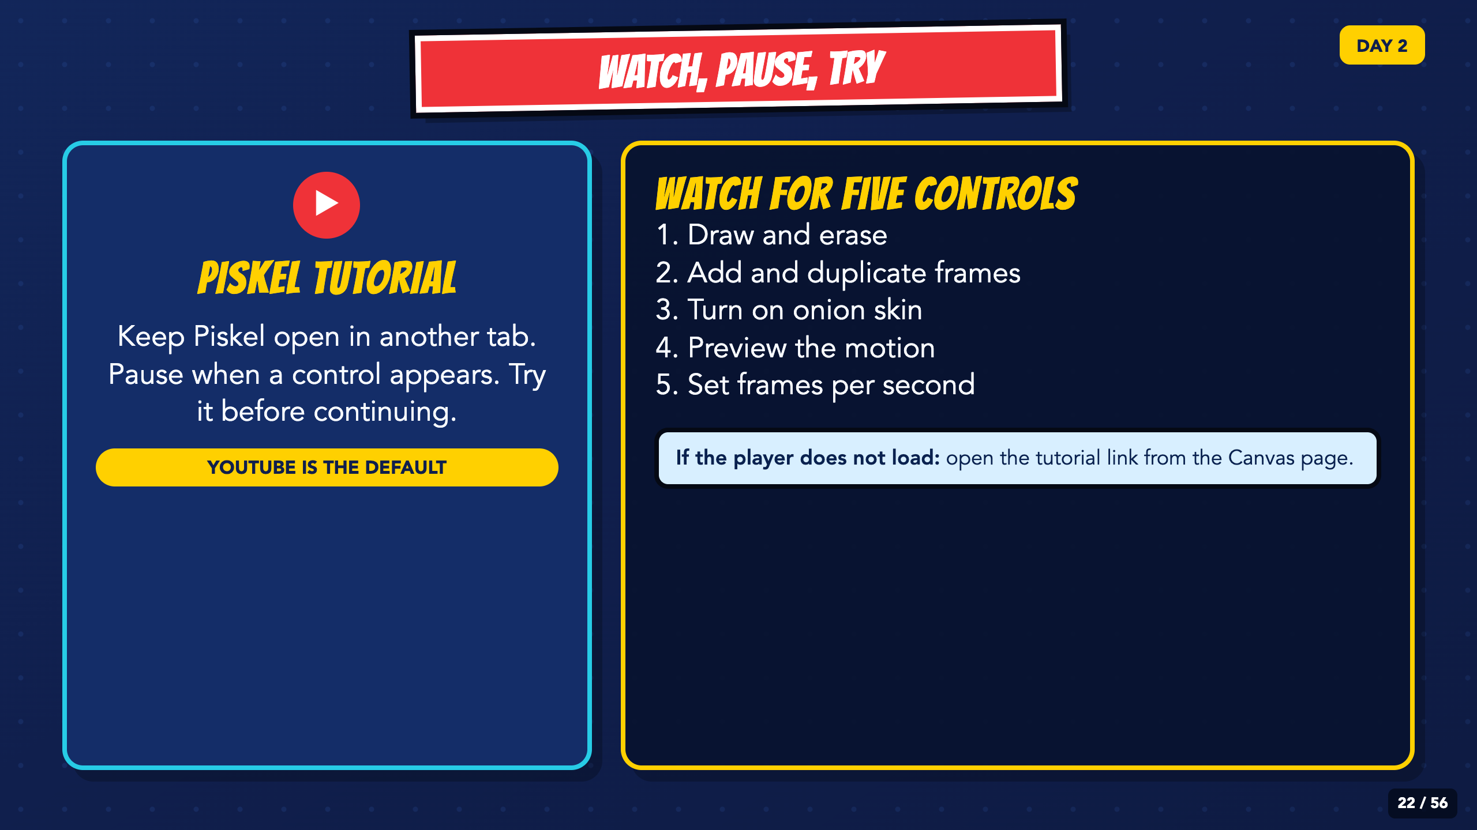
Notes:
The YouTube tutorial is the ready default. If you choose Edpuzzle, copy the lesson, reconnect the Day 2 assignment through External Tool, save unpublished, and test Student View before publishing.
[Sources]
- Irving ISD VILS 2027 Template Animation student pages, rubric, and facilitator guide.
- Piskel tutorial video: https://www.youtube.com/watch?v=gBn2WeY5yf8
- Optional reusable Edpuzzle lesson and Canvas setup guide: https://edpuzzle.com/media/68b65575f867be144b483551 and https://support.edpuzzle.com/hc/en-us/articles/360025042091-Using-Edpuzzle-With-Canvas
- Piskel official site and FAQ: https://www.piskelapp.com/ and https://www.piskelapp.com/faq/

Slide 23
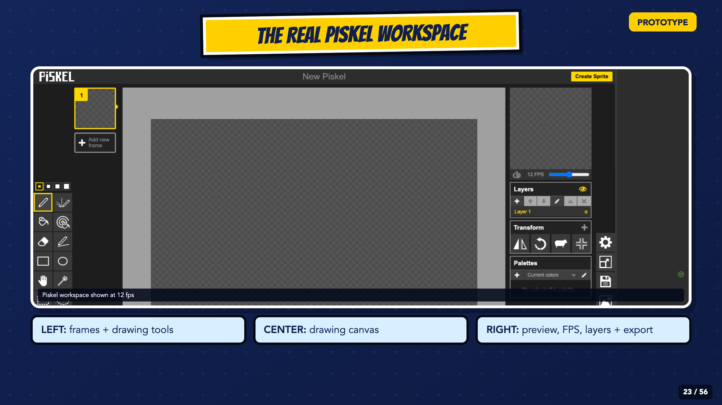
Notes:
Use the current Piskel screenshot to orient students to the frame list and tools on the left, the canvas in the center, and preview, FPS, layers, and export controls on the right. Students should point to each area on their own screen.
[Sources]
- Irving ISD VILS 2027 Template Animation student pages, rubric, and facilitator guide.
- Piskel official site and FAQ: https://www.piskelapp.com/ and https://www.piskelapp.com/faq/
- Piskel source, browser support, and Apache-2.0 license: https://github.com/piskelapp/piskel

Slide 24
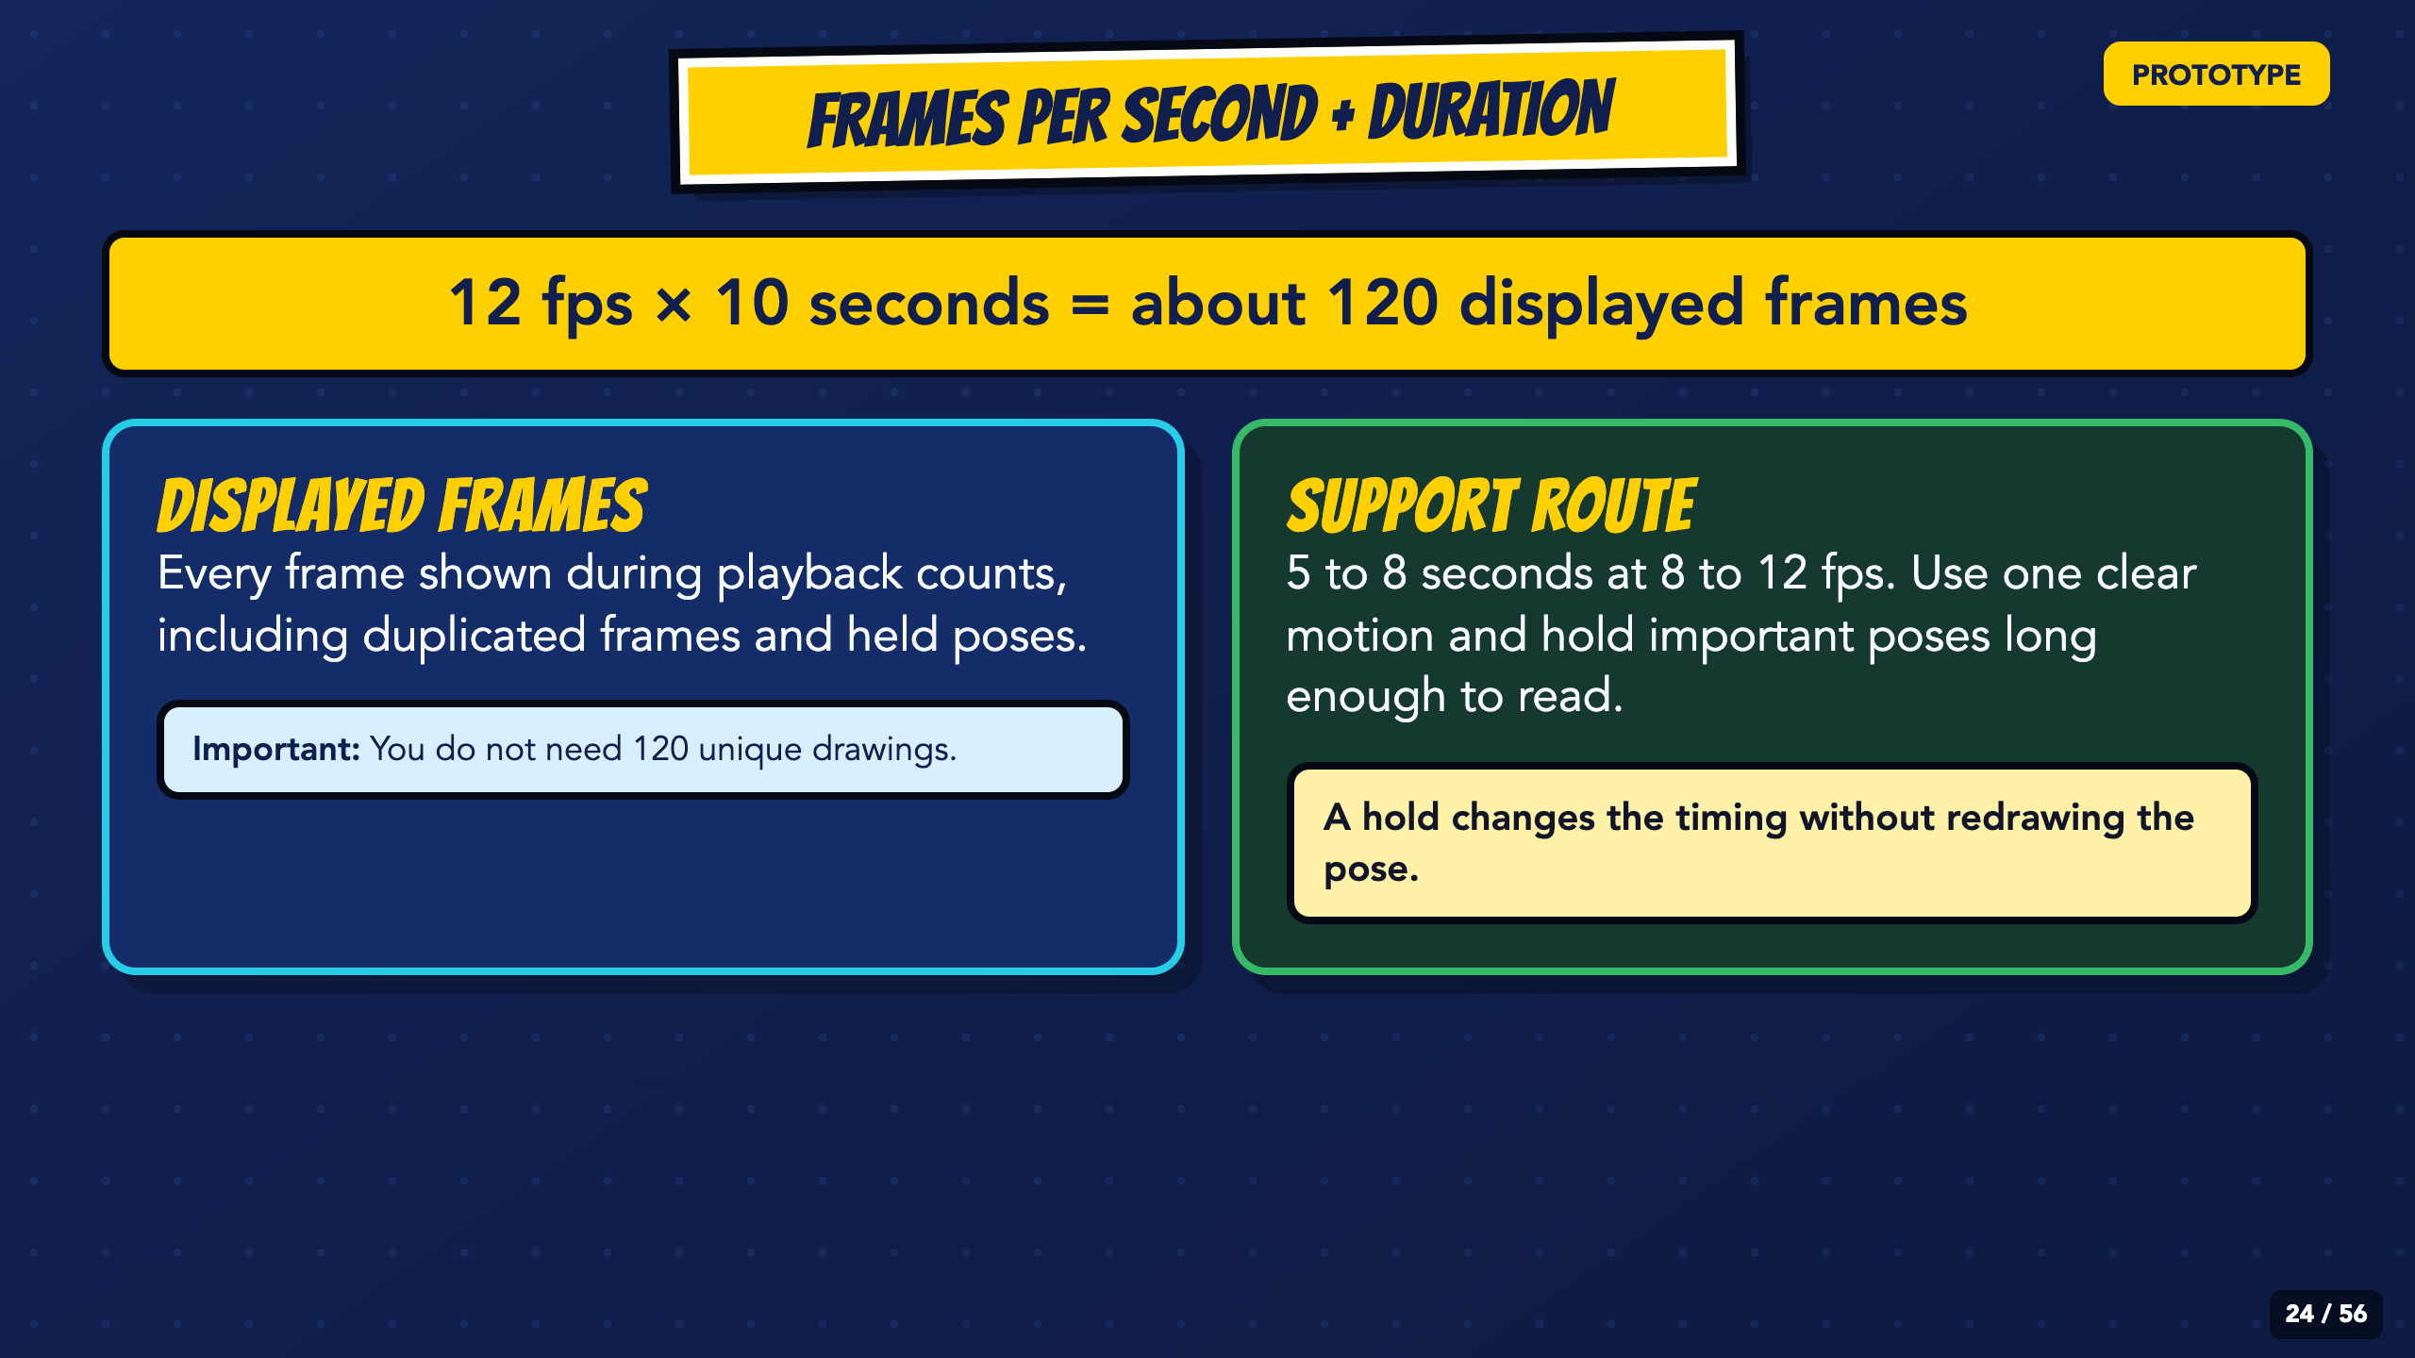
Notes:
Explain displayed frames rather than requiring 120 unique drawings. Duplicated frames and holds count toward the 10-second target and are legitimate timing tools.
[Sources]
- Irving ISD VILS 2027 Template Animation student pages, rubric, and facilitator guide.
- Piskel official site and FAQ: https://www.piskelapp.com/ and https://www.piskelapp.com/faq/

Slide 25
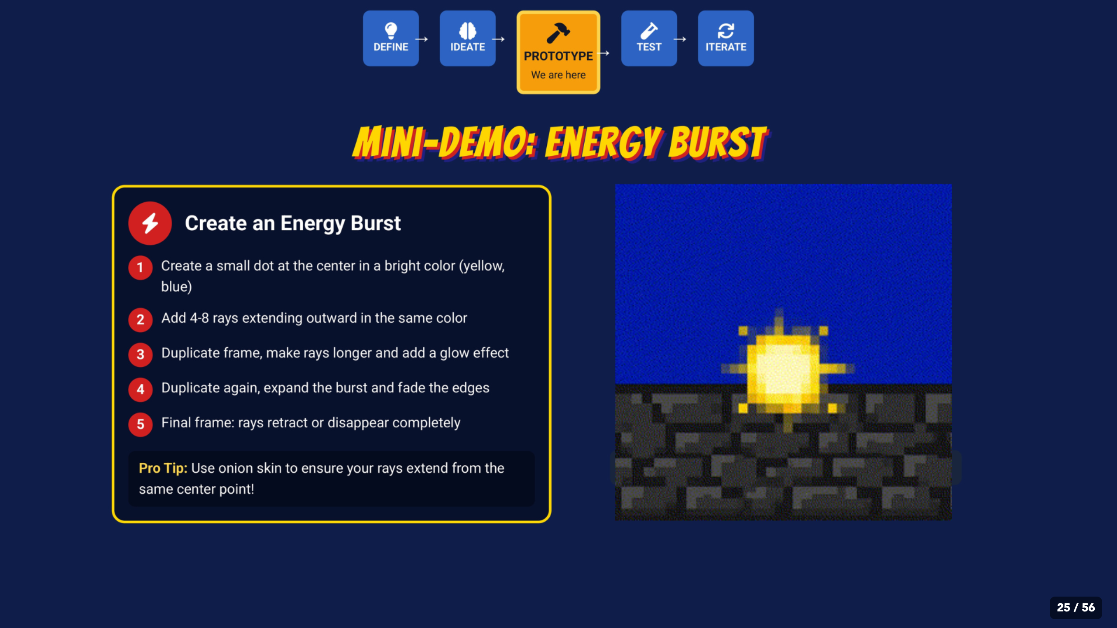
Notes:
Model this as one optional practice motion. Students learn duplicate, onion skin, preview, and small changes; they do not have to copy the exact art.
[Sources]
- Irving ISD VILS 2027 Template Animation student pages, rubric, and facilitator guide.
- Course-author-created Superhero Piskel Canva deck: Superhero Micro-Animation in Piskel.
- Piskel official site and FAQ: https://www.piskelapp.com/ and https://www.piskelapp.com/faq/

Slide 26
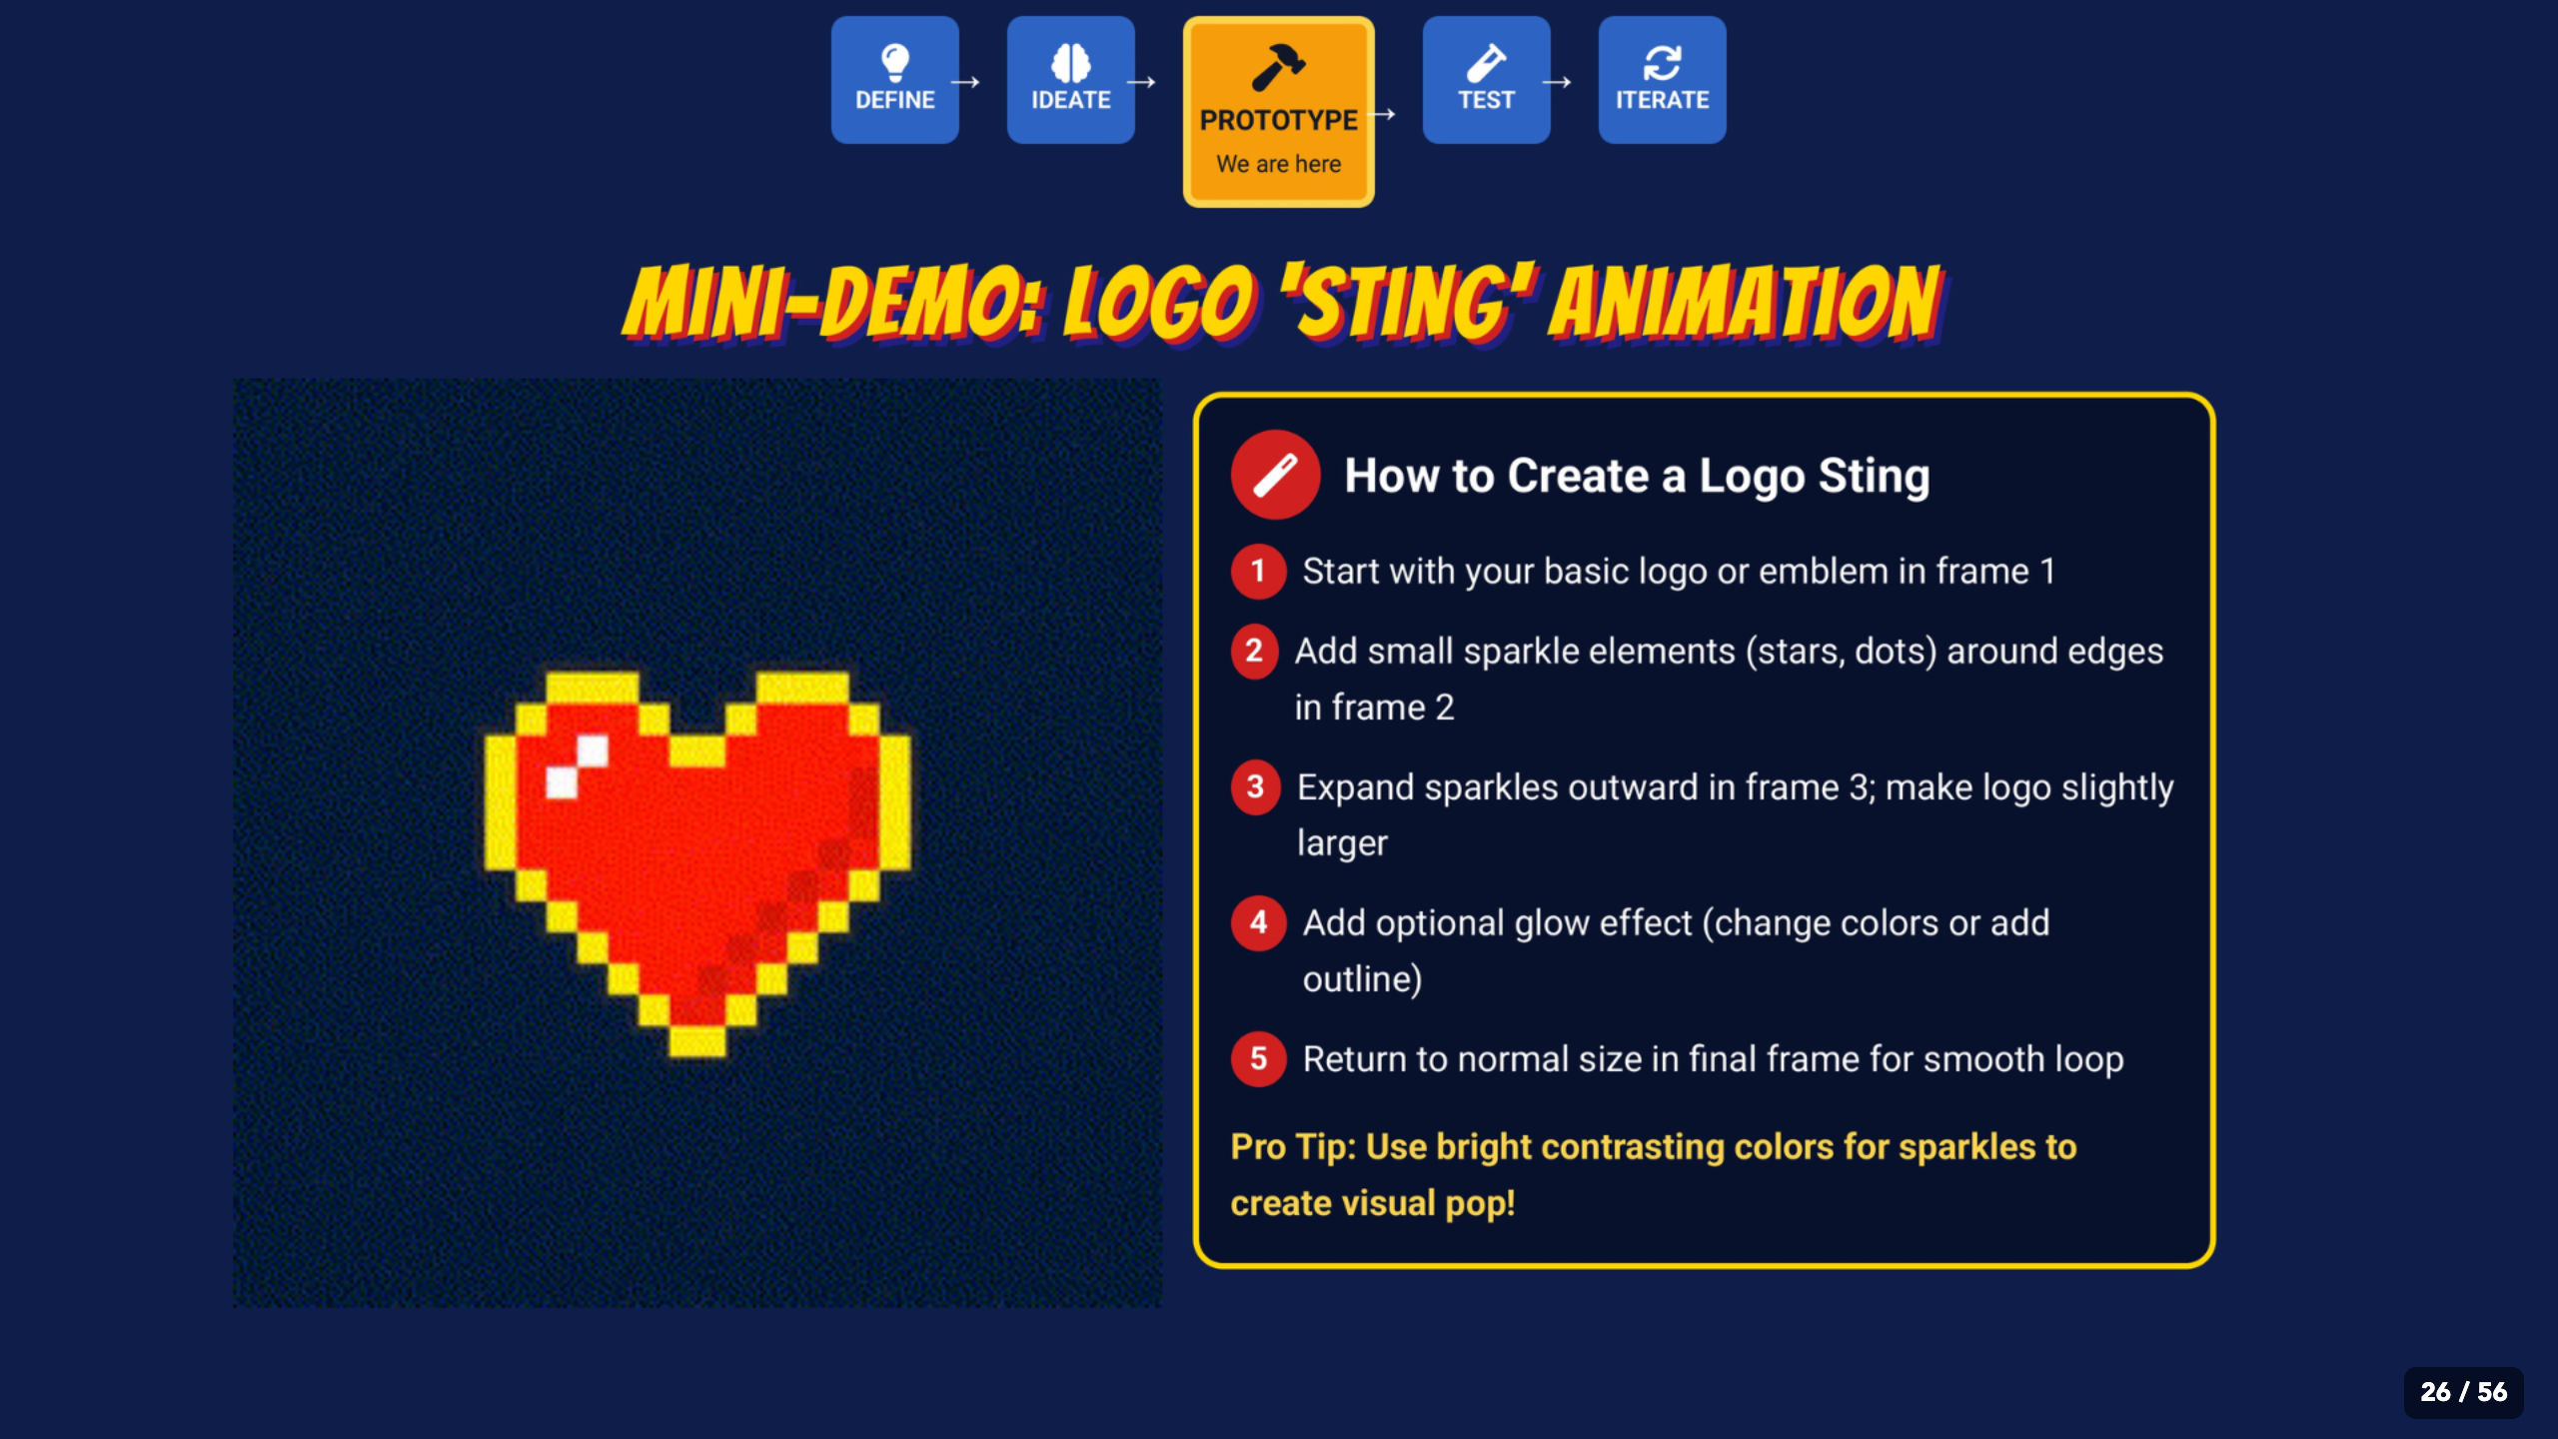
Notes:
Use the logo sting only as another motion pattern. Students can animate a character, object, effect, or emblem if it communicates the planned action.
[Sources]
- Irving ISD VILS 2027 Template Animation student pages, rubric, and facilitator guide.
- Course-author-created Superhero Piskel Canva deck: Superhero Micro-Animation in Piskel.
- Piskel official site and FAQ: https://www.piskelapp.com/ and https://www.piskelapp.com/faq/

Slide 27
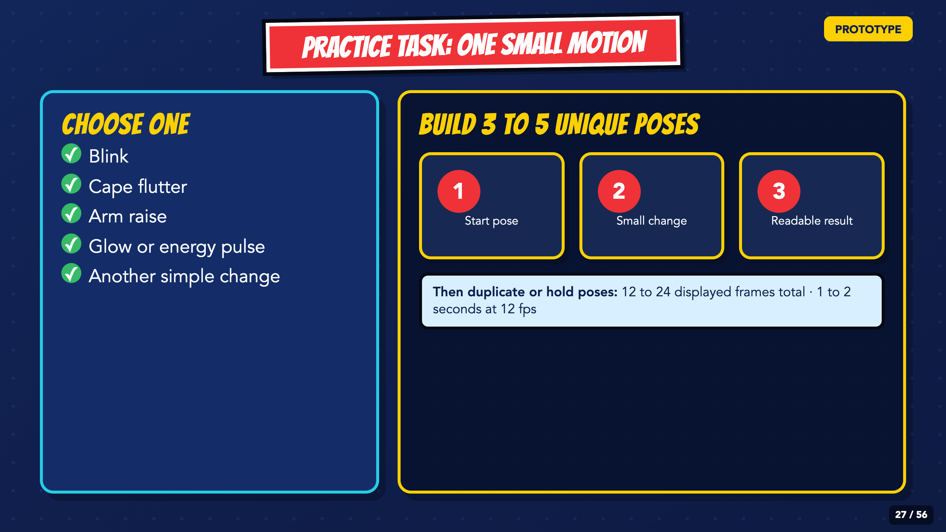
Notes:
Keep the practice small. Students build 3 to 5 unique poses, then duplicate or hold poses until the GIF contains 12 to 24 displayed frames at 12 fps. The goal is one to two seconds of readable motion.
[Sources]
- Irving ISD VILS 2027 Template Animation student pages, rubric, and facilitator guide.
- Piskel official site and FAQ: https://www.piskelapp.com/ and https://www.piskelapp.com/faq/

Slide 28
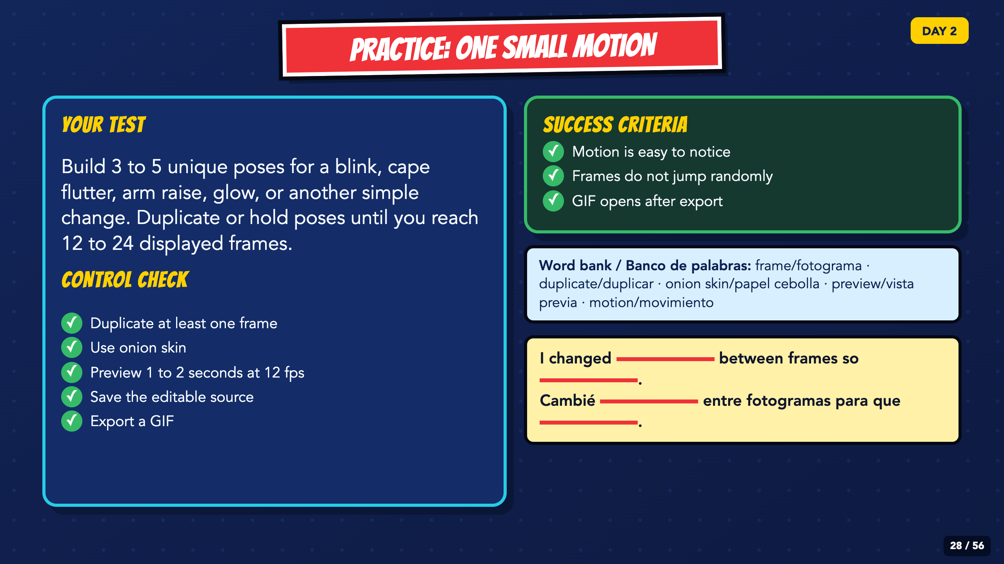
Notes:
Leave this slide projected. Check for 3 to 5 unique poses, 12 to 24 displayed frames, onion skin, a one-to-two-second preview at 12 fps, the editable source, and a working GIF. Use the bilingual stem when students explain what changed.
[Sources]
- Irving ISD VILS 2027 Template Animation student pages, rubric, and facilitator guide.
- Piskel official site and FAQ: https://www.piskelapp.com/ and https://www.piskelapp.com/faq/

Slide 29
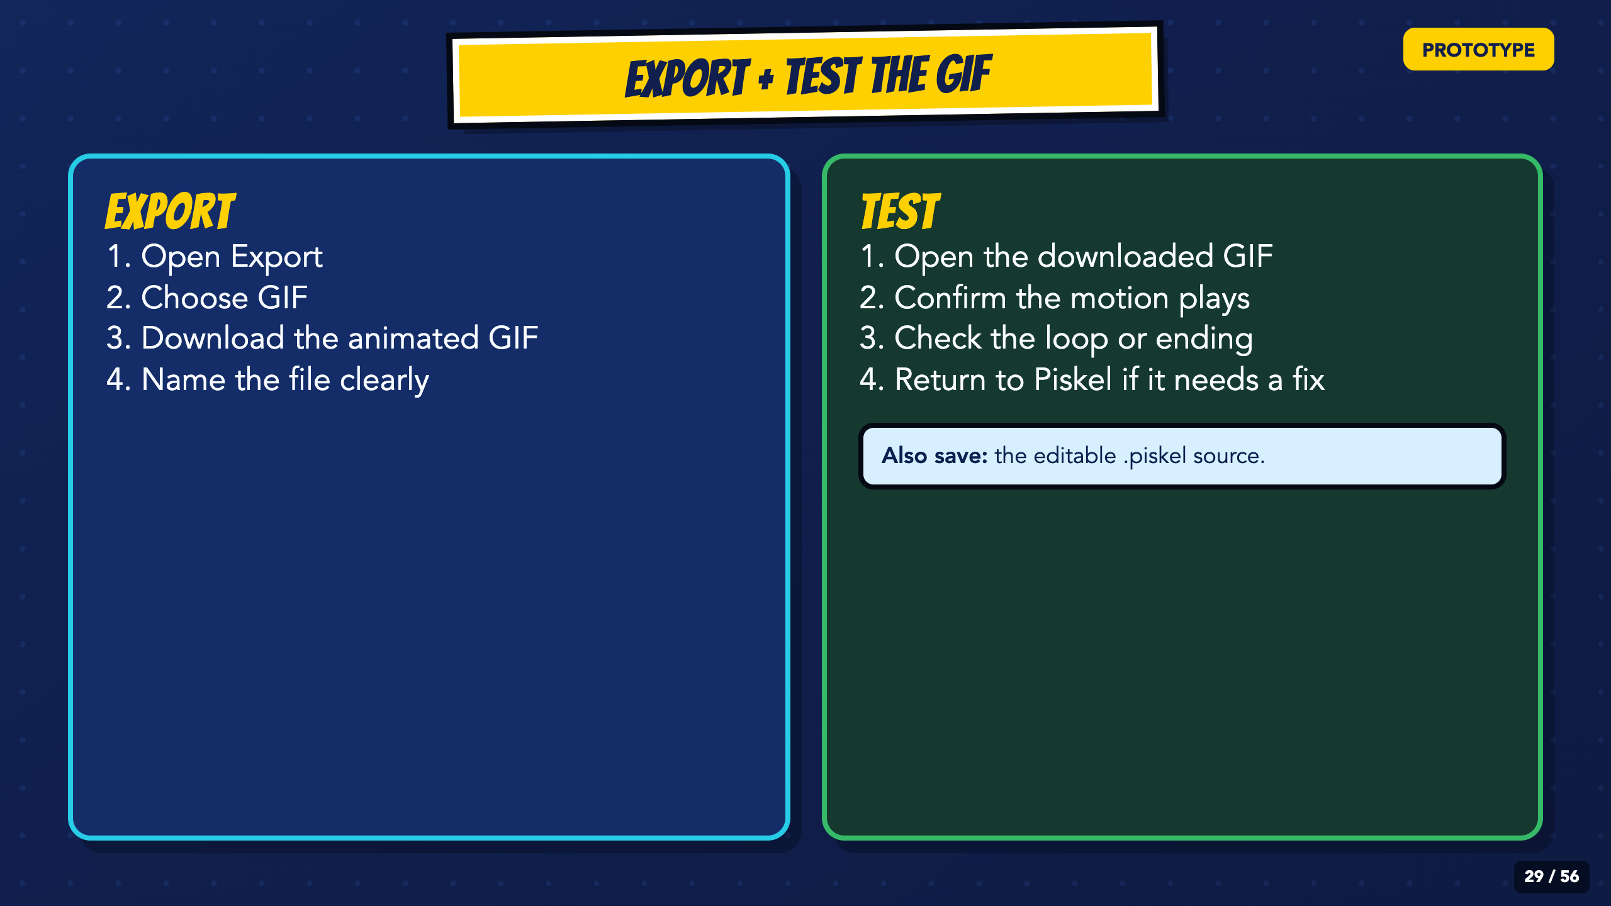
Notes:
Export a test GIF and open it outside Piskel. Fix the export now rather than discovering a broken file on Day 5.
[Sources]
- Irving ISD VILS 2027 Template Animation student pages, rubric, and facilitator guide.
- Piskel official site and FAQ: https://www.piskelapp.com/ and https://www.piskelapp.com/faq/

Slide 30
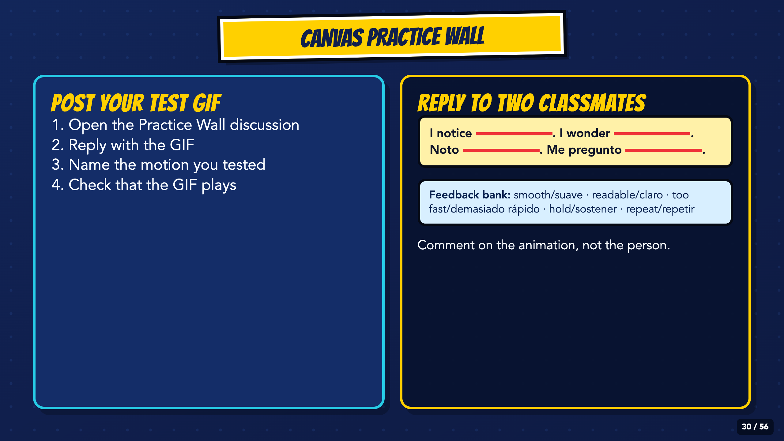
Notes:
Students post the GIF to the Canvas Practice Wall and reply to two classmates. Feedback names a visible motion or timing choice, not the quality of the person or drawing.
[Sources]
- Irving ISD VILS 2027 Template Animation student pages, rubric, and facilitator guide.

Slide 31
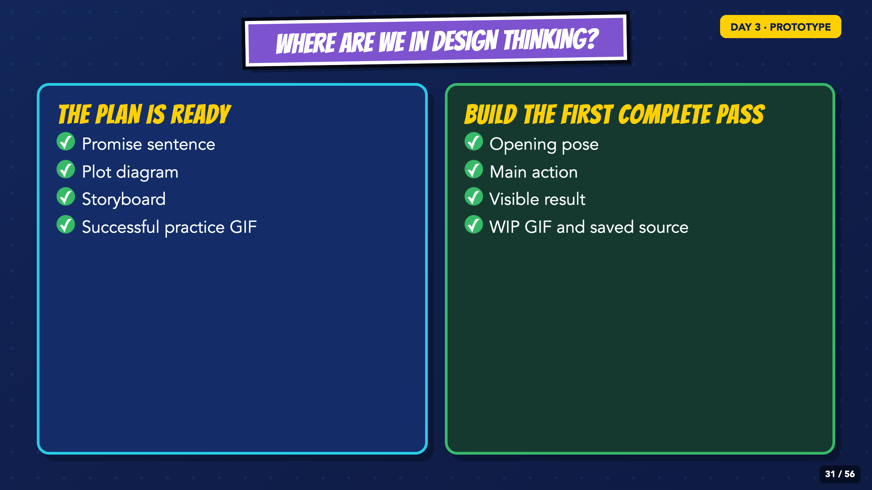
Notes:
Re-enter at Prototype. Today students build a complete rough version before polishing any one section.
[Sources]
- Irving ISD VILS 2027 Template Animation student pages, rubric, and facilitator guide.

Slide 32
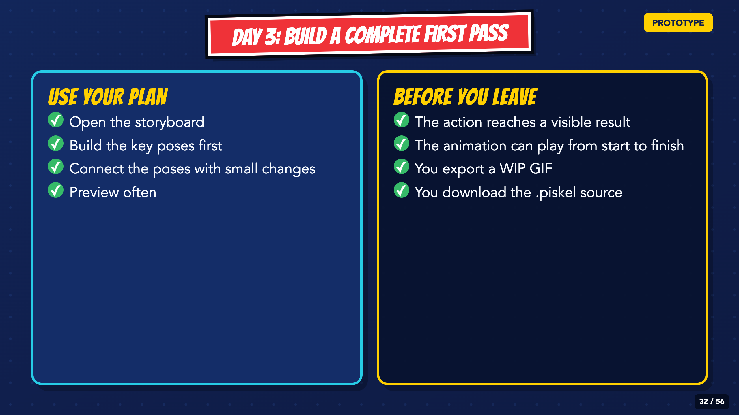
Notes:
Require the opening, action, result, WIP GIF, and editable source before students leave. A partial but polished opening is not the checkpoint.
[Sources]
- Irving ISD VILS 2027 Template Animation student pages, rubric, and facilitator guide.

Slide 33
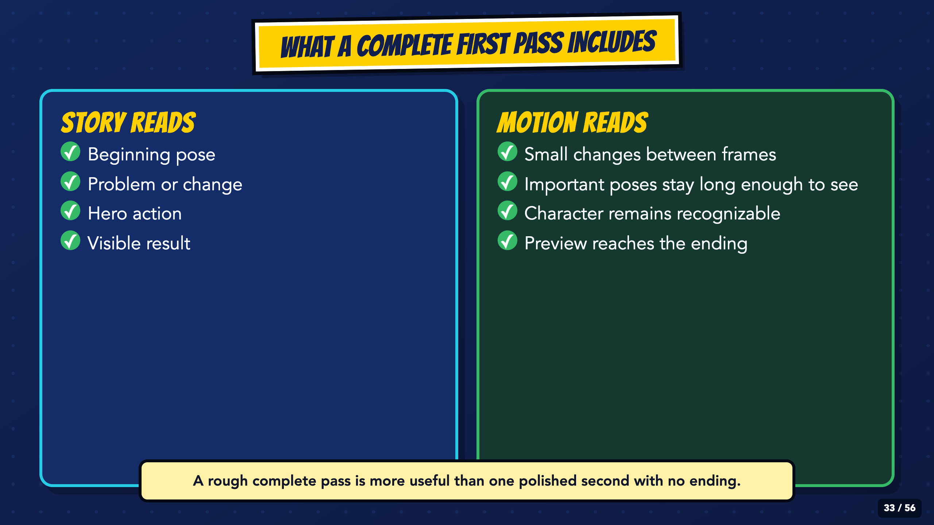
Notes:
Use the two columns as the definition of a complete first pass. Readability and a reachable ending come before decorative effects.
[Sources]
- Irving ISD VILS 2027 Template Animation student pages, rubric, and facilitator guide.

Slide 34
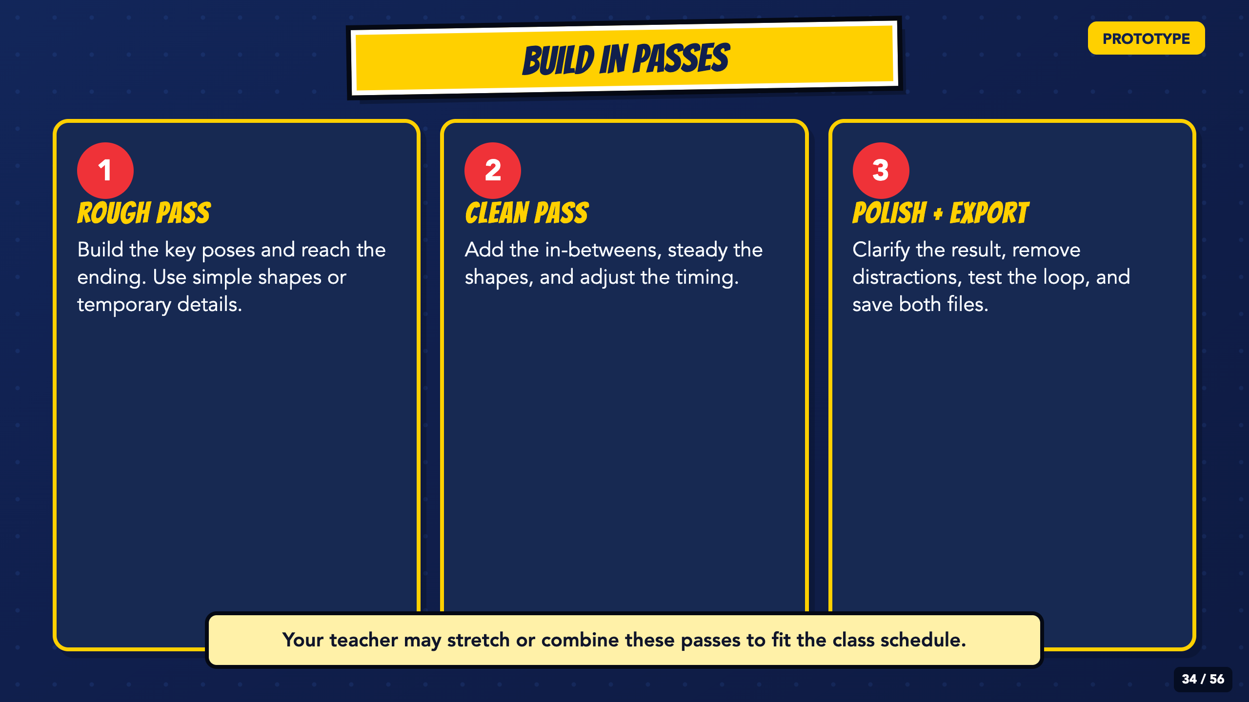
Notes:
Use the three passes as a flexible production order, not a timer. Students should reach the ending in the rough pass before they spend time polishing one section.
[Sources]
- Irving ISD VILS 2027 Template Animation student pages, rubric, and facilitator guide.

Slide 35
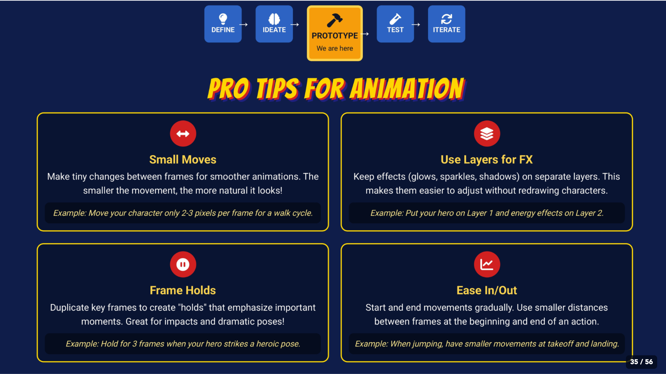
Notes:
Teach only the tip a student needs. Small moves and frame holds usually solve more problems than adding new effects.
[Sources]
- Irving ISD VILS 2027 Template Animation student pages, rubric, and facilitator guide.
- Course-author-created Superhero Piskel Canva deck: Superhero Micro-Animation in Piskel.

Slide 36
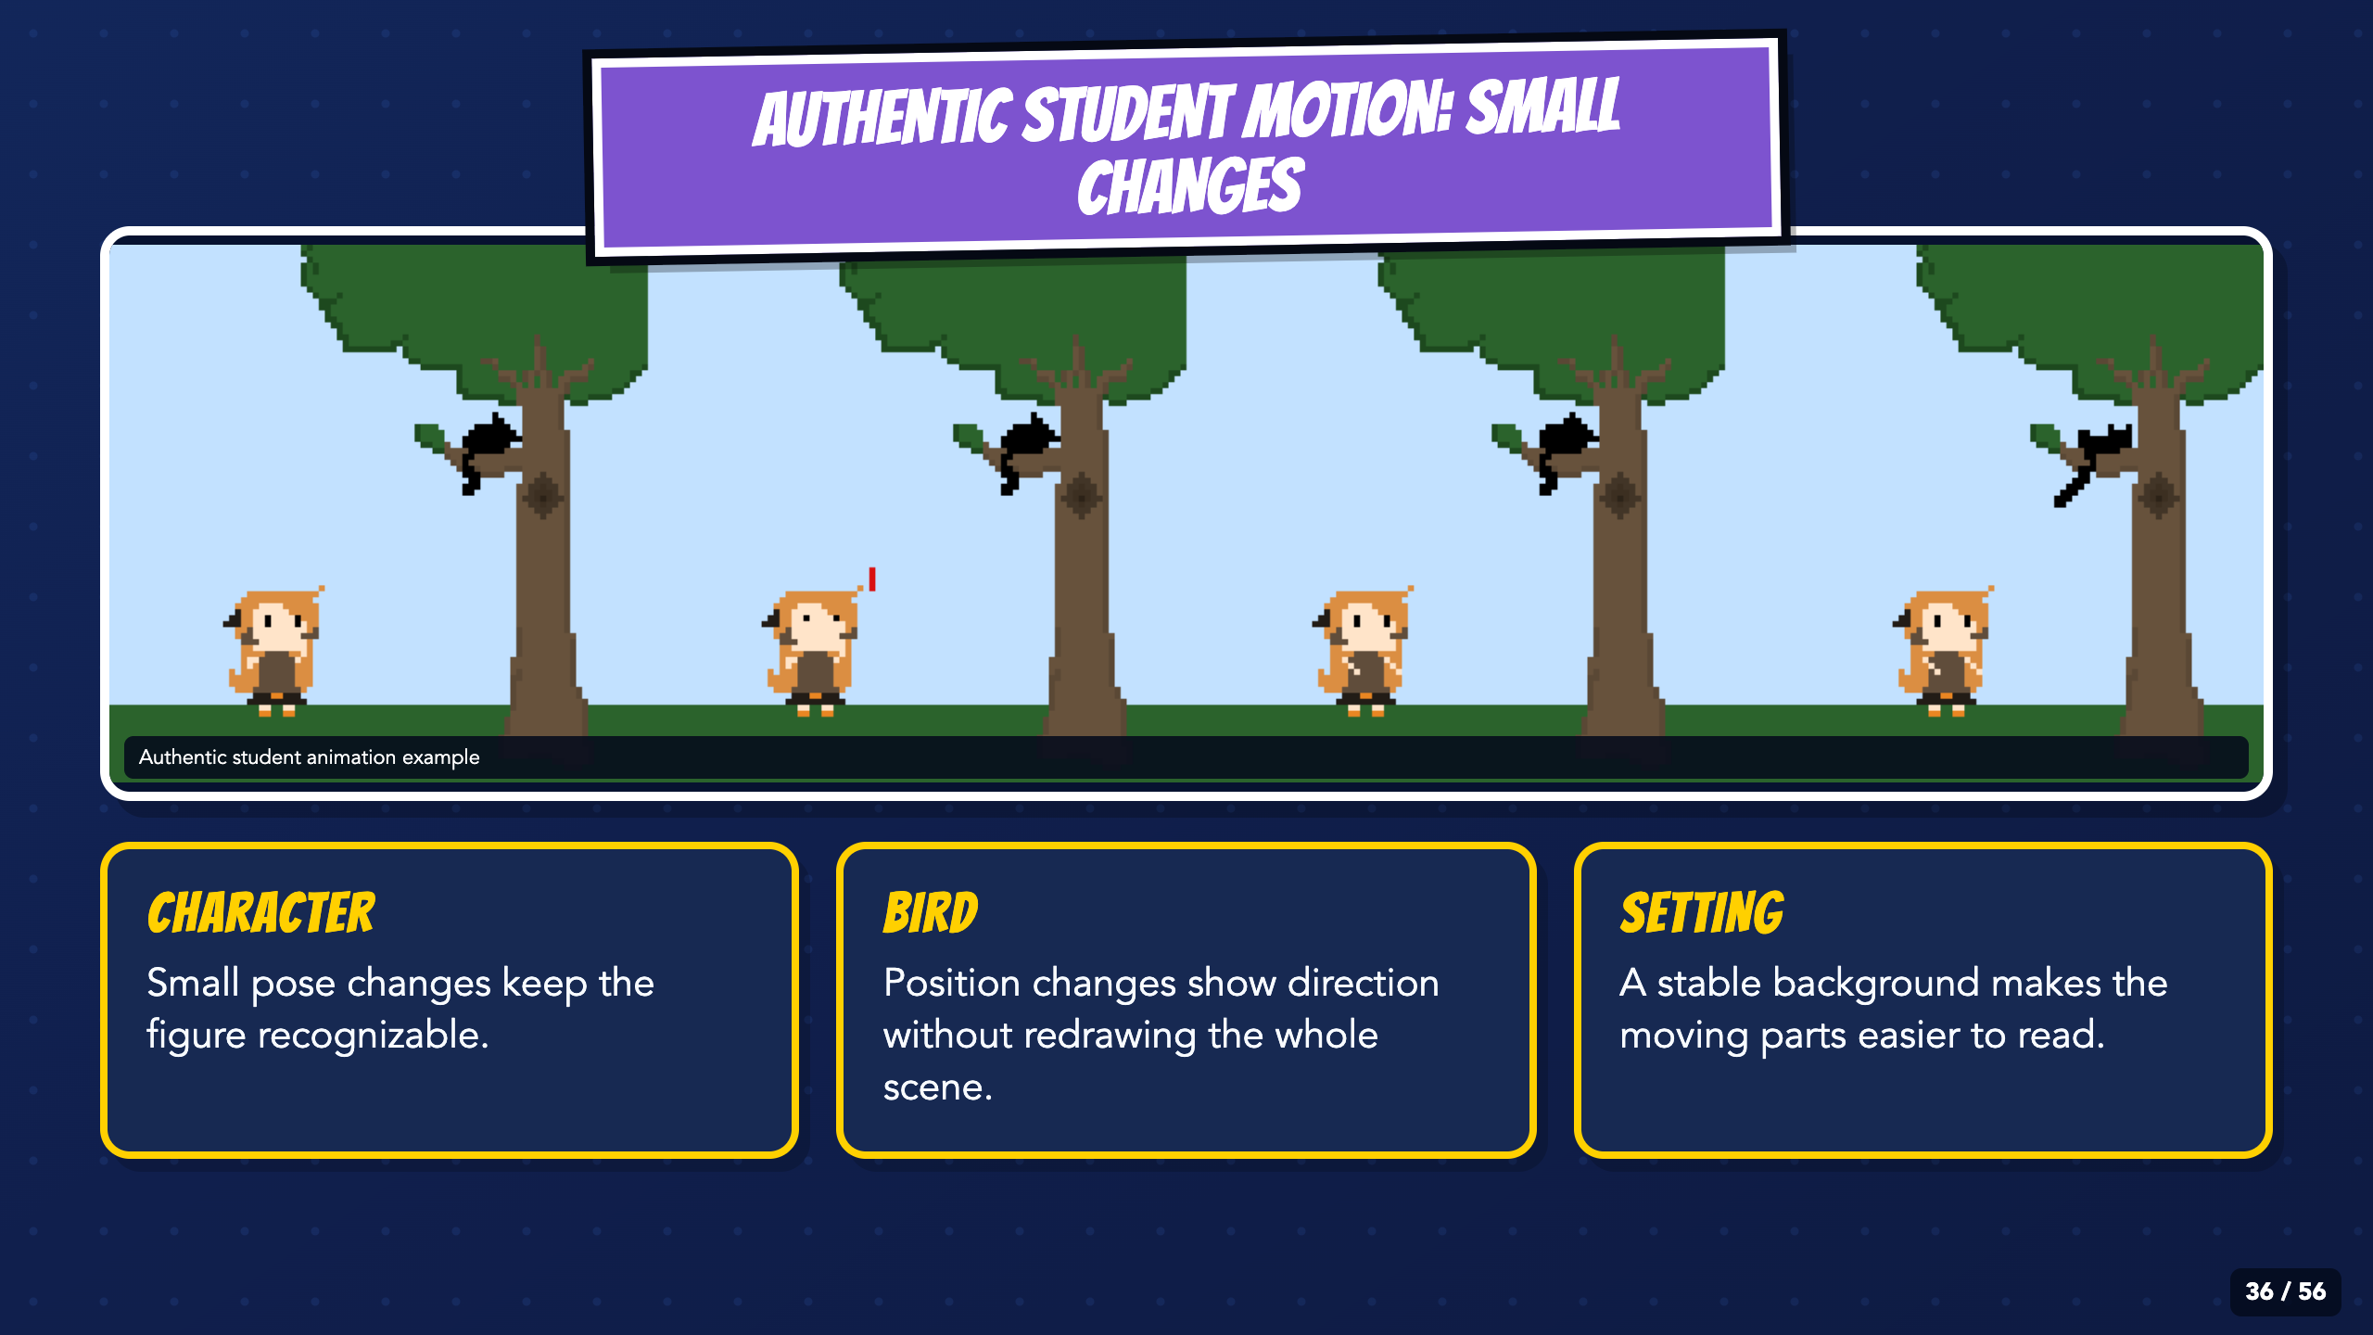
Notes:
Pause on each frame. Ask what moves, what stays stable, and why the character remains recognizable. The work is authentic and is not a perfection target.
[Sources]
- Irving ISD VILS 2027 Template Animation student pages, rubric, and facilitator guide.
- Authentic student work supplied by the course author; source filenames and student identity withheld.

Slide 37
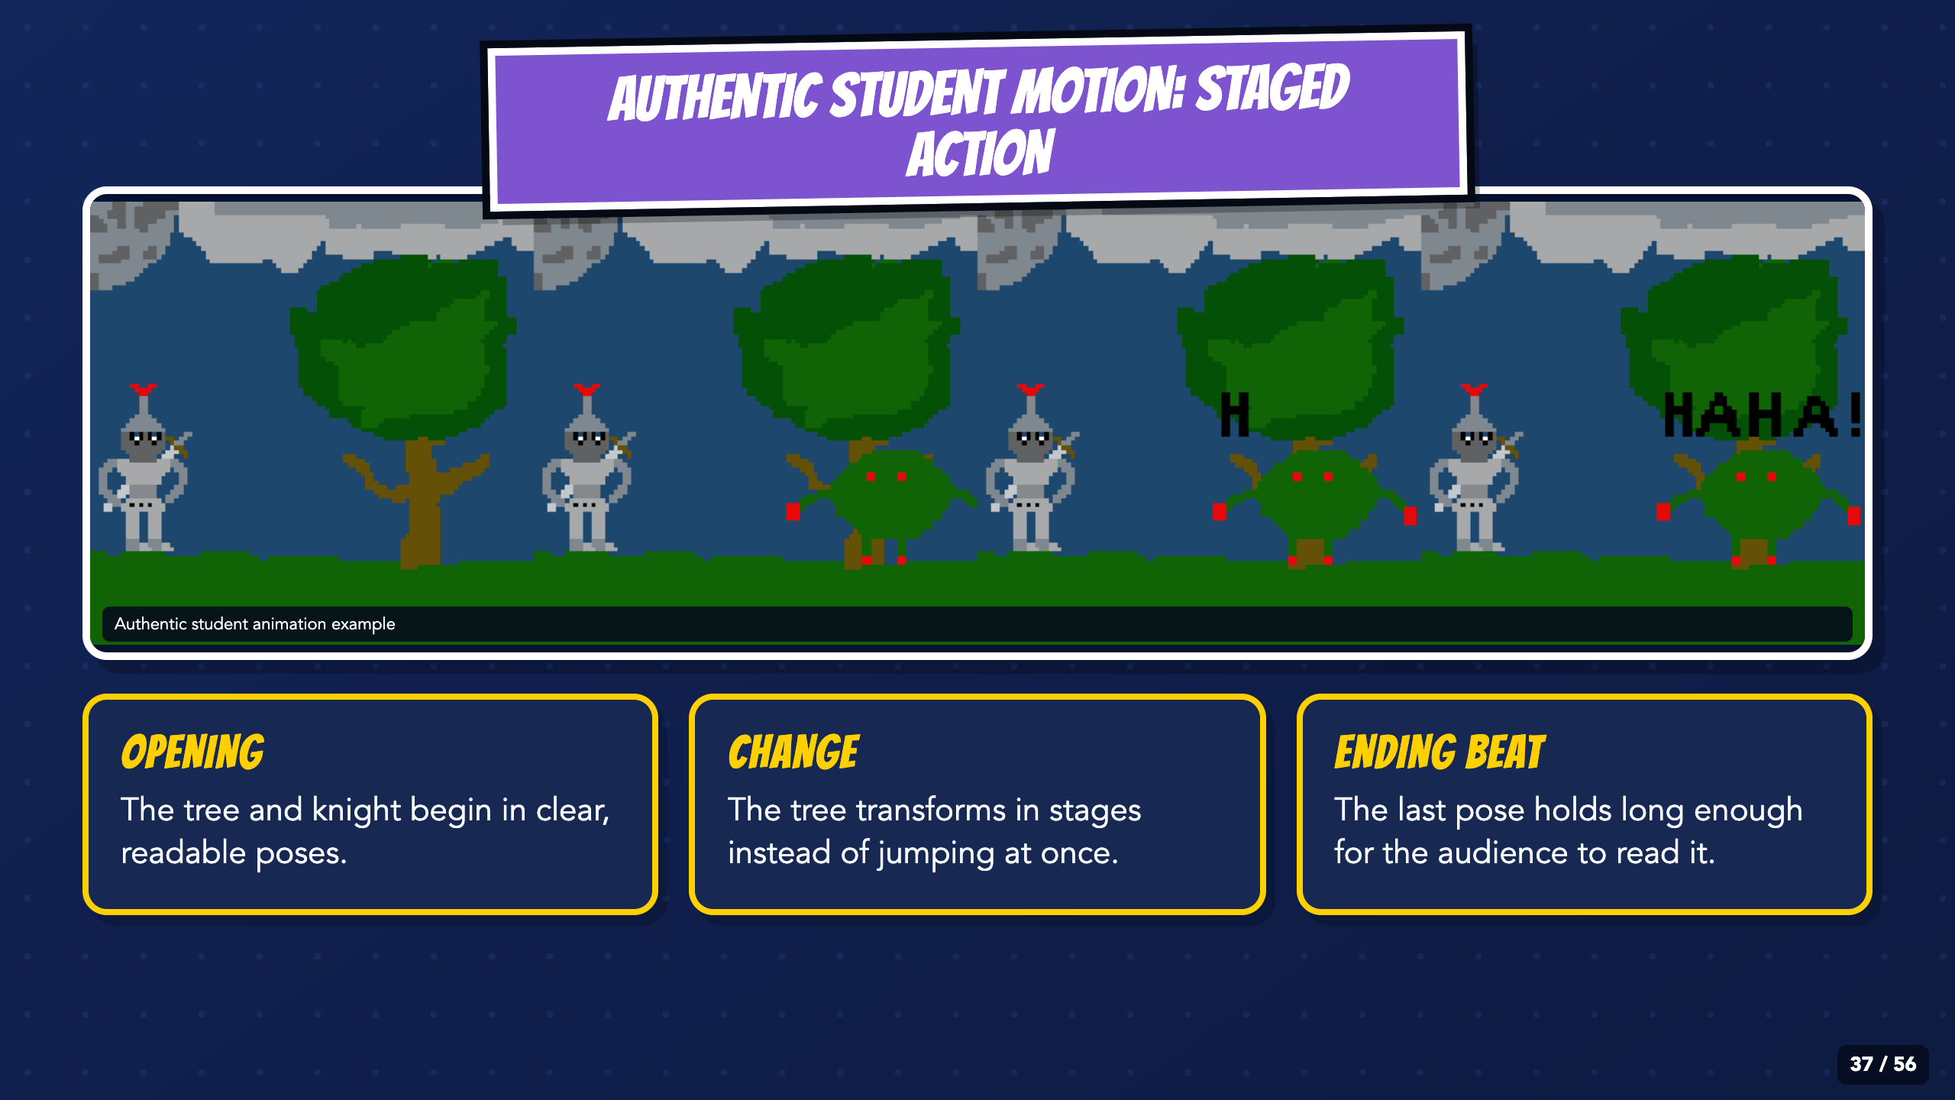
Notes:
Trace the transformation from left to right. Point out the staged change and held ending beat. Students can use a simpler visual style and still meet the target.
[Sources]
- Irving ISD VILS 2027 Template Animation student pages, rubric, and facilitator guide.
- Authentic student work supplied by the course author; source filenames and student identity withheld.

Slide 38
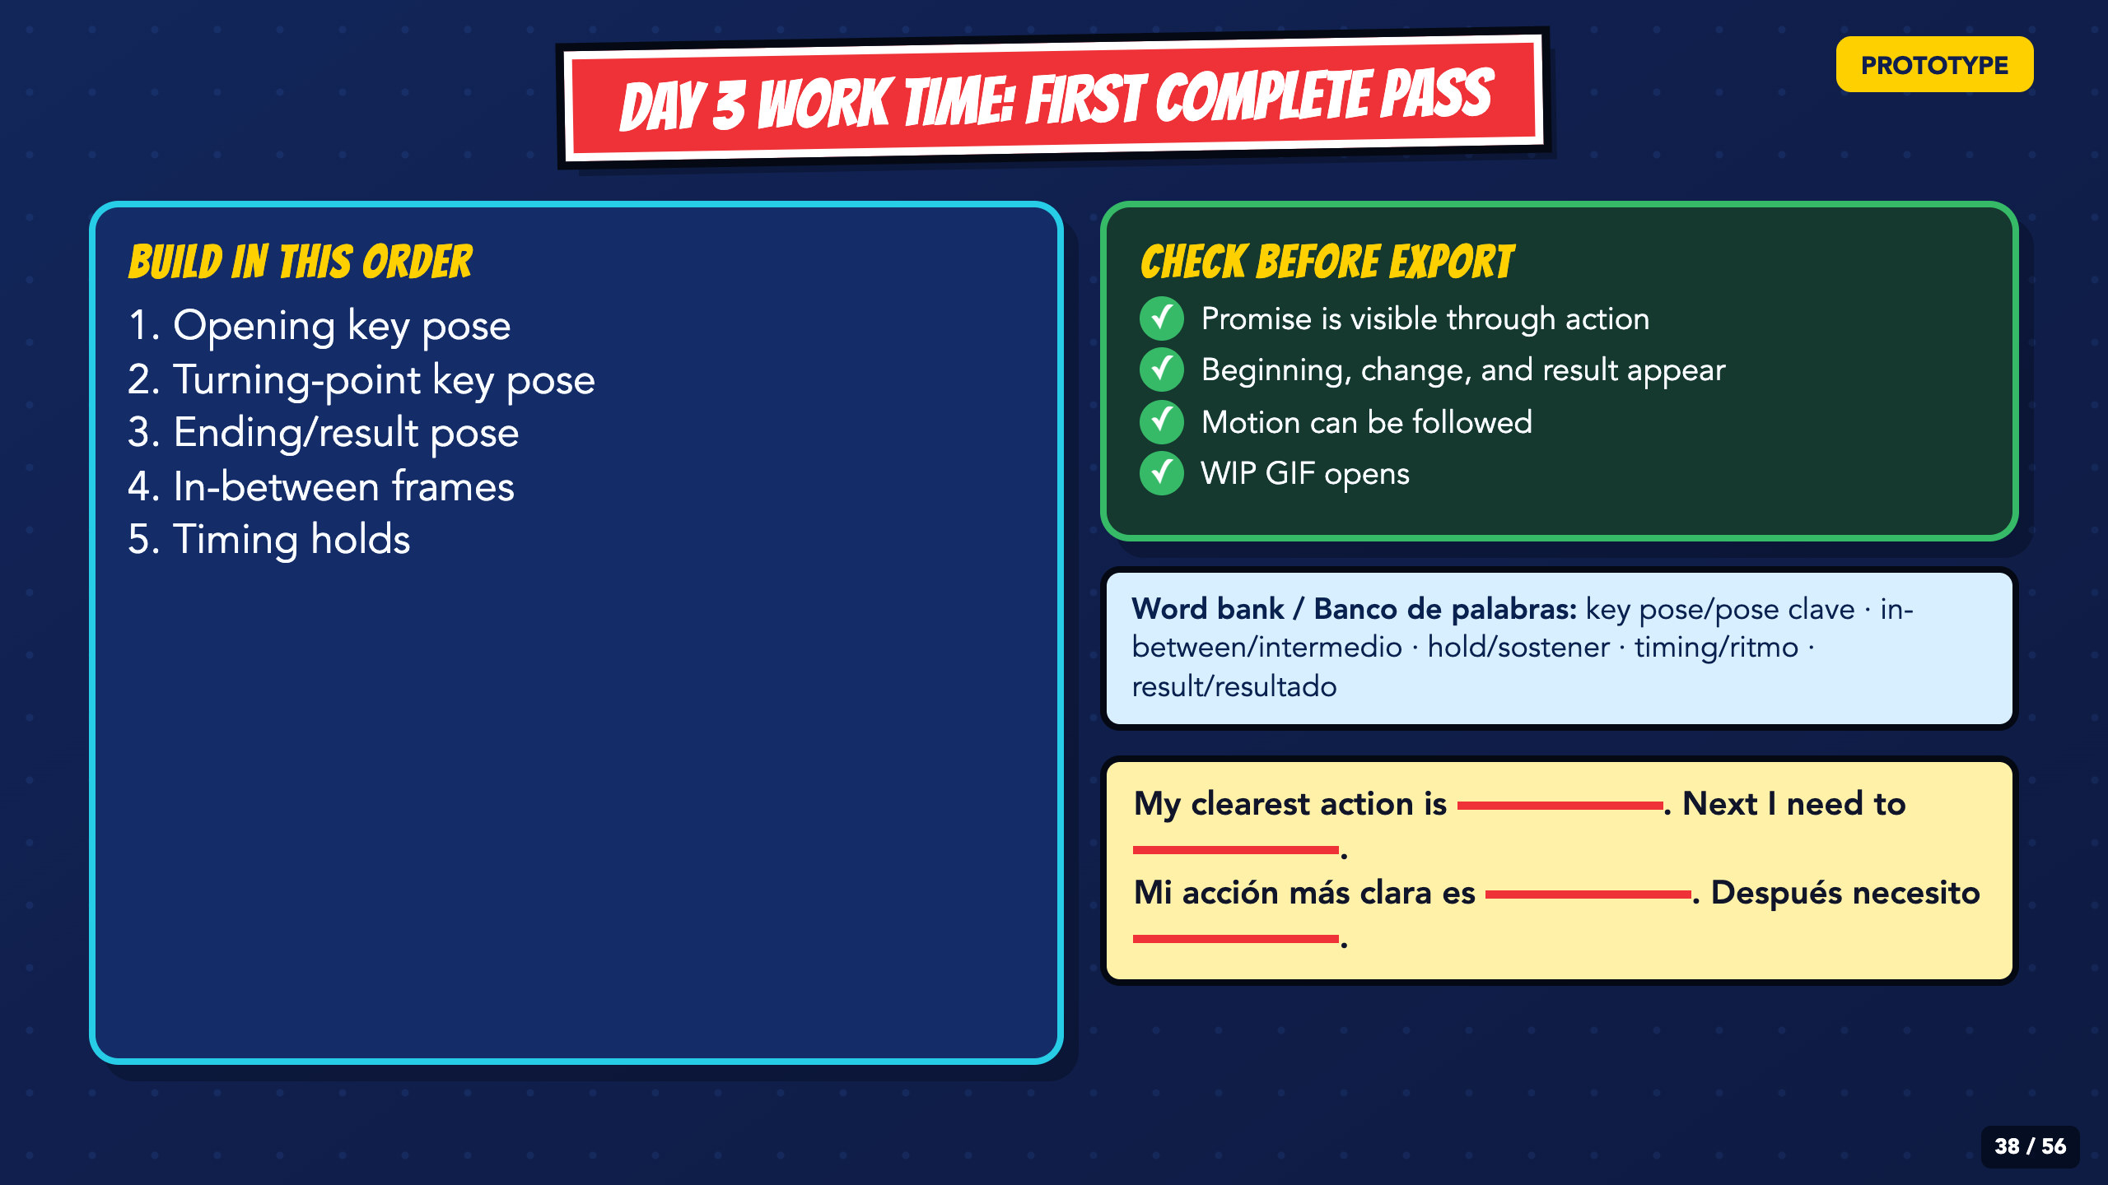
Notes:
Leave this slide projected during Day 3 production. Confer with students using the same order: key poses, in-betweens, timing holds, export.
[Sources]
- Irving ISD VILS 2027 Template Animation student pages, rubric, and facilitator guide.

Slide 39
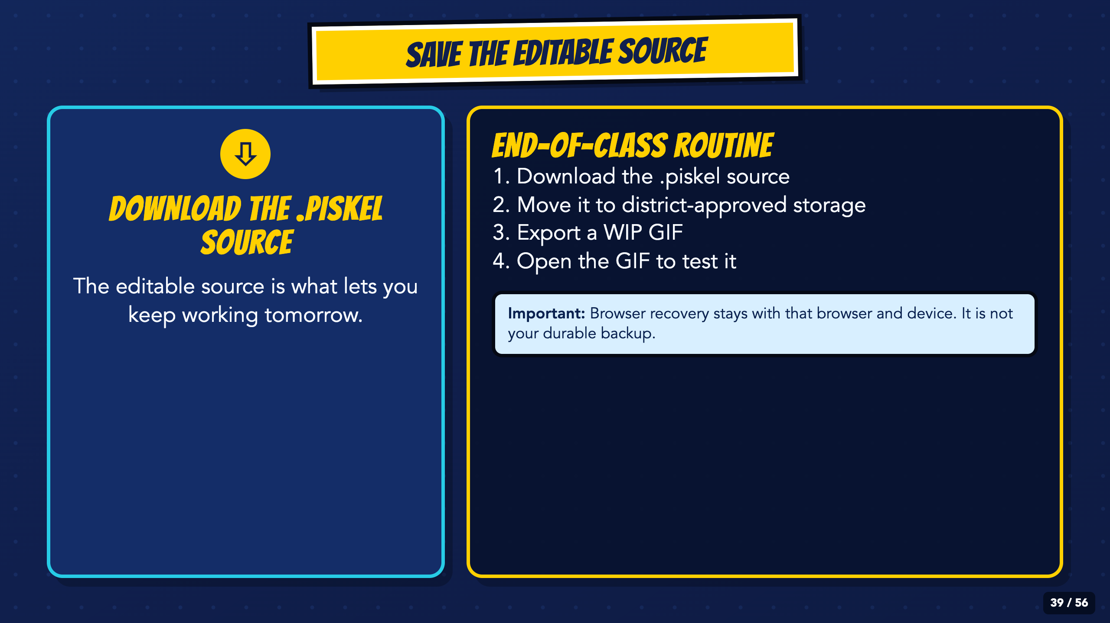
Notes:
Run the save routine before cleanup. The `.piskel` source is the editable project; browser recovery is only a local safety net and the GIF cannot be used to continue editing.
[Sources]
- Irving ISD VILS 2027 Template Animation student pages, rubric, and facilitator guide.
- Piskel official site and FAQ: https://www.piskelapp.com/ and https://www.piskelapp.com/faq/
- Piskel source, browser support, and Apache-2.0 license: https://github.com/piskelapp/piskel

Slide 40
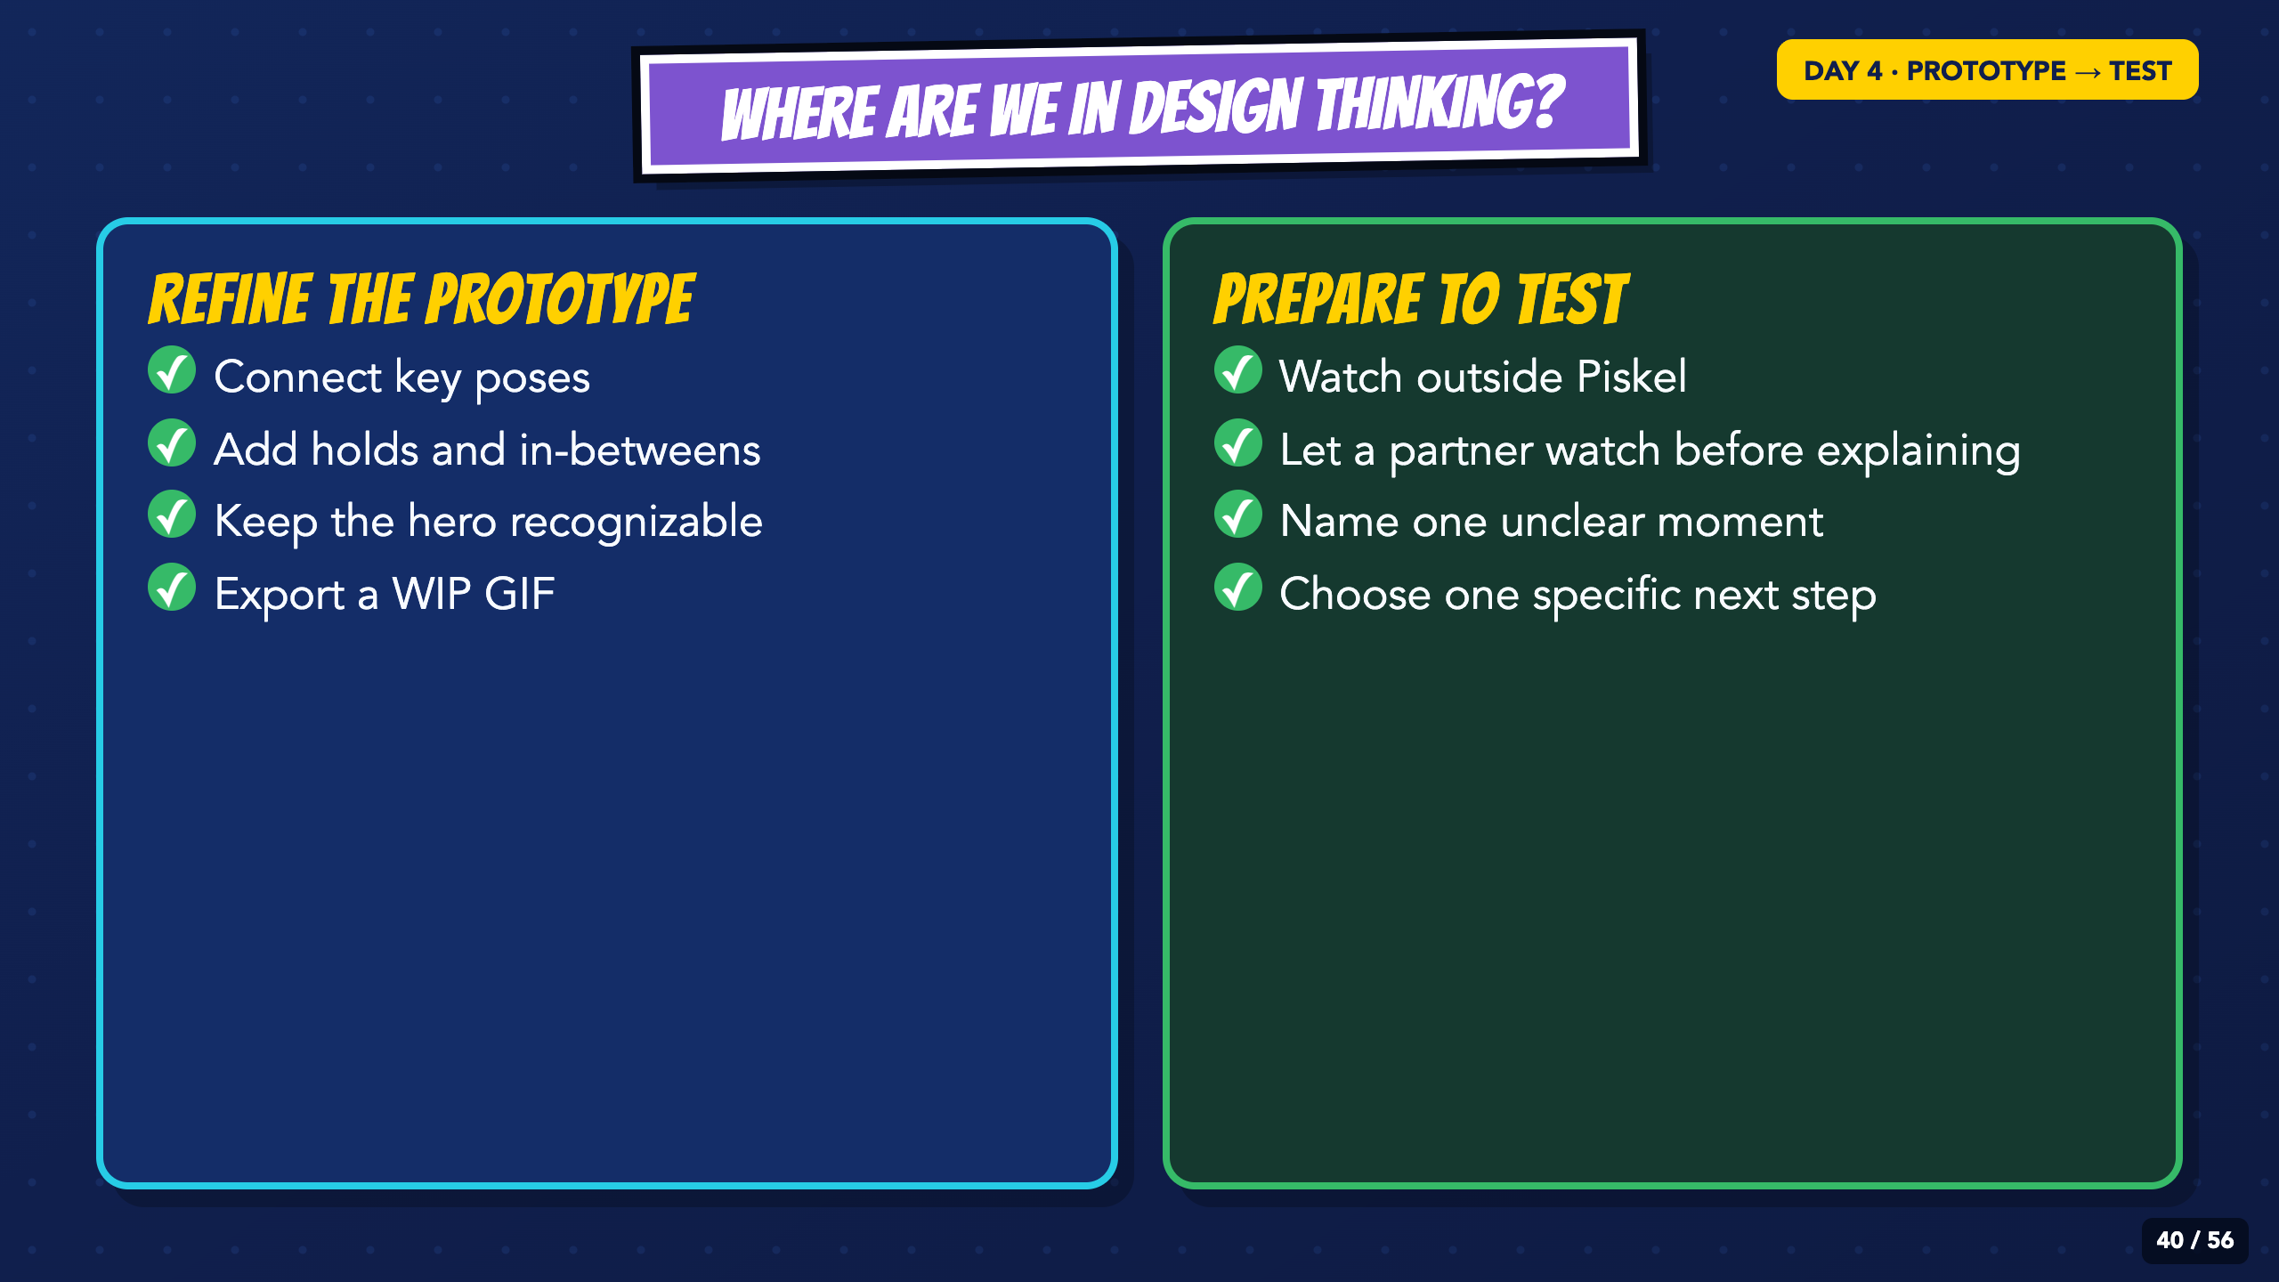
Notes:
Day 4 continues Prototype and prepares for Test. Students finish the action, control timing, and leave with one feedback-based next step.
[Sources]
- Irving ISD VILS 2027 Template Animation student pages, rubric, and facilitator guide.

Slide 41
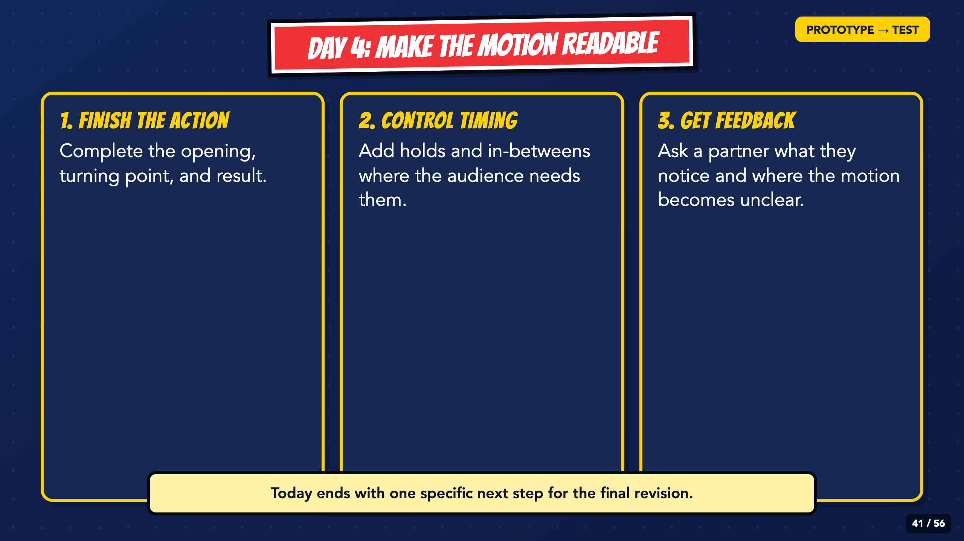
Notes:
Read the three jobs. Do not let the feedback step disappear because a student spent the whole period adding decoration.
[Sources]
- Irving ISD VILS 2027 Template Animation student pages, rubric, and facilitator guide.

Slide 42
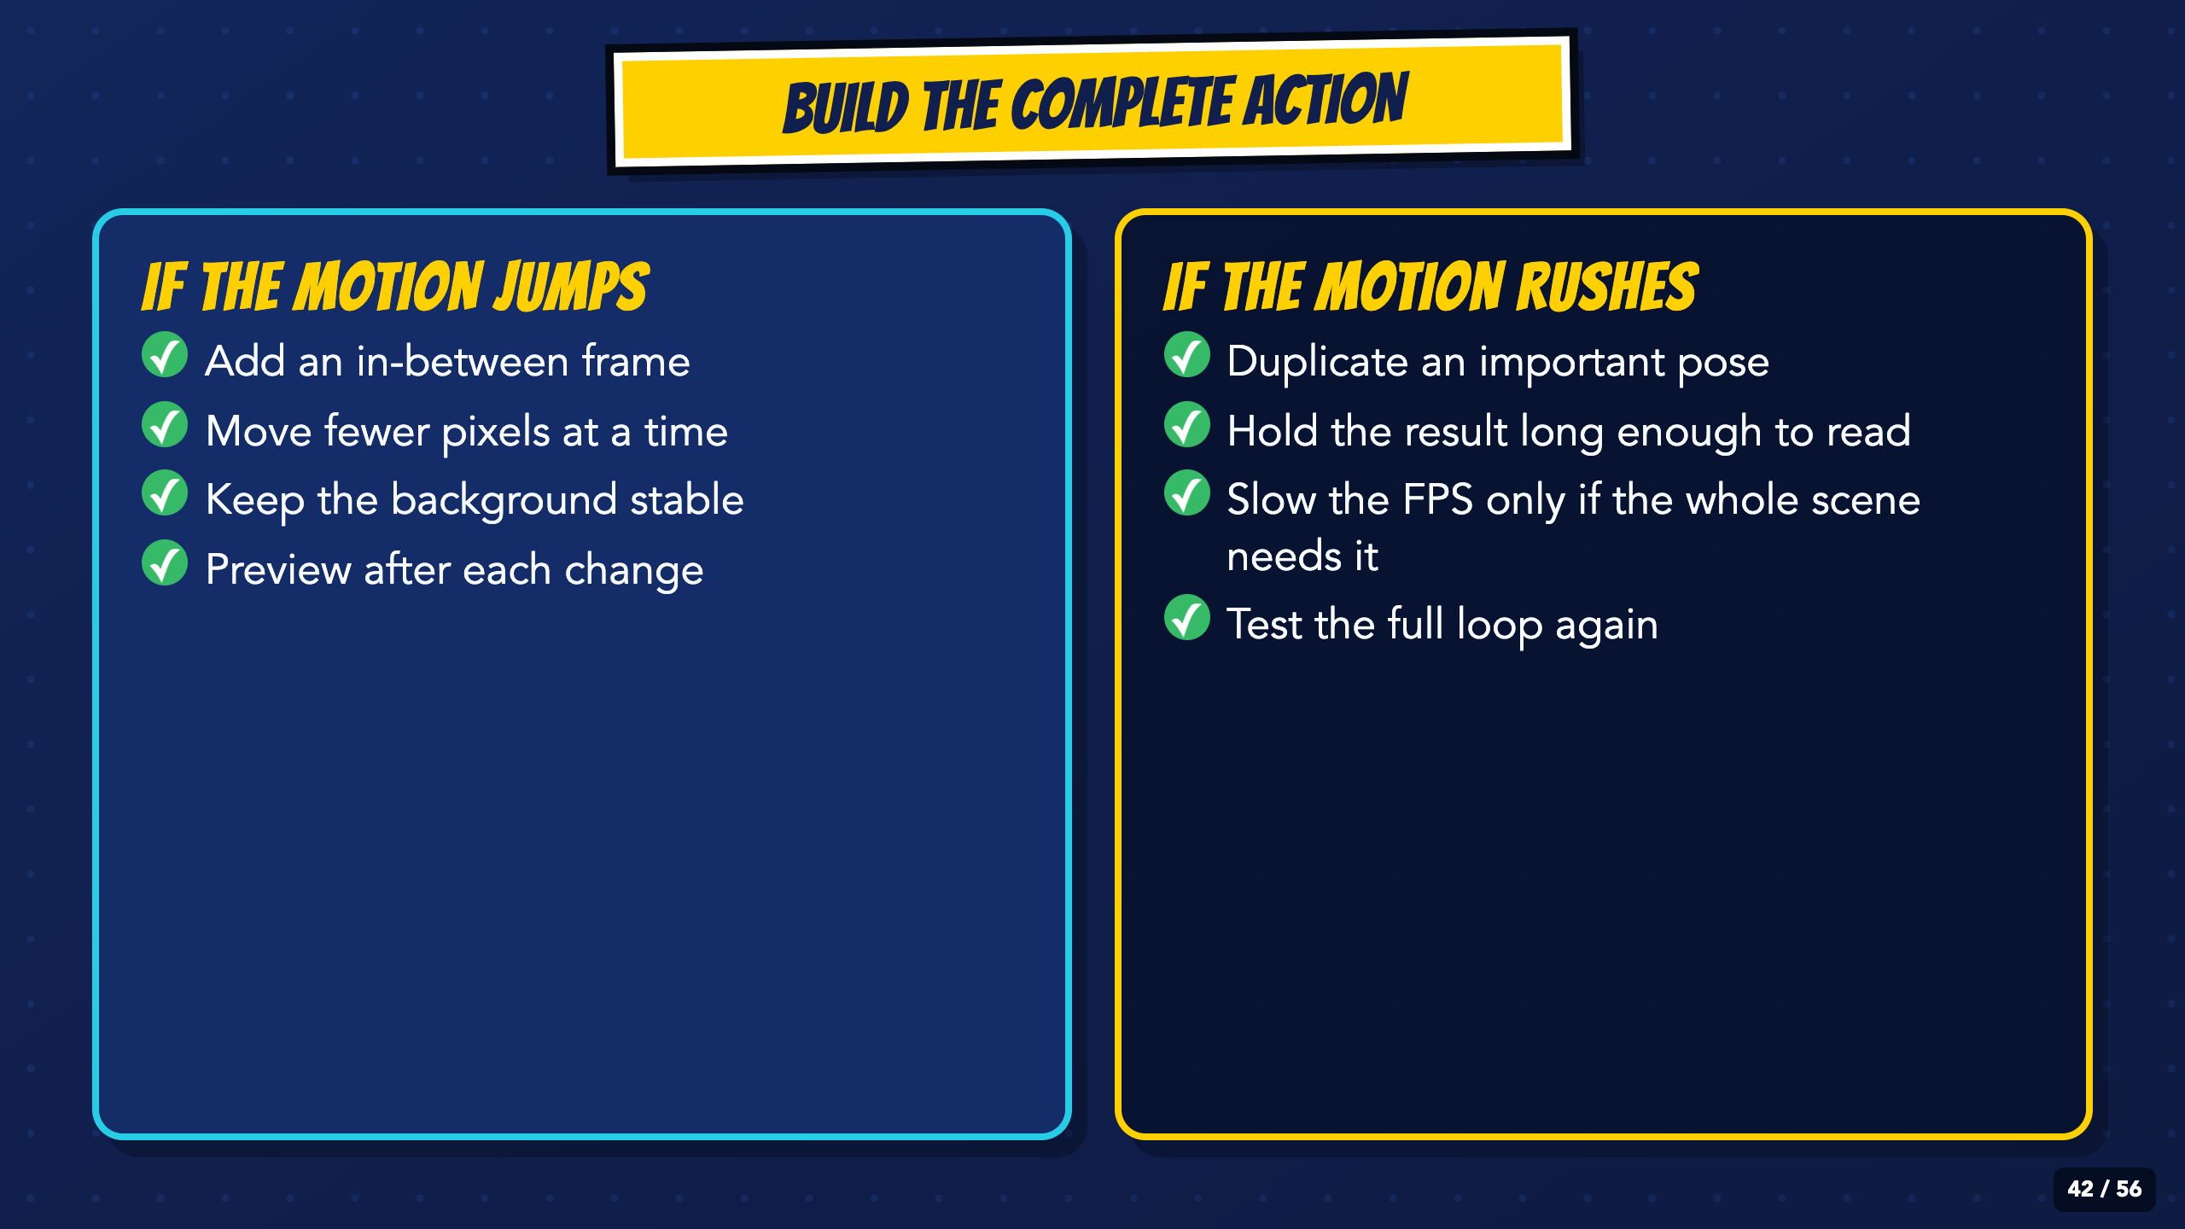
Notes:
Use the left column for jumping motion and the right column for rushed motion. Students should test one fix before making several changes at once.
[Sources]
- Irving ISD VILS 2027 Template Animation student pages, rubric, and facilitator guide.

Slide 43
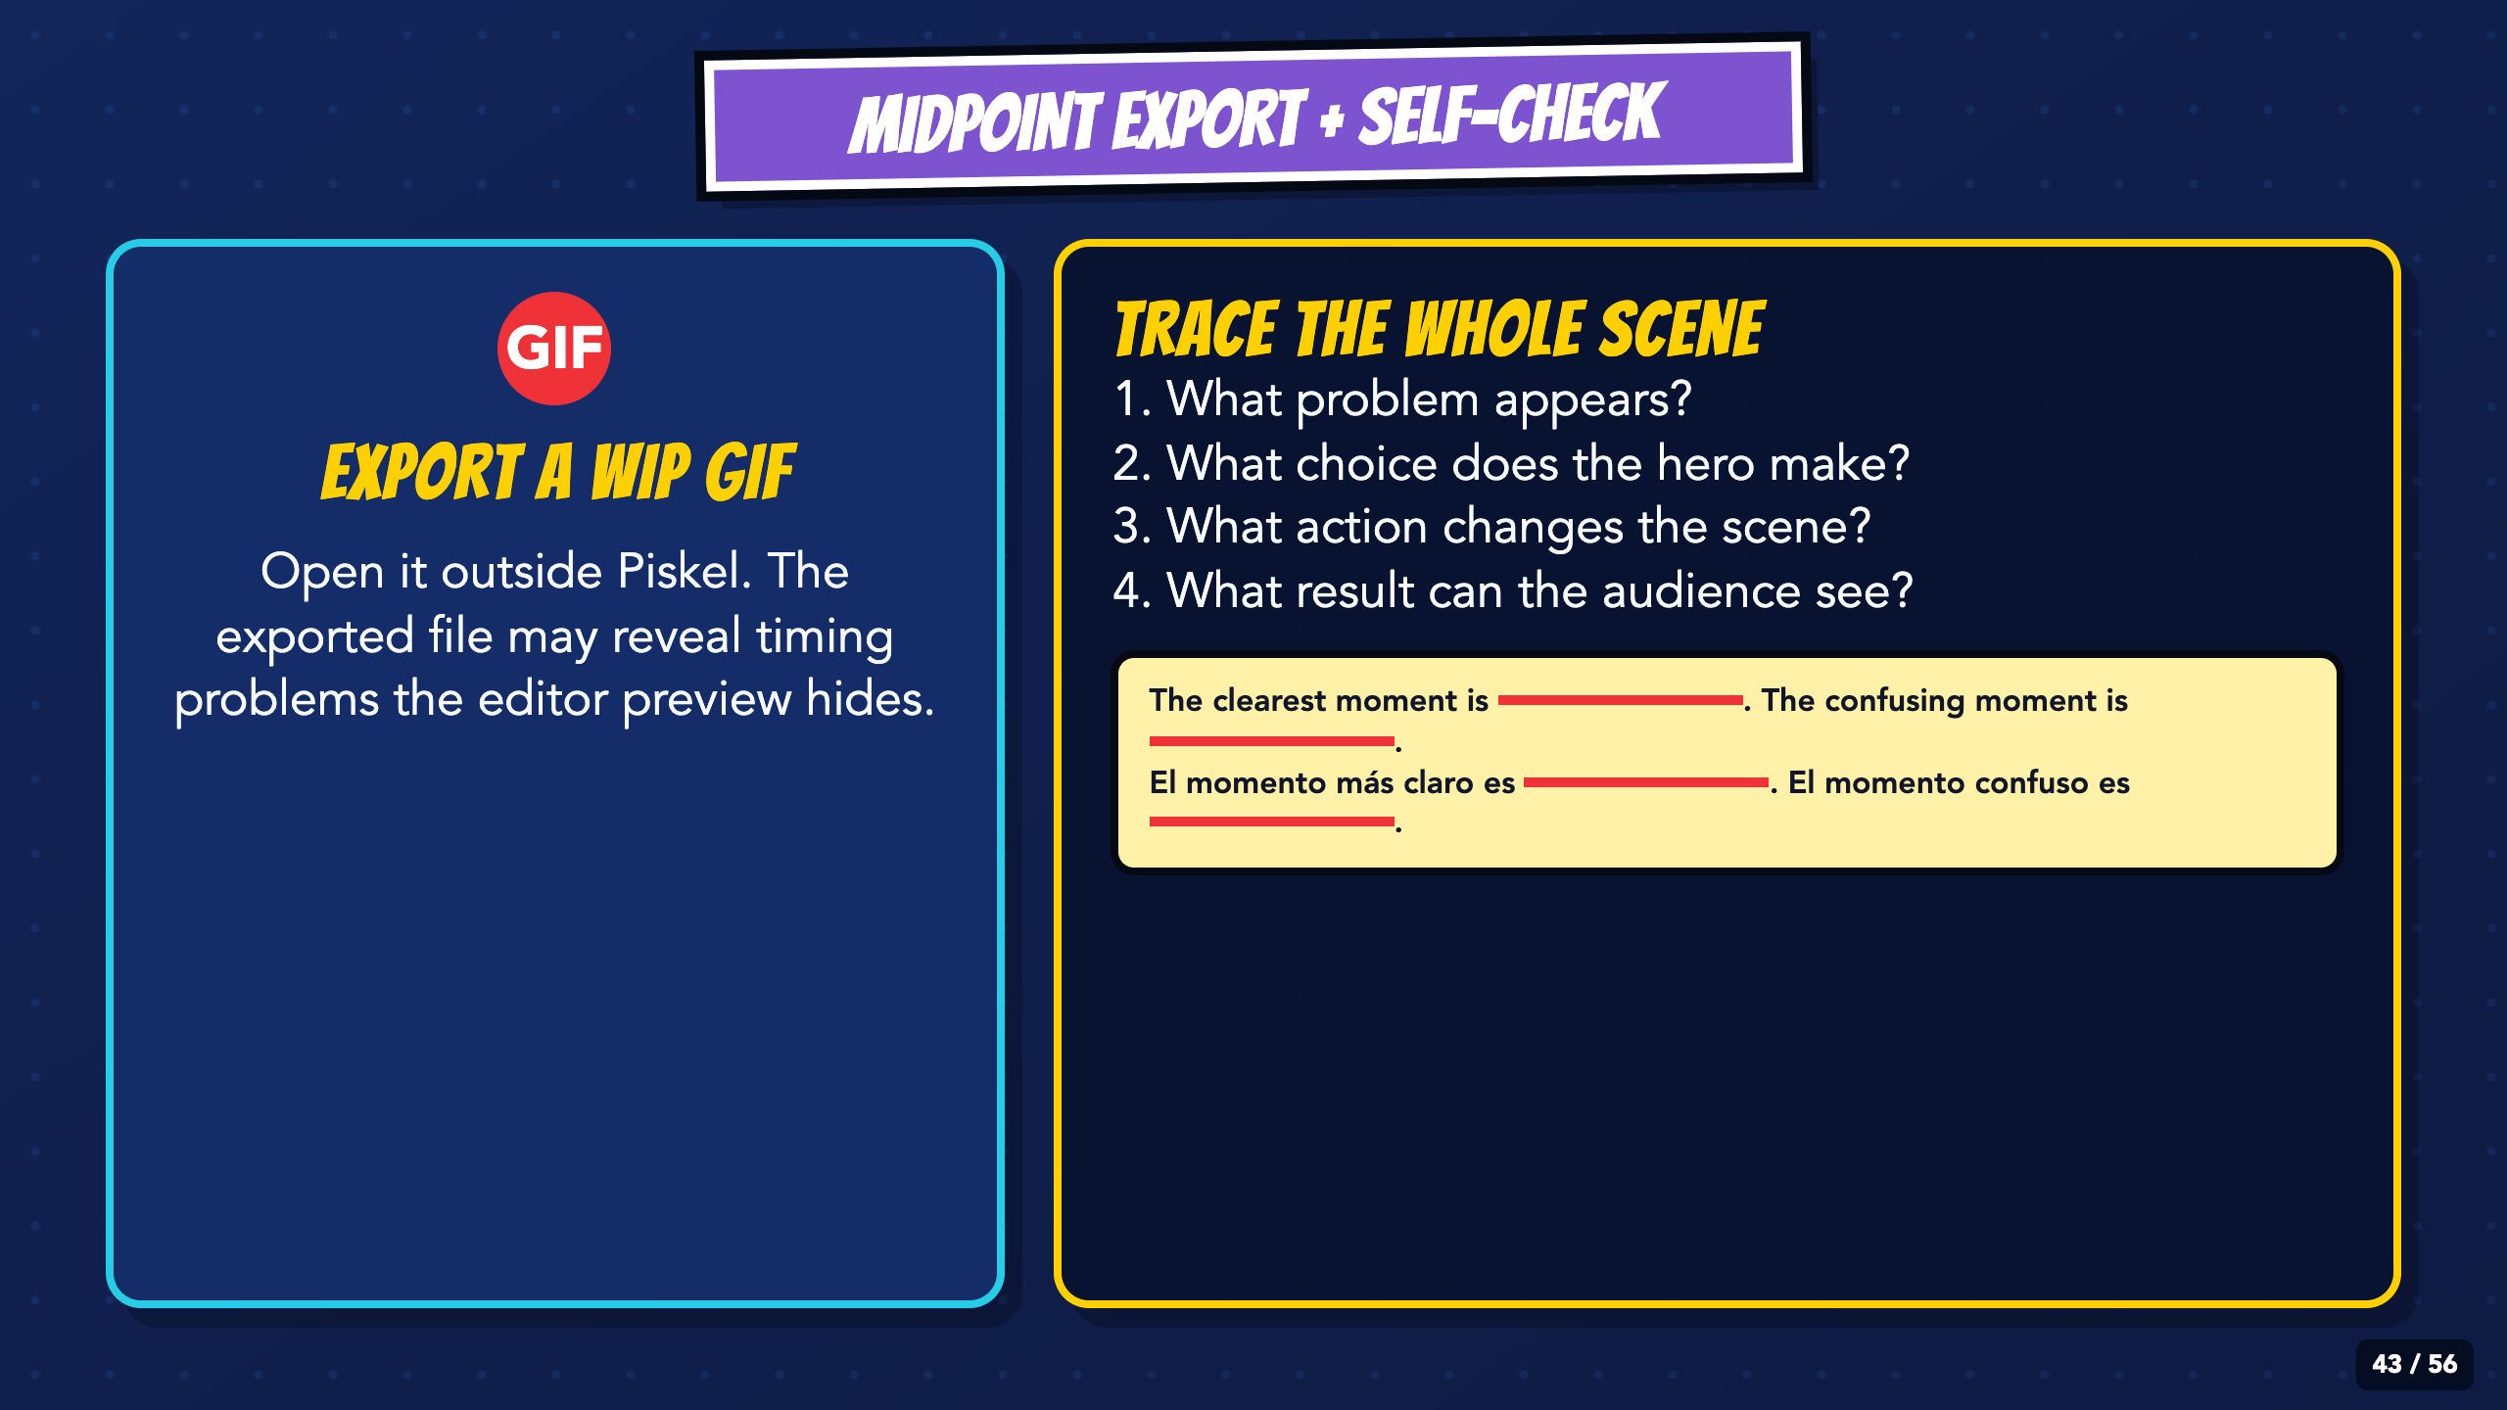
Notes:
Require a midpoint GIF and let students watch it outside Piskel. The four questions test whether the promise reads as a visible action and result.
[Sources]
- Irving ISD VILS 2027 Template Animation student pages, rubric, and facilitator guide.

Slide 44
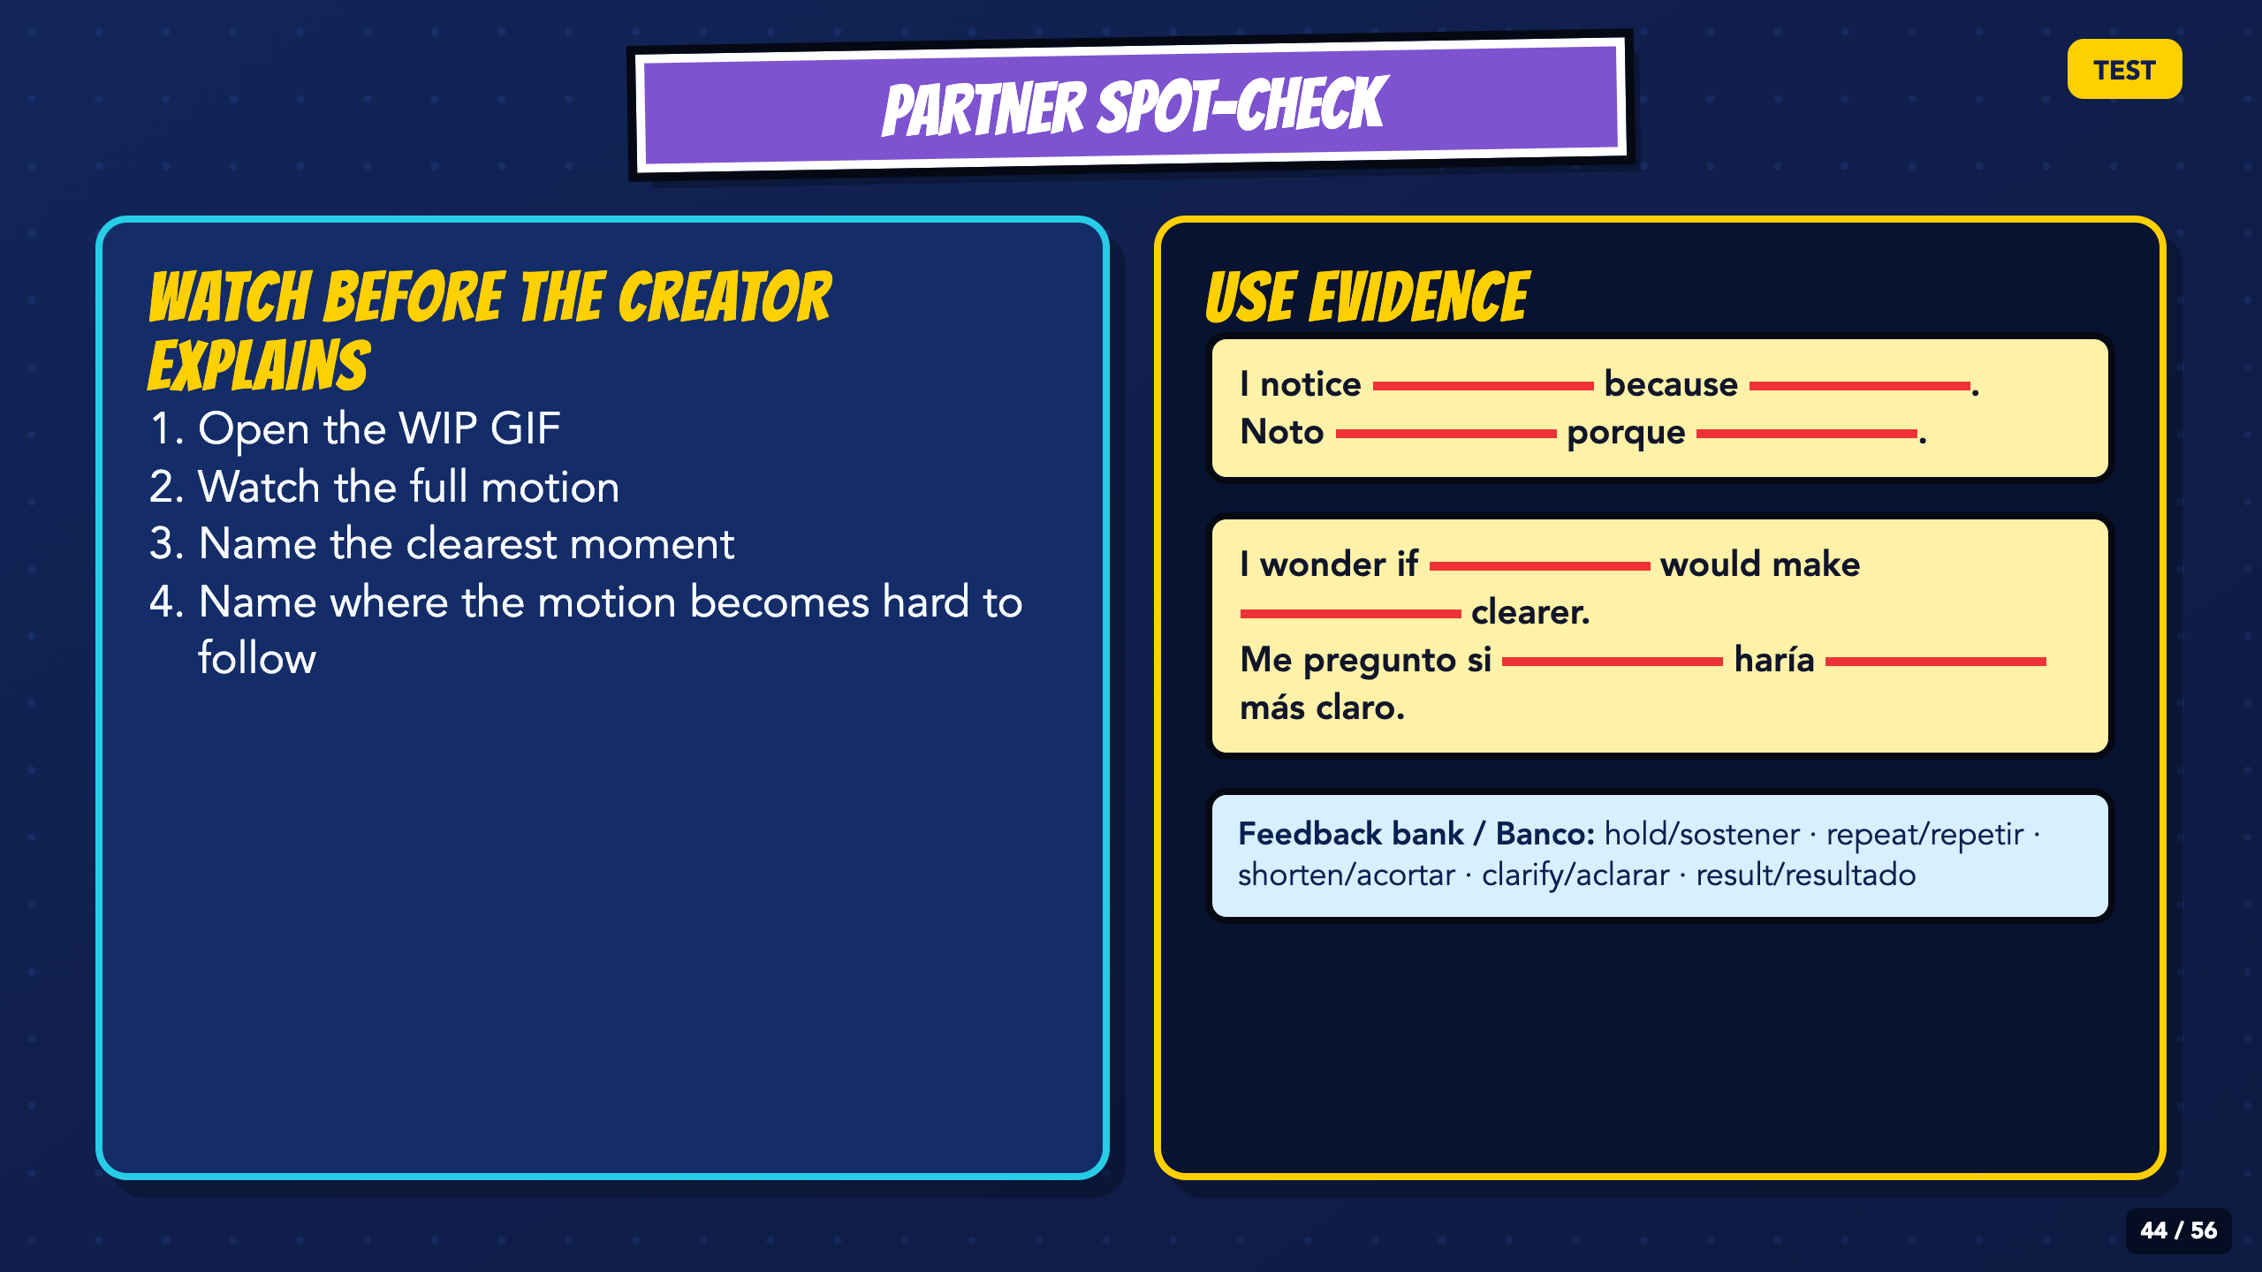
Notes:
Partners watch before the creator explains. Use the projected stems; a specific notice and wonder become evidence for the final revision.
[Sources]
- Irving ISD VILS 2027 Template Animation student pages, rubric, and facilitator guide.

Slide 45
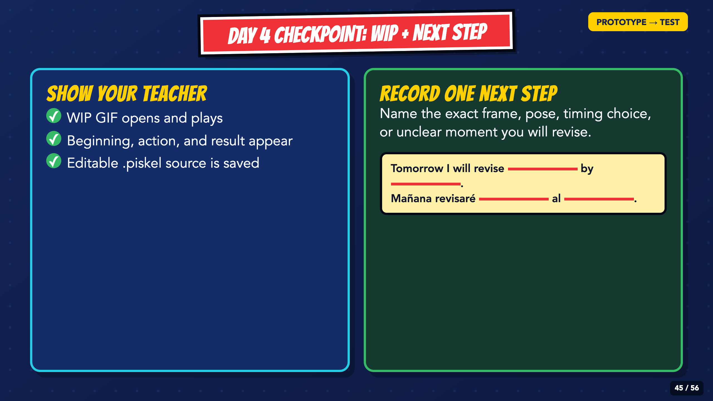
Notes:
Students export the WIP and record one next step. The step should name a frame, pose, timing choice, or unclear moment.
[Sources]
- Irving ISD VILS 2027 Template Animation student pages, rubric, and facilitator guide.

Slide 46
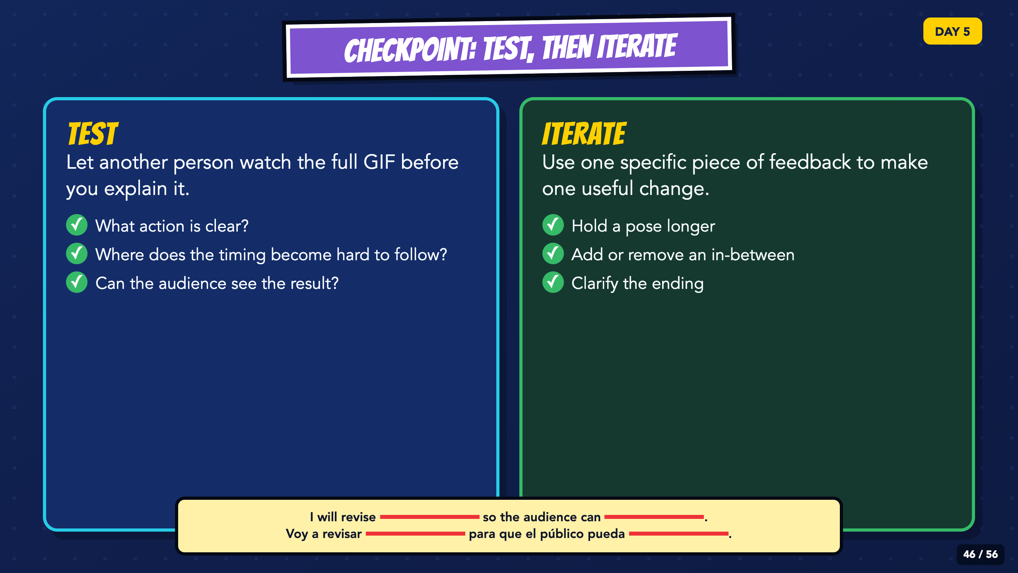
Notes:
Move the class into Test, then Iterate. The audience watches before the creator explains, and each student uses one specific comment to make one useful change.
[Sources]
- Irving ISD VILS 2027 Template Animation student pages, rubric, and facilitator guide.

Slide 47
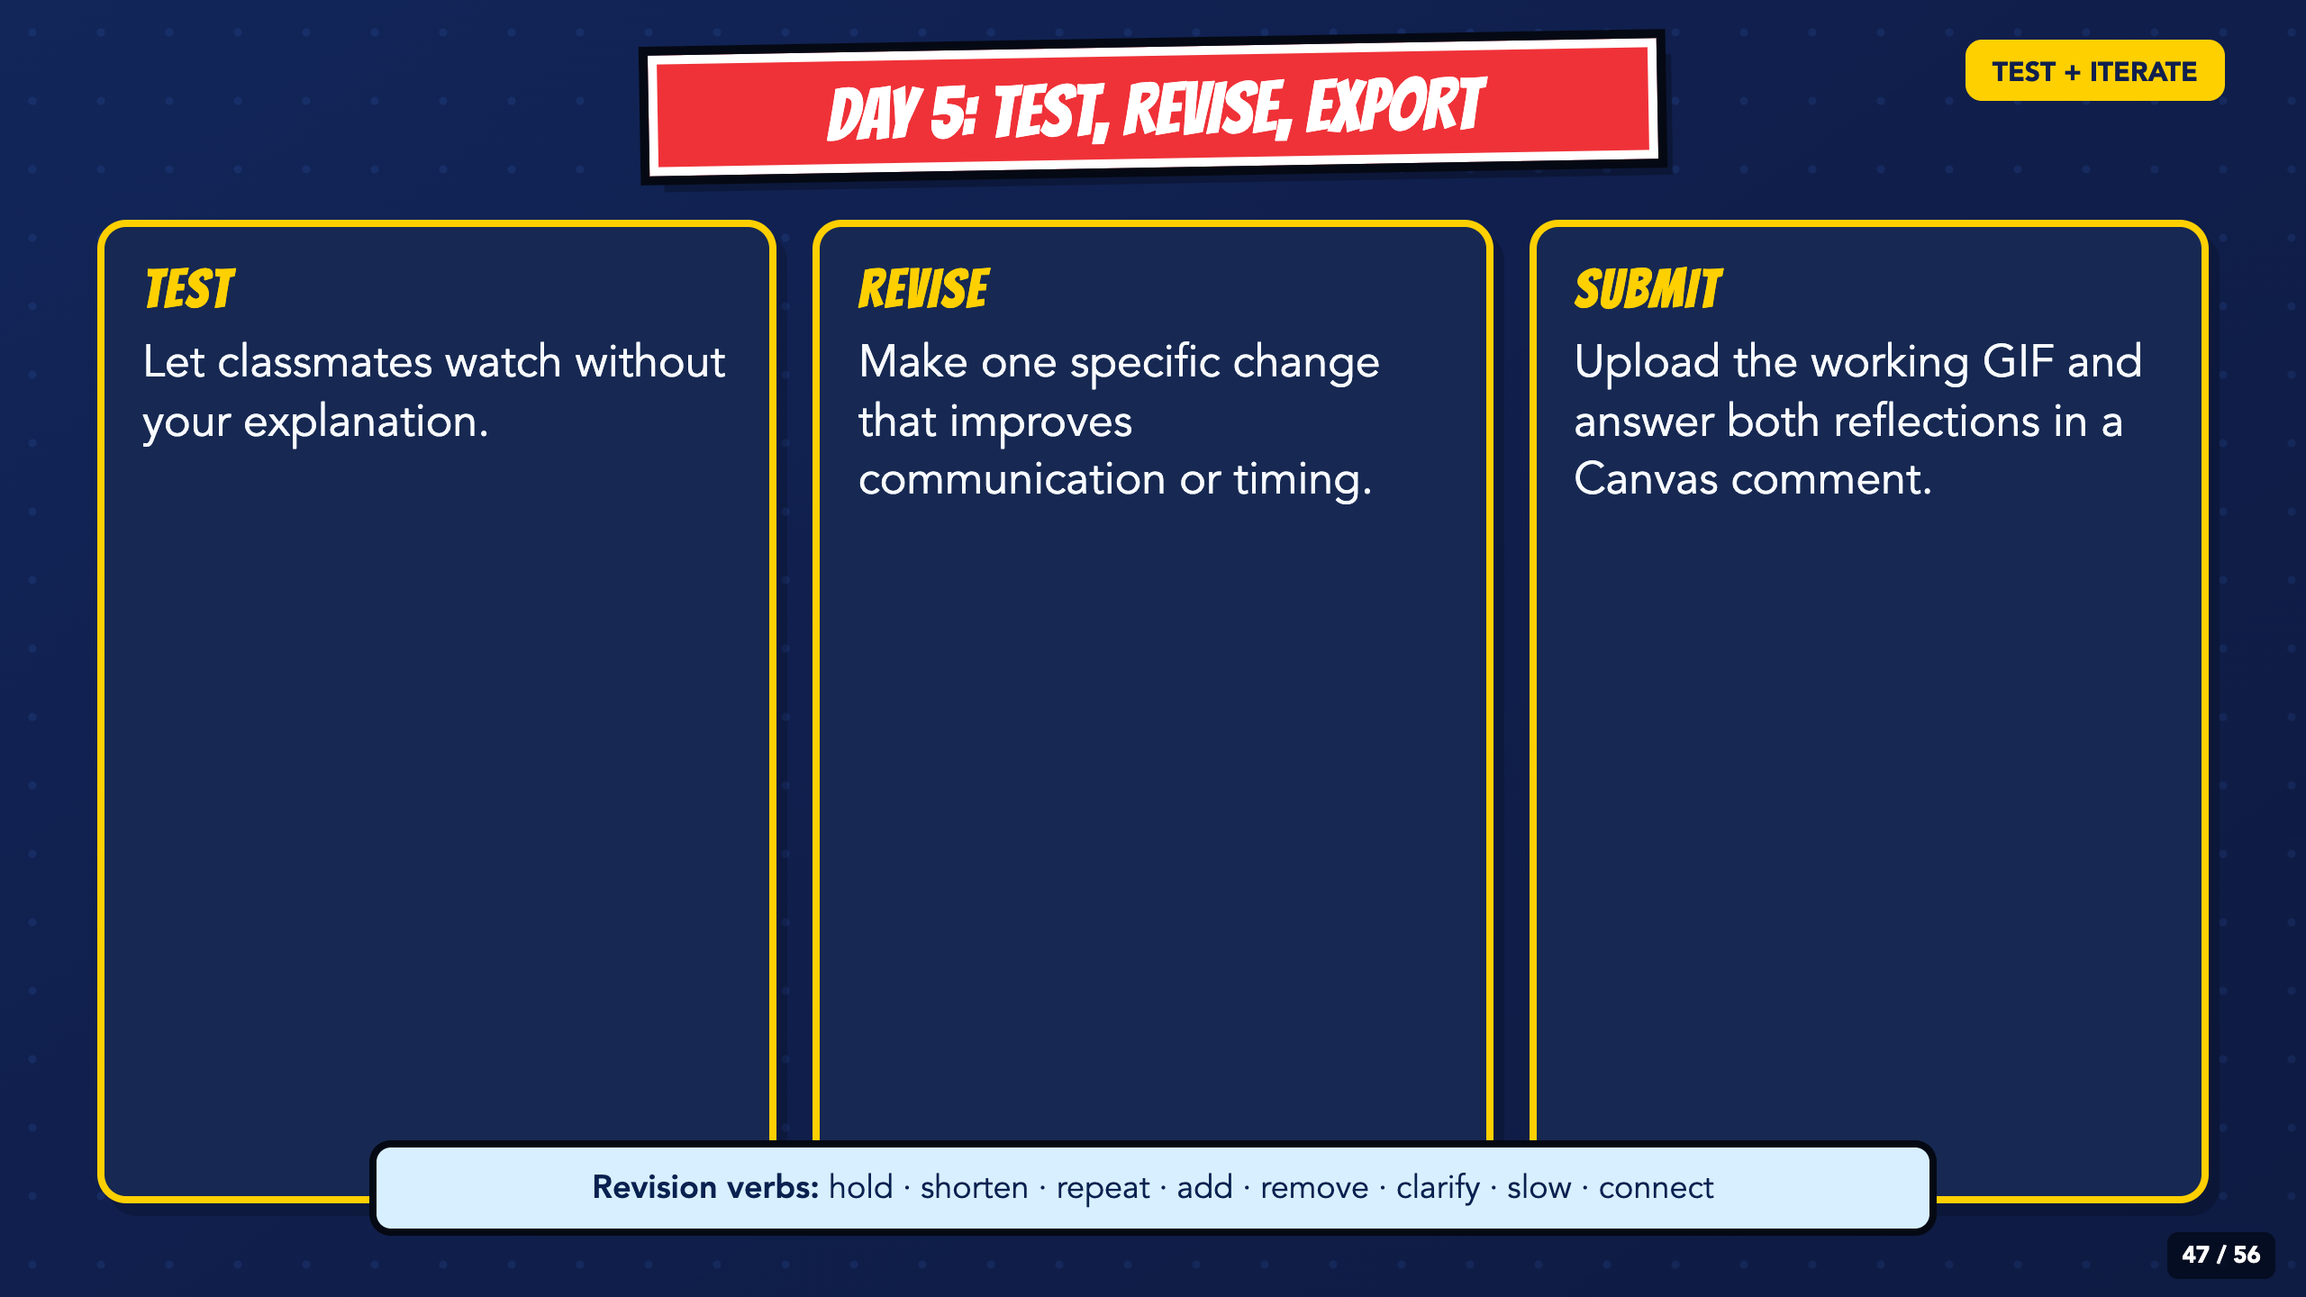
Notes:
Preview the three jobs and the submission-comment requirement. Students should know that reflection is part of the final submission, not an extra page.
[Sources]
- Irving ISD VILS 2027 Template Animation student pages, rubric, and facilitator guide.

Slide 48
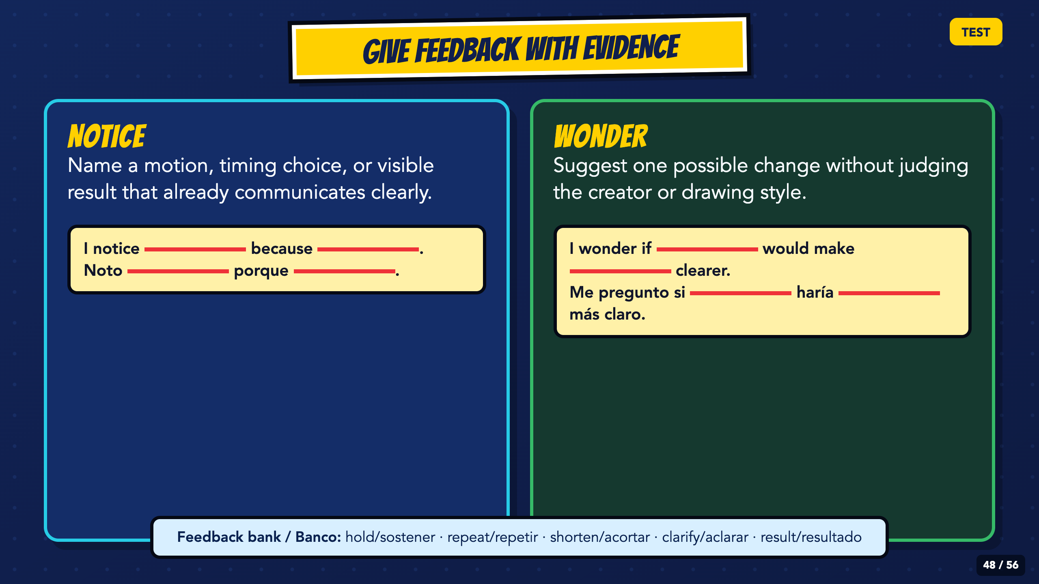
Notes:
Model the bilingual notice and wonder stems with a visible motion or timing detail. Replace praise such as 'looks good' with evidence and one possible change.
[Sources]
- Irving ISD VILS 2027 Template Animation student pages, rubric, and facilitator guide.

Slide 49
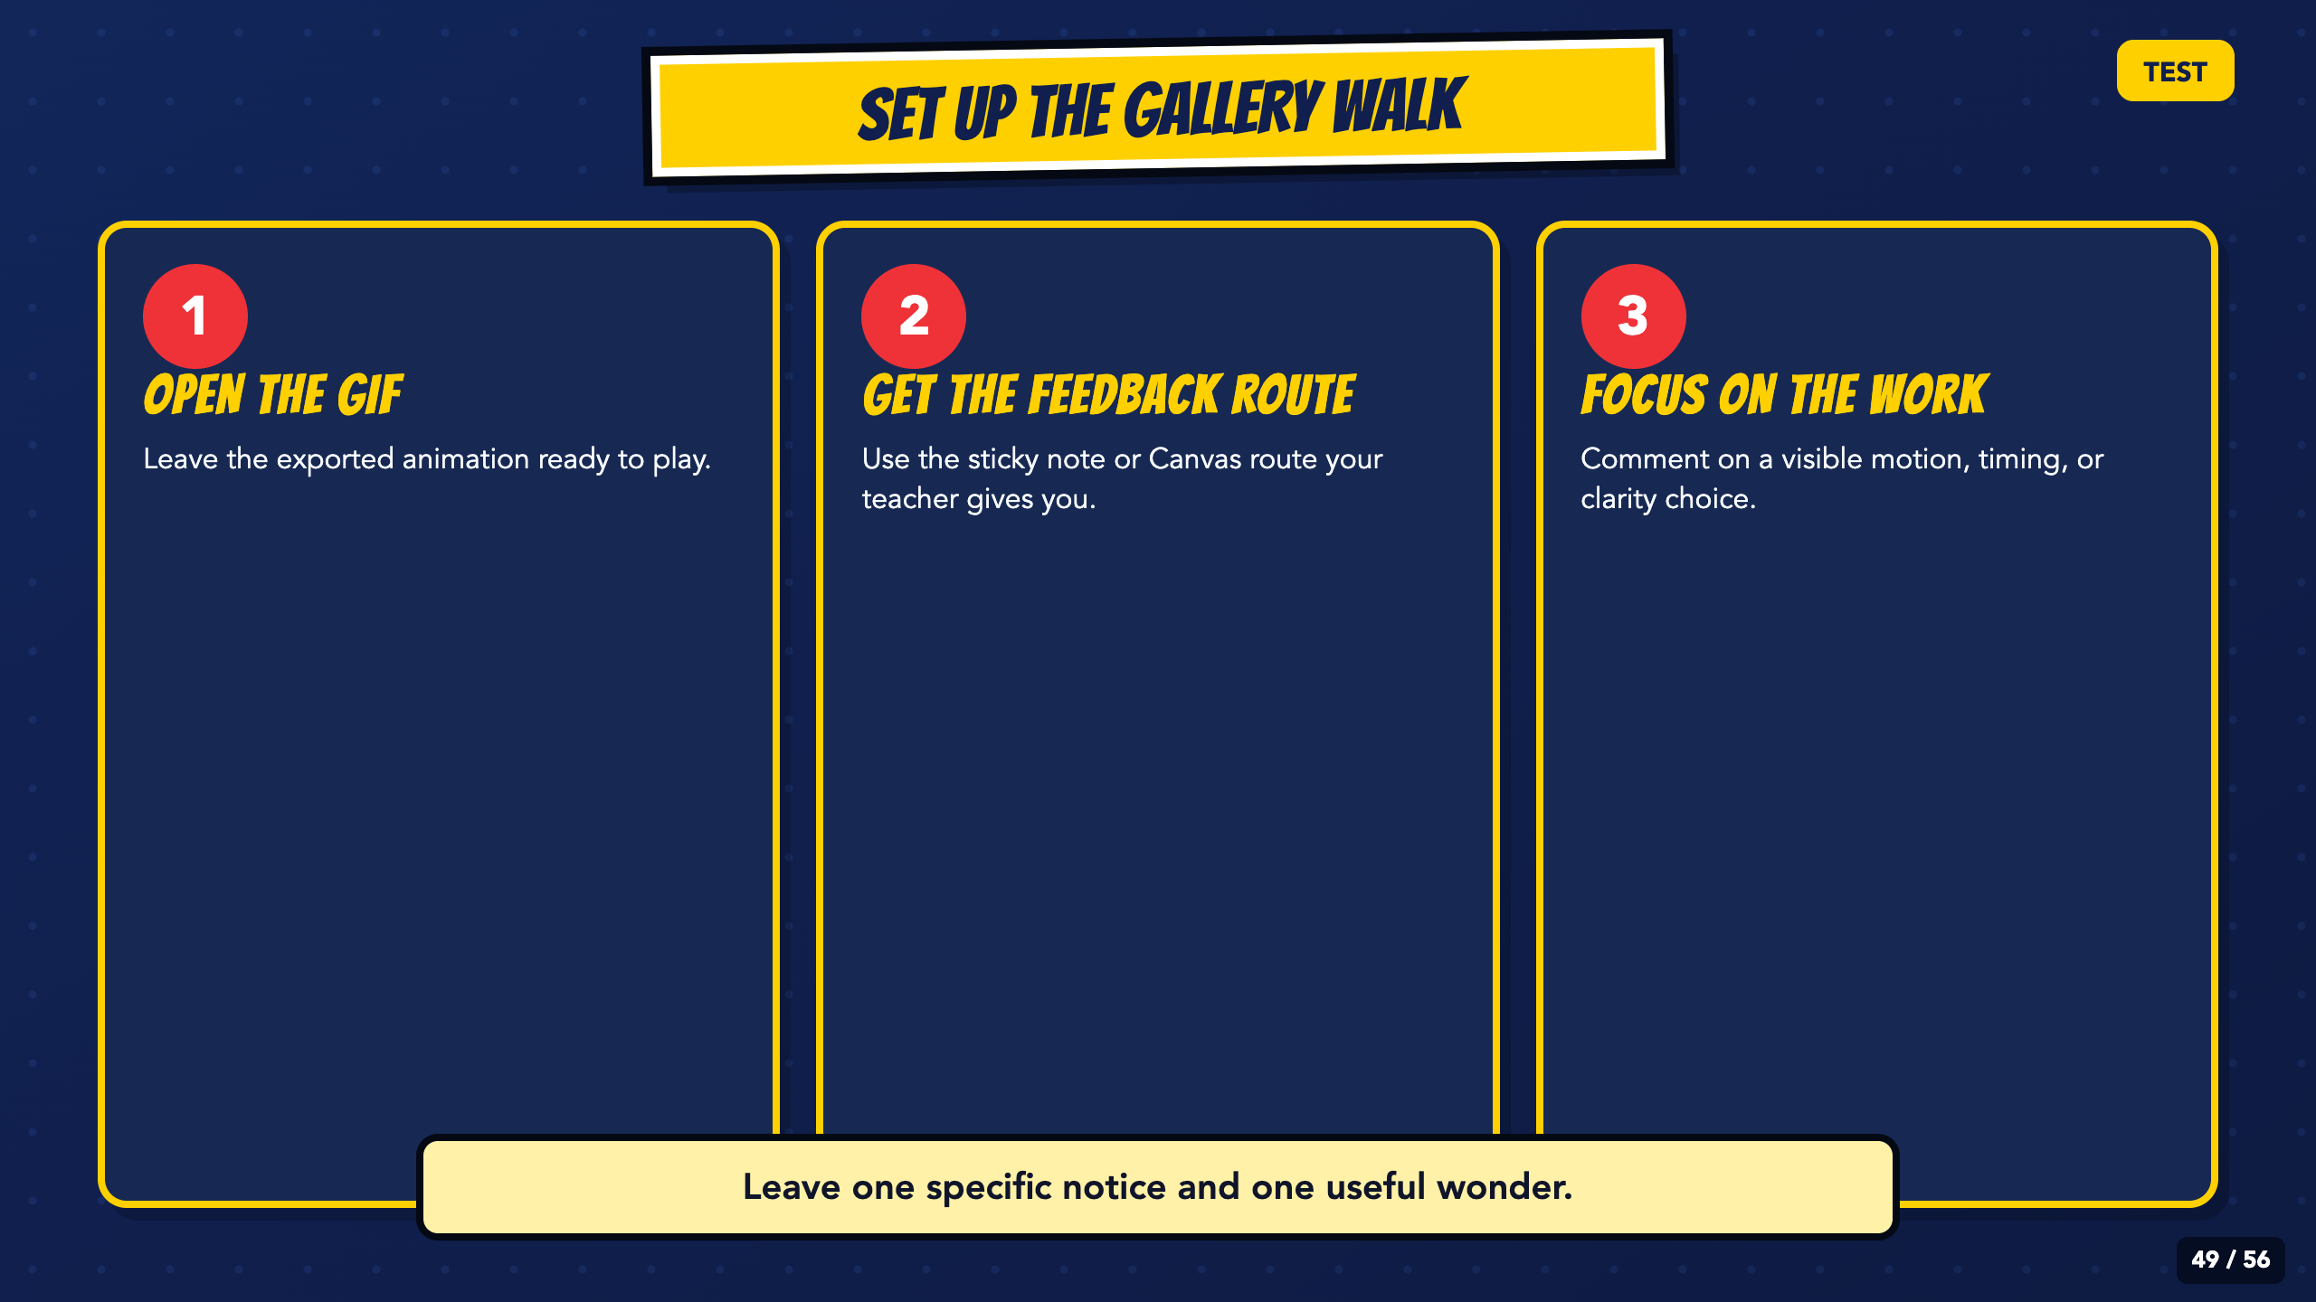
Notes:
Set up the gallery walk before students move. Leave computers open to the exported GIF, not the editable project.
[Sources]
- Irving ISD VILS 2027 Template Animation student pages, rubric, and facilitator guide.

Slide 50
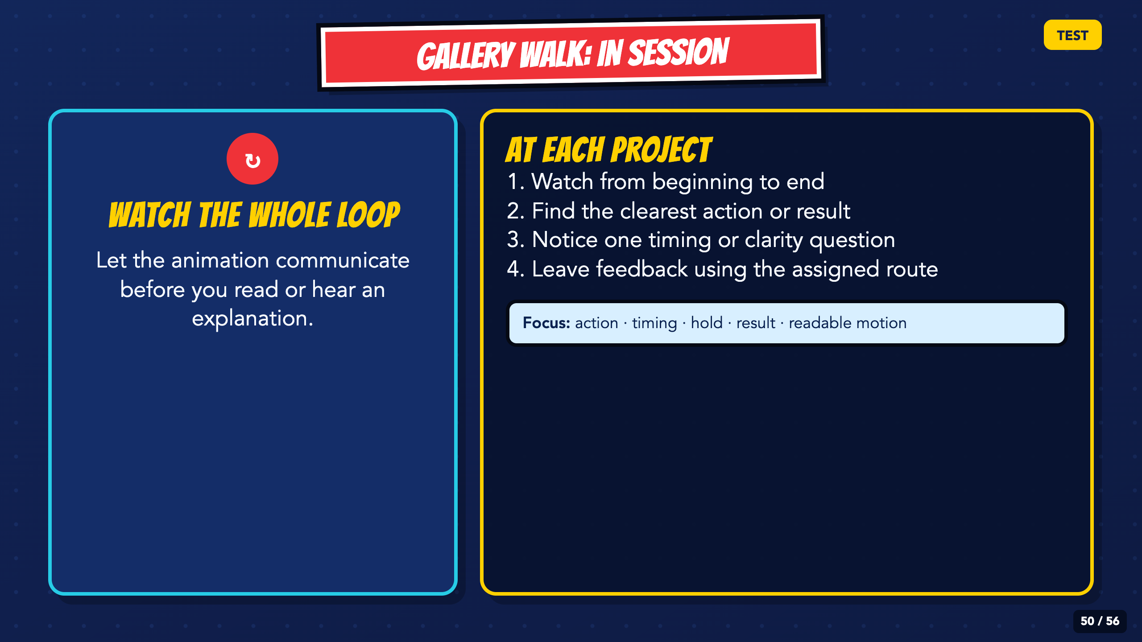
Notes:
Keep the movement routine brief and quiet. Students leave feedback on at least three animations and focus on the work, not the creator.
[Sources]
- Irving ISD VILS 2027 Template Animation student pages, rubric, and facilitator guide.

Slide 51

Notes:
Collect patterns from the feedback. Ask which comments point to a communication problem, which point to timing, and which can wait for a future project.
[Sources]
- Irving ISD VILS 2027 Template Animation student pages, rubric, and facilitator guide.

Slide 52

Notes:
Each student chooses one targeted revision. A revision may hold a pose, add an in-between, clarify the result, or remove a distracting element.
[Sources]
- Irving ISD VILS 2027 Template Animation student pages, rubric, and facilitator guide.

Slide 53

Notes:
Use the standard or approved support route already assigned. Both routes require a clear action and result, working source and GIF files, and the same rubric.
[Sources]
- Irving ISD VILS 2027 Template Animation student pages, rubric, and facilitator guide.
- Piskel official site and FAQ: https://www.piskelapp.com/ and https://www.piskelapp.com/faq/

Slide 54

Notes:
Leave this slide projected for submission. Students upload the GIF, open it to prove it plays, then answer both bilingual stems in a Canvas submission comment.
[Sources]
- Irving ISD VILS 2027 Template Animation student pages, rubric, and facilitator guide.

Slide 55

Notes:
Preview the exact five criteria before students submit. The support route is not penalized for length; it is scored on the same communication, timing, revision, and file expectations.
[Sources]
- Irving ISD VILS 2027 Template Animation student pages, rubric, and facilitator guide.

Slide 56

Notes:
Close with evidence. Ask students to name the strongest moment and the specific action the audience can count on their hero to take.
[Sources]
- Irving ISD VILS 2027 Template Animation student pages, rubric, and facilitator guide.

