Slide 1
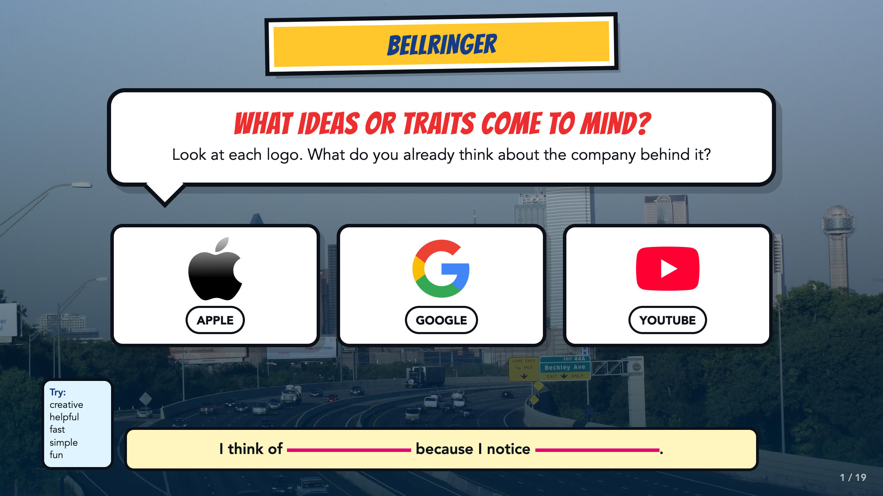
Notes:
Give students 60 to 90 seconds to write. Ask for an idea or trait plus a visible or lived reason. Different readings are acceptable when students use evidence.
[Sources]
- Course author's Smart Solutions superhero reference materials.
- Dallas skyline photograph by medea_material, CC BY 2.0: https://commons.wikimedia.org/wiki/File:Skyline_of_Dallas,_TX.jpg
- Apple logo, Apple Inc., public-domain simple logo; trademarked: https://commons.wikimedia.org/wiki/File:Apple_Logo.svg
- Google G logo, Google LLC, public-domain simple logo; trademarked: https://commons.wikimedia.org/wiki/File:Google_%22G%22_logo.svg
- YouTube full-color icon, Google / YouTube, public-domain simple logo; trademarked: https://commons.wikimedia.org/wiki/File:YouTube_full-color_icon_(2024).svg

Slide 2
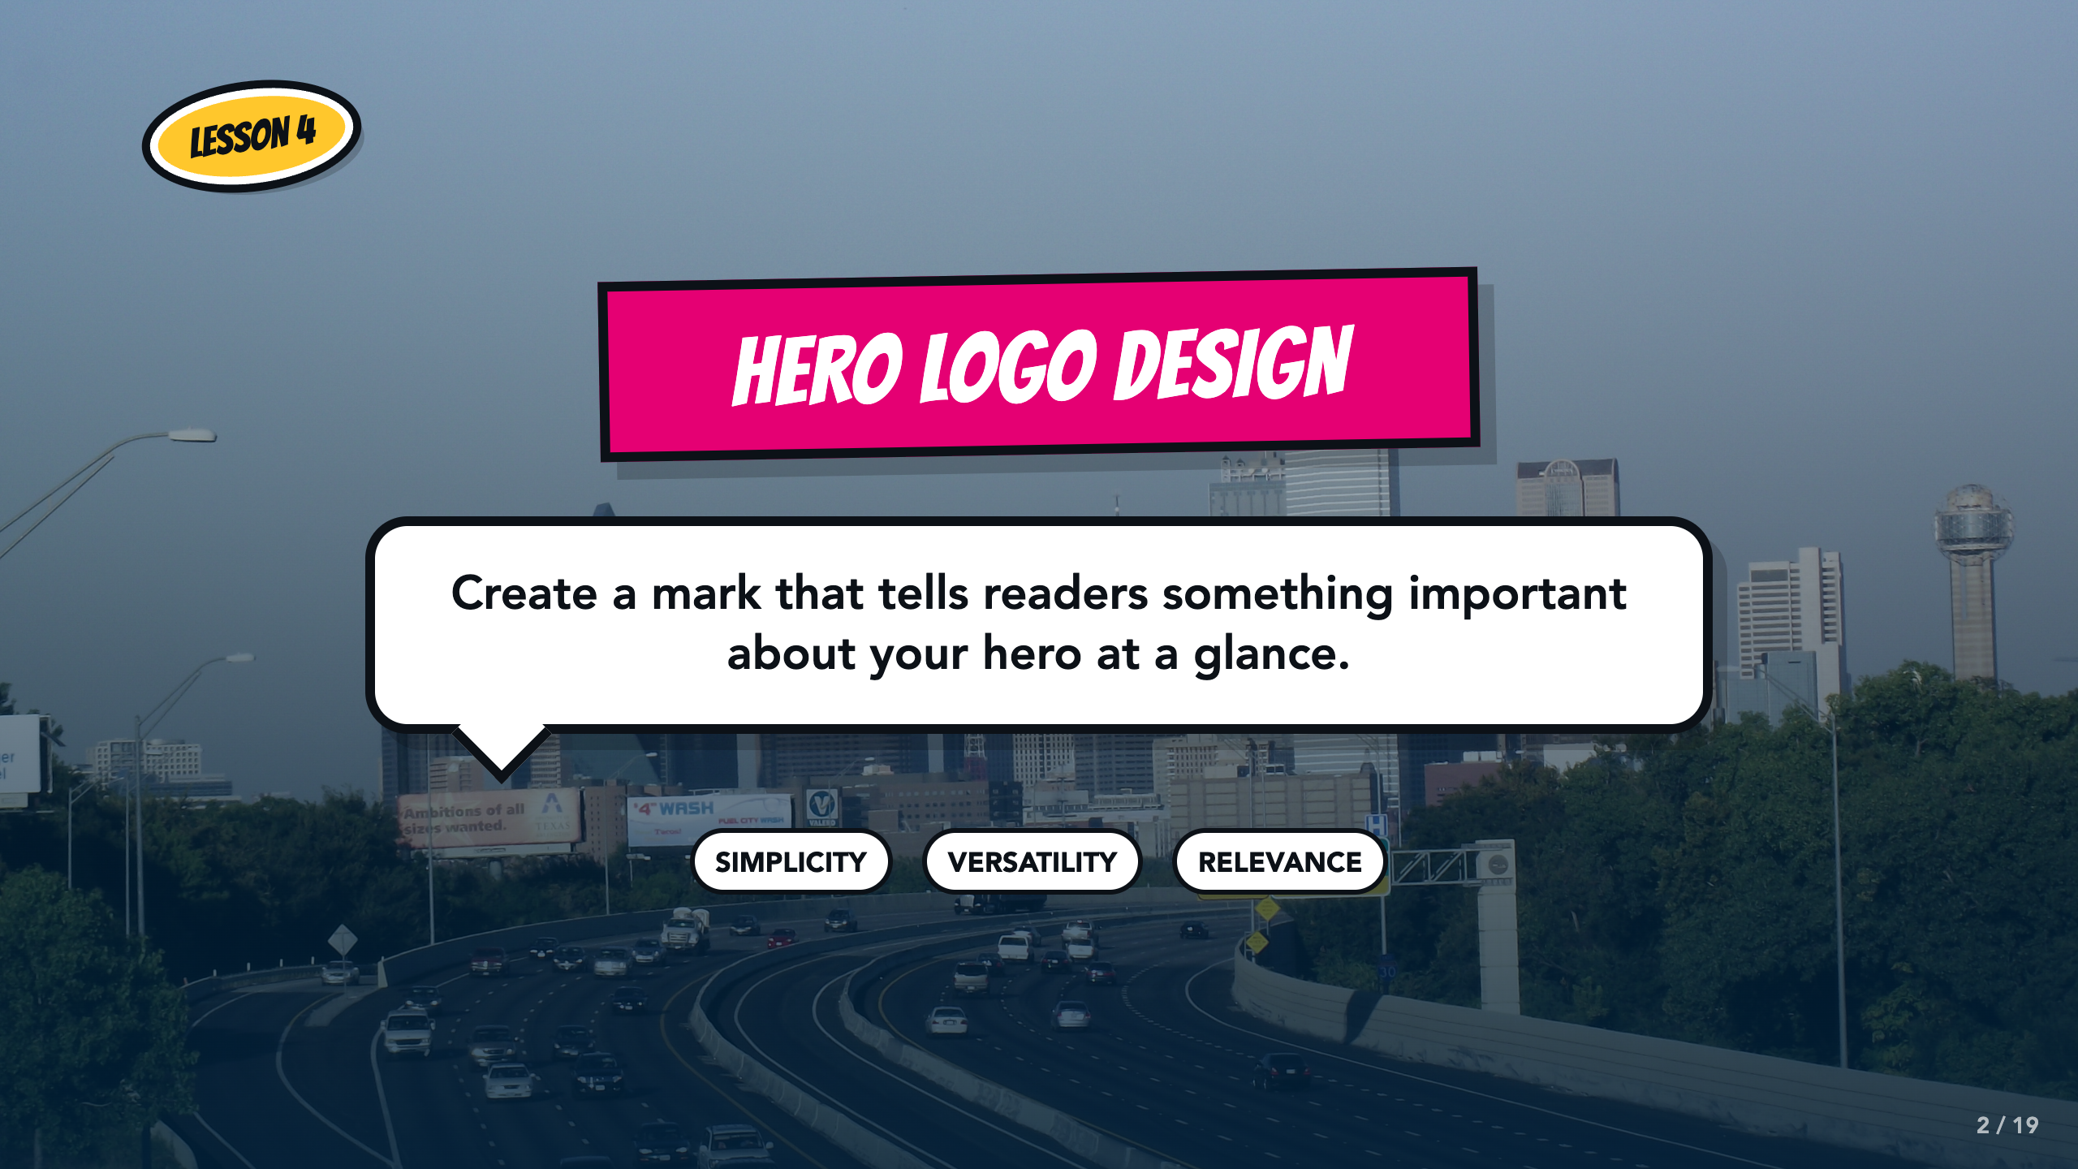
Notes:
Frame the lesson narrowly: students are designing a hero logo today. Formal brand-promise writing belongs in the optional Animation unit.
[Sources]
- Course author's Smart Solutions superhero reference materials.
- Dallas skyline photograph by medea_material, CC BY 2.0: https://commons.wikimedia.org/wiki/File:Skyline_of_Dallas,_TX.jpg
- Course author-approved Comics Lesson 4 requirements and success criteria.

Slide 3
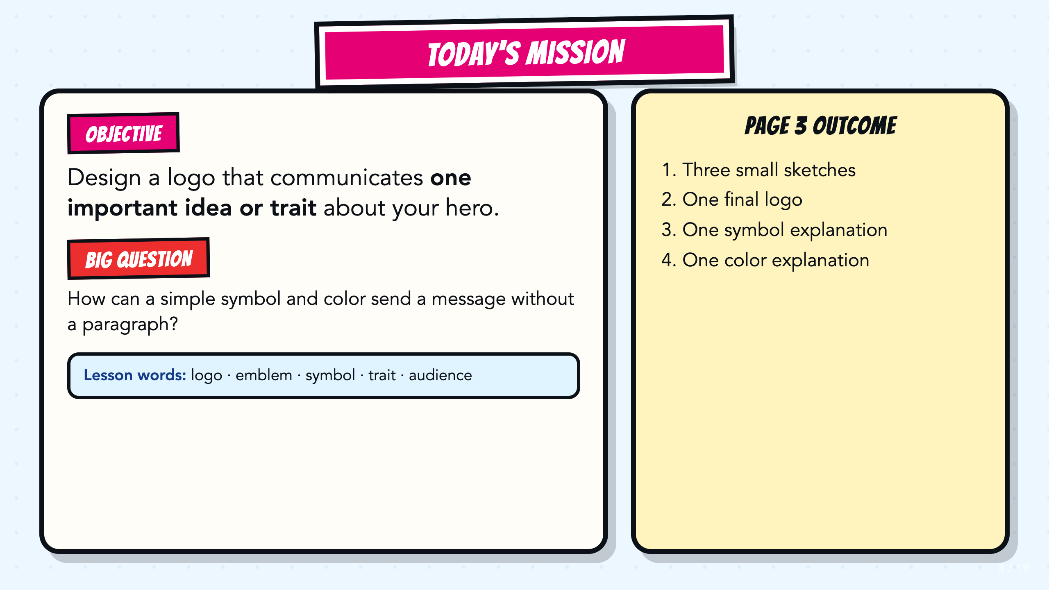
Notes:
Read the objective and Page 3 outcome aloud. Point students to the five lesson words and keep them visible as needed.
[Sources]
- Course author's Smart Solutions superhero reference materials.
- Course author-approved Comics Lesson 4 requirements and success criteria.

Slide 4
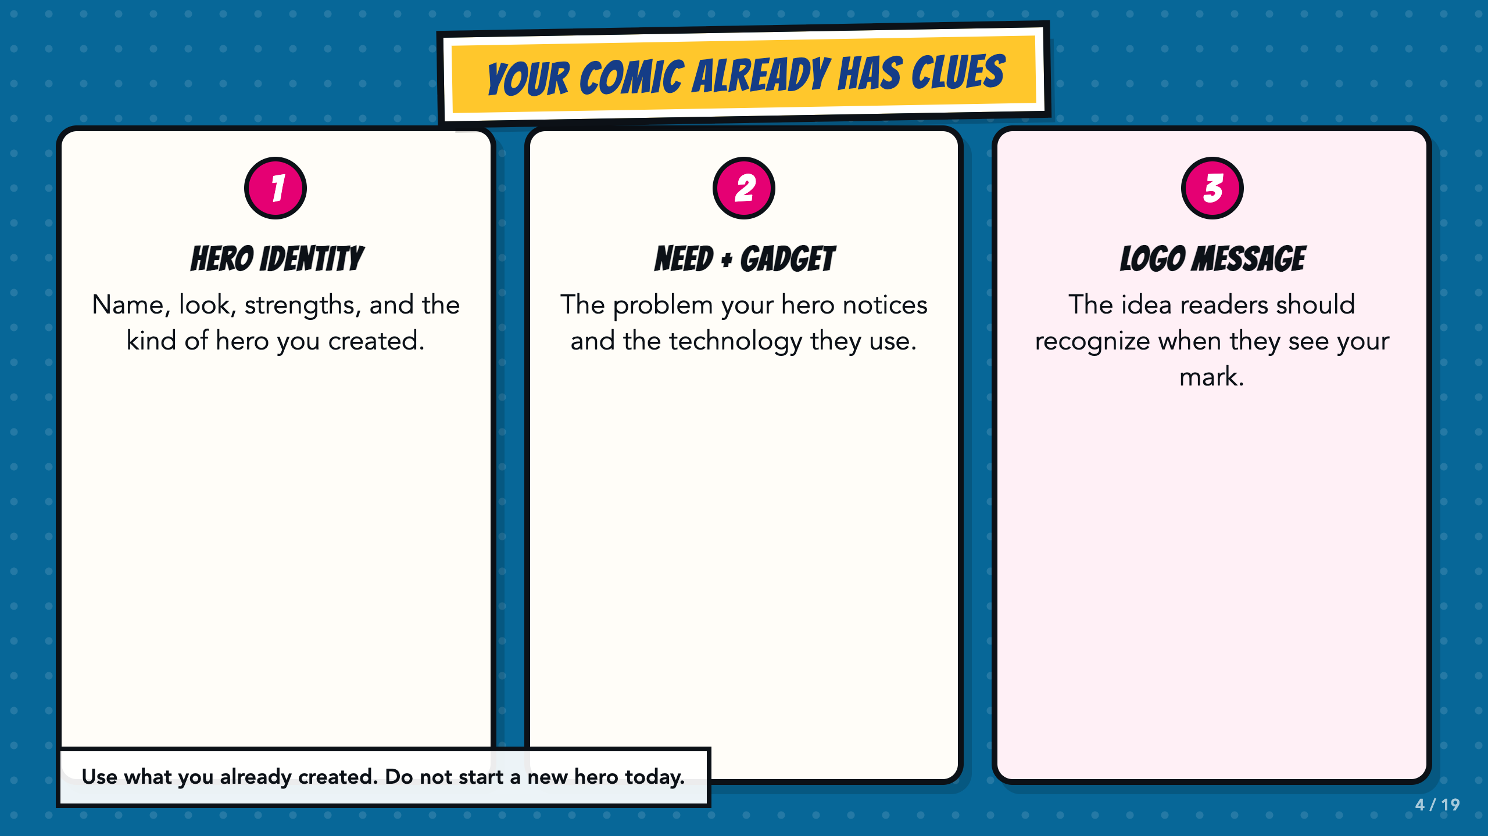
Notes:
Have students point to Pages 1 and 2. Today they reuse those choices instead of inventing a new hero.
[Sources]
- Course author's Smart Solutions superhero reference materials.
- Course author-approved Comics Lesson 4 requirements and success criteria.

Slide 5
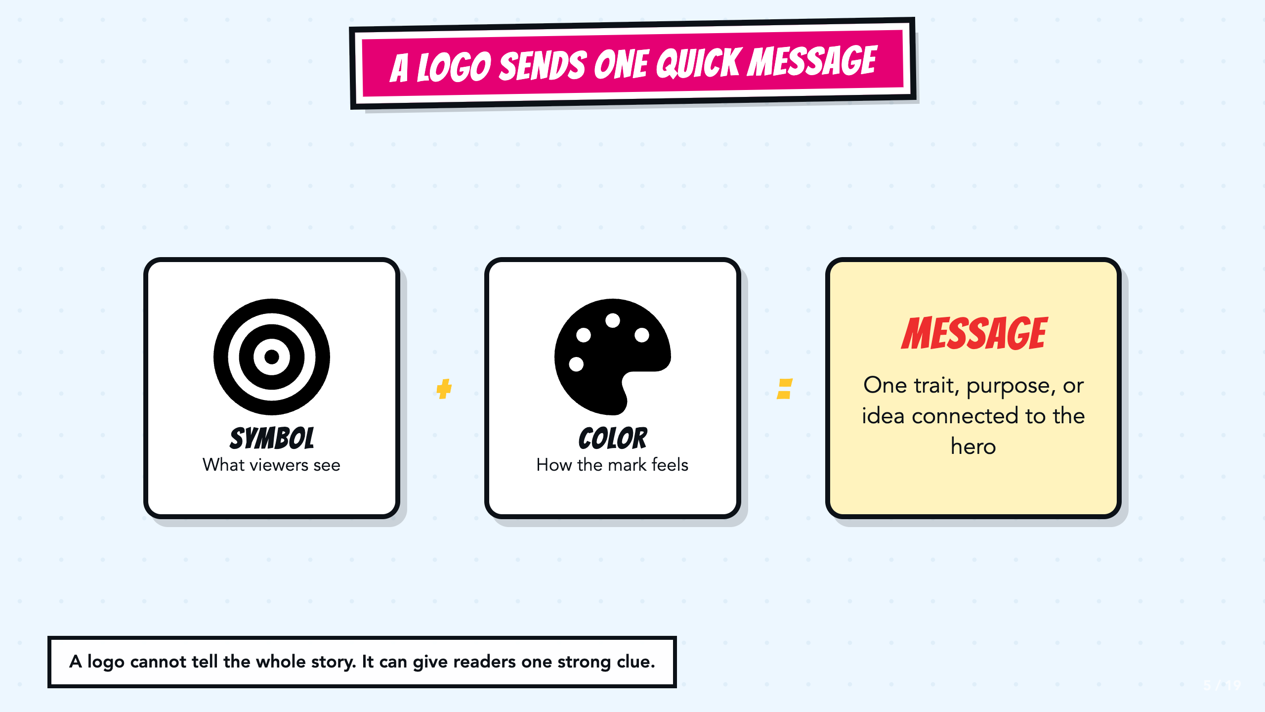
Notes:
Emphasize one quick message. A logo is not expected to tell the whole story or prove a formal promise.
[Sources]
- Course author's Smart Solutions superhero reference materials.
- Course author-approved Comics Lesson 4 requirements and success criteria.
- Font Awesome Free solid icons, Fonticons, Inc., CC BY 4.0: https://fontawesome.com/license/free

Slide 6
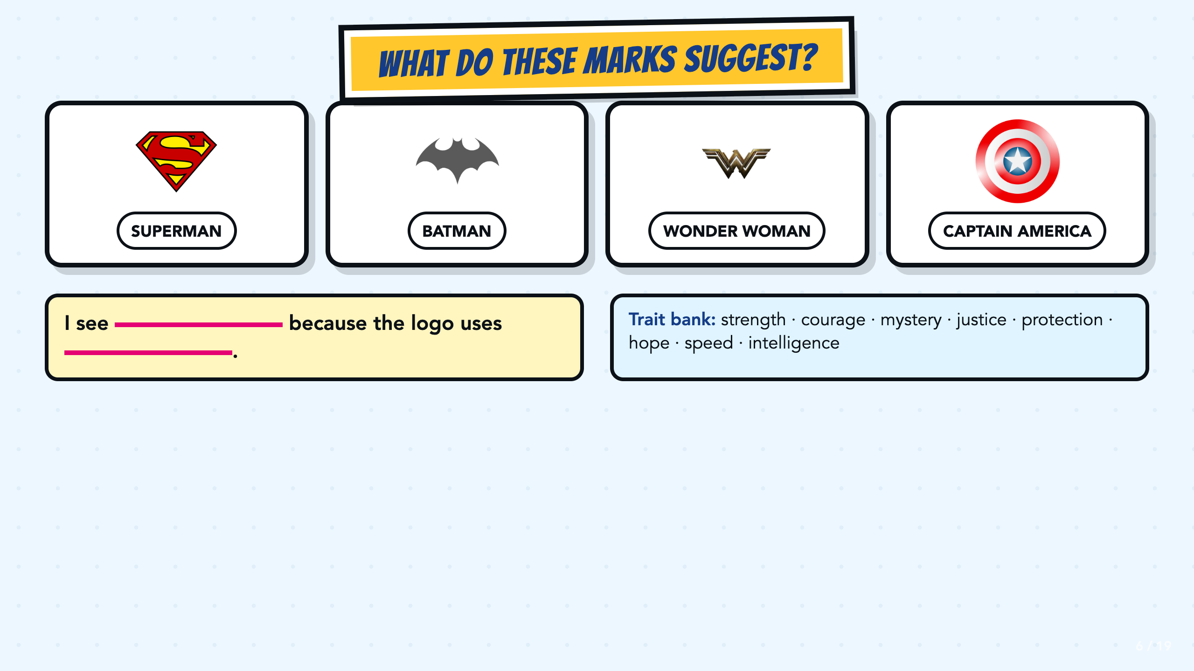
Notes:
Students complete the evidence stem before whole-class sharing. Do not treat one interpretation as the only correct answer when a student can point to a visible clue.
[Sources]
- Course author's Smart Solutions superhero reference materials.
- Superman shield, DC Comics, public-domain simple logo; trademarked: https://commons.wikimedia.org/wiki/File:Superman_shield.svg
- Batman logo by Nagarro Support, CC BY-SA 4.0: https://commons.wikimedia.org/wiki/File:Batman_logo.jpg
- Wonder Woman logo and emblem, public-domain simple logo; trademarked: https://commons.wikimedia.org/wiki/File:Wonder_woman_logo_and_emblem.png
- Captain America shield, public-domain simple geometric logo; trademarked: https://commons.wikimedia.org/wiki/File:Captain_America%27s_shield.svg

Slide 7
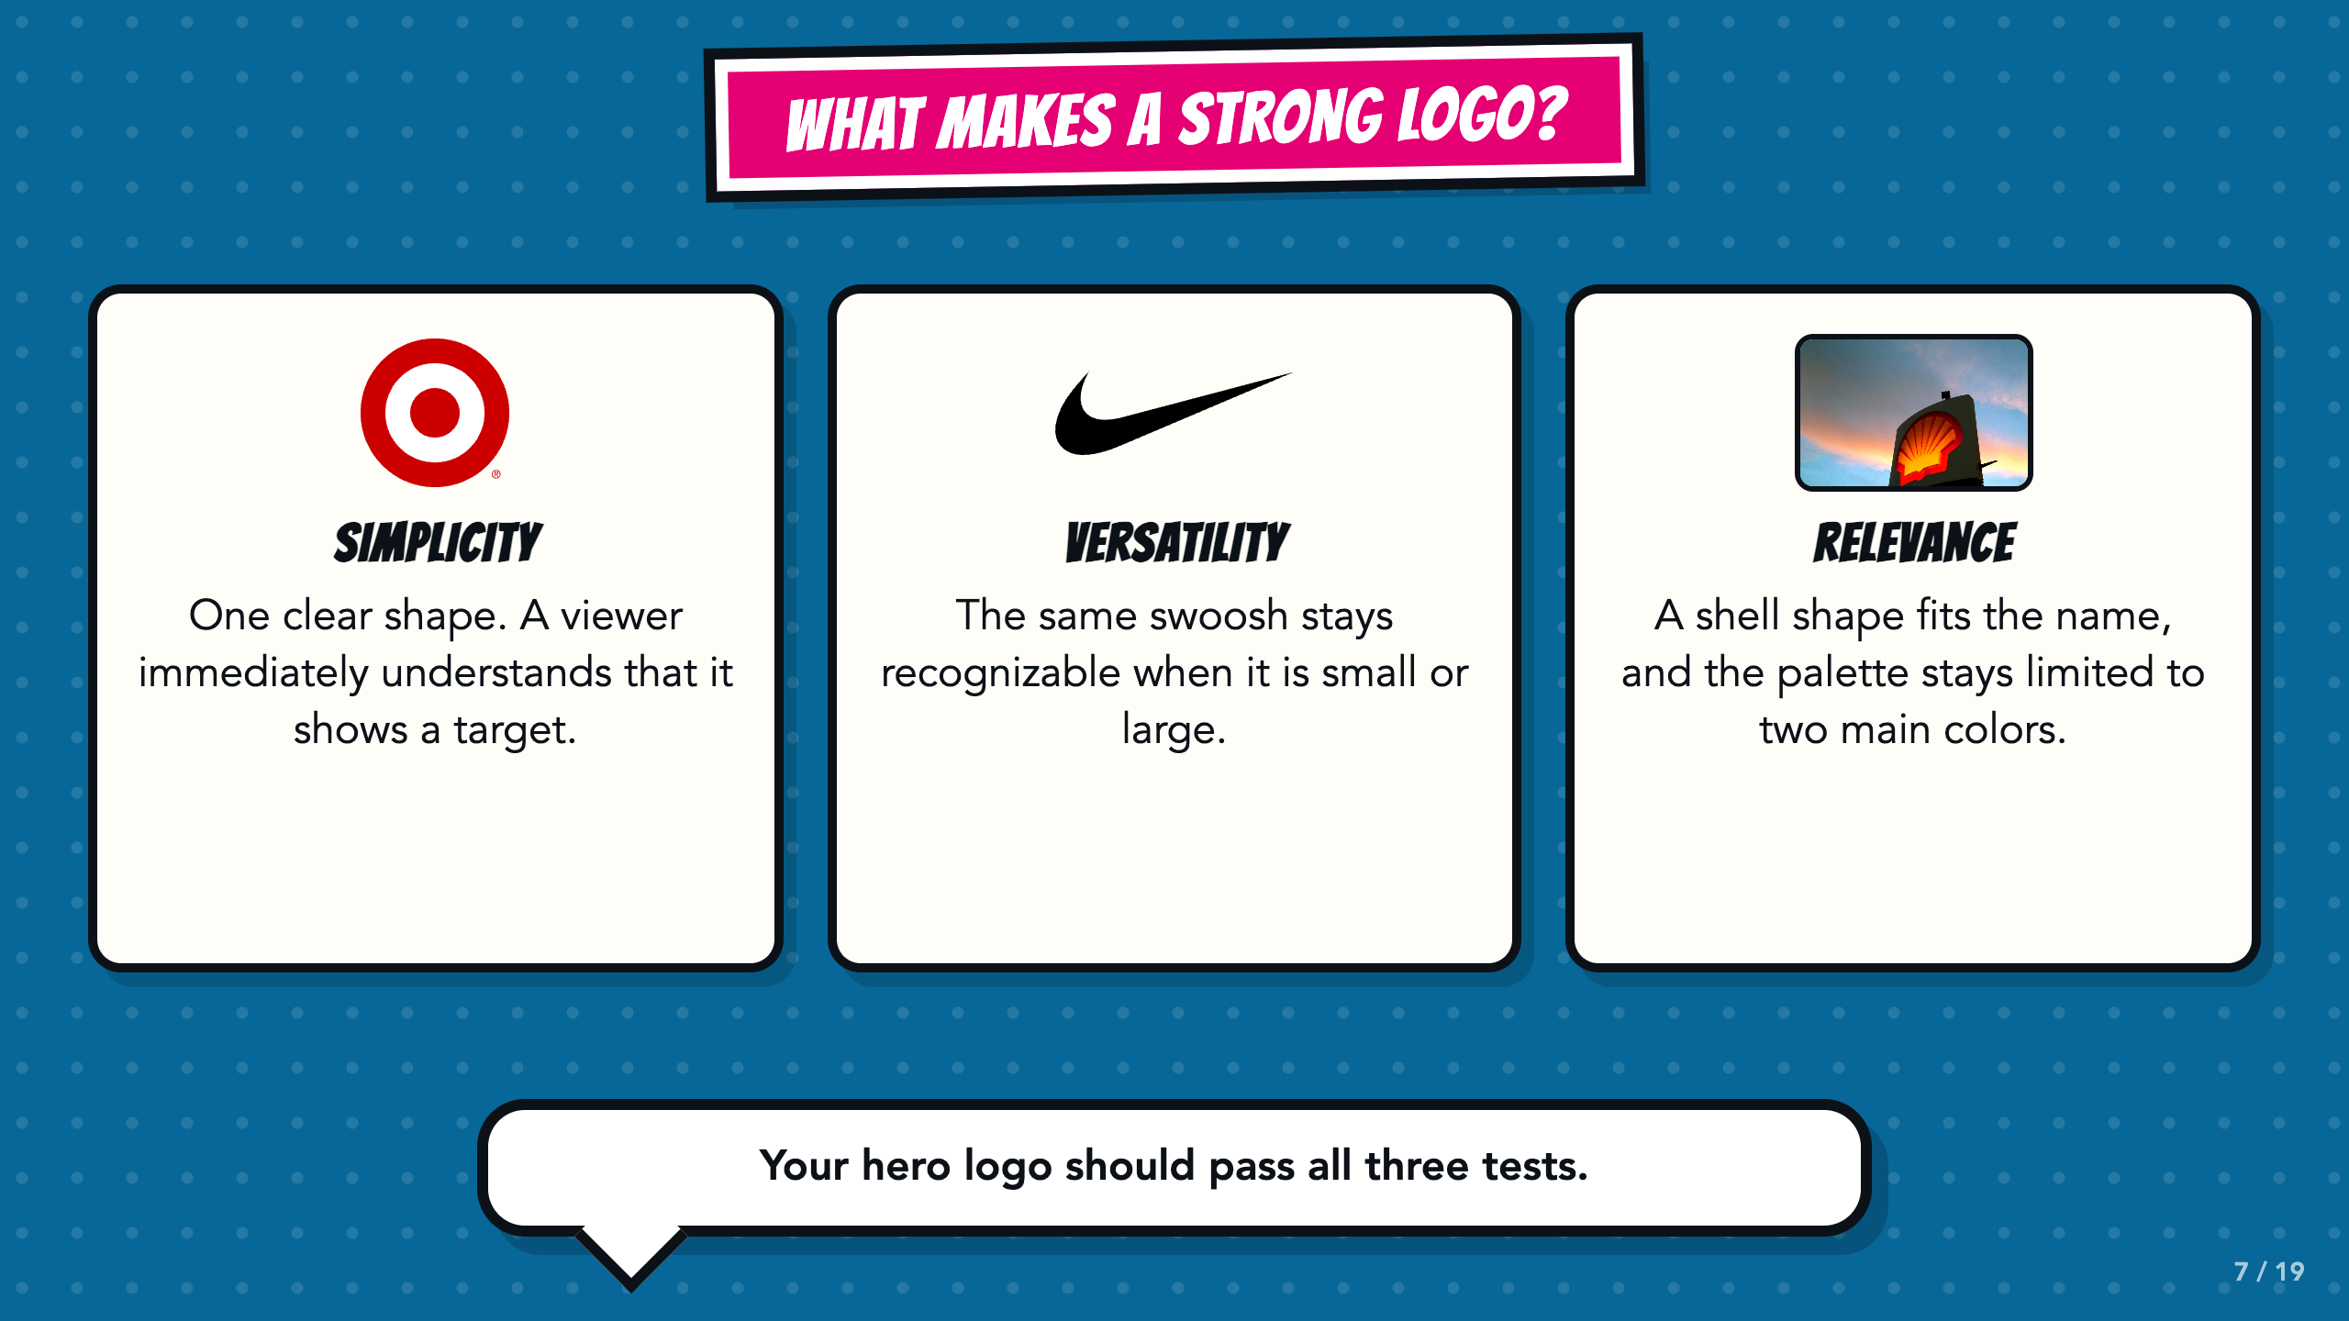
Notes:
Teach the three criteria through the visible real-world examples. Target demonstrates simplicity because the mark is one easily understood bullseye. Nike demonstrates versatility because the same simple swoosh remains recognizable at different sizes. The Shell sign demonstrates relevance through a symbol tied to the name and a limited two-color palette. These examples are used for design analysis, not endorsement.
[Sources]
- Course author's Smart Solutions superhero reference materials.
- Course author-approved Comics Lesson 4 requirements and success criteria.
- Target bullseye logo, Target Corporation, public-domain simple geometric logo; trademarked: https://commons.wikimedia.org/wiki/File:Target_Corporation_logo.svg
- Nike Swoosh by Carolyn Davidson, public-domain simple logo in the United States; trademarked: https://commons.wikimedia.org/wiki/File:Nike_sport_logo.svg
- Shell logo photograph by Nopple, CC0 1.0: https://commons.wikimedia.org/wiki/File:Shell_logo.jpg

Slide 8
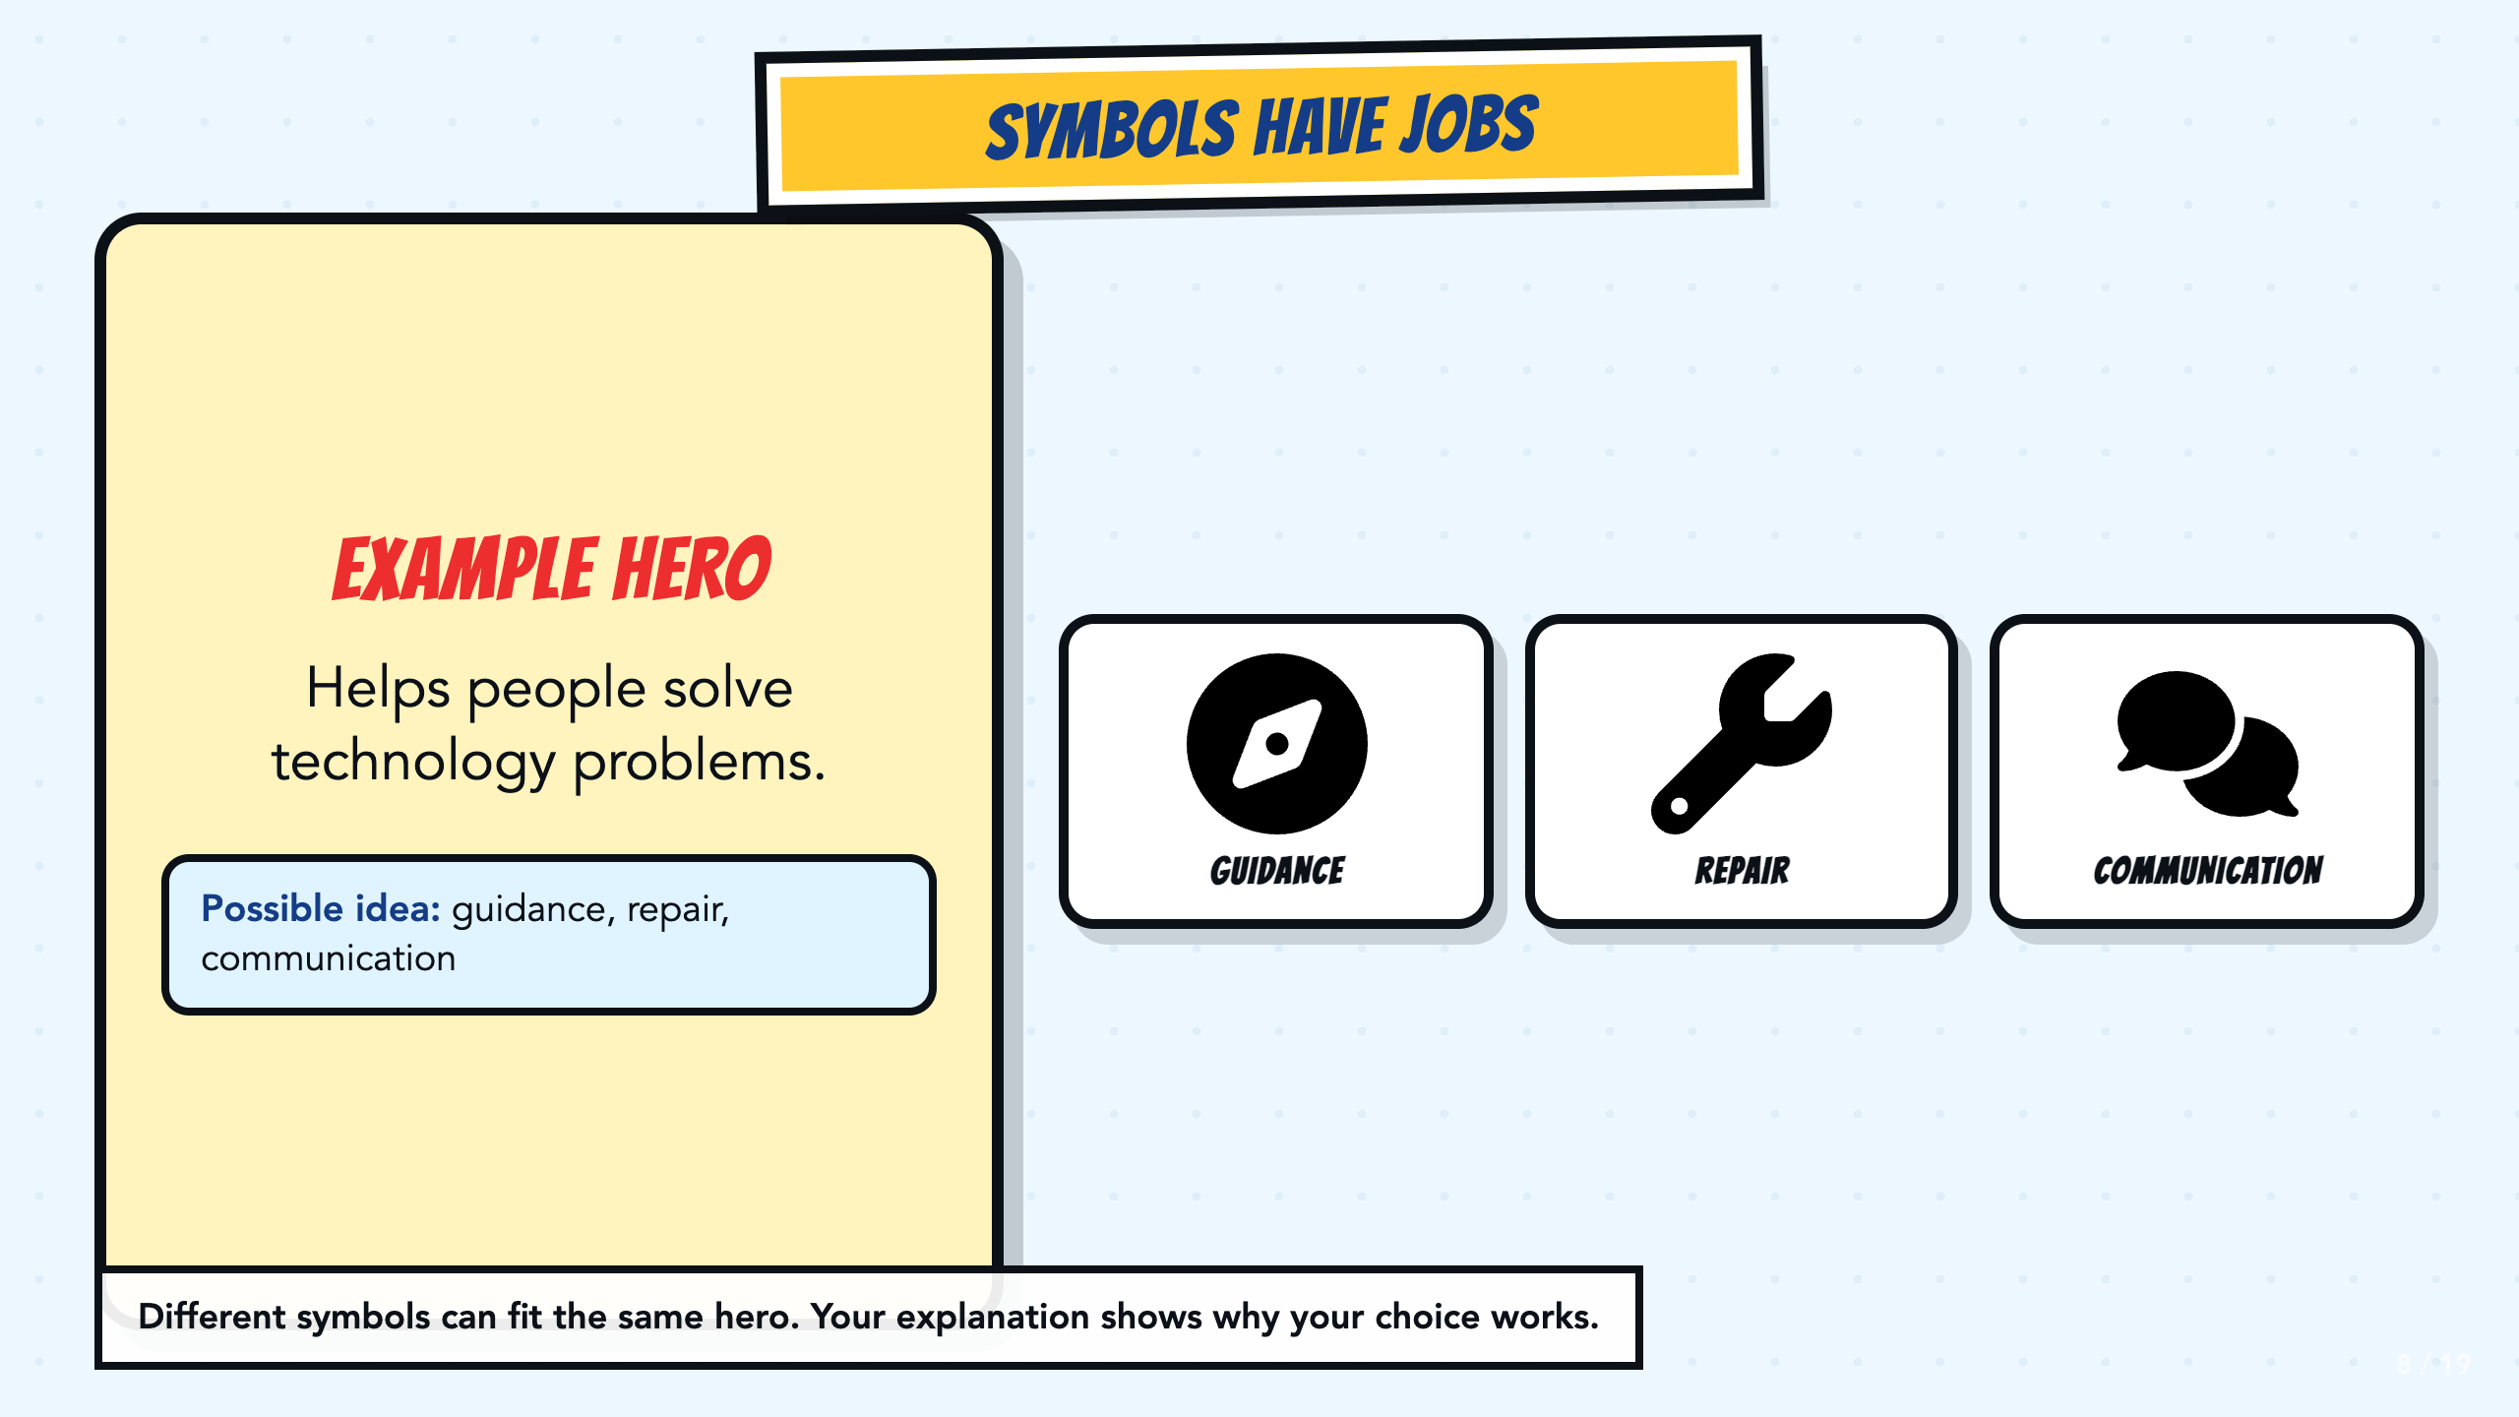
Notes:
Model divergent thinking: one hero purpose can produce several valid symbols. Require students to explain why their selected symbol fits.
[Sources]
- Course author's Smart Solutions superhero reference materials.
- Course author-approved Comics Lesson 4 requirements and success criteria.
- Font Awesome Free solid icons, Fonticons, Inc., CC BY 4.0: https://fontawesome.com/license/free

Slide 9
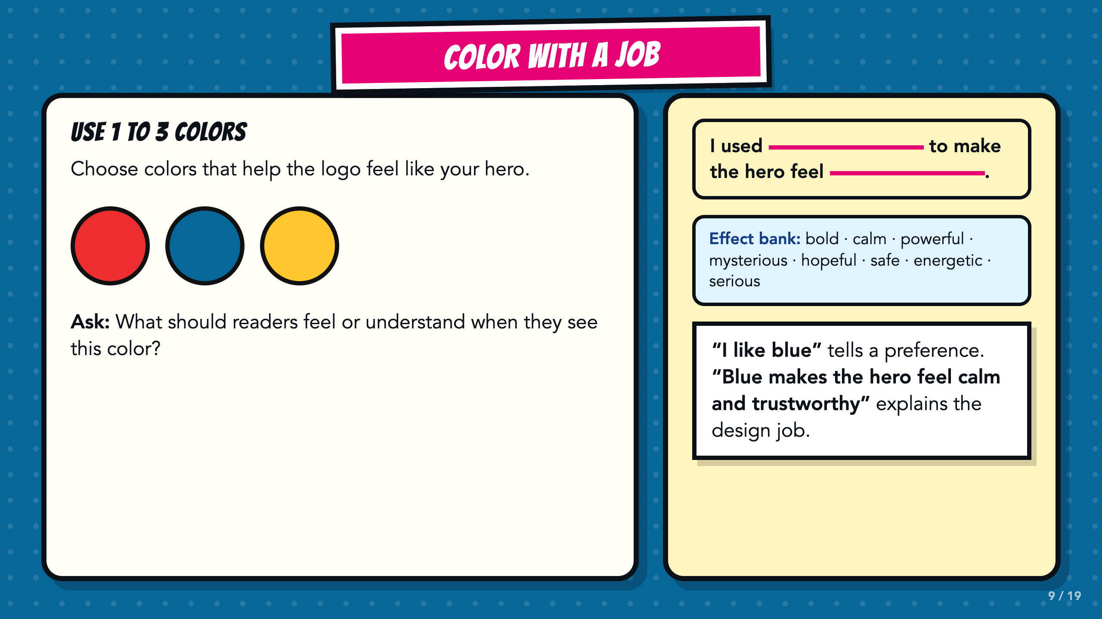
Notes:
Ask for an intended effect, not a universal color meaning. Color interpretation changes by context and culture. Personal preference alone does not explain the design job.
[Sources]
- Course author's Smart Solutions superhero reference materials.
- Course author-approved Comics Lesson 4 requirements and success criteria.

Slide 10
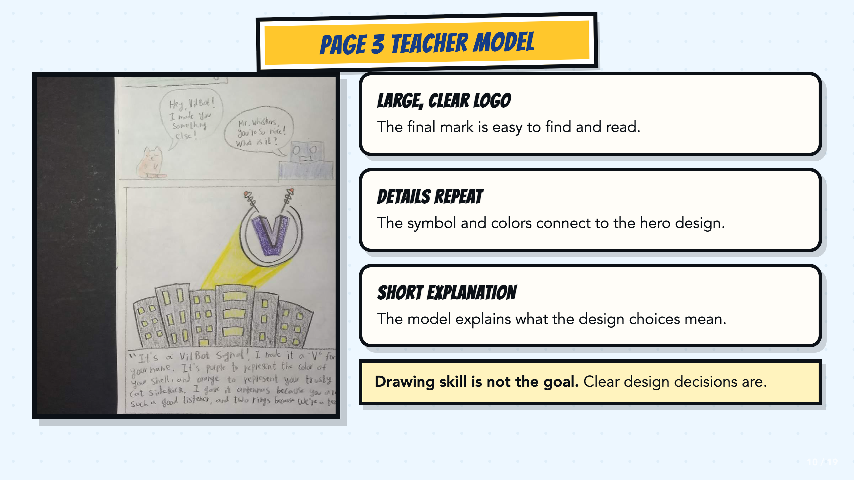
Notes:
Use this teacher model to make the outcome concrete. Point out the large final mark, repeated details, and explanation. Drawing skill is not the scoring target.
[Sources]
- Course author's Smart Solutions superhero reference materials.
- Teacher-created VilBot Page 3 model supplied by the course author.

Slide 11
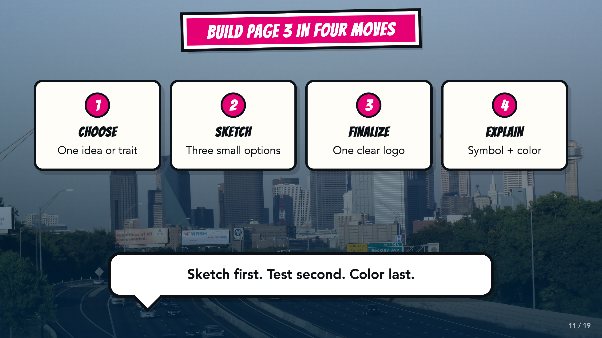
Notes:
Preview all four moves before students begin. Sketch first, test second, color last.
[Sources]
- Course author's Smart Solutions superhero reference materials.
- Course author-approved Comics Lesson 4 requirements and success criteria.
- Dallas skyline photograph by medea_material, CC BY 2.0: https://commons.wikimedia.org/wiki/File:Skyline_of_Dallas,_TX.jpg

Slide 12
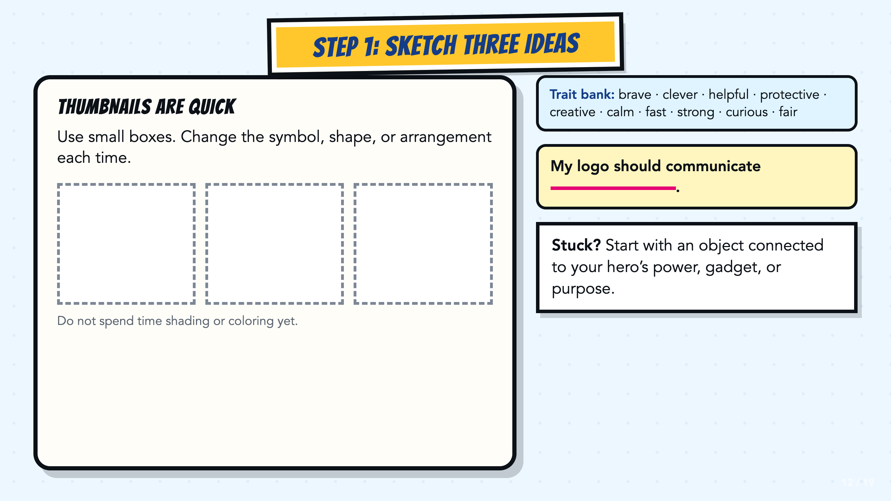
Notes:
Set a short sketch window if useful for your room. Students should change the symbol, shape, or arrangement across three thumbnails.
[Sources]
- Course author's Smart Solutions superhero reference materials.
- Course author-approved Comics Lesson 4 requirements and success criteria.

Slide 13
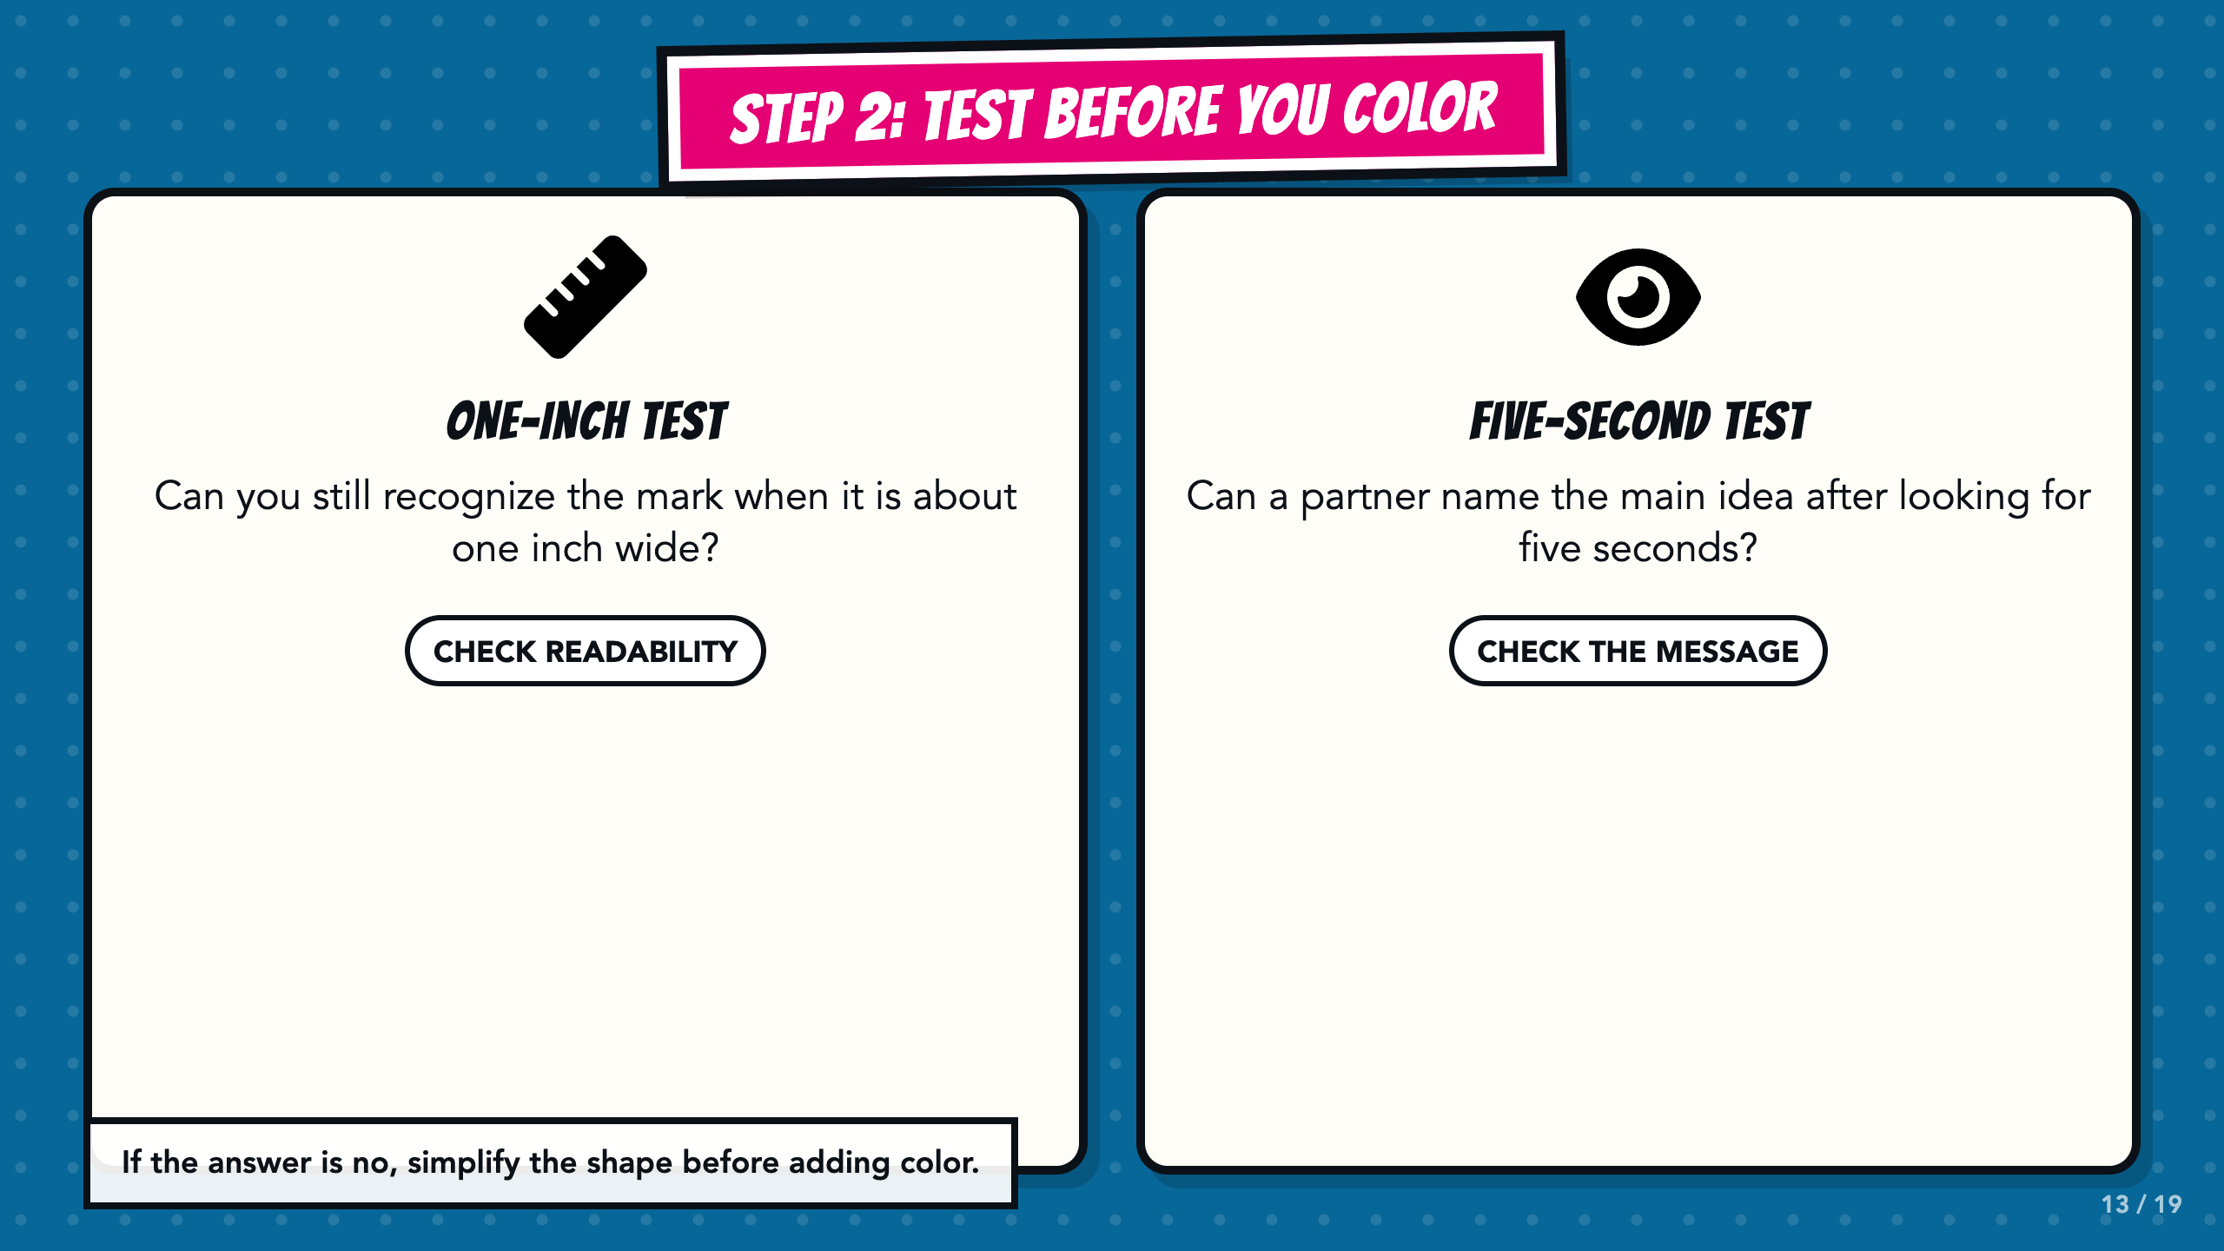
Notes:
Run both tests before students add color. The one-inch test checks readability; the five-second test checks whether the intended idea is visible.
[Sources]
- Course author's Smart Solutions superhero reference materials.
- Course author-approved Comics Lesson 4 requirements and success criteria.
- Font Awesome Free solid icons, Fonticons, Inc., CC BY 4.0: https://fontawesome.com/license/free

Slide 14
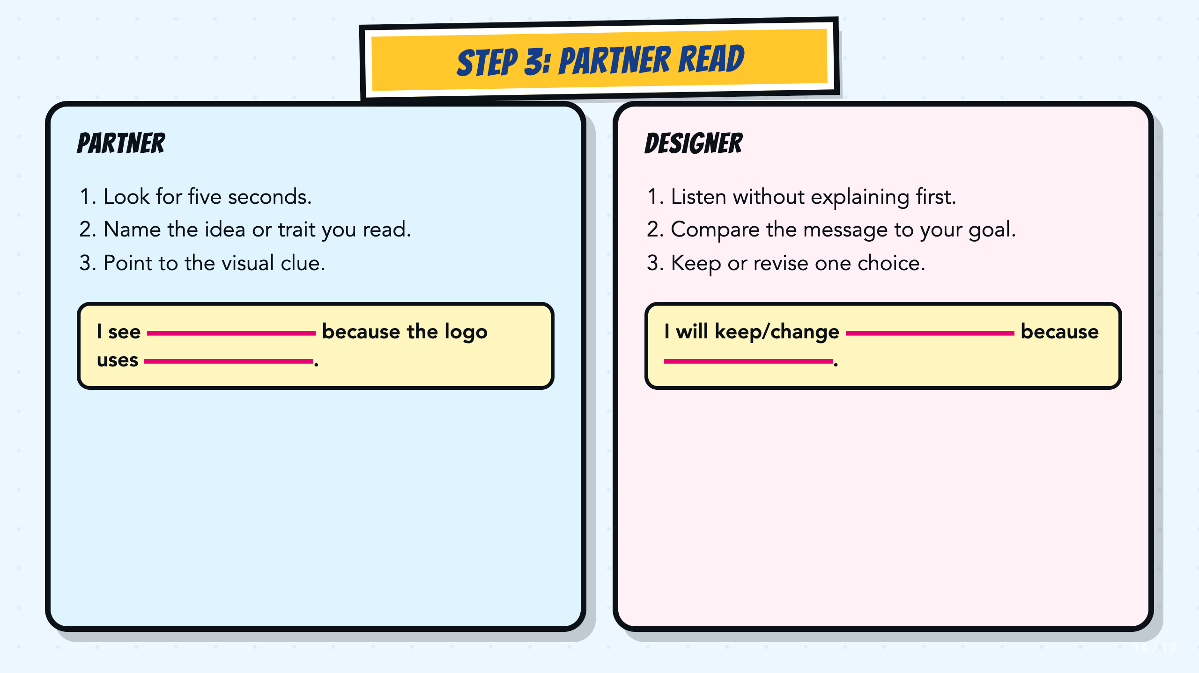
Notes:
The partner speaks before the designer explains. The designer then decides what evidence to use and what to revise.
[Sources]
- Course author's Smart Solutions superhero reference materials.
- Course author-approved Comics Lesson 4 requirements and success criteria.

Slide 15
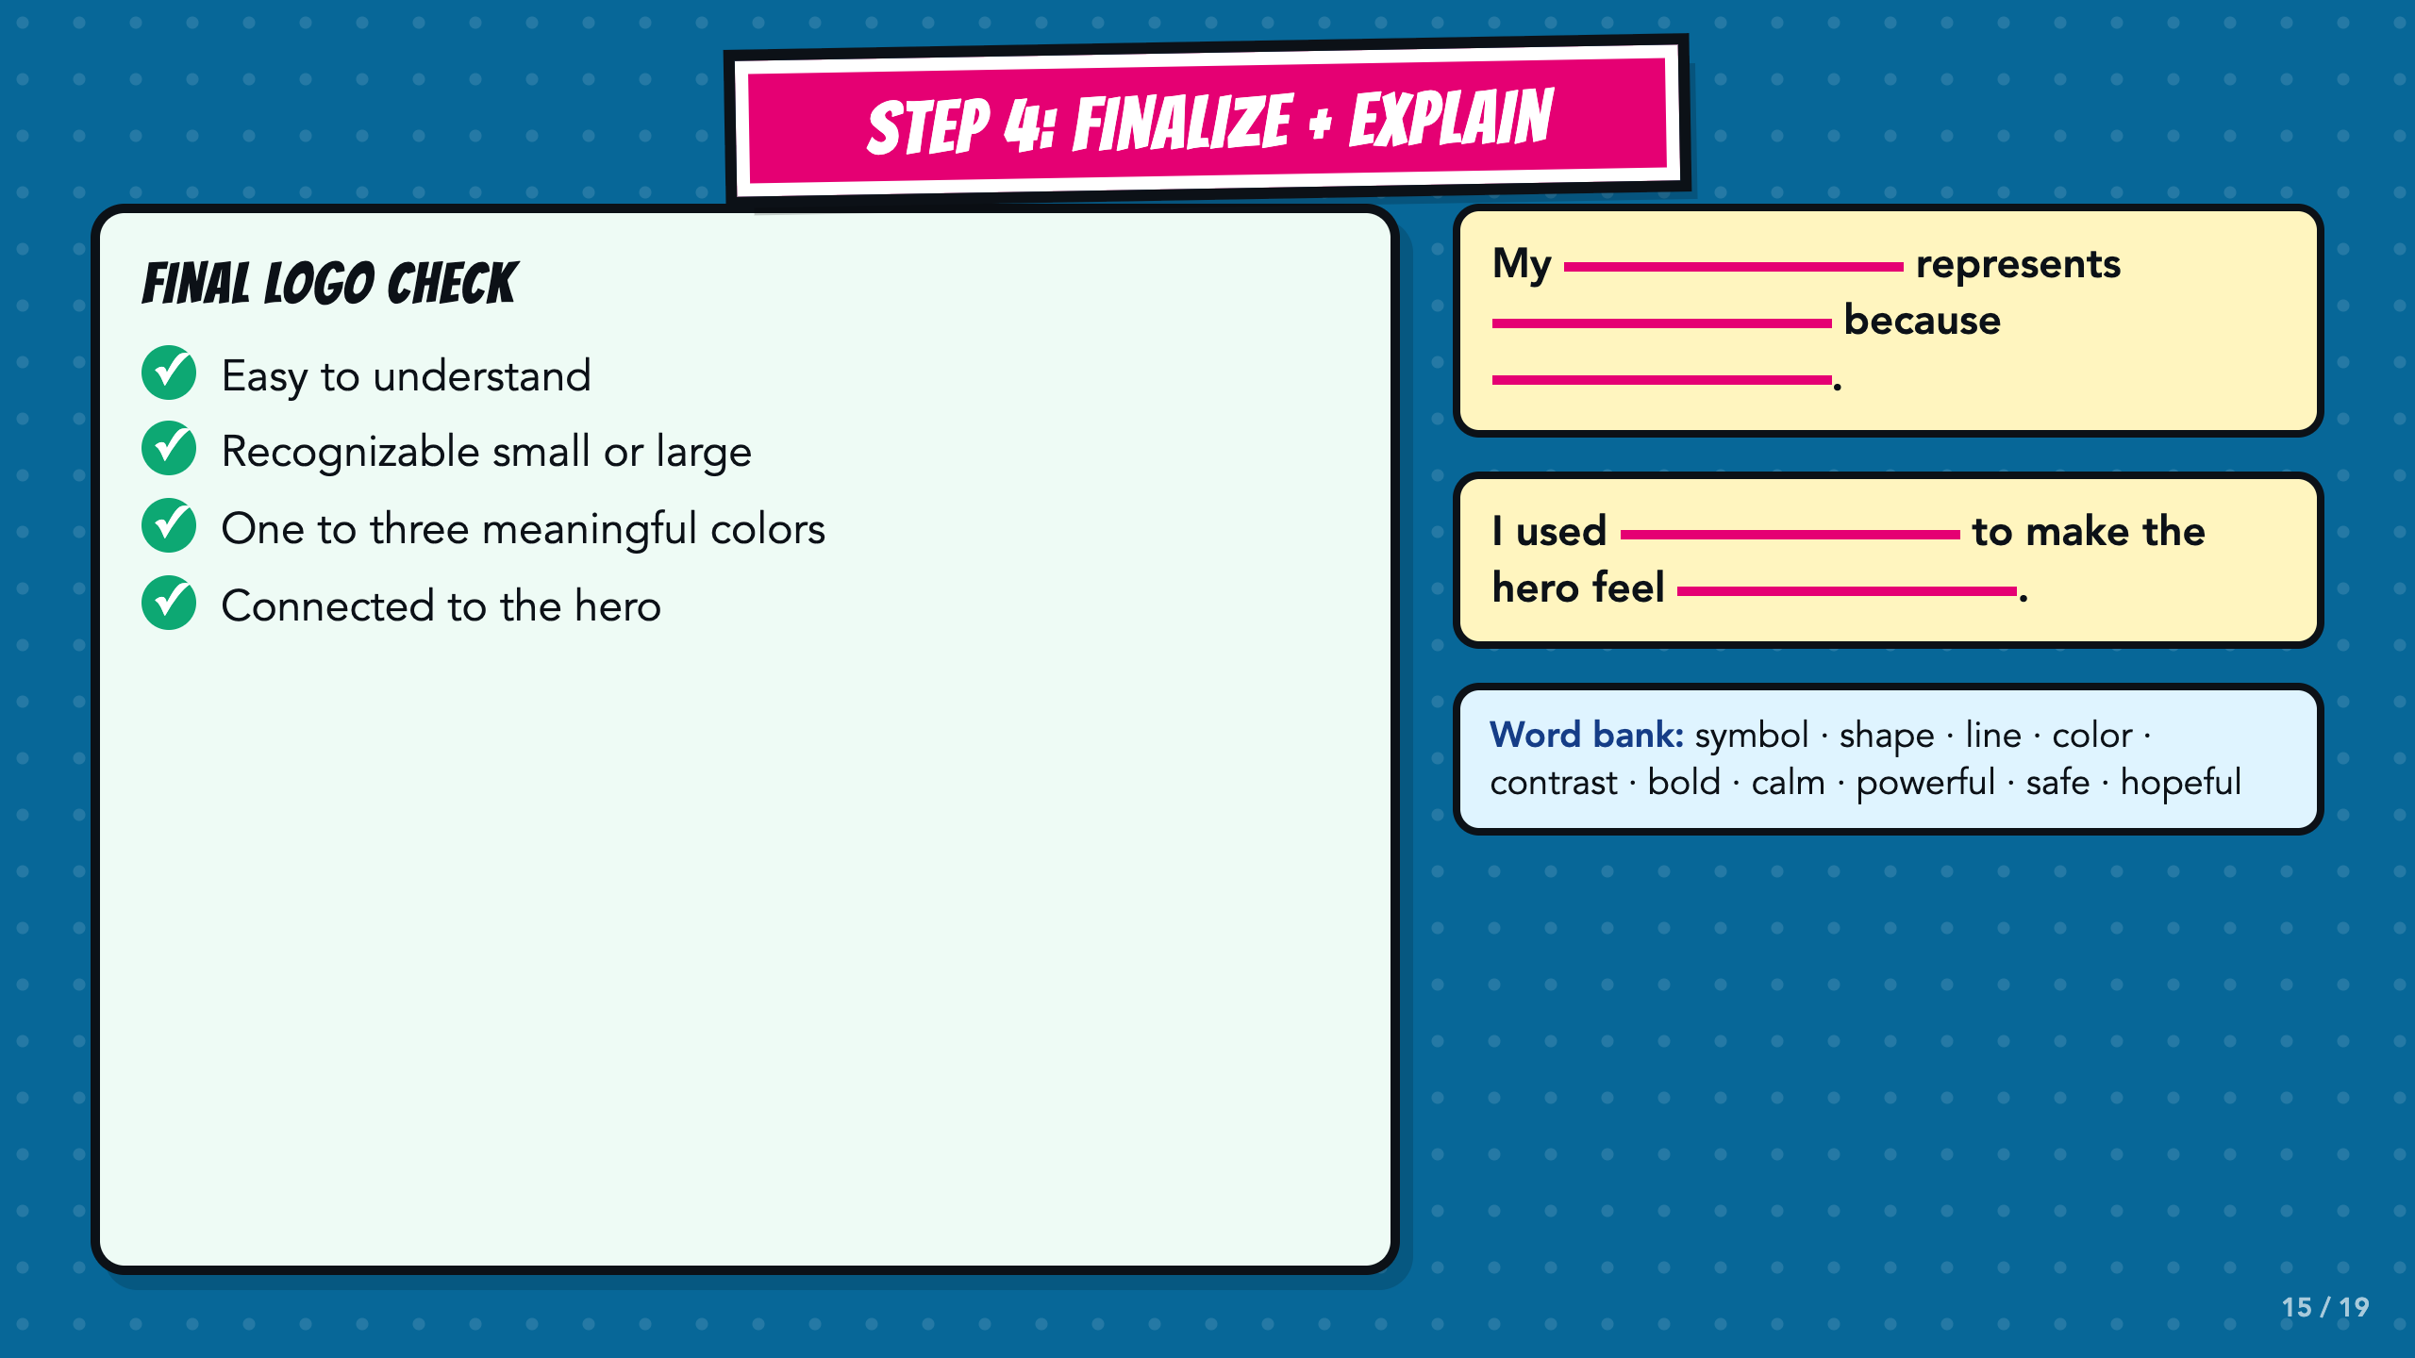
Notes:
Require one symbol explanation and one color explanation. Use the final check to reinforce simplicity, versatility, and relevance. Keep the word bank and sentence stems available for emerging bilingual students.
[Sources]
- Course author's Smart Solutions superhero reference materials.
- Course author-approved Comics Lesson 4 requirements and success criteria.

Slide 16
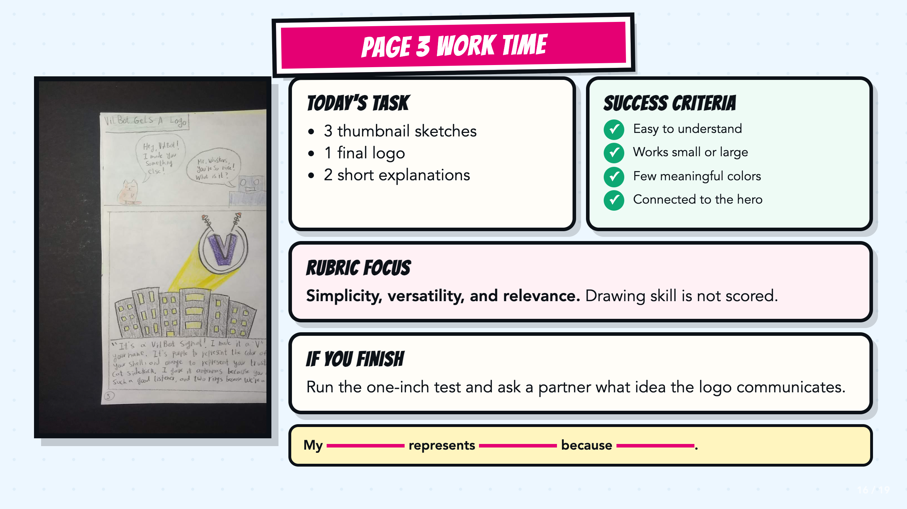
Notes:
Leave this slide projected during independent or partner work. It holds the task, success criteria, rubric focus, next step, sentence stem, and teacher model without prescribing room routines.
[Sources]
- Course author's Smart Solutions superhero reference materials.
- Course author-approved Comics Lesson 4 requirements and success criteria.
- Teacher-created VilBot Page 3 model supplied by the course author.

Slide 17
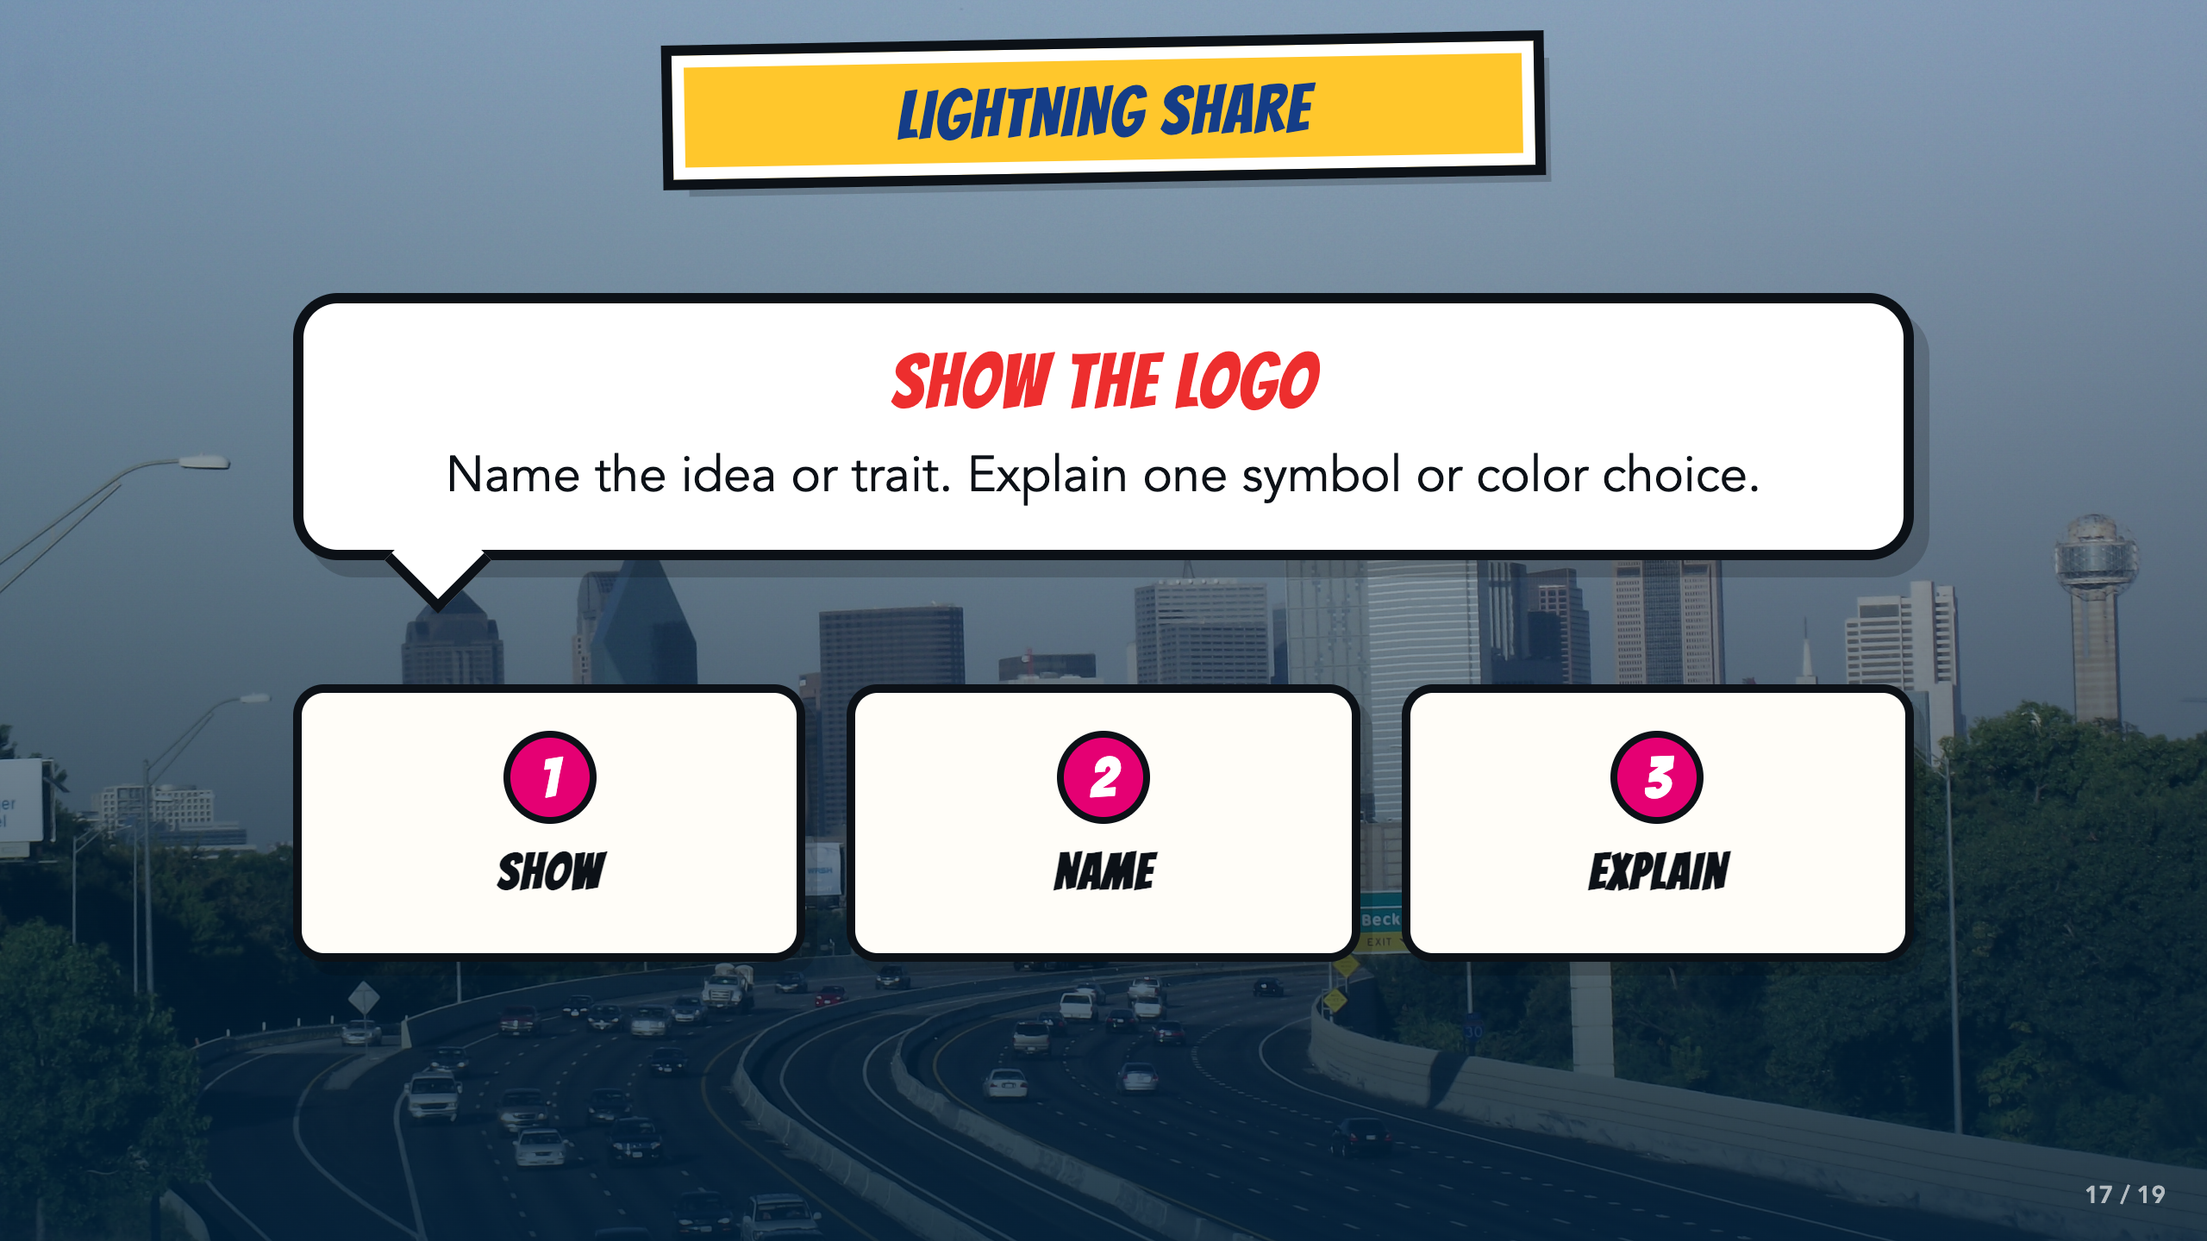
Notes:
Keep shares brief: show the logo, name the idea or trait, and explain one choice. A small sample is enough when time is short.
[Sources]
- Course author's Smart Solutions superhero reference materials.
- Course author-approved Comics Lesson 4 requirements and success criteria.
- Dallas skyline photograph by medea_material, CC BY 2.0: https://commons.wikimedia.org/wiki/File:Skyline_of_Dallas,_TX.jpg

Slide 18
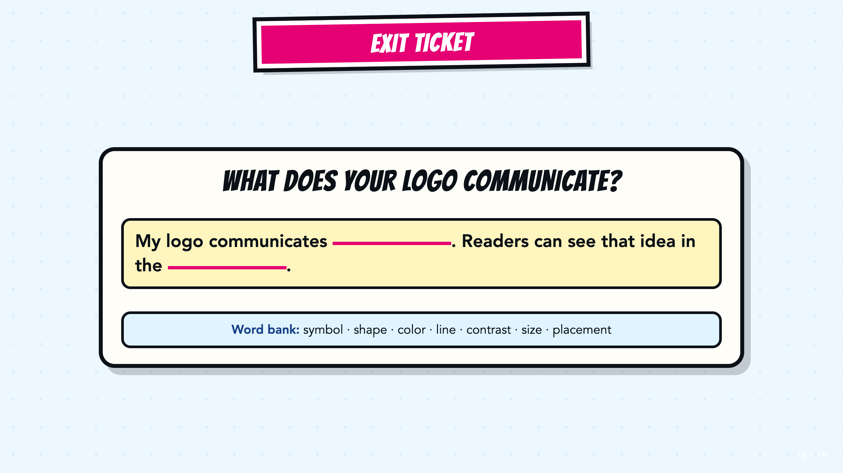
Notes:
Use the exit stem in Canvas or on paper. Accept a symbol, shape, color, line, contrast, size, or placement as the visible evidence.
[Sources]
- Course author's Smart Solutions superhero reference materials.
- Course author-approved Comics Lesson 4 requirements and success criteria.

Slide 19
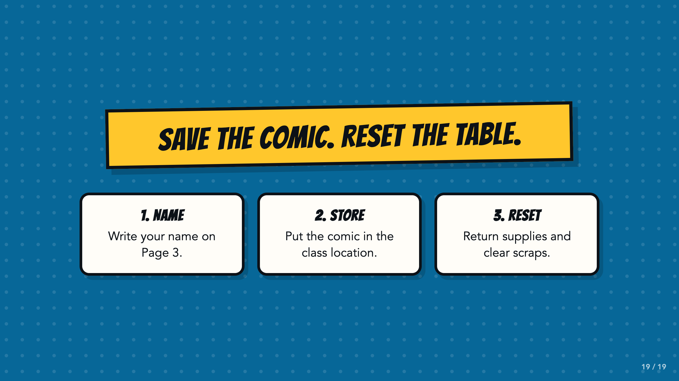
Notes:
Use or adapt this reset routine. The lower area stays open for a teacher-specific room reminder.
[Sources]
- Course author's Smart Solutions superhero reference materials.
- Course author-approved Comics Lesson 4 requirements and success criteria.

