Slide 1
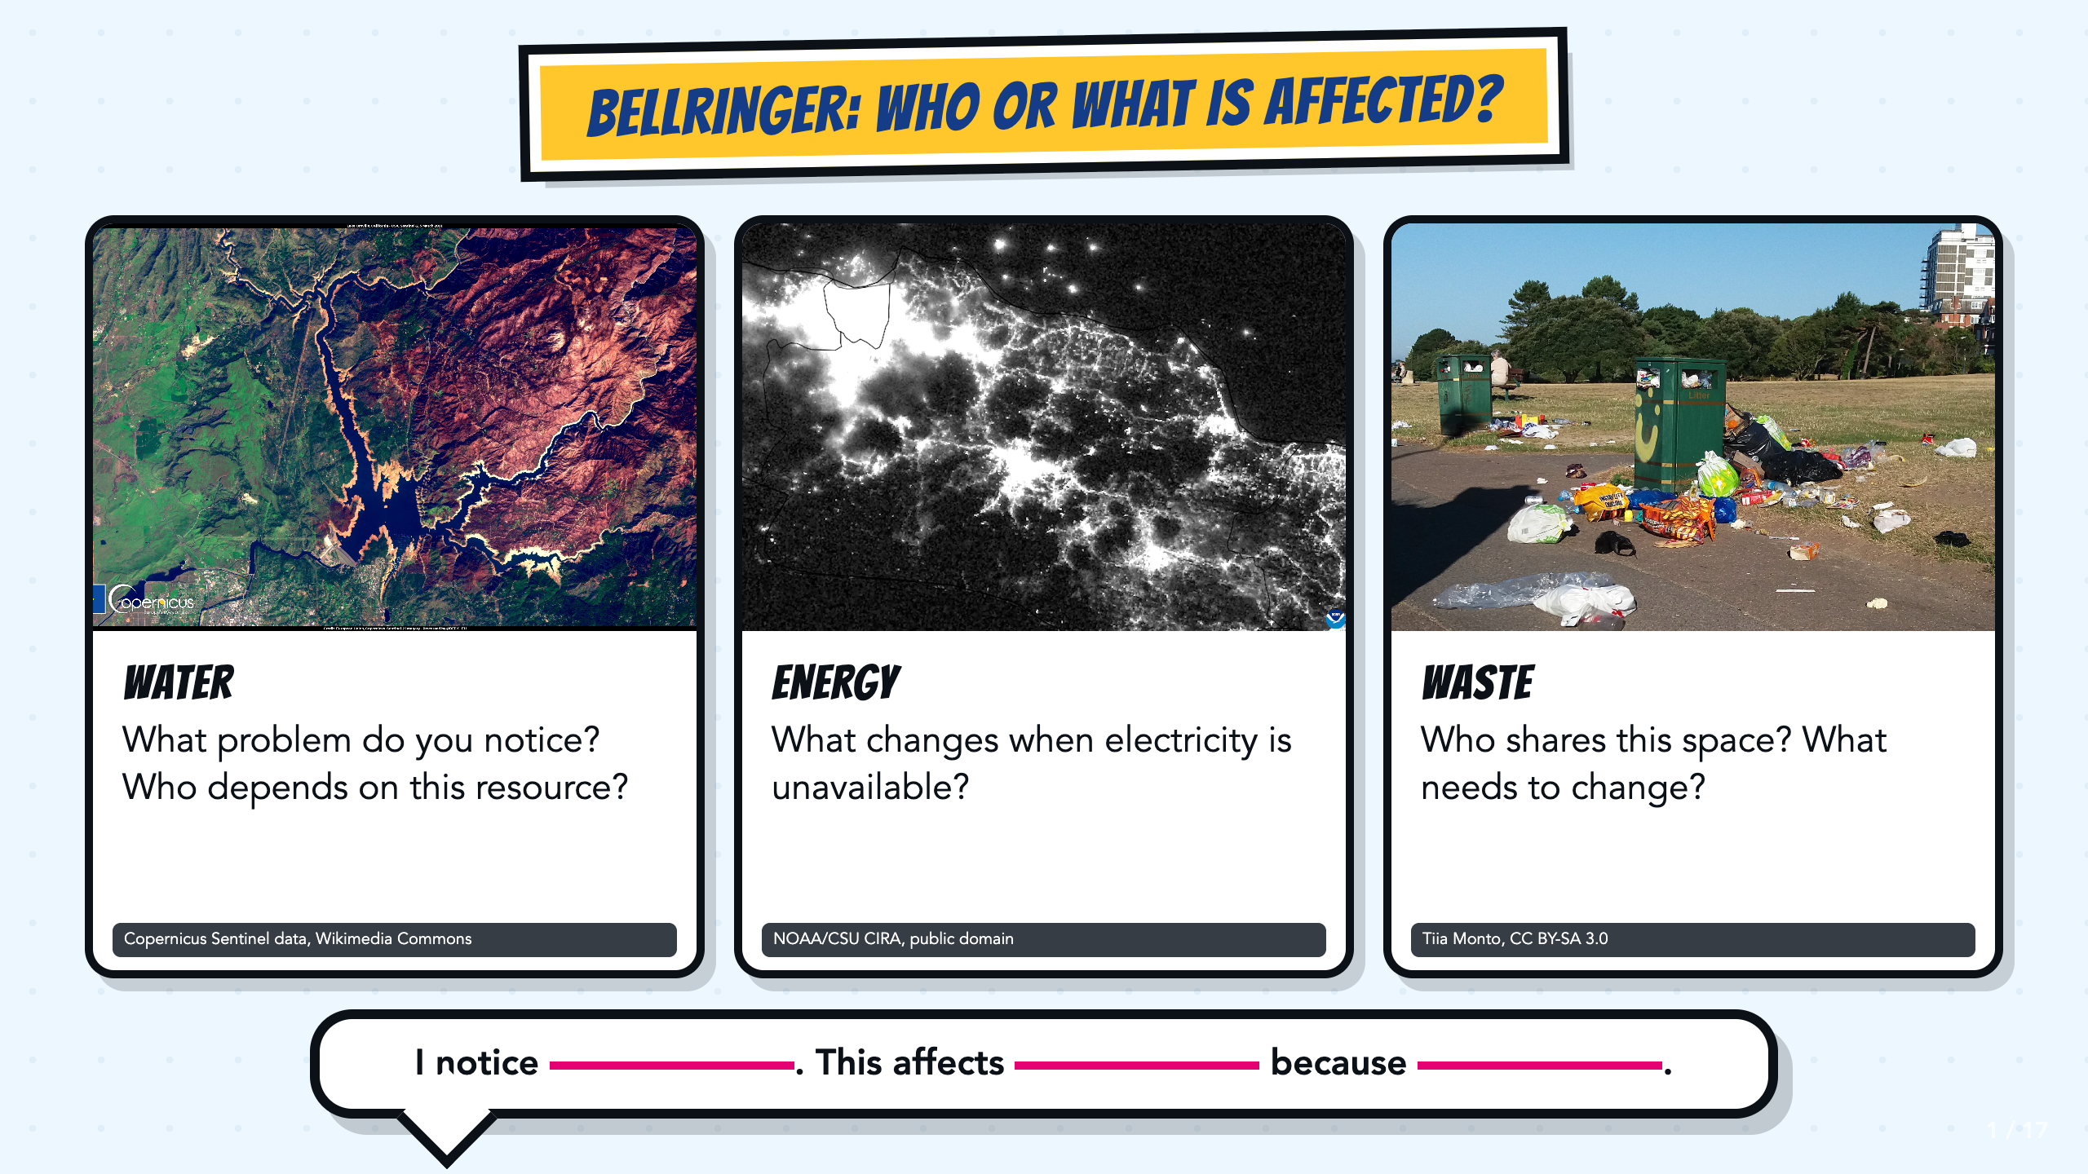
Notes:
Give students one minute to study all three photographs. Let them name what they notice before asking who or what is affected. Use the sentence stem for a quick write, partner share, or call-out.
[Sources]
- Copernicus Sentinel data, Severe drought in California, USA, Wikimedia Commons: https://commons.wikimedia.org/wiki/File:Severe_drought_in_California,_USA.jpg
- NOAA/CSU CIRA, Power Blackout on Java in Indonesia, public domain, Wikimedia Commons: https://commons.wikimedia.org/wiki/File:Power_Blackout_on_Java_in_Indonesia_(CIRA_2019-08-04_-_201908041806_n20-snpp_viirs_dnb_javablackout_nolabels0).png
- Tiia Monto, Trash in park, CC BY-SA 3.0, Wikimedia Commons: https://commons.wikimedia.org/wiki/File:Trash_in_park.jpg

Slide 2
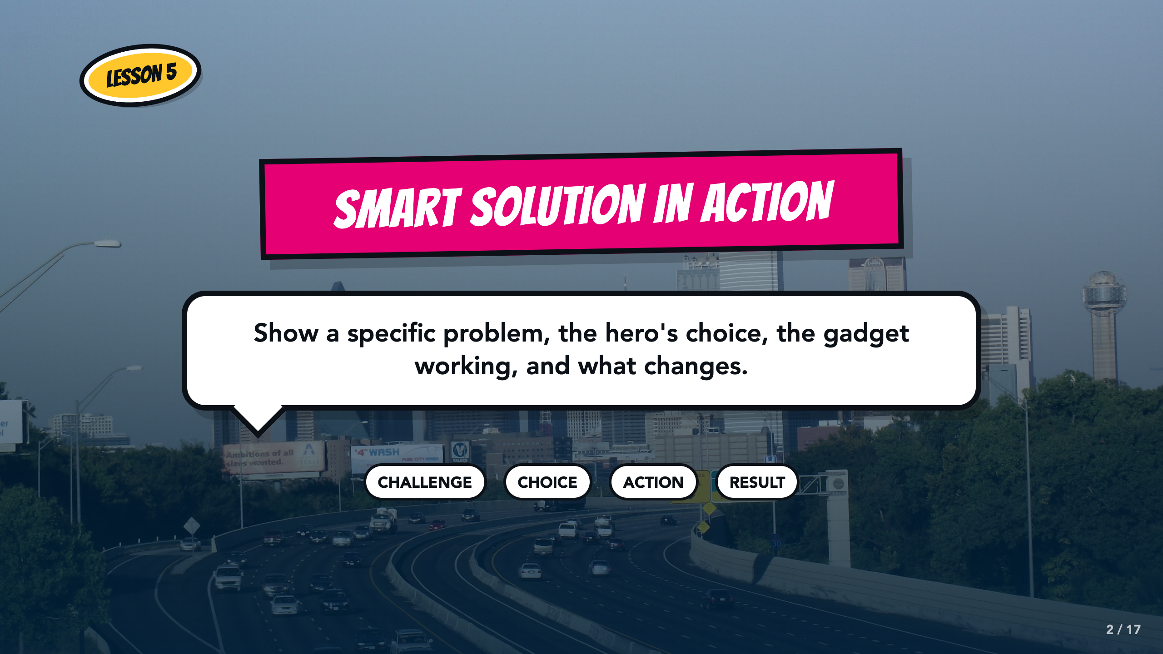
Notes:
Frame the final comic page as a cause-and-effect sequence. Students will show the challenge, the hero's choice, the gadget action, and a visible result.
[Sources]
- medea_material, Skyline of Dallas, TX, CC BY 2.0, Wikimedia Commons: https://commons.wikimedia.org/wiki/File:Skyline_of_Dallas,_TX.jpg
- ASU Identifying Challenges in Your Communities facilitator guide, teacher copy: https://docs.google.com/document/d/1JwuSSRtIizdjKJ0lHQR75Gyxw0ZuNVdKZGZQwXzeGbA/copy

Slide 3
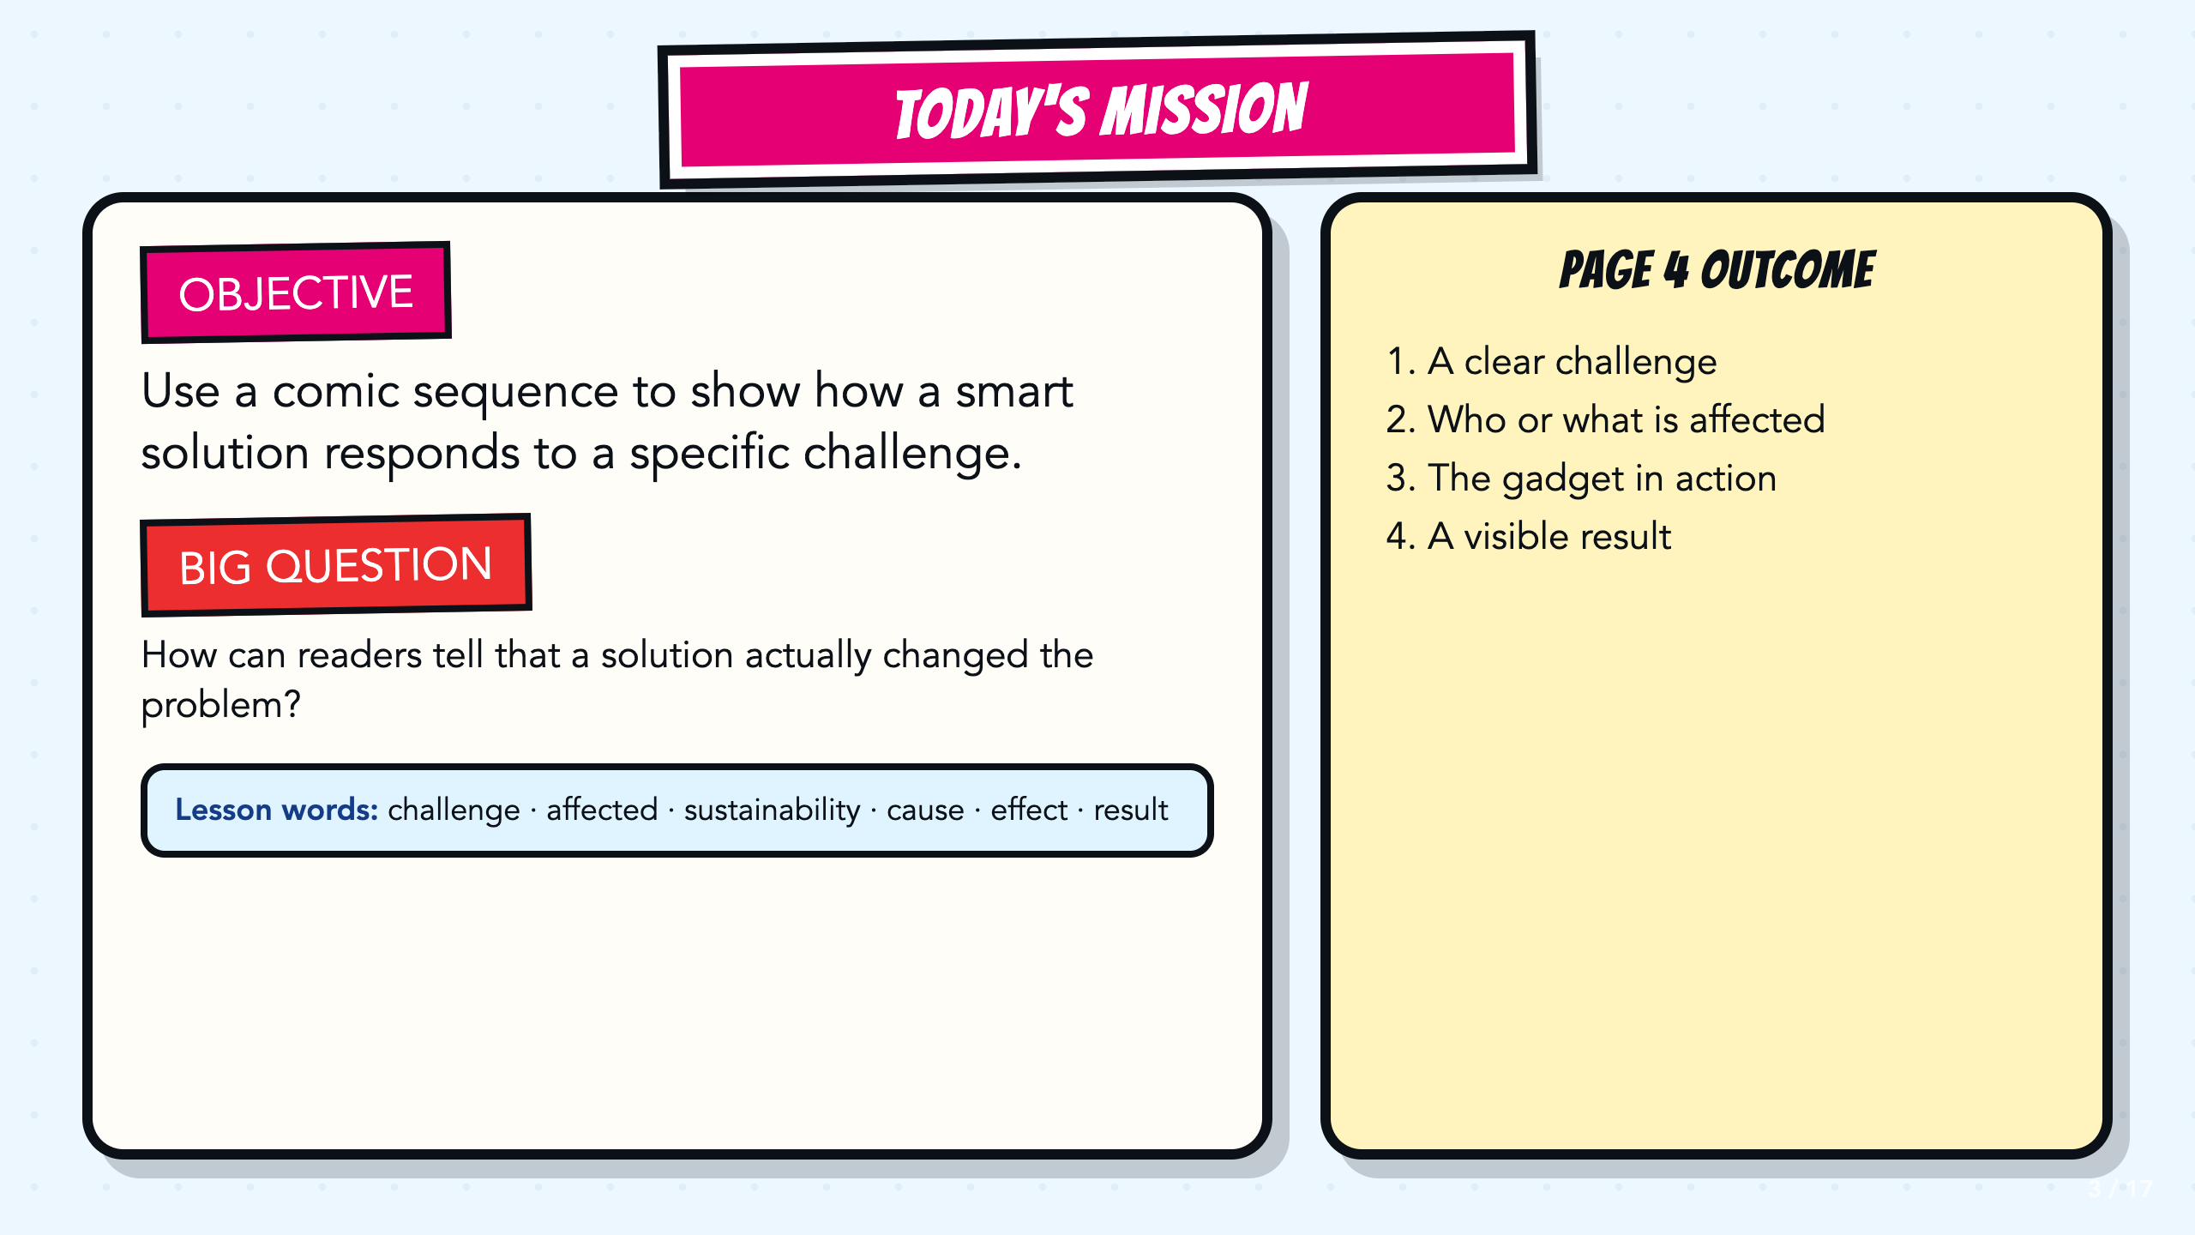
Notes:
Read the objective and Page 4 outcome aloud. Ask students to point to the page in their comic where today's work belongs.
[Sources]
- ASU Identifying Challenges in Your Communities facilitator guide, teacher copy: https://docs.google.com/document/d/1JwuSSRtIizdjKJ0lHQR75Gyxw0ZuNVdKZGZQwXzeGbA/copy
- ASU Identifying Challenges in Your Communities presentation, teacher copy: https://docs.google.com/presentation/d/1OIJnbxQIhfM9WmfXTnHTuC5i_WKXaqkO9k0SUvDGvp0/copy

Slide 4
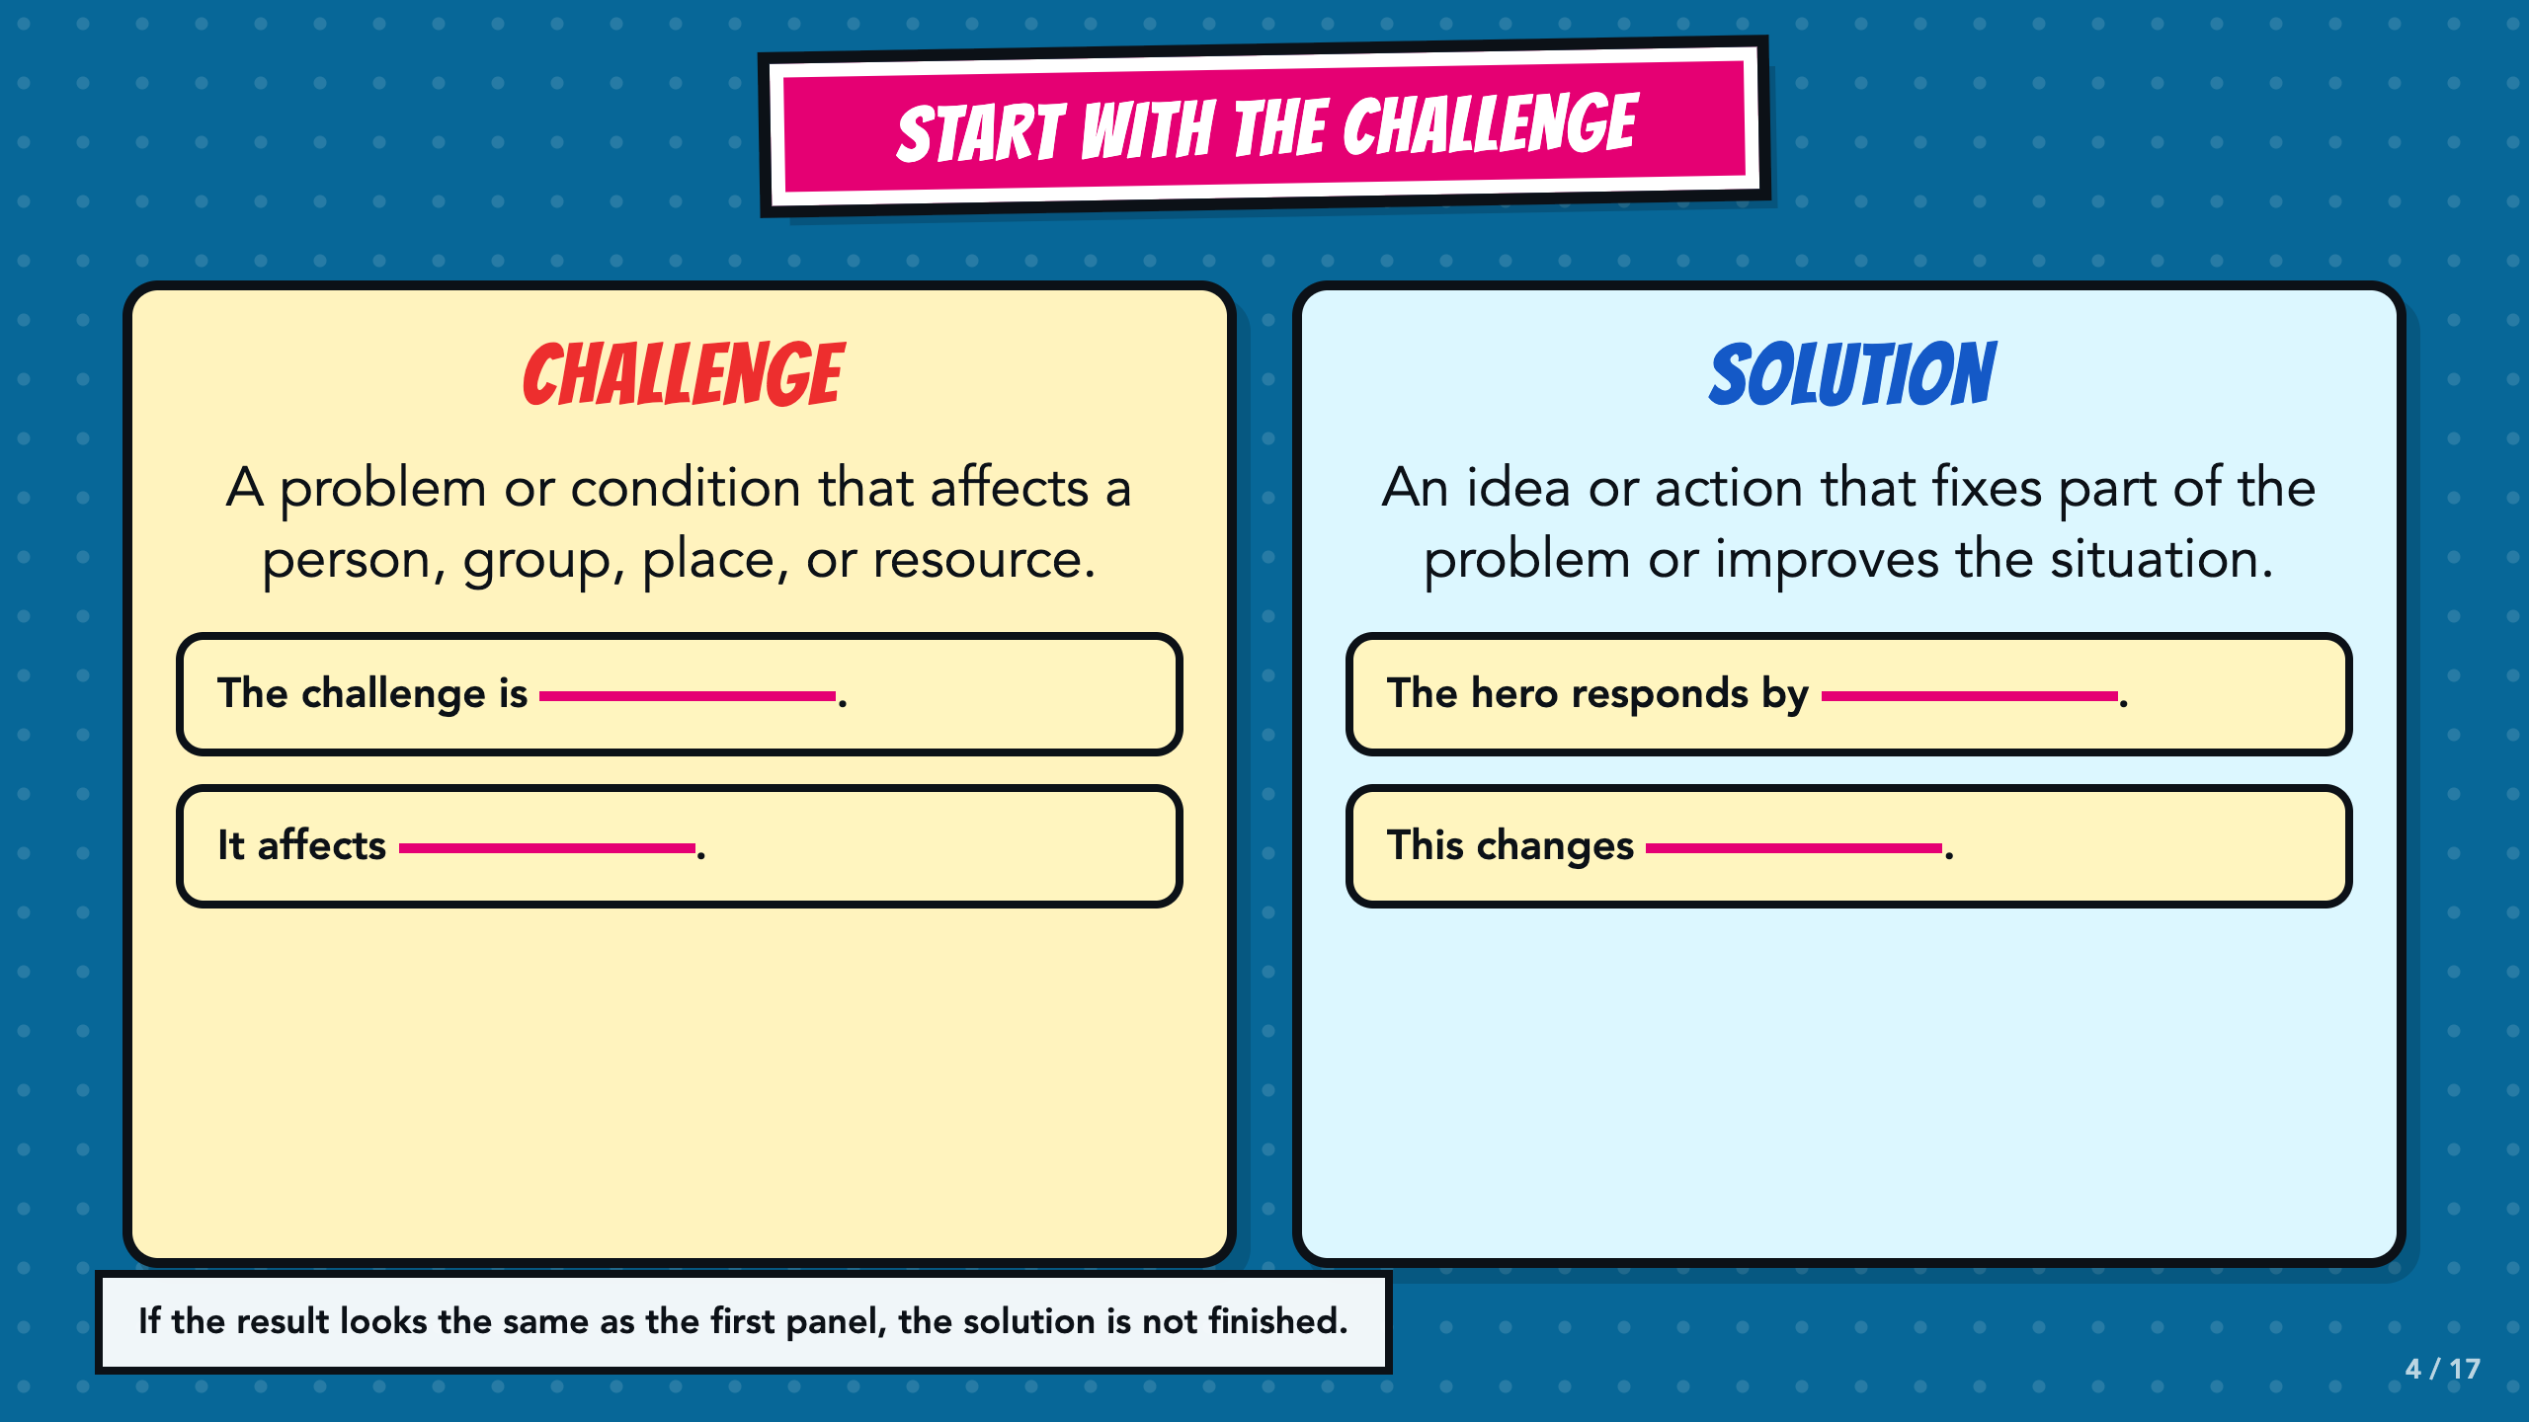
Notes:
Build the two definitions from student examples. A challenge affects someone or something. A solution improves at least part of that situation. Return to the bottom check whenever a result is unclear.
[Sources]
- ASU Identifying Challenges in Your Communities facilitator guide, teacher copy: https://docs.google.com/document/d/1JwuSSRtIizdjKJ0lHQR75Gyxw0ZuNVdKZGZQwXzeGbA/copy
- ASU Identifying Challenges in Your Communities presentation, teacher copy: https://docs.google.com/presentation/d/1OIJnbxQIhfM9WmfXTnHTuC5i_WKXaqkO9k0SUvDGvp0/copy

Slide 5
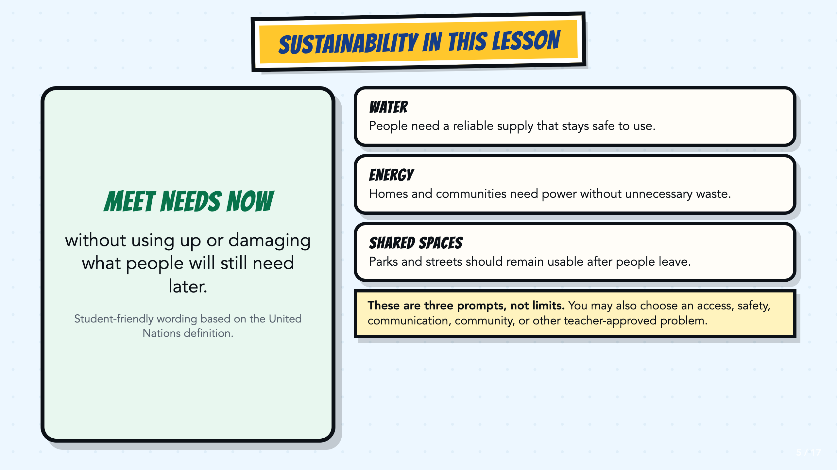
Notes:
Keep sustainability narrow and concrete here: meeting a need now while protecting what people will still need later. Make clear that water, energy, and shared-space challenges are optional prompts. Students may instead use an approved access, safety, communication, community, or other problem that fits their existing hero and gadget.
[Sources]
- United Nations, What is sustainable development?: https://www.un.org/sustainabledevelopment/blog/2023/08/what-is-sustainable-development/
- ASU + Verizon Mapping Sustainability facilitator guide, teacher copy: https://docs.google.com/document/d/1u8MFHRMjT4c-NuFj85K5bi6QhyX8Rx6O/copy

Slide 6
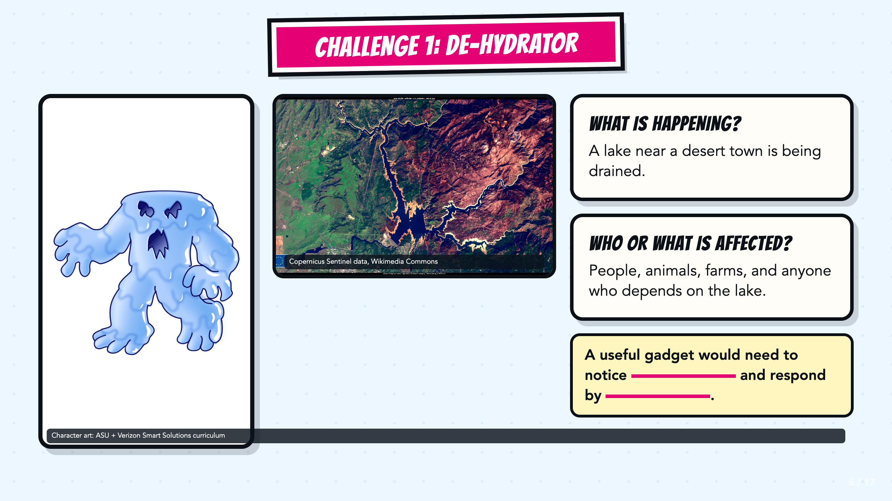
Notes:
Read the drought context, then have partners finish the stem with one kind of information a gadget could receive and one useful response. Accept several workable solutions.
[Sources]
- Copernicus Sentinel data, Severe drought in California, USA, Wikimedia Commons: https://commons.wikimedia.org/wiki/File:Severe_drought_in_California,_USA.jpg
- ASU + Verizon Mapping Sustainability facilitator guide, teacher copy: https://docs.google.com/document/d/1u8MFHRMjT4c-NuFj85K5bi6QhyX8Rx6O/copy
- ASU + Verizon Mapping Sustainability presentation, teacher copy: https://docs.google.com/presentation/d/1wLmWv11evu872SNgYDrXIUlDrSCTgHGU/copy

Slide 7
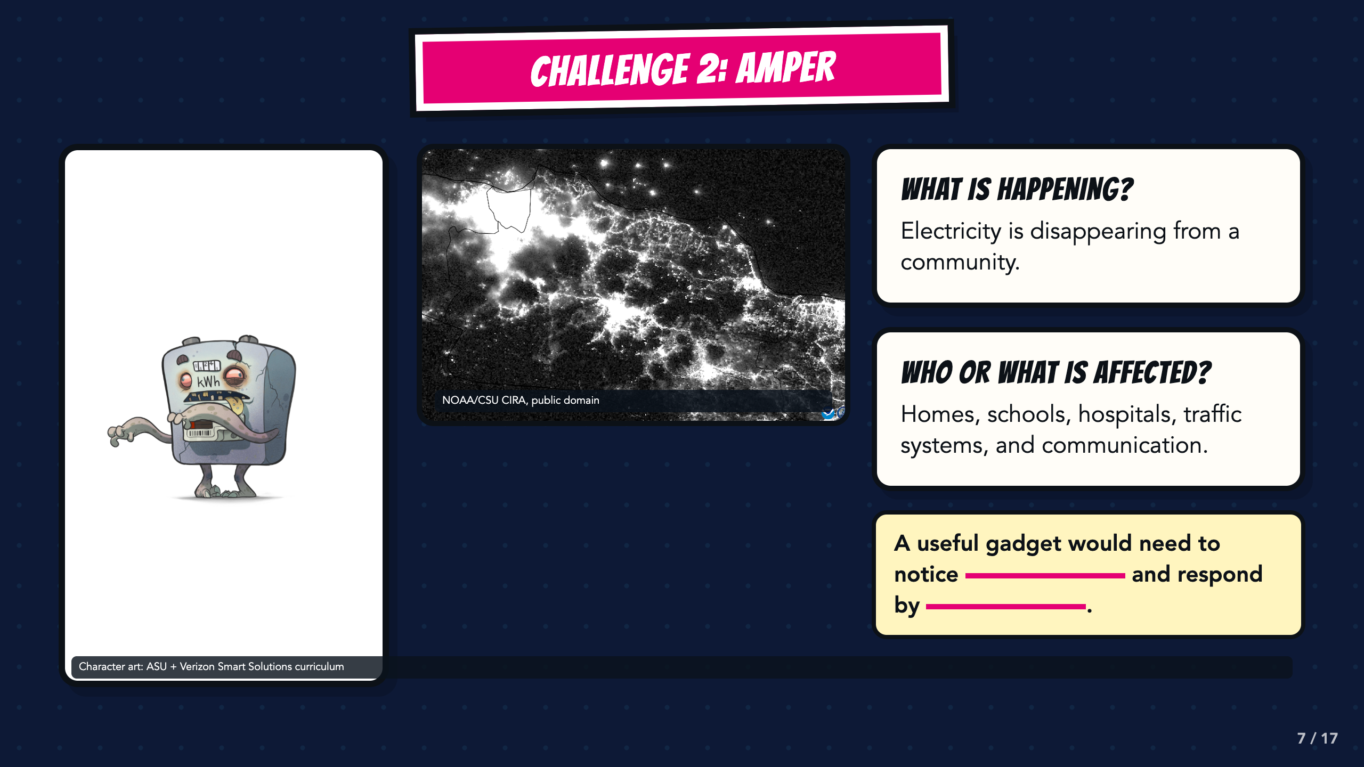
Notes:
Use the blackout image to make the effect of lost electricity visible. Ask students which systems would be affected first and what information a gadget would need before it could respond.
[Sources]
- NOAA/CSU CIRA, Power Blackout on Java in Indonesia, public domain, Wikimedia Commons: https://commons.wikimedia.org/wiki/File:Power_Blackout_on_Java_in_Indonesia_(CIRA_2019-08-04_-_201908041806_n20-snpp_viirs_dnb_javablackout_nolabels0).png
- ASU + Verizon Mapping Sustainability facilitator guide, teacher copy: https://docs.google.com/document/d/1u8MFHRMjT4c-NuFj85K5bi6QhyX8Rx6O/copy
- ASU + Verizon Mapping Sustainability presentation, teacher copy: https://docs.google.com/presentation/d/1wLmWv11evu872SNgYDrXIUlDrSCTgHGU/copy

Slide 8
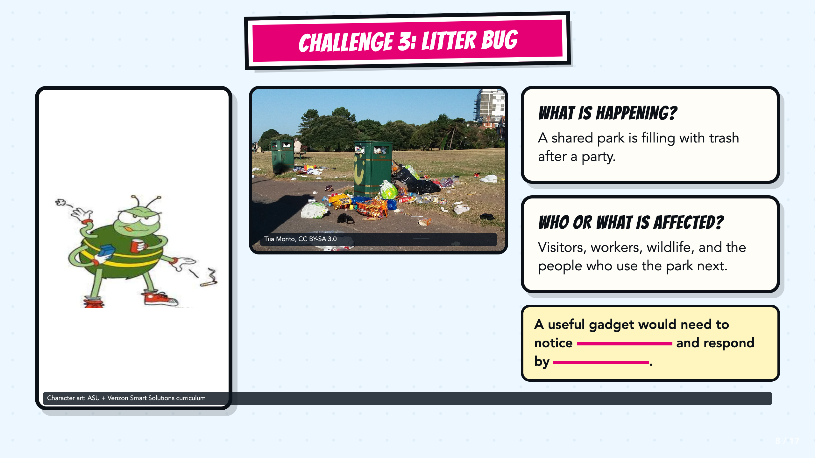
Notes:
Ask students to distinguish the trash itself from the larger challenge: a shared space is becoming unsafe or unusable. The response should change what happens next, not only decorate the scene.
[Sources]
- Tiia Monto, Trash in park, CC BY-SA 3.0, Wikimedia Commons: https://commons.wikimedia.org/wiki/File:Trash_in_park.jpg
- ASU + Verizon Mapping Sustainability facilitator guide, teacher copy: https://docs.google.com/document/d/1u8MFHRMjT4c-NuFj85K5bi6QhyX8Rx6O/copy
- ASU + Verizon Mapping Sustainability presentation, teacher copy: https://docs.google.com/presentation/d/1wLmWv11evu872SNgYDrXIUlDrSCTgHGU/copy

Slide 9
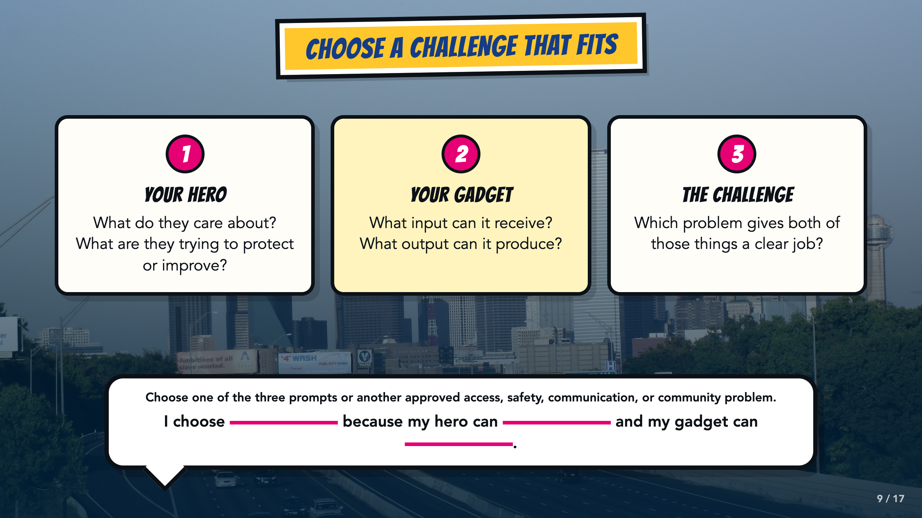
Notes:
Students may use one of the three inherited prompts or an approved access, safety, communication, community, or other problem. They should choose a challenge that gives both their existing hero and their Page 2 gadget a clear job. Use the stem to test the fit before anyone begins drawing.
[Sources]
- ASU Identifying Challenges in Your Communities facilitator guide, teacher copy: https://docs.google.com/document/d/1JwuSSRtIizdjKJ0lHQR75Gyxw0ZuNVdKZGZQwXzeGbA/copy

Slide 10
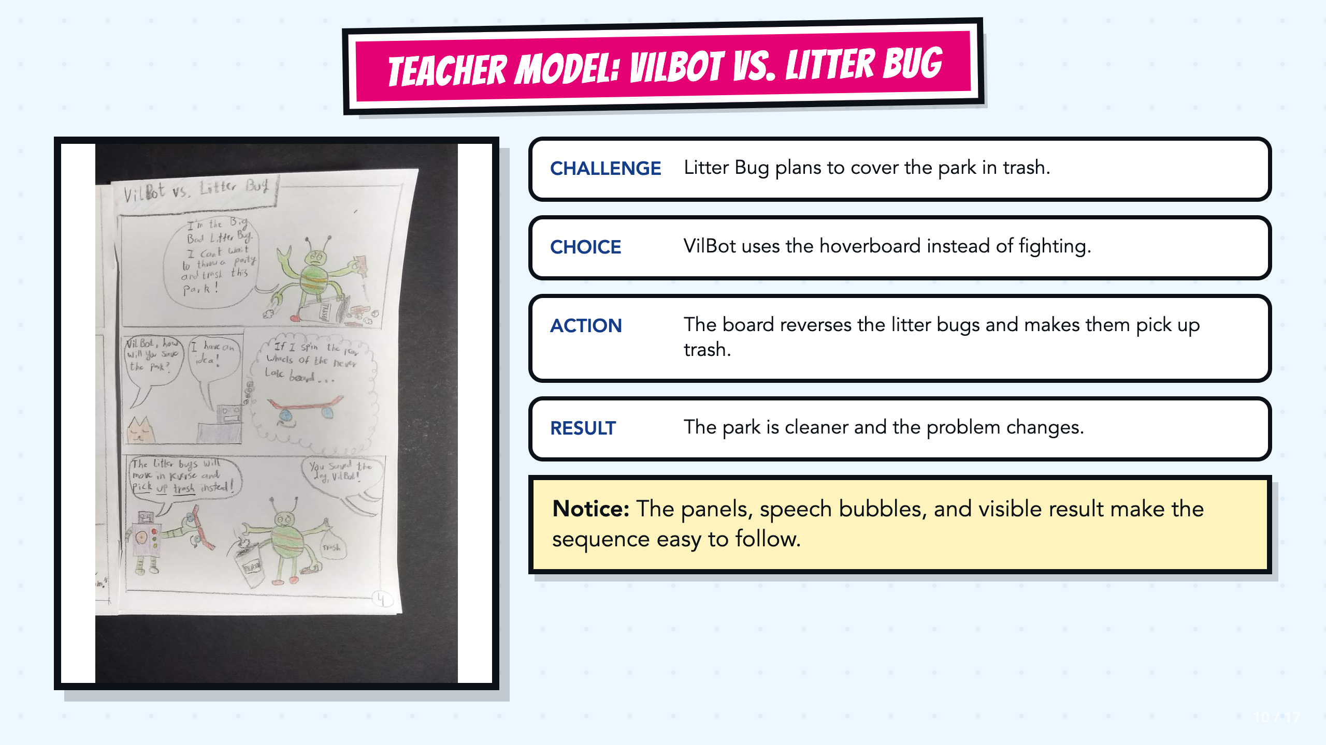
Notes:
Read the VilBot example from first panel to last. Point out the challenge, VilBot's choice, the gadget action, and the visible result. The sequence works because the page carries the explanation.
[Sources]
- Teacher-created VilBot comic exemplar used in the Smart Solutions course.

Slide 11
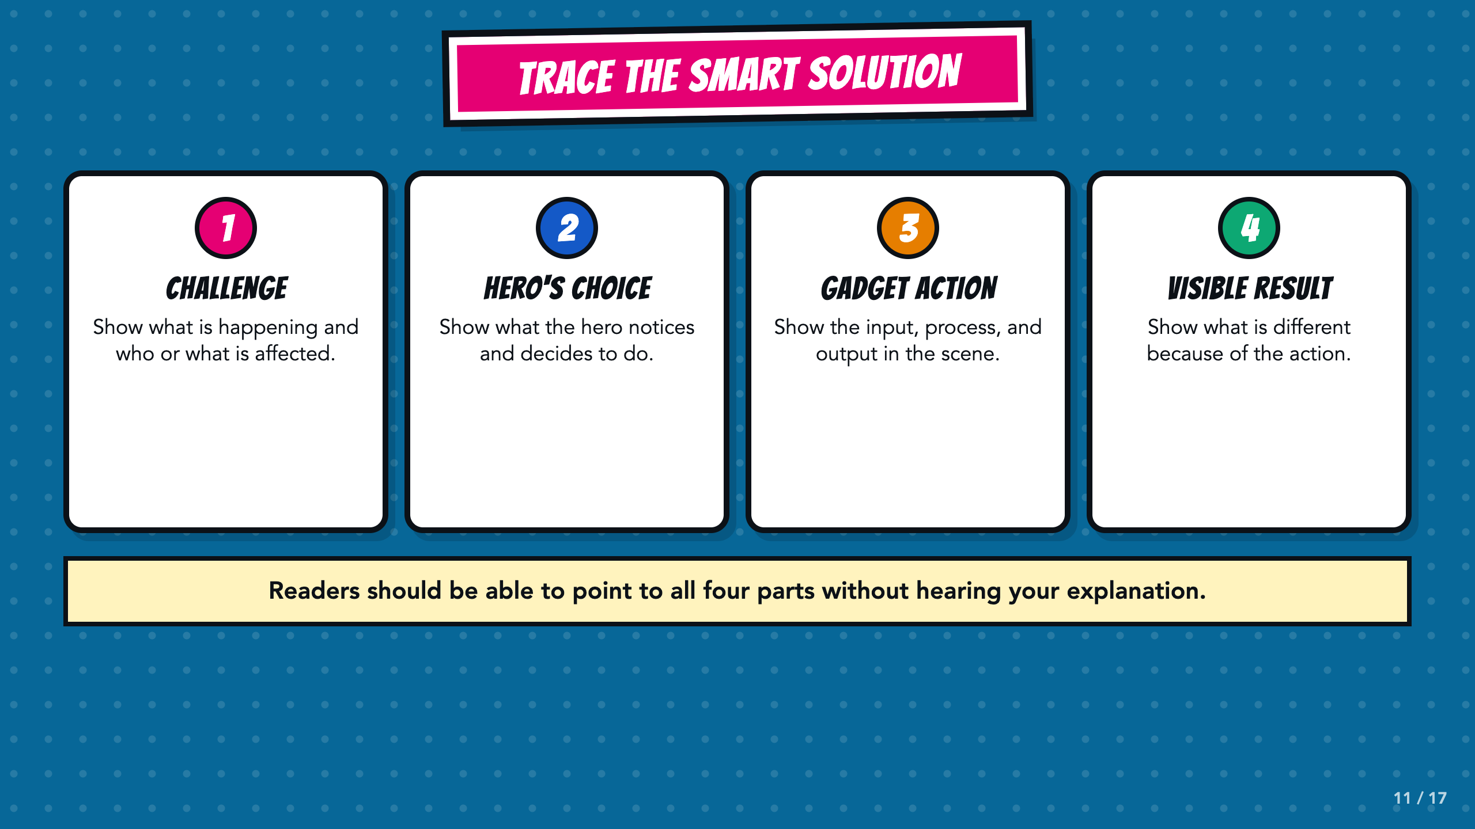
Notes:
Use these four labels as a trace. In the gadget-action section, ask students to name the input, the process or rule, and the output already established on Page 2.
[Sources]
- ASU Identifying Challenges in Your Communities facilitator guide, teacher copy: https://docs.google.com/document/d/1JwuSSRtIizdjKJ0lHQR75Gyxw0ZuNVdKZGZQwXzeGbA/copy

Slide 12
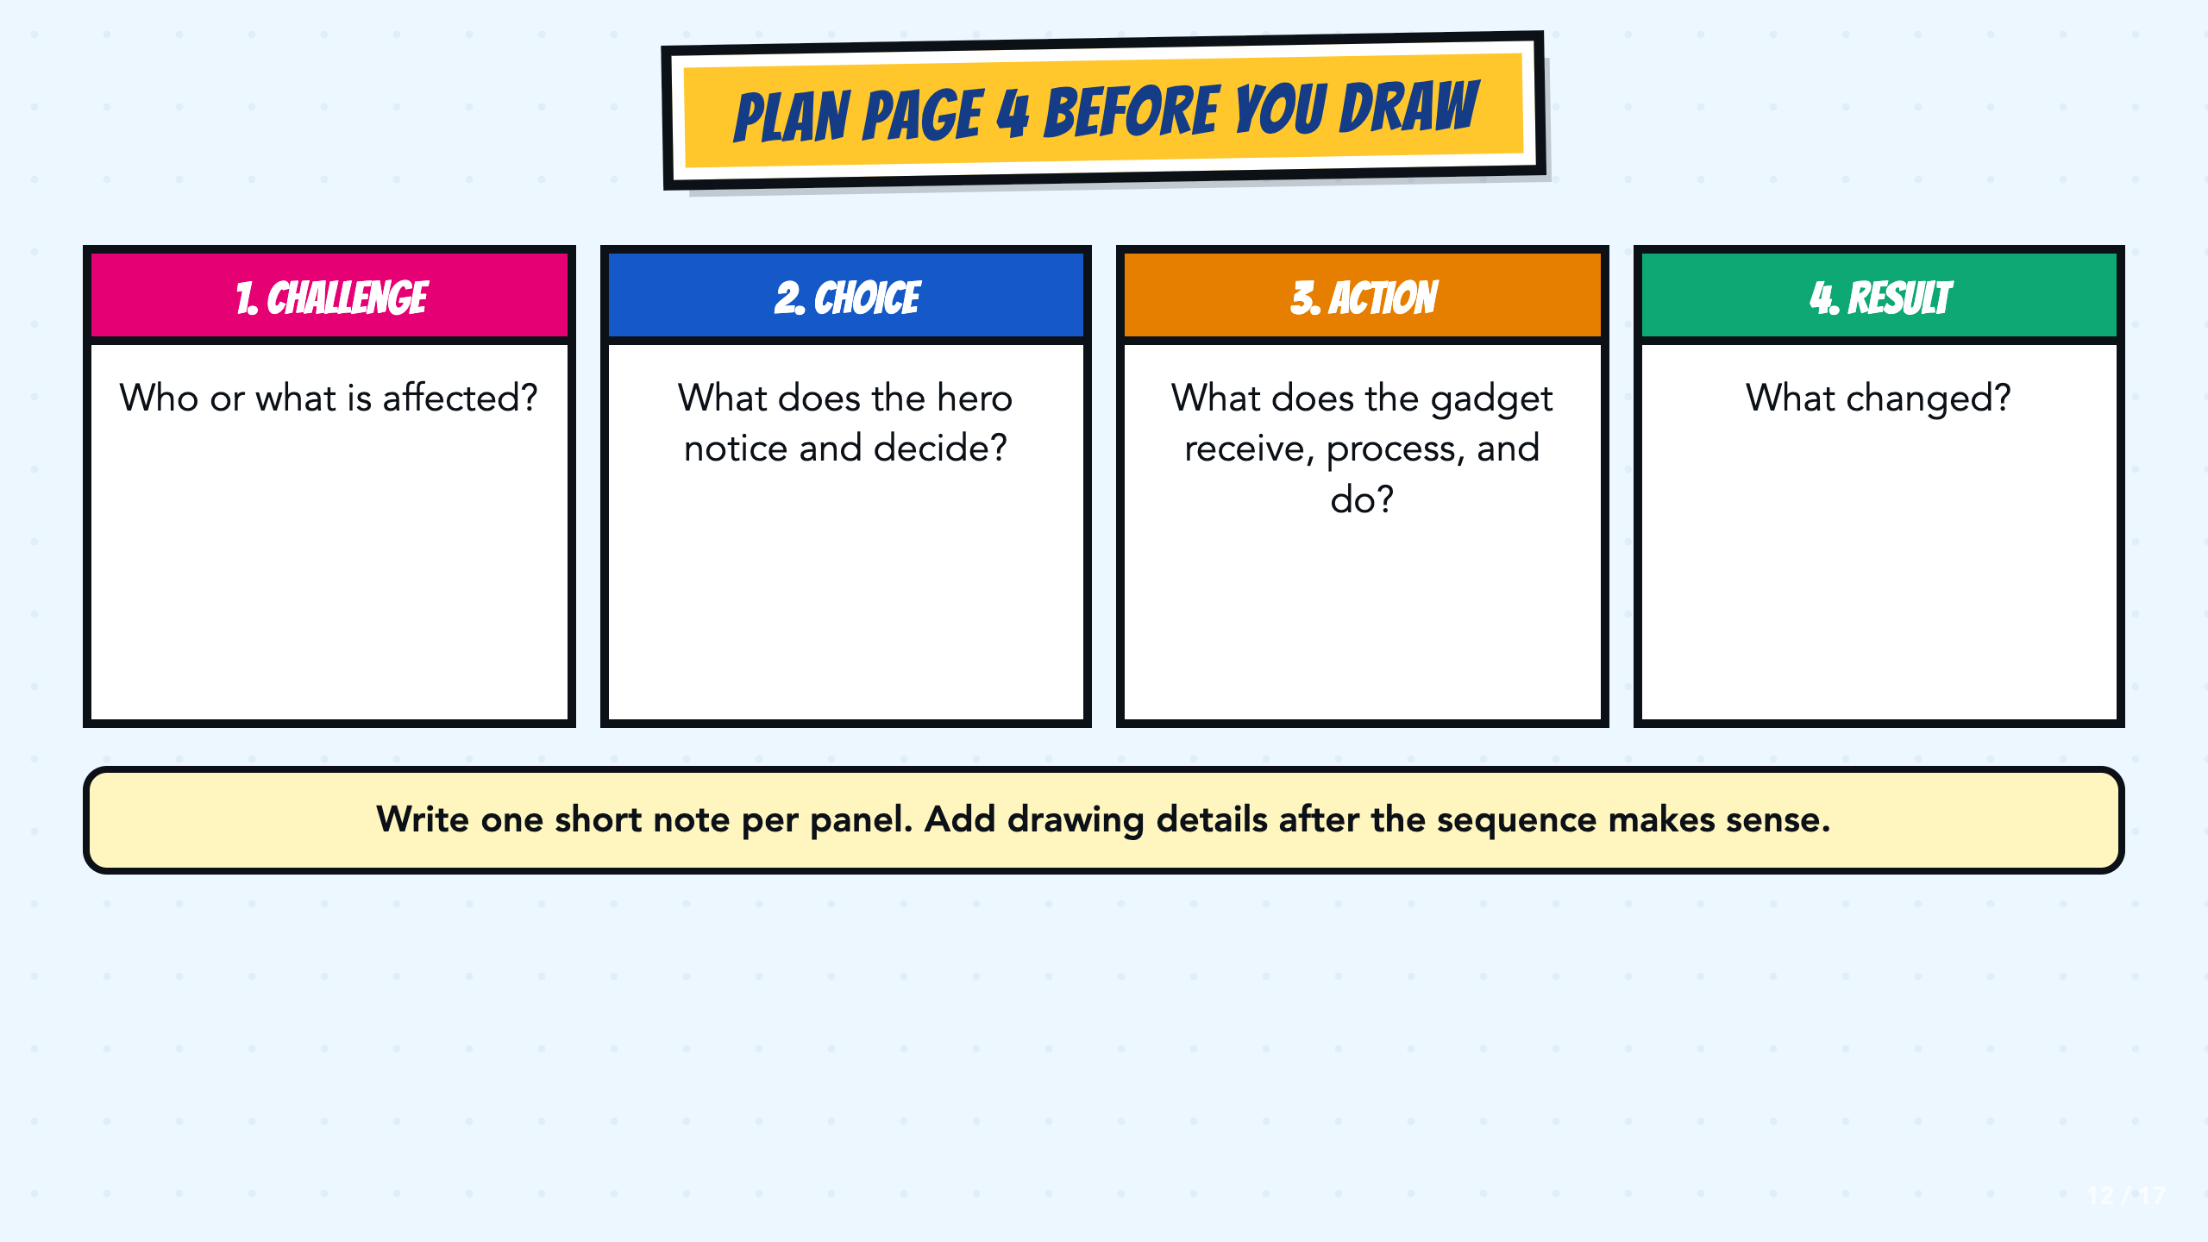
Notes:
Have students write one short planning note in each box before drawing. Check the order and the visible result first. Drawing details come after the sequence works.
[Sources]
- ASU Identifying Challenges in Your Communities facilitator guide, teacher copy: https://docs.google.com/document/d/1JwuSSRtIizdjKJ0lHQR75Gyxw0ZuNVdKZGZQwXzeGbA/copy

Slide 13
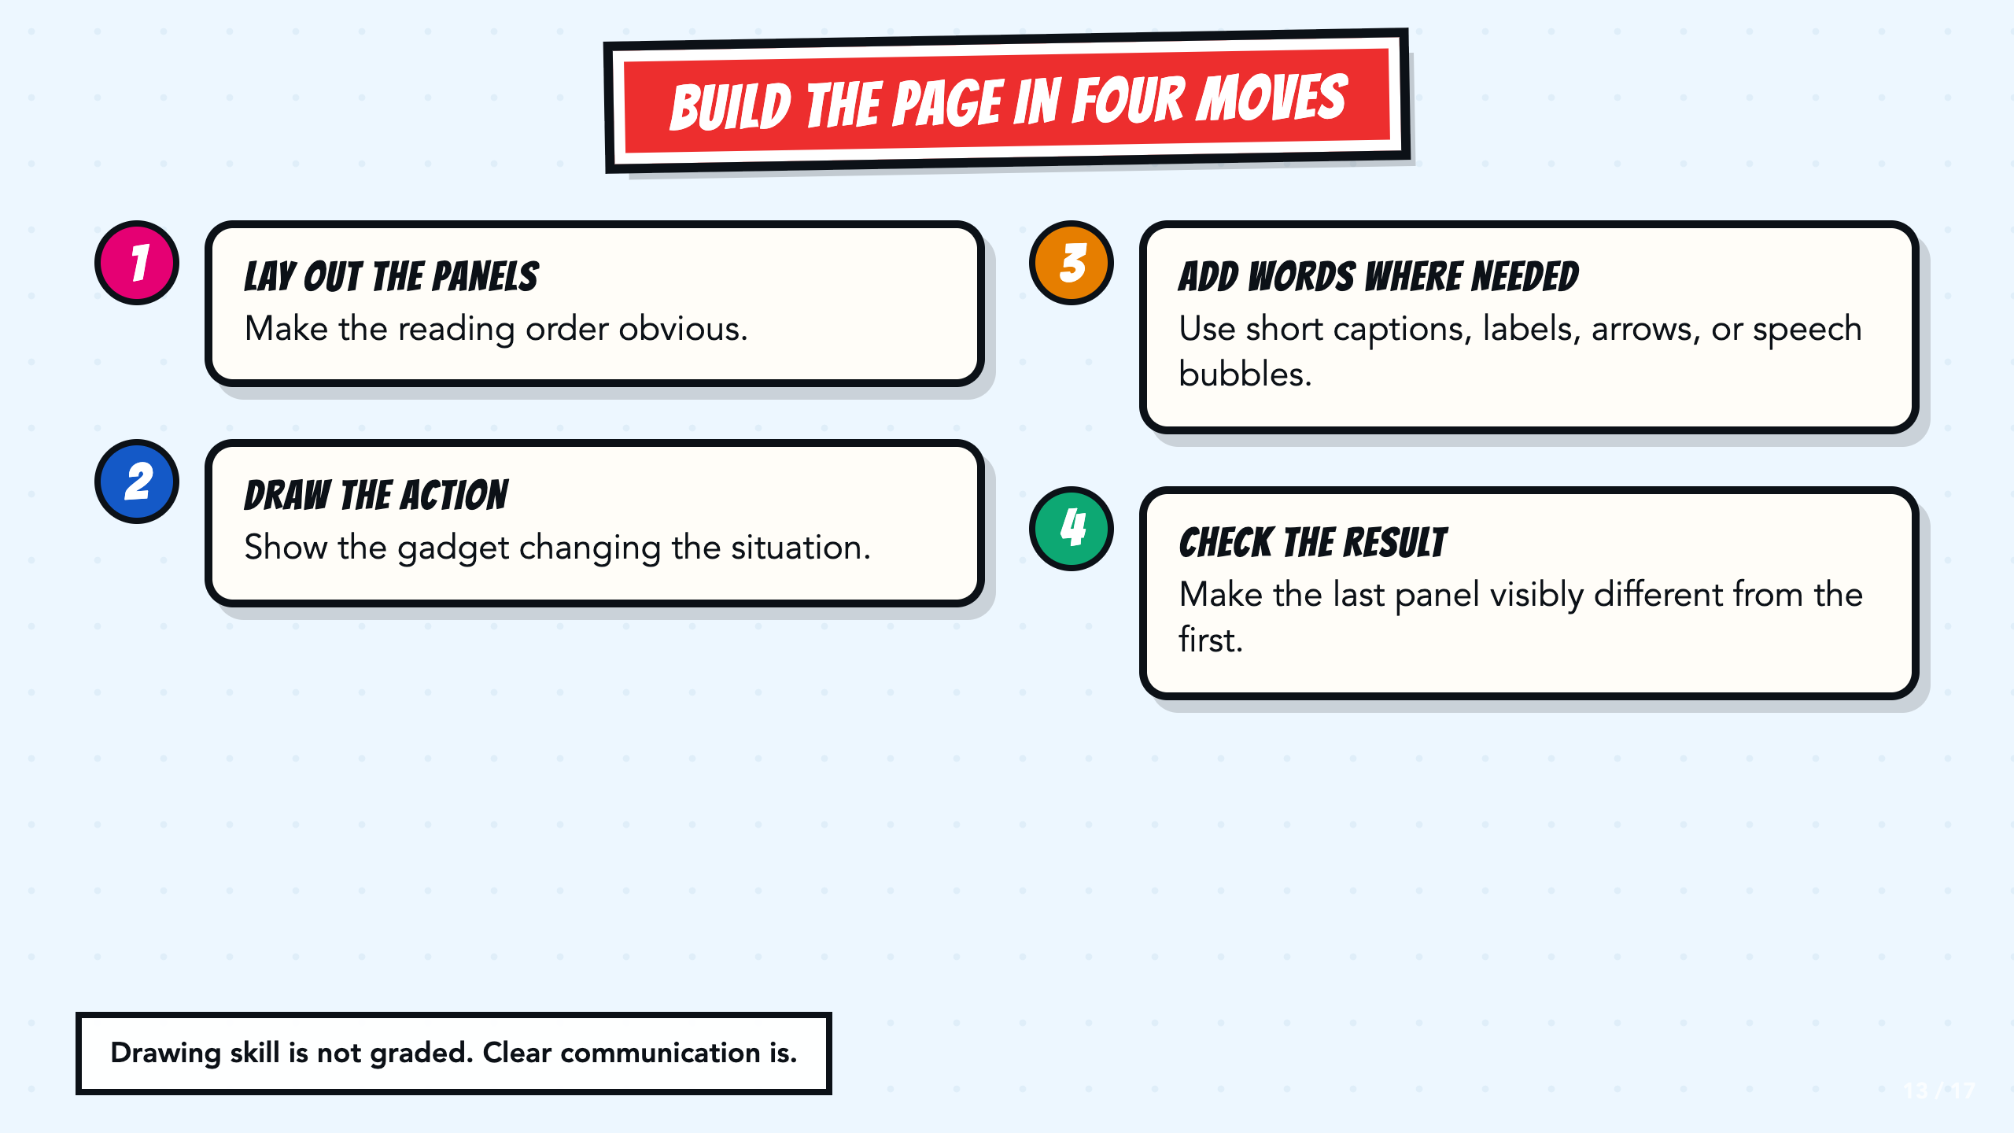
Notes:
Model the four moves quickly. Remind students that drawing skill is not scored. The reader needs to see the action, follow the order, and understand what changed.
[Sources]
- Teacher-created VilBot comic exemplar used in the Smart Solutions course.

Slide 14
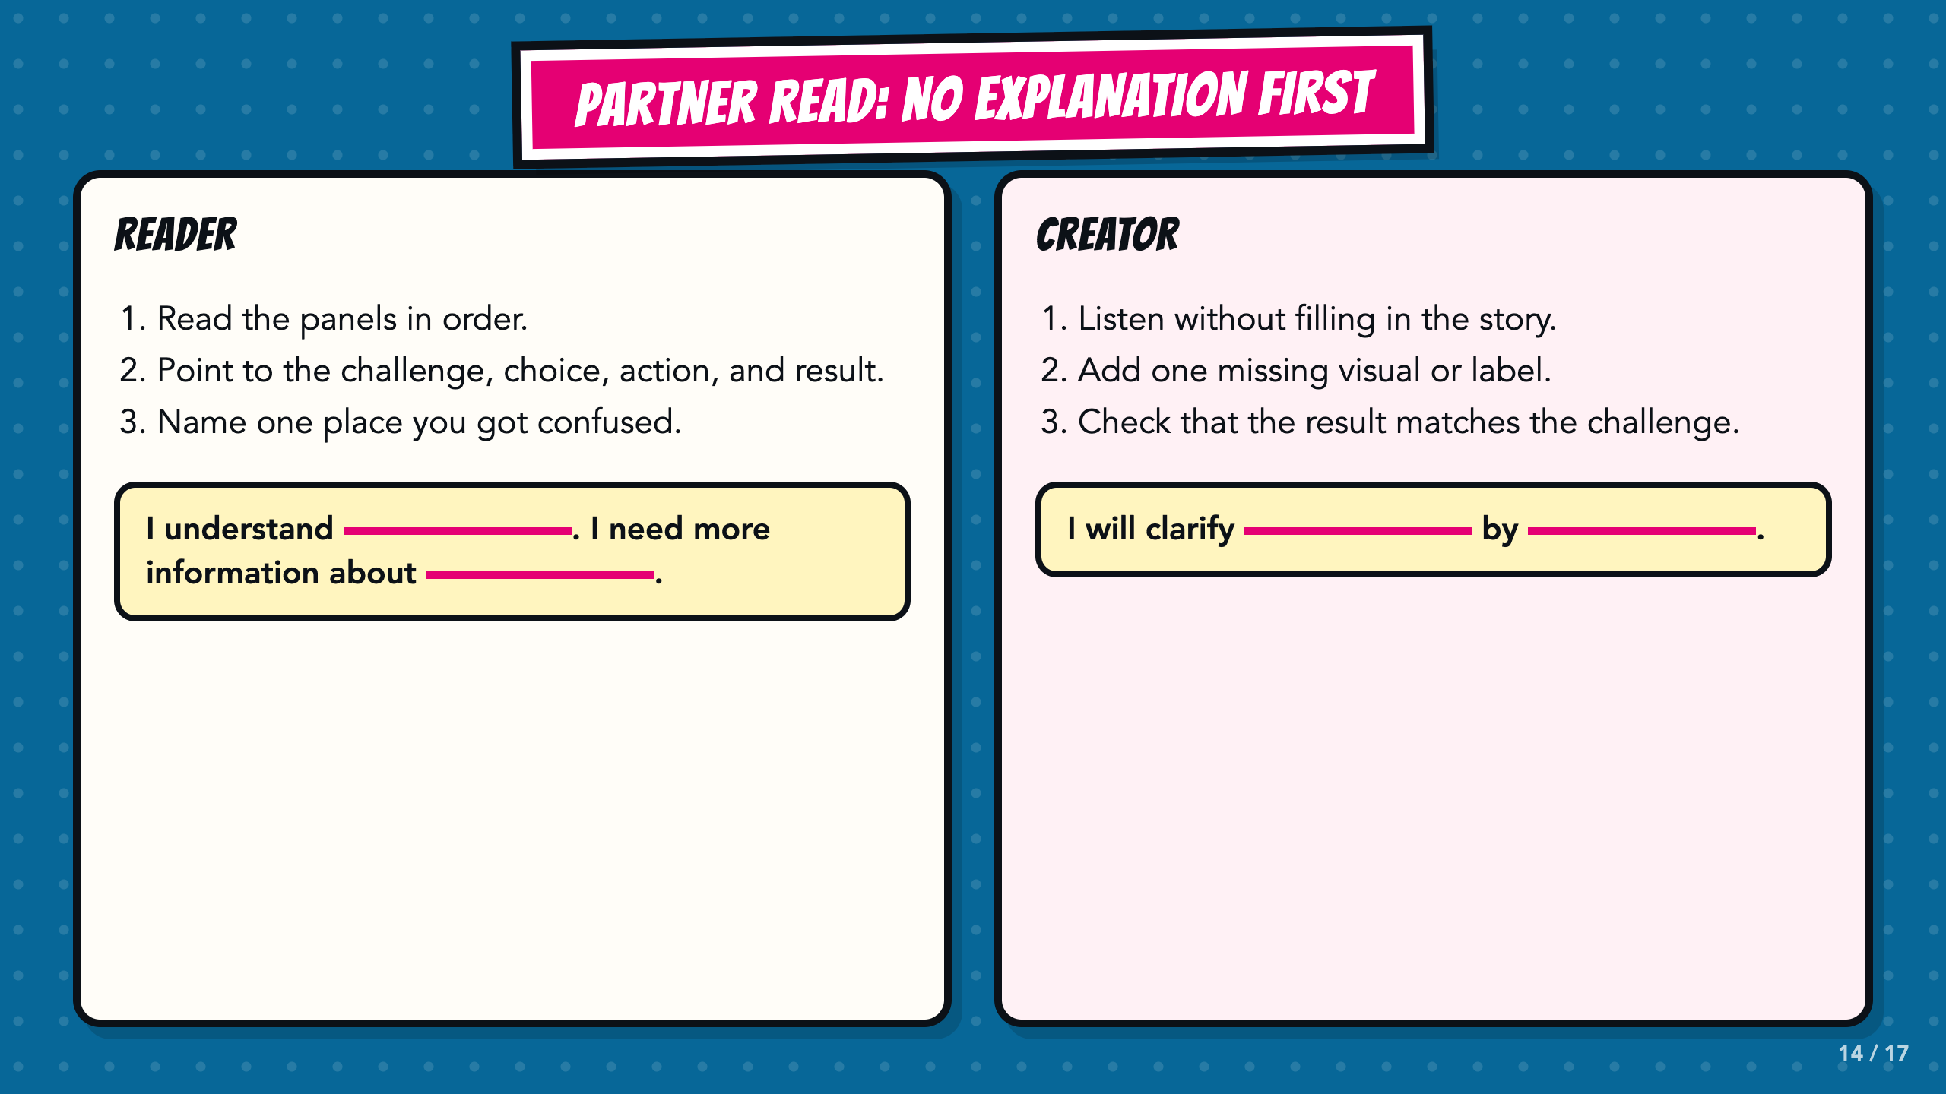
Notes:
The reader goes first and the creator stays quiet. If the reader cannot point to one of the four parts, the creator adds a visual, label, caption, arrow, or speech bubble.
[Sources]
- ASU Identifying Challenges in Your Communities facilitator guide, teacher copy: https://docs.google.com/document/d/1JwuSSRtIizdjKJ0lHQR75Gyxw0ZuNVdKZGZQwXzeGbA/copy

Slide 15
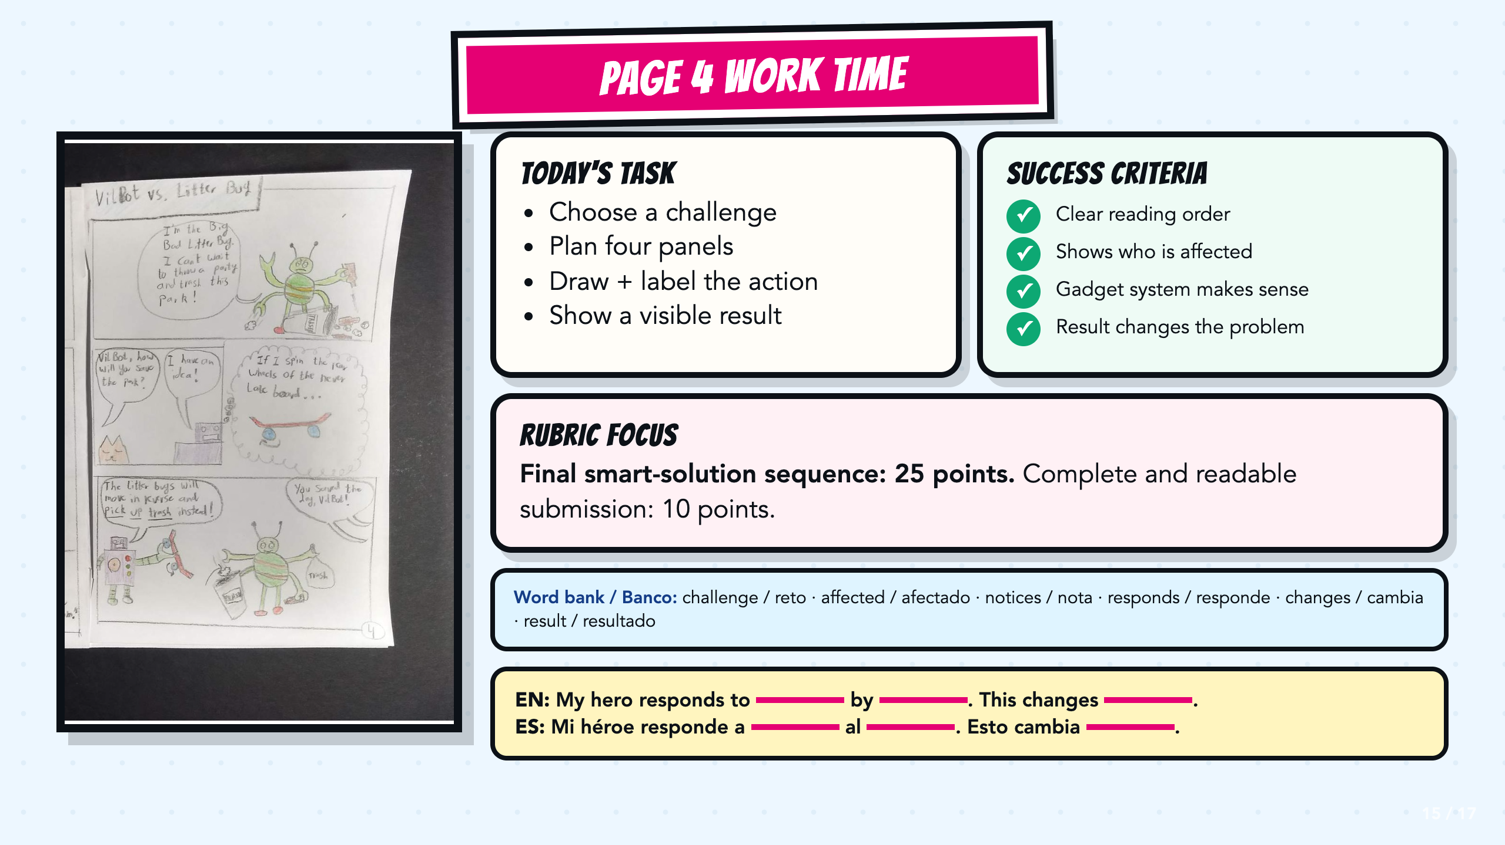
Notes:
Leave this slide projected during work time. Read the exact rubric focus before students begin. Direct students to the bilingual word bank and sentence stems when they need language support.
[Sources]
- Teacher-created VilBot comic exemplar used in the Smart Solutions course.

Slide 16
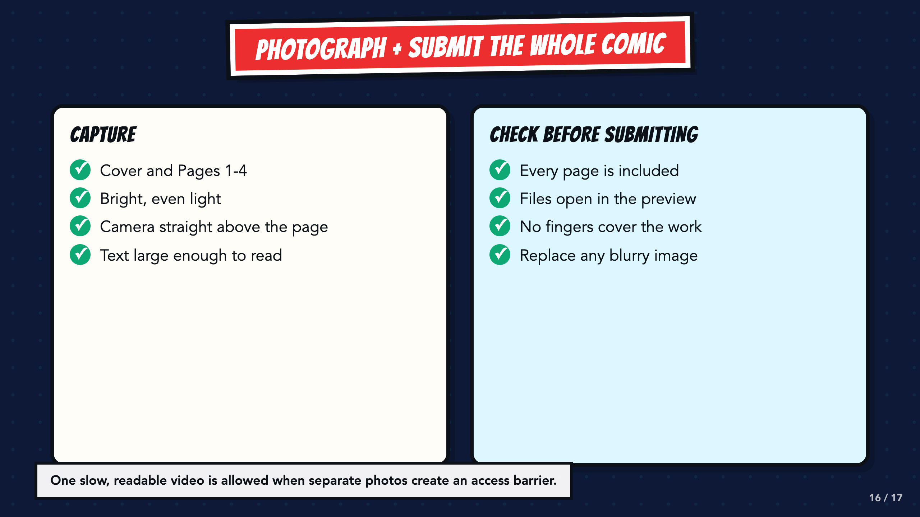
Notes:
Students submit the entire comic: cover and Pages 1 through 4. Let a student use one slow, readable video when separate photographs create a barrier. Preview every file before submitting.
[Sources]
- Teacher-created VilBot comic exemplar used in the Smart Solutions course.

Slide 17
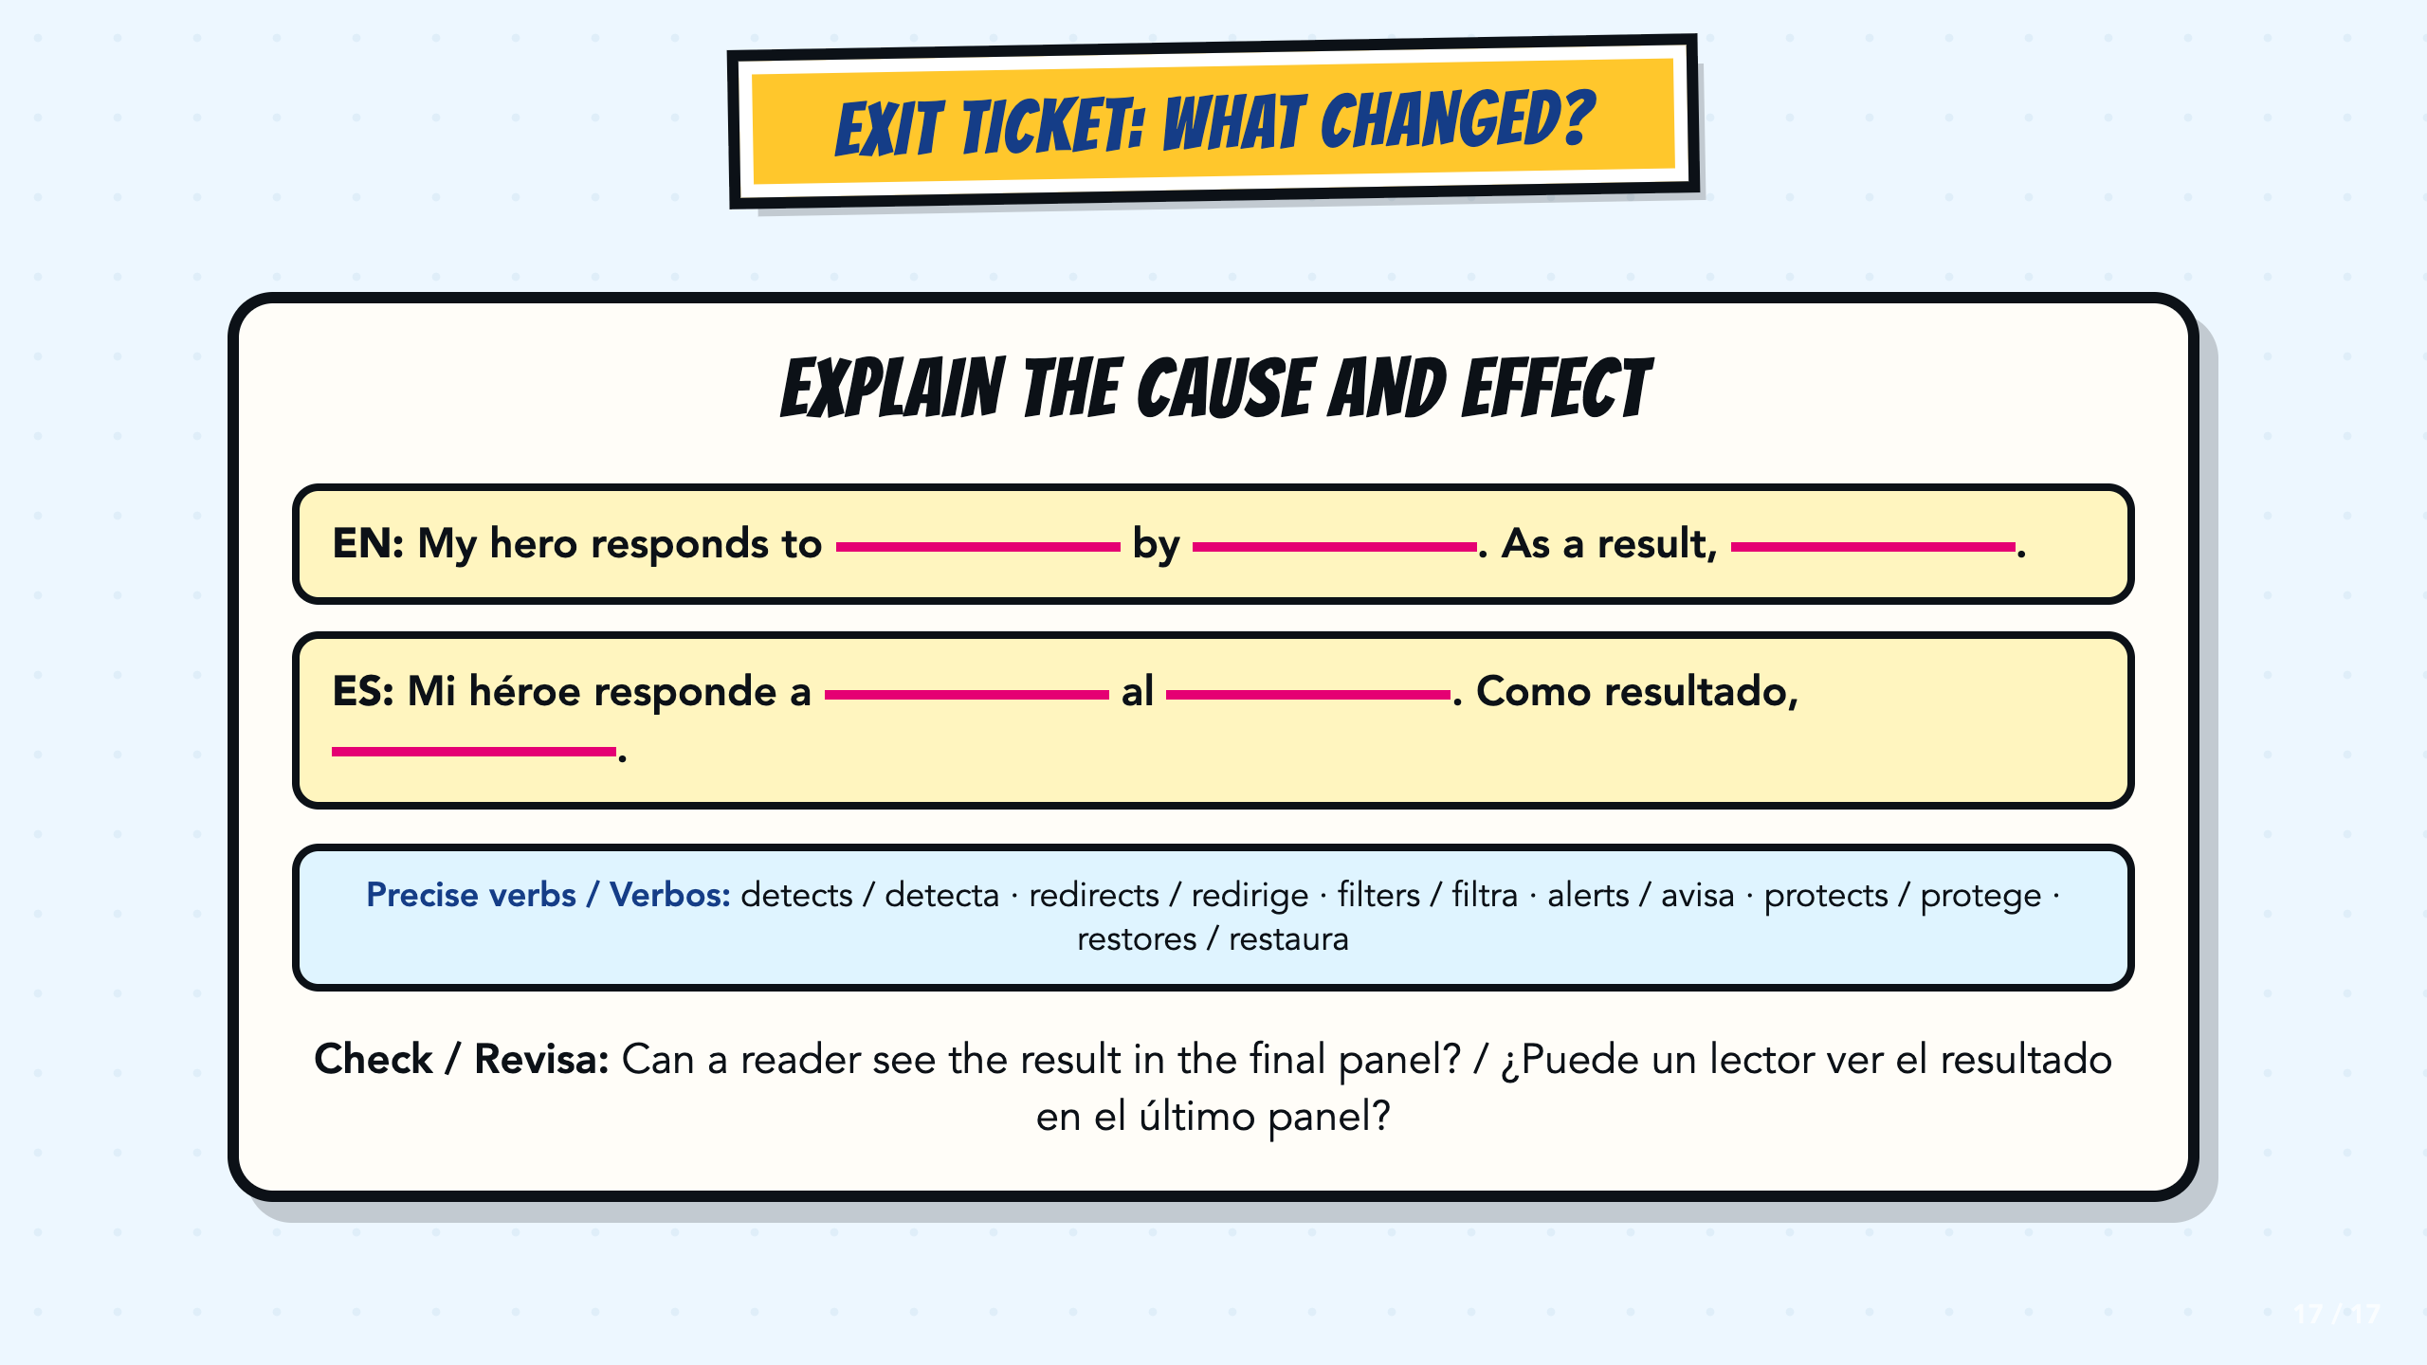
Notes:
Use the bilingual cause-and-effect stem as a written or oral exit ticket. Listen for a specific challenge, a clear response, and a result that a reader can actually see in the final panel.
[Sources]
- ASU Identifying Challenges in Your Communities facilitator guide, teacher copy: https://docs.google.com/document/d/1JwuSSRtIizdjKJ0lHQR75Gyxw0ZuNVdKZGZQwXzeGbA/copy

