Slide 1






Email Etiquette: Bellringer Activity
What do you already know about writing professional emails?
With your partner, brainstorm and write down everything you know about email communication on your whiteboard.
Work with
Use your
Level 2
5 minutes
your partner
whiteboard
voices
Thought Starters:
Email structure
Subject lines
Greetings/closings
Professional tone
Email formatting
Common mistakes

Slide 2
 |  | Standards & Materials
T | Email Etiquette | TEKS (7) The student creates professional documents required for employment. The student is expected to: (B) write appropriate business correspondence… Materials: Laptop/Tablet Pencil, Worksheet
O | Learn and practice professional communications through email etiquette
D | Complete focused Notes, group email correction, and independent email draft activity.
A | Carbon Copy (CC), Blind Carbon Copy (BCC), Forward, Recipient
Y | How can using email correctly make you appear more professional?
What’s Happening TODAY

Slide 3
How to Write an Email
Step 1: Vocabulary (5min) - Write down the definitions to the vocabulary words on your paper
Step 2: Lesson (10min) - I will talk about the parts of an email. We will practice some examples.
Step 3: Group Practice (10min) - Work with your group to analyze the errors of an email
Step 4: Exit Ticket (20 min) - Gimkit
Step 5: Email Summative - You will draft your own emails

Slide 4

REFLECT
We might use email instead of social apps when ________.
Emailing is different than social media because ________.
When might we choose to use email rather than Instagram, TikTok, or Snapchat?
How is emailing different?
Think, Pair, Share
Notes:
Use this as an opening to discuss general online communication before moving to our more specific purpose: emailing. If you are using this digitally (for distance learning), consider having students type their answers in a Google Doc with other peers if you want to maintain the peer interactions.

Slide 5

Use email communication to connect with people in a more professional online setting.
Because of the professional nature, we need to be mindful of the tone, formatting, diction, and content of our messages.

Slide 6

When you are writing an email, DO NOT do the following:
Treat emails like text messages, DMs, or other messages on social media
Send without having all of the major components (we’ll discuss this in a bit)
Expect an immediate response

Slide 7

When you are writing an email, DO the following:
Use proper spelling and grammar
Get to the point quickly
Read through your email at least twice before you send it
Treat it as a more professional form of writing

Slide 8

Attachment | Open a new window to write an email
To box | This is where you write the email of the primary recipient
CC | Carbon copy – use this to add additional recipients
BCC | Blind carbon copy – use this to include others in the email chain privately (without others seeing who is on the recipient list)
Subject | Think of this like a title for an essay. It should be short and to the point. It should NOT be your entire message.
Reply | This button will reply to the person who directly sent you the message
Reply all | This button will reply your message to EVERYONE on the original email list
Forward | Use this button to re-send an email to a new recipient
Draft | This is an email you started but did not send
On any email platform, there might be some words you might not be familiar with.
Notes:
You have this handout and a blank version in the file “Email Cheat Sheet.” I like to introduce this live with the students and work them through these buttons on my screen or with a document camera.

Slide 9
Lost your notes? Re do them now
Attachment | Include a picture or file in your email
To box | This is where you write the email address of the primary recipient
CC | Carbon copy – send a copy of the email to another recipient
BCC | Blind carbon copy – sends the copy of the email to someone, but no one can see that the email was sent to them.
Subject | The topic of your email. Only a few words.
Reply | Button: reply only to the person who sent you the message
Reply all | This button will reply your message to EVERYONE on the email list
Forward | Use this button to re-send an email to a new person
Draft | This is an email you started but did not send
On any email platform, there might be some words you might not be familiar with.
Notes:
You have this handout and a blank version in the file “Email Cheat Sheet.” I like to introduce this live with the students and work them through these buttons on my screen or with a document camera.

Slide 10
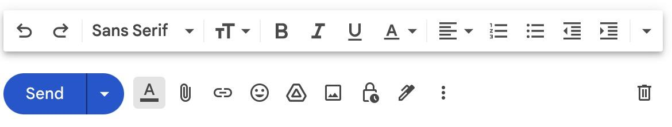
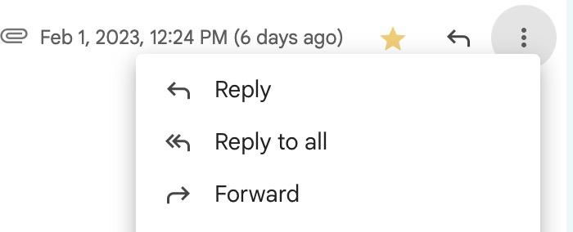
Icons (draw these next to the word)

Slide 11
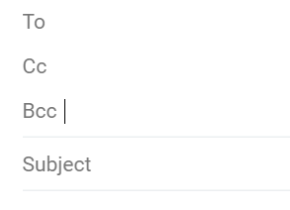
To Box:
The “To” line is where you put the email address of who you are directly sending it to.
The “Cc” line means “carbon copy.” This is to send a copy of the email to someone.
The “Bcc” line means “blind carbon copy.” This also sends the copy of the email to someone, but no one can see that the email was sent to them.

Slide 12
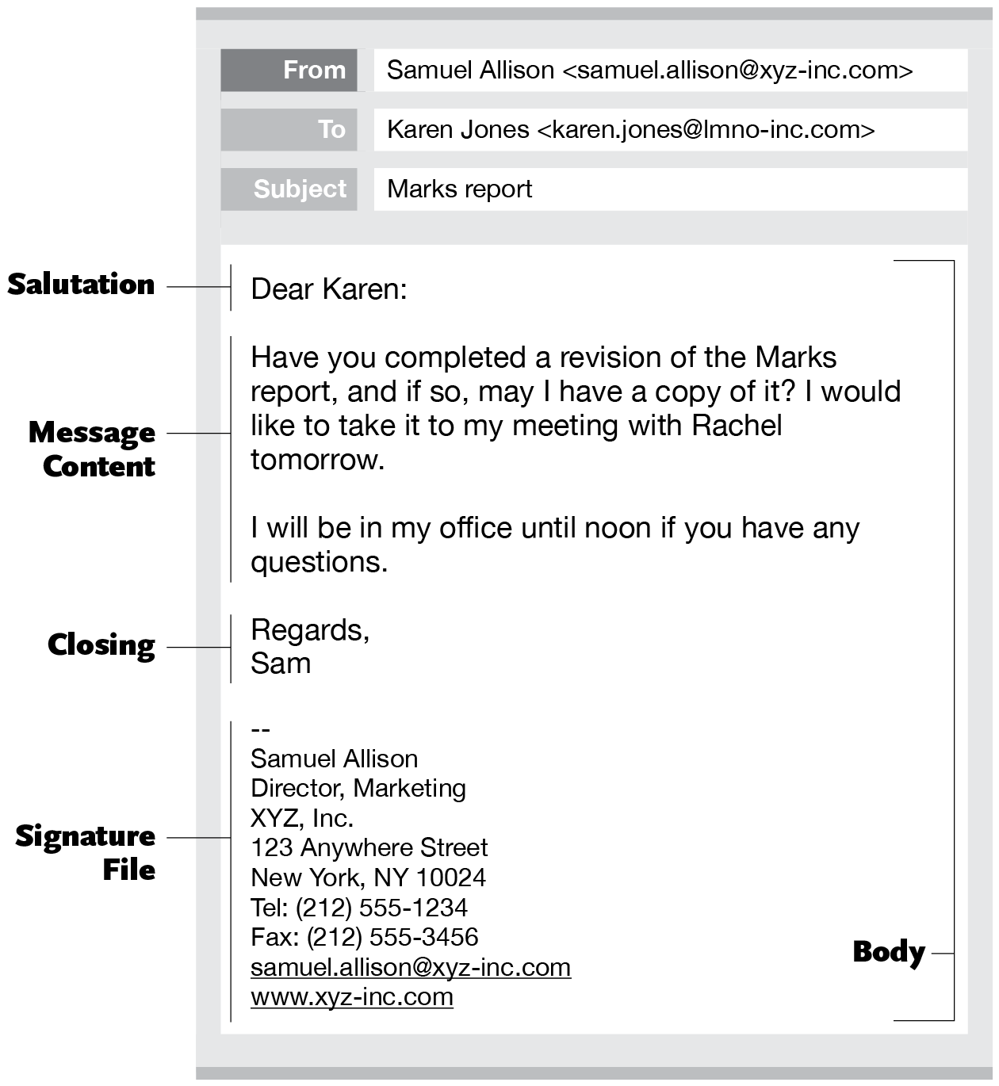
Subject Line
The title of your email. It should be short and to the point. It should NOT be your entire message.
ALWAYS include a subject
  The recipient should know the topic of the email before they read it.
Example:
  Help on Lesson 2
  Question about Next Week

Slide 13
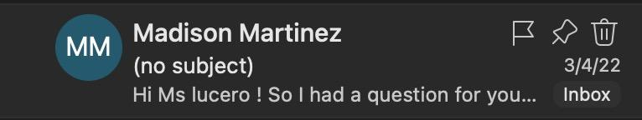
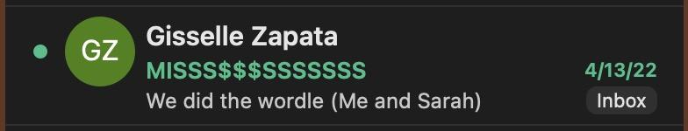
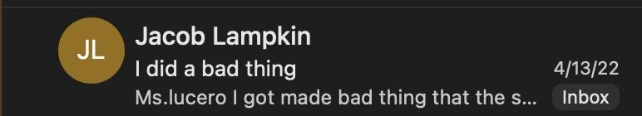

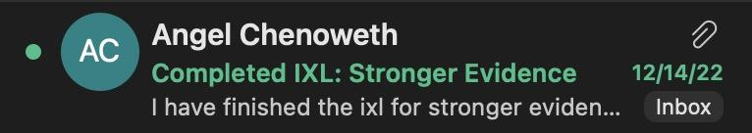
Subject Line
The topic of your email. It should be short and to the point. It should NOT be your entire message.
ALWAYS include a subject
  The recipient should know the topic of the email before they read it.
Example:
  Help on Lesson 2
  Question about Next Week

Slide 14

You have a question about graduation requirements.
  “Question Regarding Graduation Requirements”
You will be absent from school for four days and need to let certain people know.
  “Upcoming Absence from School”
You have a scheduling conflict and will be unable to stay for a meeting.
  “Scheduling Conflict 3/22”
You cannot make it to practice today because you are sick.
  “Feeling Ill – Cannot make Practice”

Slide 15
What might the different subject lines be for emails of this nature?
A missing assignment that you submitted late and want to let the teacher know
An absence from school due to being sick
A question about the upcoming field trip
Stop and Jot
on Whiteboard

Slide 16
What might the different subject lines be for emails of this nature?
A missing assignment
  “Missing Reading Vocab” (plug in your assignment)
An absence from school
  “Absence – Make-up Work”
A question about the upcoming field trip
  “Question about Museum Field Trip”

Slide 17
Greeting [Salutation]
The topic of your email. It should be short and to the point. It should NOT be your entire message.
Address the person the same way you would in person.
For Example:
As a student, you wouldn’t call me “Elisha,” so you’re not going to start your email with “Dear Elisha, …”
Instead, you would say, “Dear Ms. Lucero, …” or “Hi, Ms. Lucero”

Slide 18
Body (Message)
Get to the purpose of your email.
Keep it short and to the point.
For Example:
“I can’t find Lesson 3 online. Can you please direct me to where I can find it?”

Slide 19
Closing
Thank them or tell them you look forward to hearing from them.
Sincerely,
[Your Name]
For Example:
Thank you for your help.
Sincerely,
Ms. Lucero

Slide 20
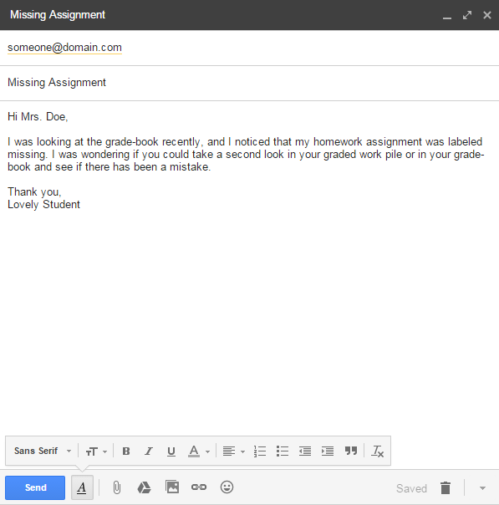
Let’s review the basics. Please capture these notes onto your handout.
Find your teacher’s email either on the school’s website, your teacher’s syllabus, or simply ask your teacher.
Be sure to copy down the email address correctly.
Your subject should capture the essence of the email in just a few words.
For example, if you were asking about making up a quiz, the subject might be “Quiz Make-up;” keep it simple.
Start by addressing your teacher formally. Hi/Hello/Good morning are all appropriate salutations.
In your email, be sure to respectably mention your concern or question.
Close your email with a closing salutation such as Thank you/Thank you for your time/Have a great day.
Notes:
This slide is animated so that you can control the pacing of notes. Teachers, consider providing the filled-in ones (skeletal notes) to students who may benefit from having them.

Slide 21
Examples
NEW MESSAGE
To | teacher@123.com
Subject | Hi I noticed that I Have an f. what can I do to bring up my grade?
Body
The message of the body should NOT go in the subject line. What would be an appropriate subject line for this message?

Slide 22

REFLECT
Much like texting and social media communication, email relies on tone because we have no face-to-face or body language communication to show emotion, intent, and feeling.
What are some things people do in writing that could send the wrong attitude or tone?
Think Pair Share

Slide 23
Examples
NEW MESSAGE
To | teacher@123.com
Subject | FIX MY GRADE
Body | I TURNED IN THE ASSIGNMENT YESTERDAY!
What elements of this email are impacting the tone? How might this email be received?

Slide 24
Examples
NEW MESSAGE
To | teacher@123.com
Subject | Regarding My Grade
Body | Good morning, I noticed that I earned a 75% on last week’s assignment. Could you tell me more about why I earned this grade?
What elements of this email are impacting the tone? How might this email be received?

Slide 25

Diction, or word choice, is critical in email communication and is largely what separates our informal communication and formal communication. It also goes hand in hand with tone.
While there are many ways to communicate online, consider how you mostly communicate or would communicate with the following people:
Family
Friends
Teachers
Colleagues
Strangers
Acquaintances
REFLECT
How does our diction change with different audiences?

Slide 26
Examples
NEW MESSAGE
To | teacher@123.com
Subject | Grade
Body | Hey hey, What’s up? I’d like to discuss my grade with u!
What about the word choice of this email impacts it formality?

Slide 27



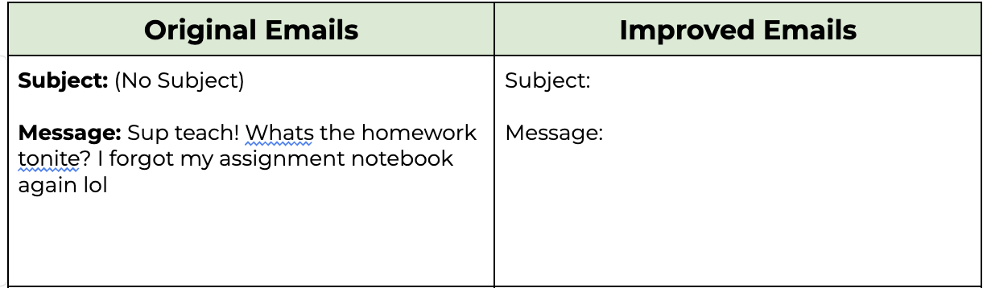
Practice
Email Communication Practice Activity
Voice Level 2
Partner Work
Talking with your table only
Work with one other person
Example Email:
Task Instructions:
You and your partner will receive four unprofessional email
examples. For each email:
1. Review the original email and identify what makes it
unprofessional
2. Rewrite both the subject line and message content to
communicate the same information professionally
3. Include proper greetings, clear language, and appropriate closing
4. Be prepared to share your revisions with the class

Slide 28

At least one recipient in the To box
A Subject line with fewer than 10 words
An opening greeting
Their name is spelled correctly
Short, chunked paragraphs
Closing
Name at the end
No spelling/grammar issues
Proper capitalization
No squiggly red lines under words
Appropriate tone and diction for audience
REMINDER
Use your checklist as a guide to proofreading your email before you send it.

Slide 29

Go to gmail.com (or your email provider).
On the top left, click the “Compose” button.
In the “To” field, write the email addresses of the recipients.
Write a brief subject line.
Write a message.
At the bottom, click the blue “Send” button.
REMINDER
Be sure that you are logged in to the correct email address, preferably your school/professional account.

Slide 30
Assignment
Now you will practice what you learned by sending me an email!
Open your student email.
Start a new email.
  In the Subject Line, write “My Favorite Activity - Period”
    Ex: My Favorite Activity - 1st Period
Send me an email with the following information:
  An activity we’ve done this year that you’ve liked the most.
  WHY you liked it
  Do not say “I haven’t liked anything.” That may be true, but find something you hated less than the other lessons.
Make sure to write in complete sentences with capitalization and punctuation.

Slide 31






Email Assignment: My Favorite Activity
Today you'll practice your email skills by sharing your favorite class activity. Follow the steps below:
1
Email Setup
Open your student email
Start a new email
Subject line: My Favorite Activity - [Your Period]
Example: "My Favorite Activity - 1st Period"
2
Email Content
Share these 2 things in your email:
Your favorite class activity:
Sentence Starters:
"My favorite activity in class this year was _______."
"I really enjoyed when we did _______."
"The class activity I liked most was _______."
Why you enjoyed it:
Sentence Starters:
"I liked this activity because _______."
"This was my favorite because _______."
"What I enjoyed most about this activity was _______."
Tip: If you didn't enjoy any activities, that's okay! Think about which activity was the least difficult or most interesting for you.
3
Writing Guidelines
Write in complete sentences
Use proper capitalization
Include correct punctuation

Slide 32
Bell Ringer
The three parts of an email are ________.
What are the three main parts of an email?
Talk with your partner as you come in
Notes:
Use this as an opening to discuss general online communication before moving to our more specific purpose: emailing. If you are using this digitally (for distance learning), consider having students type their answers in a Google Doc with other peers if you want to maintain the peer interactions.

